Slide 1














WP7 Project Management
H2020 LEIT RIA - ICT-10-2016 – Software Technology
2016/12/01 – 2019/11/30
Caroline Landry
Project Technical Manager
INRIA, France

Slide 2
Tracking (1)
Meetings
Monthly calls with all partners
WP5 & WP4: regulars calls with all partners
WP1, WP2 and WP3: dedicated calls and working sessions by video conferences
KTH/INRIA: weekly calls
9 in-person meetings

Slide 3
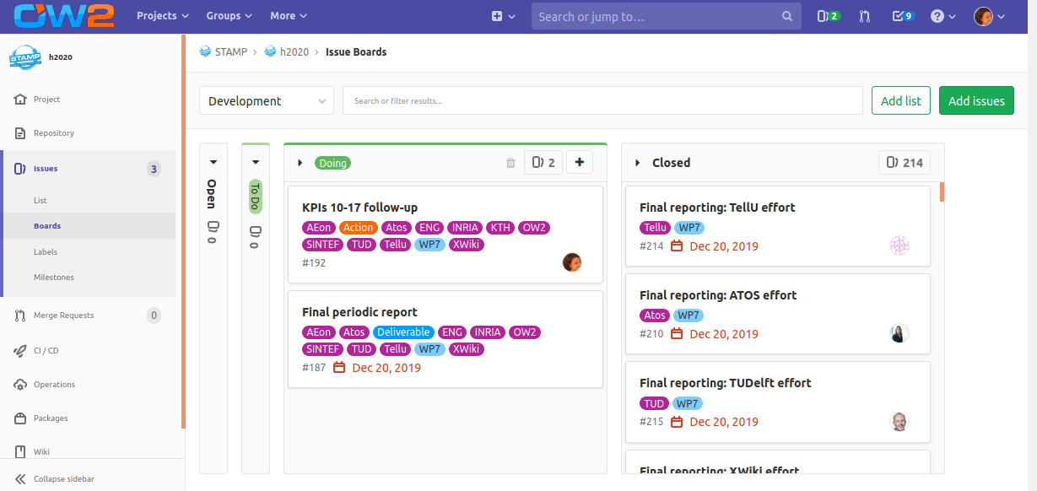
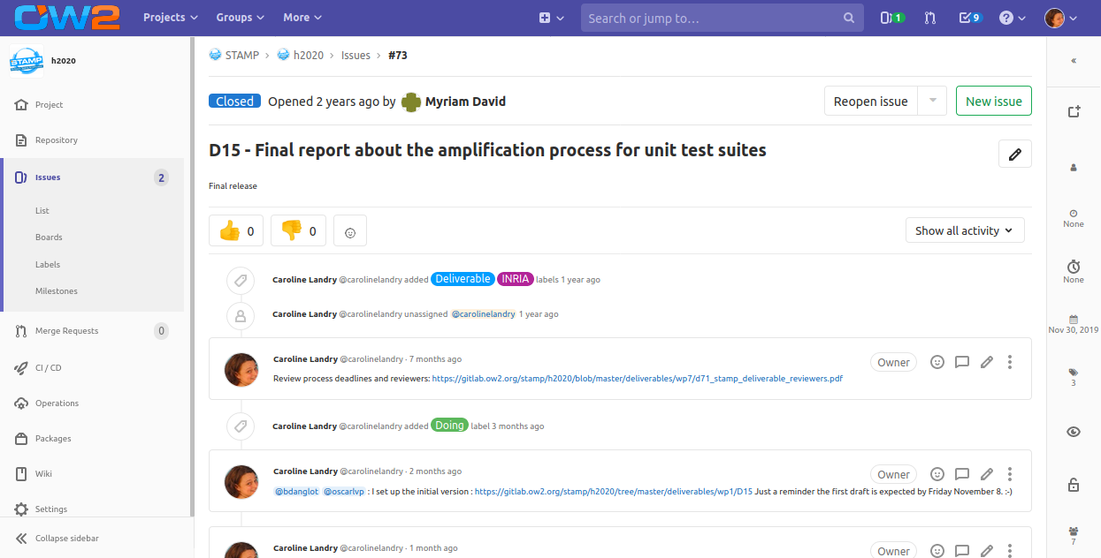
Tracking (2)
Deliverables
Milestones
Actions

Slide 4
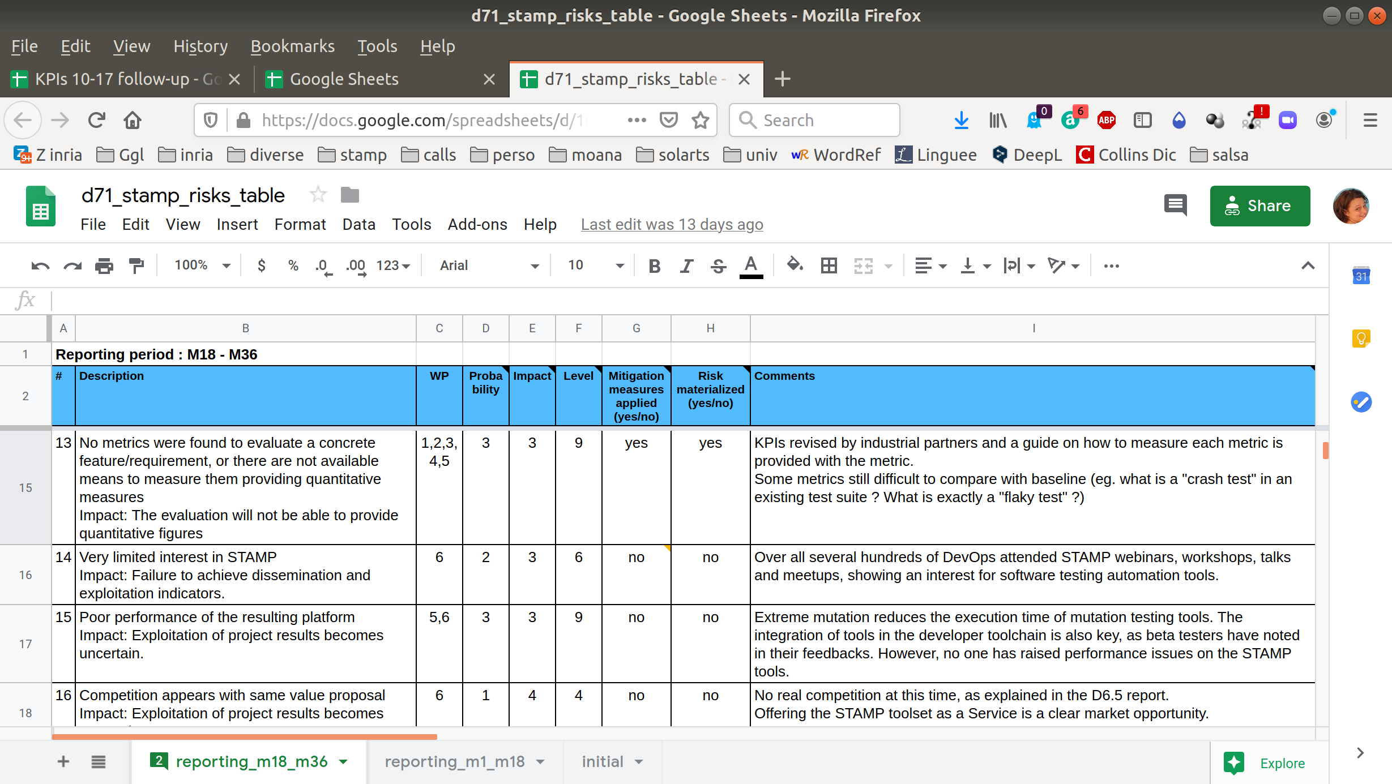
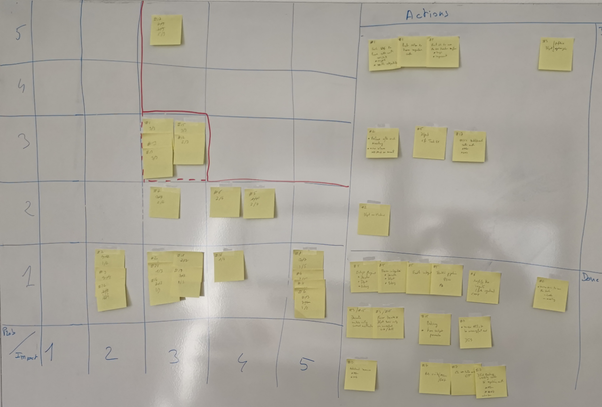
Tracking (3)
Risks management

Slide 5
Tracking (4)
Unplanned activities (PR2)
Amendment
Change tasks assignments of T1.4 and 5.4 from ATOS Turkey to ATOS IT
Update WP3 objectives, task 3.2, deliverables D3.2 and D3.3 deadline
Update WP4 task 4.1
Update WP5 project KPIs
Updated version of the DoA part A
Updated version of the DoA part B
Request letter
Document reviews
Revised version of D1.2
Revised version of D3.1
Revised version of D3.2
Additional project interim review

Slide 6
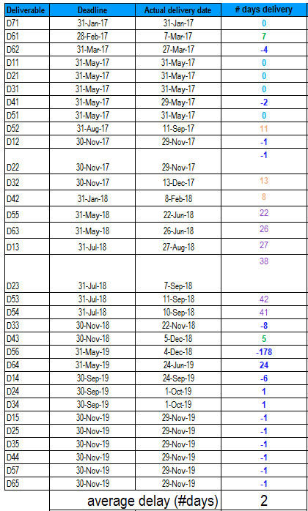
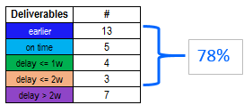
Deliverables

Slide 7
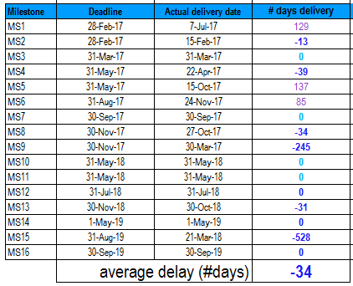
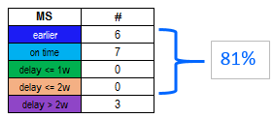
Milestones

Slide 8
Advisory board
Workshops
December 2017, Madrid
October 2018, Paris
January 2019, Sophia
Members
Henry Coles (PIT),
Francisco Gortazar (University Rey Juan Carlos)
Manuel Martinez (Nokia)

Slide 9
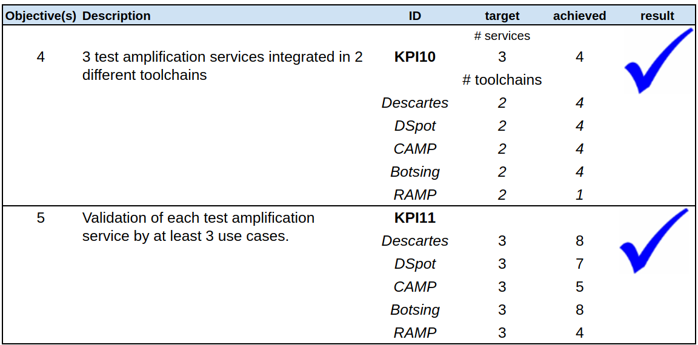
Project KPIs

Slide 10
Effort (1)

Slide 11
Effort (2)

Slide 12
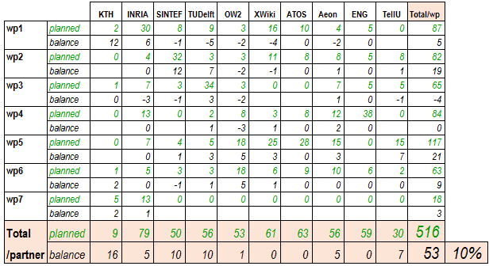
Effort (3)

Slide 13
Effort (4)
KTH
planned efforts were underestimated when moving
INRIA
Some PMs moved from WP3 to WP1
Some additional PMs allocated to WP1 to achieve the industrial maturity level
Unplanned tasks (additional review, amendments and detailed management of some partners)
SINTEF
Mainly additional effort on WP2 because of turnover

Slide 14
Effort (5)
TUDelft
Effort was divided differently mainly because of WP3 reorientation after mid-term review
OW2
Difficulty to hire people impacted WP1/WP2
PMs re-allocated to WP5 to implement CI tools
More dissemination than planned and additional effort on exploitation and business plan to help Activeeon (WP6)
XWiki
Technical work in WP1/WP2 faster than planned
Effort re-allocated mainly on WP5 to achieve the metrics and the KPIs

Slide 15
Effort (6)
Tellu
WP3 contribution faster than planned and so some effort shifted from WP3 to WP2
Additional effort on WP5 in the final year to work on TelluCloud
Activeeon
2PMs achieved by INRIA on WP1 because of turnover (PR1)
More effort on WP2/WP3/WP4/WP5 because of 1 senior engineer replaced by 2 junior engineers

Slide 16
Personnel costs

Slide 17


Questions & Answers
17

