Slide 1













PMP / PIT for Multi module Project

Slide 2


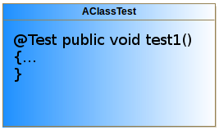

PIT inputs and outputs
Classes to mutate
Test Suite
PIT
Mutation engine
{mutation operators}

Slide 3

PIT project
target
classes
test-classes
target
target
target
PIT project
MavenProject
MavenProject
MavenProject
pom.xml
pom.xml
pom.xml
MavenProject
MavenProject
MavenProject
pom.xml
pom.xml
pom.xml
MavenProject
pom.xml
MavenProject
pom.xml

Slide 4
PITMP – PIT for Multi module Projects
target
classes
test-classes
target
target
target
PMP project
MavenProject
MavenProject
MavenProject
pom.xml
pom.xml
pom.xml
MavenProject
MavenProject
MavenProject
pom.xml
pom.xml
pom.xml
MavenProject
pom.xml
MavenProject
pom.xml

