Slide 1













STAMP
or
Test Amplification to DevTestOps Service

Slide 2




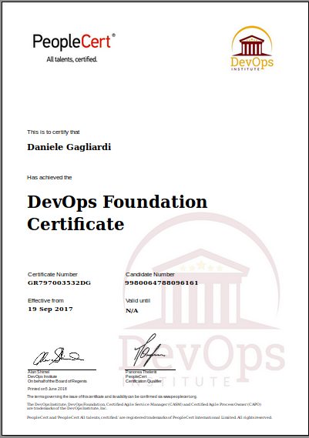

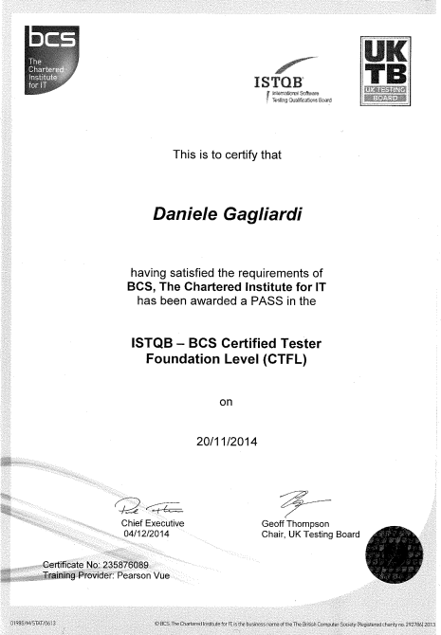



Me
STAMP
WP4 Leader
ENG
Tech Manager
OW2
TC/BoD
Daniele Gagliardi
@dangagliar
SW Test
Enthusiast
Spago4Q
Team member

Slide 3



Agenda
Scenario
Idea
How-to

Slide 4





Scenario – DevOps - CALMS
2007
A movement
2007
A movement
Culture
2007
A movement
2007
A movement
2007
A movement
Lean
Automation
Measurement
Sharing

Slide 5
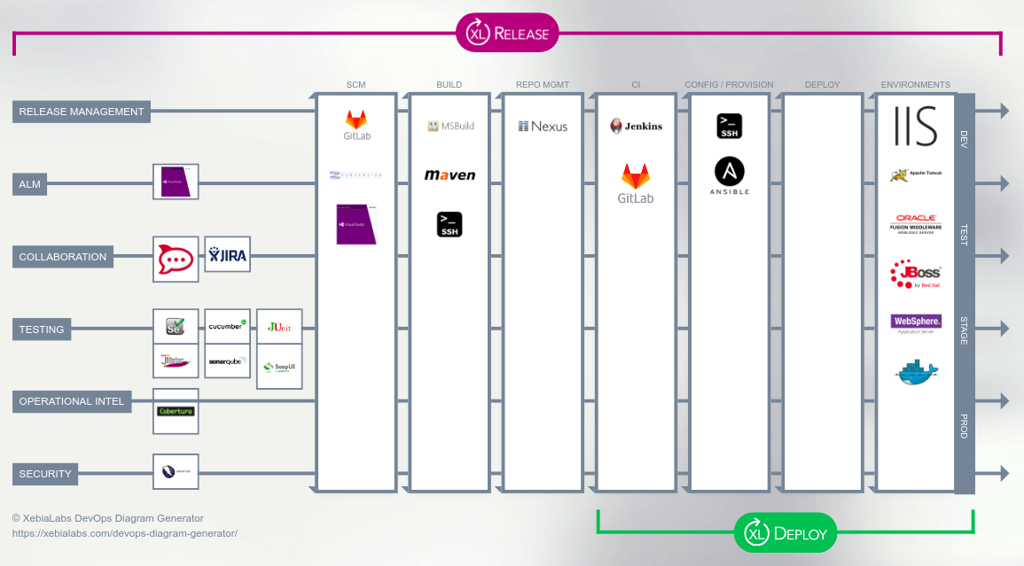


Scenario – You need an infra

Slide 6

Scenario – Risk: Continuous Bugs
There is an old saying in testing, Bilbo Baggins: Automating a bad test only gives you bad results faster. The same thing applies to DevOps.
By Joel Lee (maxbat) (http://maxbat.deviantart.com/) [CC BY-SA 4.0 (https://creativecommons.org/licenses/by-sa/4.0)], via Wikimedia Commons

Slide 7
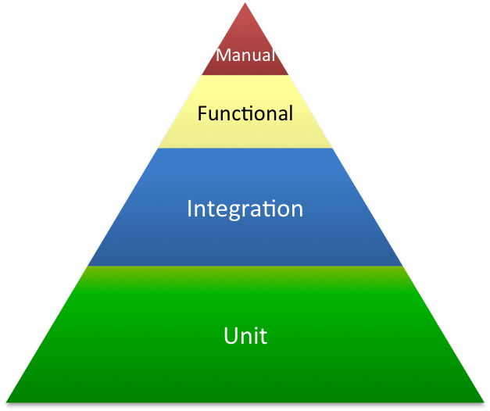

Scenario – how to have good tests?
Vision: test pyramid & bug filter
Bugs detected by unit tests
Bugs detected by IT
How can I improve it?
Etc
Etc
How can I reproduce it?

Slide 8
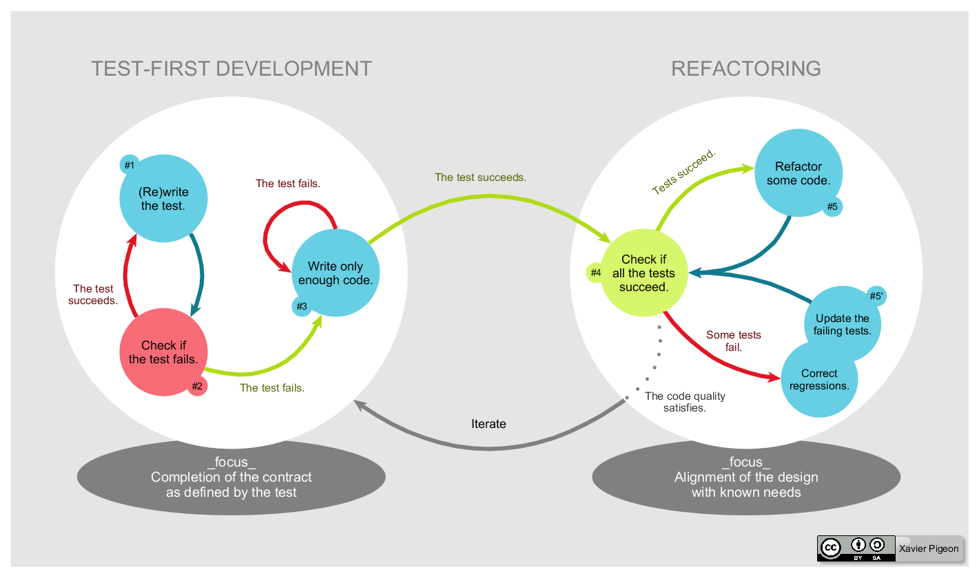
Scenario – how to have good tests?
Practice: TDD
How good are your tests ?

Slide 9









Scenario – Heterogeneous World
How can I manage test conf ?

Slide 10
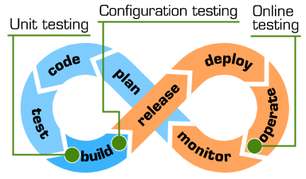
Idea – Software Testing AMPlification
What about a software that produces test variants from your test cases?
What about a software that tests your tests?
What about a software that produces variants from your test configurations and execute your tests against them?
What about a software that reproduces a production bug simply analysing your production logs?
What about a test automation solution that let you emphasize test and quality in your DevOps processes?

Slide 11
Idea – Software Testing AMPlification
A suite to increase your capacity to detect bugs
  Descartes (“test your tests”)
  DSpot (“amplify your tests”)
  CAMP (Configuration AMPlification)
  TECOR (TEst COnfiguration executoR)
  Evocrash (generate test case to reproduce bugs)
Use it by the means of standalone shell scripts
Available as Maven plugin
Use it within Eclipse IDE
Amplify your TDD practice

Slide 12
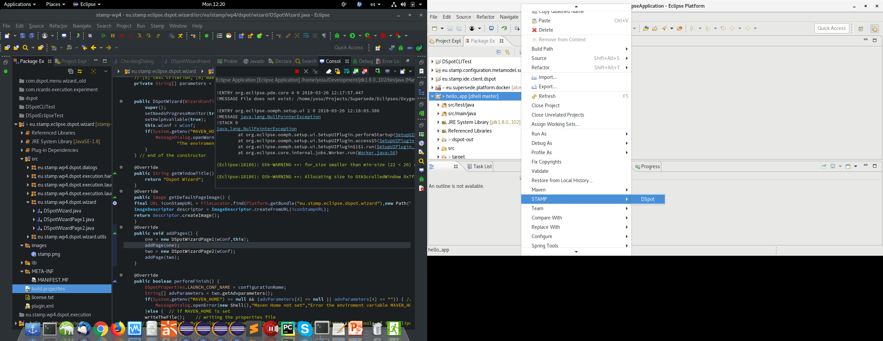
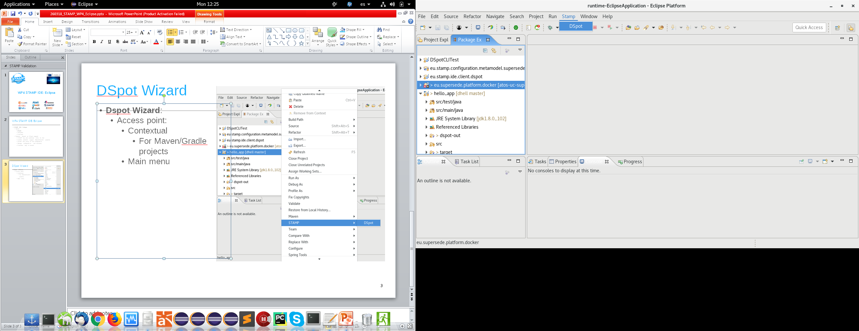
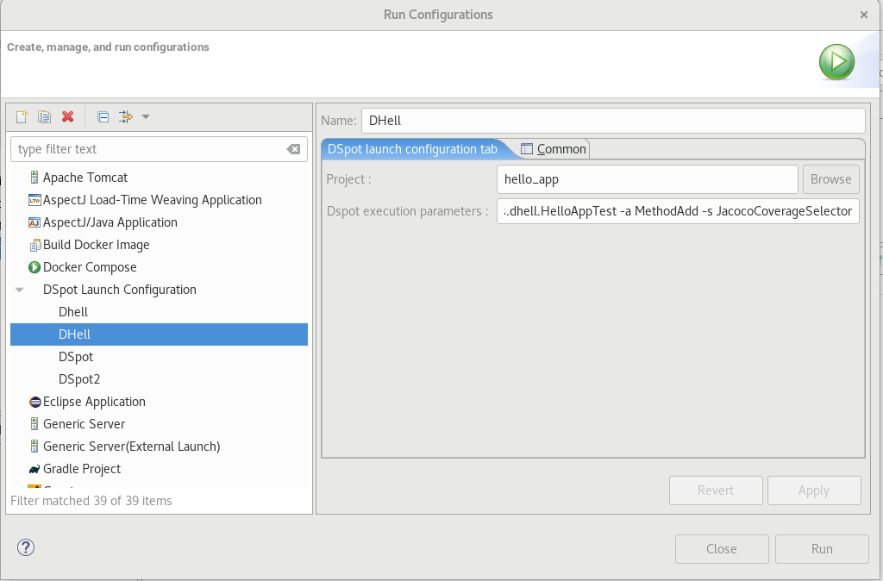
How to – use DSpot within Eclipse
DSpot Wizard
Execute it and check results in Eclipse Console
Manage multiple configurations and executions
<numero>

Slide 13
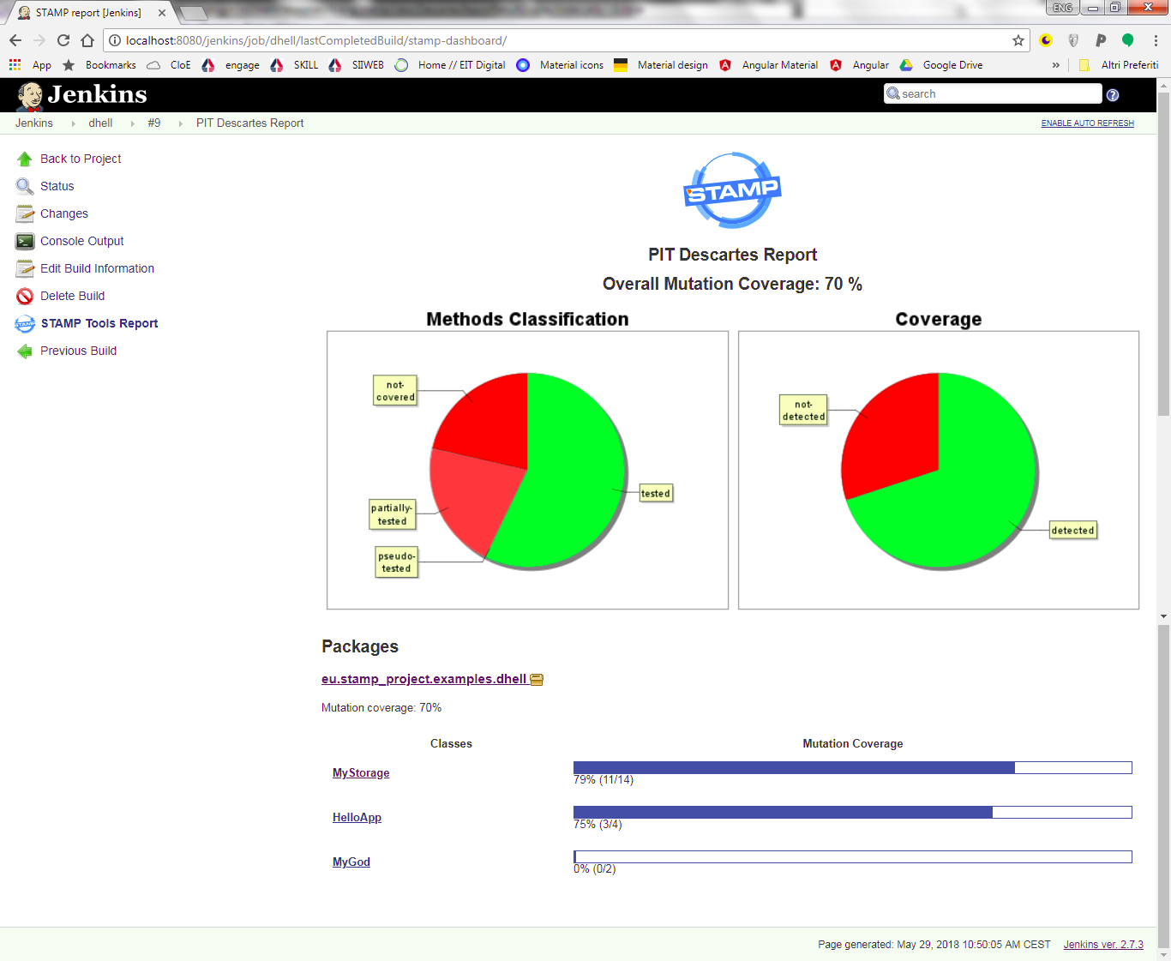
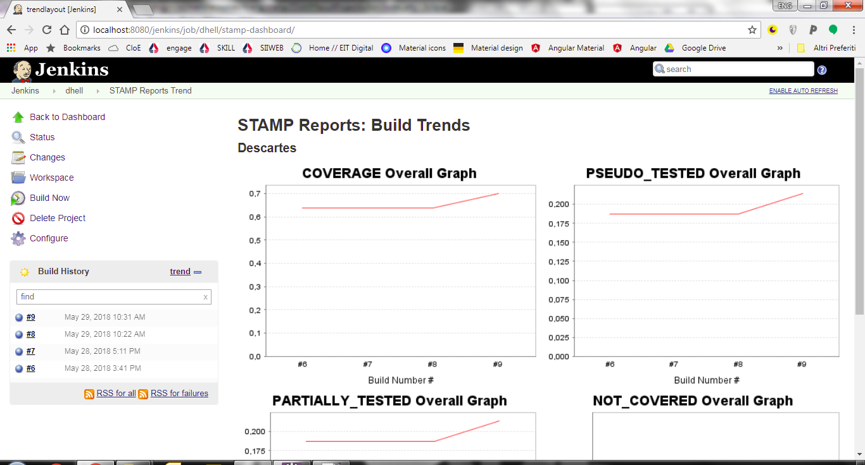
How to – use Descartes within Jenkins
Create a freestyle job to run PIT Descartes
Add a post build action to generate STAMP reports
Execute it
Check trends
<numero>

Slide 14
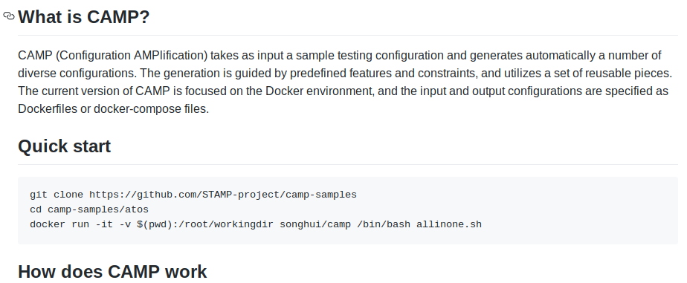
How to – CAMP
Design your test configuration (Docker)
Feed CAMP with it
Use new test configurations within your manual and automatic tests as well
<numero>

Slide 15
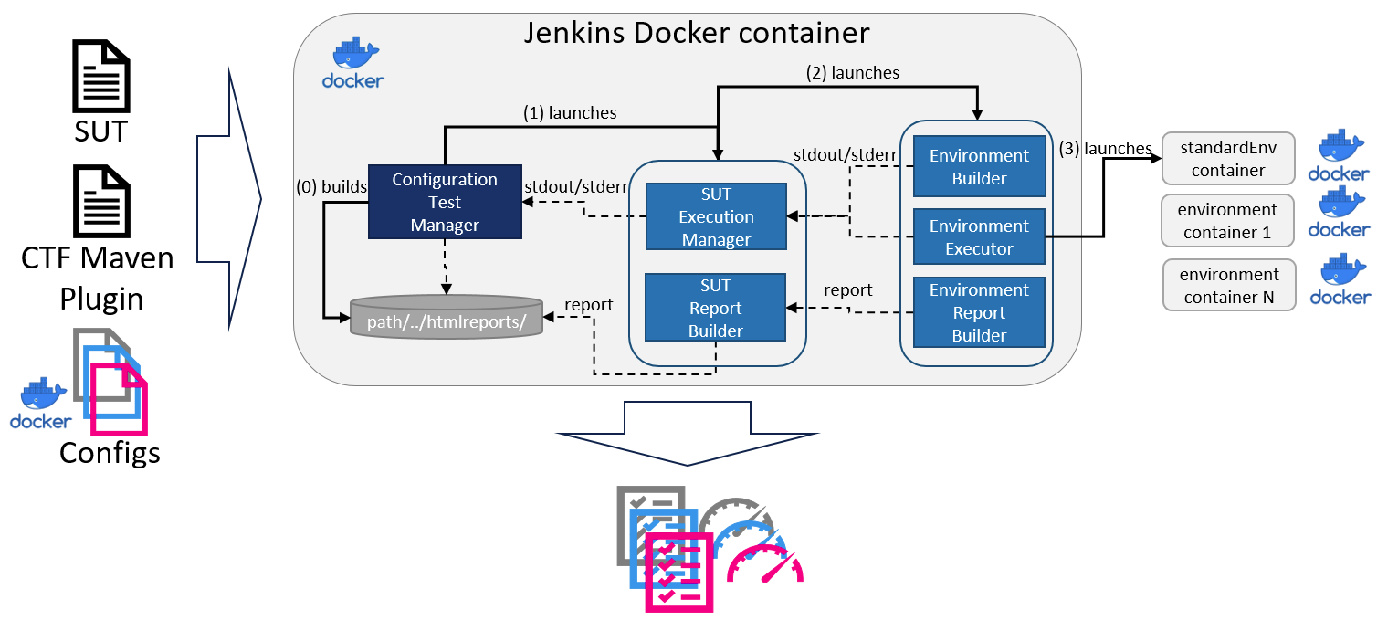
How to – TECOR
Execute your test cases against multiple configurations
Use it as standalone or into your continuous delivery pipeline
<numero>

Slide 16
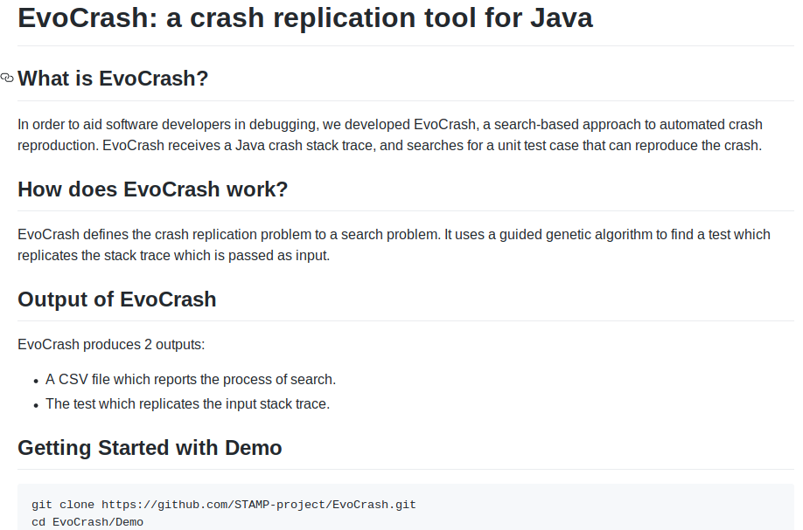
How to – Reproduce crashes
Feed Evocrash with your production logs
… Evocrash generates a test case able to reproduce the bug : just fix it
(saved 2 days to manually reproduce a crash : have a nice weekend :-))
<numero>

Slide 17
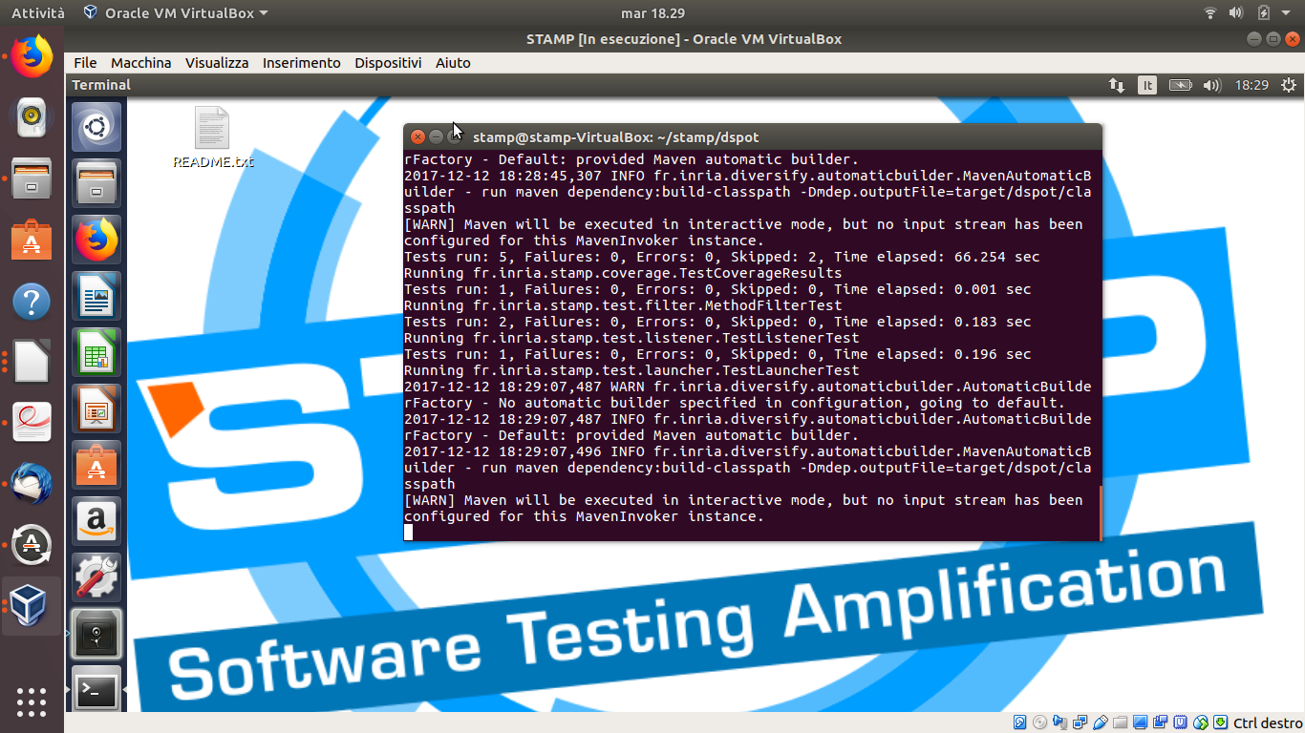
How to – try it with STAMP virtual lab
<numero>

Slide 18
How to – now you can have this

Slide 19
Conclusions
It’s not about “computers write software”: at least now, computers need people as much as we need them
Want to try it? Getting started for Dummies (see references)
Want to contribute? Github repo (see references)
Next steps:
  Optimizations and enhancements
  Microservices
  More Jenkins, Github and Gitlab integrations
  Metrics enhancements
  More use cases and experiments
  A lot of other stuff: stay tuned!

Slide 20
References
STAMP Official site: https://www.stamp-project.eu/
STAMP code: https://github.com/STAMP-project/
STAMP for dummies:
  https://github.com/STAMP-project/dspot/blob/master/docs/dspot-for-dummies.md
  https://github.com/STAMP-project/pitest-descartes/blob/master/docs/descartes-for-dummies-mvn.md
  More tutorials are coming….
The Practical Test Pyramid - https://martinfowler.com/articles/practical-test-pyramid.html
Avoiding continuous Bugs: Speed and Quality in DevOps - https://www.techwell.com/techwell-insights/2017/07/avoiding-continuous-bugs-speed-and-quality-devops

Slide 21


Thank you!
Questions?
Answers
Tweets?

