Slide 1
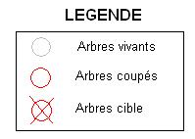
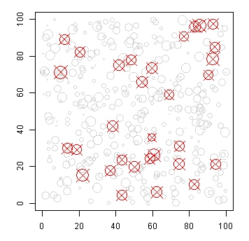
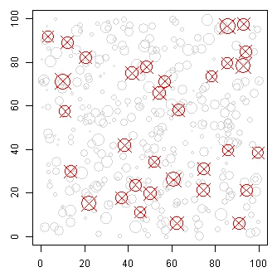
Exemples de prélèvement
aAggregateMax = 0
distBuffer = 0
aAggregateMax = 0
distBuffer = 5

Slide 2
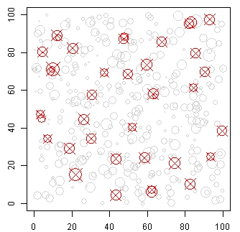
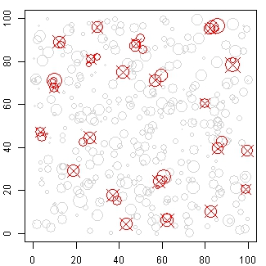
Exemples de prélèvement
aAggregateMax = 20
distBuffer = 5
aAggregateMax = 50
distBuffer = 5

Slide 3
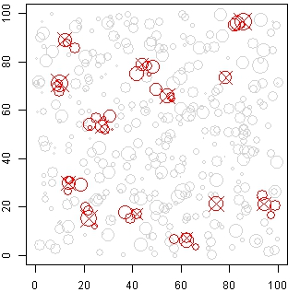
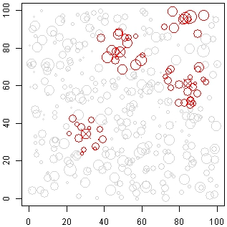
Exemples de prélèvement
aAggregateMax = 100
distBuffer = 5
aAggregateMax = 500
distBuffer = 5

Slide 4
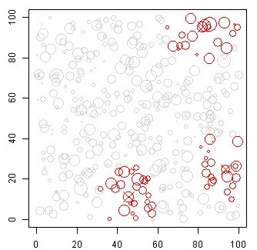
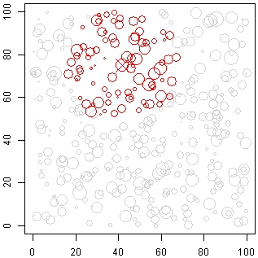
Exemples de prélèvement
aAggregateMax = 1000
distBuffer = 0
aAggregateMax = 5000
distBuffer = 5

