Slide 1
Estimated smoking state transition probabilities

Slide 2
Cover sheet
Smoking state transition probabilities webpage https://stapm.gitlab.io/smoking_state_transitions.html
Citation:
Gillespie D, Webster L, Leeming G, Opazo-Breton M, Brennan A (2023). smktrans: An R Package for estimating smoking state transition probabilities from cross-sectional survey data. R package version 1.6.0. The University of Sheffield. doi: https://doi.org/10.17605/OSF.IO/YGXQ9.
Contact: duncan.gillespie@sheffield.ac.uk

Slide 3
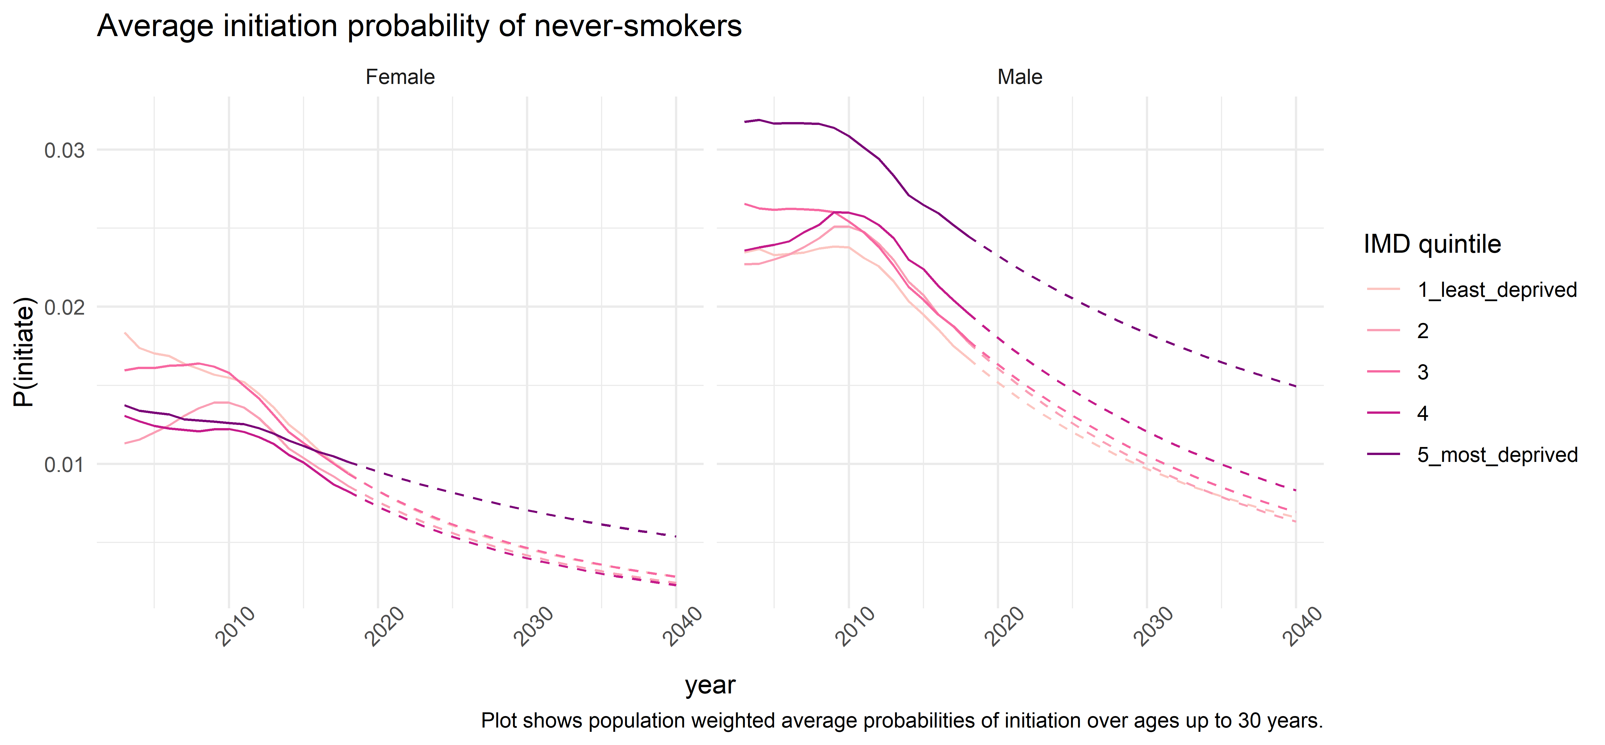
Initiation

Slide 4
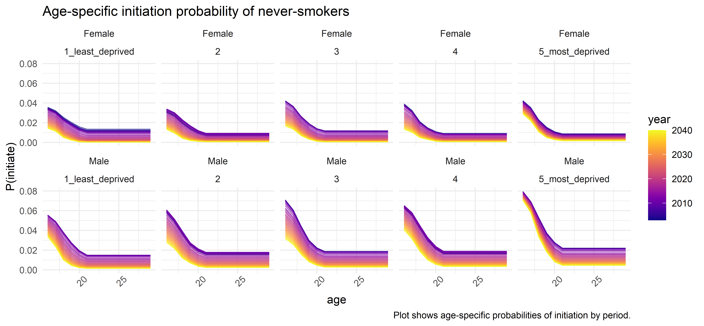

Slide 5
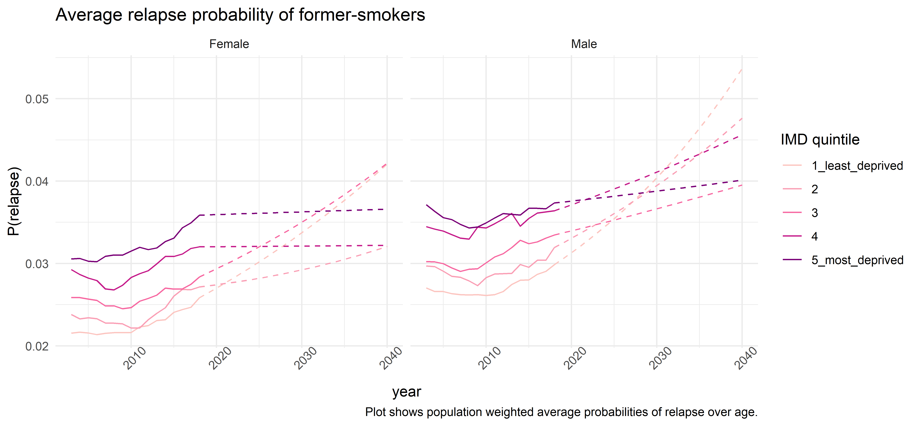
Relapse

Slide 6
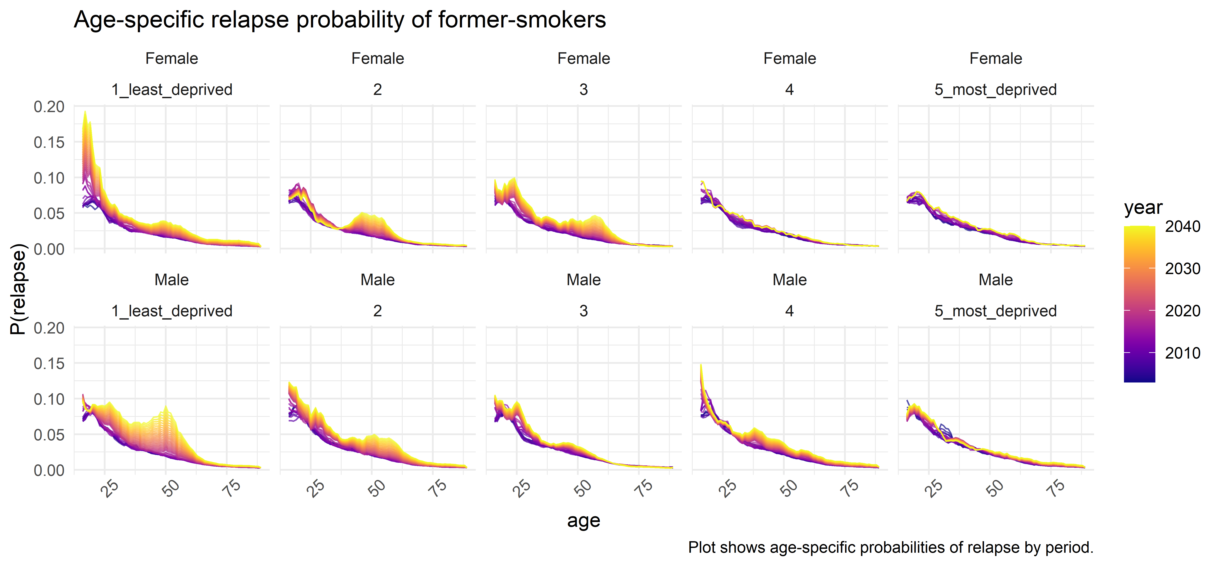

Slide 7
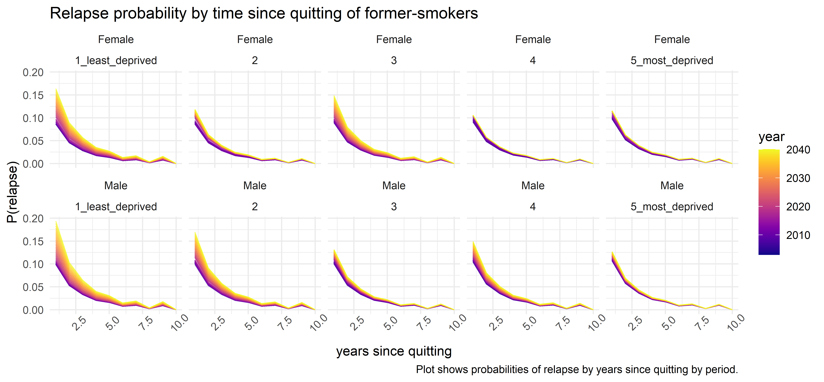

Slide 8
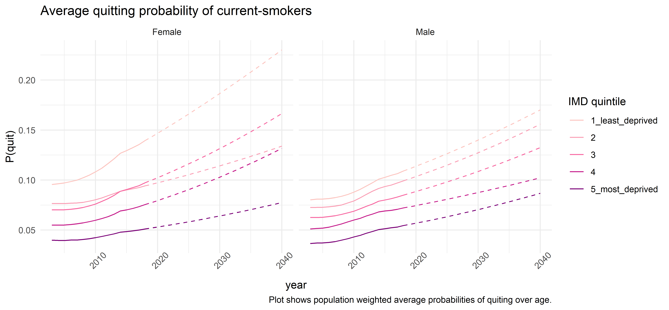
Quitting

Slide 9
