Slide 1
Estimated smoking state transition probabilities

Slide 2
Cover sheet
Smoking state transition probabilities webpage https://stapm.gitlab.io/smoking_state_transitions.html
Citation:
Gillespie D, Webster L, Leeming G, Opazo-Breton M, Brennan A (2023). smktrans: An R Package for estimating smoking state transition probabilities from cross-sectional survey data. R package version 1.6.0. The University of Sheffield. doi: https://doi.org/10.17605/OSF.IO/YGXQ9.
Contact: duncan.gillespie@sheffield.ac.uk

Slide 3
Key parameters
Main dataset: Scottish Health Survey First year of survey data: 2008 Last year of survey data: 2019 Earliest year on which forecast trends are based: 2015 Last year of continuing trends in the forecast: 2044 Final year: 2100 Minimum age: 16 Maximum age: 89

Slide 4
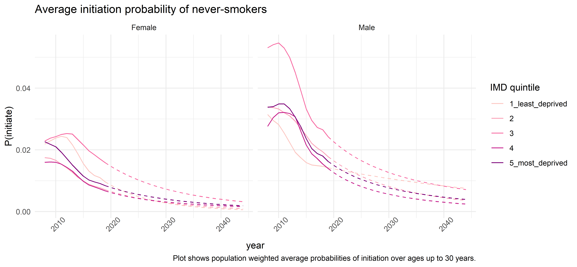
Initiation

Slide 5
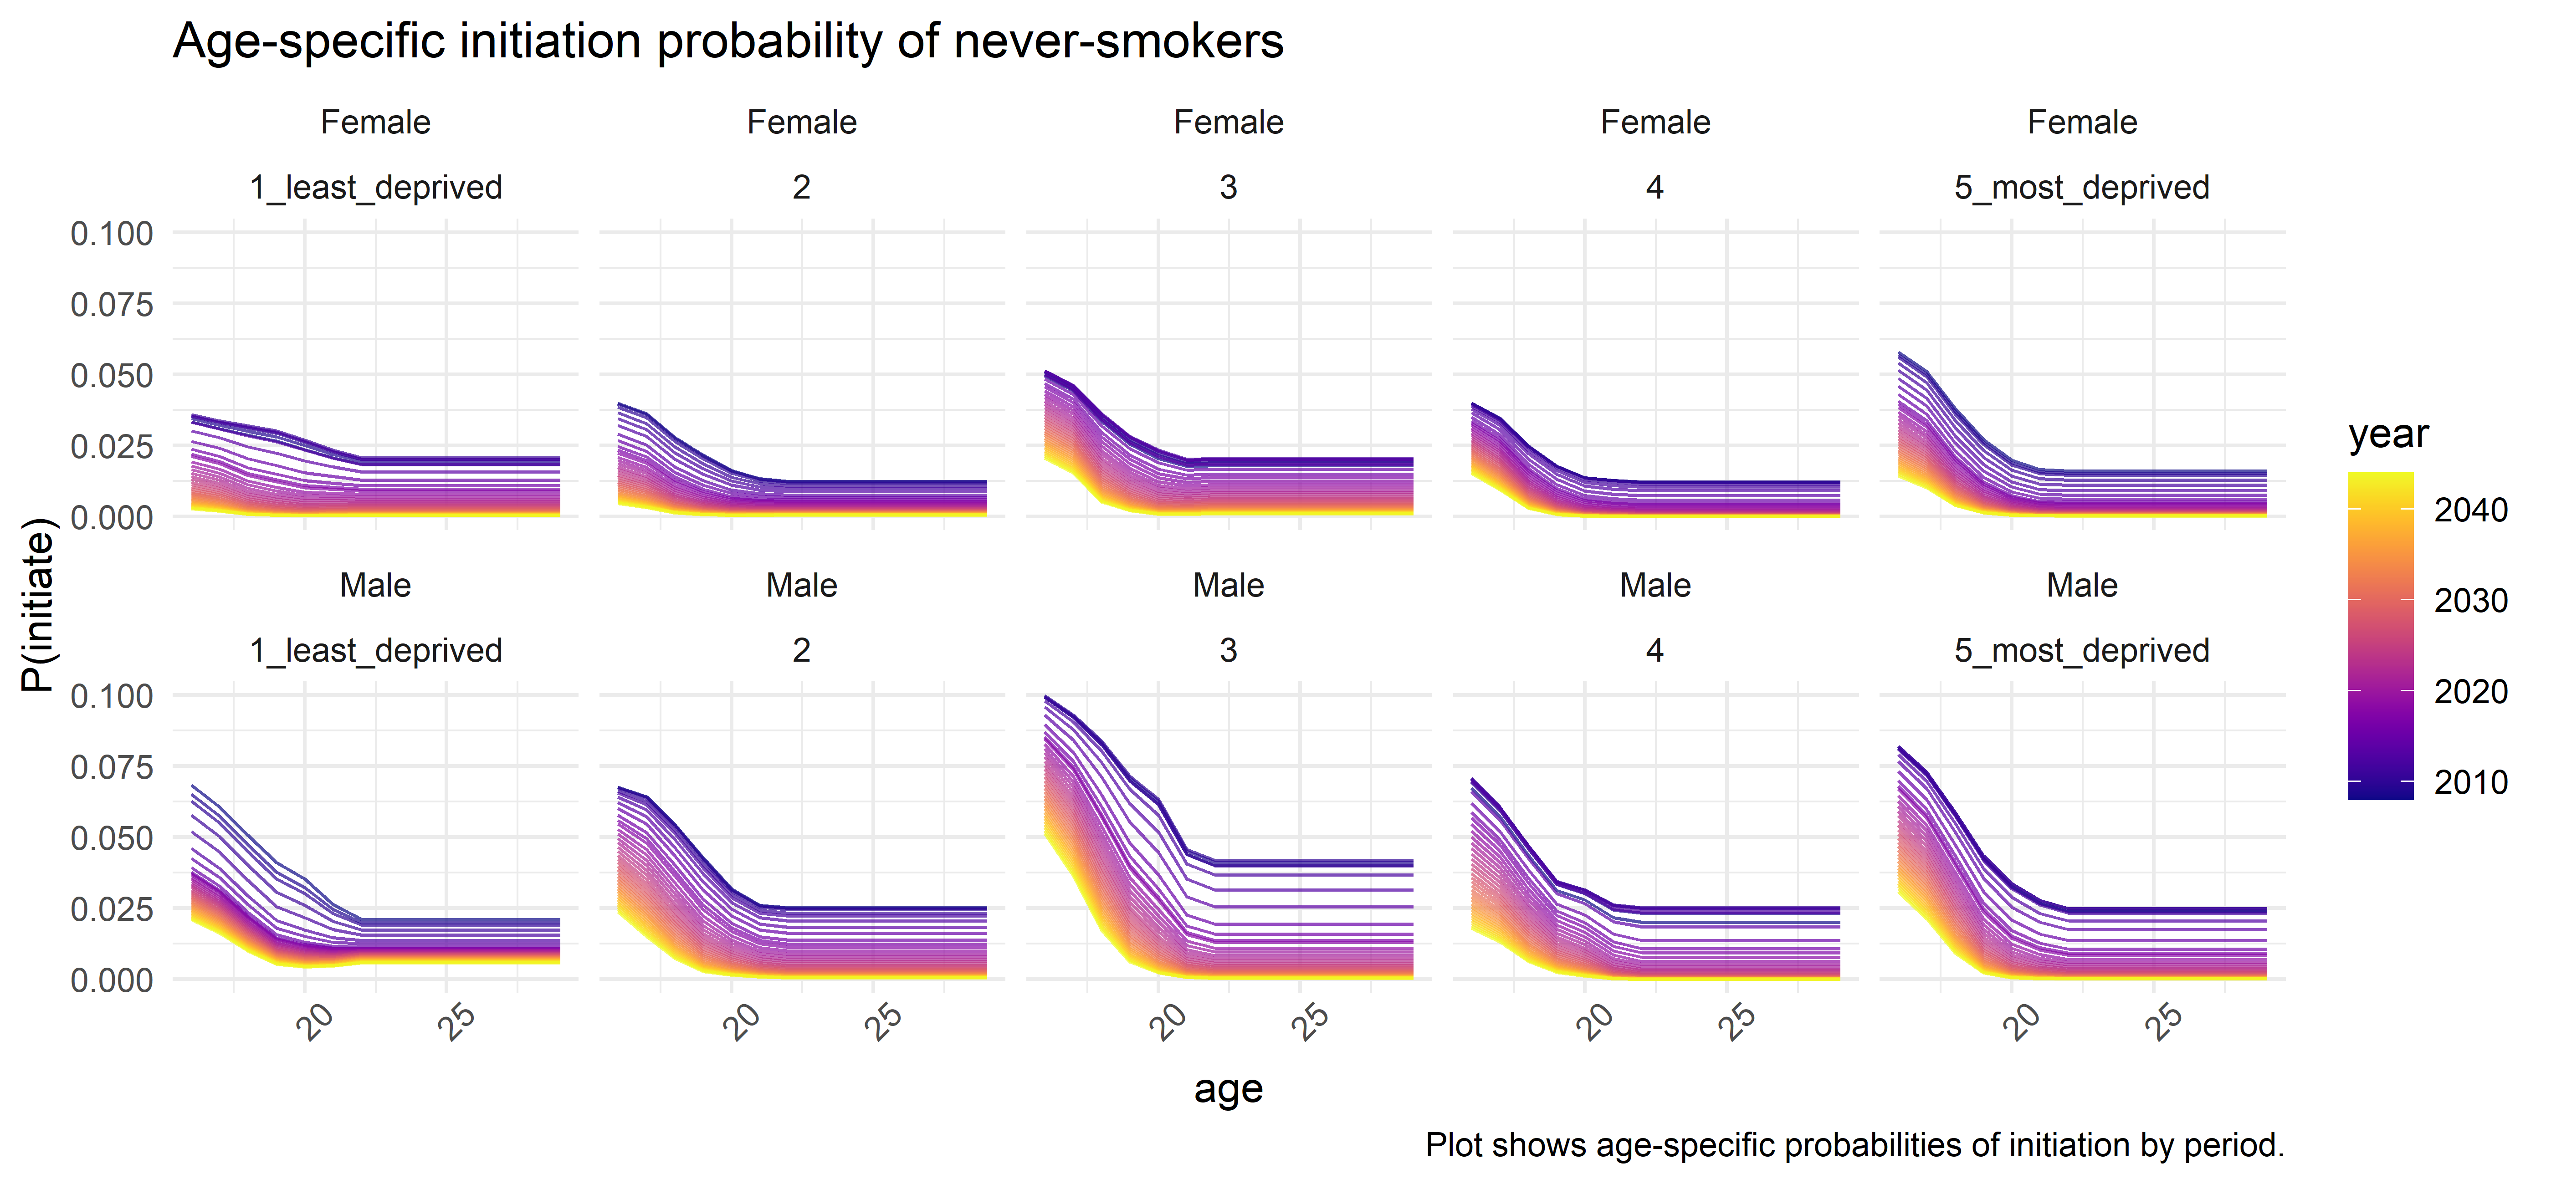

Slide 6
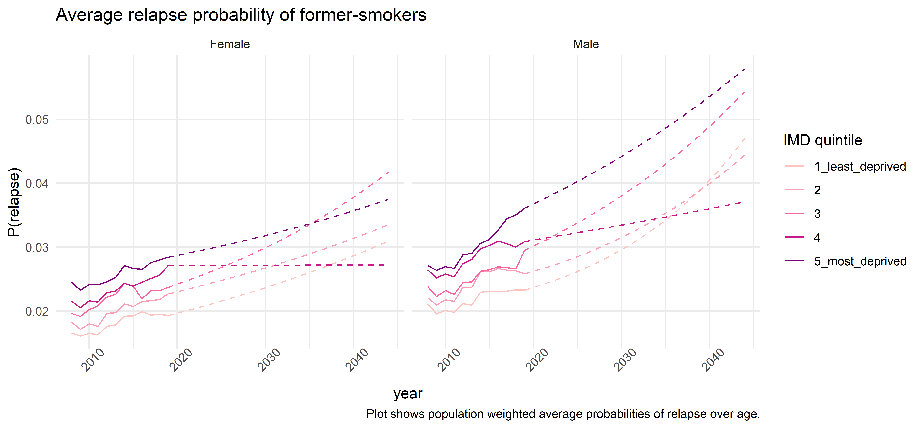
Relapse

Slide 7
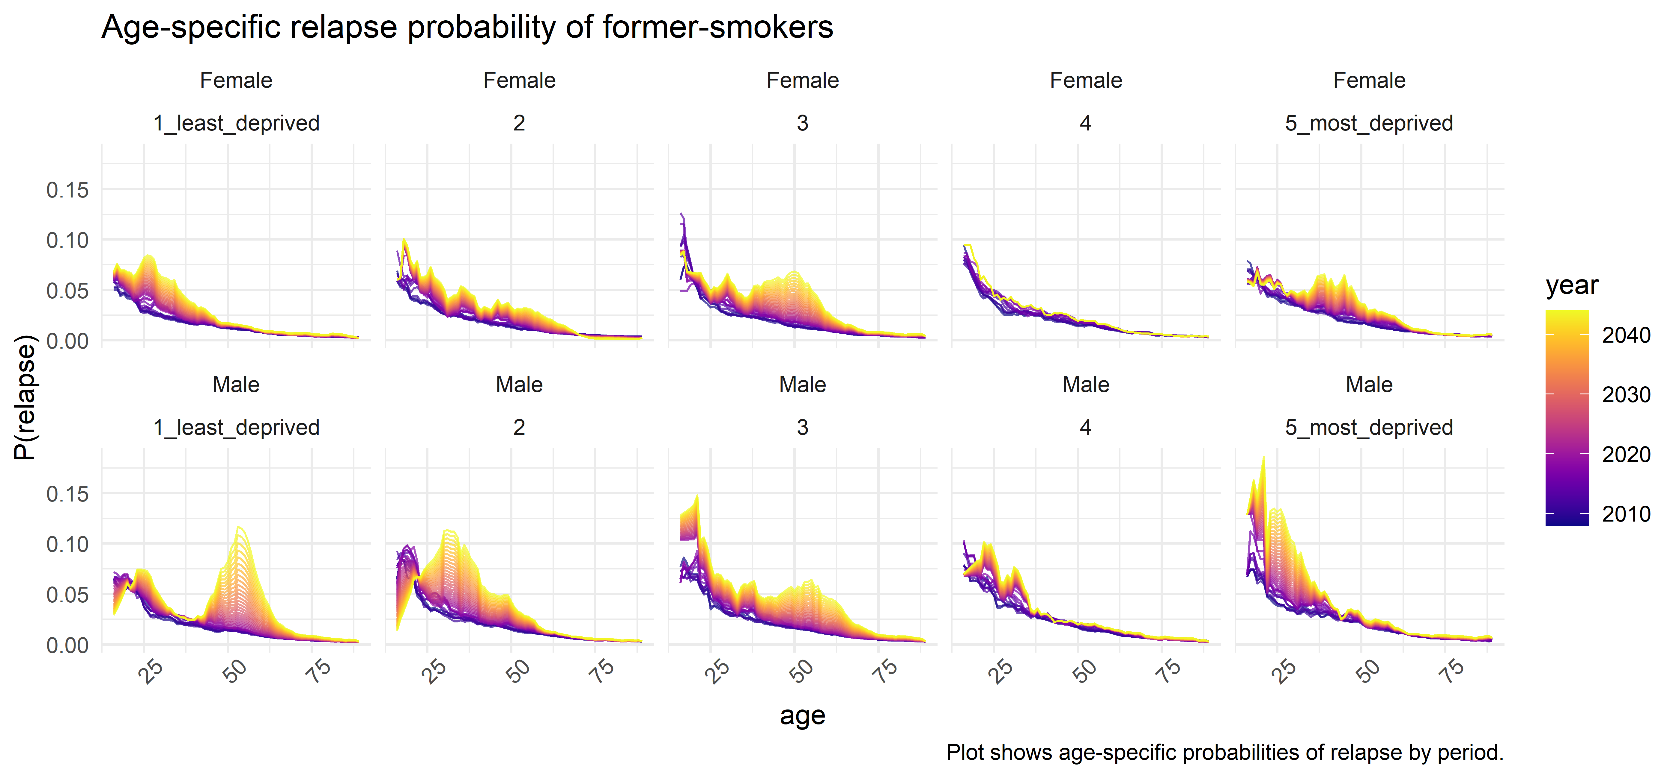

Slide 8
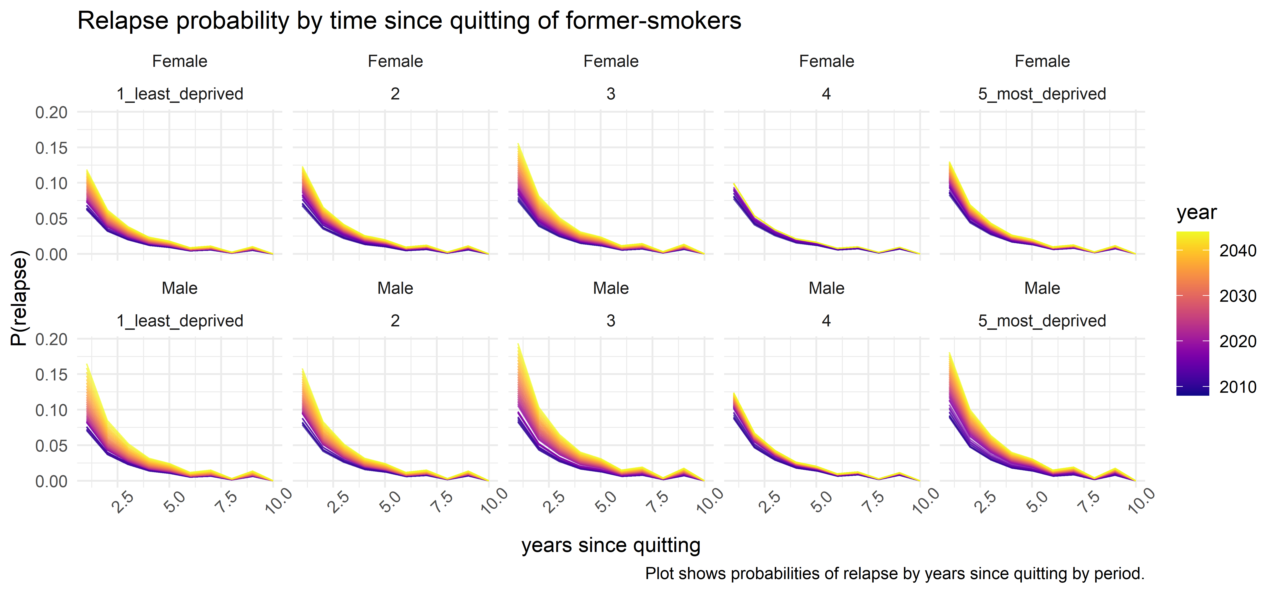

Slide 9
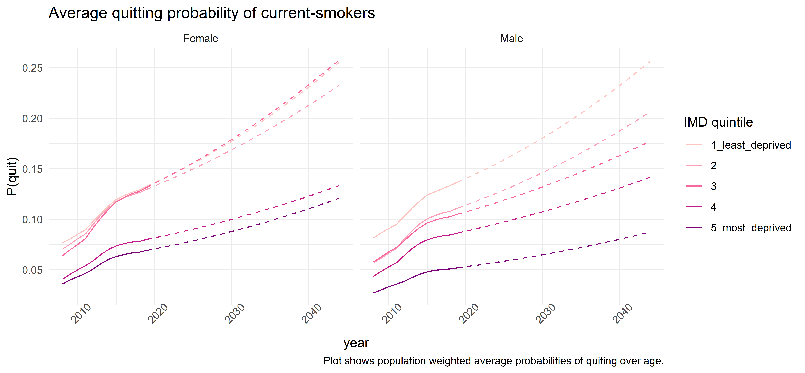
Quitting

Slide 10
