Slide 1


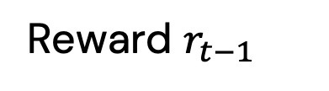
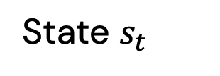

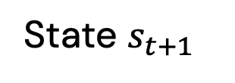

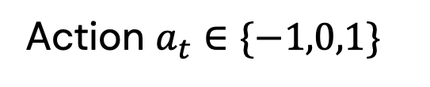

Environment
Space for vehicle type $j$
Space for vehicle type $k$
State $s_{t}$
State $s_{t+1}$
Reward $r_{t}$
Reward $r_{t−1}$
RL-CSM-blockface
Agent
Action $a_{t}∈\{−1,0,1\}$

