Slide 1

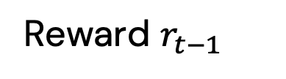

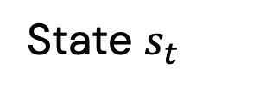

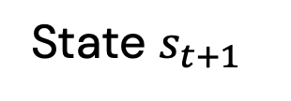
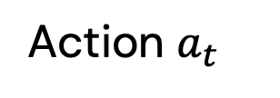
State $s_{t}$
State $s_{t+1}$
Reward $r_{t−1}$
Reward $r_{t}$
Environment
RL-CSM Agent
Space for vehicle type $j$
Space for vehicle type $k$
Action $a_{t}$

