Slide 1
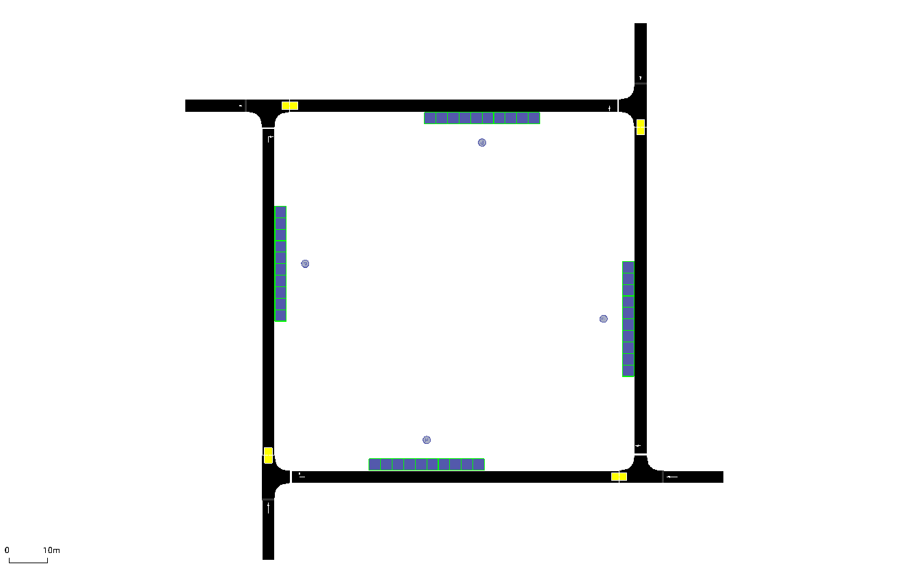




$$f_{2}$$
$$f_{1}$$
1
10 spaces per curb
2
Side length 100m
0
3
$$f_{0}$$
$$f_{3}$$

