Slide 1

Internet Explorer
Flavio Kluser, Joël Kessler, Linus Schlumberger, Fabien Morgan

Slide 2


Challenge
Track: SBB
Customers reserving multiple bike reservations for different train rides
Customers stop feeling the need to reserve their spot to far in advance
Artificial Intelligence that predicts how much time the customer has left to reserve his bike spot

Slide 3
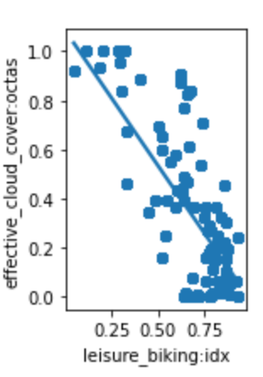
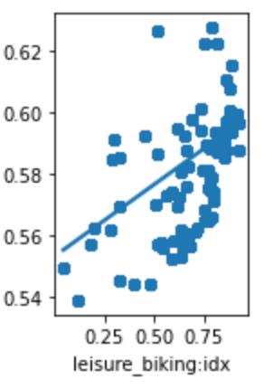
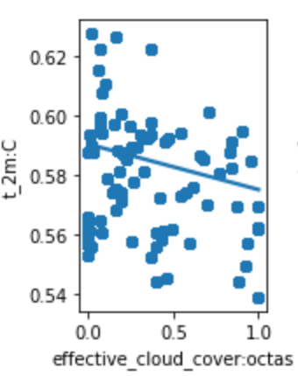
Data
Historical train data with the utilization of the bike reservations
Weather data
School holidays
Trained on over 50’000 datapoints

Slide 4












$$Inputs$$
$$Binary outputs$$
$$Weather$$
$$64h$$
$$32h$$
$$16h$$
$$Holidays$$
$$8h$$
$$Number of$$
$$reservations$$
$$4h$$
$$2h$$
From – To station
$$1h$$

Slide 5




Architecture
Frontend
Backend
AI Model
Web Socket
SBB API

Slide 6
Notes:
Dynamic, scalable Web Application
Mockup for

Slide 7
Roadmap
Targeted Weather/Holiday Data
Data processing
Proof of Concept
Initial ML model
Optimization of our ML model
Finishing UI

Slide 8


