Slide 1
Personalized training recommendations
Helsana
Case Pitch
Arben Nuhija, IT Team Lead Health Platform
arben.nuhija@helsana.ch

Slide 2
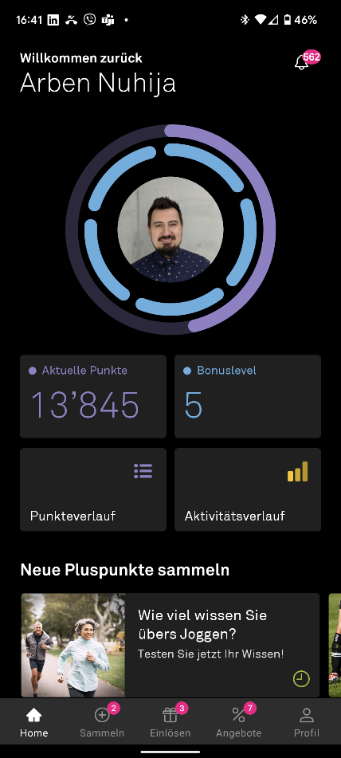
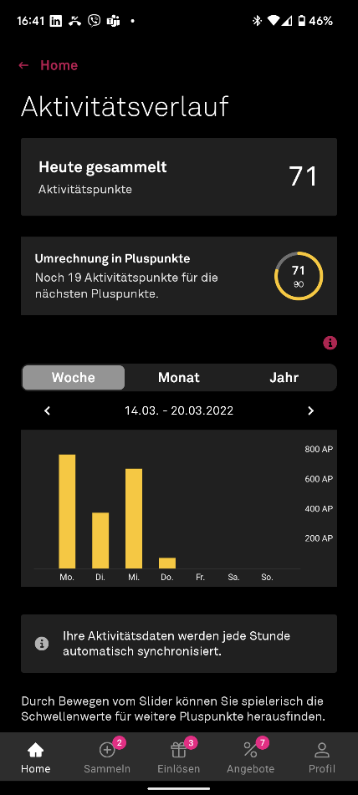
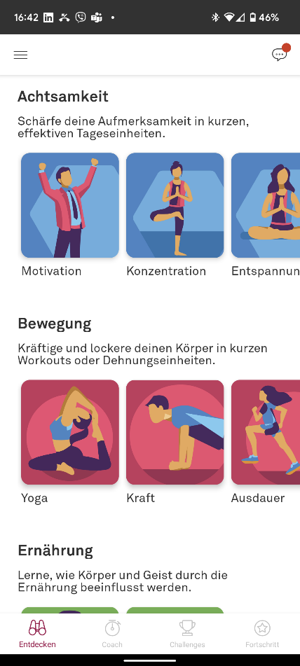
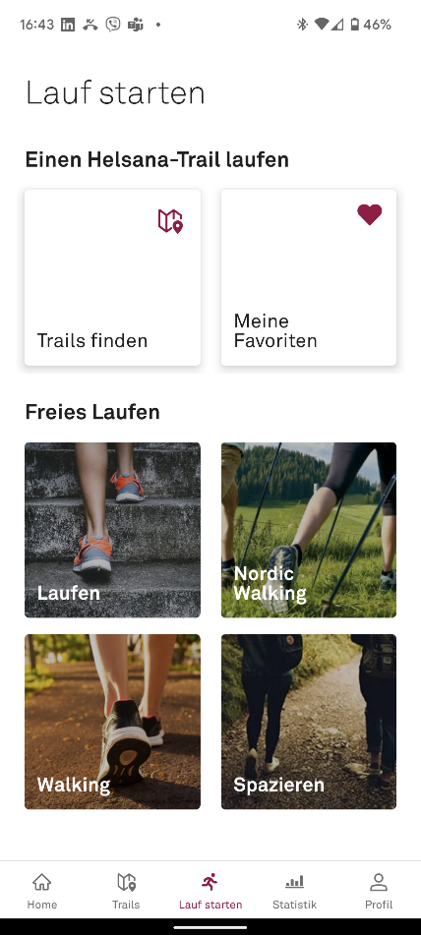



PERSONALIZED TRAINING RECOMMENDATIONS

Slide 3





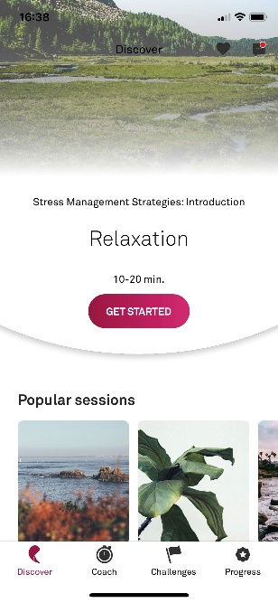
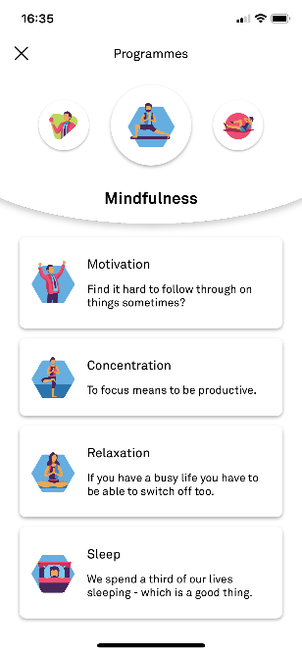
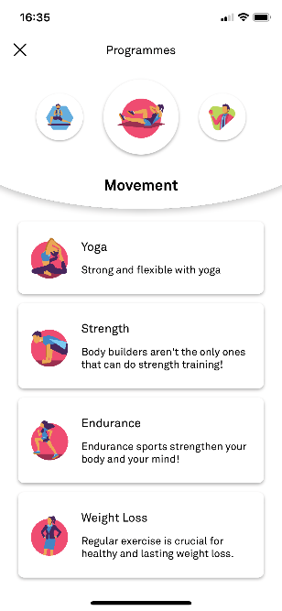
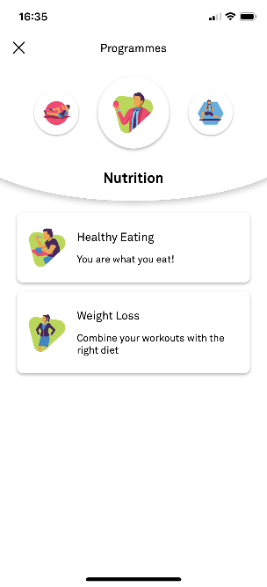






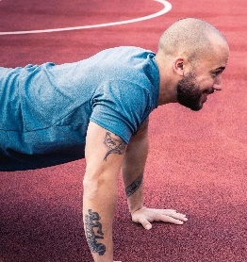
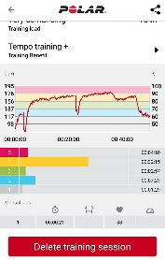



PERSONALIZED TRAINING RECOMMENDATIONS

Slide 4

PERSONALIZED TRAINING RECOMMENDATIONS
Personal recommendations

Slide 5

Personalized training RECOMMENDATIONS
One more buddy
After this session we’ll recover
… and get a healthy lunch
Arben Nuhija, IT Team Lead Health Platform
arben.nuhija@helsana.ch

