Slide 1
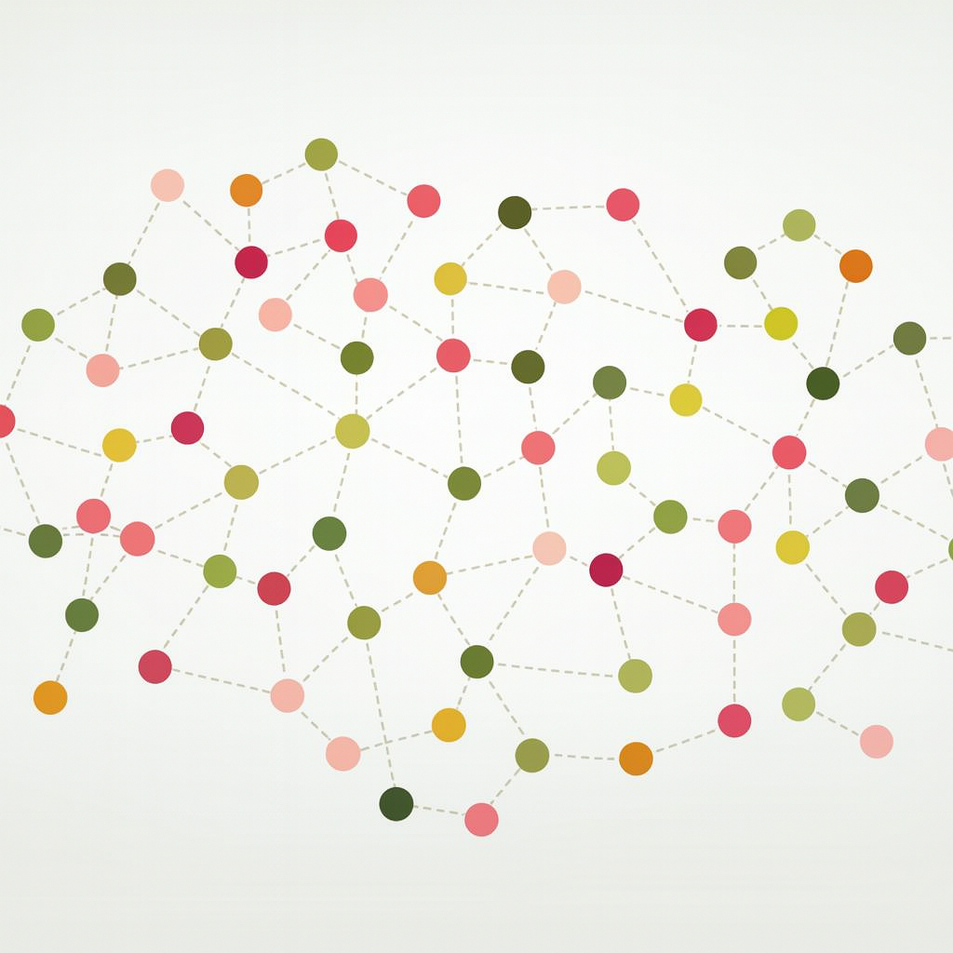
K-Nearest Neighbors

Slide 2
Instance-based vs Model-based
Instance-Based
  Stores the training data and defers computation to prediction time
  No parameters are learned; the data itself is the model
Model-Based
  Learns a fixed set of parameters during training, then discards the data
  Prediction uses only the fitted parameters

Slide 3
How KNN Works

Slide 4
What Is KNN?
A supervised, instance-based model for both regression and classification
Fast to fit and predict on moderate-sized data
Frequently a strong baseline despite its simplicity

Slide 5
K-NN Method
PREDICTION ALGORITHM
Given a query point x, compute the distance d(x, xᵢ) to every training point xᵢ, i = 1, …, n
How should the distance d(·, ·) be defined?
Let Nₖ(x) denote the indices of the k training points nearest to x
Predict the target value ŷ for the query point x:
Regression: ŷ = (1/k) Σ yᵢ, for i ∈ Nₖ(x)
Classification: ŷ = the majority class among { yᵢ : i ∈ Nₖ(x) }
Both are the uniform-weight case; see weighted k-NN

Slide 6
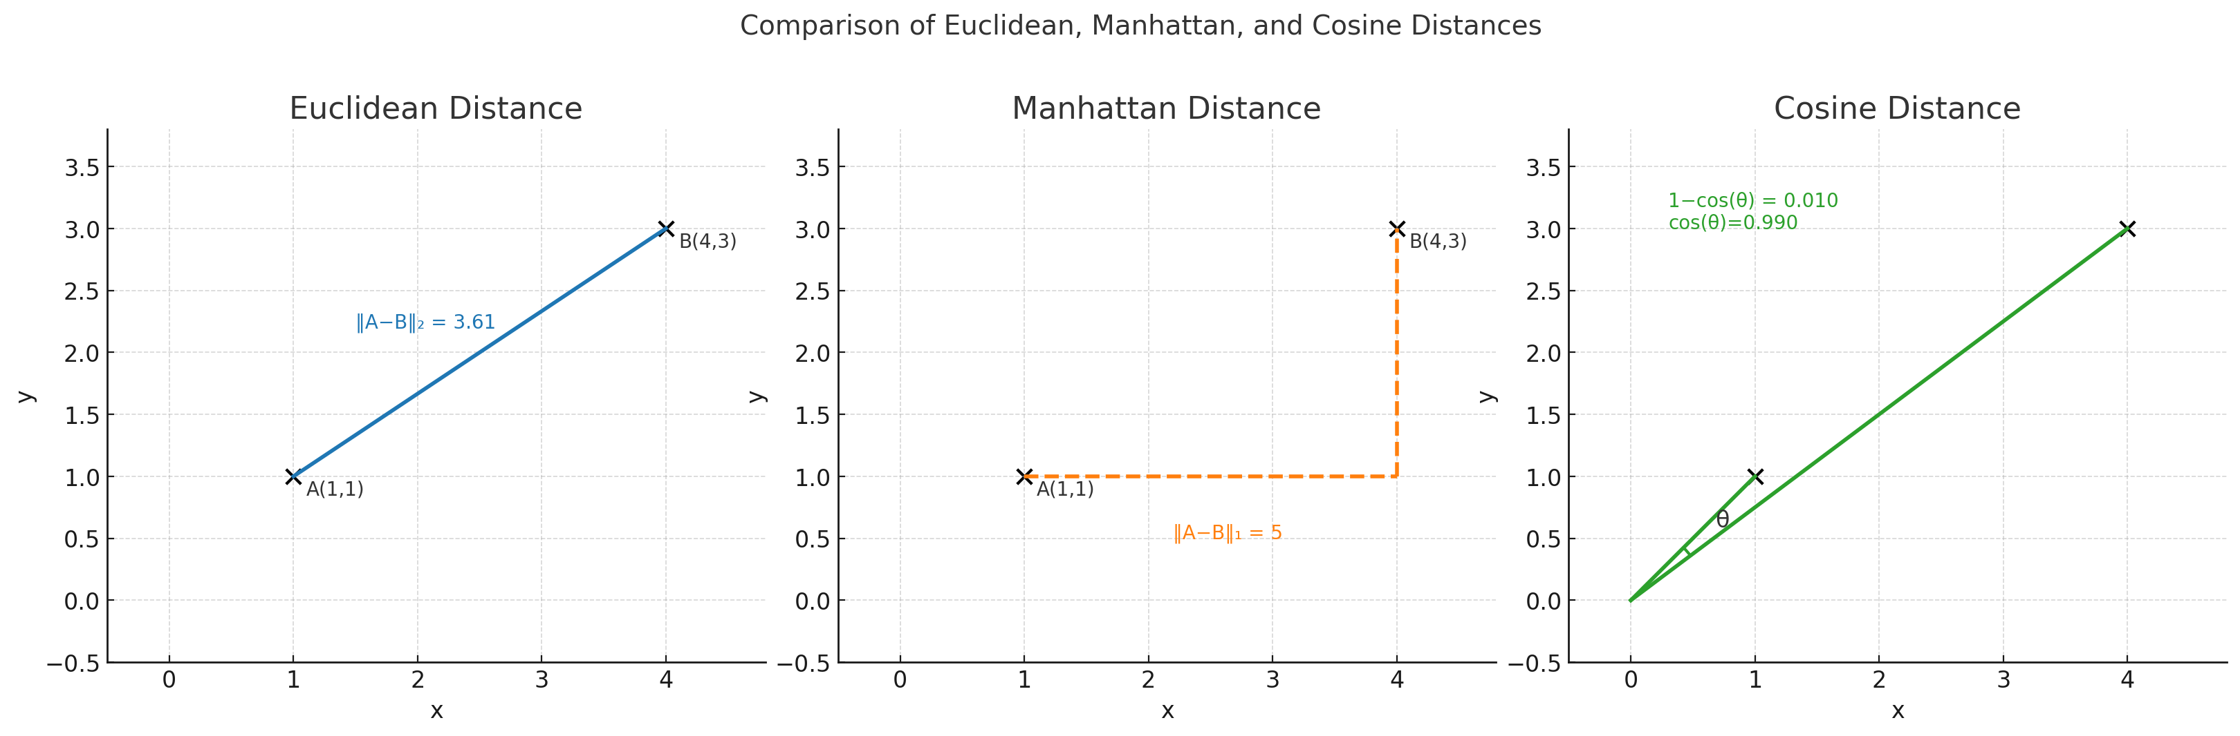
Choice of Distance
Euclidean: the default choice for continuous, well-scaled features
Cosine: preferred for high-dimensional or sparse data

Slide 7
k-nn regression

Slide 8



Visualization of KNN
Values of $y$
Training data
8
4
9
7
$$x_{1}$$
6
5
6
2
4
3
4
4
$$x_{2}$$

Slide 9
Visualization of KNN
Values of $y$
Training data
8
4
9
7
$$x_{1}$$
6
?
5
6
4
4
3
4
2
$$x_{2}$$

Slide 10
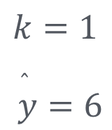
Visualization of KNN
Values of $y$
Training data
8
4
9
7
$$k=1$$
$$\overset{̂}{y}=6$$
$$x_{1}$$
6
?
5
6
4
4
3
4
2
$$x_{2}$$

Slide 11
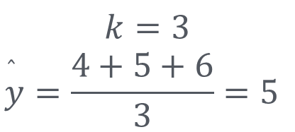
Visualization of KNN
Values of $y$
Training data
8
4
9
7
$$k=3$$
$$\overset{̂}{y}=\frac{4+5+6}{3}=5$$
$$x_{1}$$
6
?
5
6
4
4
3
4
2
$$x_{2}$$

Slide 12
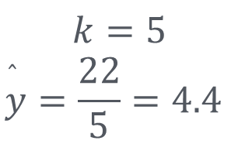
Visualization of KNN
Values of $y$
Training data
8
4
9
7
$$k=5$$
$$\overset{̂}{y}=\frac{22}{5}=4.4$$
$$x_{1}$$
6
?
5
6
4
4
3
4
2
$$x_{2}$$

Slide 13
k-nn classification

Slide 14
Visualization of KNN
Values of $y$
Training data
$$x_{1}$$
$$x_{2}$$

Slide 15
Visualization of KNN
Values of $y$
Training data
$$x_{1}$$
?
$$x_{2}$$

Slide 16
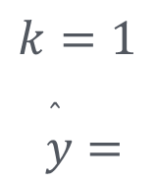
Visualization of KNN
Values of $y$
Training data
$$k=1$$
$$\overset{̂}{y}=$$
$$x_{1}$$
?
$$x_{2}$$

Slide 17
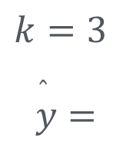
Visualization of KNN
Values of $y$
Training data
$$k=3$$
$$\overset{̂}{y}=$$
$$x_{1}$$
?
$$x_{2}$$

Slide 18
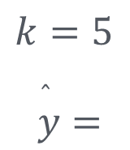
Visualization of KNN
Values of $y$
Training data
$$k=5$$
$$\overset{̂}{y}=$$
$$x_{1}$$
?
$$x_{2}$$

Slide 19
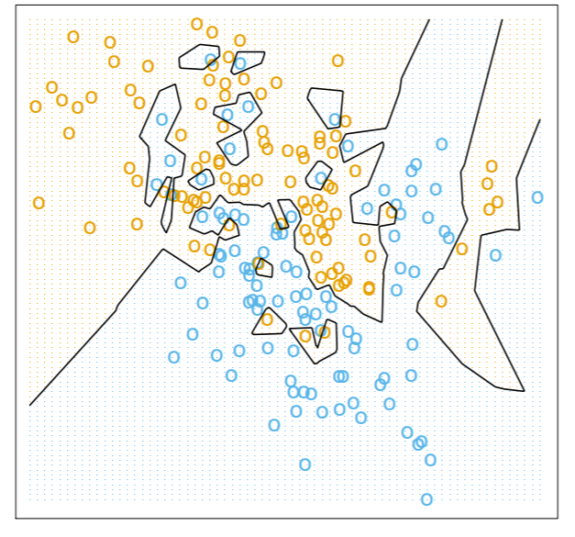
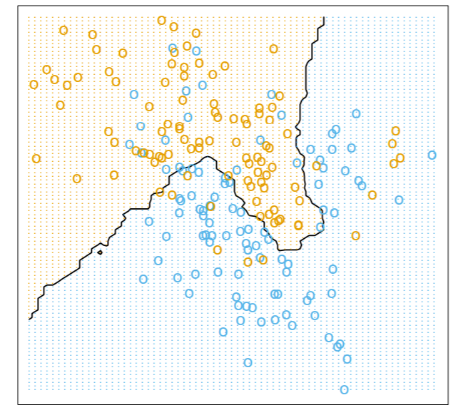
Effect of k on Decision Boundary
1 - NN
15 - NN
https://fderyckel.github.io/machinelearningwithr/knnchapter.html

Slide 20
Weighted k-NN
Idea: weight neighbors by proximity
  Let wᵢ ∝ 1 / d(x, xᵢ) for i ∈ Nₖ(x)
  Closer neighbors carry more influence than distant ones
Regression
  ŷ = Σ wᵢyᵢ / Σ wᵢ, a weighted mean rather than a plain average
Classification
  ŷ = argmax over classes c of Σ wᵢ·1{yᵢ = c}, a weighted vote
Why it helps
  Larger k becomes safer: distant neighbors dilute the prediction less
  Ties in classification break naturally
Caveats
  Weighting amplifies the effect of poorly scaled features
  1 / d diverges when the query point coincides with a training point

Slide 21
KNN: Key Takeaways
When does kNN work well?
  Continuous, well-scaled features with moderate dimensionality
  Simple, non-parametric, no explicit training phase
Choosing k
  Small k: sensitive to noise, can overfit
  Large k: smooths boundaries, but may underfit
  Distance weighting reduces sensitivity to k
Distance metrics
  Euclidean by default; Cosine for sparse data
Where does kNN struggle?
  High dimensions: distances lose meaning, so neighbors become unreliable
  Large datasets: distances to all points make prediction slow
  Noisy or irrelevant features distort neighbor selection
  Class imbalance biases predictions toward the majority class
Always scale features
  Distance-based methods are dominated by large-magnitude variables

