Slide 1
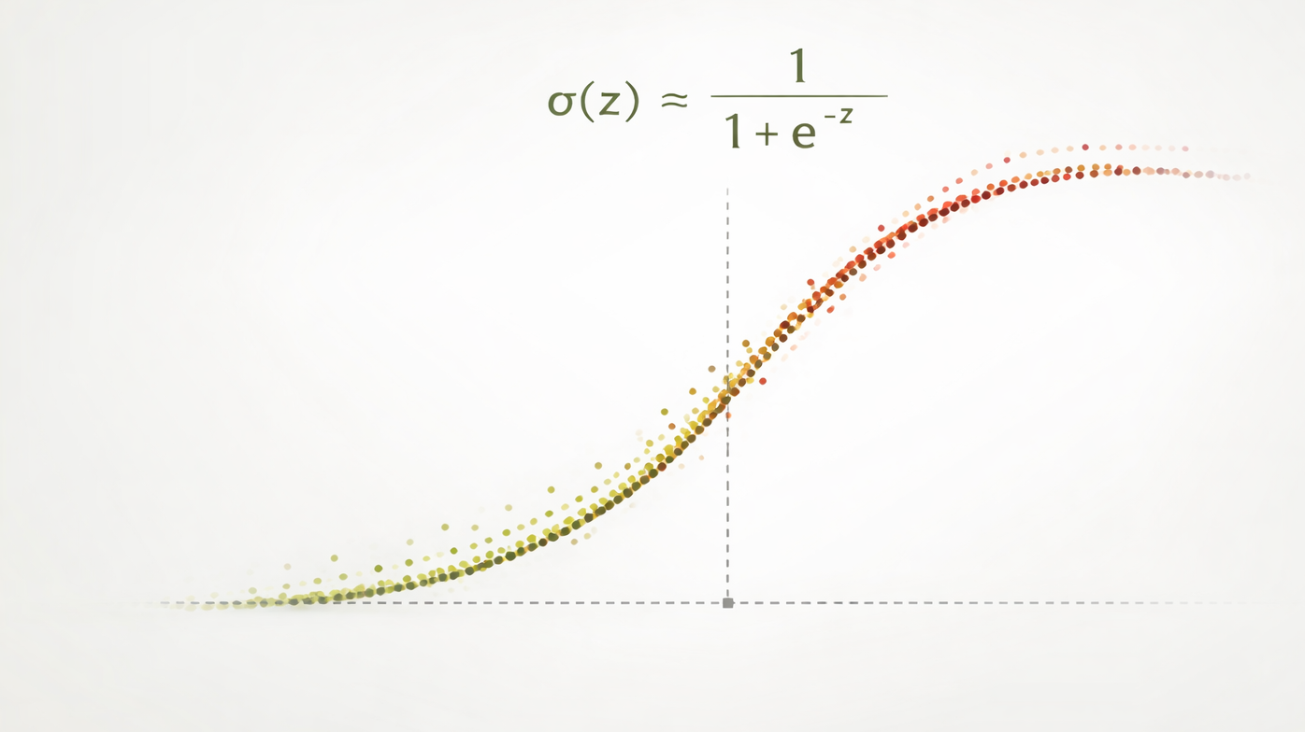
Logistic Regression
Notes:
Today: logistic regression as the bridge from linear models to classification. The whole lecture is one idea — keep the linear score, change what we do with it.

Slide 2
Outline
One idea runs through the whole lecture: keep the linear score z = wᵀx + b, and change what we do with it.
Part 1 — Setting Up the Model
How do we adapt linear regression for a (probabilistic) classifier?
Part 2 — Fitting the Model
How do we learn the parameters of this model? (w and b)
Part 3 — Using the Model
How do we turn a probability into a decision, and how do we check our work?
Notes:
Set expectations up front. The three parts map to three questions: what is the model, how do we fit it, how do we use it. Point at the closing line as the contract for the lecture.

Slide 3
Part 1 — Setting Up the Model
From a binary outcome to a probability model.
• Why is linear regression the wrong tool here?
Unbounded predictions: ŷ ∈ (−∞, ∞), not [0,1]
Wrong error model: assumes Gaussian noise, not Bernoulli
• We need a function that maps a real-valued score into (0,1)?
Notes:
Signpost. Tell students that everything in Part 1 is model definition — no fitting yet.

Slide 4
Motivation: Binary Outcomes
Goal: predict a binary outcome y ∈ {0,1} from a feature vector x ∈ ℝᵖ
Running example: predicting credit-card default (y = 1) from account balance.
Notation used throughout
x = (x₁, …, xₚ): features (predictors) measured on one observation
w ∈ ℝᵖ: weights (coefficients), one per feature
b ∈ ℝ: bias (intercept)
p = P(y = 1 | x): probability the outcome is 1, given the features
Notes:
Fix notation before any math. Introduce the Default/balance example here — it returns on the odds, loss, and worked-example slides. Linear regression is not wrong so much as mismatched.

Slide 5
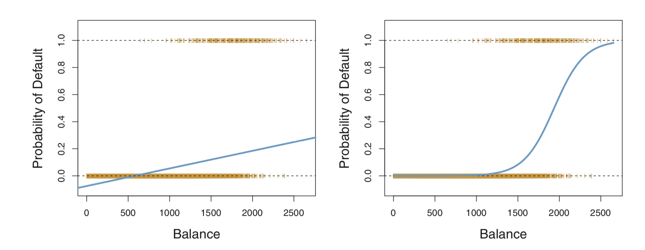
Linear vs. Logistic, Side by Side
Both panels fit default probability against account balance.
Left: the linear fit leaves the [0,1] range, predicting negative probabilities at low balances. Right: the sigmoid fit stays in (0,1) and bends where default risk actually changes.
Figure from Introduction to Statistical Learning by James et al.
Notes:
Have students read the left panel first and say out loud what is wrong with it. Point at the region where the linear fit dips below zero. This motivates the sigmoid on the next slide.

Slide 6
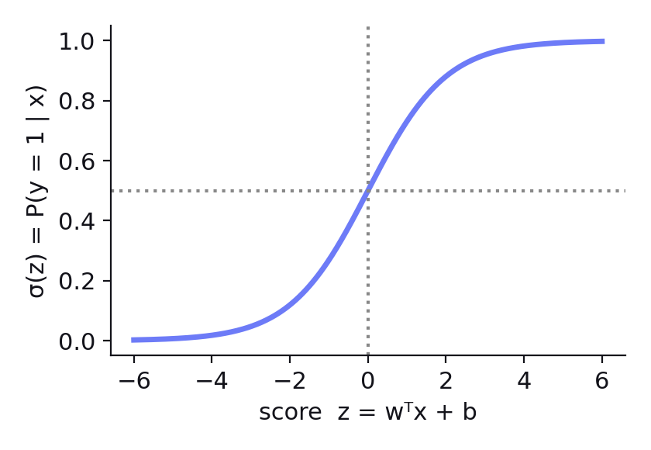
From Linear Scores to Probabilities
Linear predictor (score):
z = wᵀx + b
  In linear regression, z is out output! (prediction)
  Here, it is a latent score
We need a smooth, monotonic map from ℝ into (0,1):
σ(z) = 1 / (1 + e⁻ᶻ)
Sigmoid or Logistic function
Model:
P(y = 1 | x) = σ(wᵀx + b)
What is P(y = 0 | x)?
By symmetry: P(y = 0 | x) = 1 − σ(z) = σ(−z)
Notes:
Stress that z is a latent score on the whole real line. The sigmoid is the smooth monotone squashing function that makes the log-odds linear. Close by previewing the logit as the inverse.

Slide 7
Odds and the Logit
Odds
The ratio of success to failure probability:
odds(x) = p / (1 − p)
p ∈ (0,1) ⇒ odds ∈ (0, ∞)
A probability of 0.2 is odds of 0.25 — one default for every four non-defaults.
Odds rescale a probability onto (0, ∞), but they are still not linear in the features.
Log-odds (the logit)
The sigmoid and the logit are exact inverses — each undoes the other:
p = σ(wᵀx + b) ⟺ logit(p) = wᵀx + b
where logit(p) = log( p / (1 − p) )
and σ(z) = 1 / (1 + e⁻ᶻ)
σ carries a log-odds score into a probability; the logit carries a probability back to the score.
Taking the log is what makes the scale linear — logistic regression is a linear model on the log-odds scale.
Notes:
Define odds concretely with the Default numbers before writing the logit. The punchline: the model is linear, but in log-odds, not probability.

Slide 8
Reading the Coefficients
The log-odds is an ordinary linear equation:
logit(p) = log( p / (1 − p) ) = wᵀx + b
So read wⱼ exactly as a coefficient in linear regression — the change in the response for a one-unit increase in xⱼ, holding the others fixed. The only difference is that the response is the log-odds.
Exponentiate to move to the odds scale:
odds = p / (1 − p) = exp(wᵀx + b)
A one-unit increase in xⱼ therefore multiplies the odds by exp(wⱼ) — the odds ratio.
Rules of thumb
wⱼ > 0 raises the probability of y = 1; wⱼ < 0 lowers it; wⱼ = 0 means no effect
wⱼ = 0.7 ⇒ exp(0.7) ≈ 2, so each unit of xⱼ roughly doubles the odds
Default example: w = 2.0 for balance (in $1,000s) ⇒ exp(2.0) ≈ 7.4, so each extra $1,000 multiplies the odds of default by about 7.4
Note
Coefficients are not changes in probability — the same odds ratio moves a probability a lot near 0.5 and very little near 0 or 1.
Notes:
This is the interpretability payoff and the most exam-relevant idea. Additive in log-odds, multiplicative in odds. Spend real time on the trap: odds ratios are constant, probability changes are not.

Slide 9
Part 2 — Fitting the Model
From a model to fitted values of w and b.
• What probability model generated the data?
• What objective does that model imply?
• How do we minimize it when there is no closed form?
Notes:
Signpost. The model is now fully specified; everything in Part 2 is estimation.

Slide 10
The Bernoulli Model
Explicitly model the data-generating process:
y | x ~ Bernoulli(p), p = σ(wᵀx + b)
A Bernoulli random variable equals 1 with probability p and 0 with probability 1 − p — a single weighted coin flip. Each customer either defaults or does not; the model sets the bias of that coin.
Why this choice
It matches the binary nature of the data
It gives a principled, likelihood-based
Notes:
The Bernoulli assumption is what earns us a likelihood — loss, optimization, and inference all follow from this one line.

Slide 11
From Likelihood to Cross-Entropy
Likelihood: how probable the observed data are under the model. For one observation:
P(y | x) = pʸ (1 − p)¹⁻ʸ
The exponents just select the right factor: p when y = 1, and 1 − p when y = 0.
Log-likelihood for n independent observations:
ℓ(w, b) = Σᵢ [ yᵢ log pᵢ + (1 − yᵢ) log(1 − pᵢ) ]
Loss = negative log-likelihood, also called cross-entropy loss:
ℒ(w, b) = − Σᵢ [ yᵢ log pᵢ + (1 − yᵢ) log(1 − pᵢ) ]
Maximizing the likelihood is exactly minimizing cross-entropy. A customer who defaulted but was given p ≈ 0 contributes a very large loss.
Notes:
Show the exponent trick, then make the punchline explicit: maximum likelihood and minimum cross-entropy are the same optimization. Use a badly-scored Default customer to make the loss concrete.

Slide 12
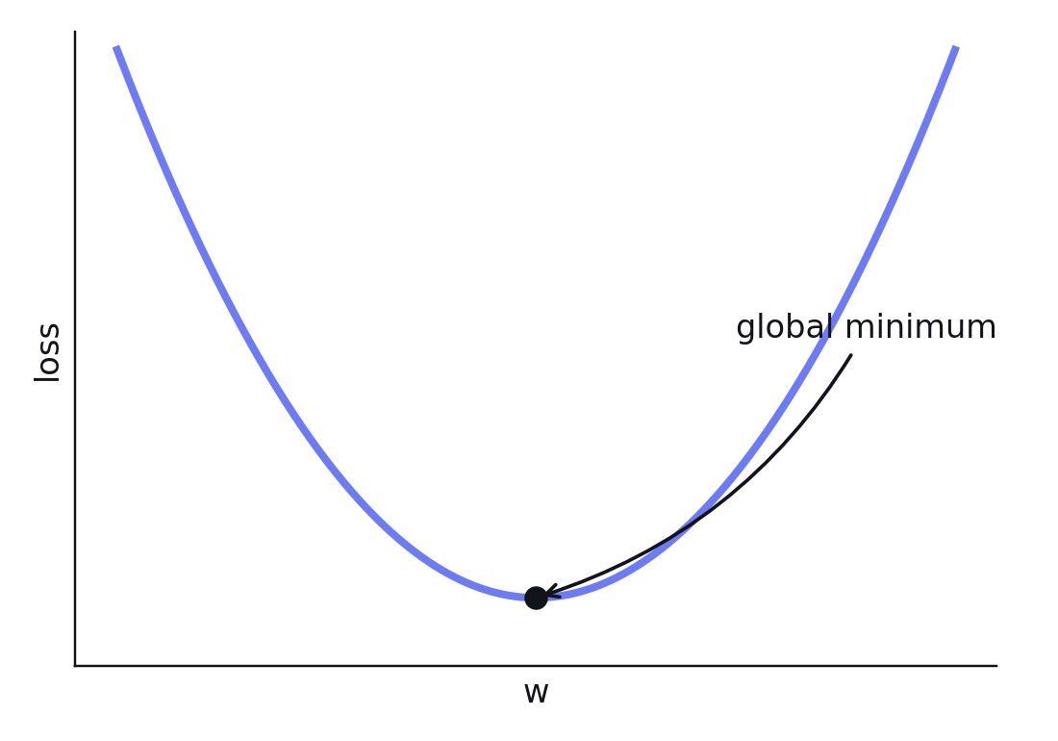
Optimization I: The Problem
Objective:
min over (w, b): ℒ(w, b)
Properties
Convex — the loss surface is one bowl, so any local minimum is the global one
No closed form — there is no normal equation, so we solve numerically
Methods: gradient descent, stochastic gradient descent (SGD), Newton’s method.
Can add an L1 or L2 penalty to this problem convex while controlling overfitting.
Notes:
Convexity is why we can be relaxed about initialization and local minima. Contrast with neural networks. Flag the regularization preview so the closing slide is not a surprise.

Slide 13
Optimization Setup

Slide 14
Optimization II: Gradient Descent
Gradient of the loss with respect to the weights:
∂ℒ/∂w = Σᵢ (pᵢ − yᵢ) xᵢ
Update rule: step downhill, w ← w − η · ∂ℒ/∂w, where η is the learning rate.
A direct parallel to linear regression
Linear regression: updates use residuals (ŷ − y)
Logistic regression: updates use probabilistic errors (p − y)
Interpretation
p > y: the gradient pushes the prediction down toward 0
p < y: the gradient pulls the prediction up toward 1
p ≈ y: the signal is small — that observation is already explained
Notes:
The (p − y) form is the memorable takeaway: same update shape as linear regression, with probabilities in place of fitted values.

Slide 15
Part 3 — Using the Model
From a fitted probability to a decision.
• How does a probability become a predicted class?
• Who decides the threshold, and on what grounds?
• Can you run the whole pipeline yourself?
Notes:
Signpost. The model is fitted; everything left is deployment and evaluation.

Slide 16
Classification: The Decision Rule
Logistic regression outputs probabilities. Classification needs one more ingredient — a decision threshold τ:
ŷ = 1 if P(y = 1 | x) ≥ τ, otherwise ŷ = 0
The standard choice is τ = 0.5, which is equivalent to classifying on the sign of the score z.
Why τ = 0.5 is only a default
It implicitly assumes a false positive and a false negative cost the same.
Nothing in the fitting procedure chose it — the model never saw τ.
Changing τ changes the predictions without refitting the model.
Notes:
Separate the model from the decision rule. Emphasize that τ is chosen after fitting and can be changed freely.

Slide 17
Choosing the Threshold
Set τ from the cost of each error type, not by habit.
Medical screening: a missed case (false negative) is far costlier than a false alarm, so lower τ — catch more positives and accept more false positives
Fraud review: each flag costs analyst time, so raise τ to protect precision
Credit default: a lender who loses more on a bad loan than on a declined application should lower τ
Types of mistakes
False positive: predicted 1, actually 0. False negative: predicted 0, actually 1.
Sweeping τ from 0 to 1 traces the ROC and precision–recall curves — the subject of the next lecture.
Notes:
Ask the class which errors are expensive in their own domain, then set τ from that. Define false positive and false negative explicitly before the ROC preview.

Slide 18
Check Your Understanding
A model fit to the Default data (balance in $1,000s) gives w = 2.0, b = −7.0. For a customer with a $2,000 balance (x = 2.0), work out the predicted probability and the class label.
Step 1 — compute the score
z = wᵀx + b = 2.0(2.0) − 7.0 = −3.0
Step 2 — convert the score to a probability
p = σ(−3.0) = 1 / (1 + exp(3.0)) ≈ 0.047
Step 3 — apply the decision rule
p = 0.047 < τ = 0.5 ⇒ predict ŷ = 0 (no default)
Now try it yourself: what is the predicted class at a $4,000 balance, and what threshold would flip the $2,000 answer?
Notes:
Work steps 1–3 on the board, then give the class two minutes on the closing questions. Answers: at x = 4.0, z = 1.0 and p ≈ 0.73 ⇒ predict default; any τ below about 0.047 flips the $2,000 case. Numbers are illustrative, in the spirit of the Default example in James et al.

Slide 19
Conceptual Summary
1. Start with the linear regression structure: z = wᵀx + b
2. Interpret z as the log-odds (logit) of the outcome
3. Apply the sigmoid to turn the score into a probability
4. Model the outcome with a Bernoulli likelihood
5. Minimize the cross-entropy loss (convex, no closed form)
6. Solve with gradient-based optimization
7. Apply a threshold τ to turn probabilities into class decisions
You should now be able to
Compute a predicted probability from w, b, and x by hand
Interpret any coefficient as an odds ratio, and say why it is not a probability change
Justify a threshold from the relative cost of the two error types
Notes:
Walk the seven steps backwards — from a class decision back to the linear score — to check each link. Then read the three capability statements as the study checklist.

