Slide 1

Random FOrests

Slide 2
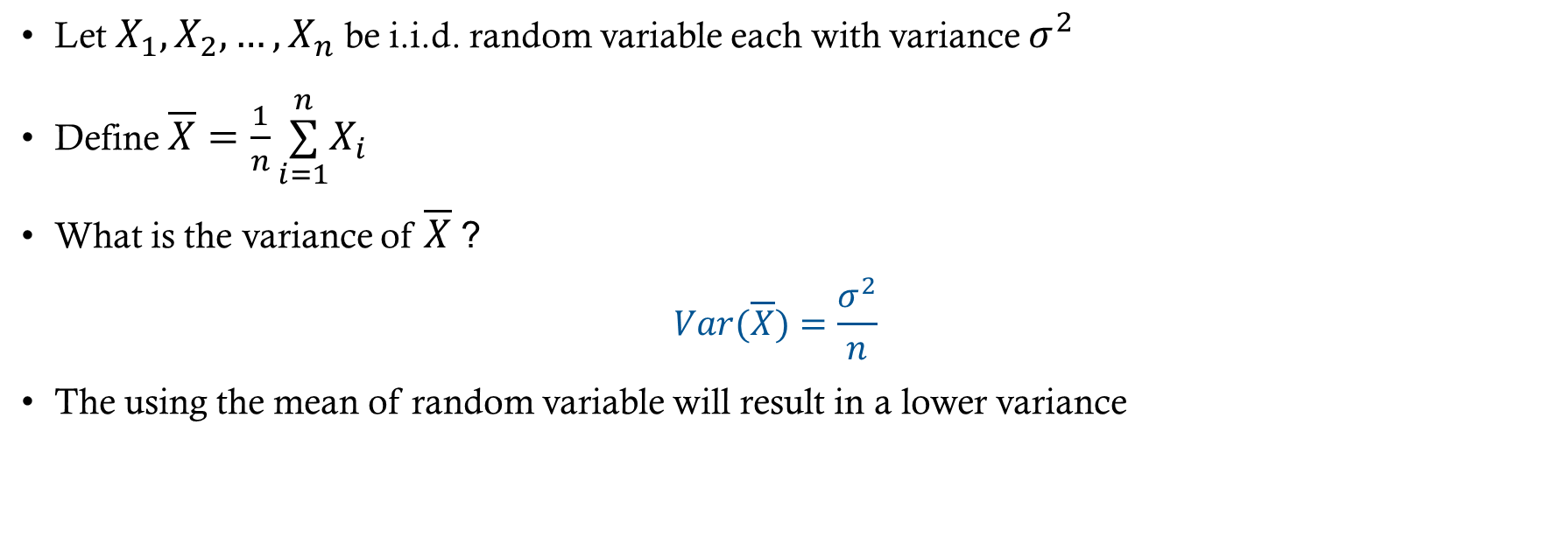
Improving Variance
Let $X_{1},X_{2},…,X_{n}$ be i.i.d. random variable each with variance $σ^{2}$
Define $\overline{X}=\frac{1}{n}\overset{n}{\underset{i=1}{∑}}X_{i}$
What is the variance of $\overline{X}$ ?
$$Var(\overline{X})=\frac{σ^{2}}{n}$$
The using the mean of random variable will result in a lower variance

Slide 3
Applying this principle to trees
Reduce the variance in the predictions by building a lot trees and averaging the results to produce a final prediction
But how can we get more data to build new trees?

Slide 4
Bootstrap Aggregation (ing)
Bagging is an ensemble* method which uses bootstrap sampling to generate multiple predictions and
  Take a random sample of the training data with replacement
  Build a tree using the sampled data
  Make predictions with the model
  Repeat B times
  Average predictions across all models for final prediction
*An ensemble method an any method that involves aggregating predictions over multiple models

Slide 5
More about bagging
Bagging can be using for both regression and classification
  Regression predictions are the mean
  Classification predictions are the majority vote
Bagging can also be used with models that aren’t decision trees

Slide 6
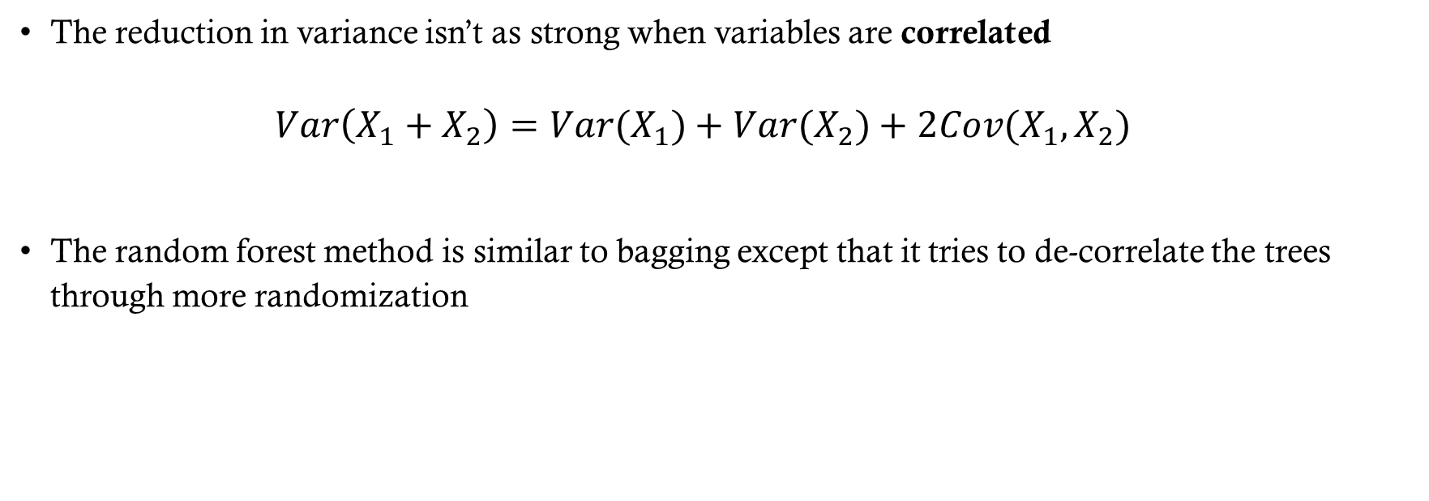
What if the predictions aren’t independent?
The reduction in variance isn’t as strong when variables are correlated
$Var\left(X_{1}+X_{2}\right)=Var(X_{1})+Var(X_{2})+2Cov(X_{1},X_{2})$
The random forest method is similar to bagging except that it tries to de-correlate the trees through more randomization

Slide 7
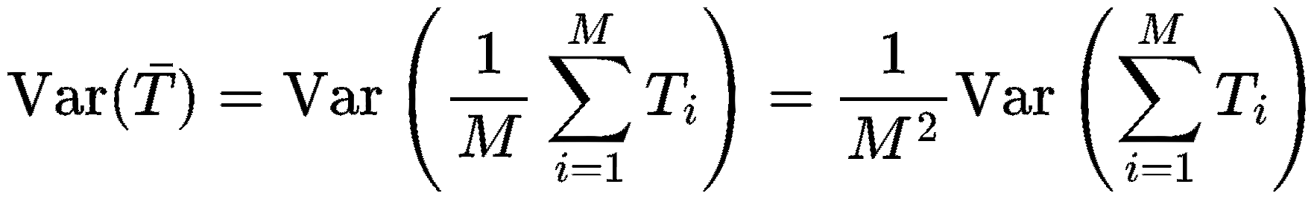
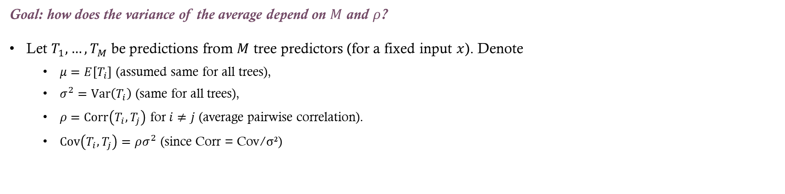
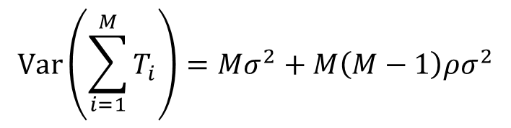
Ensemble variance: setup
Goal: how does the variance of the average depend on $M$ and $ρ$?
Let $T_{1},…,T_{M}$ be predictions from $M$ tree predictors (for a fixed input $x$). Denote
  $μ=E\left[T_{i​}\right]$ (assumed same for all trees),
  $σ^{2}=Var⁡\left(T_{i}\right)$ (same for all trees),
  $ρ=Corr⁡\left(T_{i} , T_{j}\right)$ for $i≠j$ (average pairwise correlation).
  $Cov⁡\left(T_{i} , T_{j}\right)=ρσ^{2}$ (since Corr = Cov/σ²)
Expand the variance of the sum: “M variance terms + M(M−1) covariance terms”
$$Var\left(\sum_{i=1}^{M}{T_{i}}\right)=Mσ^{2}+M\left(M−1\right)ρσ^{2}$$
Notes:
Now substitute:
$$Var⁡\left(T_{i}\right)=σ^{2}$$
$$Cov⁡\left(T_{i} , T_{j}\right)=ρσ^{2}$$
There are:
$M$variance terms
$M\left(M−1\right)$covariance terms
So:
$$=Mσ^{2}+M\left(M−1\right)ρσ^{2}$$
Divide by $M^{2}$:
$$Var⁡\left(\overset{ˉ}{T}\right)=\frac{Mσ^{2}}{M^{2}}+\frac{M\left(M−1\right)ρσ^{2}}{M^{2}}$$
Simplify:
$$=\frac{σ^{2}}{M}+ρσ^{2}\frac{M−1}{M}$$
Rearrange:
$$\boxed{Var⁡\left(\overset{ˉ}{T}\right)=ρσ^{2}+\frac{1−ρ}{M}σ^{2}}$$

Slide 8
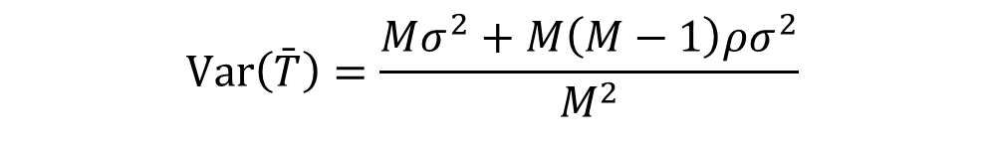
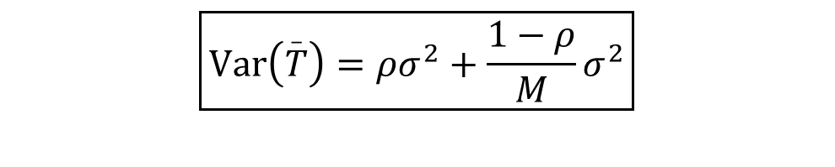
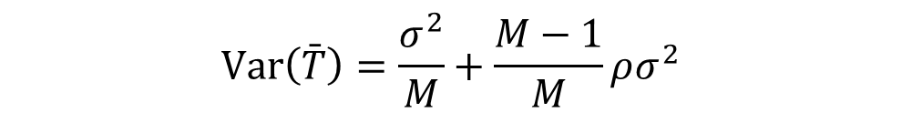
Ensemble variance: the result
Start from the expansion, then divide by M²:
What it tells us
ρ = 0: Var = σ²/M, matching slide 2
ρ = 1: Var = σ², so averaging gives no benefit
M → ∞: Var → ρσ², so more trees cannot remove the correlated part
Random forests lower ρ by de-correlating the trees
$$Var\left(\bar{T}\right)=\frac{Mσ^{2}+M\left(M−1\right)ρσ^{2}}{M^{2}}$$
Simplify, then rearrange:
$$Var\left(\bar{T}\right)=\frac{σ^{2}}{M}+\frac{M−1}{M}ρσ^{2}$$
$$\boxed{Var⁡\left(\overset{_}{T}\right)=ρσ^{2}+\frac{1−ρ}{M}σ^{2}}$$

Slide 9
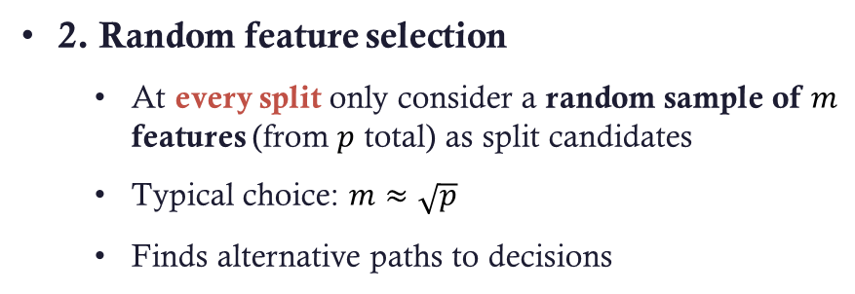
Two sources of randomness
1. Bootstrap sampling
  Each tree is trained on a bootstrap sample of the observations
  Different trees see different data
2. Random feature selection
  At every split only consider a random sample of $m$ features (from $p$ total) as split candidates
  Typical choice: $m≈\sqrt{p}$
  Finds alternative paths to decisions
With bagging alone, most trees pick the very strong predictor, so predictions stay similar. Random feature selection adds a second source of randomness that forces different splits, de-correlating the trees.

Slide 10
Model Interpretation
The bad news: The increase in predictive ability decreases the interpretability of the model (compared to one tree)
  We can’t just draw the tree anymore
The good news: We can get an overall idea of feature importance measured by:
  Finding splits using a particular feature
  Computing the average impurity reduction across all trees
  Features with the largest average decrease in impurity (Gini or entropy) are the most important
  Scikit-learn scales so that feature importances sum to 1

Slide 11
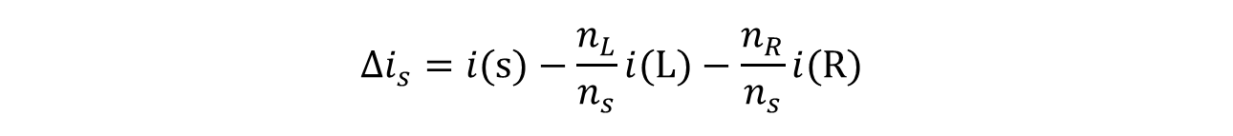
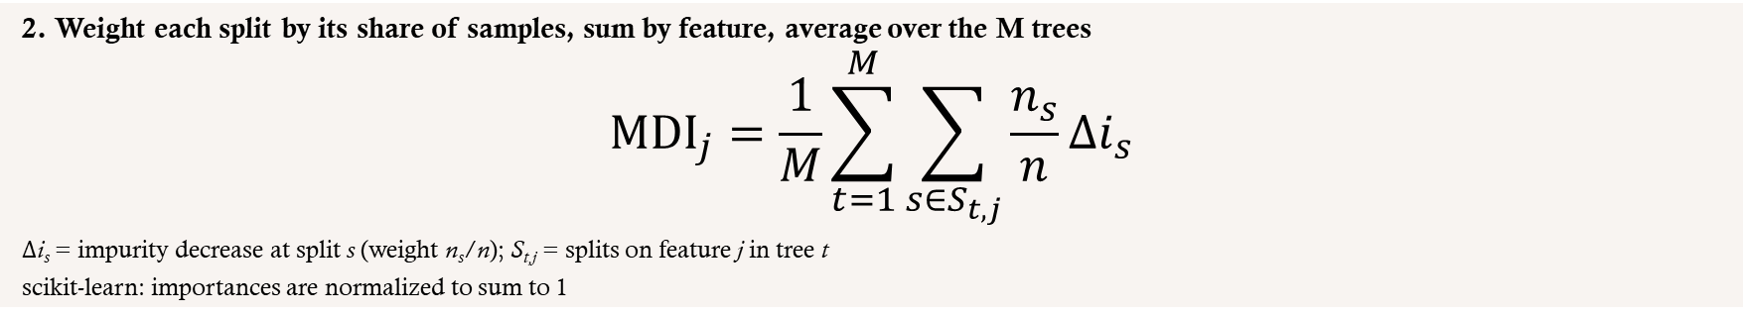
Mean Decrease in Impurity: Calculation
How it is calculated
  Using the impurity measure (Gini or entropy) from the Model Interpretation slide
Split s (n_{s})
1. One split s on feature j
$$Δi_{s}=i(s)−\frac{n_{L}}{n_{s}}i(L)−\frac{n_{R}}{n_{s}}i(R)$$
Left (n_{L})
Right (n_{R})
2. Weight each split by its share of samples, sum by feature, average over the M trees
$${MDI}_{j}=\frac{1}{M}\sum_{t=1}^{M}{\sum_{s∈S_{t,j}}{\frac{n_{s}}{n}Δi_{s}}}$$
Δi_{s} = impurity decrease at split s (weight n_{s}/n); S_{t,j} = splits on feature j in tree t
scikit-learn: importances are normalized to sum to 1

Slide 12
Mean Decrease in Impurity: Interpretation
How to interpret it
  Larger value: the fitted model used that feature more to reduce impurity
  Not causal: it does not show the feature causes the outcome, or how changing it affects predictions
Caveats
  Correlated features can share or distort importance
  Impurity-based importance can favor high-cardinality features
  Values depend on the model and the dataset
Takeaway: MDI shows how much each feature helped reduce split impurity in this fitted forest.

Slide 13
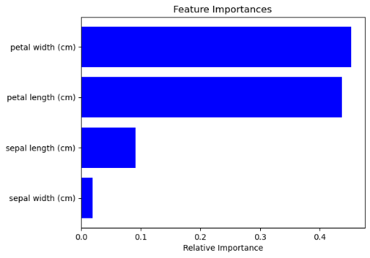
Example of Feature Importance

Slide 14
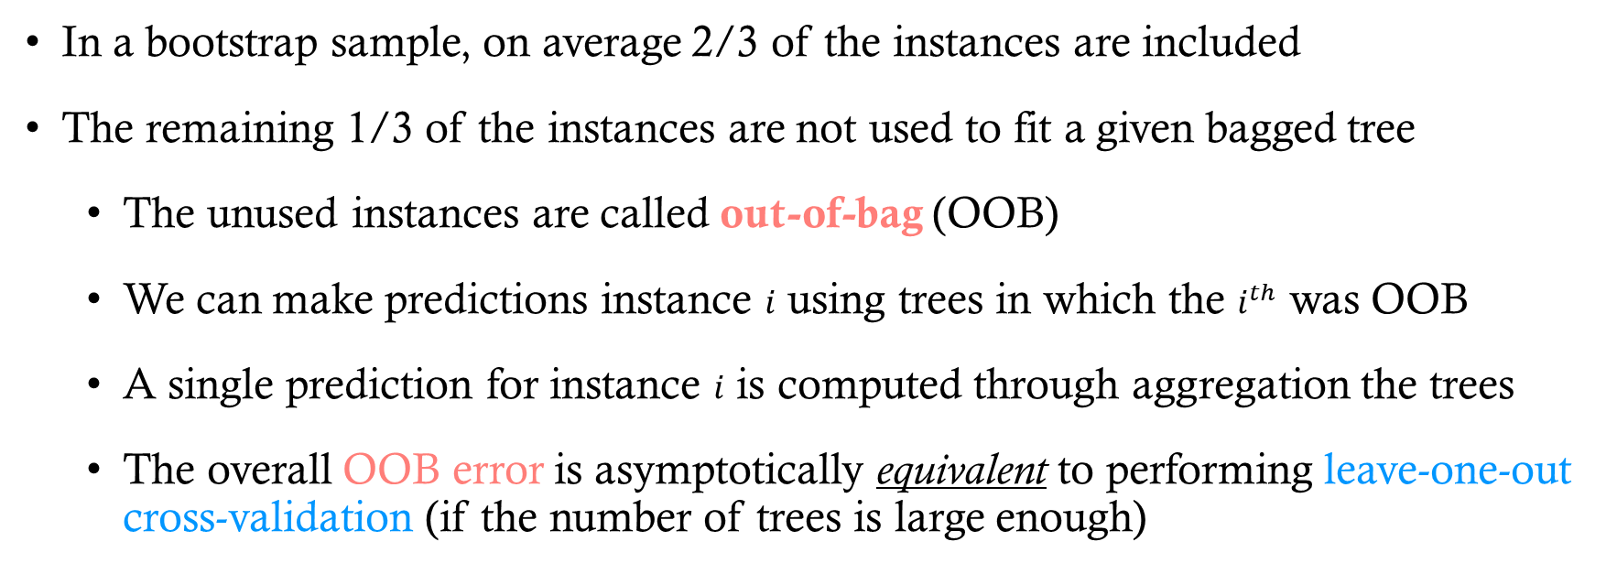
Out of Bag Error Estimation
In a bootstrap sample, on average 2/3 of the instances are included
The remaining 1/3 of the instances are not used to fit a given bagged tree
  The unused instances are called out-of-bag (OOB)
  We can make predictions instance $i$ using trees in which the $i^{th}$ was OOB
  A single prediction for instance $i$ is computed through aggregation the trees
  The overall OOB error is asymptotically equivalent to performing leave-one-out cross-validation (if the number of trees is large enough)

Slide 15
OOB Samples
Probability an instance is out-of-bag
  Each of the n draws (with replacement) picks a given instance with probability 1/n
  So one draw misses it with probability 1 − 1/n
  All n draws miss it, so P(OOB) = (1 − 1/n)^{n}
  As n → ∞: (1 − 1/n)^{n} → e⁻¹ ≈ 0.368
  So ≈ 36.8% of instances are OOB and ≈ 63.2% (about 2/3) are in the bag
How OOB samples are used
  OOB error: predict each instance using only trees that did not see it; it approximates leave-one-out CV
  Tuning: compare OOB error across M and m without cross-validation
  Choosing M: add trees until the OOB error levels off
  OOB permutation importance: shuffle a feature in the OOB samples and measure the rise in error
Each tree leaves out about 1/3 of the data, so the forest gets a built-in validation set at no extra cost.

Slide 16
Tuning Parameters (Bagging and RF)
n_estimators: number of trees in forest
  Increasing does not lead to overfitting
criterion: Gini impurity or entropy
max_features: Number of features to consider at each split
Tuning parameters associated with base estimator

