Slide 1

Random Forest Proximities

Slide 2
Benefits of Random Forests
Classification and regression
Mixed variable types
Estimate of generalization error
Trivially parallelizable
Scale invariant
Insensitive to outliers in predictor space
Model non-linear relationships
Natural produce a measure of similarity

Slide 3
Random Forest Proximities
“[Proximities] are one of the most useful tools in random forests.”
--Leo Breiman
Original description:
“The proximities originally formed a NxN matrix. After a tree is grown, put all of the data, both training and oob, down the tree. If cases k and n are in the same terminal node increase their proximity by one. At the end, normalize the proximities by dividing by the number of trees.”
https://www.stat.berkeley.edu/~breiman/RandomForests/cc_home.htm#:~:text=few%20data%20sets.-,Proximities,by%20the%20number%20of%20trees.

Slide 4
Proximities in a Nutshell
“Proximities don’t just measure the similarity of the variables---they also take into account the importance of the variables.”
“Two cases that have quite different predictor variables might have large proximity if they differ only on variables that are not important.”
“Two cases that have quite similar values of the predictor variables might have small proximity if they differ on inputs that are important.”
--Adele Cutler

Slide 5
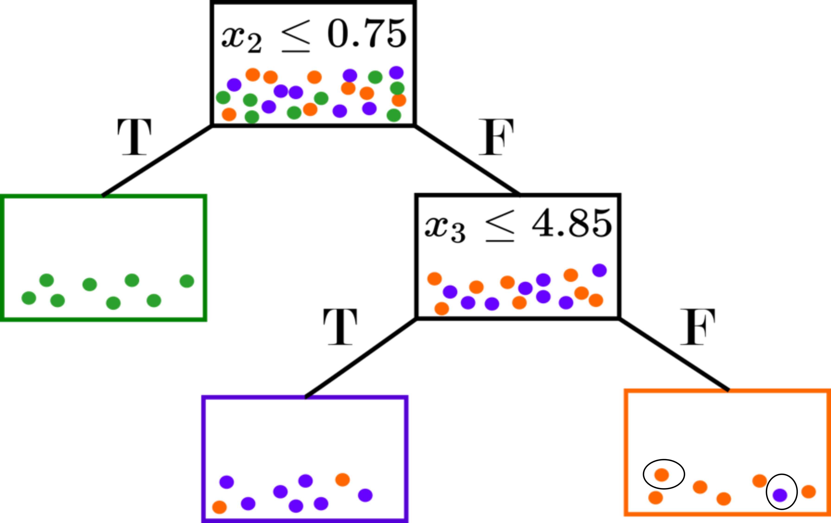
What are Random Forest Proximities
Proximities as a metric
A measure of “closeness”
Supervised, but not class-conditional
Based on splits (optimized over responses)
Natural incorporation of variable importance

Slide 6
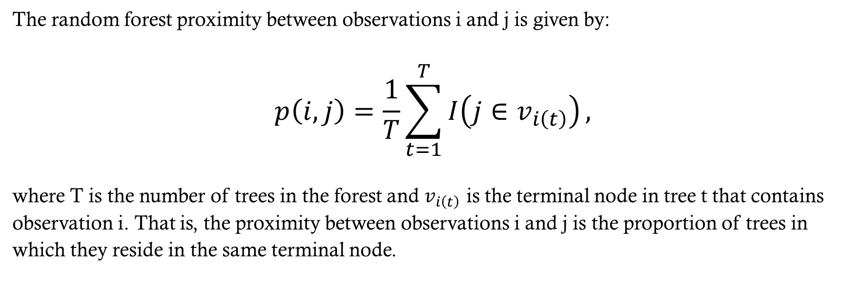
Original formulation
The random forest proximity between observations i and j is given by:
$$p\left(i,j\right)=\frac{1}{T}\sum_{t=1}^{T}{I\left(j∈v_{i\left(t\right)}\right)},$$
where T is the number of trees in the forest and $v_{i\left(t\right)}$ is the terminal node in tree t that contains observation i. That is, the proximity between observations i and j is the proportion of trees in which they reside in the same terminal node.

Slide 7
OOB Formulation
The original proximities accentuate class differences
Artificial separation (sometimes linearly separable) is encoded
This does not match the generalization error rate (or OOB rate)
An alternative formulation uses only OOB points (ESL, Hastie 2009):
  “In growing a random forest, an N × N proximity matrix is accumulated for the training data. For every tree, any pair of OOB observations sharing a terminal node has their proximity increased by one. This proximity matrix is then represented in two dimensions using multidimensional scaling. The idea is that even though the data may be high-dimensional, involving mixed variables, etc., the proximity plot gives an indication of which observations are effectively close together in the eyes of the random forest classifier. “

Slide 8
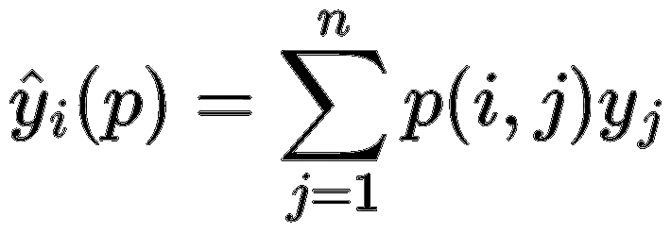
Proximities as Neighbor-based Predictor
What do we want?
The similarity measure to encapsulate the supervised learning from the random forest!
E.g., we want a proximity-weighted predictor to match the RF OOB predictions.
This is not the case with the original definition, even when limiting it to OOB points only.
Why does this not work?
The voting mechanism in random forests considers all training instances, not just pairwise relationships.
Similar to KNN or kernel SVM Predictions:

Slide 9
Accuracy Preserving Proximities
Account for Prediction
Proximities to be defined between an OOB point and all “similar” training points.
Tree-wise proximities proportionate to size of terminal node.
Proximity weighted predictor matches OOB or test predictions.

Slide 10
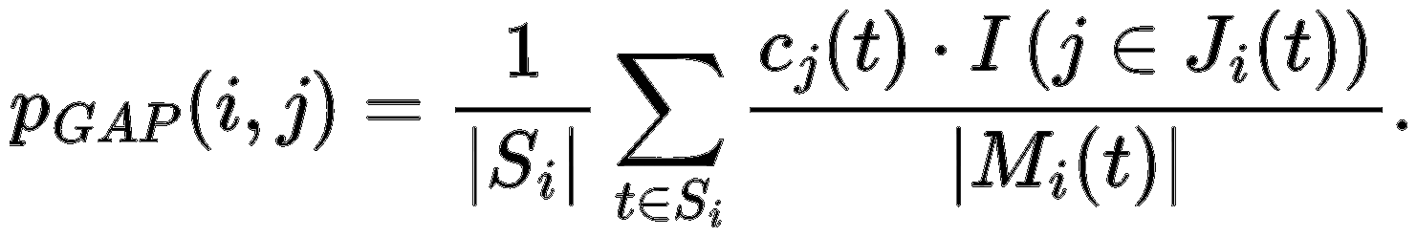
Random Forest Geometry- and Accuracy-Preserving Proximities
Sᵢ: Trees where obs. i is OOB
Jᵢ(t): In-bag indices in node with i in tree t
Mᵢ(t): Multiset of in-bag indices in i’s terminal node
cⱼ(t): In-bag count of obs. J in tree t.

Slide 11
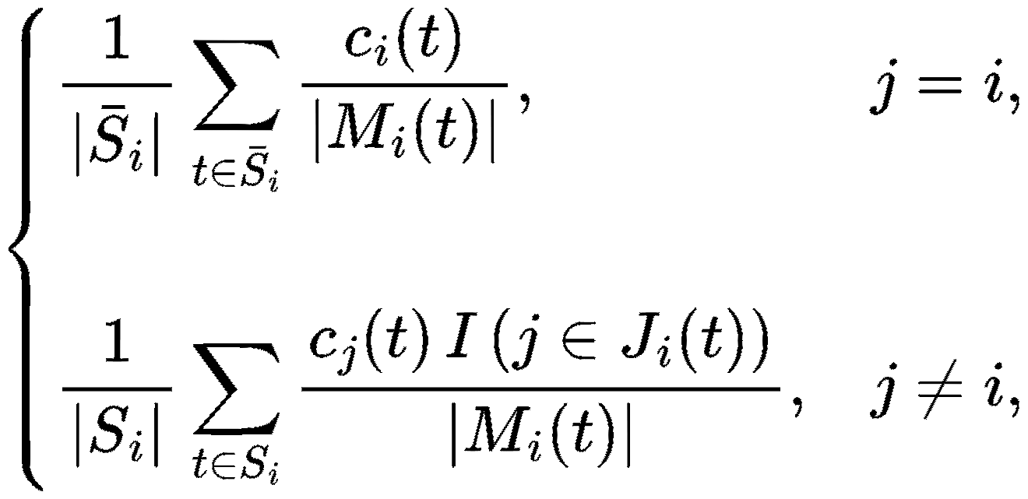
RF-GAP Proximities Notes
RF-GAP proximities are not symmetric!
By design, p(i, i) = 0 to serve as proper weights for RF predictions.
For some applications, we must reassign self-similarity and symmetrize.
This guarantees that self-similarity is maximal but on the same scale.

Slide 12
Applications of Proximities
Visualization
Imputation
Outlier Detection
Uncertainty Quantification
Manifold Learning/Alignment

Slide 13
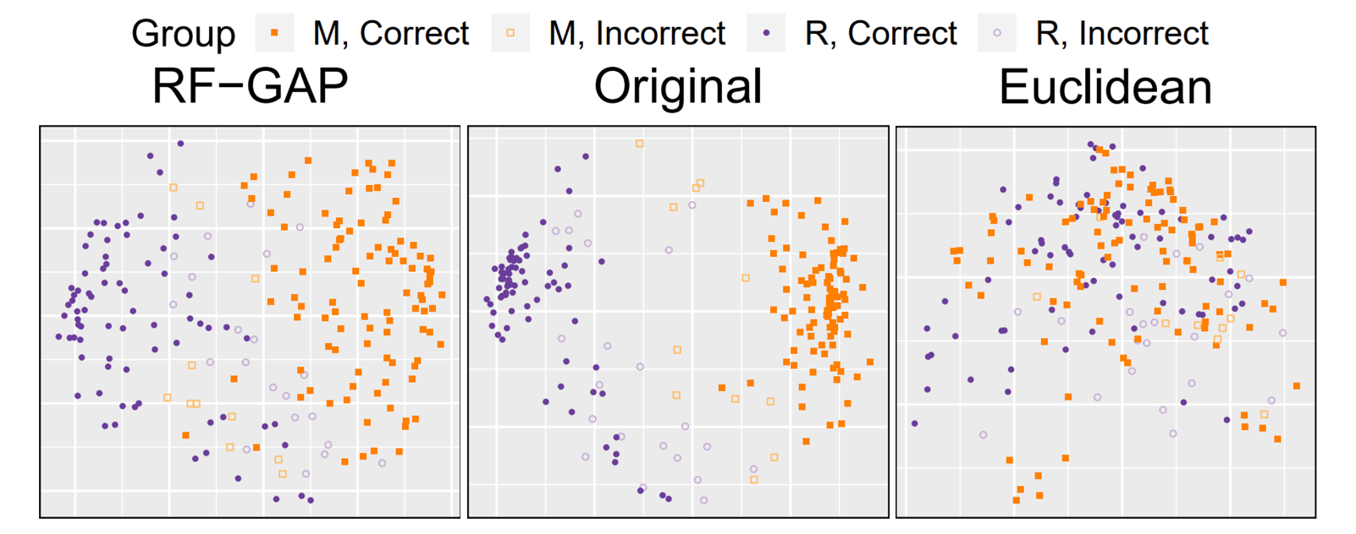
Multi-dimensional scaling for Visualization
Notes:
MDS applied to Euclidean distances and RF proximities (Original and OOB) on the Sonar dataset~\citep{UCI2019}. The RF accuracy was 84.13\%. It is clear supervision helps, but the original proximities show exaggerated class separation, while OOB presents some level of noise.

Slide 14
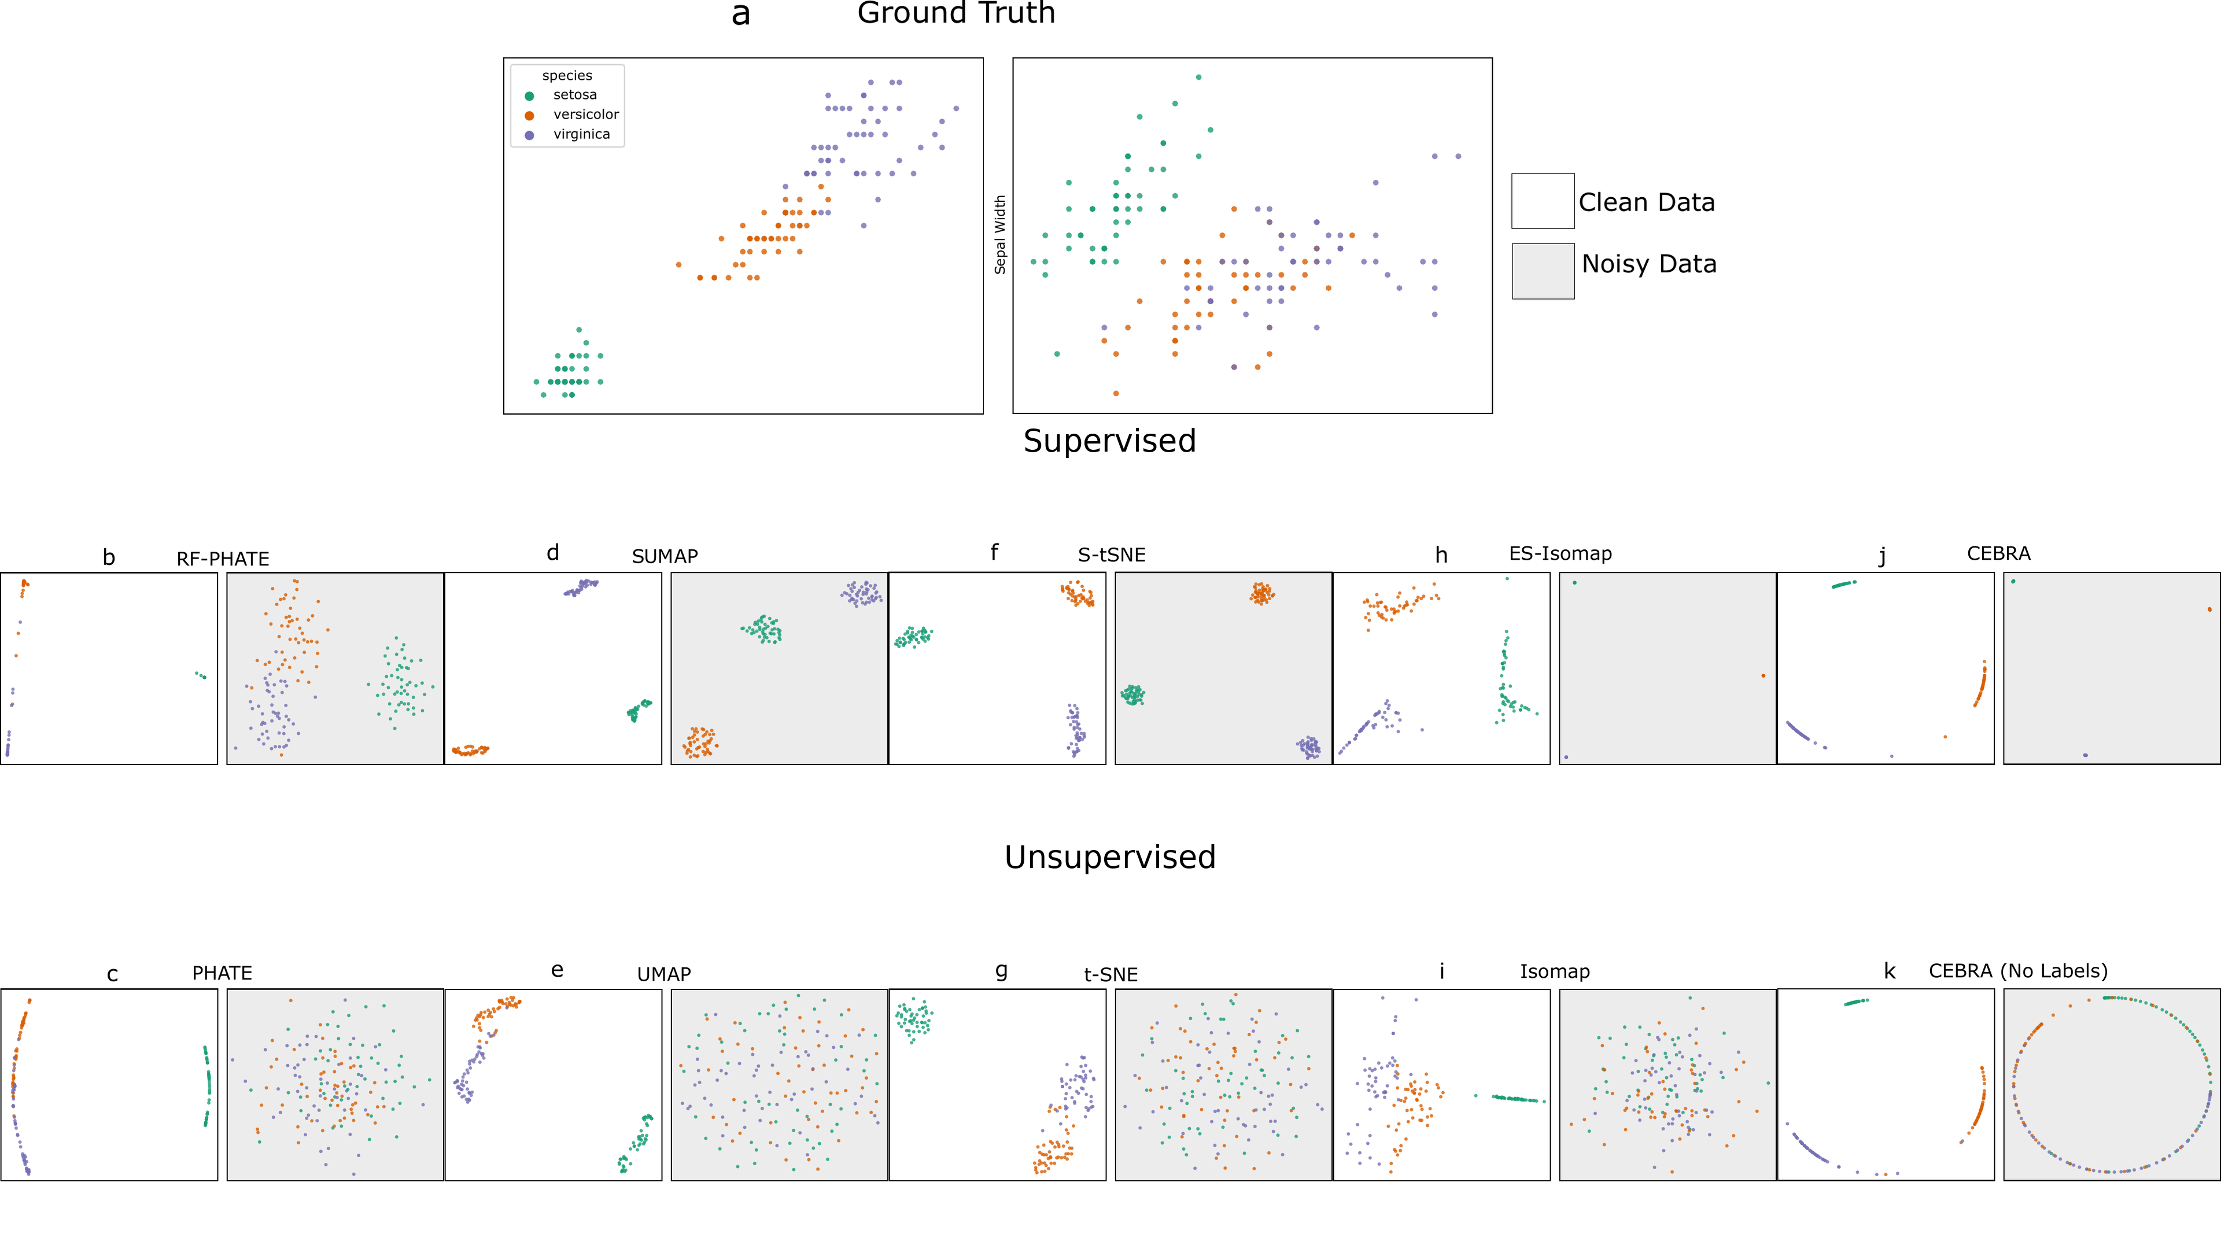

Slide 15
Oversampling

Slide 16
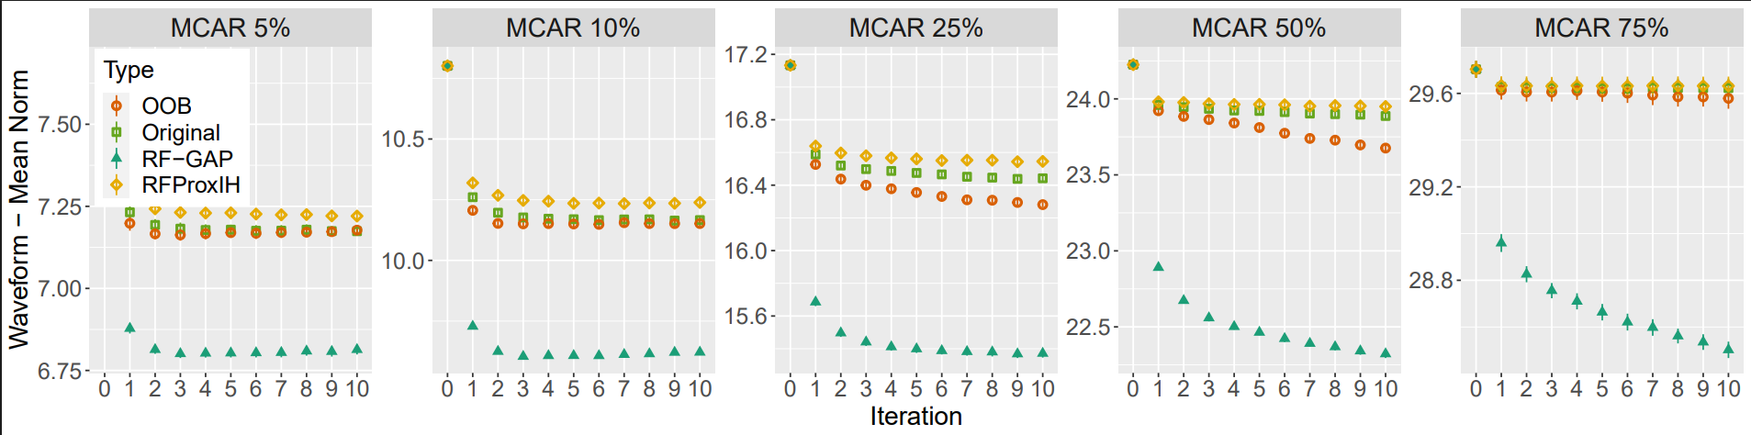
Imputation

Slide 17
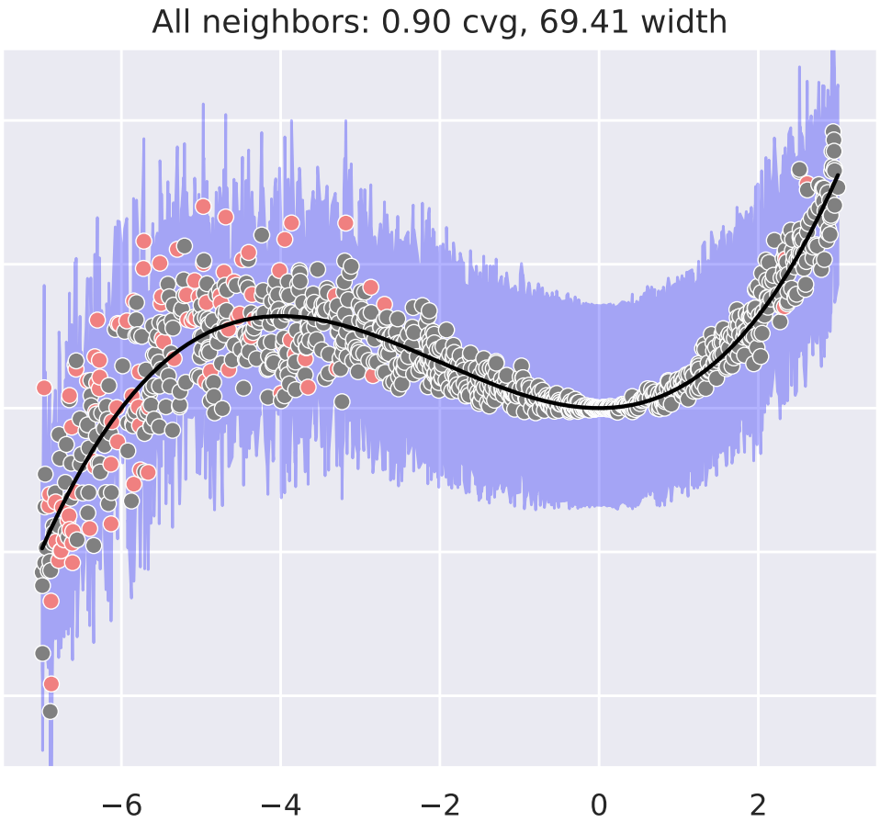

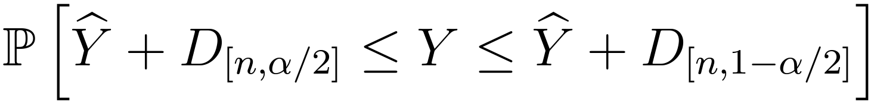
Intervals from Out-of-Bag Error Distribution (Haozhe Zhang and Nordman, 2020)

Slide 18
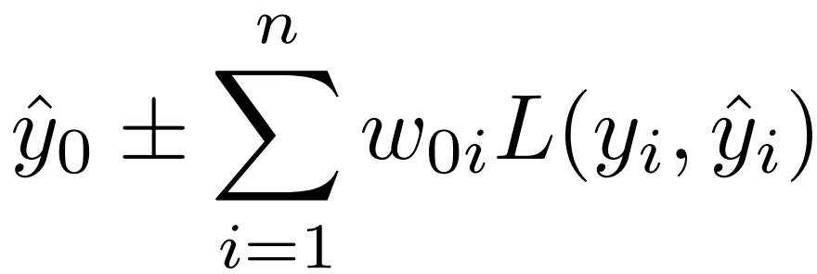
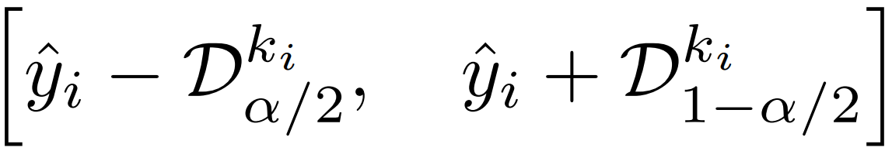
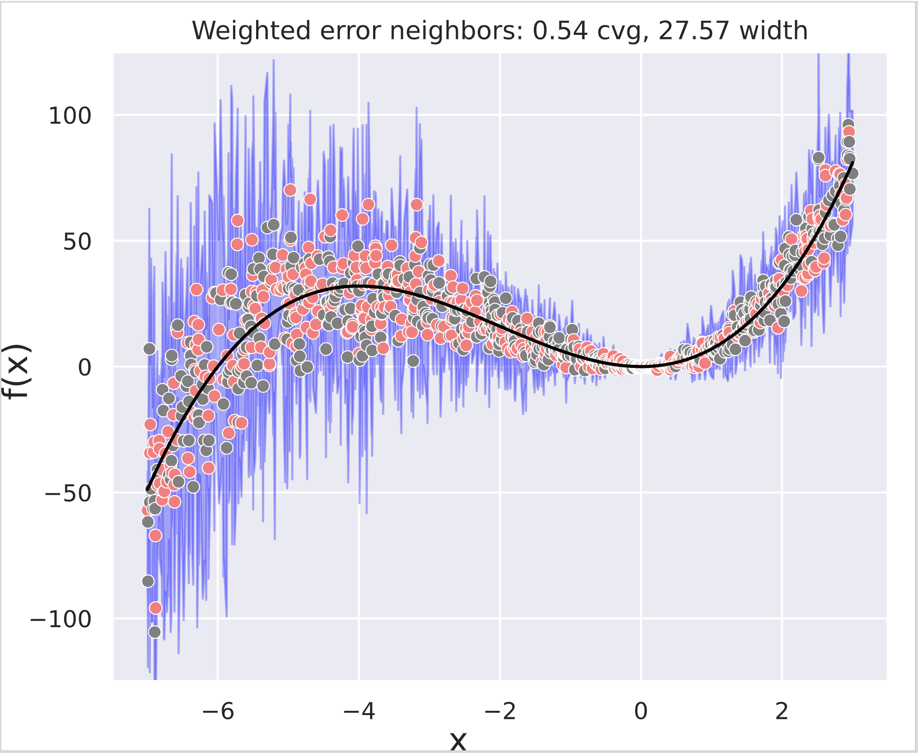
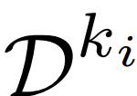



Regression – Prediction Intervals
Random Forest Interval Residual Estimation (RF-FIRE)
(1) Weighted out-of-bag errors:
(2) Localized error distribution:
Where:
is the distribution of OOB errors limited to the nearest* neighbors of .
*Nearest based on RF-GAP proximity

Slide 19
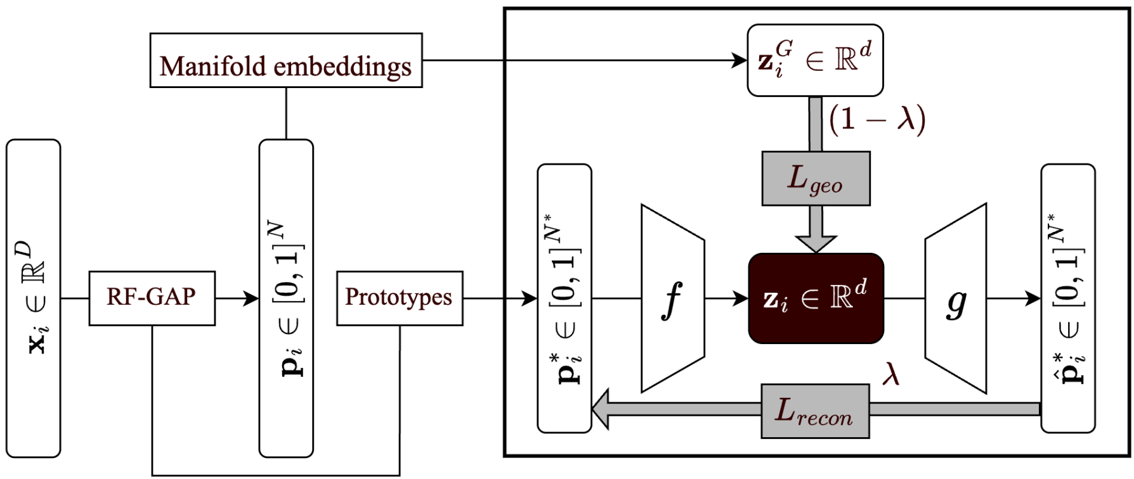
Random Forest Autoencoders

Slide 20
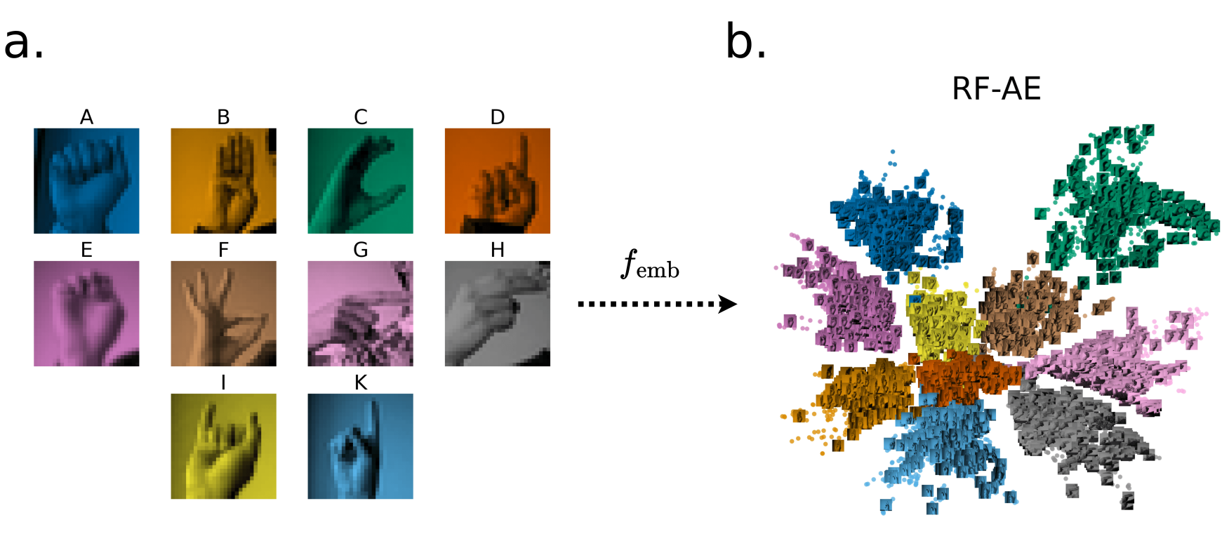
RF-AE Example

Slide 21
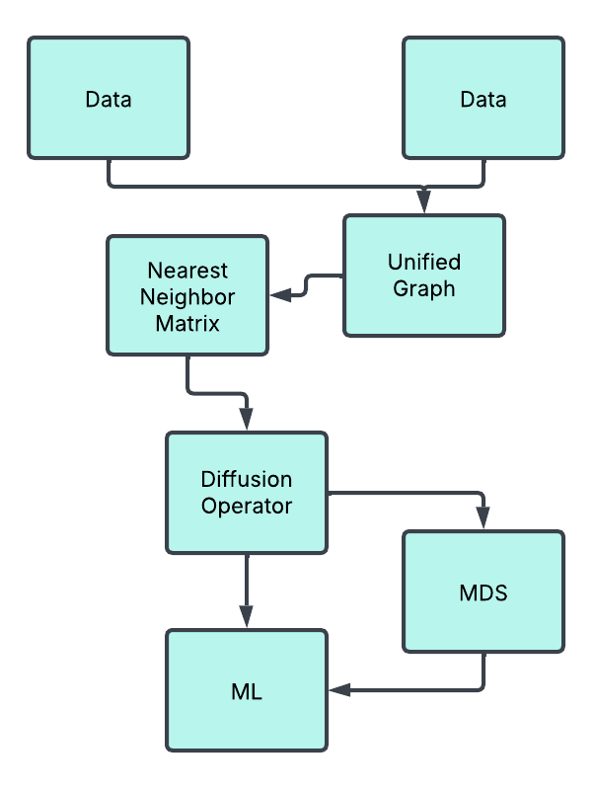

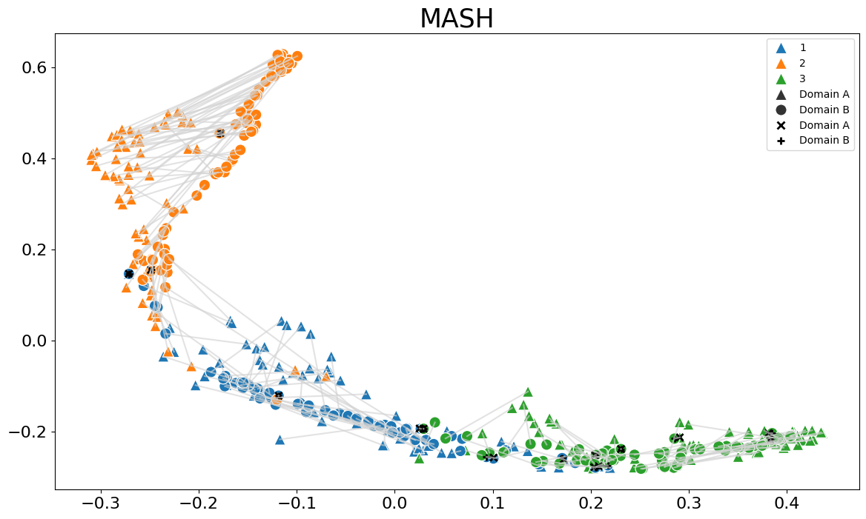
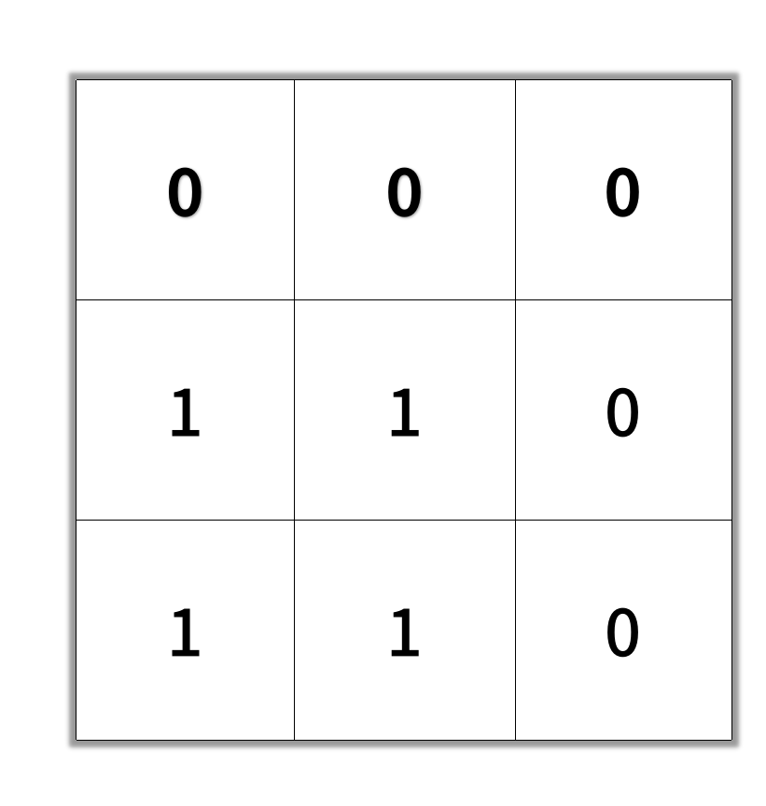
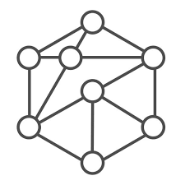
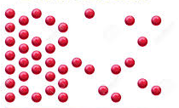
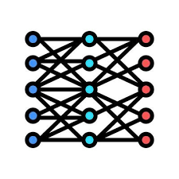

RF-Manifold Alignment
RF-MASH’s resulting manifold on the seeds data set

Slide 22
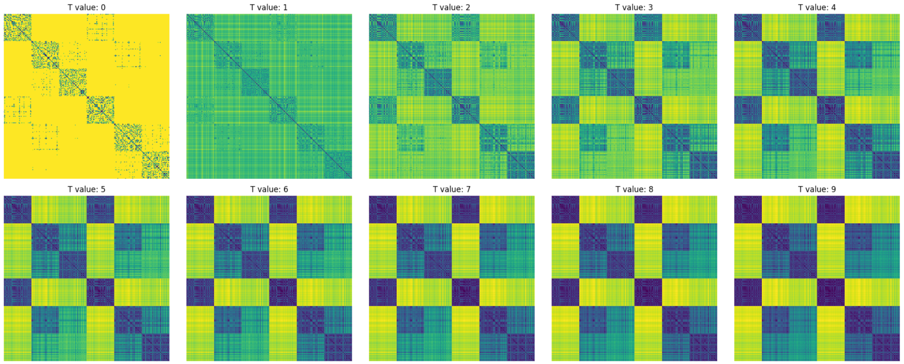
Diffusion over Combined Proximities

