Slide 1
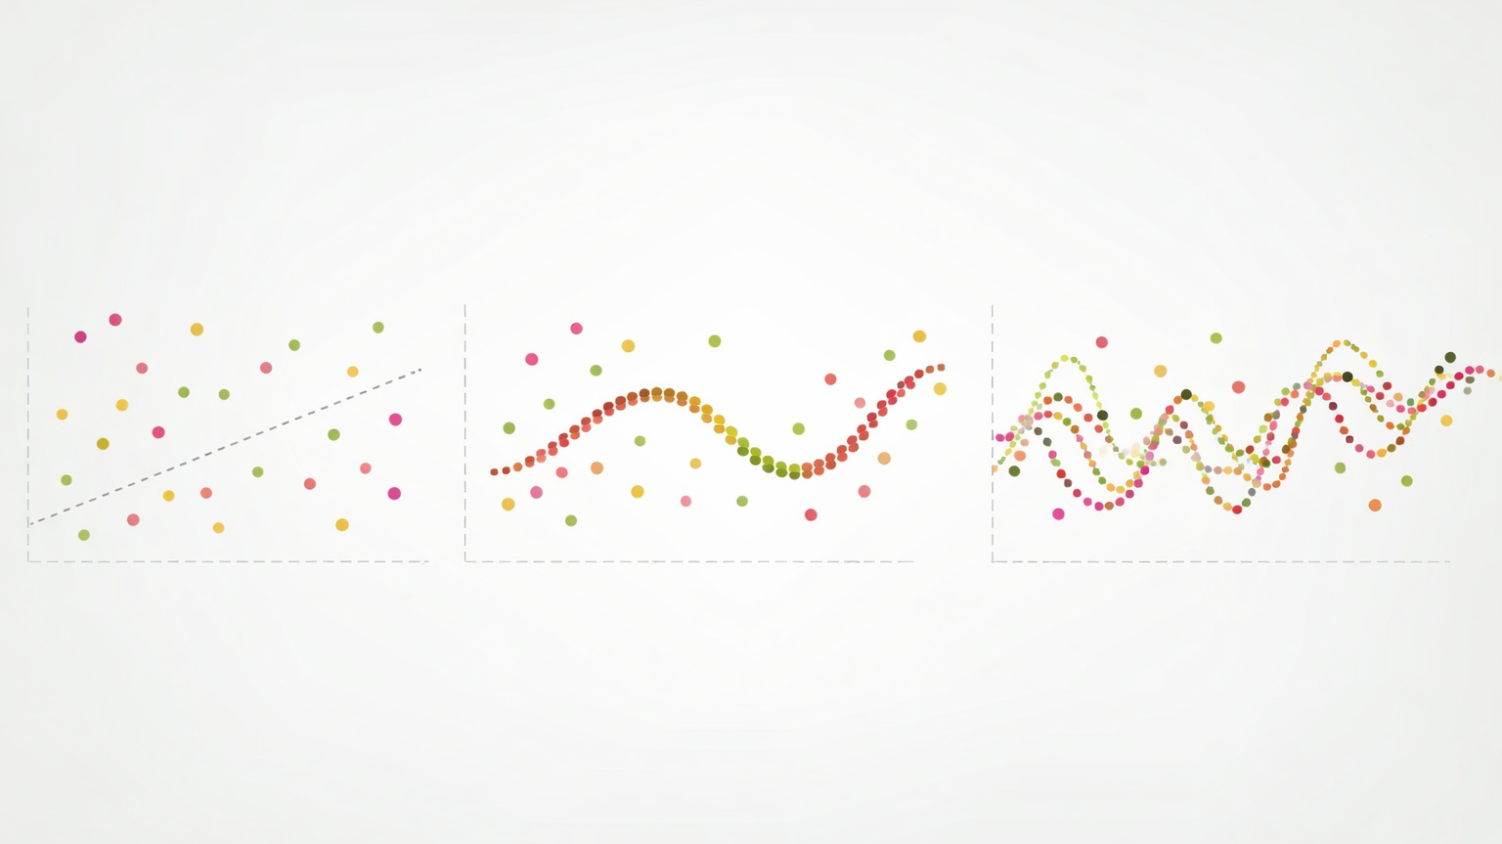
Model fitting

Slide 2
Overfitting vs Underfitting
Underfitting: Model is too simple to learn the underlying structure of the data
Overfitting: Model is too complex and learns the noise in the training data

Slide 3
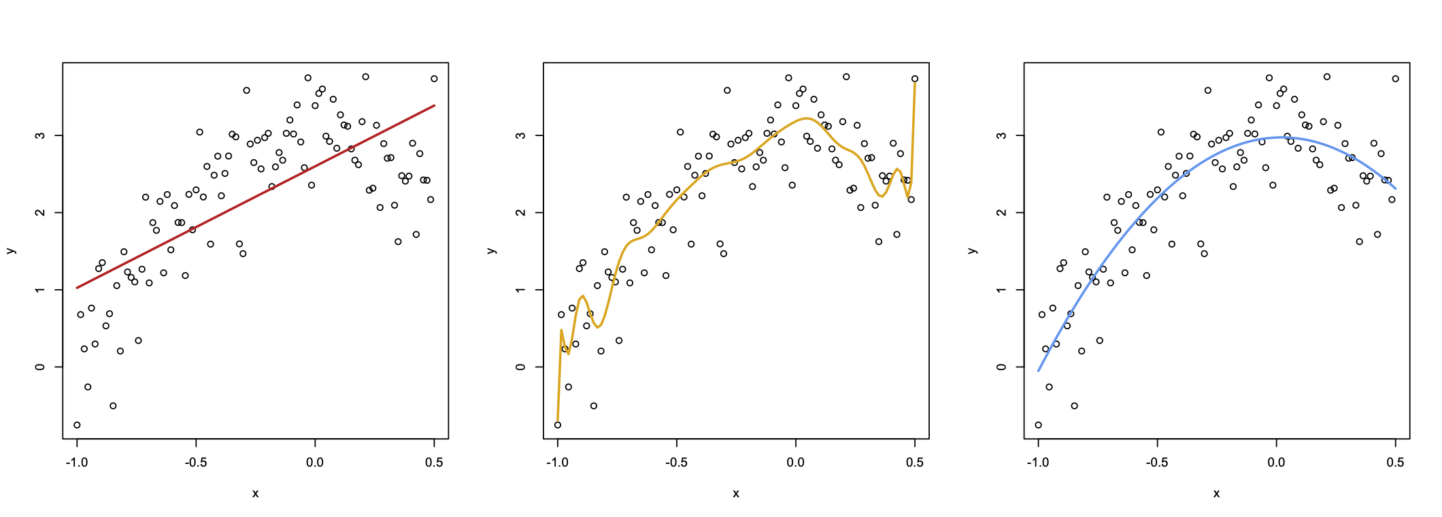
Overfitting vs Underfitting
Underfit Model
Overfit Model
Good Model

Slide 4
Underfitting
Symptoms, causes, and fixes for a model that is too simple
Identifying: The model performs poorly on both training and test data
Possible fixes:
    Use a more complex model
    Find better features
    Reduce constraints on model (less regularization)
    Tune hyperparameters

Slide 5
Overfitting
Symptoms, causes, and fixes for a model that is too complex
Identifying: The model performs well on training data but poorly on test data
Possible fixes:
    Use a simpler model
    Add constraints on model (more regularization)
    Gather more data
    Tune hyperparameters

Slide 6
Example: one dataset, three fits
Same 30 points, fit with polynomials of degree 1, 4, and 15
Training error always falls as degree rises — test error does not
What to look for:
    Degree 1: high training and test error (underfit)
    Degree 4: both errors low and close together (good fit)
    Degree 15: training error near zero, test error jumps (overfit)
    Flexibility (complexity) is a dial to tune, not a goal to maximize

Slide 7
Checkpoint
A model reports training R² = 0.99 and test R² = 0.42
What is happening, and what would you try first?
Work through it:
    Which error is large — training, test, or both?
    Does the gap point to high bias or high variance?
    Would a simpler model, more regularization, or more data help?
    Two minutes with a neighbor, then we compare answers

Slide 8
Bias-Variance Tradeoff
The balance of finding a model that doesn’t underfit or overfit is related to the bias-variance tradeoff
  Bias is the error from approximating a real-life problem with a simpler model
  Variance is how much the prediction changes with a different training set from the same population
In general, as a model becomes more flexible and complex, variance increases and bias decreases
  Overfitting is associated with high variance
  Underfitting is associated with high bias

Slide 9
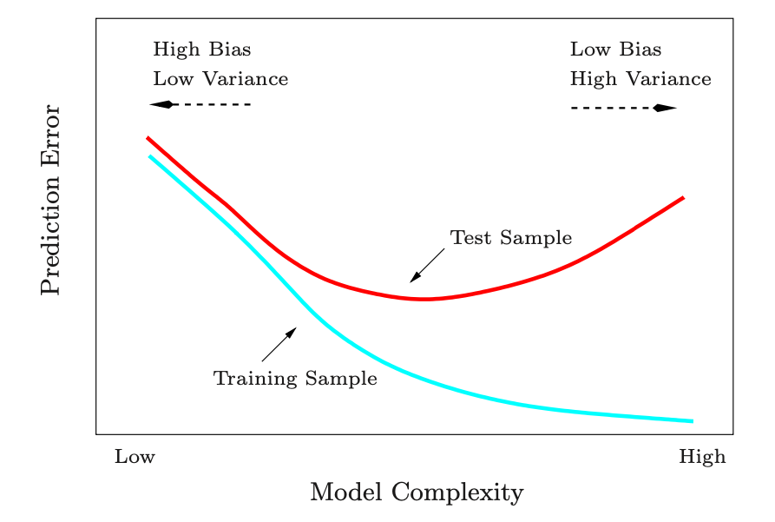
Bias-Variance Tradeoff
From “Elements of Statistical Learning” page 38, by Hastie et al

Slide 10
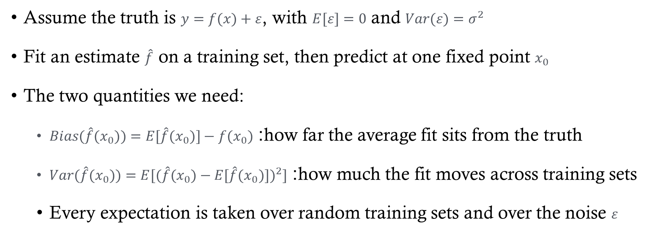
Bias and Variance
Assume the truth is $y=f(x)+ε$, with $E[ε]=0$ and $Var(ε)=σ^{2}$
Fit an estimate $\hat{f}$ on a training set, then predict at one fixed point $x_{0}$
The two quantities we need:
    $Bias(\hat{f}(x_{0}))=E[\hat{f}(x_{0})]−f(x_{0})$: how far the average fit sits from the truth
    $Var(\hat{f}(x_{0}))=E[{(\hat{f}(x_{0})−E[\hat{f}(x_{0})])}^{2}]$: how much the fit moves across training sets
    Every expectation is taken over random training sets and over the noise $ε$

Slide 11
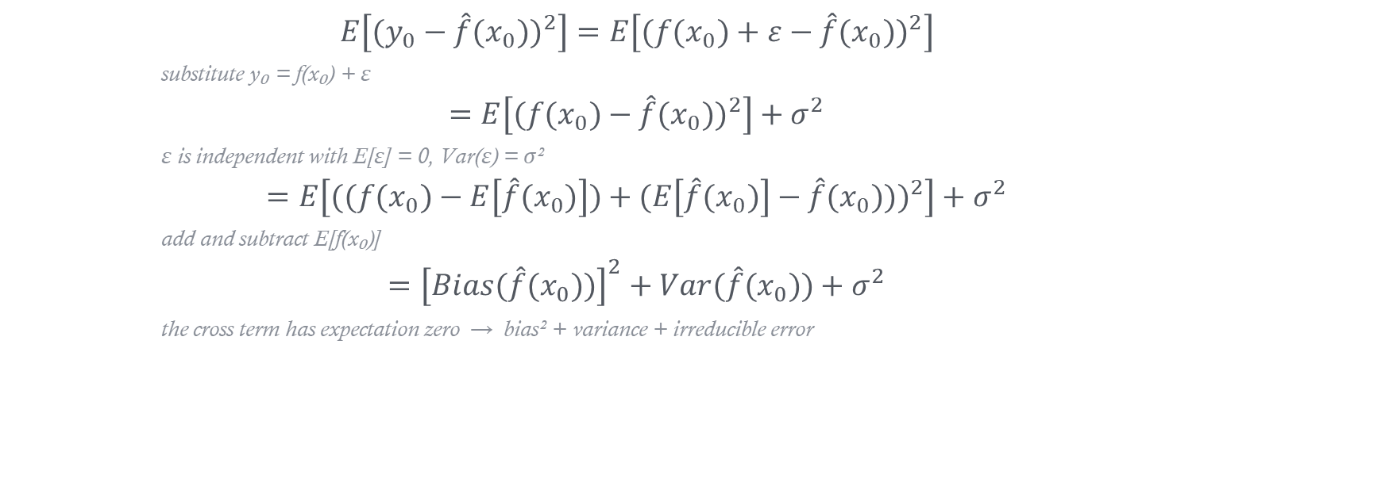
Deriving the tradeoff (Proof Sketch)
$$E\left[(y_{0}−\hat{f}(x_{0}))^{2}\right]=E\left[(f(x_{0})+ε−\hat{f}(x_{0}))^{2}\right]$$
substitute y₀ = f(x₀) + ε
$$=E\left[(f(x_{0})−\hat{f}(x_{0}))^{2}\right]+σ^{2}$$
ε is independent with E[ε] = 0, Var(ε) = σ²
$$=E\left[((f(x_{0})−E\left[\hat{f}(x_{0})\right])+(E\left[\hat{f}(x_{0})\right]−\hat{f}(x_{0})))^{2}\right]+σ^{2}$$
add and subtract E[f̂(x₀)]
$$={\left[Bias(\hat{f}(x_{0}))\right]}^{2}+Var(\hat{f}(x_{0}))+σ^{2}$$
the cross term has expectation zero → bias² + variance + irreducible error

Slide 12
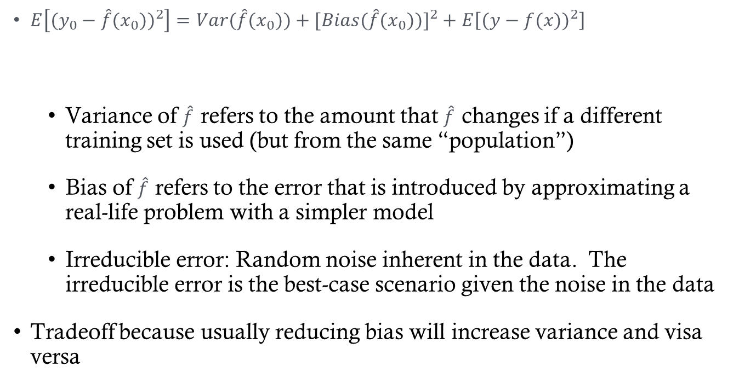
Bias-Variance Tradeoff
$E\left[(y_{0}−\hat{f}(x_{0}))^{2}\right]=Var(\hat{f}(x_{0}))+[Bias(\hat{f}(x_{0}))]^{2}+E\left[(y−f(x))^{2}\right]$
    Variance of $\hat{f}$ refers to the amount that $\hat{f}$ changes if a different training set is used (but from the same “population”)
    Bias of $\hat{f}$ refers to the error that is introduced by approximating a real-life problem with a simpler model
    Irreducible error: Random noise inherent in the data. The irreducible error is the best-case scenario given the noise in the data
Tradeoff because usually reducing bias will increase variance and visa versa
Variance
Bias (squared)
Irreducible error

Slide 13
K-nn recall
Recall what we learned about KNN classification and regression
  Will a low value of k be more likely to overfit or underfit?
    How does this relate to bias/variance?
  Will a high value of k be more likely to overfit or underfit?
    How does this relate to bias/variance?

Slide 14
Testing and Validating

Slide 15
How well does my model work?
In the prediction setting:
  Model evaluation: how well does our machine learning model generalize to new data?
  Don’t get caught in the weeds of the possible validation methods
  Find an honest metric to quantify future model performance

Slide 16
How well does my model work?
The only way to evaluate how well a model predicts is to apply it to new data
Comparing test metrics to training metrics can also help identify overfitting
What if new data (with labels) isn’t readily available
(and it usually isn’t)

Slide 17
Model Evaluation Strategies

Slide 18
Train / Validation / Test
Split the data once, and give each piece a single job
The test set is touched exactly once, at the very end
The three roles:
    Training set (~60%): fit the model parameters
    Validation set (~20%): tune hyperparameters, compare models
    Test set (~20%): estimate generalization error
Training ~60%
Validation ~20%
Test ~20%

Slide 19
Leave-one-out cross-validation (LOOCV)
LOOCV is k-fold with k = n: every observation takes one turn as the test set
The model is fit n times, each on the other n − 1 observations
LOOCV is deterministic! (Not random).
Fit 1
test
Fit 2
test
Fit 3
test
⋮
⋮
Fit n
test

Slide 20
K-fold cross-validation

Slide 21
Choosing k (the number of folds)
The data scientist has yet another choice to make: k
  k=n is leave-one-out cross-validation (LOOCV), this is deterministic
  k=5 or k=10 are other popular choices
Bias–variance tradeoff in k-fold CV:
  Small k → less training data per fit, so a more biased (pessimistic) estimate
  Large k → nearly full training sets, so little bias, but overlapping folds make the estimate more variable
  For tuning, bias matters less than finding the minimum error
  Computational cost scales with k
  LOOCV is by far the most expensive choice

Slide 22
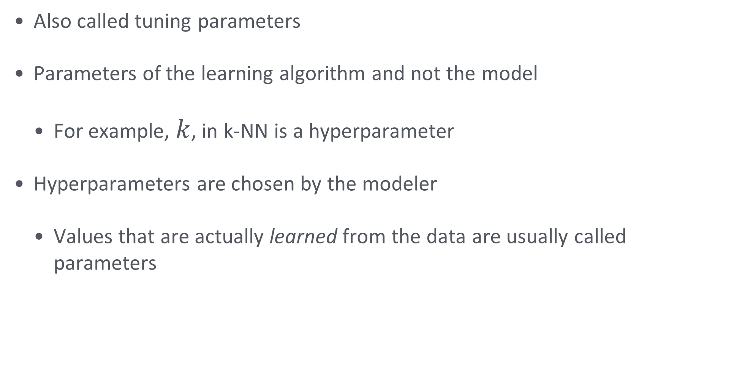
Hyperparameters
Also called tuning parameters
Parameters of the learning algorithm and not the model
  For example, $k$, in k-NN is a hyperparameter
Hyperparameters are chosen by the modeler
  Values that are actually learned from the data are usually called parameters

Slide 23
A typical approach
Split data into training and test sets
Train the model several times using different values of the hyperparameter
  Choose the hyperparameter value that performs best on the training set as measured with k-fold cross-validation
Use the test set to compute the generalization error
Remember that the goal is to get a good estimate of the generalization error

Slide 24
A tempting approach…
Split data into a training and a test set
Train the model for many hyperparameter values
Choose the hyperparameter value that performs best on test set

Slide 25
Why that approach leaks
Choosing on the test set makes the test score optimistic
Illustrative: try 200 hyperparameter values, keep the best test score
What you see vs. what you get:
    Reported test accuracy: 91%
    Accuracy on genuinely new data: 84%
    The 7-point gap is selection, not learning
    Fix: tune with cross-validation inside the training set, or use nested CV

Slide 26
Summary: from symptom to remedy
Diagnose from the gap between training and test error
Then match the remedy to the diagnosis
Quick reference:
    Both errors high → underfit → more flexibility, better features
    Training low, test high → overfit → simplify, regularize, add data
    Both low and close → good fit → report the test error once
    Always keep an untouched estimate of generalization error

