Slide 1

Regularization

Slide 2
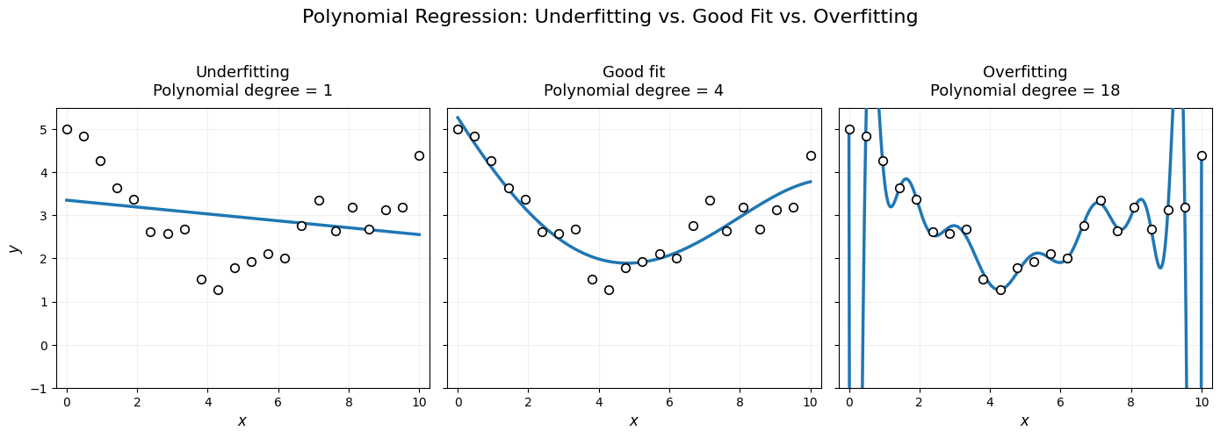
Why do we need regularization?
Recall: Fit
Notes:
Talking points:
Start with the three-panel figure: same data, three model complexities.
Underfit (degree 1): the model is too rigid — high bias, misses the curvature.
Good fit (degree 4): captures the signal without chasing noise.
Overfit (degree 18): passes near every point but will generalize terribly to new data.
Ask the class: which model has the lowest training error? (The overfit one.) That is exactly why training error alone is a bad model-selection criterion.
Bridge: regularization gives us a dial between these extremes without having to guess the right polynomial degree.
(Figure generated with a short matplotlib script; source available in the course repo.)

Slide 3
Regularization
Regularization: techniques that constrain a model to reduce overfitting and improve generalization
Two broad families:
Explicit – add a penalty term directly to the loss function
Implicit – constrain the model through the algorithm or training process

Slide 4
Explicit Regularization
Intentionally and directly add a regularization term to the loss function
Explicitly modify the optimization objective
Examples (not exhaustive, but these are the most common):
L1 Regularization (Lasso)
L2 Regularization (Ridge)
Elastic Net (combine L1 and L2 regularization)

Slide 5
Implicit Regularization
Any regularization method that does not explicitly modify the cost or objective function
Can be a byproduct of an algorithm, the learning process, or other choices made in training
Examples (not exhaustive):
Early stopping (in gradient-based optimization, stop training before convergence is reached)
Dropout (randomly ignoring some parts of a neural network)
Pruning (simplifying a grown decision tree)
Data augmentation (adding synthetic data to increase the sample size)

Slide 6
Example of Explicit Regularization in Linear Regression

Slide 7

Least Squares: The Baseline
Least squares cost function: finds the 𝛽's that minimize
$J(β)=\frac{1}{n}\overset{n}{\underset{i=1}{∑}}{\left(y_{i}−β_{0}−\overset{p}{\underset{j=1}{∑}}β_{j}x_{ij}\right)}^{2}$

Slide 8
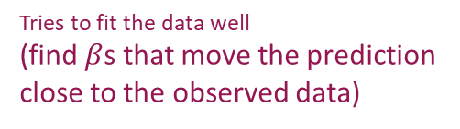
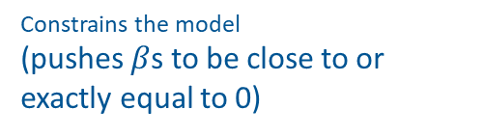
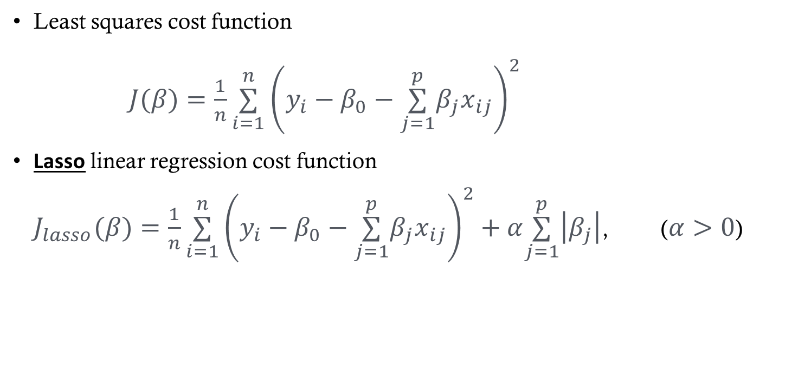
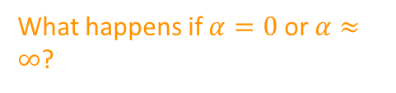
L1 Penalty: LASSO
Least squares cost function
$J(β)=\frac{1}{n}\overset{n}{\underset{i=1}{∑}}{\left(y_{i}−β_{0}−\overset{p}{\underset{j=1}{∑}}β_{j}x_{ij}\right)}^{2}$
Lasso linear regression cost function $J_{lasso}(β)=\frac{1}{n}\overset{n}{\underset{i=1}{∑}}{\left(y_{i}−β_{0}−\overset{p}{\underset{j=1}{∑}}β_{j}x_{ij}\right)}^{2}+α\overset{p}{\underset{j=1}{∑}}\left|β_{j}\right|$, ($α>0$)
Tuning parameter that controls relative impact of two criteria
What happens if $α=0$ or $α≈∞$?
Tries to fit the data well (find $β$s that move the prediction close to the observed data)
Constrains the model (pushes $β$s to be close to or exactly equal to 0)

Slide 9
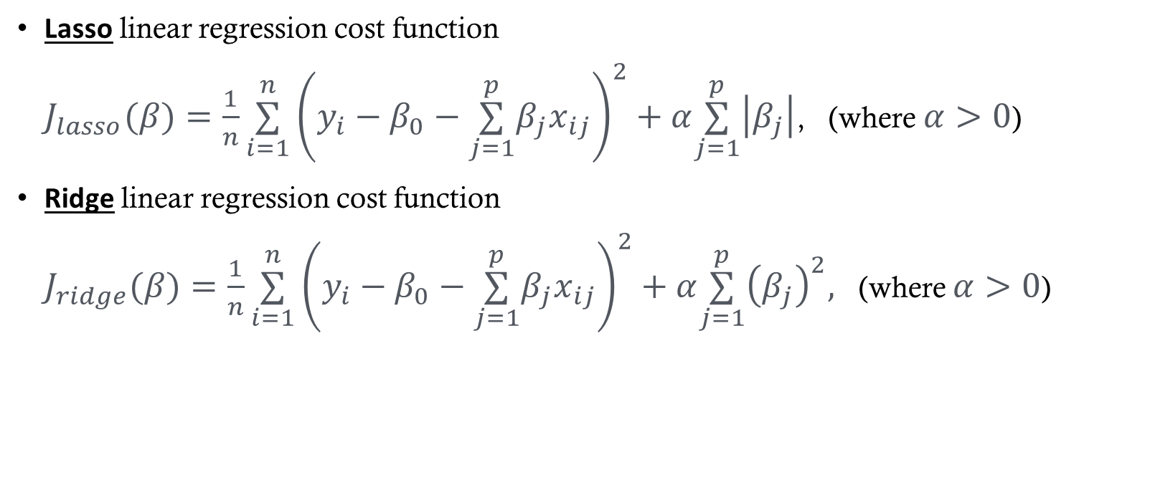
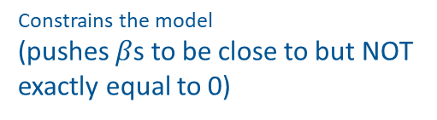
ℓ1 vs ℓ2 Penalties
ℓ1 penalty
Lasso linear regression cost function $J_{lasso}(β)=\frac{1}{n}\overset{n}{\underset{i=1}{∑}}{\left(y_{i}−β_{0}−\overset{p}{\underset{j=1}{∑}}β_{j}x_{ij}\right)}^{2}+α\overset{p}{\underset{j=1}{∑}}\left|β_{j}\right|$, (where $α>0$)
Ridge linear regression cost function $J_{ridge}(β)=\frac{1}{n}\overset{n}{\underset{i=1}{∑}}{\left(y_{i}−β_{0}−\overset{p}{\underset{j=1}{∑}}β_{j}x_{ij}\right)}^{2}+α\overset{p}{\underset{j=1}{∑}}{\left(β_{j}\right)}^{2},$ (where $α>0$)
ℓ2 penalty
Constrains the model (pushes $β$s to be close to but NOT exactly equal to 0)

Slide 10
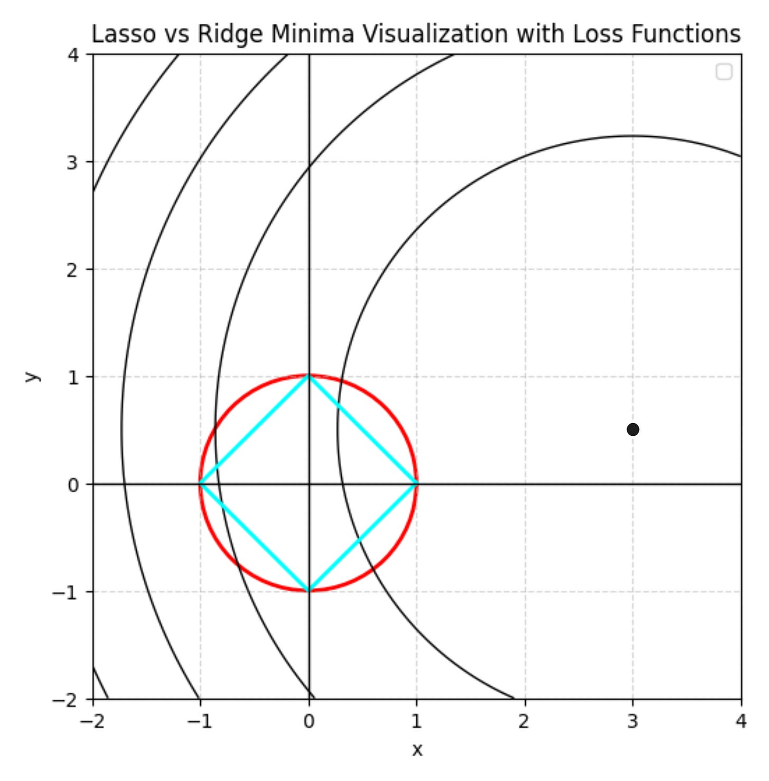
Lasso v. Ridge Visualization
Let’s explore this further in Desmos: https://www.desmos.com/3d
https://www.vizuaranewsletter.com/p/if-regularization-is-easy-can-you: This is a great source for an intuitive description!

Slide 11
Ridge vs Lasso
 | Lasso (ℓ1) | Ridge (ℓ2)
Coefficients | Can be driven to exactly 0 | Shrink toward 0, never exactly 0
Variable selection | Built in | None — keeps every feature
Correlated features | Picks one somewhat arbitrarily; estimates unstable | Spreads weight across them; estimates stable
Performs best when | Many features contribute little to prediction | Many features contribute, and are correlated
Neither method universally dominates — the right choice depends on how many features actually matter.

Slide 12
Choosing the Tuning Parameter
α controls the bias–variance tradeoff
α → 0: back to ordinary least squares (low bias, high variance)
α → ∞: all coefficients shrink toward 0 (high bias, low variance)
Choose α by k-fold cross-validation: fit over a grid of α values, pick the one minimizing CV error
The regularization path plots coefficients against α — useful for seeing which features survive
Always standardize predictors first: penalties are not scale-invariant, so units change the answer
The intercept β₀ is not penalized

Slide 13
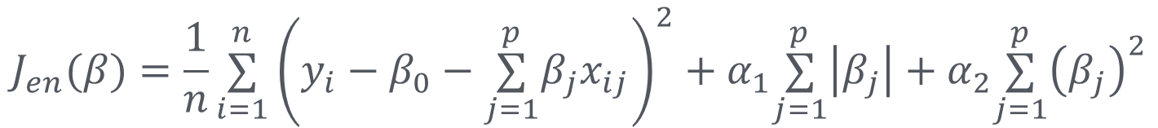
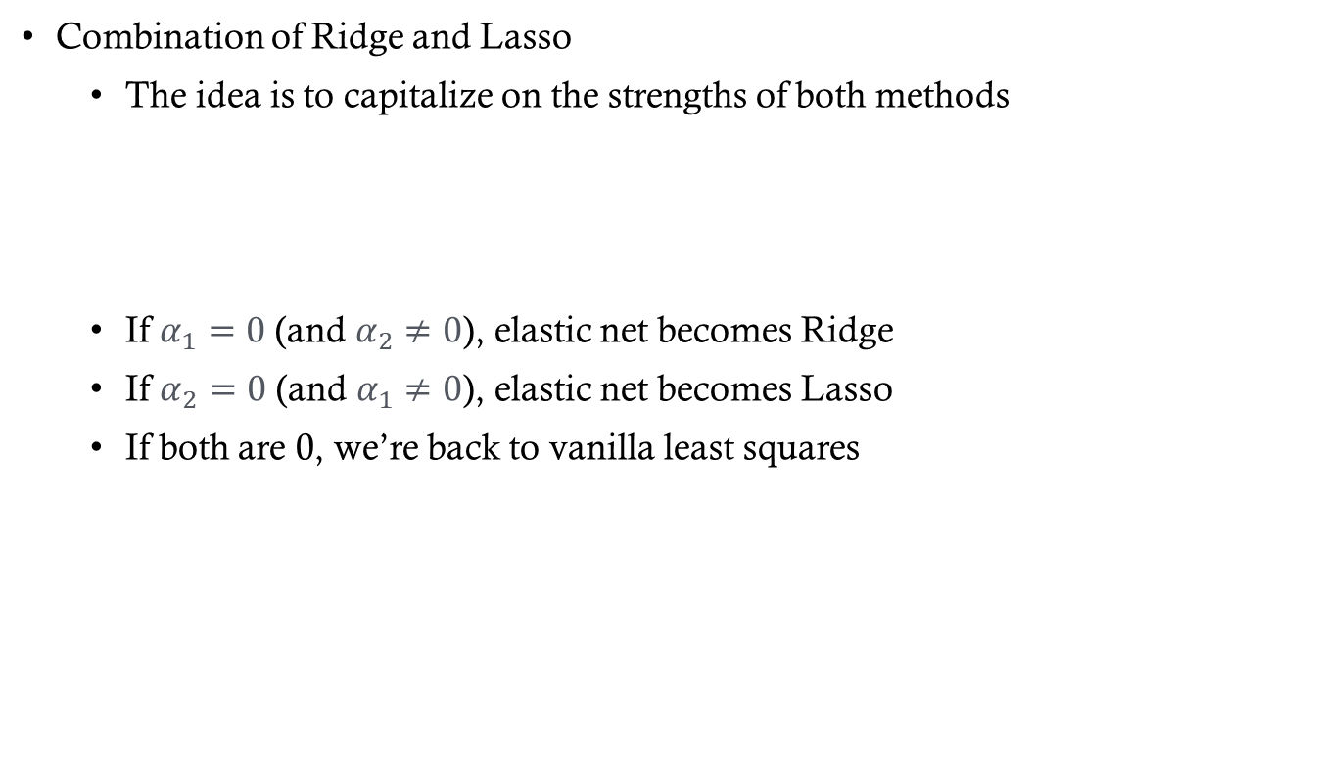
Elastic-Net Regularization
Combination of Ridge and Lasso
The idea is to capitalize on the strengths of both methods
If $α_{1}=0$ (and $α_{2}≠0$), elastic net becomes Ridge
If $α_{2}=0$ (and $α_{1}≠0$), elastic net becomes Lasso
If both are 0, we’re back to vanilla least squares
$$J_{en}(β)=\frac{1}{n}\overset{n}{\underset{i=1}{∑}}{\left(y_{i}−β_{0}−\overset{p}{\underset{j=1}{∑}}β_{j}x_{ij}\right)}^{2}+α_{1}\overset{p}{\underset{j=1}{∑}}\left|β_{j}\right|+α_{2}\overset{p}{\underset{j=1}{∑}}{\left(β_{j}\right)}^{2}$$

Slide 14
In Practice: Fitting Regularized Models
Python — scikit-learn
make_pipeline(StandardScaler(), LassoCV(cv=10)).fit(X, y)
R — glmnet
cv.glmnet(X, y, alpha = 1)
alpha: 1 = Lasso, 0 = Ridge, between = Elastic Net
Penalty-weight conventions differ between packages

Slide 15
Regularization Generally
Regularization is a general idea, not a linear-regression trick
Used in logistic regression, neural networks, decision trees, and more
Implicit forms need no penalty term: early stopping, dropout, pruning
Applies to weights, complexity, or the training process itself

Slide 16
Regularized Models in scikit-learn
By default: LogisticRegression, SVC, MLP
By design: Ridge, Lasso, ElasticNet
By complexity: tree pruning, boosting, early stopping
No penalty: LinearRegression

Slide 17
Key Takeaways
Regularization is the dial that controls model complexity
Lasso: sparse coefficients, built-in variable selection
Ridge: stable shrinkage, handles correlated features
Elastic Net: the middle ground
Standardize first, then tune α by cross-validation

