Slide 1
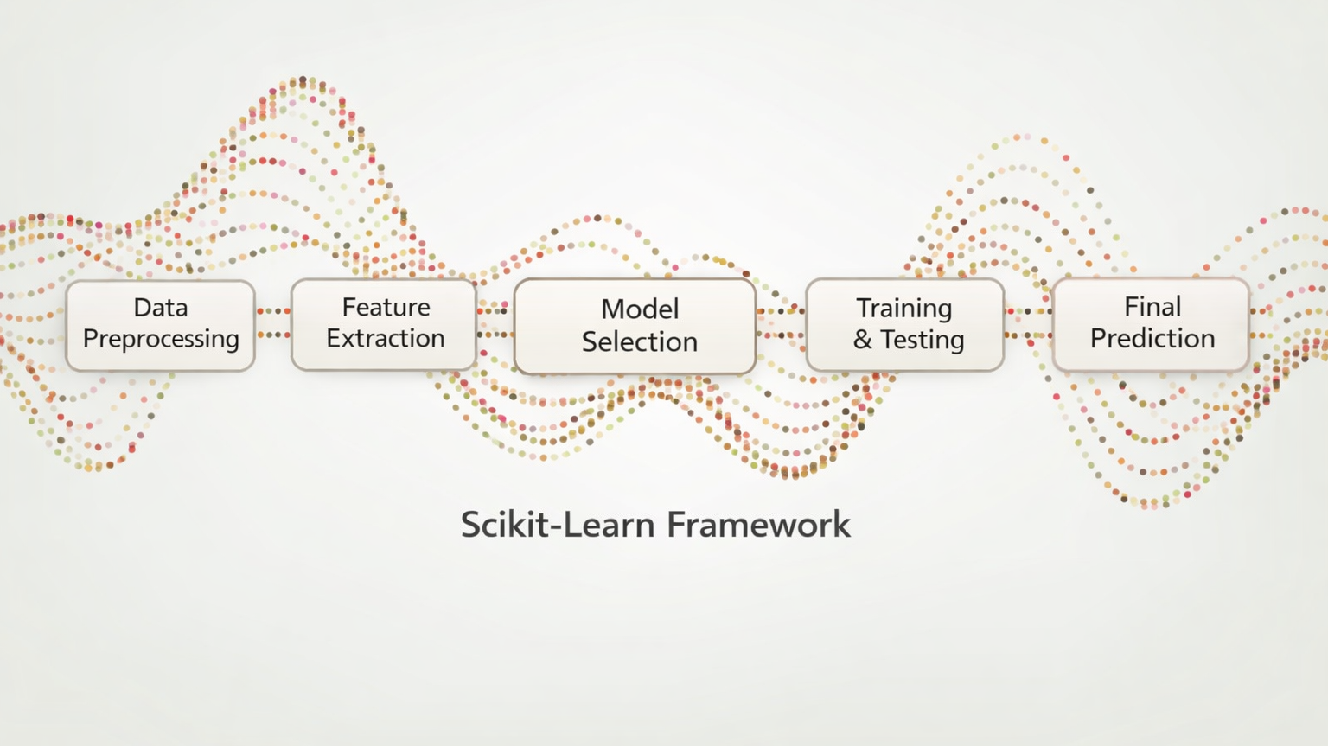
Introduction to Scikit-Learn

Slide 2
What is Scikit-Learn
Scikit-Learn is one of the best-known Python packages for machine learning
scikit-learn.org
It provides efficient versions of many common ML algorithms
It has a clean, uniform, and streamlined API
Once you understand the syntax of Scikit-Learn, it is straightforward to use any model inside the library
In Python, Scikit-Learn is called with sklearn
import sklearn

Slide 3
Scikit-Learn Design
Consistency: * All objects share a consistent and sensible interface
Inspection: * All hyperparameter and learned parameters are directly accessible (as attributes of the object) * Learn parameters have an underscore suffix
Nonproliferation of classes: * Datasets and hyperparameters are Pandas, Numpy, or base Python objects
Composition: * Existing building blocks are reused as much as possible
Sensible defaults: * Most parameters have reasonable default values

Slide 4
Scikit-Learn Design: Consistency
Estimators:
Any object that can estimate some parameter based on a dataset
The .fit() method performs the estimation

Slide 5
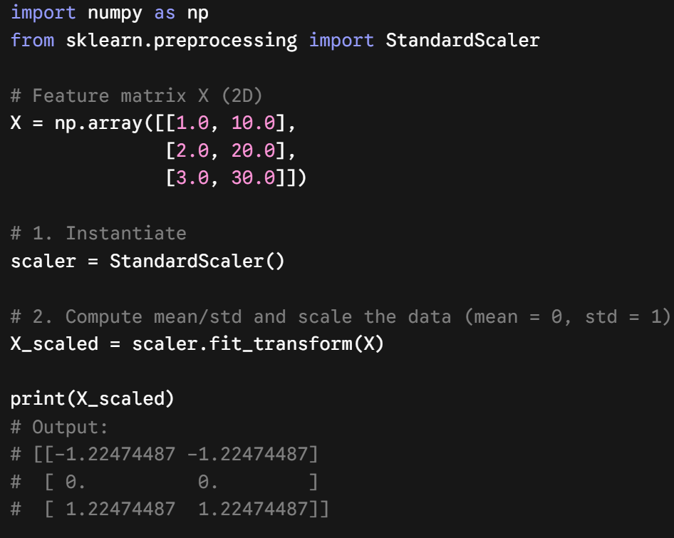
Scikit-Learn Design
Transformers:
Estimators that can also transform a dataset
Transformation is performed with the .transform() method
The .fit_transform() method fits and transforms in one step
Example: StandardScaler

Slide 6
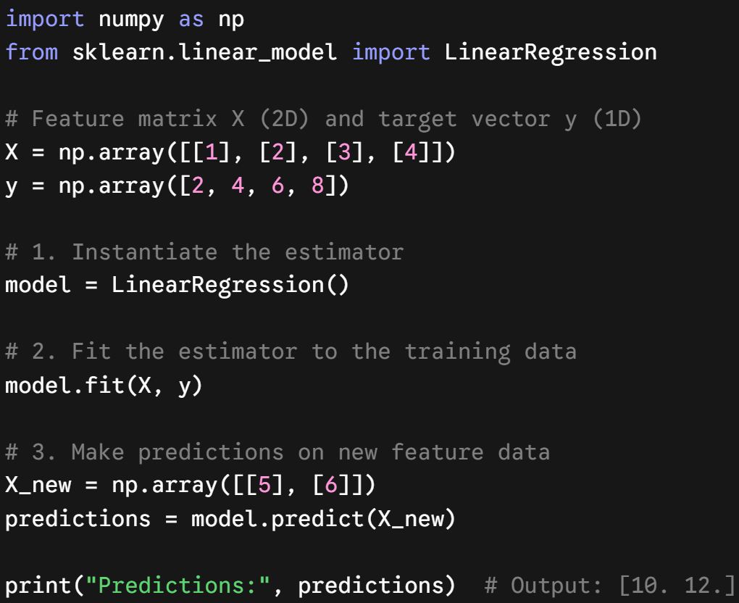
Scikit-Learn Design
Predictors:
Estimators that are capable of making predictions
Has a .predict() method
Usually have a built-in .score() method
Example: LinearRegression

Slide 7
Object-oriented modeling
A model is an object:
It has state (learned parameters)
It has methods (fit, predict)
This allows:
Reuse
Inspection
Composition (pipelines)
from sklearn.linear_model import LinearRegression
# Model instantiation
model = LinearRegression()
#Model fit
model.fit(X, y)
model.predict(X_new)
#Model learned parameters:
coefficients = model.coef_

Slide 8
Simple Scikit-Learn Usage
Prepare the data into a feature matrix and a target vector
Choose a model and import the estimator class from Scikit-Learn
Instantiate the model class and choose hyperparamters (not all models classes have hyperparameters)
Fit the model by calling the .fit() method
Apply the model with the .predict() or the .transform() method
Class: Scikit-Learn makes extensive use of Python classes and object oriented programming principles
Hyperparameters: Also called tuning parameters are parameters of the learning algorithm and not the model. That is, its value is used to control the learning process and is chosen by the modeler rather than learned from the data.

Slide 9
Preparing your data
The data should be in tabular form
Generally, Numpy or Pandas objects
The rows should be the observations or samples
The feature matrix (X) should be a 2D Numpy array or a Pandas DataFrame
This applies even when there is only 1 feature
Note: if only one feature, it often must be reshaped using .reshape(-1, 1)
The target (Y) should be a 1D Numpy array or a Pandas Series

Slide 10
Example
import numpy as np
from sklearn.linear_model import LinearRegression
# Create simple data
X = np.array([1, 2, 3, 4, 5]).reshape(-1, 1) # feature matrix (n_samples, n_features)
y = np.array([2, 4, 6, 8, 10]) # target vector
# Instantiate and fit the model
model = LinearRegression()
model.fit(X, y)
# Make predictions
y_pred = model.predict(X)
# Inspect learned parameters
print("Slope:", model.coef_[0])
print("Intercept:", model.intercept_)

Slide 11
Review the documentation!
A large part of learning Scikit-Learn is getting comfortable with the documentation
The documentation is vast and sometimes intimidating but learning how to read it will help you know how to implement the right model for your situation
https://scikit-learn.org/stable/

Slide 12
Preprocessing can leak information
Without a pipeline
Fit preprocessing on all of X.
Then cross-validate the model.
Validation-fold values influence the preprocessing statistics.
Result: overly optimistic scores.
With a pipeline
Fit preprocessing only on each training fold.
Apply learned steps to that fold's validation data.
Training and validation boundaries stay intact.
Result: trustworthy cross-validation.

Slide 13
Why use scikit-learn Pipelines?
A pipeline treats the full workflow as one estimator:
Prevents leakage during train/test splits and cross-validation
Applies the same preprocessing to training, validation, and new data
Keeps code concise and reproducible: one object for .fit(), .predict(), and .score()
Works directly with cross_val_score and GridSearchCV
Tune step parameters with step__parameter (for example, "model__n_neighbors")

Slide 14
How to build a pipeline: scale + KNN
from sklearn.pipeline import Pipeline
from sklearn.preprocessing import StandardScaler
from sklearn.neighbors import KNeighborsRegressor
knn_pipe = Pipeline([
("scale", StandardScaler()),
("model", KNeighborsRegressor(n_neighbors=5)),
])
knn_pipe.fit(X_train, y_train)
y_pred = knn_pipe.predict(X_test)

Slide 15
different steps for different columns
Numerical columns
impute -> scale
numeric = Pipeline([
("impute", SimpleImputer(strategy="median")),
("scale", StandardScaler()),
])
preprocess = ColumnTransformer([
("num", numeric, ["age", "income"]),
("cat", OneHotEncoder(handle_unknown="ignore"), ["city"]),
])
model = Pipeline([
("prep", preprocess),
("reg", LinearRegression()),
])
model.fit(X_train, y_train)
Categorical columns
one-hot encode
Combined features
Linear Regression

