Slide 1
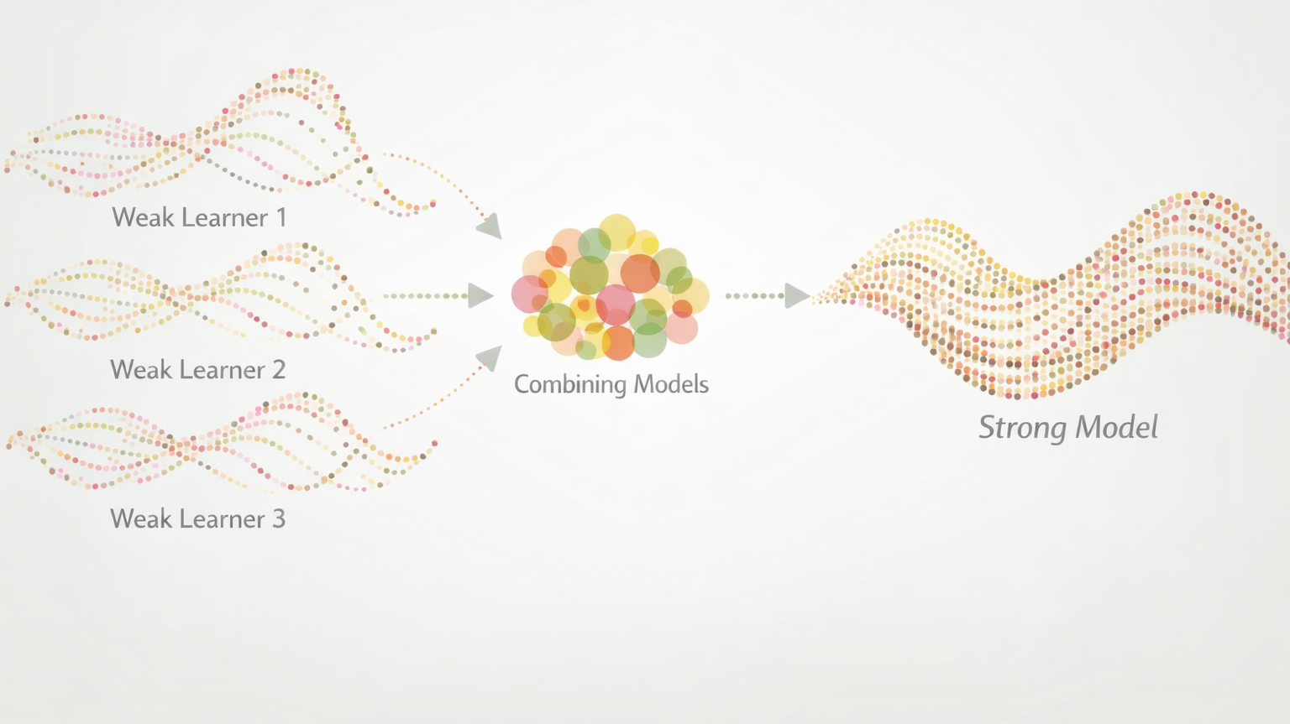
Boosting

Slide 2
Boosting
Boosting is a technique that was developed to improve weak learners
  Models that are not much better than random guessing
  Simple (few tuning parameters) and fast to train
  Decision “stumps” are commonly used weak learners
Idea: boosting methods train models sequentially and try to “fix the mistakes” of the preceding model

Slide 3
Foundational Boosting Algorithms
Adaptive Boosting (AdaBoost) — increase the weight of misclassified observations
Gradient Boosting — learn and then correct the mistakes by predicting residuals
  Modern implementations:
    XGBoost (Extreme gradient boosting)
    LightGBM (Light gradient boosting machine)
    Catboost (Categorical boosting)

Slide 4
AdaBoost
Adaptive Boosting (AdaBoost)
Introduced in 1997 by Yoav Freund and Robert Schapire
The main idea is to “pay more attention” to instances that were misclassified or had large errors
  Focus learning on difficult instances
  “Study” topics you missed last time

Slide 5
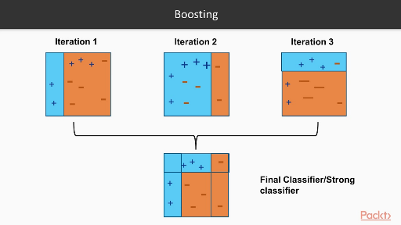
AdaBoost

Slide 6
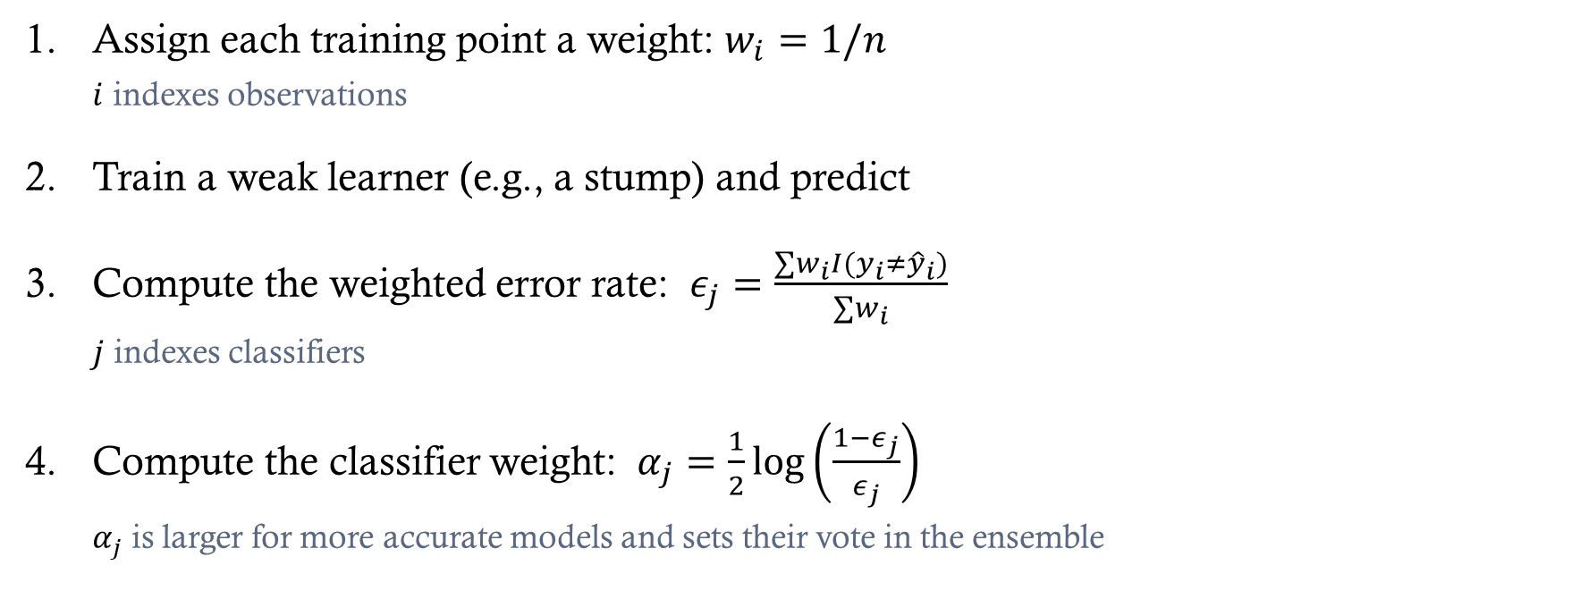
AdaBoost Algorithm
Assign each training point a weight: $w_{i}=1/n$
  $i$ indexes observations
Train a weak learner (e.g., a stump) and predict
Compute the weighted error rate: $ε_{j}=\frac{∑w_{i}I(y_{i}≠{\hat{y}}_{i})}{∑w_{i}}$
  $j$ indexes classifiers
Compute the classifier weight: $α_{j}=\frac{1}{2}log\left(\frac{1−ε_{j}}{ε_{j}}\right)$
  $α_{j}$ is larger for more accurate models and sets their vote in the ensemble

Slide 7
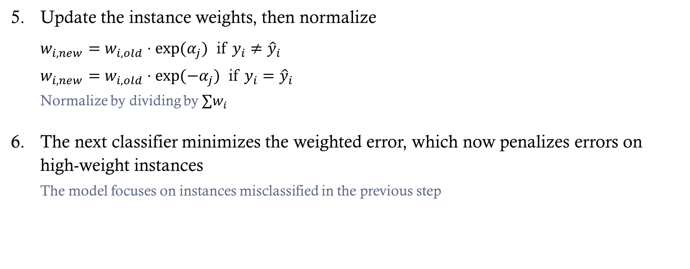
AdaBoost
Update the instance weights, then normalize
  $w_{i,new}=w_{i,old}⋅exp(α_{j})$ if $y_{i}≠{\hat{y}}_{i}$
  $w_{i,new}=w_{i,old}⋅exp(−α_{j})$ if $y_{i}={\hat{y}}_{i}$
  Normalize by dividing by $∑w_{i}$
The next classifier minimizes the weighted error, which now penalizes errors on high-weight instances
  The model focuses on instances misclassified in the previous step

Slide 8
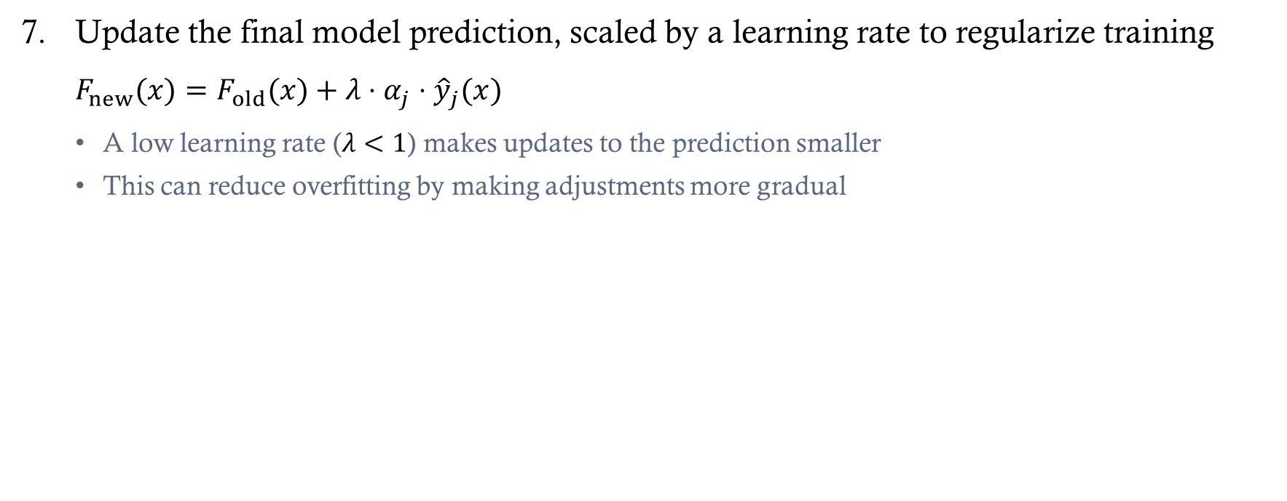
AdaBoost
Update the final model prediction, scaled by a learning rate to regularize training
  $F_{new}(x)=F_{old}(x)+λ⋅α_{j}⋅{\hat{y}}_{j}(x)$
  A low learning rate ($λ<1$) makes updates to the prediction smaller
  This can reduce overfitting by making adjustments more gradual

Slide 9
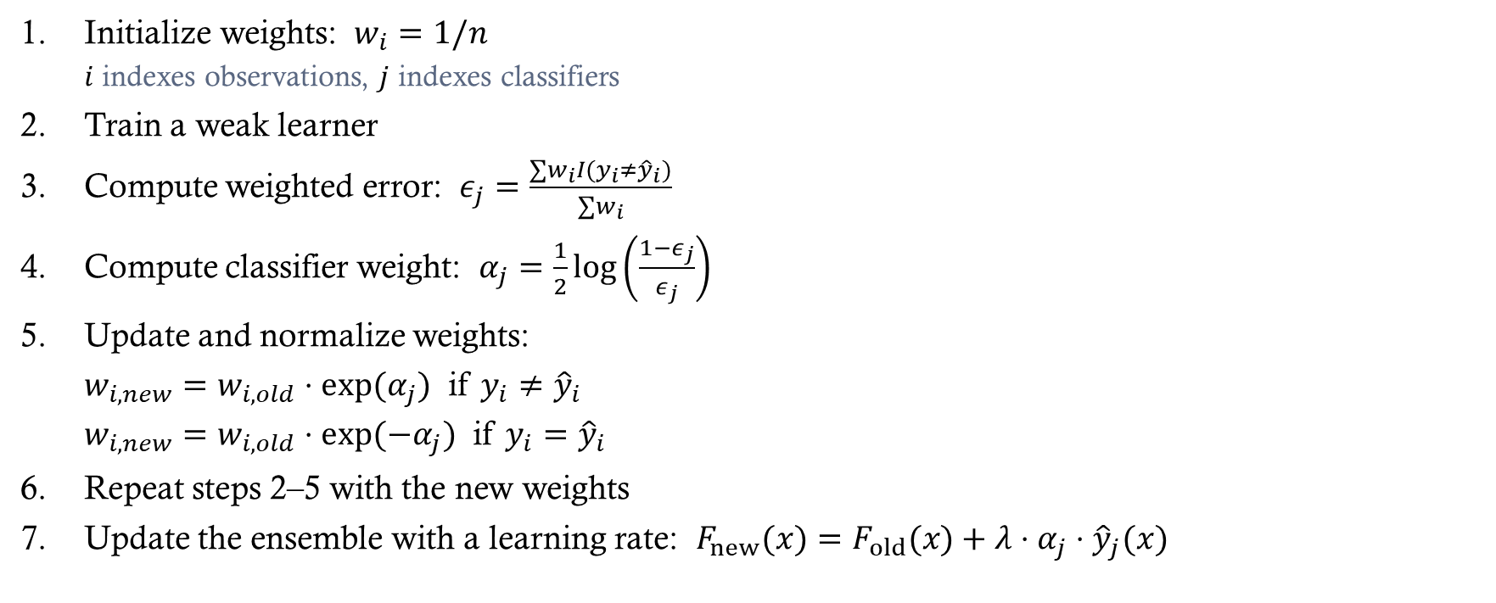
AdaBoost Summary
Initialize weights: $w_{i}=1/n$
  $i$ indexes observations, $j$ indexes classifiers
Train a weak learner
Compute weighted error: $ε_{j}=\frac{∑w_{i}I(y_{i}≠{\hat{y}}_{i})}{∑w_{i}}$
Compute classifier weight: $α_{j}=\frac{1}{2}log\left(\frac{1−ε_{j}}{ε_{j}}\right)$
Update and normalize weights:
  $w_{i,new}=w_{i,old}⋅exp(α_{j})$ if $y_{i}≠{\hat{y}}_{i}$
  $w_{i,new}=w_{i,old}⋅exp(−α_{j})$ if $y_{i}={\hat{y}}_{i}$
Repeat steps 2–5 with the new weights
Update the ensemble with a learning rate: $F_{new}(x)=F_{old}(x)+λ⋅α_{j}⋅{\hat{y}}_{j}(x)$

Slide 10
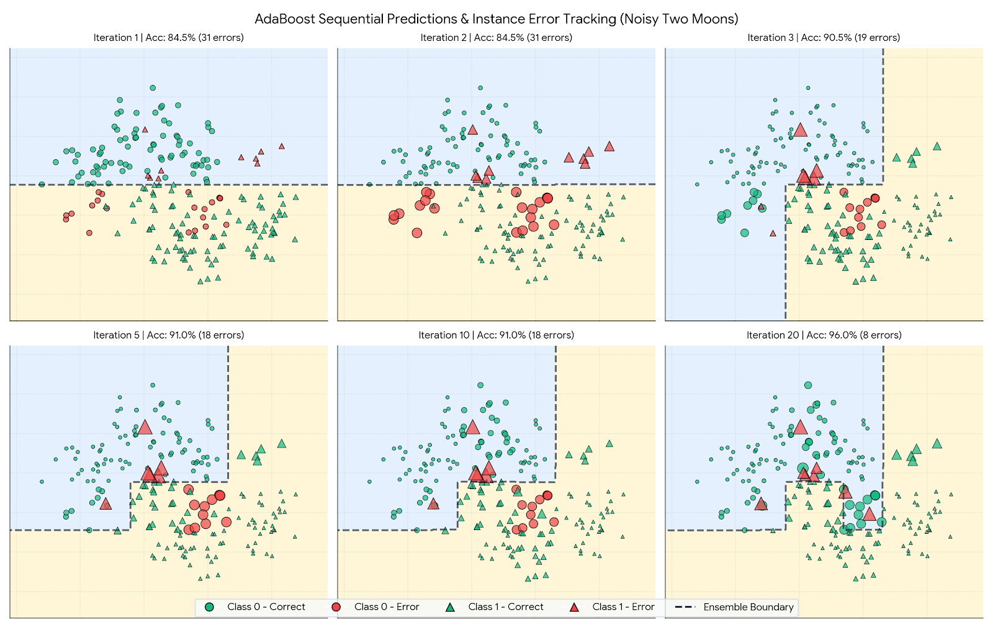
Notes:
import numpy as np
import matplotlib.pyplot as plt
from matplotlib.lines import Line2D
from sklearn.datasets import make_moons
from sklearn.tree import DecisionTreeClassifier
# 1. Generate Noisy Two Moons Dataset
np.random.seed(42)
X, y_raw = make_moons(n_samples=200, noise=0.25, random_state=42)
y = np.where(y_raw == 0, -1, 1) # Convert labels to {-1, +1}
N = len(X)
# 2. Fit AdaBoost Manually to Track Intermediate States
n_estimators = 20
estimators = []
estimator_weights = []
sample_weights_history = []
ensemble_scores_history = []
w = np.ones(N) / N
F = np.zeros(N)
for t in range(n_estimators):
# Fit base decision stump (max_depth=1)
stump = DecisionTreeClassifier(max_depth=1, random_state=42 + t)
stump.fit(X, y, sample_weight=w)
pred = stump.predict(X)
# Calculate weighted error rate
misclassified = (pred != y)
err = np.sum(w[misclassified]) / np.sum(w)
err = np.clip(err, 1e-10, 1 - 1e-10)
# Calculate estimator weight (alpha)
alpha = 0.5 * np.log((1.0 - err) / err)
# Store iteration diagnostics
sample_weights_history.append(w.copy())
estimators.append(stump)
estimator_weights.append(alpha)
# Accumulate ensemble score F(x) = sum(alpha_m * h_m(x))
F += alpha * pred
ensemble_scores_history.append(F.copy())
# Update sample weights for next iteration
w = w * np.exp(-alpha * y * pred)
w = w / np.sum(w) # Normalize weights
# 3. Setup Grid for Decision Boundary Visualization
x_min, x_max = X[:, 0].min() - 0.5, X[:, 0].max() + 0.5
y_min, y_max = X[:, 1].min() - 0.5, X[:, 1].max() + 0.5
xx, yy = np.meshgrid(np.linspace(x_min, x_max, 250), np.linspace(y_min, y_max, 250))
grid_points = np.c_[xx.ravel(), yy.ravel()]
# 4. Plot Selected Sequential Iterations
steps_to_show = [1, 2, 3, 5, 10, 20]
fig, axes = plt.subplots(2, 3, figsize=(15, 9.5), dpi=130)
axes = axes.ravel()
# Color definitions for instance errors
COLOR_CORRECT = '#10B981' # Emerald Green (Correct Prediction)
COLOR_ERROR = '#EF4444' # Bright Red (Misclassified / Error)
for idx, step_num in enumerate(steps_to_show):
ax = axes[idx]
t = step_num - 1 # 0-indexed iteration
# Compute ensemble output across grid up to step t
F_grid = np.zeros(len(grid_points))
for m in range(t + 1):
F_grid += estimator_weights[m] * estimators[m].predict(grid_points)
Z = np.sign(F_grid).reshape(xx.shape)
# Plot background ensemble decision regions & boundary line (F(x) = 0)
ax.contourf(xx, yy, Z, levels=[-1.5, 0, 1.5], colors=['#DBEAFE', '#FEF3C7'], alpha=0.7)
ax.contour(xx, yy, F_grid.reshape(xx.shape), levels=[0], colors=['#1E293B'], linewidths=2.0, linestyles='--')
# Evaluate cumulative ensemble predictions at step t
ens_pred = np.sign(ensemble_scores_history[t])
is_correct = (ens_pred == y)
# Scale point sizes dynamically by sample weight w_i
w_t = sample_weights_history[t]
sizes = np.clip(35 * (w_t / np.mean(w_t)), 15, 250)
# Subsets for class & error status
c0_corr = (y == -1) & is_correct
c0_err = (y == -1) & (~is_correct)
c1_corr = (y == 1) & is_correct
c1_err = (y == 1) & (~is_correct)
# Plot Class 0 (Circles) & Class 1 (Triangles)
ax.scatter(X[c0_corr, 0], X[c0_corr, 1], s=sizes[c0_corr], c=COLOR_CORRECT, marker='o', edgecolors='black', linewidth=0.6, alpha=0.85)
ax.scatter(X[c0_err, 0], X[c0_err, 1], s=sizes[c0_err], c=COLOR_ERROR, marker='o', edgecolors='black', linewidth=0.8, alpha=0.9)
ax.scatter(X[c1_corr, 0], X[c1_corr, 1], s=sizes[c1_corr], c=COLOR_CORRECT, marker='^', edgecolors='black', linewidth=0.6, alpha=0.85)
ax.scatter(X[c1_err, 0], X[c1_err, 1], s=sizes[c1_err], c=COLOR_ERROR, marker='^', edgecolors='black', linewidth=0.8, alpha=0.9)
acc = np.mean(is_correct) * 100
n_errors = np.sum(~is_correct)
ax.set_title(f"Iteration {step_num} | Acc: {acc:.1f}% ({n_errors} errors)", fontsize=11, fontweight='bold', pad=8)
ax.set_xlim(x_min, x_max)
ax.set_ylim(y_min, y_max)
ax.tick_params(left=False, bottom=False, labelleft=False, labelbottom=False)
ax.grid(True, linestyle=':', alpha=0.4)
# Master Legend & Plot Title
fig.suptitle("AdaBoost Sequential Predictions & Instance Error Tracking (Noisy Two Moons)", fontsize=15, fontweight='bold', y=0.98)
legend_elements = [
Line2D([0], [0], marker='o', color='w', label='Class 0 - Correct', markerfacecolor=COLOR_CORRECT, markeredgecolor='black', markersize=9),
Line2D([0], [0], marker='o', color='w', label='Class 0 - Error', markerfacecolor=COLOR_ERROR, markeredgecolor='black', markersize=9),
Line2D([0], [0], marker='^', color='w', label='Class 1 - Correct', markerfacecolor=COLOR_CORRECT, markeredgecolor='black', markersize=9),
Line2D([0], [0], marker='^', color='w', label='Class 1 - Error', markerfacecolor=COLOR_ERROR, markeredgecolor='black', markersize=9),
Line2D([0], [0], color='#1E293B', lw=2, linestyle='--', label='Ensemble Boundary'),
]
fig.legend(handles=legend_elements, loc='lower center', ncol=5, fontsize=11, frameon=True, facecolor='#F8FAFC', edgecolor='#CBD5E1', bbox_to_anchor=(0.5, 0.01))
plt.tight_layout(rect=[0, 0.06, 1, 0.95])
plt.show()

Slide 11
Gradient Boosting
Gradient Boosting directly targets the residuals (regression) or gradient of the loss function (classification)
At each step, a new weak learner is fit to the residual or pseudo-residuals

Slide 12
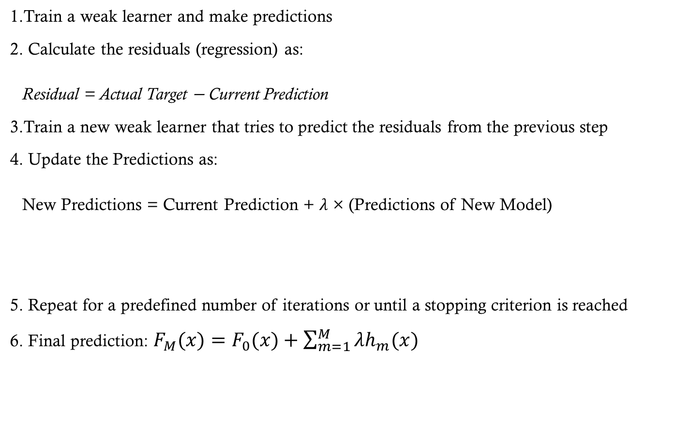
Gradient Boosting
Train a weak learner and make predictions
Calculate the residuals (regression) as:
Residual = Actual Target − Current Prediction
Train a new weak learner that tries to predict the residuals from the previous step
Update the Predictions as:
New Predictions = Current Prediction + $λ$ × (Predictions of New Model)
Repeat for a predefined number of iterations or until a stopping criterion is reached
Final prediction: $F_{M}(x)=F_{0}(x)+\sum_{m=1}^{M}{λh_{m}(x)}$
“Predicted Residuals”
Learning Rate

Slide 13

Example (with $λ=1$)
Step 1
Current Target
Current Predictions
Y | Yhat-1 | Resid-1 | Yhat-2 | Resid-2 | Yhat-3 | Final Prediction
0.05 | 0.12 | −0.07 | −0.09 | 0.02 | 0.01 | 0.04
0.59 | 0.53 | 0.07 | 0.04 | 0.03 | −0.07 | 0.50
0.17 | 0.12 | 0.04 | 0.04 | 0.00 | 0.01 | 0.17
−0.07 | 0.12 | −0.19 | −0.09 | −0.10 | 0.01 | 0.04
0.34 | 0.12 | 0.22 | 0.16 | 0.06 | 0.01 | 0.29

Slide 14
Example in a Table
Step 2
Current Target
Y | Yhat-1 | Resid-1 | Yhat-2 | Resid-2 | Yhat-3 | Final Prediction
0.05 | 0.12 | −0.07 | −0.09 | 0.02 | 0.01 | 0.04
0.59 | 0.53 | 0.07 | 0.04 | 0.03 | −0.07 | 0.50
0.17 | 0.12 | 0.04 | 0.04 | 0.00 | 0.01 | 0.17
−0.07 | 0.12 | −0.19 | −0.09 | −0.10 | 0.01 | 0.04
0.34 | 0.12 | 0.22 | 0.16 | 0.06 | 0.01 | 0.29

Slide 15
Example in a Table
Step 2
Current Target
Current Predictions
Y | Yhat-1 | Resid-1 | Yhat-2 | Resid-2 | Yhat-3 | Final Prediction
0.05 | 0.12 | −0.07 | −0.09 | 0.02 | 0.01 | 0.04
0.59 | 0.53 | 0.07 | 0.04 | 0.03 | −0.07 | 0.50
0.17 | 0.12 | 0.04 | 0.04 | 0.00 | 0.01 | 0.17
−0.07 | 0.12 | −0.19 | −0.09 | −0.10 | 0.01 | 0.04
0.34 | 0.12 | 0.22 | 0.16 | 0.06 | 0.01 | 0.29

Slide 16
Example in a Table
Step 3
Current Target
Y | Yhat-1 | Resid-1 | Yhat-2 | Resid-2 | Yhat-3 | Final Prediction
0.05 | 0.12 | −0.07 | −0.09 | 0.02 | 0.01 | 0.04
0.59 | 0.53 | 0.07 | 0.04 | 0.03 | −0.07 | 0.50
0.17 | 0.12 | 0.04 | 0.04 | 0.00 | 0.01 | 0.17
−0.07 | 0.12 | −0.19 | −0.09 | −0.10 | 0.01 | 0.04
0.34 | 0.12 | 0.22 | 0.16 | 0.06 | 0.01 | 0.29

Slide 17
Example in a Table
Step 3
Current Target
Current Predictions
Y | Yhat-1 | Resid-1 | Yhat-2 | Resid-2 | Yhat-3 | Final Prediction
0.05 | 0.12 | −0.07 | −0.09 | 0.02 | 0.01 | 0.04
0.59 | 0.53 | 0.07 | 0.04 | 0.03 | −0.07 | 0.50
0.17 | 0.12 | 0.04 | 0.04 | 0.00 | 0.01 | 0.17
−0.07 | 0.12 | −0.19 | −0.09 | −0.10 | 0.01 | 0.04
0.34 | 0.12 | 0.22 | 0.16 | 0.06 | 0.01 | 0.29

Slide 18
Example in a Table
Y | Yhat-1 | Resid-1 | Yhat-2 | Resid-2 | Yhat-3 | Final Prediction
0.05 | 0.12 | −0.07 | −0.09 | 0.02 | 0.01 | 0.04
0.59 | 0.53 | 0.07 | 0.04 | 0.03 | −0.07 | 0.50
0.17 | 0.12 | 0.04 | 0.04 | 0.00 | 0.01 | 0.17
−0.07 | 0.12 | −0.19 | −0.09 | −0.10 | 0.01 | 0.04
0.34 | 0.12 | 0.22 | 0.16 | 0.06 | 0.01 | 0.29

Slide 19
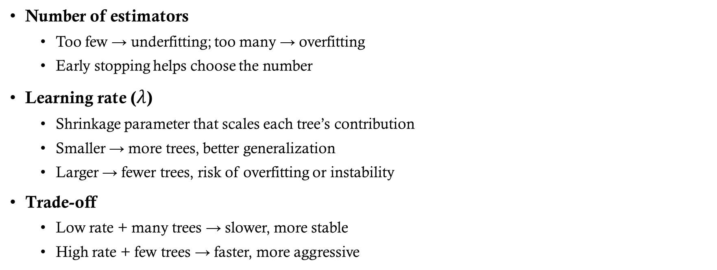
Tuning Parameters
Number of estimators
  Too few → underfitting; too many → overfitting
  Early stopping helps choose the number
Learning rate ($λ$)
  Shrinkage parameter that scales each tree’s contribution
  Smaller → more trees, better generalization
  Larger → fewer trees, risk of overfitting or instability
Trade-off
  Low rate + many trees → slower, more stable
  High rate + few trees → faster, more aggressive

Slide 20
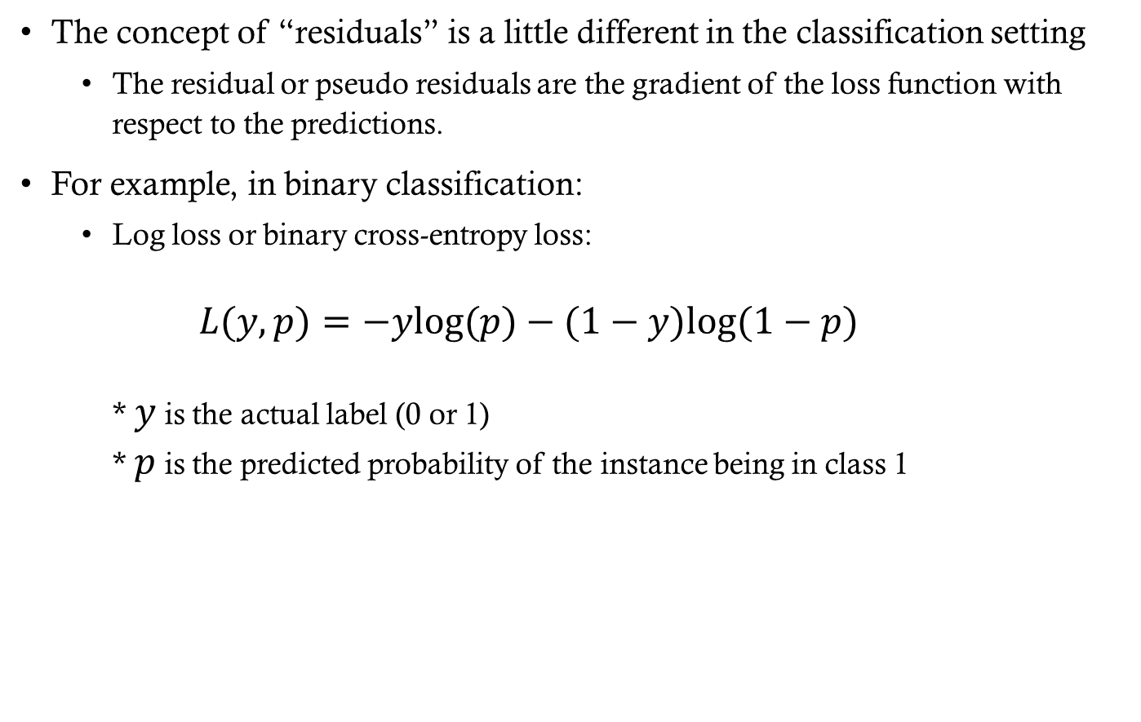
Gradient Boosting for Classification
The concept of “residuals” is a little different in the classification setting
  The residual or pseudo residuals are the gradient of the loss function with respect to the predictions.
For example, in binary classification:
  Log loss or binary cross-entropy loss:
  $L(y,p)=−ylog(p)−(1−y)log(1−p)$
  * $y$ is the actual label (0 or 1)
  * $p$ is the predicted probability of the instance being in class 1

Slide 21
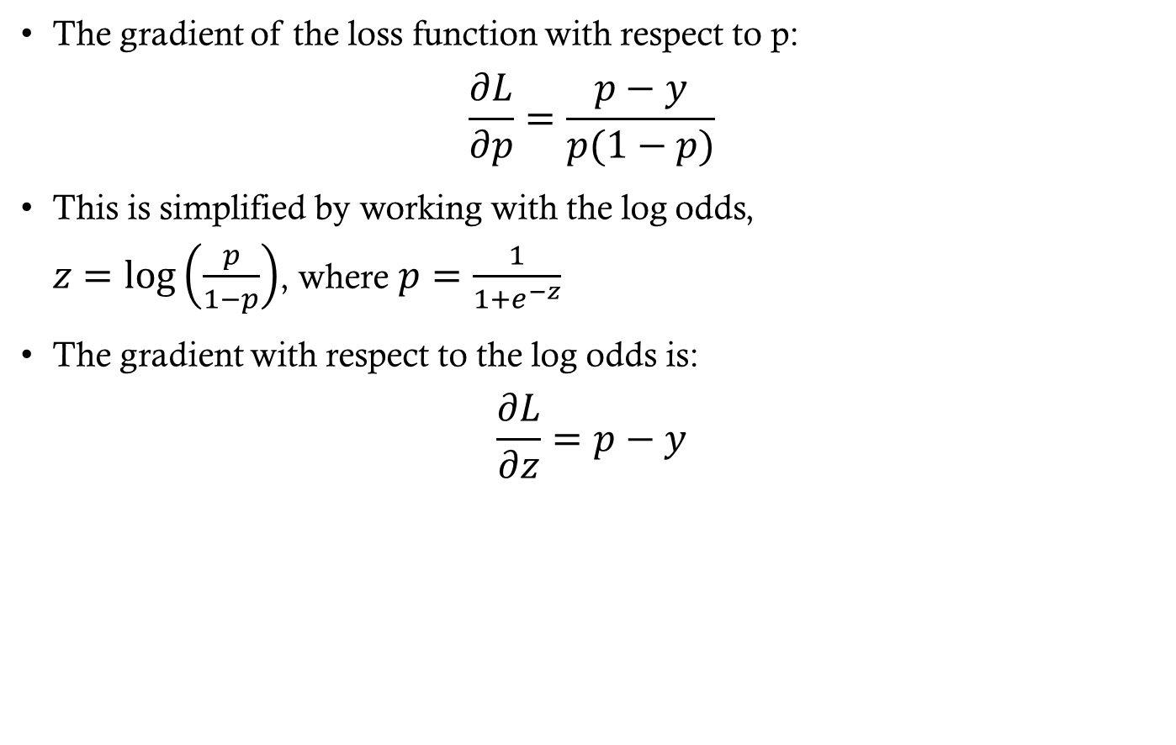
Gradient Boosting for Classification
The gradient of the loss function with respect to p:
$\frac{∂L}{∂p}=\frac{p−y}{p(1−p)}$
This is simplified by working with the log odds,
$z=log\left(\frac{p}{1−p}\right)$, where $p=\frac{1}{1+e^{−z}}$
The gradient with respect to the log odds is:
$\frac{∂L}{∂z}=p−y$

Slide 22
Implementations of Gradient Boosting
Scikit-Learn
  GradientBoostingClassifier / GradientBoostingRegressor
  Can be slower on large datasets
  HistGradientBoosting provides a faster, histogram-based implementation
XGBoost (Extreme Gradient Boosting)
  Highly optimized and efficient
  Supports L1 and L2 regularization
  Handles missing values automatically
  Parallelized and widely used in industry
LightGBM (Light Gradient Boosting Machine)
  Very fast for large datasets
  Histogram-based learning for efficiency
  Leaf-wise tree growth strategy
  Native handling of categorical features
  Memory efficient
CatBoost
  Strong performance with minimal tuning
  Excellent handling of categorical variables
  Reduces preprocessing requirements

Slide 23
Installing boosting libraries
Using pip
XGBoost
pip install xgboost
LightGBM
pip install lightgbm
CatBoost
pip install catboost
Using conda
XGBoost
conda install -c conda-forge py-xgboost
LightGBM
conda install -c conda-forge lightgbm
CatBoost
conda install -c conda-forge catboost

