Slide 1
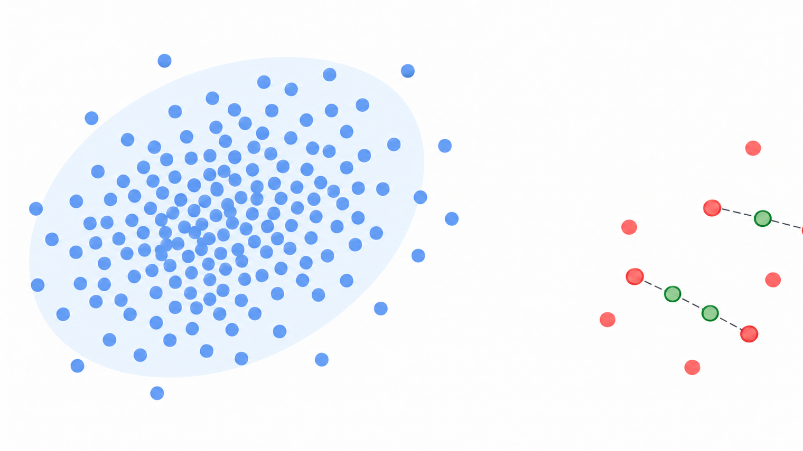
Imbalance

Slide 2
Rare outcomes, important decisions
Class imbalance means one class is much rarer than another.
The minority class often matters most, as in fraud or equipment failure.
Imbalance can reflect the real world without indicating a data error.
Learn minority patterns that remain useful in deployment.
Which costs more: a missed case or a false alarm?
Notes:
Class imbalance occurs when one class is much less frequent than another. Minority outcomes can include fraud, equipment failure, positive medical screens, or security intrusions. Imbalance is a property of the data-generating process. The modeling challenge is useful minority-class behavior without distorting deployment. Ask students about the consequences of false negatives versus false positives. The suggested prevalences in the source are illustrative examples, not universal empirical rates.
[Sources]
User-provided class_imbalance_slide_content.md, Slide 1.
[/Sources]

Slide 3
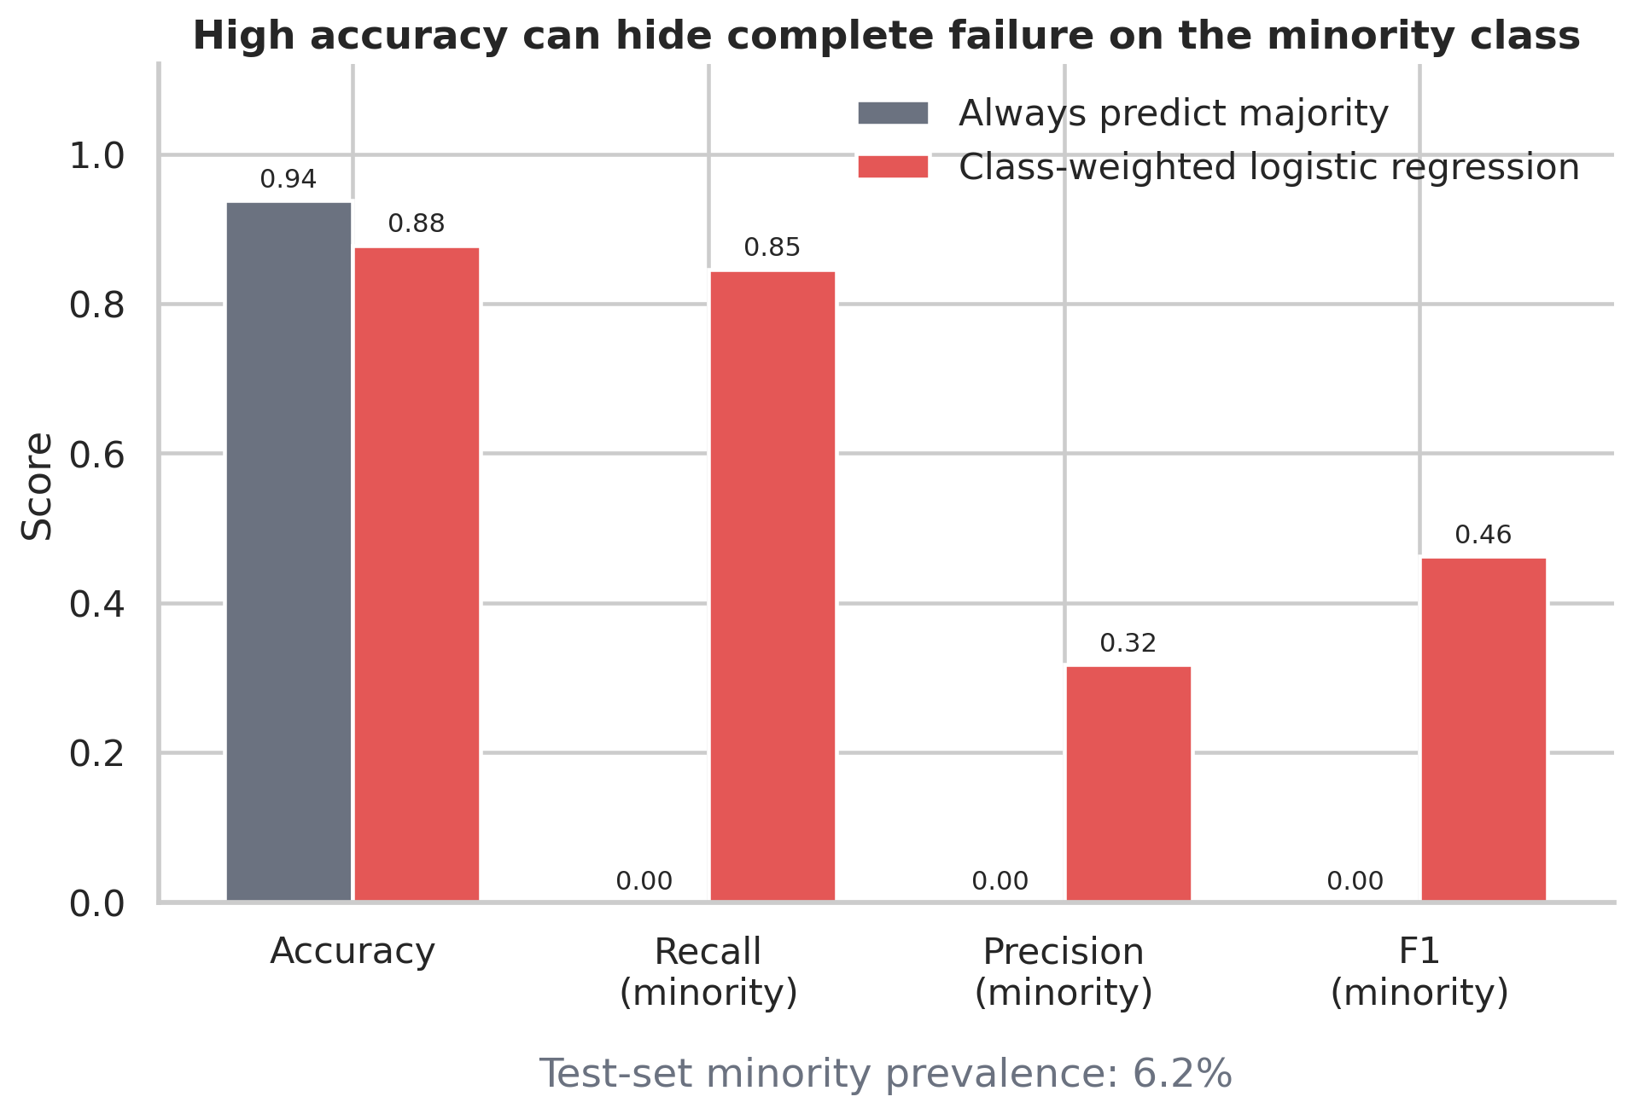
High accuracy can hide missed cases
With 95% negatives, always predicting negative gives 95% accuracy and 0% positive recall.
Accuracy weights class performance by prevalence.
A high AUC can still require threshold adjustment for a useful precision/recall tradeoff.
Illustrative figure: 6.2% minority prevalence.
Metrics: recall, precision, F1, balanced accuracy, PR-AUC, ROC-AUC, and expected cost.
Notes:
A hypothetical dataset with 95% negative cases gives an always-negative classifier 95% accuracy and 0% positive recall. Accuracy averages over classes according to prevalence. Choose minority recall, precision, F1, balanced accuracy, PR-AUC, ROC-AUC, expected cost, or a domain-specific operating point. A useful ranking can still need threshold adjustment. The supplied image is a separate illustrative example with 6.2% minority prevalence and baseline accuracy rounded to 0.94. Precision is undefined when there are no positive predictions; the supplied figure records zero by convention.
[Sources]
User-provided class_imbalance_slide_content.md, Slide 2.
User-provided 01_accuracy_can_mislead.png.
[/Sources]

Slide 4
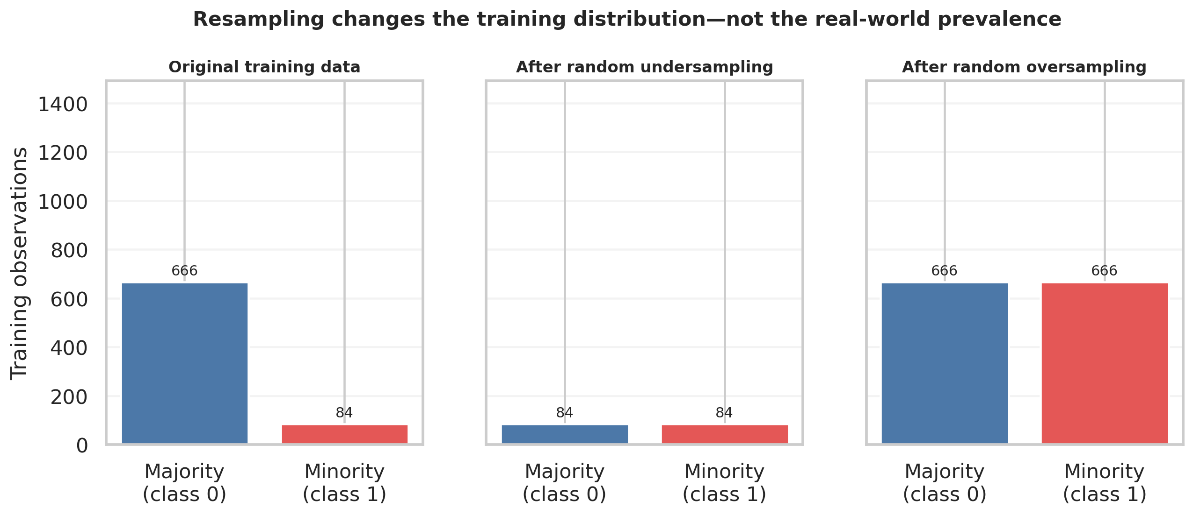
Original, training, and deployment data
Resampling changes the training distribution.
Original
Observed prevalence and feature distribution.
Training
Rows or weights after the learning intervention.
Deployment
Keep test data untouched and representative of deployment.
Notes:
Distinguish original, training, and deployment distributions. Original means observed class prevalence and feature distribution before intervention. Training means the rows and weights after weighting, undersampling, oversampling, or synthesis. Deployment means the cases and prevalence encountered in use. Resampling changes the training distribution, not real-world prevalence. Preserve the expected deployment distribution in a held-out test set. When training prevalence changes substantially, raw predicted probabilities may require calibration, or a threshold selected on validation data that reflect deployment prevalence. The supplied class-count image is illustrative.
[Sources]
User-provided class_imbalance_slide_content.md, Slide 3.
User-provided 02_resampling_class_counts.png.
[/Sources]

Slide 5
Error costs guide metric choice
Which costs more: a missed case or a false alarm?
Missed cases cost more
False alarms cost more
Recall: share of positives detected.
Test a lower threshold.
Check false alarms and workload.
Precision: share of alerts that are true.
Test a higher threshold.
Check missed positives.
Both costs known? Compare expected error cost on validation data.
Review limit? Choose a cutoff within capacity, such as 200 alerts per day.
Notes:
Establish an unmodified baseline and report minority-relevant metrics. Confirm labels, investigate label noise, and improve features before attributing all difficulty to imbalance. More real minority cases provide information that duplication cannot. Select a threshold on validation data using costs, review capacity, and the desired precision/recall tradeoff. The fraud-team example is hypothetical: analysts can investigate at most 200 model-flagged cases per day. This is an operational review-capacity limit, not a number of confirmed fraud cases or a performance score. Select the threshold on validation data to maximize expected value subject to expected daily alert volume staying within that capacity. An alert identifies possible fraud for review. A fixed threshold does not guarantee exactly 200 alerts each day, because incoming volume and scores can vary.
[Sources]
User-provided class_imbalance_slide_content.md, Slide 4.
[/Sources]
Threshold interpretation: for a fixed model and fixed evaluation cases, flag a case when its score meets or exceeds the cutoff. Lowering the cutoff expands the flagged set, so alert volume and recall cannot decrease. Raising it contracts the flagged set, so workload falls but more positives may be missed. These are directional relationships, with possible ties, rather than guaranteed strict changes at every cutoff. Choose a cutoff on representative validation data using error costs and expected deployment volume. The 200-alert capacity is illustrative. Monitor deployment volume because a fixed cutoff does not enforce a hard daily cap. Baseline fitting, label checks, feature quality, and collection of real minority observations remain important preparatory steps.
Metric selection linked to the question on slide 2: Which costs more: a missed case or a false alarm? Treat the minority event of interest as positive. Recall = TP/(TP+FN) measures the fraction of actual positives detected. Precision = TP/(TP+FP) measures the fraction of positive alerts that are true positives. When missed positives are costly, prioritize recall subject to acceptable false alarms and workload. When false alerts are costly, prioritize precision while monitoring recall. Lowering the cutoff for a fixed set of scores expands the alert set and cannot lower recall. Test a higher threshold when seeking more reliable alerts, but validate precision rather than assuming monotonic improvement.
If false-negative and false-positive costs are available, compare C_FN*FN + C_FP*FP across candidate cutoffs on representative validation data, using consistent sample sizes or per-case normalization. Keep expected deployment prevalence and alert capacity in view. The 200-alert limit remains illustrative. Weighting and resampling change training, whereas the decision objective determines the metric and final threshold. Compare these training approaches under the same cost and capacity objective; none automatically solves an asymmetric error-cost problem.

Slide 6
Random undersampling
Remove majority-class rows
Benefit
Tradeoff
Smaller training sets fit faster, reduce majority-class dominance, and may improve minority recall.
Discarded majority cases may contain useful structure, especially near the class boundary.
Best fit: an extremely large, redundant majority class relative to computation needs.
Notes:
Random undersampling removes a subset of majority observations. It gives the learner more reason to attend to the minority class and reduces majority dominance. It can decrease fitting time and improve minority recall. Discarded majority cases may contain useful structure, especially near a boundary. The strongest use case is a huge, redundant majority class relative to computation needs.
[Sources]
User-provided class_imbalance_slide_content.md, Slide 5.
[/Sources]

Slide 7
Random oversampling
Duplicate minority examples to balance training influence.
Simple and model-agnostic. Keeps all majority observations.
Duplicates can overfit flexible models or tiny minority samples.
Oversample only within each training fold.
Notes:
Random oversampling duplicates minority observations until the classes are closer to balanced. It preserves all original majority observations and increases minority influence. It is simple, model-agnostic, and often an effective baseline. Exact duplicates can promote overfitting in flexible models or very small minority samples. Apply oversampling only to training data, after splitting and inside each cross-validation fold.
[Sources]
User-provided class_imbalance_slide_content.md, Slide 6.
[/Sources]

Slide 8
Class weighting and error costs
Increase the loss attached to minority-class errors without changing the rows.
L = −∑ᵢ₌₁ⁿ [w₁yᵢ log(pᵢ) + w₀(1 − yᵢ) log(1 − pᵢ)]
Larger w₁ makes positive-class errors more influential during training.
Use class_weight="balanced" or sample_weight where the estimator supports it.
Keep all observations and avoid synthetic rows. Tune weights against the task, then validate calibration and threshold performance.
Notes:
Class weighting increases the loss assigned to minority errors without changing rows. Weighted binary cross-entropy: L = -sum from i=1 to n of [w1*yi*log(pi) + w0*(1-yi)*log(1-pi)]. Class 1 is the minority class. A larger w1 increases the influence of positive-class errors. Many estimators support LogisticRegression(class_weight="balanced") or a sample_weight vector. Weighting retains observations and avoids synthetic rows. Weights encode a modeling preference or cost ratio. Tune and validate rather than assume the default is optimal.
[Sources]
User-provided class_imbalance_slide_content.md, Slide 7.
[/Sources]

Slide 9
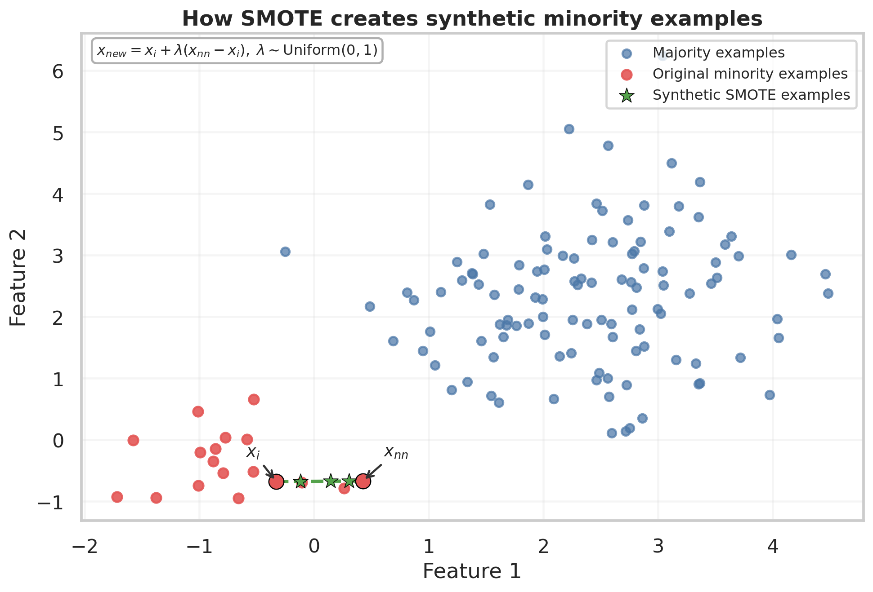
SMOTE: synthetic minority examples
Interpolate minority neighbors to add variation and smooth sparse minority regions.
The new point lies on the segment connecting the two examples.
Interpolation must create plausible cases. Scale numeric features before distance-based synthesis.
Use an appropriate method for categorical or mixed data.
Notes:
SMOTE creates synthetic examples rather than exact duplicates. Given minority point x_i and minority neighbor x_nn, x_new = x_i + lambda*(x_nn - x_i), where lambda follows Uniform(0,1). The synthetic point lies on the connecting segment. This can smooth sparse minority regions, but interpolation must produce plausible cases. Standardize numeric variables before distance-based methods. Use mixed-type or categorical methods where needed. The supplied geometry figure is illustrative.
[Sources]
User-provided class_imbalance_slide_content.md, Slide 8.
User-provided 03_smote_geometry.png.
[/Sources]

Slide 10
SMOTE: interpolation mathematics
Let xᵢ ∈ ℝᵈ be a minority observation and xⱼ a minority neighbor.
λ ∼ Uniform(0, 1)
z = xᵢ + λ(xⱼ − xᵢ) = (1 − λ)xᵢ + λxⱼ
The synthetic point z is a convex combination of the two minority observations.
Illustrative calculation
Conditional mean
xᵢ = (1, 2), xⱼ = (5, 6), λ = 0.25
z = (1, 2) + 0.25(4, 4) = (2, 3)
E[z ∣ xᵢ, xⱼ] = ½(xᵢ + xⱼ)
The midpoint of the selected pair.
Notes:
SMOTE mathematical detail. Choose a minority observation x_i and a minority neighbor x_j. Conditional on the selected pair, draw a scalar lambda uniformly on (0,1) and use the same scalar for every feature coordinate. The generated vector is x_new = x_i + lambda(x_j - x_i). Rearranging gives a convex combination, (1-lambda)x_i + lambda*x_j. Since E[lambda]=1/2, E[x_new | x_i,x_j]=(x_i+x_j)/2. This is a conditional expectation for a fixed pair, not a claim about the whole synthetic distribution.
Illustrative calculation, not observed data: (1,2)+0.25*((5,6)-(1,2))=(2,3). Coordinates assume a numeric feature space appropriate for interpolation. Scale numeric features within the training pipeline and resample training data only, as discussed in the surrounding slides.
[Sources]
User-provided class_imbalance_slide_content.md, Slide 8; existing slide 9 speaker notes. Convex-combination identity and conditional mean derived algebraically from the supplied interpolation formula. Worked example is illustrative.
[/Sources]

Slide 11
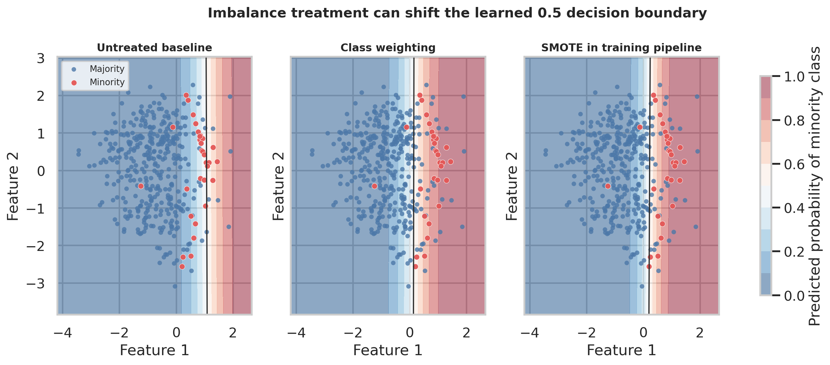
Decision boundaries after treatment
Notes:
Illustrative decision boundaries for the untreated baseline, class weighting, and SMOTE in the training pipeline. The black curve marks the learned 0.5 decision boundary. The comparison illustrates how training interventions change minority predictions. It does not establish a universal ranking of methods.
[Sources]
User-provided 04_decision_boundaries.png.
[/Sources]

Slide 12
SMOTE variants
Borderline-SMOTE
Focuses on minority points near the decision boundary when boundary coverage matters.
ADASYN
Adds more samples in difficult minority regions, with a risk of amplifying noise.
KMeans-SMOTE
Clusters before synthesis, allocating samples to suitable regions when minority data form multiple clusters.
SMOTE-NC / SMOTEN
SMOTE-NC handles numeric and categorical features. SMOTEN handles categorical features.
Compare these alternatives against weighting and random oversampling.
Notes:
Borderline-SMOTE emphasizes minority cases near a decision boundary when boundary coverage is the concern. ADASYN allocates more synthesis to hard minority regions, but may amplify noise. KMeans-SMOTE clusters first and allocates synthesis to suitable regions, useful when minority observations form multiple clusters. SMOTE-NC handles numeric and categorical features; SMOTEN handles categorical features. These are alternatives to compare, not guaranteed improvements over weighting or random oversampling.
[Sources]
User-provided class_imbalance_slide_content.md, Slide 9.
[/Sources]

Slide 13
Cleaning and hybrid approaches
Tomek links
Edited Nearest Neighbors
Find close opposite-class pairs. Removing selected examples can clean overlap near the boundary.
Remove examples whose labels disagree with their nearest neighbors to reduce local noise.
SMOTE + Tomek links: synthesis followed by overlap cleaning.
SMOTE + ENN: synthesis followed by stronger neighborhood cleaning.
Cleaning can remove legitimate difficult cases. Validate on untouched data.
Notes:
Tomek links identify close opposite-class pairs. Removing selected cases can clean ambiguous overlap. Edited Nearest Neighbors removes cases whose labels disagree with their neighbors. SMOTE plus Tomek links combines synthesis with boundary cleaning. SMOTE plus ENN uses a stronger neighborhood-cleaning step. Cleaning can help in noisy, overlapping settings but may remove legitimate difficult cases. Inspect the data and validate on an untouched distribution. Hybrids introduce more tuning choices and overfitting opportunities.
[Sources]
User-provided class_imbalance_slide_content.md, Slide 10.
[/Sources]

Slide 14
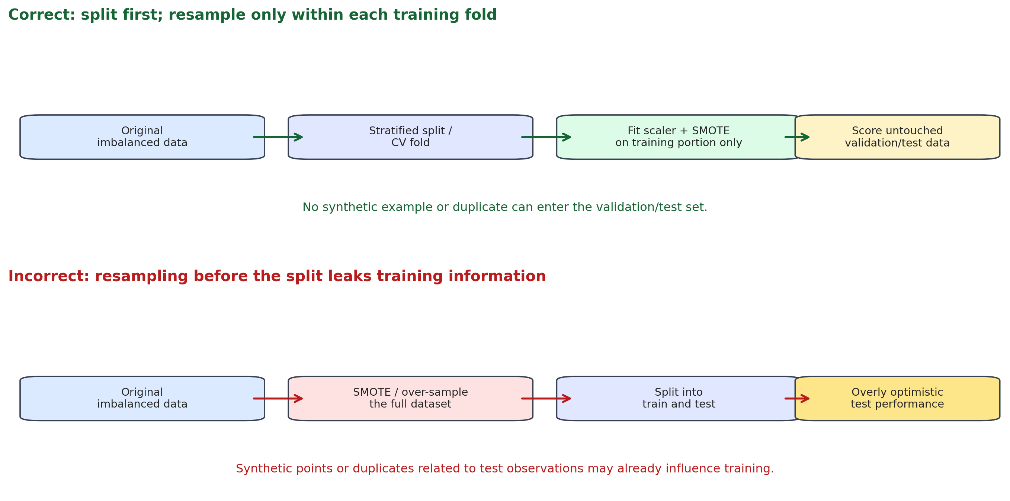
Correct and incorrect resampling
Notes:
The supplied workflow compares splitting first and resampling within each training fold against resampling the full dataset before splitting. Fit the model on the transformed training partition, then score untouched validation/test data. This visual precedes the existing pipeline implementation slide.
[Sources]
User-provided 06_resampling_leakage_workflow.png.
[/Sources]

Slide 15
Leakage-safe resampling
Split training and test data before any learned preprocessing or resampling.
Use stratified splits. Fit the scaler and resampler only on each fold’s training partition.
Score the untouched validation fold. Keep duplicates and synthetic descendants out of validation and test data.
from imblearn.pipeline import Pipeline
from imblearn.over_sampling import SMOTE
from sklearn.preprocessing import StandardScaler
from sklearn.linear_model import LogisticRegression
model = Pipeline([
("scale", StandardScaler()),
("smote", SMOTE(random_state=42)),
("classifier",
LogisticRegression(max_iter=2000)),
])
Pass this pipeline to cross-validation.
Notes:
Split before learned preprocessing or resampling. Use stratification so the minority prevalence is represented. Within each cross-validation fold, fit scaling, resampling, and classification only on that fold’s training partition. Use imblearn.pipeline.Pipeline. Duplicates and synthetic descendants of training observations must never enter validation or test sets.
from imblearn.pipeline import Pipeline
from imblearn.over_sampling import SMOTE
from sklearn.preprocessing import StandardScaler
from sklearn.linear_model import LogisticRegression
model = Pipeline([
("scale", StandardScaler()),
("smote", SMOTE(random_state=42)),
("classifier", LogisticRegression(max_iter=2000)),
])
[Sources]
User-provided class_imbalance_slide_content.md, Slide 11.
[/Sources]

Slide 16
Method comparison for deployment
Method | Mechanism | Benefit | Risk / limitation | Best-use scenario
Random undersampling | Remove majority rows | Faster fitting, less dominance | Loses useful majority structure | Huge, redundant majority class
Random oversampling | Duplicate minority rows | Simple, keeps all majority rows | Duplicates may overfit | Quick baseline for small or medium data
Class weighting | Increase minority error loss | Keeps all original rows | Tune weights and calibration | First intervention for many classifiers
SMOTE | Interpolate minority neighbors | Adds nonduplicate variation | Implausible or overlapping cases | Numeric, sufficiently dense neighborhoods
Borderline- SMOTE | Synthesize near boundary | Emphasizes difficult boundary cases | Sensitive to noise and overlap | Boundary errors dominate
ADASYN | Synthesize in hard regions | Adapts to local difficulty | May amplify label noise | Uneven minority-region difficulty
Notes:
Compare methods using mechanism, primary benefit, risk or limitation, and best-use scenario. Random undersampling removes majority rows but may lose useful structure. Random oversampling retains majority data but duplicates may overfit. Class weighting retains original rows but requires task-appropriate weights and calibration checks. SMOTE adds nonduplicate variation but may generate implausible or overlapping examples. Borderline-SMOTE focuses on boundary errors but is sensitive to noise. ADASYN adapts to local difficulty but may amplify noisy or mislabeled regions.
[Sources]
User-provided class_imbalance_slide_content.md, Slide 12.
[/Sources]

Slide 17
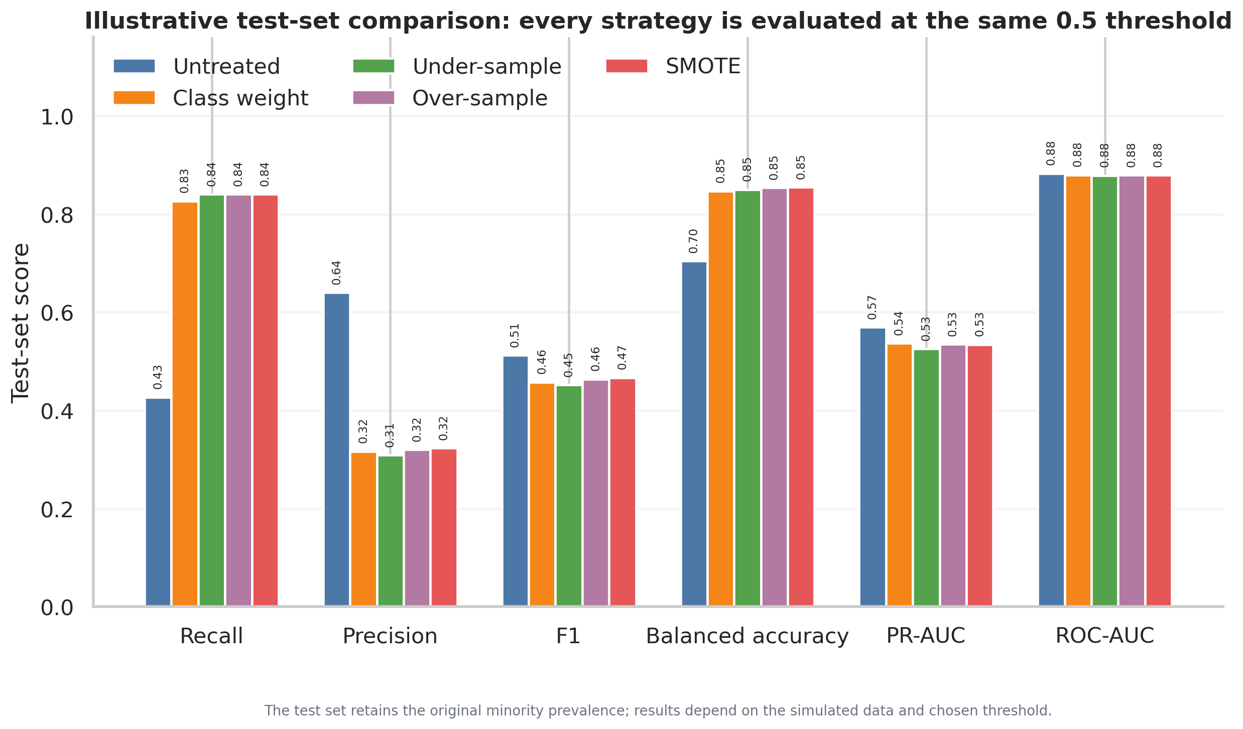
Performance at a common threshold
Notes:
Illustrative simulated-data test-set comparison at a common 0.5 threshold. The test set retains original minority prevalence. Weighting and resampling increase recall and balanced accuracy in this example while reducing precision and F1 relative to the untreated classifier. ROC-AUC values all round to 0.88. Results depend on the simulated data and threshold. These figures are not a universal performance ranking.
[Sources]
User-provided 05_performance_comparison.png.
[/Sources]

Slide 18
A practical workflow
1 Define the decision
Specify the positive class, deployment prevalence, and error consequences.
2 Establish the baseline
Inspect recall, precision, PR-AUC, balanced accuracy, calibration, and thresholds.
3 Compare a small set
Compare thresholds, weighting, random over/undersampling, and one or two SMOTE-family methods.
4 Validate the full pipeline
Use stratified cross-validation and reserve an untouched final test set.
Choose the method and threshold that meet the deployment objective.
Notes:
Define the positive class, likely deployment prevalence, and false-negative/false-positive consequences. Build an unmodified baseline. Inspect recall, precision, PR-AUC, balanced accuracy, calibration, and threshold-specific performance. Try threshold selection and weighting before or alongside resampling. Compare a small justified set including weighting, random resampling, and one or two SMOTE-family methods. Use stratified cross-validation with preprocessing and resampling inside the pipeline, reserving a final untouched test set. Select the method and threshold that meet the deployment objective rather than merely balancing the training table. Balancing is a tool, not a substitute for a clear objective, representative validation, or careful error analysis.
[Sources]
User-provided class_imbalance_slide_content.md, Slide 13.
[/Sources]

