Slide 1
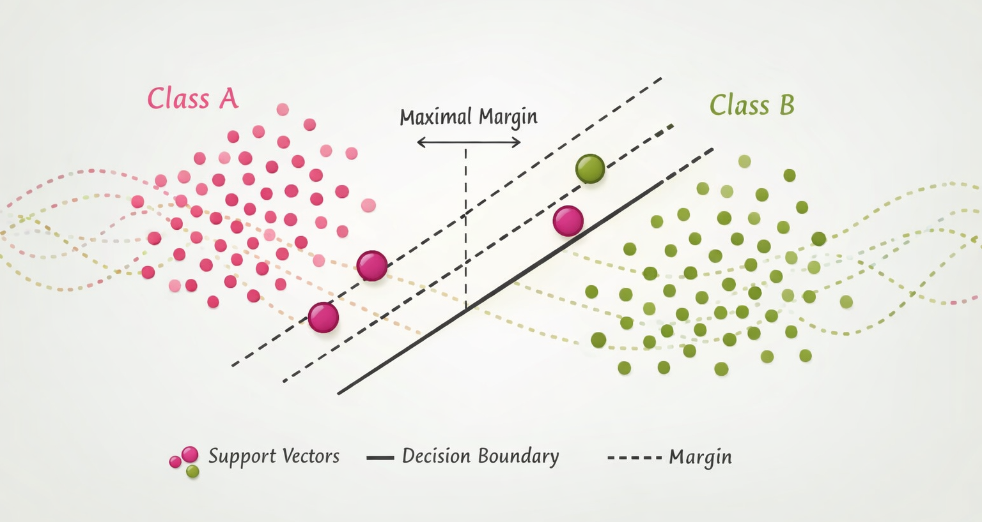
Support Vector Machines

Slide 2
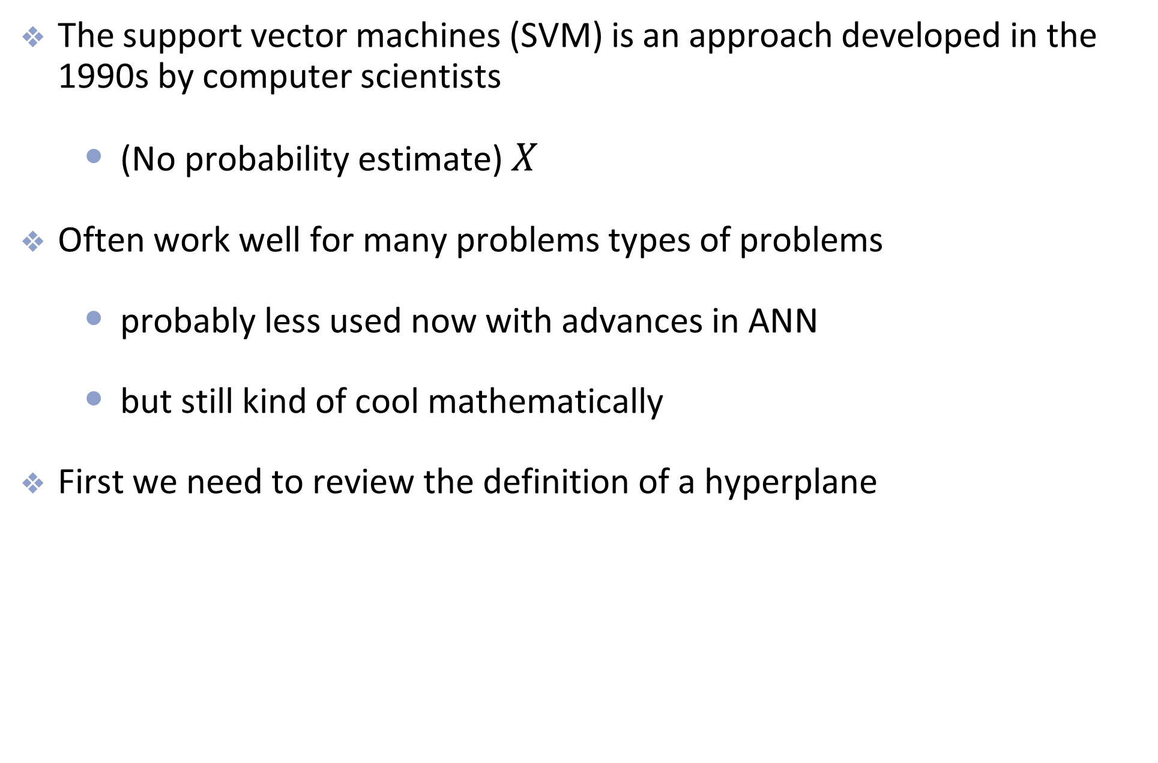
Introduction to SVM
The support vector machines (SVM) is an approach developed in the 1990s by computer scientists
  (No probability estimate) $X$
Often work well for many problems types of problems
  probably less used now with advances in ANN
  but still kind of cool mathematically
First we need to review the definition of a hyperplane

Slide 3
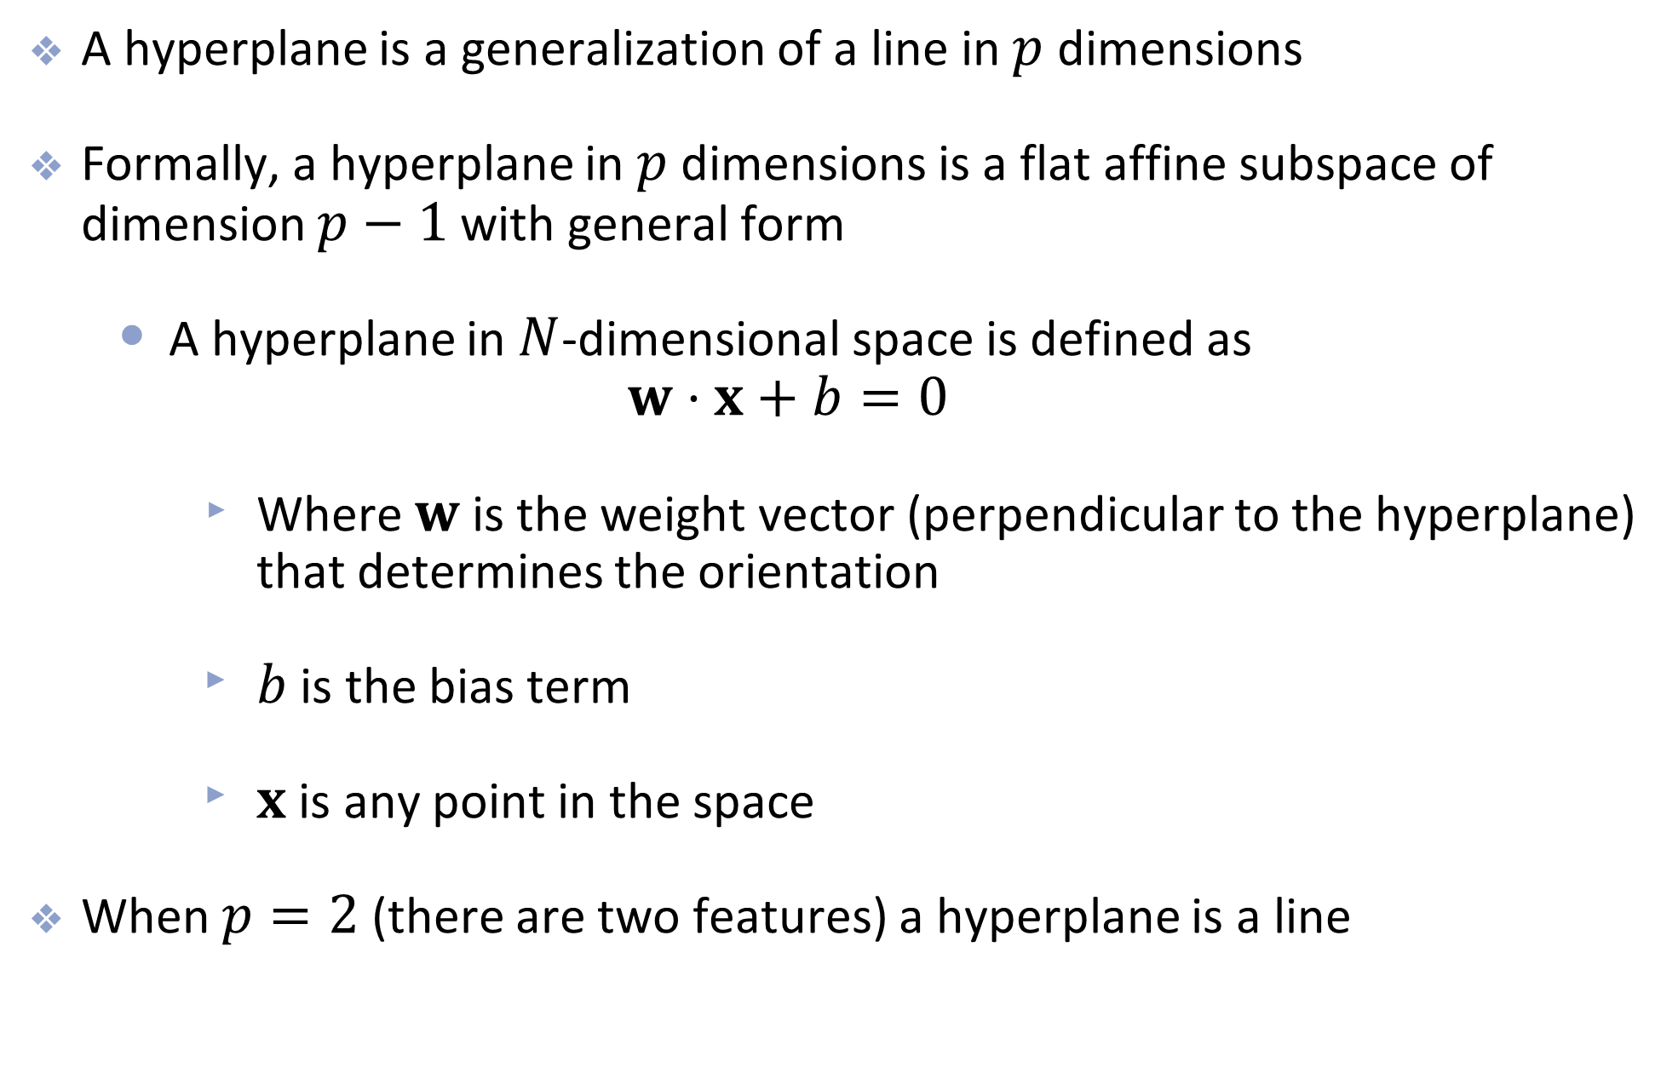
Hyperplanes
A hyperplane is a generalization of a line in $p$ dimensions
Formally, a hyperplane in $p$ dimensions is a flat affine subspace of dimension $p−1$ with general form
  A hyperplane in $N$-dimensional space is defined as
  $w⋅x+b=0$
    Where $w$ is the weight vector (perpendicular to the hyperplane) that determines the orientation
    $b$ is the bias term
    $x$ is any point in the space
When $p=2$ (there are two features) a hyperplane is a line

Slide 4
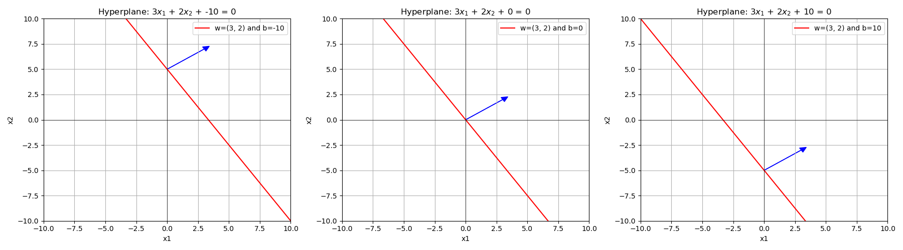
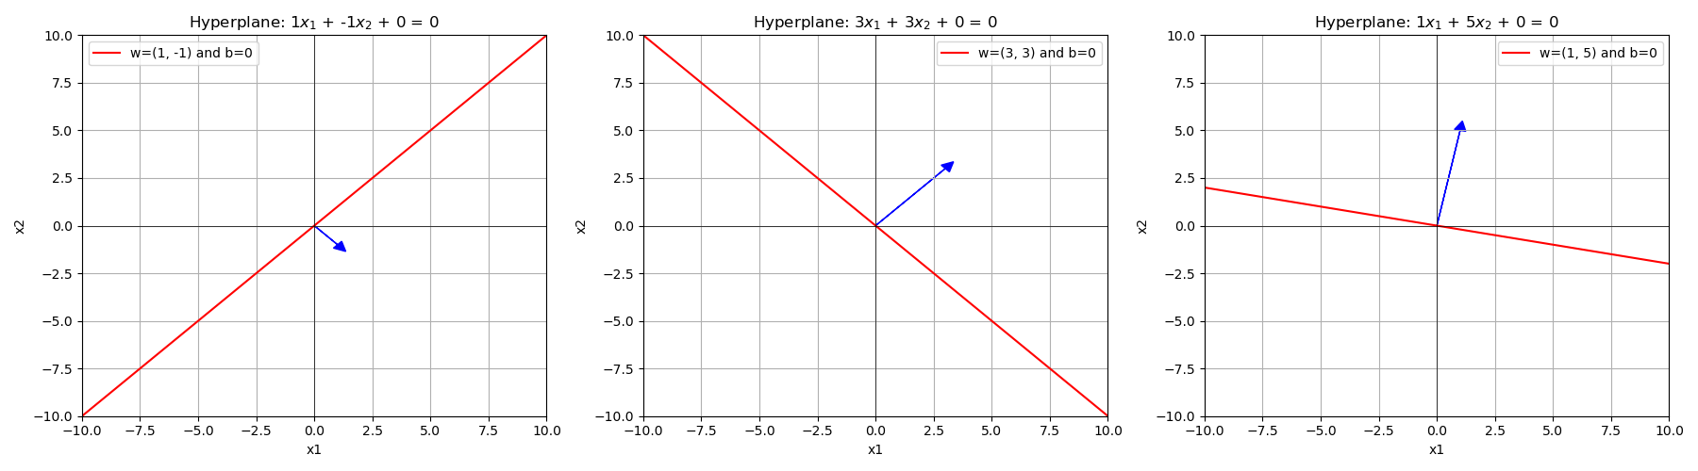
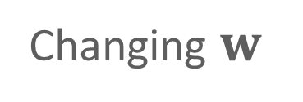
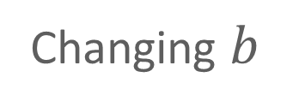
Changing $b$
Changing $w$

Slide 5
High-level view of SVM

Slide 6
Introduction to SVM
The main idea:
  Find the hyperplane that completely and optimally separates two classes in a feature space

Slide 7
Separate the group
Consider two linearly separable groups
  groups can be separated with a hyperplane
Which line (hyperplane) is the “best” separator?

Slide 8
Introduction to SVM
The main idea:
  Find the hyperplane that completely and optimally separates two classes in a feature space

Slide 9
Introduction to SVM
The main idea:
  Find the hyperplane that completely and optimally separates two classes in a feature space
  If there is no such hyperplane (because classes aren’t linearly separably)
    Soften the definition of “completely separates”
    Expand the feature space so that separation is possible

Slide 10
Maximal margin (or hard margin) classifier

Slide 11
Maximal Margin Classifier
Decision boundary is the hyperplane that is farthest from the training observations
Fits the “widest possible street”

Slide 12
Maximal Margin Classifier
Notice that only the points on the edge of the street matter
These are called support vectors (decision boundary is supported by these instances)
The support vectors are just points in this two dimensional feature space, but in higher dimensions, they will be actual vectors.

Slide 13
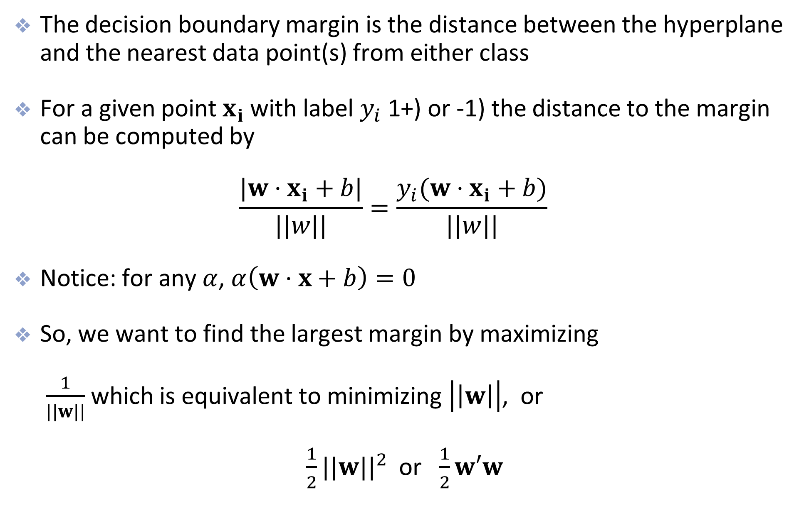
Margins
The decision boundary margin is the distance between the hyperplane and the nearest data point(s) from either class
For a given point $x_{i}$ with label $y_{i}$ (+1 or -1) the distance to the margin can be computed by
$\frac{|w⋅x_{i}+b|}{||w||}=\frac{y_{i}(w⋅x_{i}+b)}{||w||}$
Notice: for any $α$, $α\left(w⋅x+b\right)=0$
So, we want to find the largest margin by maximizing
$\frac{1}{||w||}$ which is equivalent to minimizing $\left|\left|w\right|\right|$, or
$\frac{1}{2}||w||^{2}$ or $\frac{1}{2}w′w$
Notes:
Add a slide before reviewing the distance between a point and a line.
ADD SOME SCAFFOLDING, REVISIT MATH ROOTS! REVISIT PROJECTION, DOT PRODUCT, DISTANCE TO PLANE
Here’s the crucial fact:
If $\left(w , b\right)$defines a separating hyperplane, then so does
$$\left(α , wαb\right)$$
for any positive $α$.
Why?
Because:
$$α\left(w⋅x+b\right)=0$$
defines the exact same decision boundary.
So we are free to scale $w$and $b$however we like.
Step 3: Use That Freedom to Fix the Numerator
Since we can scale arbitrarily, we choose a convenient normalization:
$$\underset{i}{\min{}}y_{i}\left(w⋅x_{i}+b\right)=1$$
This means:
The closest correctly classified point satisfies
$$y_{i}\left(w⋅x_{i}+b\right)=1$$
This is not a restriction.
It’s just choosing a scale.
Step 5: Why This Works
Originally:
$$\text{margin}=\underset{i}{\min{}}\frac{y_{i}\left(w⋅x_{i}+b\right)}{∥w∥}$$
After normalization:
$$\text{margin}=\frac{1}{∥w∥}$$
The numerator disappears because we fixed it.

Slide 14
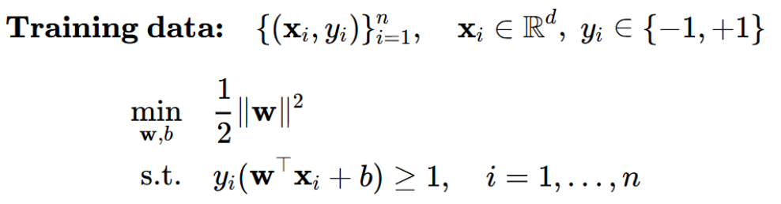
SVM Optimization Problem

Slide 15
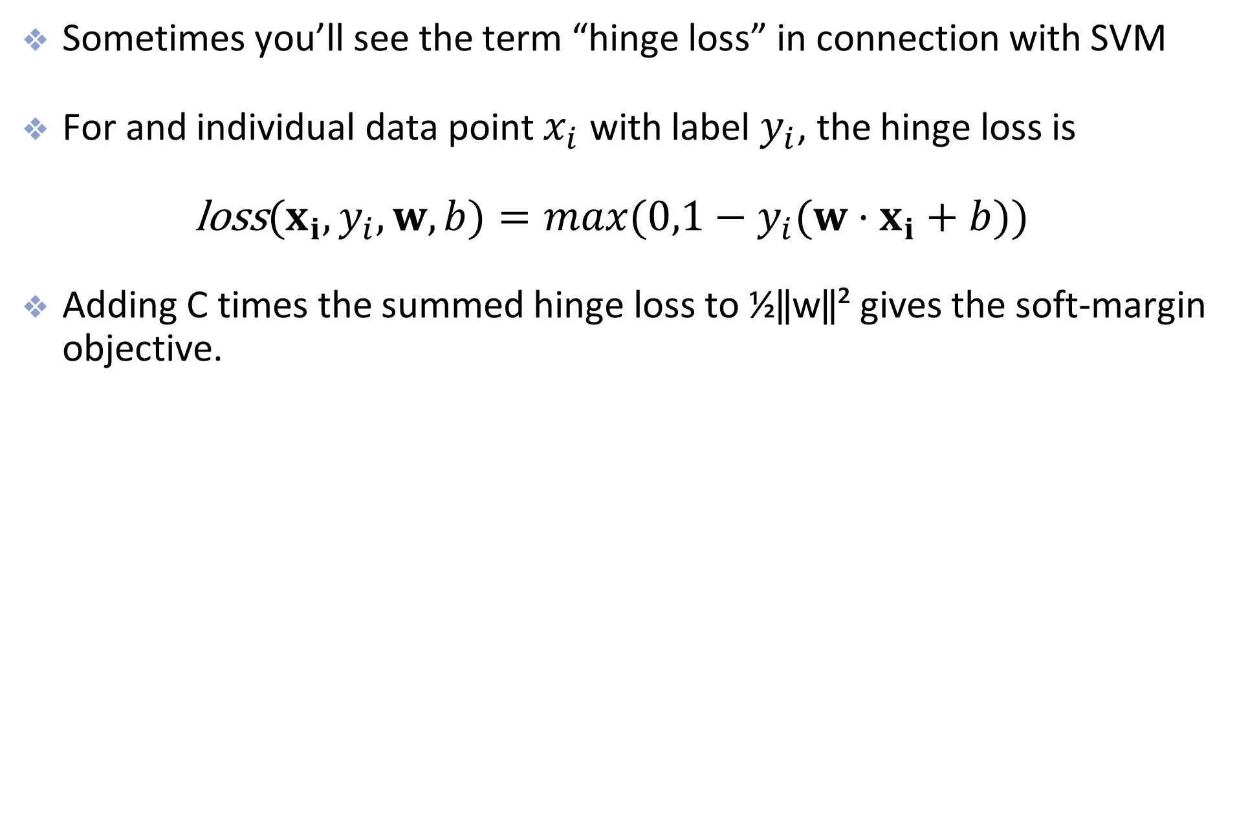
Hinge Loss
Sometimes you’ll see the term “hinge loss” in connection with SVM
For and individual data point $x_{i}$ with label $y_{i}$, the hinge loss is
$\text{loss}(x_{i},y_{i},w,b)=max(0,1−y_{i}(w⋅x_{i}+b))$
Adding C times the summed hinge loss to ½‖w‖² gives the soft-margin objective.
Notes:
Hinge loss is the margin-violation penalty in soft-margin SVM. Hard-margin SVM instead enforces every margin constraint with no slack.
[Sources]
https://scikit-learn.org/stable/modules/svm.html#mathematical-formulation
https://surnamnarendra.github.io/Fundamentals-of-Machine-Learning/lecture_25.html
[/Sources]

Slide 16
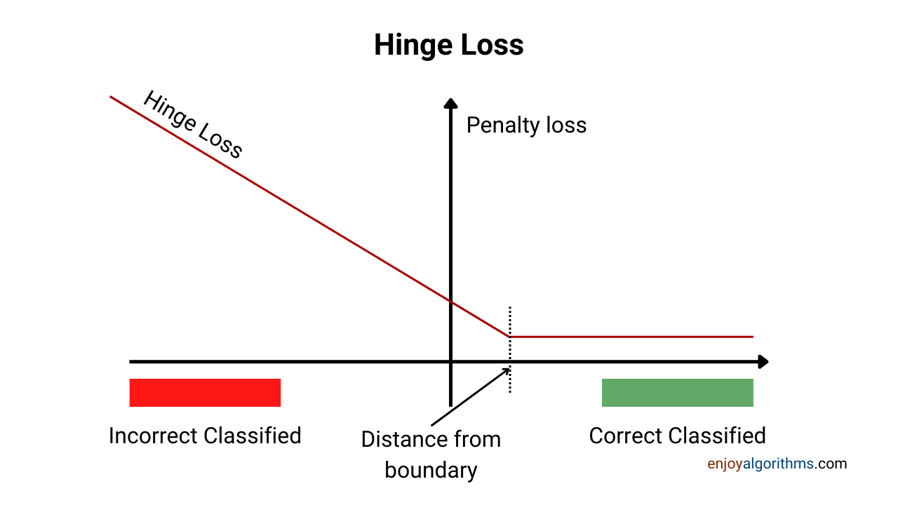
Hinge Loss

Slide 17
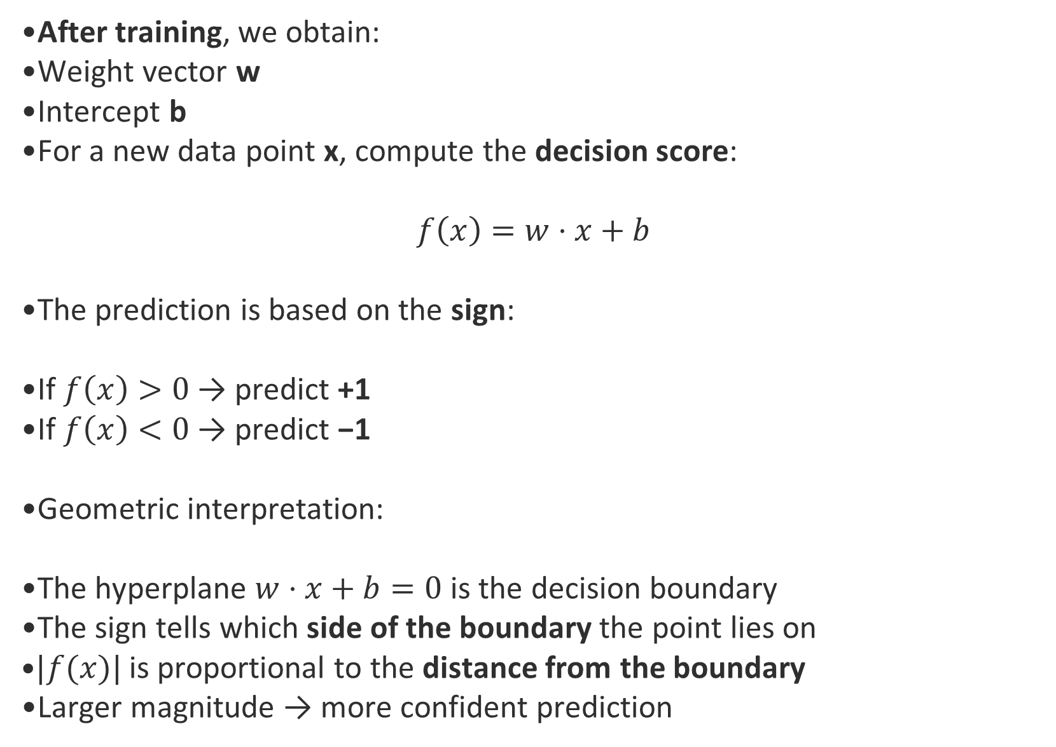
SVM Decision Process
After training, we obtain:
Weight vector w
Intercept b
For a new data point x, compute the decision score:
$$f\left(x\right)=w⋅x+b$$
The prediction is based on the sign:
If $f\left(x\right)>0$ → predict +1
If $f\left(x\right)<0$ → predict −1
Geometric interpretation:
The hyperplane $w⋅x+b=0$ is the decision boundary
The sign tells which side of the boundary the point lies on
$|f(x)|$ is proportional to the distance from the boundary
Larger magnitude → more confident prediction

Slide 18
Potential problems
What if a separating hyperplane does not exist?
Then there is no maximum marginal classifier

Slide 19
Soft Margin SVM

Slide 20
Potential problems
In this case, a natural generalization would be to allow some points to spill into the “street” or margin

Slide 21
Support Vector Classifier (Soft margin)
Hyper-parameter C controls the width of the road and the amount of over-spill that is allowed
When C is small, the margin is wider and more points are involved in determining the direction of the boundary
C=0.1
C=1
C=10

Slide 22
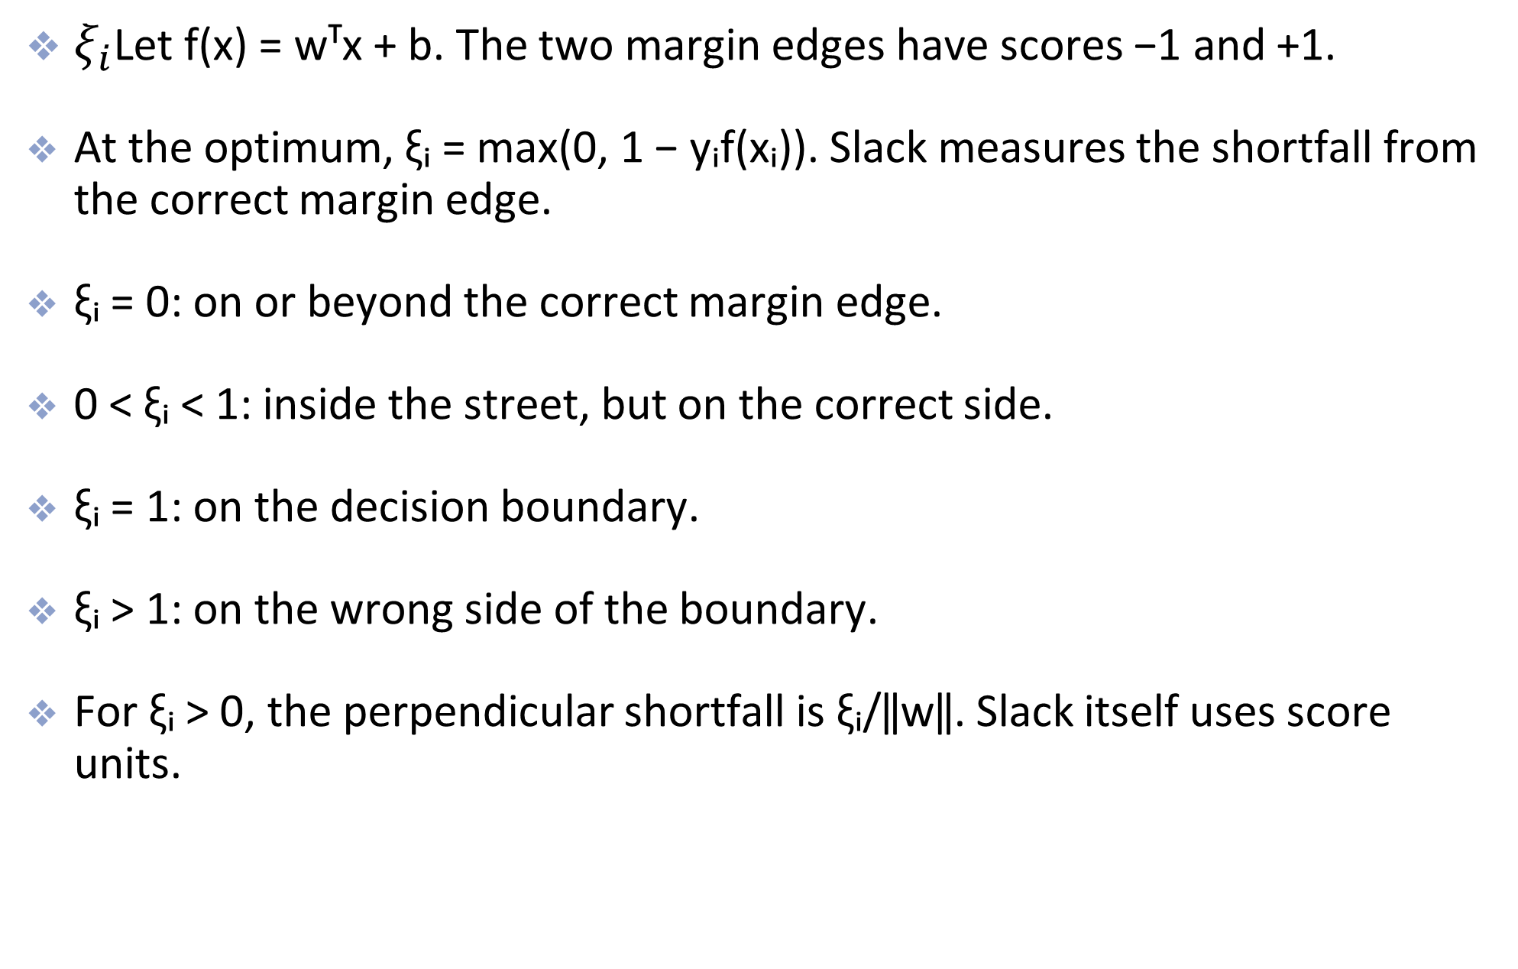
Slack Variables
$ξ_{i}$Let f(x) = wᵀx + b. The two margin edges have scores −1 and +1.
At the optimum, ξᵢ = max(0, 1 − yᵢf(xᵢ)). Slack measures the shortfall from the correct margin edge.
ξᵢ = 0: on or beyond the correct margin edge.
0 < ξᵢ < 1: inside the street, but on the correct side.
ξᵢ = 1: on the decision boundary.
ξᵢ > 1: on the wrong side of the boundary.
For ξᵢ > 0, the perpendicular shortfall is ξᵢ/‖w‖. Slack itself uses score units.
Notes:
Assume w is nonzero. Signed distance to the boundary is f(x)/||w||. For example, y=+1 and f(x)=0.4 gives slack 0.6, so the point is correctly classified but inside its margin. This makes the geometry concrete without treating slack as raw Euclidean distance.
[Sources]
https://scikit-learn.org/stable/modules/svm.html#mathematical-formulation
https://surnamnarendra.github.io/Fundamentals-of-Machine-Learning/lecture_25.html
[/Sources]

Slide 23
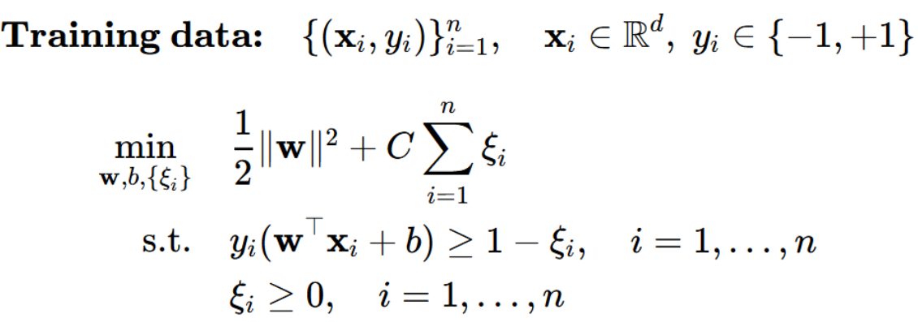
Optimization w/ Slack Variables
C > 0 sets the cost of a margin violation.
The first term favors a wider margin: total street width = 2/‖w‖.
The second term charges C for each unit of slack.
Notes:
This is the soft-margin primal for binary classification. Variables are w, b and all nonnegative slack values. With C > 0, each optimal slack equals max(0, 1 − y_i f(x_i)). C changes the tradeoff, not a fixed geometric width.
[Sources]
https://scikit-learn.org/stable/modules/svm.html#mathematical-formulation
https://surnamnarendra.github.io/Fundamentals-of-Machine-Learning/lecture_25.html
[/Sources]

Slide 24
Support Vectors
The points inside the margin (or points wrongly misclassified, if any) are the support vectors
  Only these points effect the decision boundary
  (the support vectors influence the position and orientation of the hyperplane)
  When C is small, the street is wider so more points are involved in making the decision boundary
    Can lead to underfitting
  When C is large, the street more narrow so fewer points are involved in making the decision boundary
    Can lead to overfitting

Slide 25
Non-linearly separable data

Slide 26
Non-linearly Separable
Now what happens if the classes aren’t linearly separable

Slide 27
Non-linearly Separable
One possibility is to add polynomials terms to a linear model (e.g. logistic regression)

Slide 28
Non-linearly Separable
This is the decision boundary of a logistic regression model after adding 4th order polynomials to the feature matrix

Slide 29
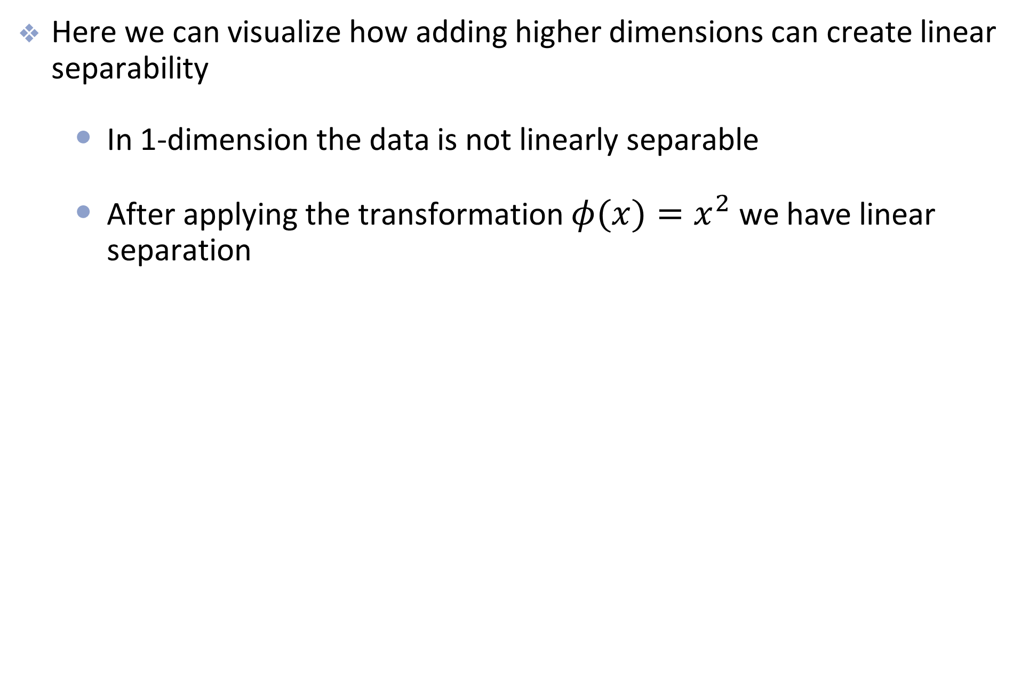
Examples
Here we can visualize how adding higher dimensions can create linear separability
  In 1-dimension the data is not linearly separable
  After applying the transformation $φ(x)=x^{2}$ we have linear separation

Slide 30
Another Example
Another Example

Slide 31
A solution and a problem
While mapping to higher-dimensional space can create linearly separable data…
…It can be computationally expensive to directly compute the transformation
  E.g., polynomial space gets really big really fast, especially with lots of features
…It is also hard to determine how many higher-dimensions to include
This is where SVMs and the Kernel Trick come to the rescue

Slide 32
Support Vector Machines

Slide 33
Support Vector Machines
The main idea behind SVMachines is to
  create linear separation by expanding the feature space
  but in a specific way using kernels
  - a computationally efficient trick for expanding the feature space
  this is called the kernel trick

Slide 34
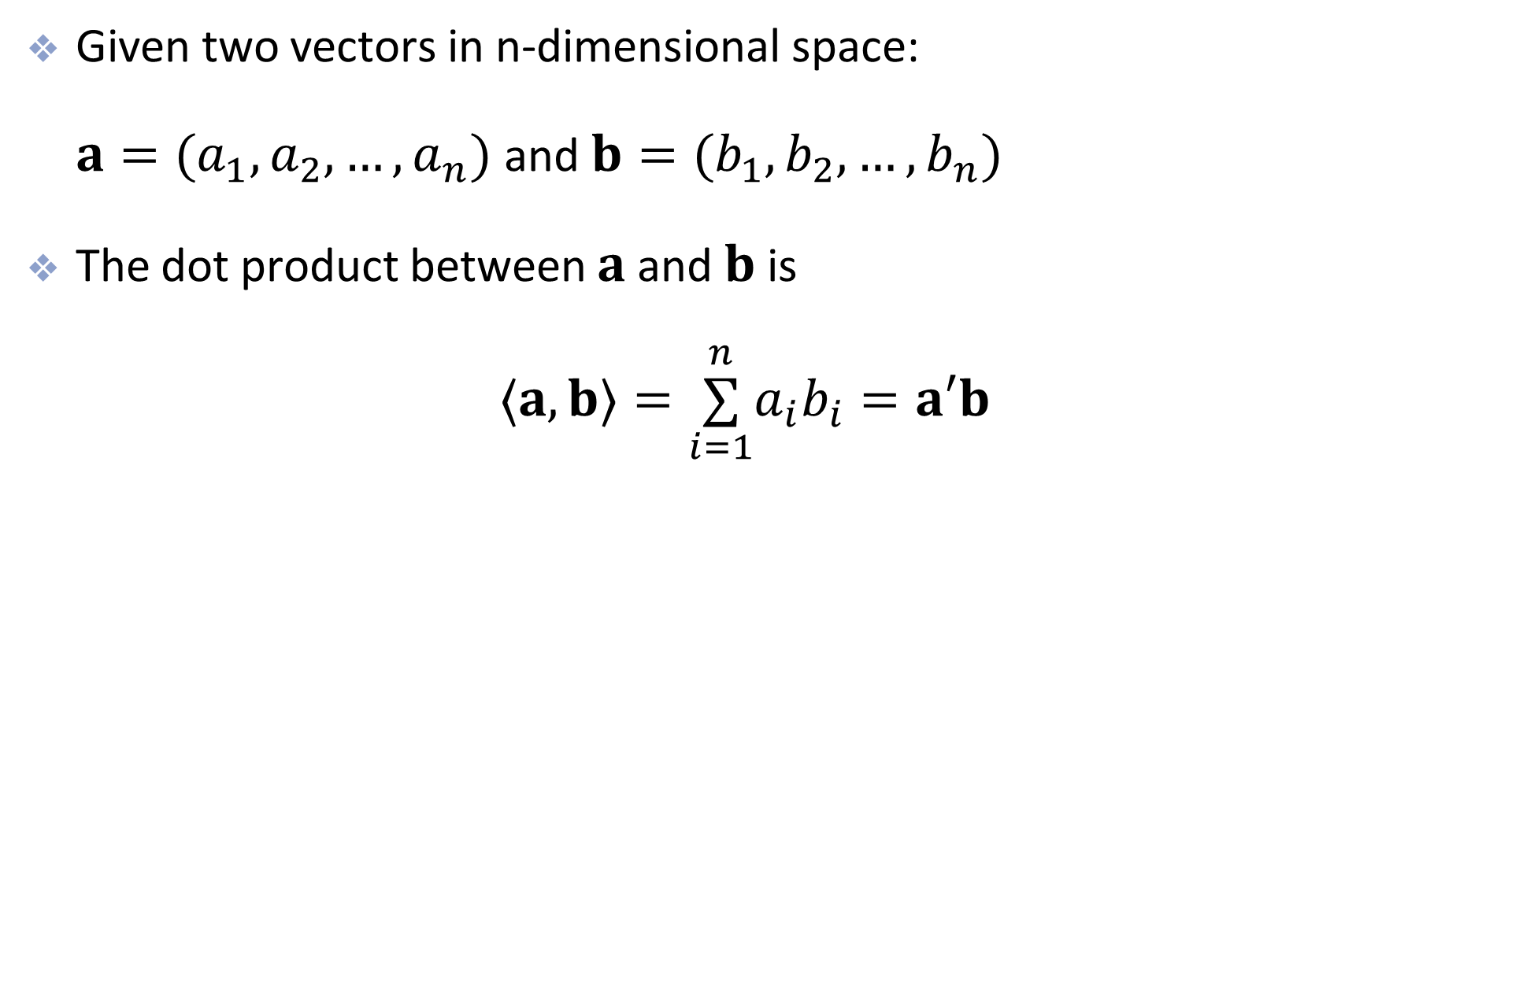
Dot Products
Given two vectors in n-dimensional space:
$a=(a_{1},a_{2},…,a_{n})$ and $b=(b_{1},b_{2},…,b_{n})$
The dot product between $a$ and $b$ is
$⟨a,b⟩=\overset{n}{\underset{i=1}{∑}}a_{i}b_{i}=a′b$

Slide 35
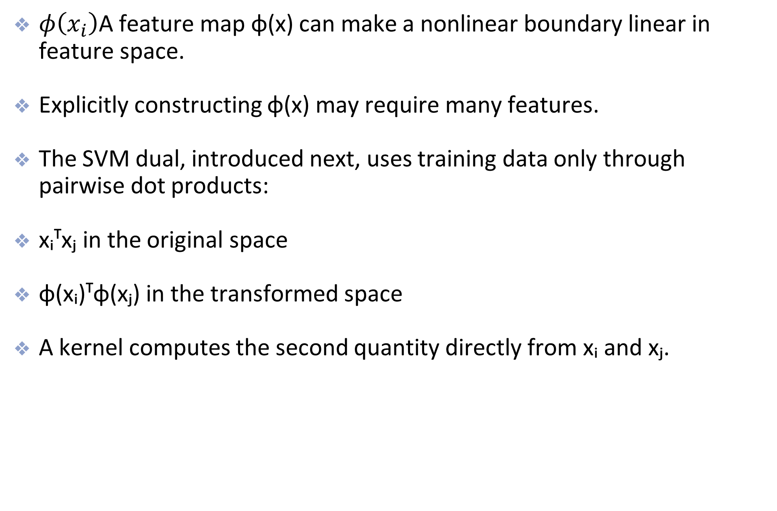
Dot Products in the Dual
$φ\left(x_{i}\right)$A feature map φ(x) can make a nonlinear boundary linear in feature space.
Explicitly constructing φ(x) may require many features.
The SVM dual, introduced next, uses training data only through pairwise dot products:
xᵢᵀxⱼ in the original space
φ(xᵢ)ᵀφ(xⱼ) in the transformed space
A kernel computes the second quantity directly from xᵢ and xⱼ.
Notes:
This claim refers specifically to the dual objective. The primal contains a weight vector in feature space. A valid positive-semidefinite kernel lets us work with inner products without constructing that vector explicitly.
[Sources]
https://scikit-learn.org/stable/modules/svm.html#mathematical-formulation
https://surnamnarendra.github.io/Fundamentals-of-Machine-Learning/lecture_25.html
[/Sources]

Slide 36
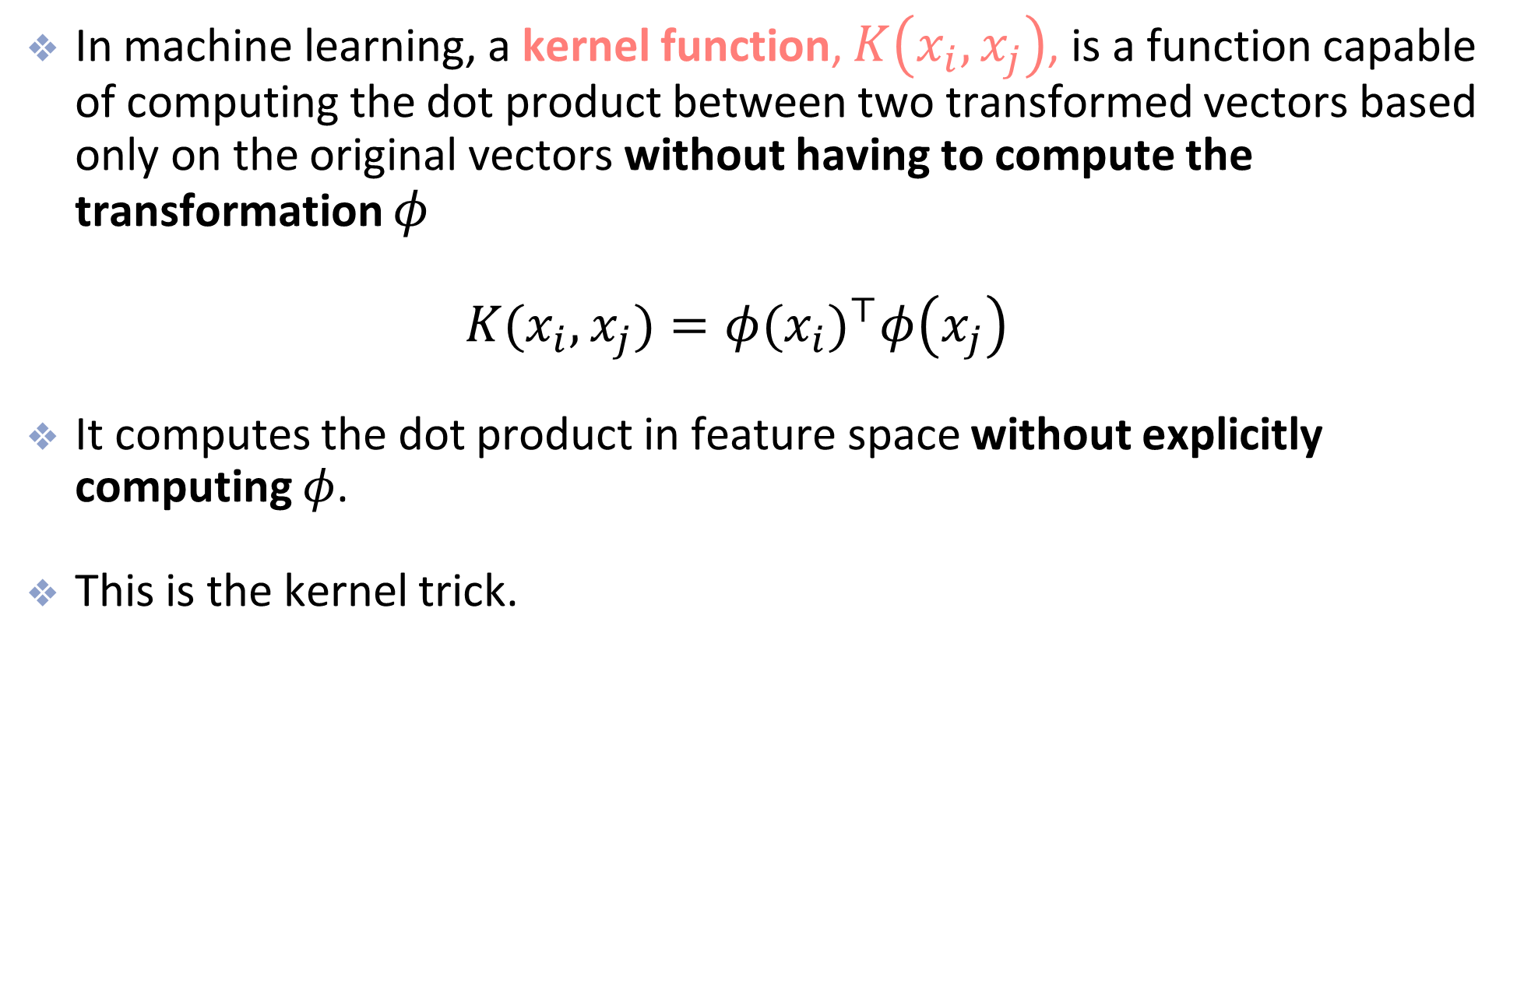
The Kernel Trick
In machine learning, a kernel function, $K\left(x_{i},x_{j}\right)$, is a function capable of computing the dot product between two transformed vectors based only on the original vectors without having to compute the transformation $φ$
$K(x_{i},x_{j})=φ(x_{i})^{⊤}φ\left(x_{j}\right)$
It computes the dot product in feature space without explicitly computing $φ$.
This is the kernel trick.

Slide 37
Common Kernels
Linear: K(a, b) = aᵀb
A straight hyperplane in the original feature space.
Polynomial: K(a, b) = (γaᵀb + r)ᵈ
Adds feature interactions. Larger degree d permits more complex global boundaries.
Gaussian RBF: K(a, b) = exp(−γ‖a − b‖²)
Nearby points have greater similarity. Larger γ makes each point’s influence more local.
The kernel changes pairwise similarities in the dual. C still sets the penalty for margin violations.
Scale features first. Tune C and kernel parameters together using validation data.
Notes:
For the standard polynomial kernel, use nonnegative gamma and offset with a nonnegative integer degree. RBF gamma is positive. Small gamma gives broad influence and can underfit, while large gamma can overfit. These are tendencies, not guarantees. Feature scaling must be learned on training data only.
[Sources]
https://scikit-learn.org/stable/modules/svm.html#mathematical-formulation
https://surnamnarendra.github.io/Fundamentals-of-Machine-Learning/lecture_25.html
[/Sources]

Slide 38
Primal and Dual: The Idea
The primal chooses the hyperplane parameters w and b, plus slack values ξᵢ.
The dual chooses one nonnegative weight αᵢ per training observation. Each weight belongs to that point’s margin constraint.
The optimization conditions connect the two views:
w = ∑ᵢ αᵢyᵢφ(xᵢ)
The dual therefore builds the normal vector from weighted training observations in feature space.
For soft-margin SVM with C > 0, strong duality gives the same optimal objective value. Neither formulation is always faster.
Notes:
Introduce concepts in 586
High-level derivation: attach multipliers alpha_i >= 0 to 1 − xi_i − y_i(w·phi(x_i)+b) <= 0 and mu_i >= 0 to −xi_i <= 0. Minimizing the Lagrangian over w yields w = sum alpha_i y_i phi(x_i). Minimizing over b gives sum alpha_i y_i = 0. Minimizing over xi gives alpha_i + mu_i = C, hence 0 <= alpha_i <= C. Convexity and strict feasibility of the soft-margin primal imply strong duality. Primal and dual optimizers are different variables, even though their optimal objective values agree.
[Sources]
https://scikit-learn.org/stable/modules/svm.html#mathematical-formulation
https://surnamnarendra.github.io/Fundamentals-of-Machine-Learning/lecture_25.html
[/Sources]

Slide 39
The SVM Dual Problem
Choose α₁, …, αₙ to maximize
∑ᵢ αᵢ − ½ ∑ᵢ ∑ⱼ αᵢαⱼyᵢyⱼ K(xᵢ, xⱼ)
Subject to: 0 ≤ αᵢ ≤ C for every i
and ∑ᵢ αᵢyᵢ = 0
K(xᵢ, xⱼ) = φ(xᵢ)ᵀφ(xⱼ). For a linear SVM, K(xᵢ, xⱼ) = xᵢᵀxⱼ.
The first term rewards weight on active constraints. The quadratic term equals ½‖w‖² for the implied w.
Notes:
All sums run over the n training observations with labels in {−1,+1}. This is the complete soft-margin classification dual. The box bound comes from the slack penalty C, while the equality constraint comes from the unpenalized intercept b. A valid positive-semidefinite kernel makes the quadratic term positive semidefinite and the maximization concave. Training uses the n by n Gram matrix K. Kernelization does not guarantee separability or low computational cost for large n.
[Sources]
https://scikit-learn.org/stable/modules/svm.html#mathematical-formulation
https://surnamnarendra.github.io/Fundamentals-of-Machine-Learning/lecture_25.html
[/Sources]

Slide 40
Interpreting Dual Weights
αᵢ = 0: the observation contributes no term to the prediction. Points strictly beyond the margin have zero weight.
0 < αᵢ < C: the observation lies exactly on its margin edge. It is a support vector.
αᵢ = C: the observation lies on or inside its margin edge. It may be correctly classified or misclassified.
Example: yᵢ = +1 and f(xᵢ) = 0.4 give ξᵢ = 0.6 and αᵢ = C. The point violates the margin, but its label is correct.
Only observations with αᵢ > 0 appear in the fitted decision function.
Notes:
These are the KKT relationships at an exact optimum for C > 0. Alpha_i = C does not imply misclassification. Points exactly on a margin may have zero alpha in degenerate solutions. Positive alpha defines a support vector in the fitted dual solution. For 0 < alpha_i < C, y_i f(x_i)=1, giving b = y_i − sum_j alpha_j y_j K(x_j,x_i). Average this expression across such support vectors. If none exist, a solver uses KKT bounds for b.
[Sources]
https://scikit-learn.org/stable/modules/svm.html#mathematical-formulation
https://surnamnarendra.github.io/Fundamentals-of-Machine-Learning/lecture_25.html
[/Sources]

Slide 41
Kernel Training and Prediction
Training: compute K(xᵢ, xⱼ) for training pairs, then solve the dual for α and recover b.
Prediction: compare a new point x with the support vectors:
f(x) = ∑ᵢ αᵢyᵢ K(xᵢ, x) + b
Predict +1 if f(x) > 0 and −1 if f(x) < 0.
A linear kernel gives f(x) = wᵀx + b. Other kernels can produce a curved boundary in the original space.
We use the same kernel in training and prediction. We never need to construct φ(x) explicitly.
Notes:
Only nonzero alpha terms need to be evaluated. The sign gives the class, not a calibrated probability. A score of exactly zero lies on the decision boundary and requires a tie convention. To recover b, use a support vector with 0 < alpha_i < C and the equality y_i f(x_i)=1, or solver bounds if there are no such points.
[Sources]
https://scikit-learn.org/stable/modules/svm.html#mathematical-formulation
https://surnamnarendra.github.io/Fundamentals-of-Machine-Learning/lecture_25.html
[/Sources]

Slide 42
Gaussian RBF Kernel

Slide 43
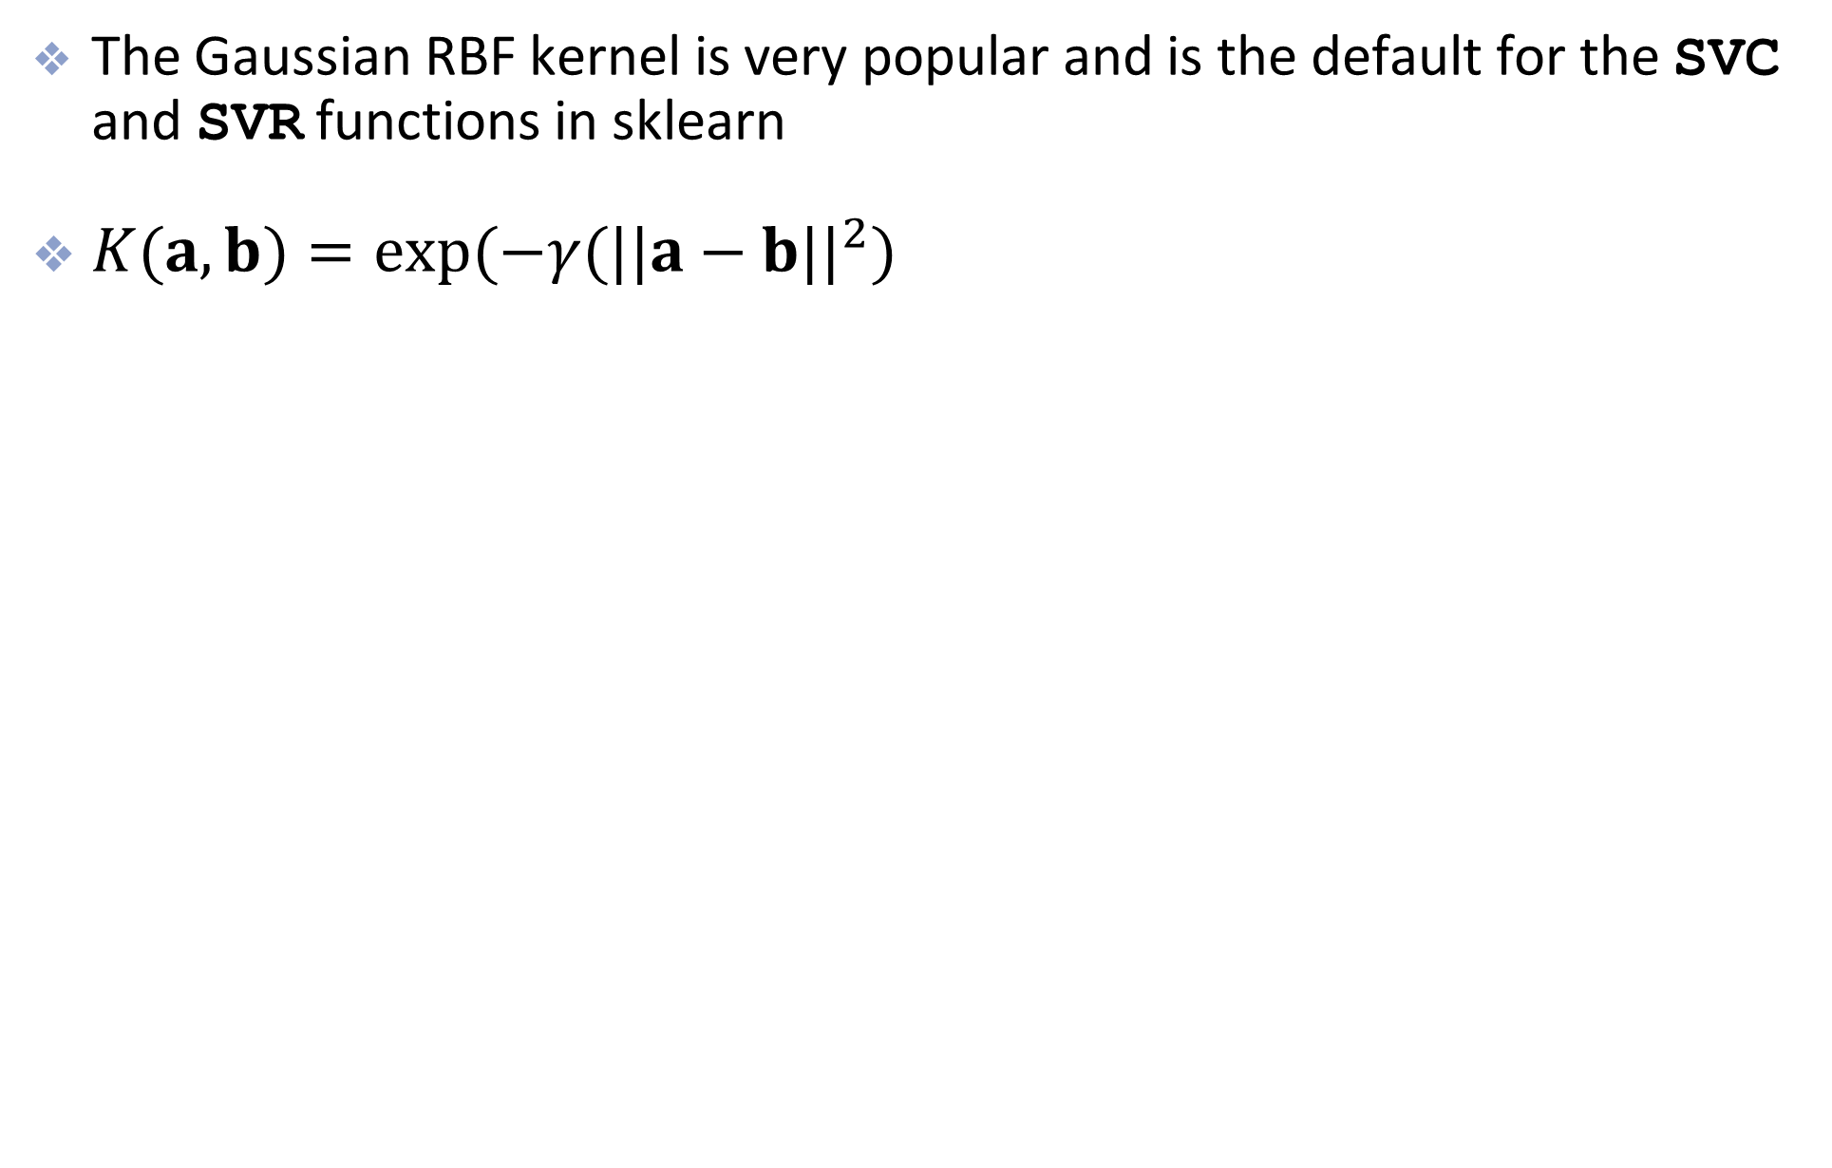
More about the RBF Kernel
The Gaussian RBF kernel is very popular and is the default for the SVC and SVR functions in sklearn
$K(a,b)=exp(−γ(||a−b||^{2})$

Slide 44
More about the RBF Kernel
Main idea
  Rather than add polynomial features, we can also add “similarity” features
  The “similarity” features will also transform to a higher dimension
    Similarity features represent the similarity between two or more data points
    For example we can add features based on the RBF similarity function from several arbitrary landmarks
    RBF kernel corresponds to infinite-dimensional space

Slide 45
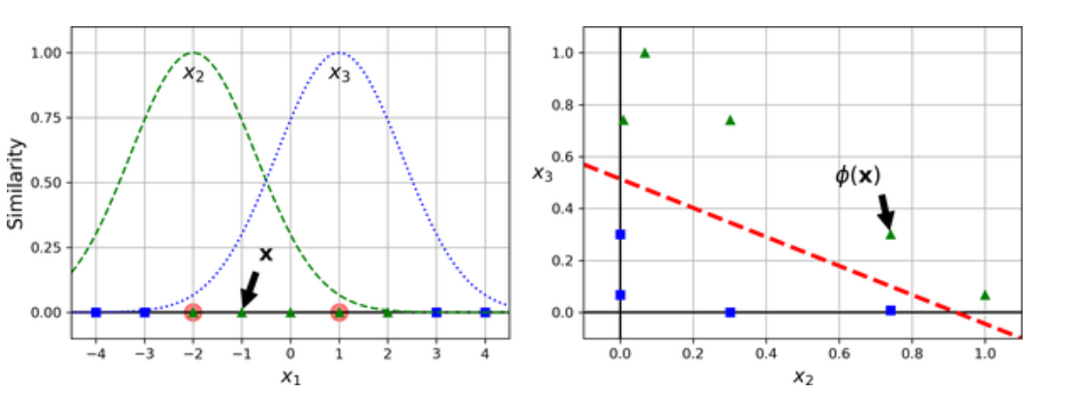
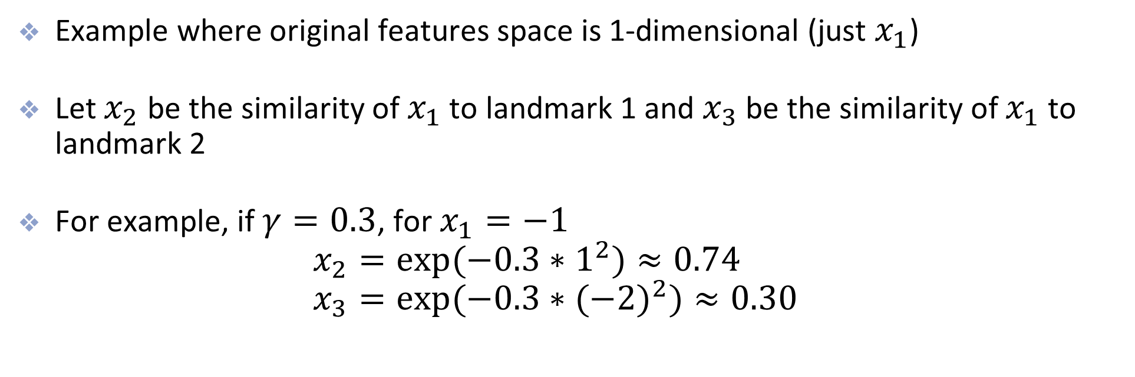
Example of Similarity Features
Example where original features space is 1-dimensional (just $x_{1}$)
Let $x_{2}$ be the similarity of $x_{1}$ to landmark 1 and $x_{3}$ be the similarity of $x_{1}$ to landmark 2
For example, if $γ=0.3$, for $x_{1}=−1$
$x_{2}=exp(−0.3∗1^{2})≈0.74$
$x_{3}=exp(−0.3∗(−2)^{2})≈0.30$

Slide 46
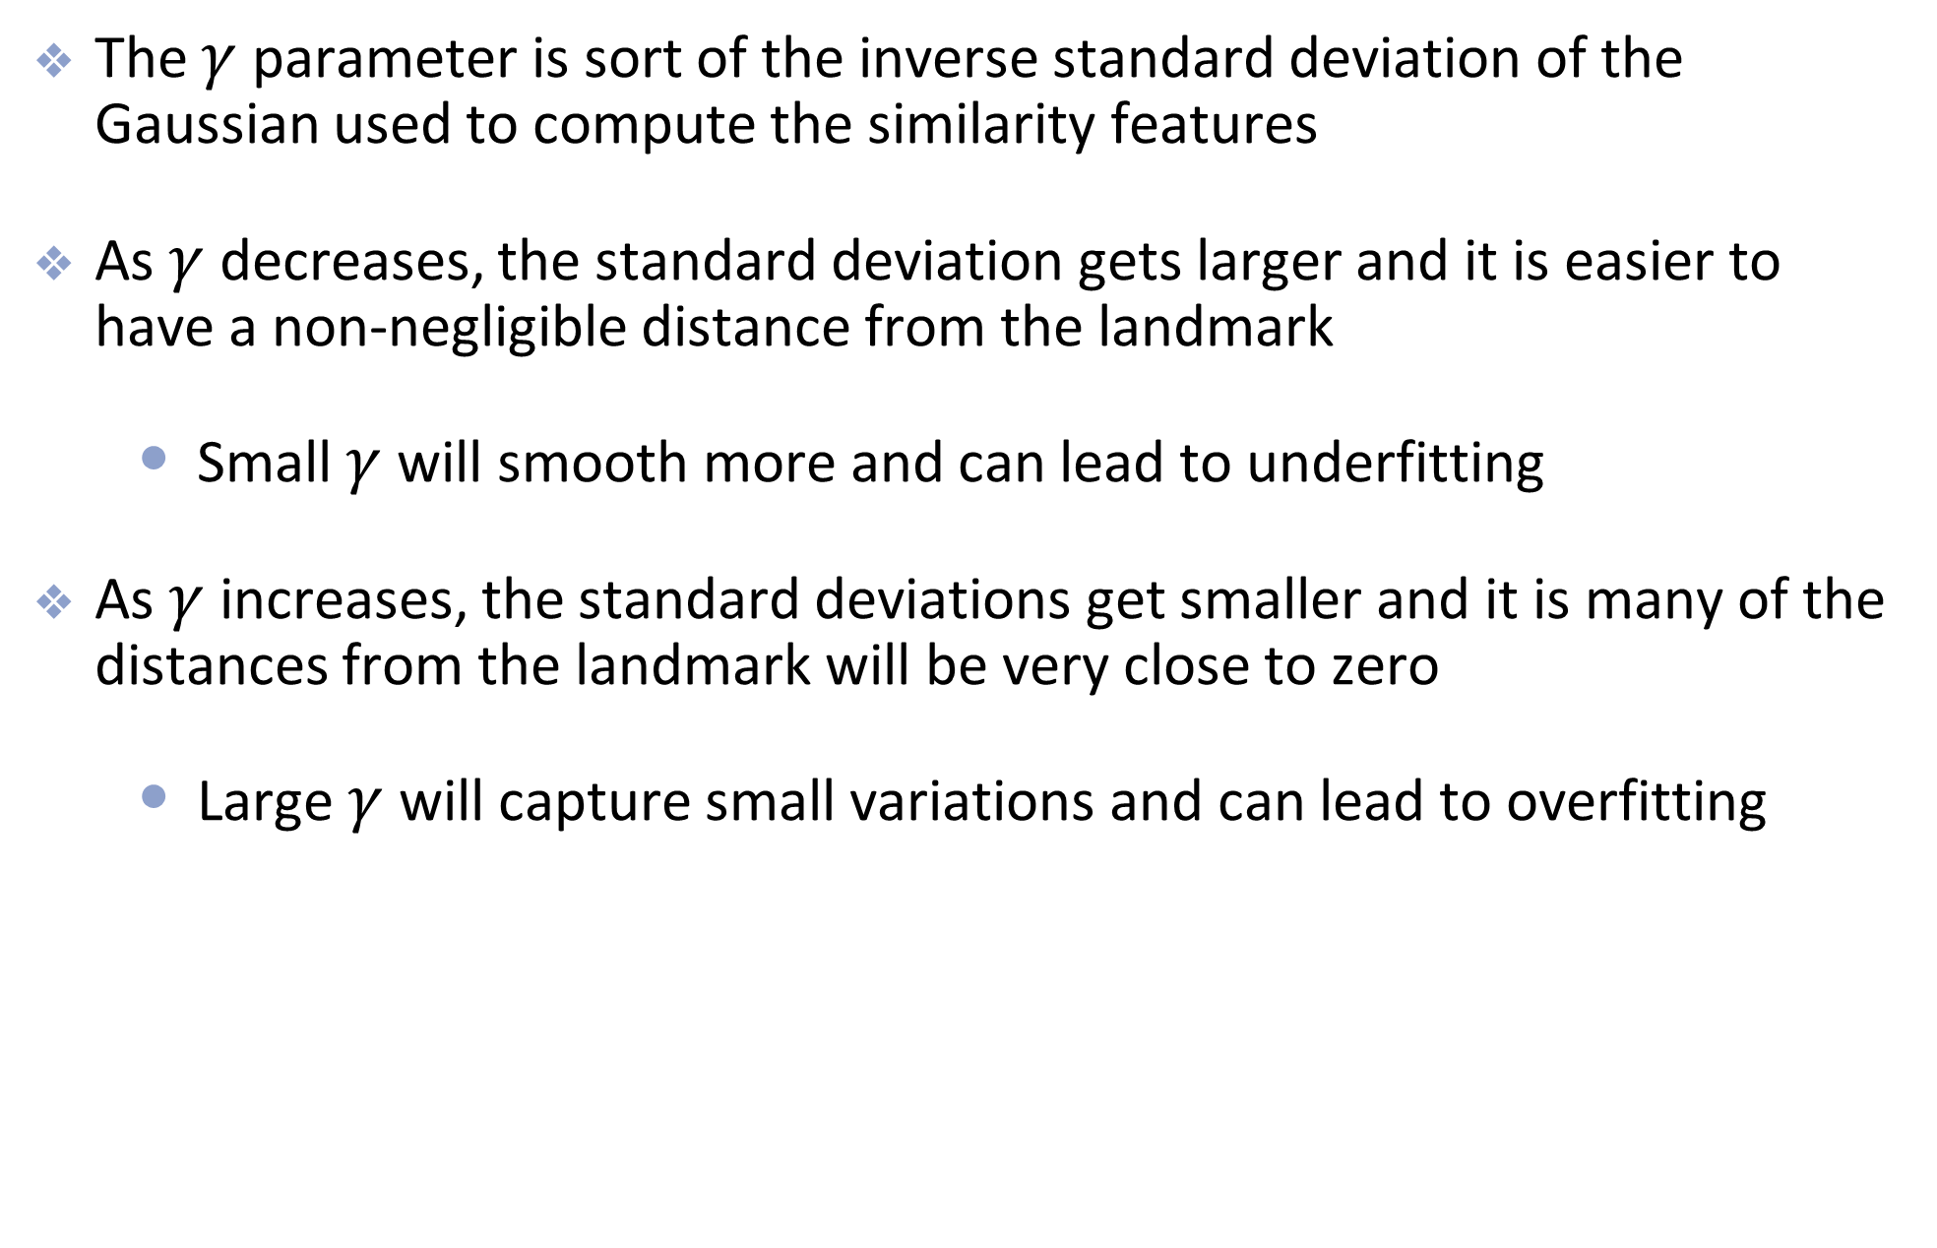
More about the RBF Kernel
The $γ$ parameter is sort of the inverse standard deviation of the Gaussian used to compute the similarity features
As $γ$ decreases, the standard deviation gets larger and it is easier to have a non-negligible distance from the landmark
  Small $γ$ will smooth more and can lead to underfitting
As $γ$ increases, the standard deviations get smaller and it is many of the distances from the landmark will be very close to zero
  Large $γ$ will capture small variations and can lead to overfitting

Slide 47
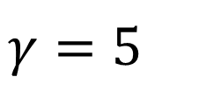
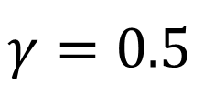
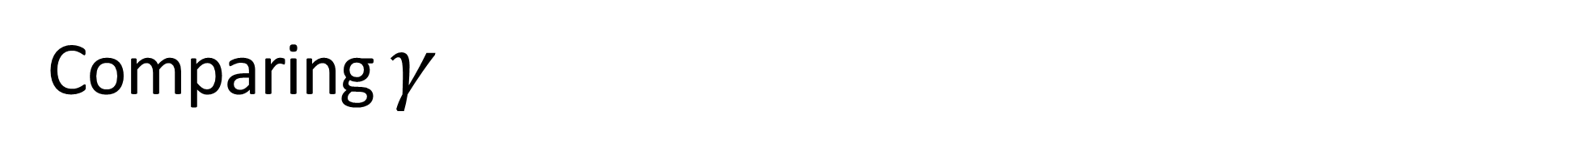
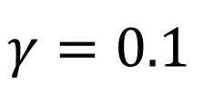
Comparing $γ$
$$γ=0.1$$
$$γ=5$$
$$γ=0.5$$

Slide 48
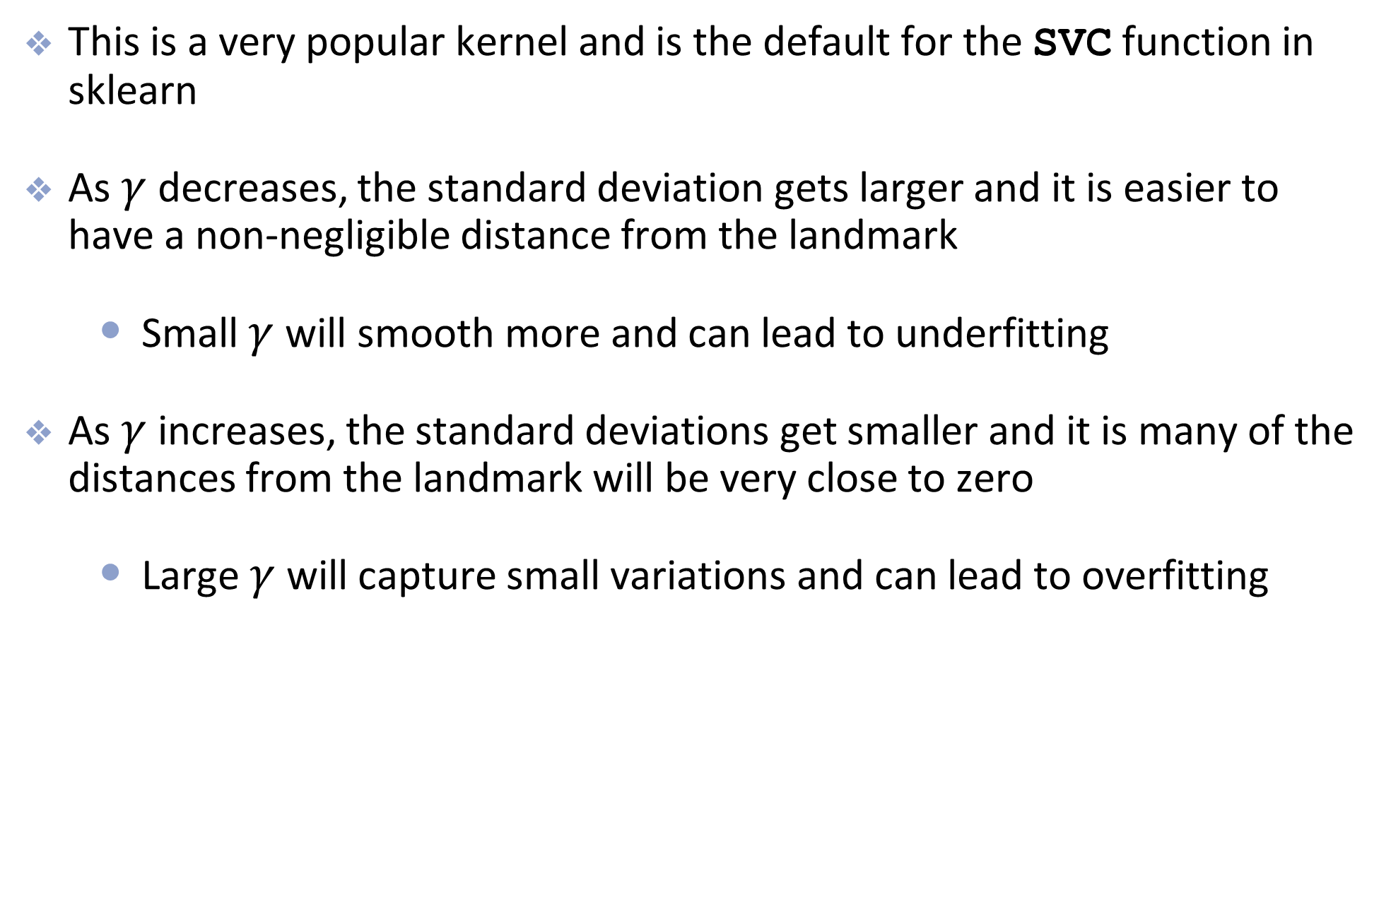
Gaussian RBF Kernel
This is a very popular kernel and is the default for the SVC function in sklearn
As $γ$ decreases, the standard deviation gets larger and it is easier to have a non-negligible distance from the landmark
  Small $γ$ will smooth more and can lead to underfitting
As $γ$ increases, the standard deviations get smaller and it is many of the distances from the landmark will be very close to zero
  Large $γ$ will capture small variations and can lead to overfitting

Slide 49
SVM Regression

Slide 50
SVR and ε-Insensitive Loss
For regression, predict a numeric response:
f(x) = wᵀx + b
The ε-tube contains points with |yᵢ − f(xᵢ)| ≤ ε. Its vertical width is 2ε in response units.
The loss is Lε(yᵢ, f(xᵢ)) = max(0, |yᵢ − f(xᵢ)| − ε). Errors inside the tube incur zero loss.
Example: if ε = 0.5 and the absolute error is 0.8, the loss is 0.3. An absolute error of 0.2 gives zero loss.
Classification penalizes a margin shortfall. SVR penalizes the amount by which a residual exceeds ε.
Notes:
Examples are illustrative calculations. This is epsilon-insensitive absolute loss, not squared error. The standard epsilon-SVR objective is 1/2 ||w||^2 + C sum_i max(0, |y_i−f(x_i)|−epsilon). The tube width is fixed by epsilon; training trades function flatness against residual excess.
[Sources]
https://scikit-learn.org/stable/modules/svm.html#mathematical-formulation
https://surnamnarendra.github.io/Fundamentals-of-Machine-Learning/lecture_25.html
[/Sources]

Slide 51
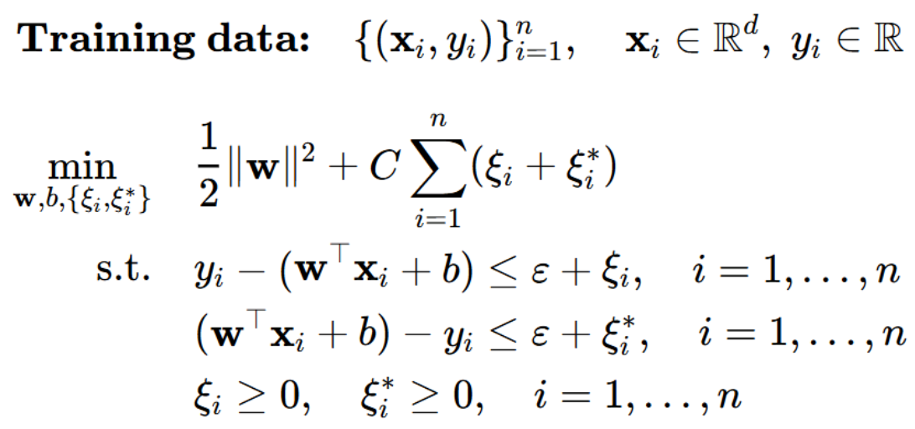
SVR Optimization
ξᵢ and ξᵢ* measure excess above and below the ε-tube.
C penalizes excess residual size, rather than counting outliers.
Notes:
Preserve the full epsilon-SVR optimization already present. With f_i = w·x_i+b, xi_i >= y_i−f_i−epsilon and xi_i* >= f_i−y_i−epsilon, with nonnegative slacks. At the optimum their sum equals the epsilon-insensitive loss.
[Sources]
https://scikit-learn.org/stable/modules/svm.html#mathematical-formulation
https://surnamnarendra.github.io/Fundamentals-of-Machine-Learning/lecture_25.html
[/Sources]

Slide 52
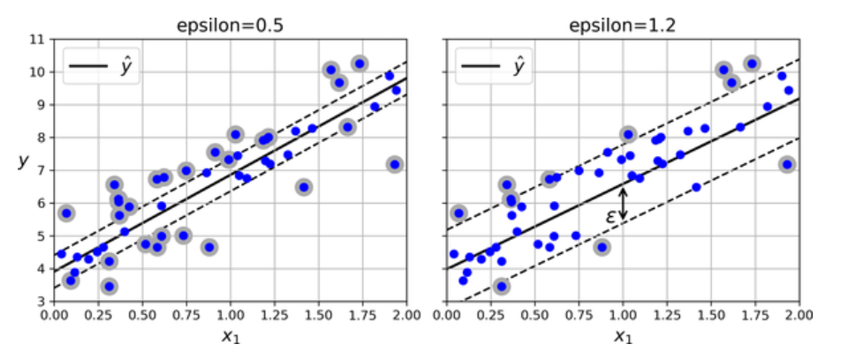
SVM Regression
Here, instead of finding the widest possible road, we want to fit as many observations on the street while limiting the number of points off the street

Slide 53
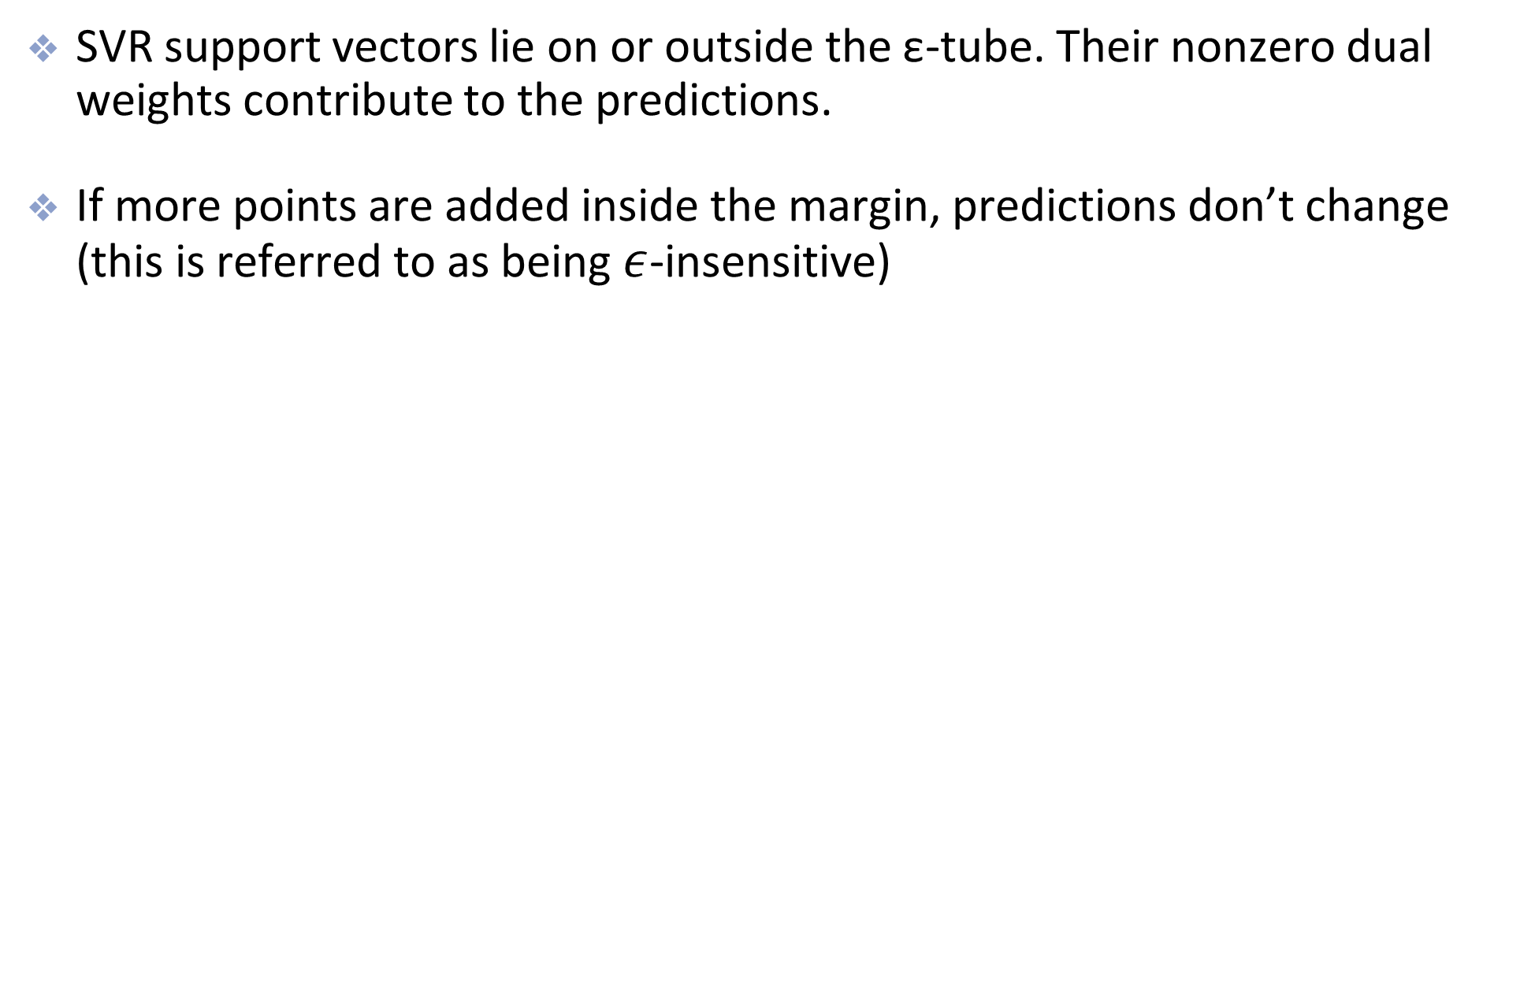
SVM Regression
SVR support vectors lie on or outside the ε-tube. Their nonzero dual weights contribute to the predictions.
If more points are added inside the margin, predictions don’t change (this is referred to as being $ε$-insensitive)
Notes:
Strictly interior points have zero dual coefficients. Points on the tube boundary can also be support vectors, so support vectors are not limited to observations outside the tube.
[Sources]
https://scikit-learn.org/stable/modules/svm.html#mathematical-formulation
https://surnamnarendra.github.io/Fundamentals-of-Machine-Learning/lecture_25.html
[/Sources]

Slide 54
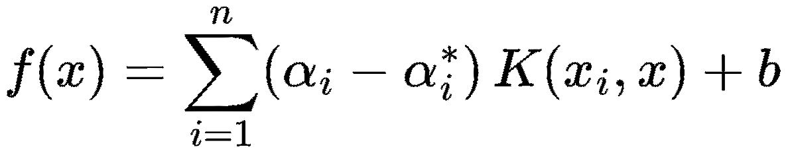
SVR Predictions
Linear SVR predicts the number f(x) = wᵀx + b. There is no sign threshold.
Kernel SVR uses the same kernel in fitting and prediction. Each support vector contributes a signed amount.
The two multipliers αᵢ and αᵢ* correspond to the two sides of the ε-tube. Their difference is the prediction weight.
Only nonzero differences contribute. The output stays in response units.
Notes:
The existing equation uses f(x)=sum_i (alpha_i−alpha_i*) K(x_i,x)+b, consistent with the residual constraints on the SVR optimization slide. The multipliers each lie in [0,C] and sum_i(alpha_i−alpha_i*)=0. Points strictly inside the epsilon-tube have both multipliers zero. Points on or outside its boundary may be support vectors.
[Sources]
https://scikit-learn.org/stable/modules/svm.html#mathematical-formulation
https://surnamnarendra.github.io/Fundamentals-of-Machine-Learning/lecture_25.html
[/Sources]

Slide 55
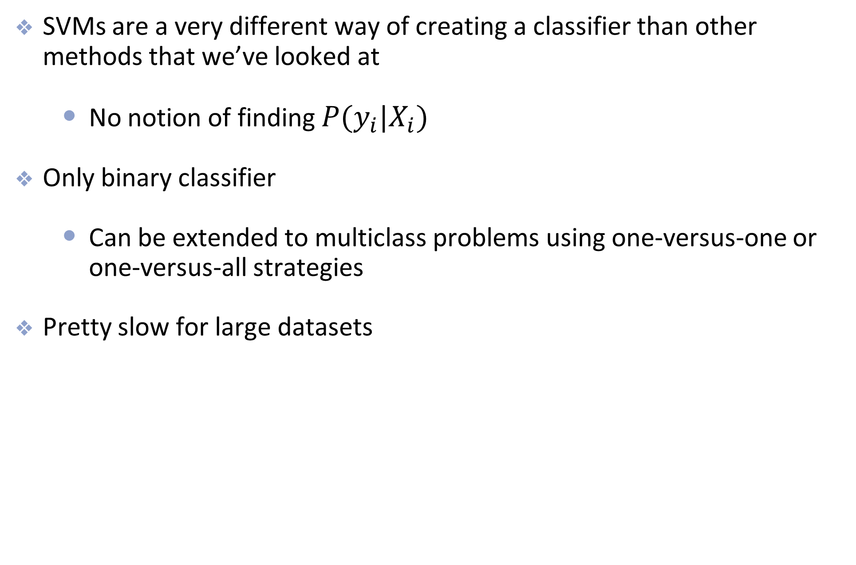
Summary
SVMs are a very different way of creating a classifier than other methods that we’ve looked at
  No notion of finding $P(y_{i}|X_{i})$
Only binary classifier
  Can be extended to multiclass problems using one-versus-one or one-versus-all strategies
Pretty slow for large datasets

