Slide 1
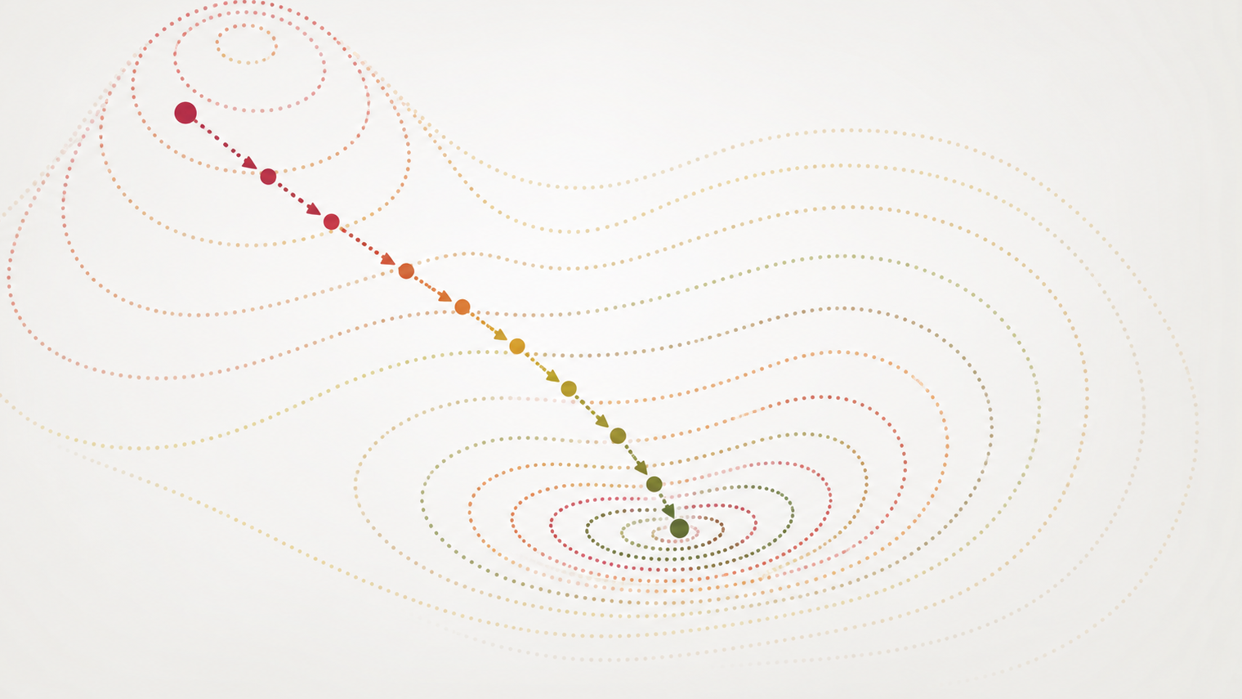
Gradient Descent (From OLS Slides)

Slide 2
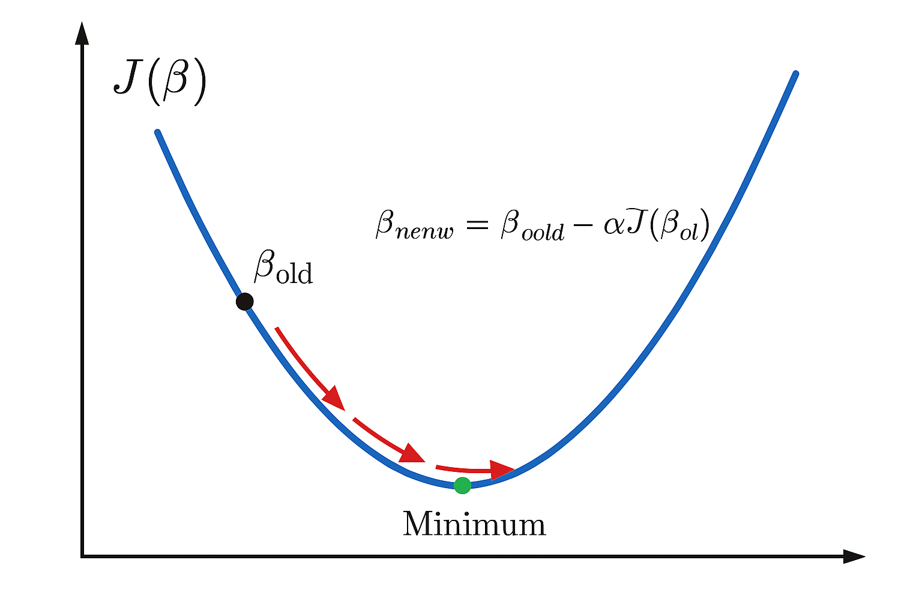
Gradient Descent (High level)
Numerical optimization algorithm that tweaks parameters iteratively until the minimum is found
  “Descend” the gradient of the cost function in the steepest direction until the minimum is reached
What is the gradient?
  The vector that points in the direction of the greatest rate of increase for a function
  It is the vector of partial derivatives

Slide 3
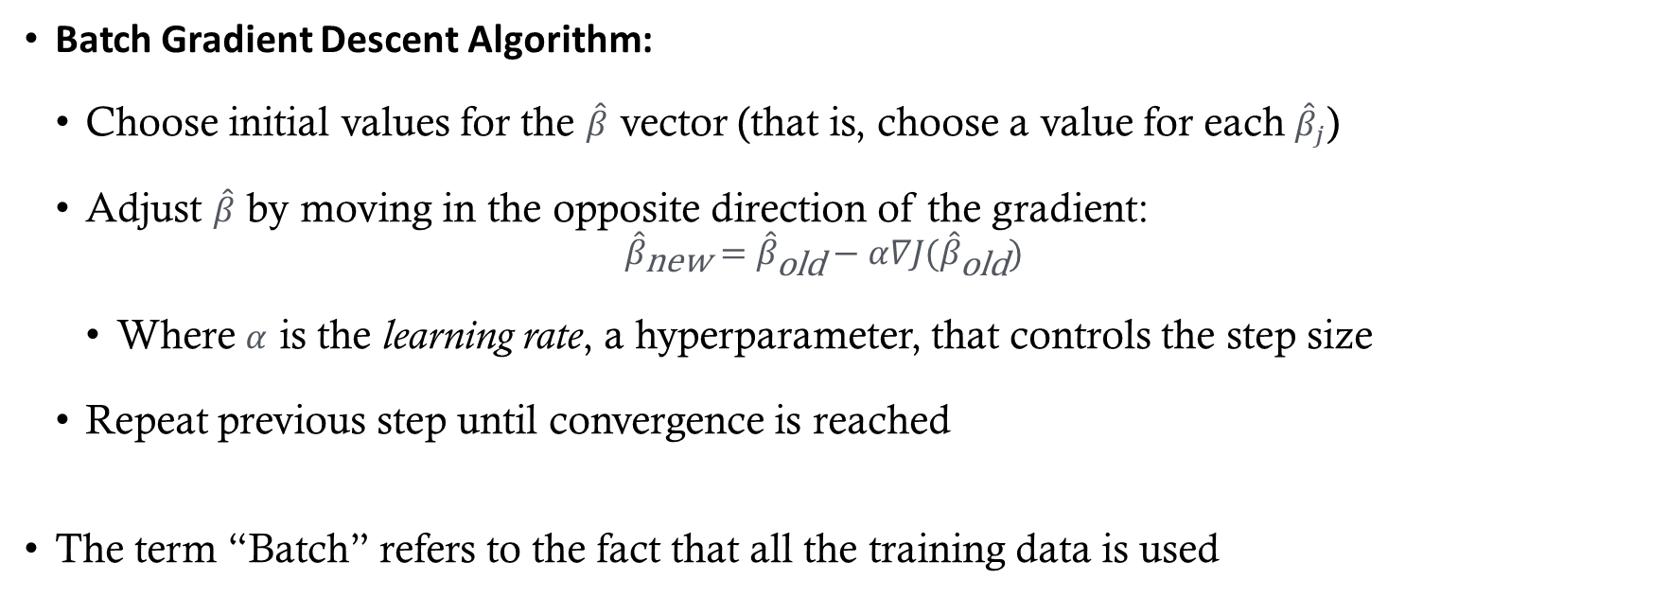
Gradient Descent
Batch Gradient Descent Algorithm:
  Choose initial values for the $\hat{β}$ vector (that is, choose a value for each ${\hat{β}}_{j}$)
  Adjust $\hat{β}$ by moving in the opposite direction of the gradient:
  ${\hat{β}}_{\text{new}}={\hat{β}}_{\text{old}}−α∇J({\hat{β}}_{\text{old}})$
    Where $α$ is the learning rate, a hyperparameter, that controls the step size
  Repeat previous step until convergence is reached
The term “Batch” refers to the fact that all the training data is used

Slide 4
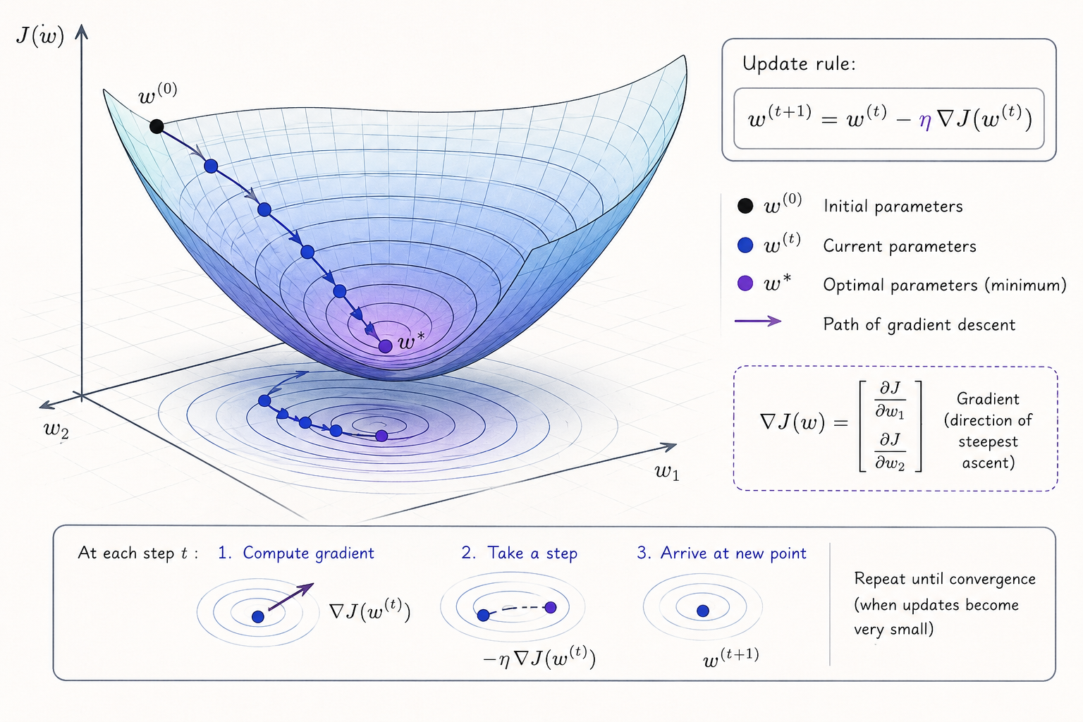

Slide 5
Learning Rate
If the learning rate is too high, the gradient descent algorithm will bounce around the minimum and never converge
  (See Figure 4-5 in HOML)
If the learning rate is too low, it could take a very long time to find the minimum
  (See Figure 4-4 in HOML)
It is common to start with a small learning rate (~0.01) and adjust based on the performance of the model

Slide 6
Gradient Descent Variations
Stochastic Gradient Descent (SGD)
  How it works:
    Chooses one random instance at each step.
    Computes the gradient based on that single instance.
  Pros:
    Faster per update (small computation).
    Randomness helps escape local minima on complex cost surfaces.
  Cons:
    Updates are noisy; the algorithm never fully “settles.”
    True minimum is rarely reached—oscillates around it.

Slide 7
Gradient Descent Variations
Mini-Batch Gradient Descent
  How it works:
    Chooses a small random subset (mini-batch) of training data at each step.
    Computes the gradient based on that subset.
  Pros:
    More stable than SGD (less noisy updates).
    Faster than full batch gradient descent for large datasets.
    Leverages vectorized operations for efficiency.
  Cons:
    Still introduces some randomness, so convergence is not perfectly smooth.
    Requires tuning batch size (too small = noisy, too large = slow).

Slide 8
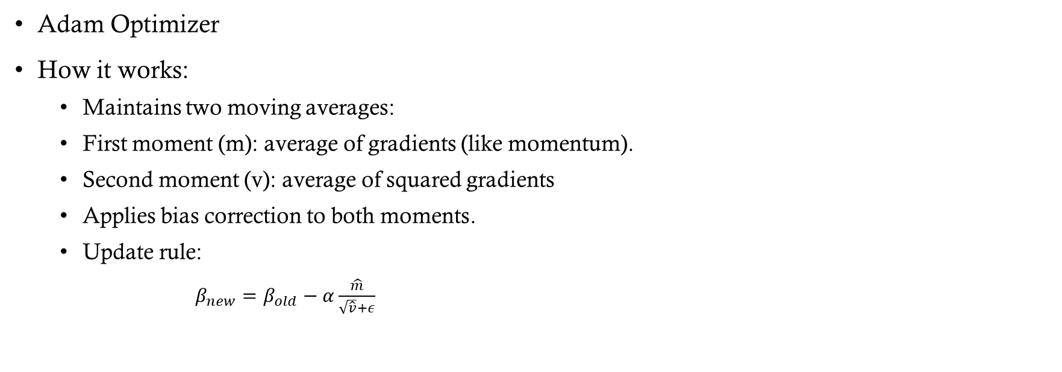
Gradient Descent Variations
Adam Optimizer
How it works:
  Maintains two moving averages:
  First moment (m): average of gradients (like momentum).
  Second moment (v): average of squared gradients
  Applies bias correction to both moments.
  Update rule:
    $β_{new}=β_{old}−α\frac{\hat{m}}{\sqrt{\hat{v}}+ε}$

Slide 9
Learning Schedule
A way to help “settle” stochastic gradient descent
Gradually reduce the learning rate according to a function called the “learning schedule”
Additional Points:
  Common schedules include:
  Step decay: Reduce learning rate by a factor after a fixed number of epochs.
  Exponential decay: Multiply learning rate by a constant factor each epoch.
  Polynomial decay: Decrease learning rate following a polynomial function.
Modern techniques:
  Cosine Annealing: Learning rate follows a cosine curve, often combined with restarts.
  One-cycle policy: Increase learning rate initially, then decrease sharply for better convergence.
  Adaptive methods (Adam, RMSProp): Adjust learning rate per parameter automatically based on gradient history.

