Slide 1
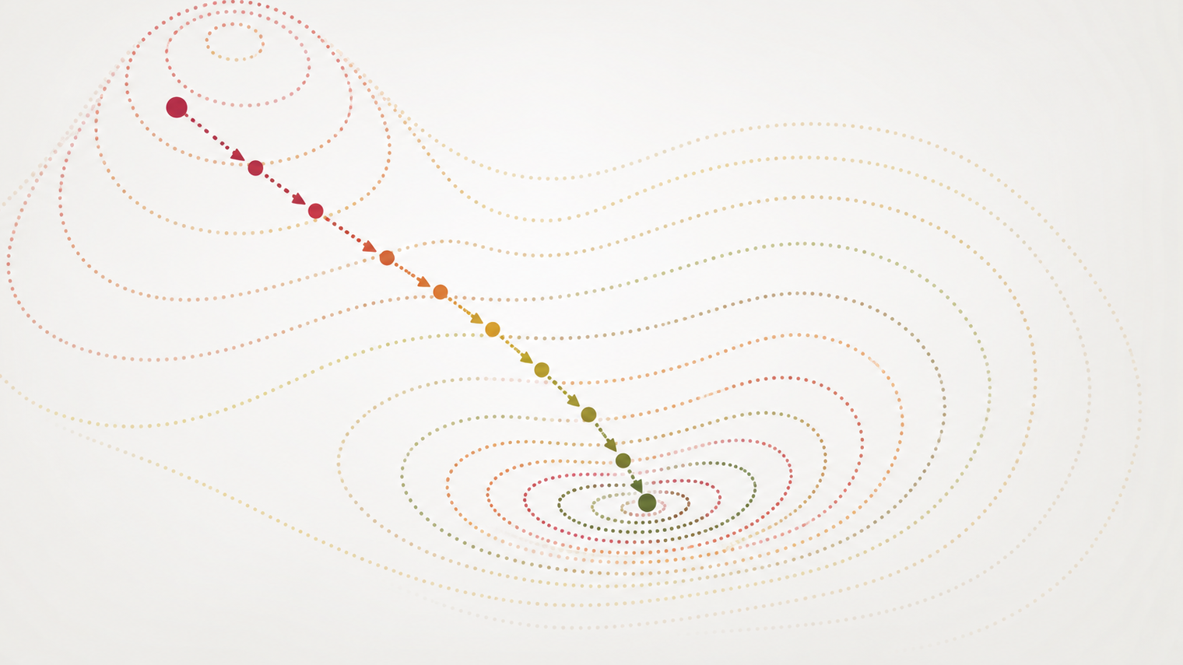
Gradient Descent

Slide 2
Optimization in machine learning
Many (all?) machine learning problems can be posed as a minimization or maximization problem
In some cases, a closed-form solution exists
  E.g., linear regression
Most of the time, a closed-form (analytic) solution doesn’t exist
  E.g., logistic regression
We can solve these problems using optimization theory

Slide 3


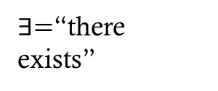
Unconstrained Optimization
An unconstrained optimization problem has the form
$$\min_{x∈ℝ^{d}}{f(x)}$$
  where $f:ℝ^{d}→ℝ$ is called the objective function.
  What about maximization?
A point $x^{∗}∈ℝ^{d}$ is called a local minimizer if $∃r>0$
such that
  $f\left(x^{∗}\right)≤f\left(x\right)∀x$ satisfying $\left\|x−x^{∗}\right\|<r$
$x^{∗}$ is called a global minimizer if
  $f\left(x^{∗}\right)≤f\left(x\right) ∀x∈ℝ^{d}$
Is a global minimizer also a local minimizer?
$∃=$“there exists”
$∀=$“for all”
Local
Global

Slide 4
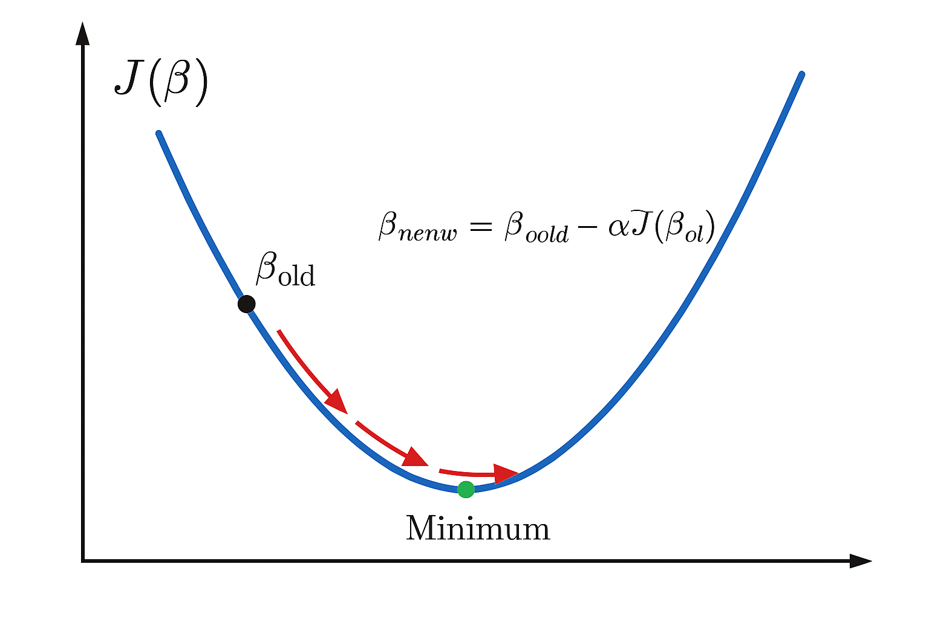
Gradient Descent (High level)
Numerical optimization algorithm that tweaks parameters iteratively until the minimum is found
  “Descend” the gradient of the cost function in the steepest direction until the minimum is reached
What is the gradient?

Slide 5
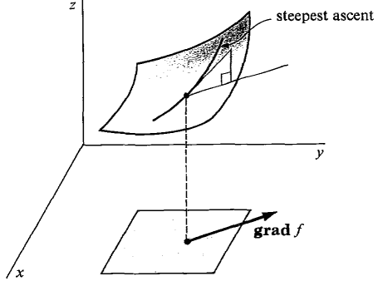




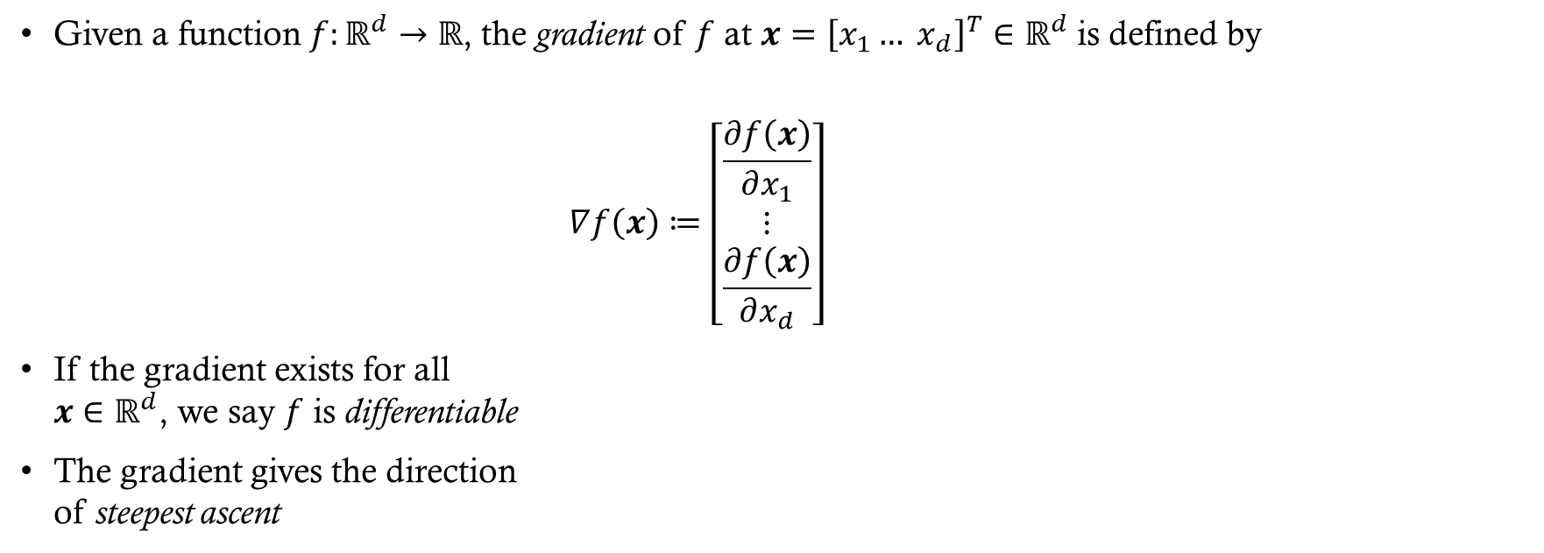
Gradient
Given a function $f:ℝ^{d}→ℝ$, the gradient of $f$ at $x={\left[x_{1}… x_{d}\right]}^{T}∈ℝ^{d}$ is defined by
$$∇f\left(x\right)≔\left[\begin{matrix}\frac{∂f\left(x\right)}{∂x_{1}} \\ ⋮ \\ \frac{∂f\left(x\right)}{∂x_{d}}\end{matrix}\right]$$
If the gradient exists for all
$x∈ℝ^{d}$, we say $f$ is differentiable
The gradient gives the direction
of steepest ascent

Slide 6

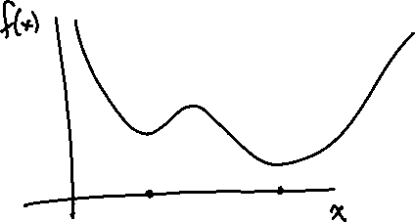
First Order Necessary Condition
If $f$ is differentiable and $x^{∗}$ is a local minimizer of $f$, then
$∇f\left(x^{∗}\right)=0.$
Note that this condition is necessary but not sufficient for $x^{∗}$ to be a local minimizer
  Why?
If $∇f\left(x\right)=0$ for some $x$, then $x$ is said to be a critical point or a stationary point of $f$

Slide 7
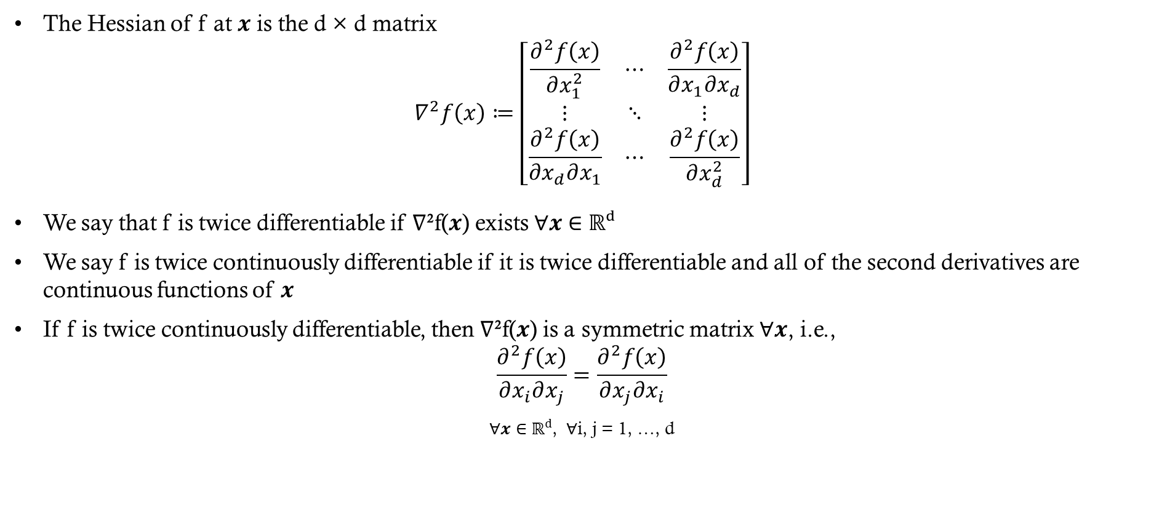
Hessian
The Hessian of f at 𝒙 is the d × d matrix
$$∇^{2}f\left(x\right)≔\left[\begin{matrix}\frac{∂^{2}f\left(x\right)}{∂x_{1}^{2}} & ⋯ & \frac{∂^{2}f\left(x\right)}{∂x_{1}∂x_{d}} \\ ⋮ & ⋱ & ⋮ \\ \frac{∂^{2}f\left(x\right)}{∂x_{d}∂x_{1}} & ⋯ & \frac{∂^{2}f\left(x\right)}{∂x_{d}^{2}}\end{matrix}\right]$$
We say that f is twice differentiable if ∇²f(𝒙) exists ∀𝒙 ∈ ℝᵈ
We say f is twice continuously differentiable if it is twice differentiable and all of the second derivatives are continuous functions of 𝒙
If f is twice continuously differentiable, then ∇²f(𝒙) is a symmetric matrix ∀𝒙, i.e.,
$$\frac{∂^{2}f\left(x\right)}{∂x_{i}∂x_{j}}=\frac{∂^{2}f\left(x\right)}{∂x_{j}∂x_{i}}$$
∀𝒙 ∈ ℝᵈ, ∀i, j = 1, …, d

Slide 8
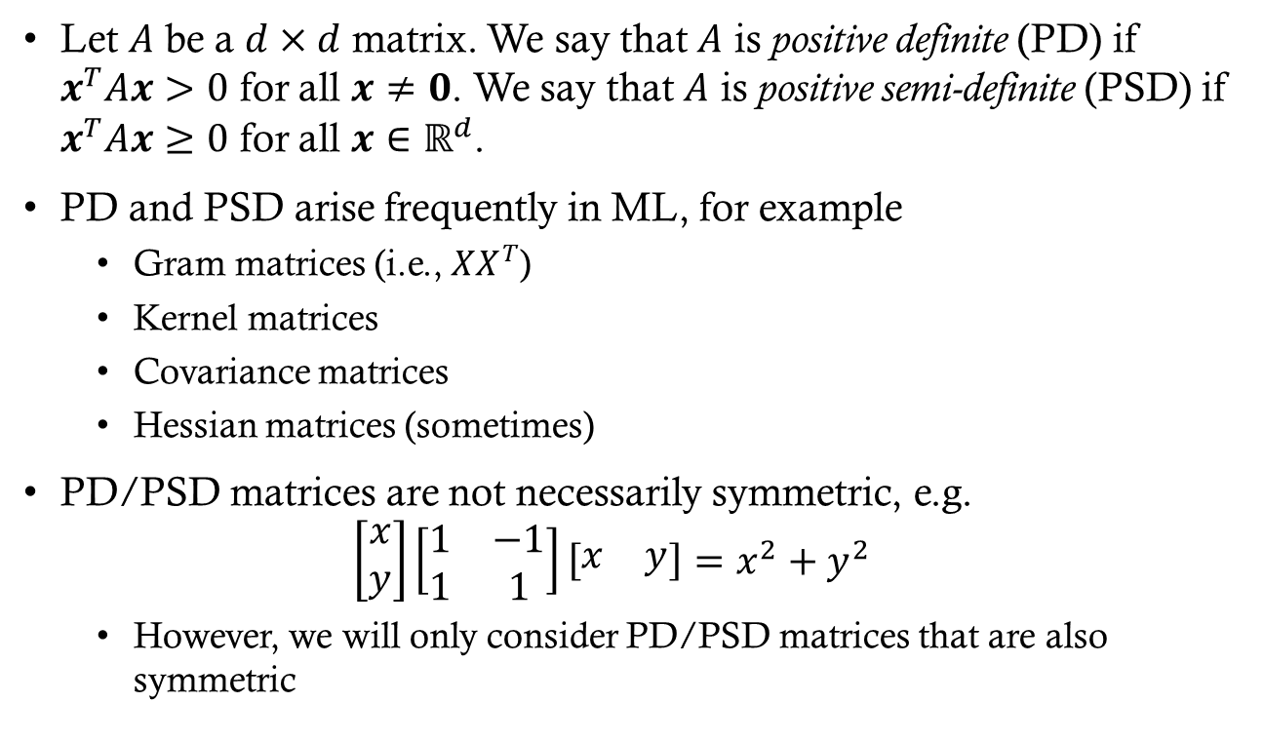
Positive (Semi-)Definite Matrices
Let $A$ be a $d×d$ matrix. We say that $A$ is positive definite (PD) if $x^{T}Ax>0$ for all $x≠0$. We say that $A$ is positive semi-definite (PSD) if $x^{T}Ax≥0$ for all $x∈ℝ^{d}$.
PD and PSD arise frequently in ML, for example
  Gram matrices (i.e., $XX^{T}$)
  Kernel matrices
  Covariance matrices
  Hessian matrices (sometimes)
PD/PSD matrices are not necessarily symmetric, e.g.
$\left[\begin{matrix}x \\ y\end{matrix}\right]\left[\begin{matrix}1 & −1 \\ 1 & 1\end{matrix}\right]\left[\begin{matrix}x & y\end{matrix}\right]=x^{2}+y^{2}$
  However, we will only consider PD/PSD matrices that are also symmetric
Notes:
Gram matrices and kernel matrices — background notes
GRAM MATRIX
• Given vectors v1,...,vn, the Gram matrix G has entries G_ij = <v_i, v_j> (inner products). In matrix form, if X is the n x d data matrix whose rows are the vectors, then G = X X^T (n x n). The related d x d matrix X^T X is also commonly called a Gram matrix — it is the one that appears in the OLS normal equations.
• G is always symmetric and positive semi-definite: for any z, z^T G z = z^T X X^T z = ||X^T z||^2 >= 0.
• G is positive definite (not just semi-definite) exactly when the vectors are linearly independent. This is why OLS has a unique solution only when X has full column rank — otherwise X^T X is singular and cannot be inverted.
• Interpretation: the Gram matrix records all pairwise similarities (angles and lengths) among the vectors; it determines the configuration up to rotation.
KERNEL MATRIX
• A kernel k(x, x') is an inner product computed in some (possibly infinite-dimensional) feature space: k(x, x') = <phi(x), phi(x')>. The kernel matrix (or Gram matrix of the kernel) is K with K_ij = k(x_i, x_j).
• So a kernel matrix is just the Gram matrix of the transformed data phi(x_1),...,phi(x_n) — hence it is symmetric PSD for any valid kernel. Mercer's theorem: a symmetric function k is a valid kernel precisely when every such K is PSD.
• The 'kernel trick': algorithms that depend on the data only through inner products (ridge regression, SVMs, PCA, Gaussian processes) can be run entirely with K, without ever forming phi(x). Common choices: linear k = x^T x', polynomial (x^T x' + c)^p, RBF/Gaussian exp(-||x - x'||^2 / 2*sigma^2).
• Practical note: K is n x n, so kernel methods scale with the number of observations, not the number of features. Numerically K is often only PSD (near-singular), so a small ridge term lambda*I is added to make it PD and safely invertible.
WHY THIS MATTERS HERE
• Both are canonical examples of symmetric PSD matrices, the same property we need for Hessians: PSD Hessian everywhere means the objective is convex, and a PD Hessian at a critical point certifies a strict local minimum.
WHY "SOMETIMES" FOR HESSIAN MATRICES?
• Unlike Gram, kernel, and covariance matrices, a Hessian is not PD/PSD by construction — it only is under conditions.
• Symmetry is essentially free: if f is twice continuously differentiable, mixed partials commute (Clairaut/Schwarz), so the Hessian is symmetric. Positive (semi-)definiteness is not free.
• The Hessian is PSD at every point exactly when f is convex, and PD at every point when f is strictly convex (e.g., squared-error loss, regularized logistic regression).
• If f is nonconvex (e.g., a neural network loss), the Hessian is indefinite over large regions — it has both positive and negative eigenvalues, which is precisely what a saddle point is — and it is negative definite near a local maximum.
• Locally, the second-order necessary condition only guarantees the Hessian is PSD AT a local minimizer, not at arbitrary points.
• Bottom line: Gram/kernel/covariance matrices are always PSD; a Hessian is PSD only when the function is convex or you are at a minimum. Hence "sometimes."

Slide 9

Second Order Necessary Condition
If $f$ is twice continuously differentiable and $x^{∗}$ is a local min, then $∇^{2}f(x^{∗})$ is positive semi-definite, i.e.,
$z^{T}∇^{2}f\left(x^{∗}\right)z≥0, ∀z∈ℝ^{d}$
  This generalizes the result from single-variable calculus that the second derivative is nonnegative at a local min

Slide 10
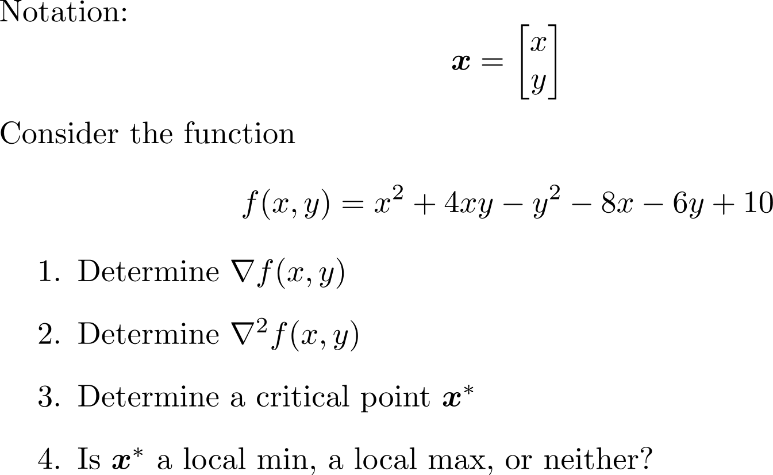
Group Exercise

Slide 11
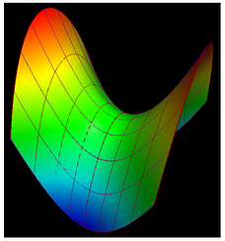

Group Exercise Solutions
$∇f\left(x,y\right)=\left[\begin{matrix}2x+4y−8 \\ 4x−2y−6\end{matrix}\right]$
$∇^{2}f\left(x,y\right)=\left[\begin{matrix}2 & 4 \\ 4 & −2\end{matrix}\right]$
$∇f\left(x,y\right)=\left[\begin{matrix}0 \\ 0\end{matrix}\right]$
$⇒\left[\begin{matrix}2 & 4 \\ 4 & −2\end{matrix}\right]\left[\begin{matrix}x \\ y\end{matrix}\right]=\left[\begin{matrix}8 \\ 6\end{matrix}\right]$
$⇒\left[\begin{matrix}x \\ y\end{matrix}\right]$=$\left[\begin{matrix}2 \\ 1\end{matrix}\right]$
$\left[\begin{matrix}0 & 1\end{matrix}\right]\left[\begin{matrix}2 & 4 \\ 4 & −2\end{matrix}\right]\left[\begin{matrix}0 \\ 1\end{matrix}\right]=−2$
  Similarly $\left[\begin{matrix}1 & 0\end{matrix}\right]\left[\begin{matrix}2 & 4 \\ 4 & −2\end{matrix}\right]\left[\begin{matrix}1 \\ 0\end{matrix}\right]=2$ so $∇^{2}f$ is neither PD nor negative definite so neither

Slide 12

Convexity
We say that $f$ is convex if
$f\left(tx+\left(1−t\right)y\right)≤tf\left(x\right)+\left(1−t\right)f\left(y\right)$
for all $x,y∈ℝ^{d}$ and $t∈\left[0,1\right]$.
We say $f$ is strictly convex if
$f\left(tx+\left(1−t\right)y\right)<tf\left(x\right)+\left(1−t\right)f\left(y\right)$
$∀x≠y$ and $t∈\left(0,1\right)$.

Slide 13

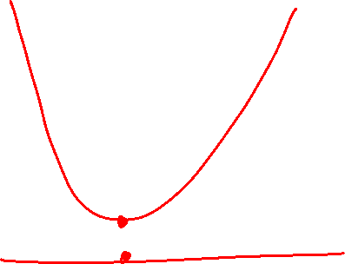
Convex functions are nice
Properties of convex functions
If $f$ is convex, then every local min is a global min
If $f$ is strictly convex, then $f$ has at most one global min

Slide 14

Convexity Example

Slide 15
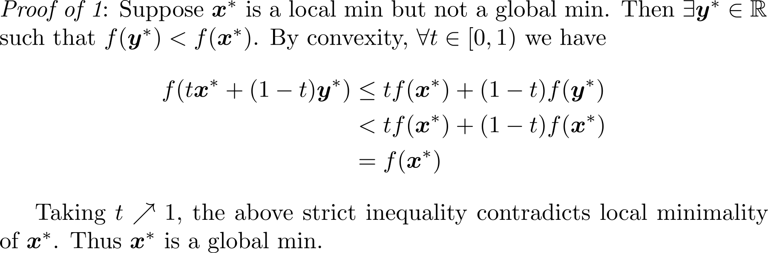
Convex functions are nice
Notes:
Do proof on board

Slide 16
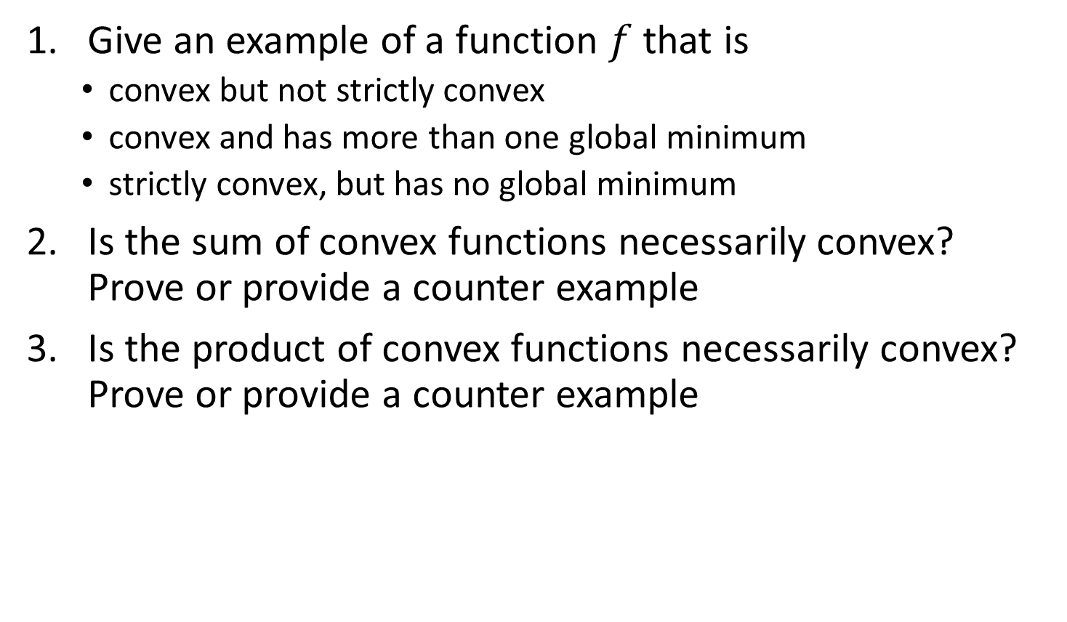
Group Exercise
Give an example of a function $f$ that is
  convex but not strictly convex
  convex and has more than one global minimum
  strictly convex, but has no global minimum
Is the sum of convex functions necessarily convex? Prove or provide a counter example
Is the product of convex functions necessarily convex? Prove or provide a counter example

Slide 17
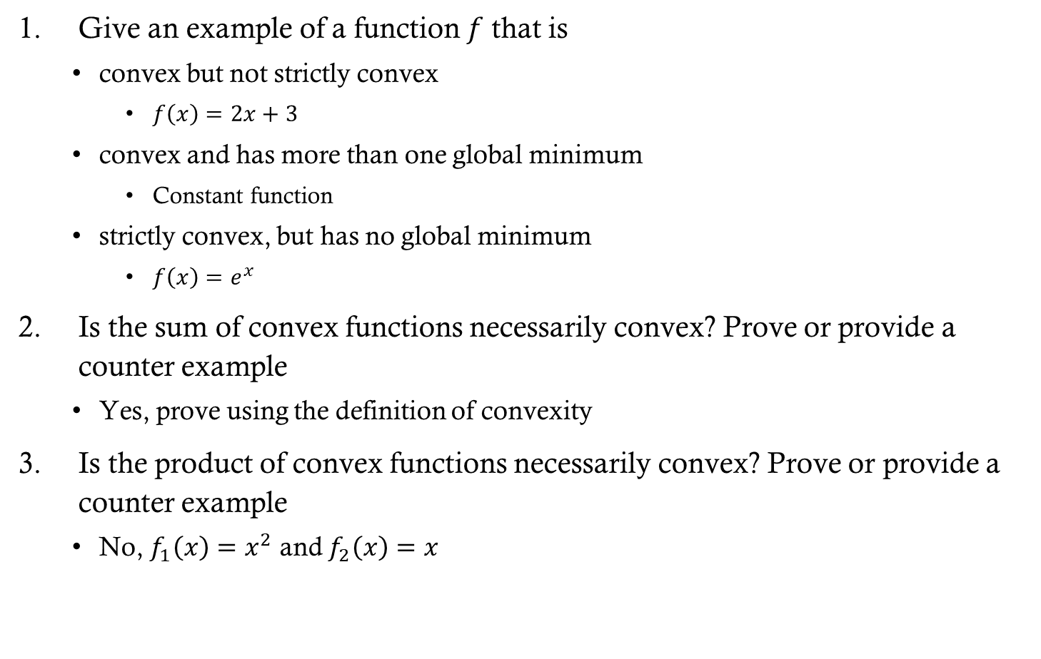
Group Exercise Solutions
Give an example of a function $f$ that is
  convex but not strictly convex
    $f\left(x\right)=2x+3$
  convex and has more than one global minimum
    Constant function
  strictly convex, but has no global minimum
    $f\left(x\right)=e^{x}$
Is the sum of convex functions necessarily convex? Prove or provide a counter example
  Yes, prove using the definition of convexity
Is the product of convex functions necessarily convex? Prove or provide a counter example
  No, $f_{1}\left(x\right)=x^{2}$ and $f_{2}\left(x\right)=x$

Slide 18
Takeaways
The combination of convexity and differentiability enables us to determine if a global minimum exists
Differentiability also provides us with methods for finding a minimum when a closed-form solution may not exist
Thus, when considering loss functions for an ML problem, convexity and differentiability are important properties to consider

Slide 19
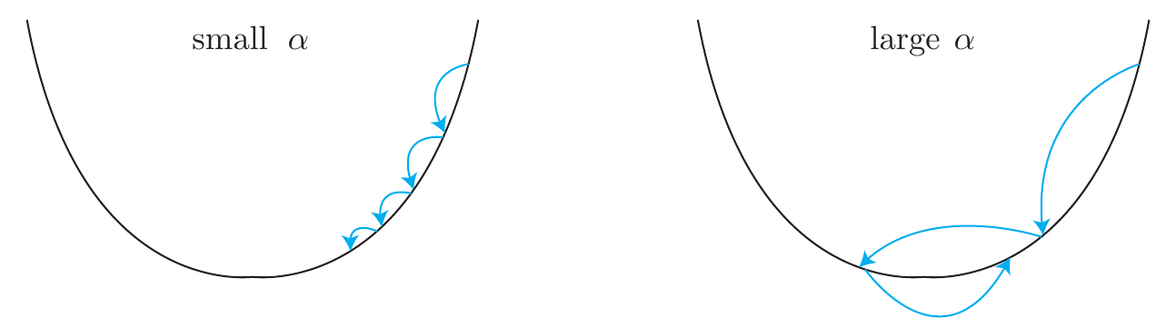
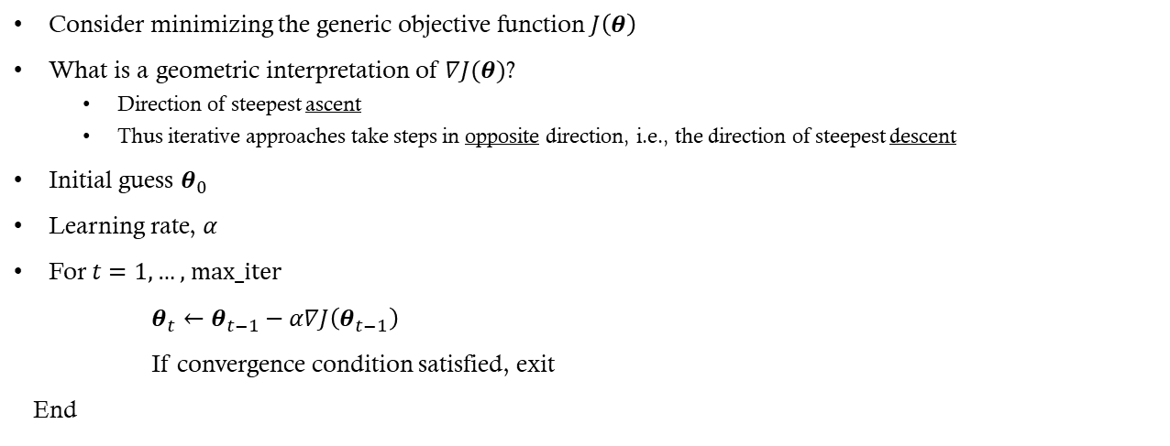
Gradient Descent (GD)
Consider minimizing the generic objective function $J\left(θ\right)$
What is a geometric interpretation of $∇J(θ)$?
  Direction of steepest ascent
  Thus iterative approaches take steps in opposite direction, i.e., the direction of steepest descent
Initial guess $θ_{0}$
Learning rate, $α$
For $t=1,…\text{, max_iter}$
$θ_{t}←θ_{t−1}−α∇J\left(θ_{t−1}\right)$
If convergence condition satisfied, exit
End

Slide 20
Learning Rate
If the learning rate is too high, the gradient descent algorithm will bounce around the minimum and never converge
  (See Figure 4-5 in HOML)
If the learning rate is too low, it could take a very long time to find the minimum
  (See Figure 4-4 in HOML)
It is common to start with a small learning rate (~0.01) and adjust based on the performance of the model

Slide 21

Learning Rate as a Function
In practice, typically need $α$ to decrease as a function of $t$
  Example: $α_{t}=\frac{1}{t}$

Slide 22

Group Exercise
What would be a good convergence condition (also known as a stopping criterion) for terminating GD?
What are some potential problems with setting $α_{t}=\frac{1}{t}$?
How could you choose $α_{t}$ to counter these problems?
Does the initialization $θ_{0}$ affect the result?

Slide 23
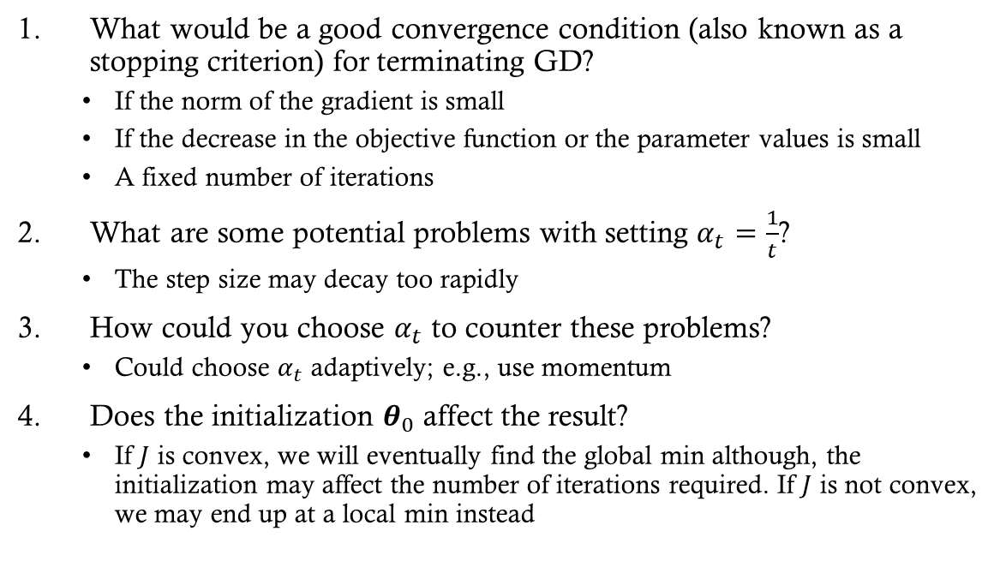
Group Exercise Solutions
What would be a good convergence condition (also known as a stopping criterion) for terminating GD?
  If the norm of the gradient is small
  If the decrease in the objective function or the parameter values is small
  A fixed number of iterations
What are some potential problems with setting $α_{t}=\frac{1}{t}$?
  The step size may decay too rapidly
How could you choose $α_{t}$ to counter these problems?
  Could choose $α_{t}$ adaptively; e.g., use momentum
Does the initialization $θ_{0}$ affect the result?
  If $J$ is convex, we will eventually find the global min although, the initialization may affect the number of iterations required. If $J$ is not convex, we may end up at a local min instead
Notes:
I’ll cover some of these optimization methods in more detail in my deep learning class next semester as they become really important in that context
For the initialization question, draw an example on the board

Slide 24
Learning Schedule
A way to help “settle” stochastic gradient descent
Gradually reduce the learning rate according to a function called the “learning schedule”
Additional Points:
  Common schedules include:
  Step decay: Reduce learning rate by a factor after a fixed number of epochs.
  Exponential decay: Multiply learning rate by a constant factor each epoch.
  Polynomial decay: Decrease learning rate following a polynomial function.
Modern techniques:
  Cosine Annealing: Learning rate follows a cosine curve, often combined with restarts.
  One-cycle policy: Increase learning rate initially, then decrease sharply for better convergence.
  Adaptive methods (Adam, RMSProp): Adjust learning rate per parameter automatically based on gradient history.

Slide 25
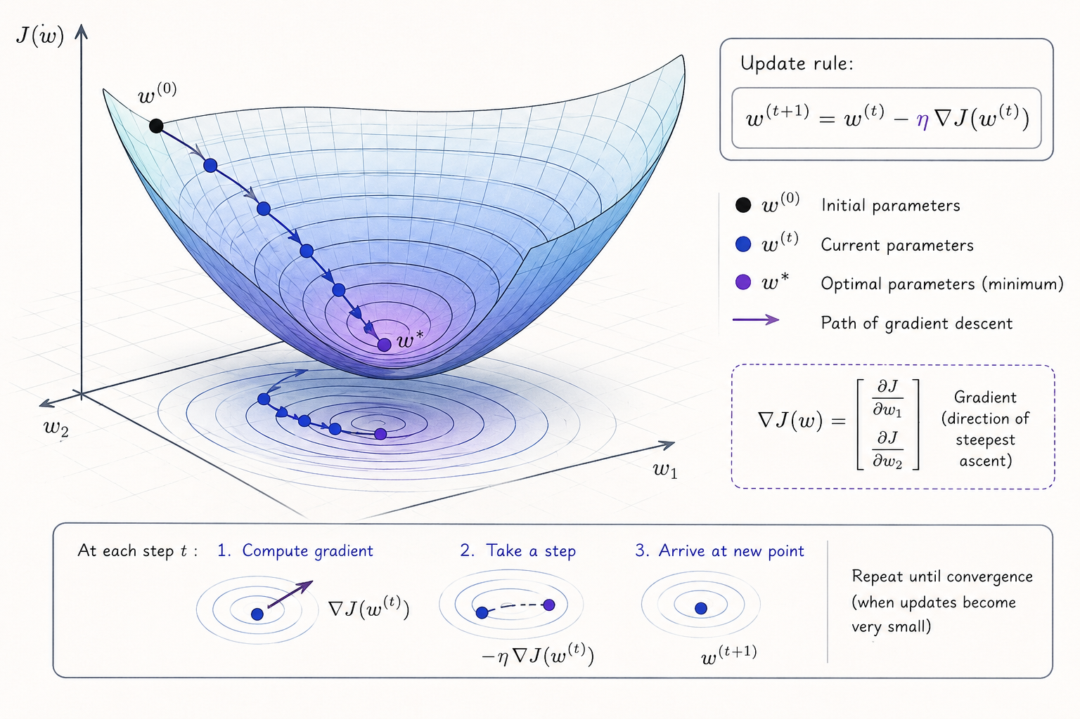

Slide 26

Stochastic Gradient Descent (SGD)
In many ML problems, we can write
$J\left(θ\right)=\sum_{i=1}^{n}{J_{i}(θ)}$
Thus
$∇J\left(θ\right)=\sum_{i=1}^{n}{∇J_{i}(θ)}$
Notes:
Recall that $L$ is the loss function and $f_{θ}$ is either our classification or regression function that depends on the parameters $θ$

Slide 27

Stochastic Gradient Descent (SGD)
In GD, we calculate the gradient using all of the data
  For large $n$, each step in the parameter space $θ$ takes a lot of computations
  Thus learning can occur slowly
For SGD, we estimate the gradient using a small random sample of training inputs
  Speeds up gradient descent and learning

Slide 28

Stochastic Gradient Descent
Pick a random set of $m<n$ training inputs
  Referred to as a mini-batch
Estimate the gradient using the samples from the mini-batch and take a step in the direction of the negative gradient
If $m$ is large enough, then the estimated gradient will be roughly equal to the gradient using the full data

Slide 29
Stochastic Gradient Descent Summary
A training epoch:
Pick a random subset of the training data
  Referred to as a mini-batch
Update the parameters using the gradient estimates from the mini-batch
Pick another random mini-batch from the remaining training points and repeat step 2
  Repeat until all training inputs have been used
Repeat multiple epochs until stopping conditions are met

Slide 30
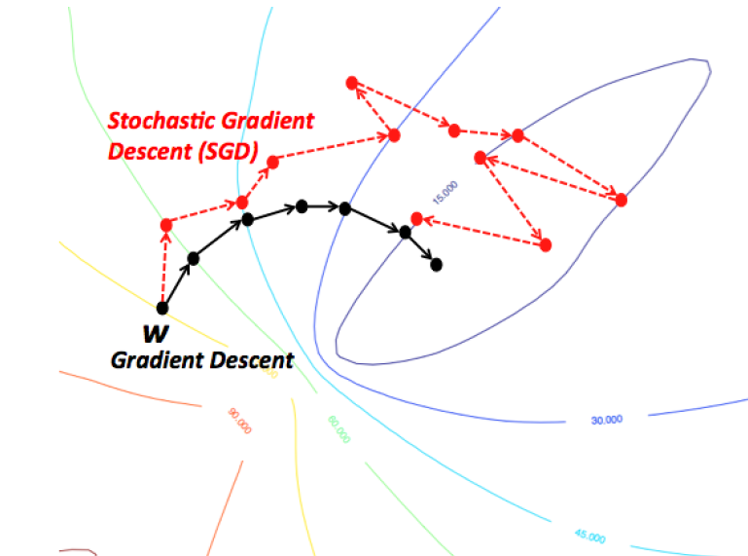
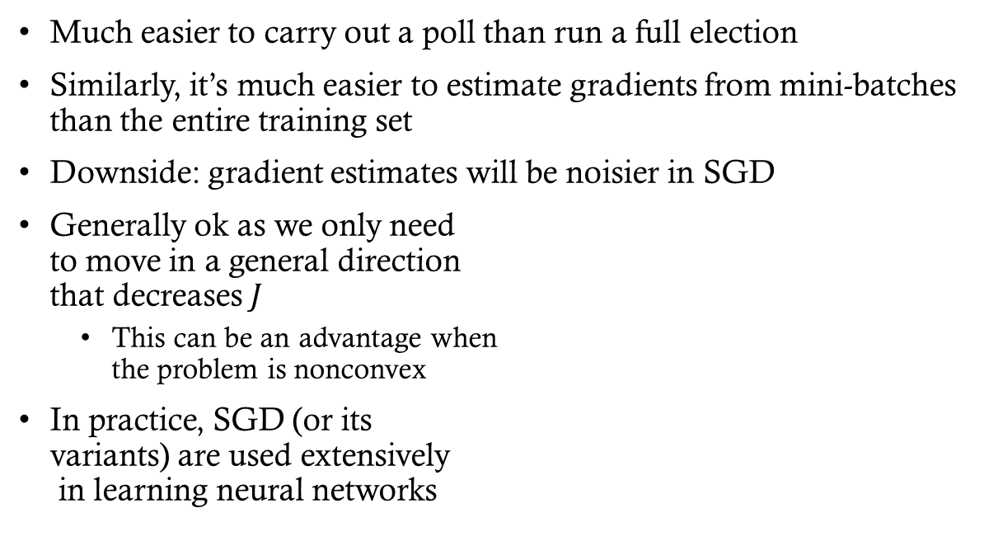
Analogy to political polling
Much easier to carry out a poll than run a full election
Similarly, it’s much easier to estimate gradients from mini-batches than the entire training set
Downside: gradient estimates will be noisier in SGD
Generally ok as we only need
to move in a general direction
that decreases $J$
  This can be an advantage when
  the problem is nonconvex
In practice, SGD (or its
variants) are used extensively
in learning neural networks

Slide 31
Gradient Descent Variations
Stochastic Gradient Descent (SGD)
  How it works:
    Uses one random training instance at each step
    Computes the gradient from that single instance
  Pros:
    Fastest per update (very small computation)
    Randomness helps escape local minima on complex cost surfaces
  Cons:
    Updates are noisy; the algorithm never fully “settles”
    True minimum is rarely reached—it oscillates around it
Mini-Batch Gradient Descent
  How it works:
    Uses a small random subset (mini-batch) at each step
    Computes the gradient from that subset
  Pros:
    More stable than SGD (less noisy updates)
    Faster than full batch GD on large datasets
    Leverages vectorized operations for efficiency
  Cons:
    Still random, so convergence is not perfectly smooth
    Requires tuning the batch size (too small = noisy, too large = slow)

Slide 32
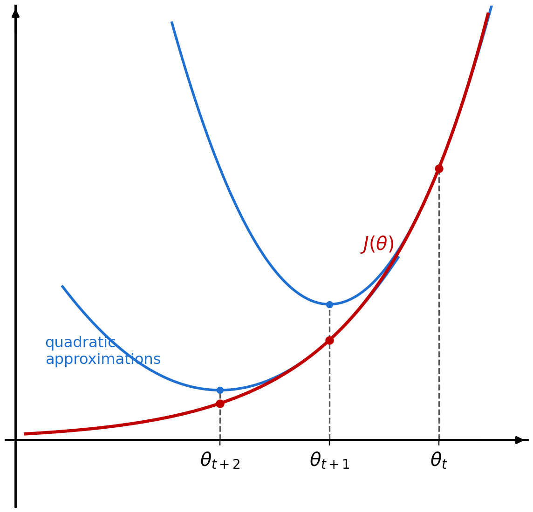


Newton’s method
Goal is to solve $∇J\left(θ\right)=0$ for an objective function $J$
Newton’s method AKA Newton-Raphson:
$$θ_{t+1}=θ_{t}−{\left(∇^{2}J\left(θ_{t}\right)\right)}^{−1}∇J\left(θ_{t}\right)$$
Newton’s method can be viewed as minimizing the second order approximation:
$$J\left(θ\right)≈J\left(θ_{t}\right)+∇J{\left(θ_{t}\right)}^{T}\left(θ−θ_{t}\right) \\ +\frac{1}{2}{\left(θ−θ_{t}\right)}^{T}∇^{2}J\left(θ_{t}\right)\left(θ−θ_{t}\right)$$
Notes:
Newton’s method approximates the objective function with a quadratic function and then jumps to the minimum of that quadratic function. Repeat until convergence.

Slide 33
Newton’s Method: Intuition
GD fits a line; Newton fits a parabola
  Jumps straight to the minimum of its quadratic model of J
The Hessian is an automatic learning rate
  (∇²J)⁻¹ shortens steps where curvature is high — no α to tune
Fast when it works
  Exact in one step on a quadratic; quadratic convergence near a min
But expensive and fragile
  O(d³) per step; Hessian may not be PD far from a min
  Fixes: damping, trust regions, quasi-Newton (BFGS, L-BFGS)

Slide 34
Group exercise
One advantage of Newton’s method is that it converges to a minimum in relatively few steps. What is a disadvantage of Newton’s method?
Answer: You have to invert a matrix (the Hessian) at each step
  This can be very slow for high-dimensional data
Thus in practice, Newton’s method is rarely used
However, Newton’s method has provided inspiration for other optimization techniques that are faster to compute

Slide 35
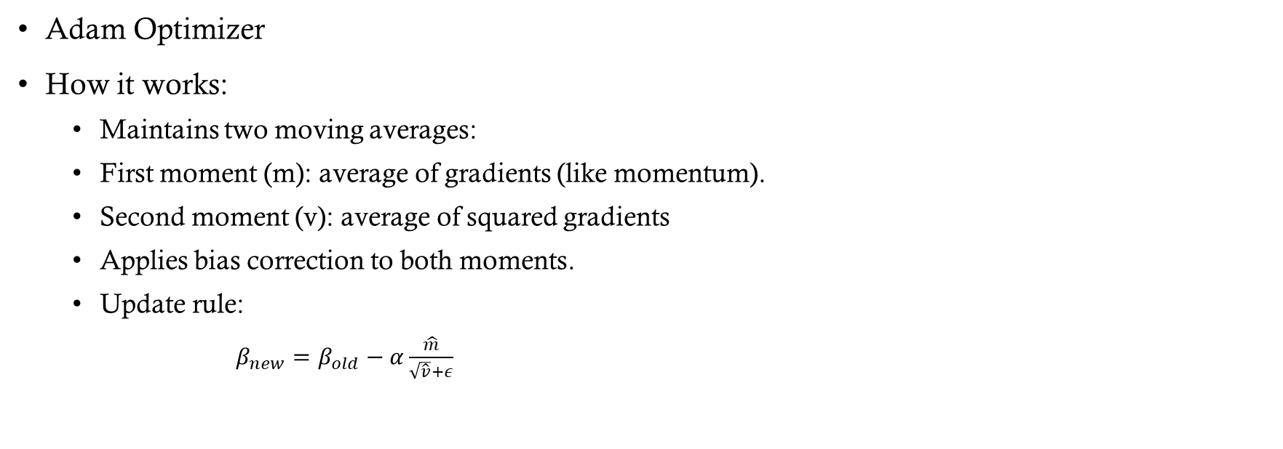
Gradient Descent Variations
Adam Optimizer
How it works:
  Maintains two moving averages:
  First moment (m): average of gradients (like momentum).
  Second moment (v): average of squared gradients
  Applies bias correction to both moments.
  Update rule:
    $β_{new}=β_{old}−α\frac{\hat{m}}{\sqrt{\hat{v}}+ε}$

