Slide 1
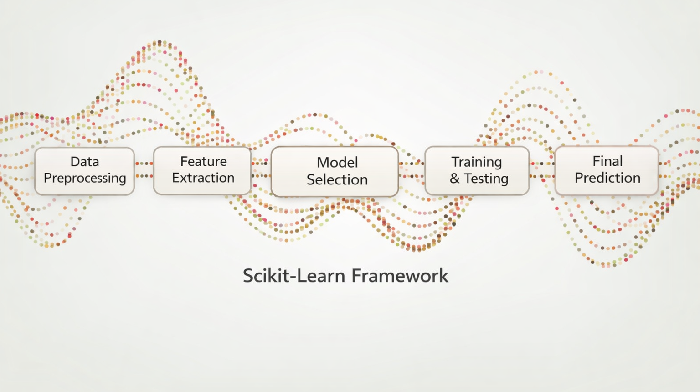
Introduction to
Scikit-Learn

Slide 2
What we'll cover
Scikit-Learn as an object-oriented library
The three core object types: estimators, transformers, predictors
Getting your data into the right shape
A worked modeling example
Pipelines: avoiding leakage and keeping workflows reproducible

Slide 3
What is Scikit-Learn
Scikit-Learn is one of the best-known Python packages for machine learning
scikit-learn.org
It provides efficient versions of many common ML algorithms
It has a clean, uniform, and streamlined API
    Once you understand the syntax of Scikit-Learn, it is straightforward to use any model inside the library
In Python, Scikit-Learn is called with sklearn
    import sklearn

Slide 4
Object-oriented modeling
A model is an object:
  It has state (learned parameters)
  It has methods (fit, predict)
This allows:
  Reuse
  Inspection
  Composition (pipelines)
from sklearn.linear_model import LinearRegression
# Model instantiation
model = LinearRegression()
#Model fit
model.fit(X, y)
model.predict(X_new)
#Model learned parameters:
coefficients = model.coef_

Slide 5
Two conventions worth knowing
Inspection:
Hyperparameters and learned parameters are plain attributes
Learned parameters end in an underscore
Sensible defaults:
Most parameters come with reasonable defaults

Slide 6
Estimators
Estimators:
  Any object that can estimate a parameter based on a dataset
  The .fit() method performs the estimation
Two Forms:
  Transformer
  Predictor

Slide 7
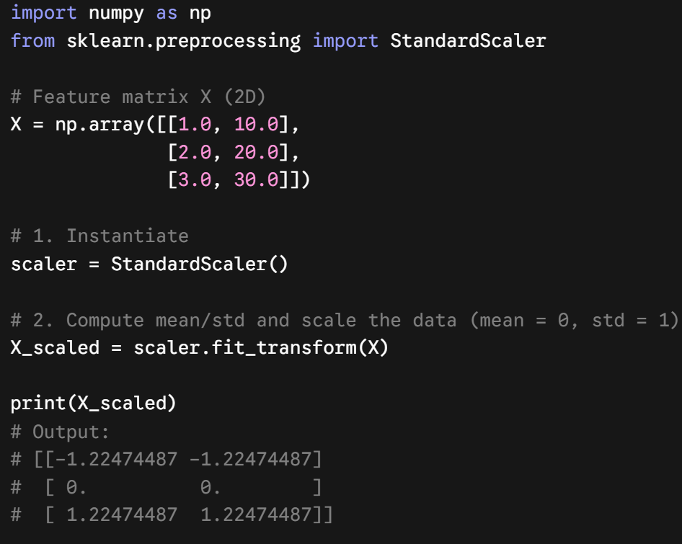
Transformers
Transformers:
  Estimators that can also transform a dataset
  Transformation is performed with the .transform() method
  The .fit_transform() method fits and transforms in one step
  Example: StandardScaler

Slide 8
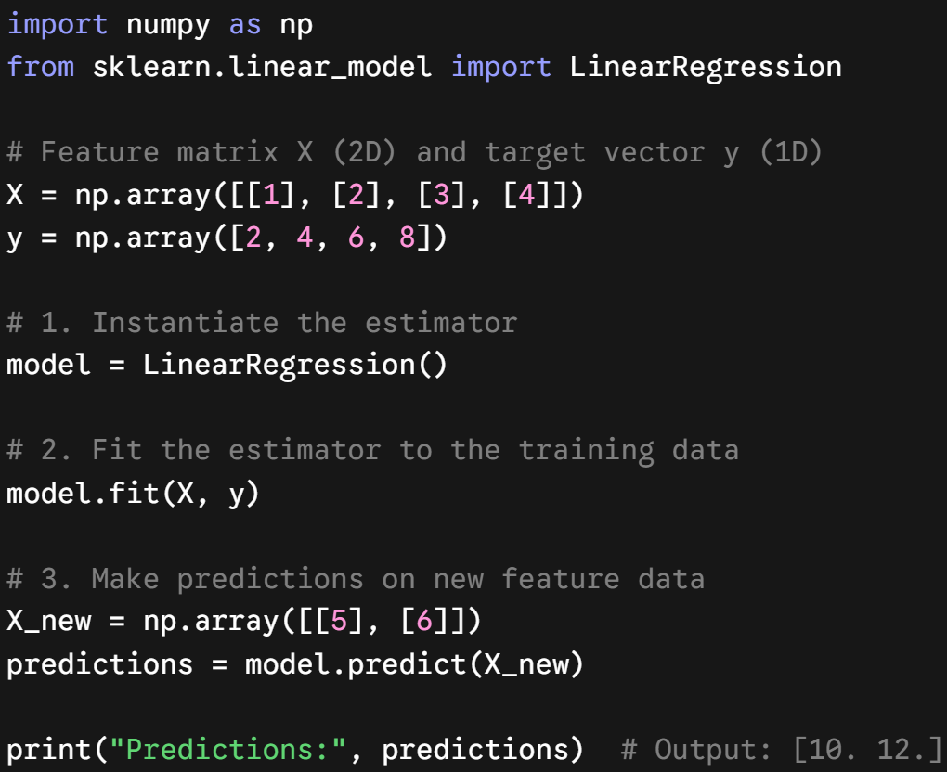
Predictors
Predictors:
  Estimators that are capable of making predictions
  Has a .predict() method
  Usually have a built-in .score() method
  Example: LinearRegression

Slide 9
Simple Scikit-Learn Usage
Prepare the data into a feature matrix and a target vector
Choose a model and import the estimator class from Scikit-Learn
Instantiate the model class and choose hyperparameters
(not all model classes have hyperparameters)
Fit the model by calling the .fit() method
Apply the model with the .predict() or the .transform() method
Class: Scikit-Learn is built on Python classes and object-oriented principles
Hyperparameters: settings you choose before fitting; they control learning and are not learned from the data

Slide 10
Preparing your data
The data should be in tabular form
    Generally, NumPy or Pandas objects
    The rows should be the observations or samples
The feature matrix (X) should be a 2D NumPy array or a Pandas DataFrame
    This applies even when there is only 1 feature
    Note: if only one feature, it often must be reshaped using .reshape(-1, 1)
The target (y) should be a 1D NumPy array or a Pandas Series

Slide 11
Example
import numpy as np
from sklearn.linear_model import LinearRegression
from sklearn.model_selection import train_test_split
# Create simple data
X = np.arange(1, 21).reshape(-1, 1) # feature matrix (n_samples, n_features)
y = 2 * X.ravel() # target vector
# Hold out a test set
X_train, X_test, y_train, y_test = train_test_split(X, y, test_size=0.2, random_state=0)
# Fit on the training data only
model = LinearRegression()
model.fit(X_train, y_train)
# Predict on the unseen test data
y_pred = model.predict(X_test)
print("Slope:", model.coef_[0])
print("Intercept:", model.intercept_)

Slide 12
Preprocessing can leak information
Without a pipeline
  Fit preprocessing on all of X.
  Then cross-validate the model.
  Validation-fold values influence the preprocessing statistics.
Result: overly optimistic scores.
With a pipeline
  Fit preprocessing only on each training fold.
  Apply learned steps to that fold's validation data.
  Training and validation boundaries stay intact.
Result: trustworthy cross-validation.

Slide 13
Why use scikit-learn Pipelines?
A pipeline treats the full workflow as one estimator:
  Prevents leakage during train/test splits and cross-validation
  Applies the same preprocessing to training, validation, and new data
  Keeps code concise and reproducible: one object for .fit(), .predict(), and .score()

Slide 14
How to build a pipeline: scale + KNN
from sklearn.pipeline import Pipeline
from sklearn.preprocessing import StandardScaler
from sklearn.neighbors import KNeighborsRegressor
knn_pipe = Pipeline([
("scale", StandardScaler()),
("model", KNeighborsRegressor(n_neighbors=5)),
])
knn_pipe.fit(X_train, y_train)
y_pred = knn_pipe.predict(X_test)

Slide 15
Different steps for different columns
Numerical columns
impute -> scale
numeric = Pipeline([
("impute", SimpleImputer(strategy="median")),
("scale", StandardScaler()),
])
preprocess = ColumnTransformer([
("num", numeric, ["age", "income"]),
("cat", OneHotEncoder(handle_unknown="ignore"), ["city"]),
])
model = Pipeline([
("prep", preprocess),
("reg", LinearRegression()),
])
model.fit(X_train, y_train)
Categorical columns
one-hot encode
Combined features
Linear Regression

Slide 16
Putting it together
Every model is an object with state and a shared interface
Learn one API and you can use nearly any model in the library
Fit on training data, apply with .predict() or .transform()
Wrap preprocessing and modeling in a pipeline to keep evaluation honest

Slide 17
Review the documentation!
A large part of learning Scikit-Learn is getting comfortable with the documentation
The documentation is vast and sometimes intimidating but learning how to read it will help you know how to implement the right model for your situation
https://scikit-learn.org/stable/

