Slide 1
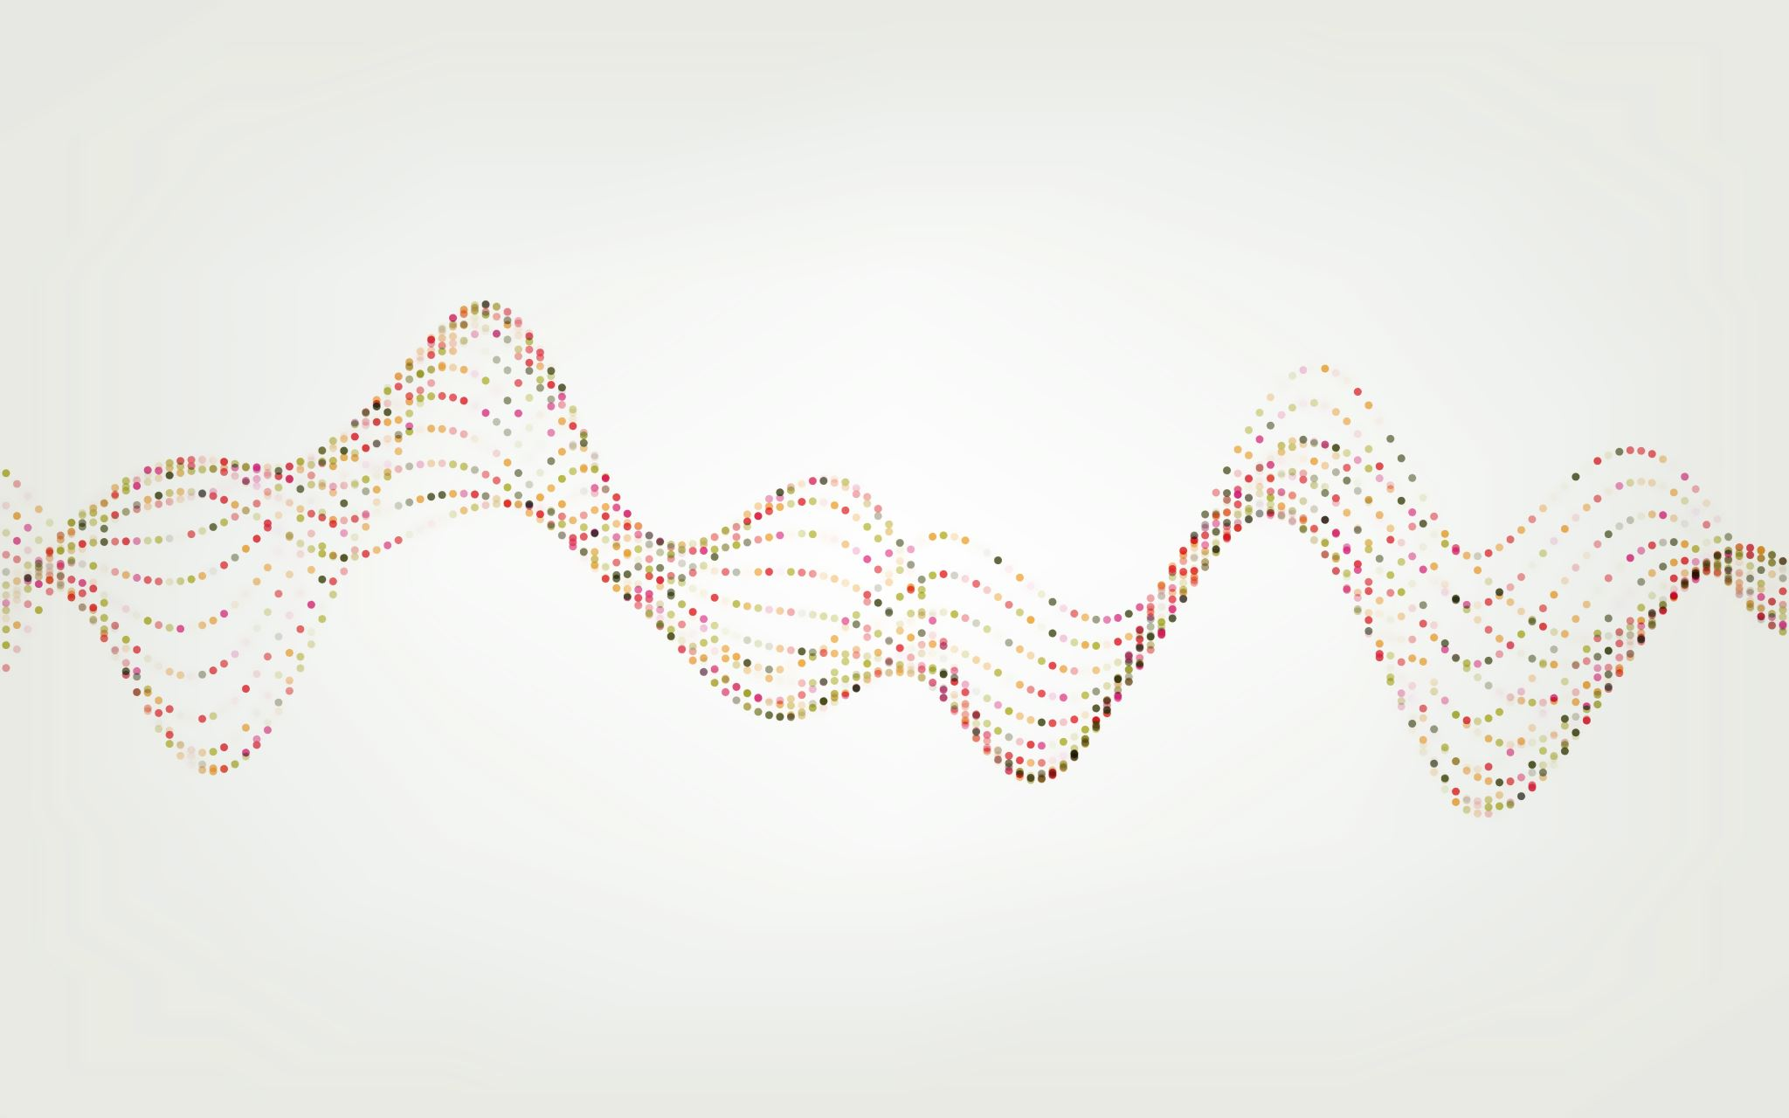
Intro to Machine Learning

Slide 2
What is Machine Learning?
“Machine learning is the field of study that gives computers the ability to learn without being explicitly programmed”
—Arthur L. Samuel, AI pioneer, 1959

Slide 3
What is Machine Learning?
A program is said to learn from experience E with respect to some task T and some performance measure P, if its performance on T, as measured by P, improves with experience E.
  — Tom Mitchell, Professor at Carnegie Mellon
  Experience: Data
  Task: Prediction, etc.
  Performance: RSME, etc.

Slide 4
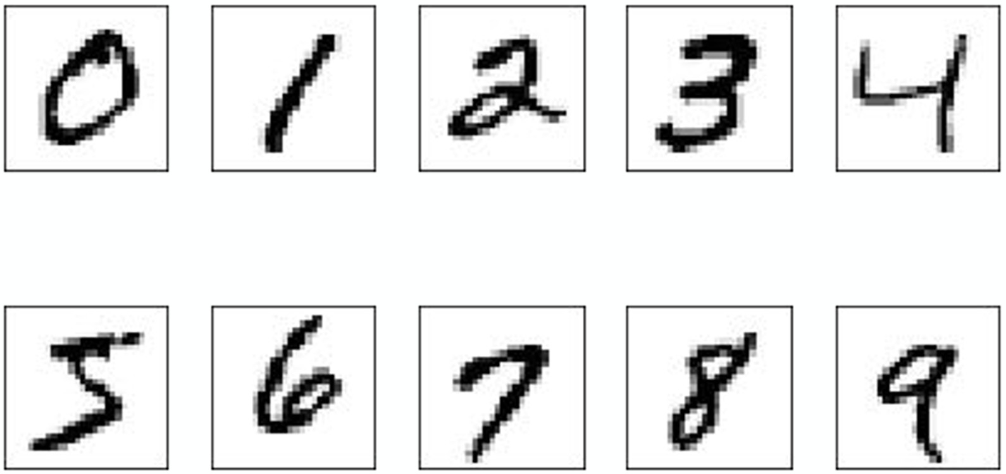
Machine learning tasks
Handwriting Recognition Example:
  Experience:
  Task:
  Performance:
Notes:
Maybe put after “what is ML”?

Slide 5
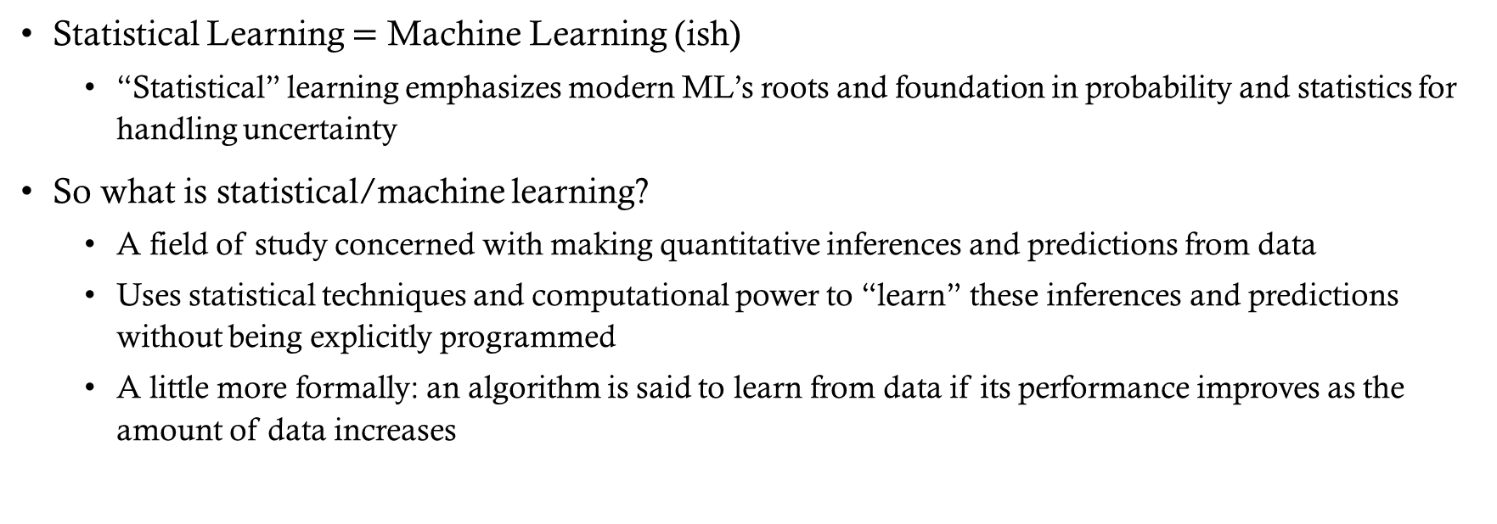
Wait, I’ve also heard about statistical learning…
Statistical Learning $=$ Machine Learning (ish)
  “Statistical” learning emphasizes modern ML’s roots and foundation in probability and statistics for handling uncertainty
So what is statistical/machine learning?
  A field of study concerned with making quantitative inferences and predictions from data
  Uses statistical techniques and computational power to “learn” these inferences and predictions without being explicitly programmed
  A little more formally: an algorithm is said to learn from data if its performance improves as the amount of data increases
Notes:
So to me and many researchers, there isn’t a difference. Others may disagree

Slide 6
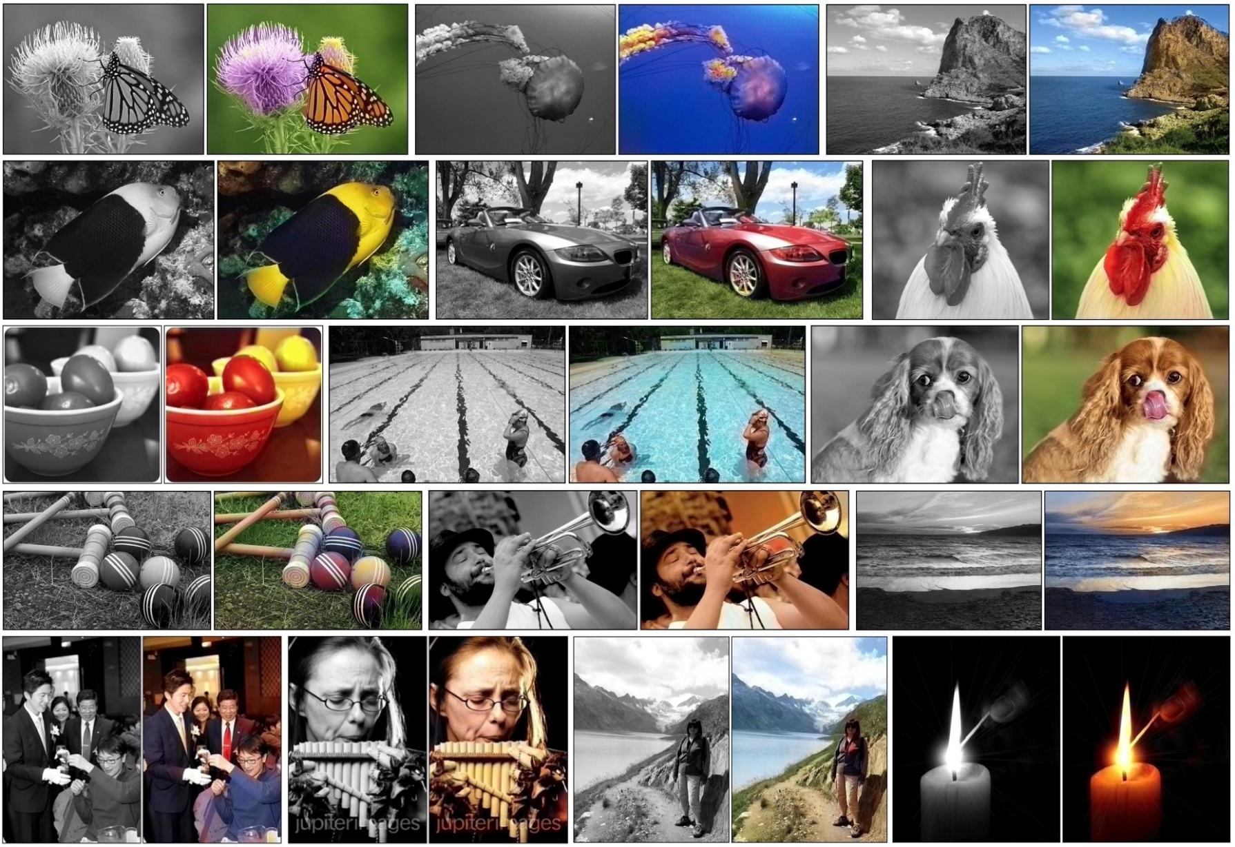
Success of Machine Learning
Image colorization (Zhang et al., 2016)

Slide 7


Success of Machine Learning
Image colorization (Zhang et al., 2016)
Colorized classical photographs by Ansel Adams

Slide 8
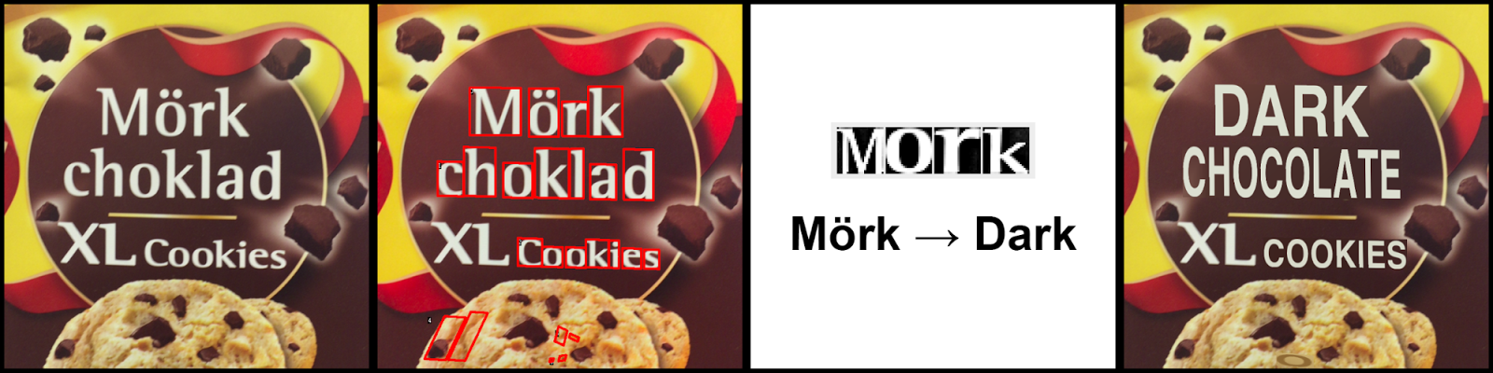
Success of Machine Learning
Real-time visual translation on smartphones
Find the letters
Recognize the letters
Translate
Render the translation in the same style
Google blog, 2015
Notes:
The entire process is done using deep neural nets

Slide 9
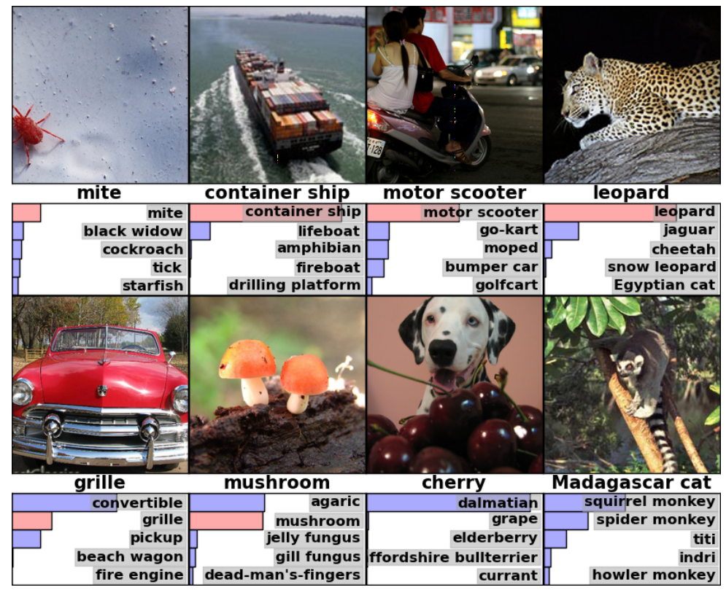
Success of Machine Learning
Object classification/detection in images (Krizhevsky et al., 2012)
Notes:
This was one of the breakthroughs, and even better results can be obtained now. Agaric is a type of mushroom

Slide 10
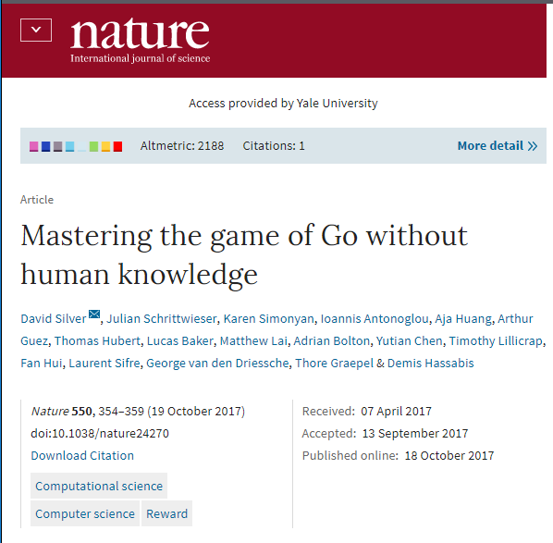
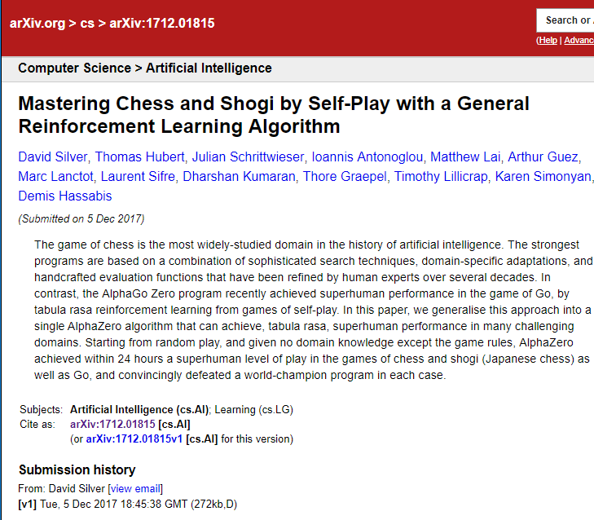
Success of Machine Learning
Alpha Go Zero
Alpha Zero
Automatic game playing

Slide 11
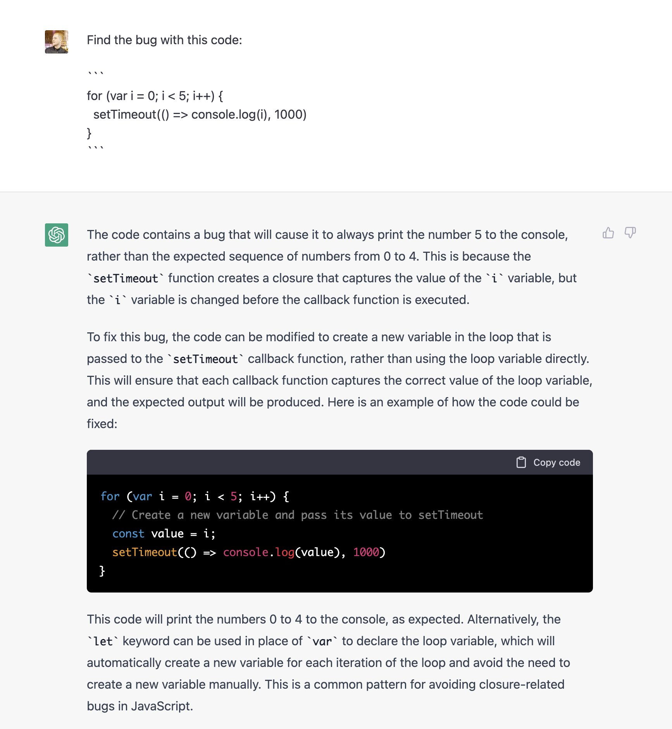
Success of Machine Learning
Automated programming with ChatGPT

Slide 12

Success of Machine Learning
AI generated art

Slide 13
I’m Just curious…
What are some of the most interesting things you have used ML/AI for?

Slide 14
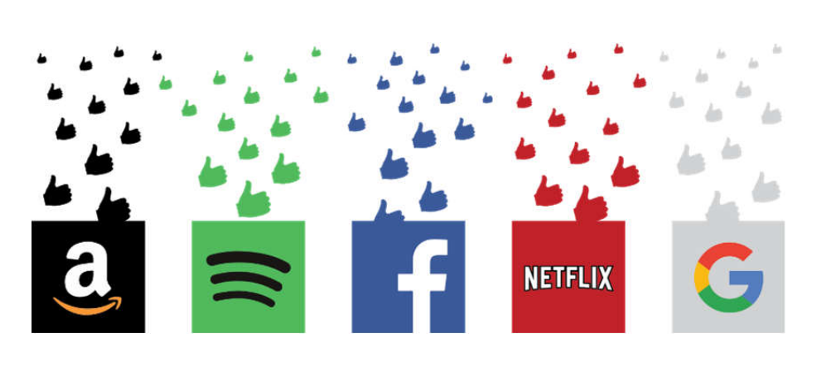
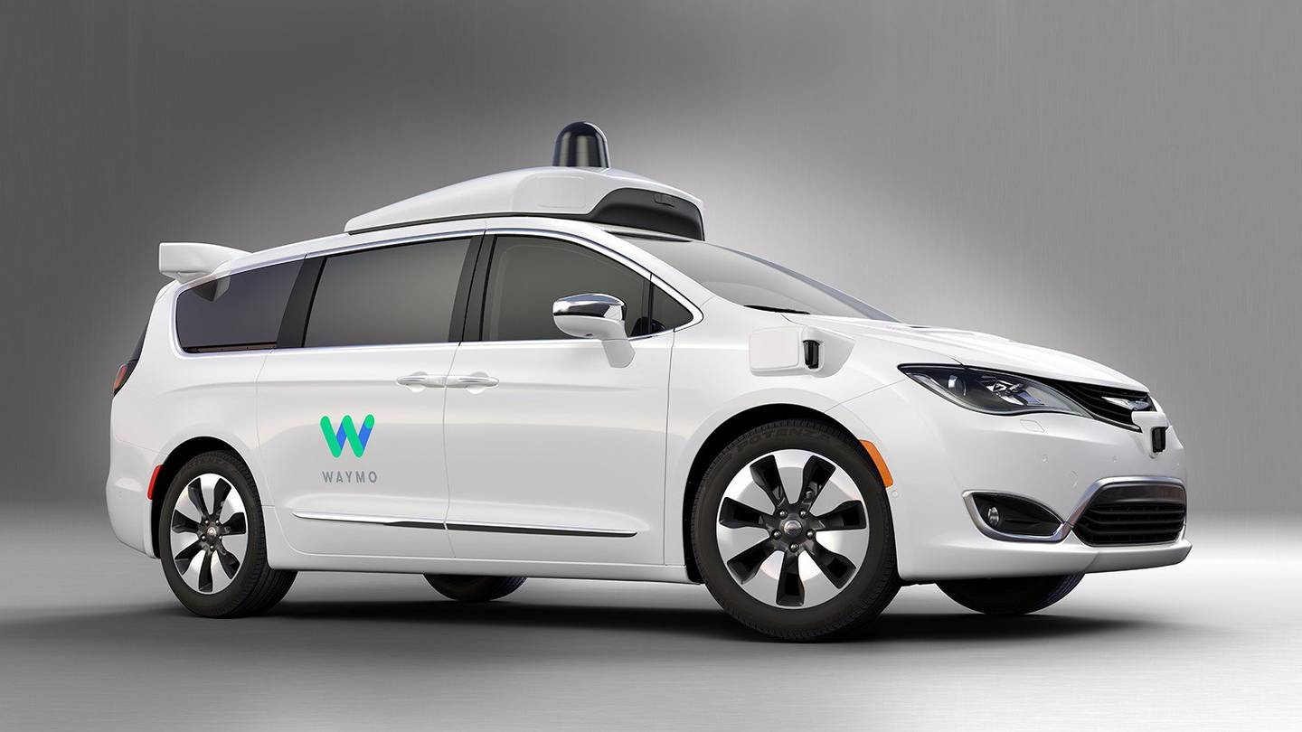
Other Machine Learning Applications
Chatbots (NLP)
Fraud detection
Route planning
Search engine refinement
Face recognition/detection
Credit risk assessment
Financial market prediction
Medical diagnosis
Personalized medicine
Electricity demand forecasting
Spam filtering
Collision avoidance systems
Speech synthesis/analysis (e.g. Siri, Alexa)
Recommender systems (e.g. Netflix, Spotify)

Slide 15
Categories of ml
Supervised Learning
  Labeled Data
  Predict Outcome
  Direct Feedback (E.g., accuracy, RMSE. Etc.)
Unsupervised Learning
  No Labels/Targets
  “Fuzzy” Feedback: No Target = No Objective Less Clear
Reinforcement Learning
  Set of states/actions
  Maximize “reward”

Slide 16
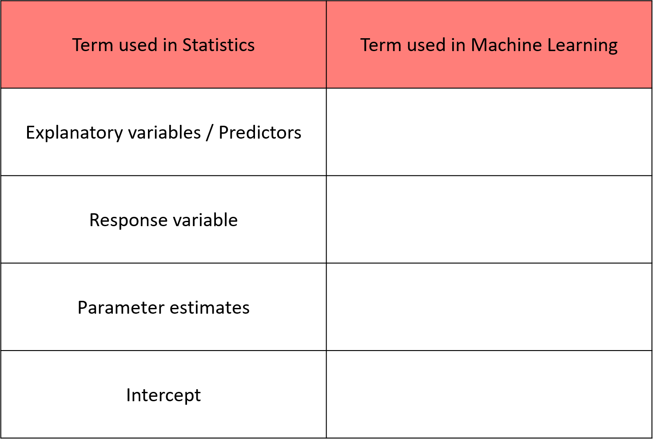
Machine Learning Vocabulary

Slide 17
Machine Learning Vocabulary
Term used in Statistics
Term used in Machine Learning
Observation / case
Example / instance
Explanatory variables / predictors
Features / input variables
Response variable
Target / label
Parameter estimates
Learned parameters / weights
Intercept
Bias term
Fitted model
Trained model
Fitted value
Prediction

Slide 18
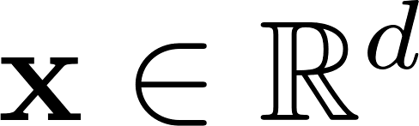

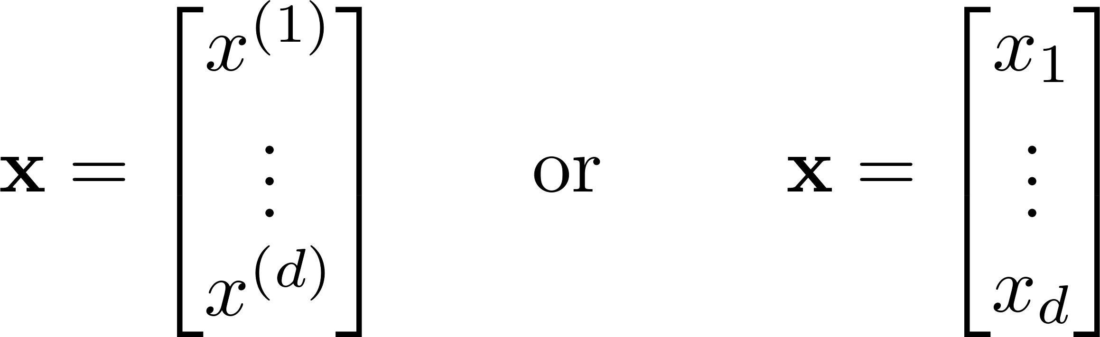

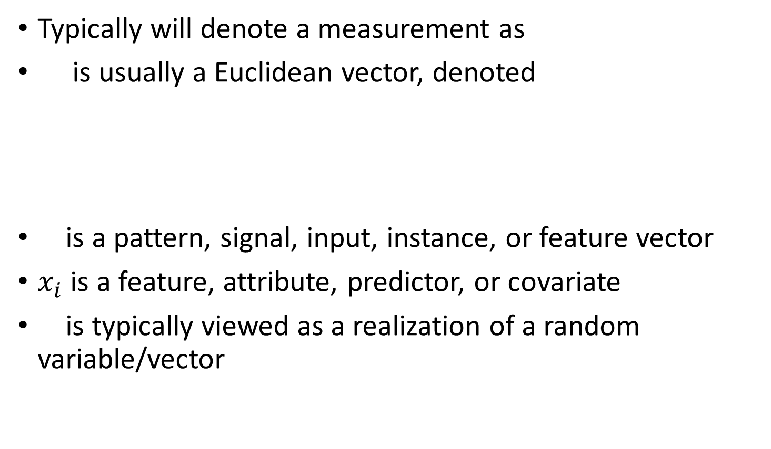
Some notation
Typically will denote a measurement as
is usually a Euclidean vector, denoted
is a pattern, signal, input, instance, or feature vector
$x_{i}$ is a feature, attribute, predictor, or covariate
is typically viewed as a realization of a random variable/vector
Notes:
JUST SOMETHING ABOUT NOTATION, UPDATE

Slide 19

Why estimate f?
Prediction
      Inputs X are available, but the output Y is unknown or future.
      $\overset{ˆ}{Y}=\overset{ˆ}{f}\left(X\right)$: a black-box model can be fine if it predicts accurately.
Inference
      Understand how Y is related to X.
      Which predictors matter? What is the direction/size of each relationship?
      Many real problems require both prediction and inference.

Slide 20
Goals of Supervised ML
Prediction
    Predict the target for new observations
    Forecast the target for future observations
Interpretation
    Which feature are associated with the target?
    What is the relationship between target and each feature?
    Are some features more important than others?
    Is there an explainable grouping in the data?

Slide 21
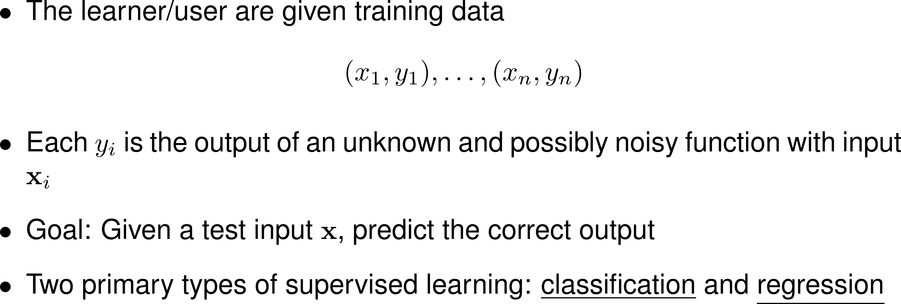
Supervised learning
Notes:
In other words, we’re trying to learn a function that maps from x to y (write down on board)

Slide 22
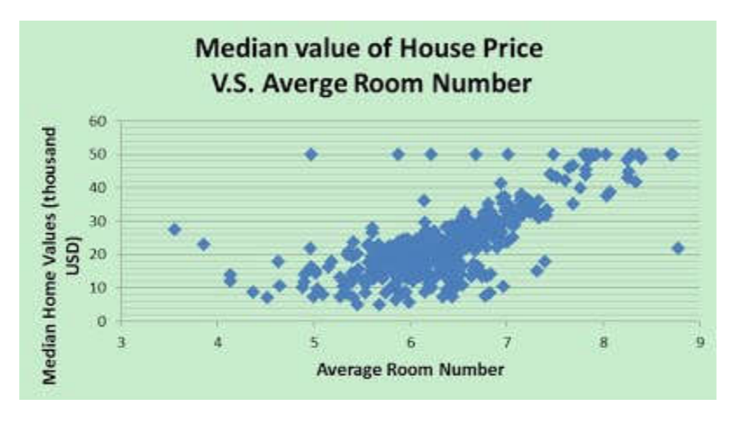
Regression
Notes:
Regression is largely left for another class

Slide 23
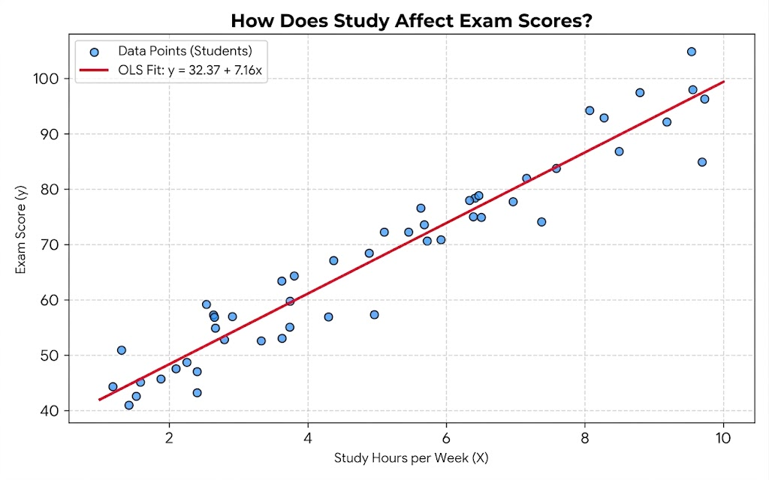
Regression
Notes:
Regression is largely left for another class

Slide 24
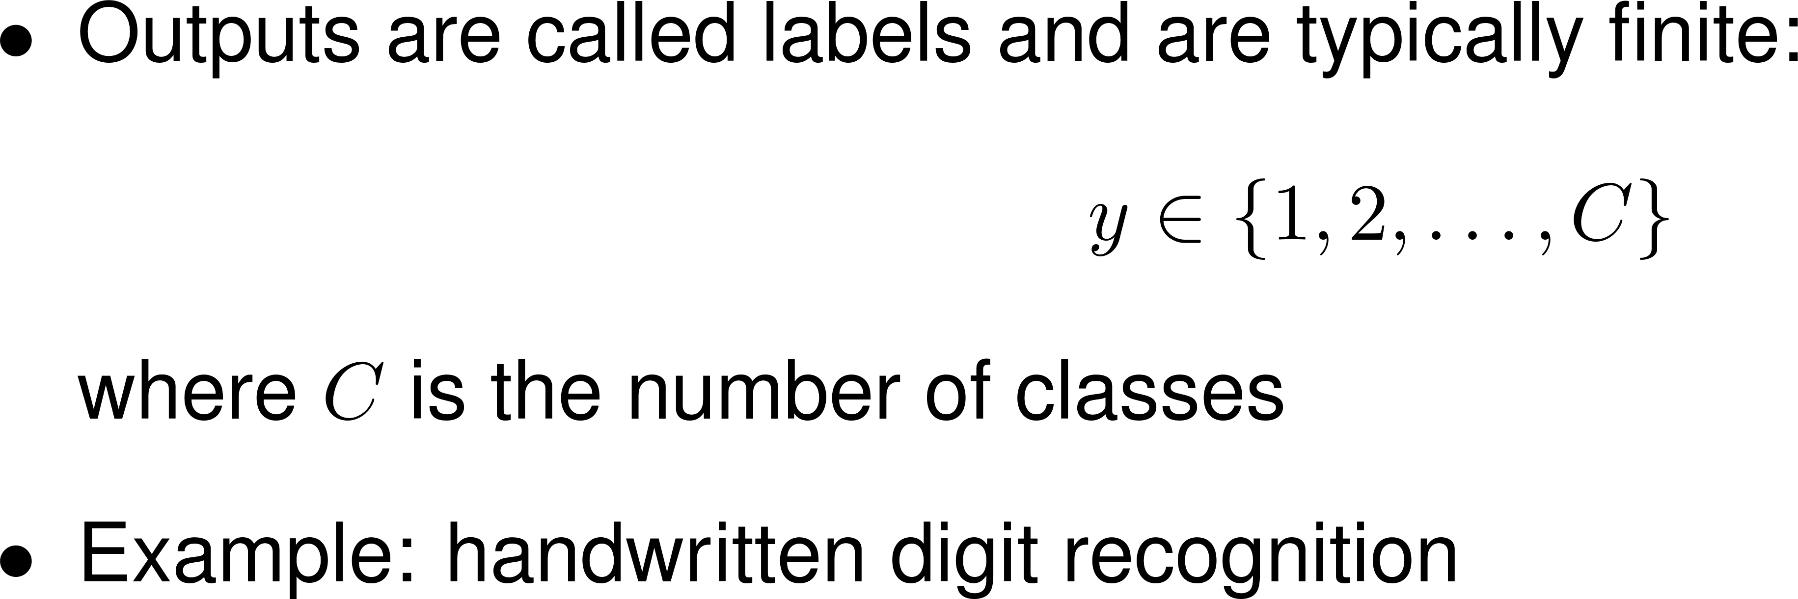
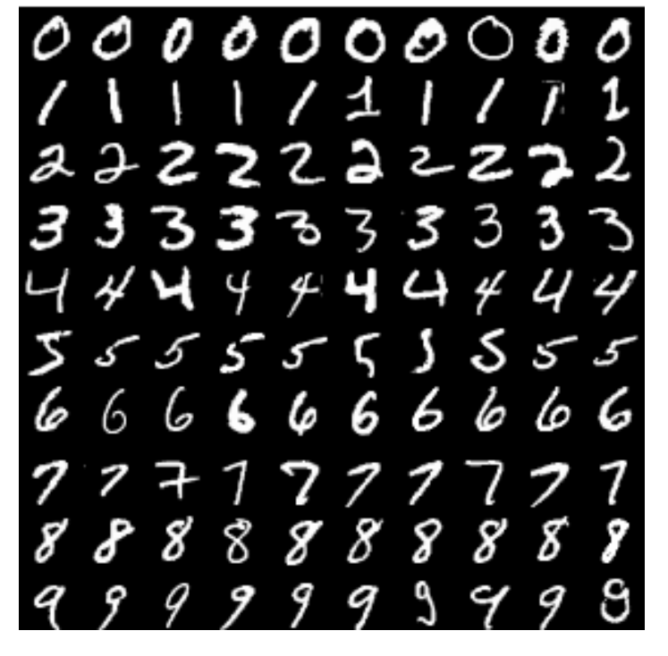
Classification

Slide 25
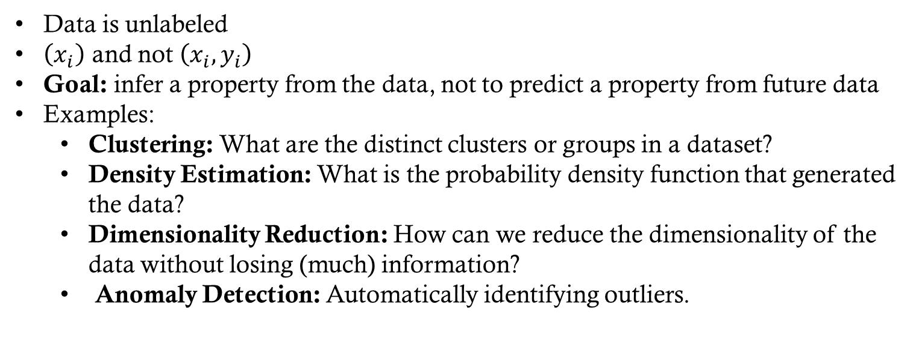
Unsupervised Learning
Data is unlabeled
$\left(x_{i}\right)$ and not $\left(x_{i},y_{i}\right)$
Goal: infer a property from the data, not to predict a property from future data
Examples:
  Clustering: What are the distinct clusters or groups in a dataset?
  Density Estimation: What is the probability density function that generated the data?
  Dimensionality Reduction: How can we reduce the dimensionality of the data without losing (much) information?
  Anomaly Detection: Automatically identifying outliers.

Slide 26
Artificial intelligence vs. machine learning
Artificial Intelligence (AI) is a broad field concerned with building systems that exhibit intelligent behavior
As a field, AI generally includes machine learning, but also includes more
Most recent, popular “AI” advances are better classified as machine learning advances
AI has become the latest buzzword, so many machine learning methods and problems are being rebranded as AI
Note: Many statistical methods have also been rebranded as ML methods…
  Linear Regression (and variants, such as LASSO)
  Logistic Regression
  Principal Components Analysis

Slide 27
Instance-based vs Model-based
Instance-Based
    Learn training data by heart
    Generalize to new observations based on similarity to existing observations
      Requires a metric that quantifies similarity
    Example: k Nearest Neighbors (k-NN)

Slide 28
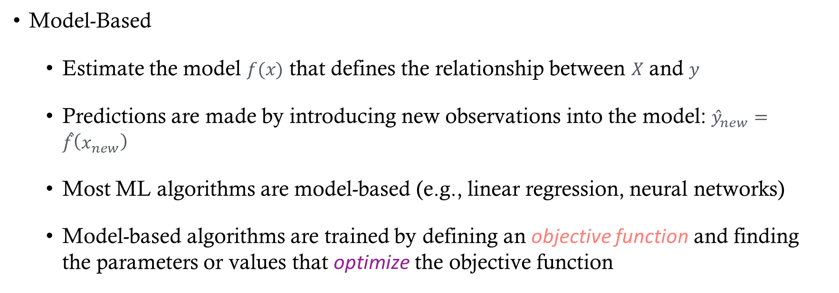
Instance-based vs Model-based
Model-Based
    Estimate the model $f(x)$ that defines the relationship between $X$ and $y$
    Predictions are made by introducing new observations into the model:${\hat{y}}_{new}=\hat{f}\left(x_{new}\right)$
    Most ML algorithms are model-based (e.g., linear regression, neural networks)
    Model-based algorithms are trained by defining an objective function and finding the parameters or values that optimize the objective function

Slide 29
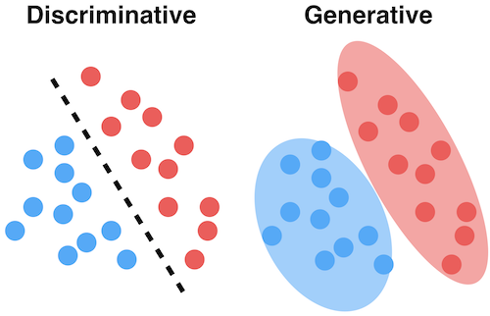
Some terms
Some adjectives used to describe ML algorithms
Distributional assumptions
  Generative: assumes a full probabilistic model of the observed data
  Discriminative: assumes a partial or no probabilistic model
Computational form
  Linear: produces a linear/affine function
  Nonlinear: not linear
Complexity
  Parametric: # of model parameters* is independent of sample size
  Nonparametric: # of model parameters* grows with sample size
Learning Type
  Lazy learner: No explicit model is built at training time (usually instance-based).
  Eager learner: A general model is built during training.
*Model parameters = parameters needed to represent the function produced by the learning algorithm
Notes:
Linear methods are often much easier to both understand and implement

Slide 30
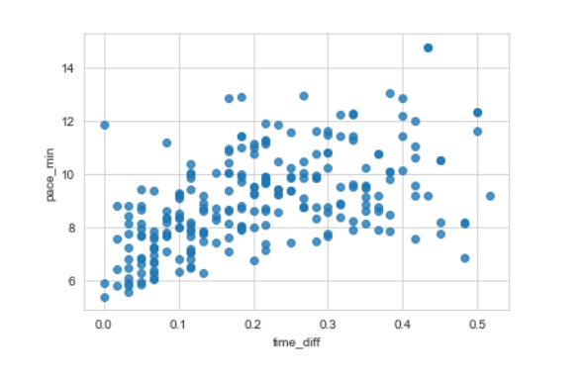
Example: simple linear regression
How does simple linear regression work?

Slide 31

Example: simple linear regression
Objective function: (this is a cost function since we want to find the minimum)
$L\left(β_{0},β_{1}\right)=\sum_{i=1}^{n}{{\left(y_{i}−\left(β_{0}+β_{1}x_{i}\right)\right)}^{2}}$
  We find the $\hat{β_{1}}$and $\hat{β_{0}}$that minimize the objective function
Optimization method:
  How do we perform the optimization?

Slide 32
General model-based training framework
Define an appropriate objective function
    Cost/Loss functions are minimized
    Utility/Fitness functions are maximized
      For example the likelihood in MLE is a utility function
“Train” the model by solving the optimization problem using an appropriate optimization method
    a “closed-form” solution (rare)
    a numerical method (usually)

Slide 33
Challenges in ml

Slide 34
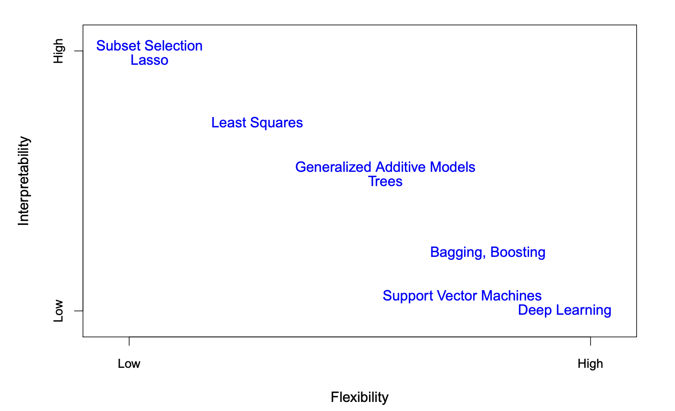
Interpretability vs Flexibility
(Graphic from ISLP)
Parametric
Non-parametric

Slide 35
Challenges in Machine Learning
Big data (both sample size and dimension)
Imbalanced labels
Noisy labels
Missing labels
Missing features
Uncertainty
Data representations
Safety (e.g., self-driving cars)
Fairness
Ethics
Explainability/Interpretability
Changing environment
Notes:
In a car crash with a self-driving car, who is to blame? The manufacturer? The software engineer?
Fairness example: Amazon built a resume analyzer using ML but scrapped it when they found it was biased against women
What if it starts snowing while driving and you haven’t trained the car for that very much?

Slide 36
Main Challenge of Machine Learning
(According to Hands On Machine Learning)
Insufficient quantity of training data
Non-representative training data
Poor-quality data
Irrelevant features
Under- and overfitting

Slide 37
Main Challenge of Machine Learning
Insufficient quantity of training data
Non-representative training data (e.g., distribution shift)
Poor-quality data
Irrelevant features
Under- and overfitting
Most of these issues boil down to one idea:
Your results are only as good as your data

Slide 38

The importance of data
Data is the fuel that powers our learning machine
No amount of model improvement can compensate for “bad” data
  “Bad” data is not always poor quality
  Sometimes “bad” data is just the wrong data for the task

Slide 39
Things to ask of your data
What data is available?
Is the data still relevant?
What other data sources might be available?
Is there enough data?
Where did the data come from?
Do you know and trust the data source?
Does the available data actually answer the question?

Slide 40
Potential biases in data
Selection bias: Data is selected for convenience or self-selected
Confirmation bias: We are less critical of data (and results) that confirm our prior beliefs
Societal bias: Data often reflects cultural stereotypes
Measurement bias: Biases due to limitations of measurement devices
Proxy measurement bias: A proxy measurement is used for something that is hard to measure
Exclusion bias: Important variables might not be measured
Sampling bias: Data isn’t representative or doesn’t reflect realities of where the ML model will run
Human bias: All data is somehow collected by humans

