Slide 1
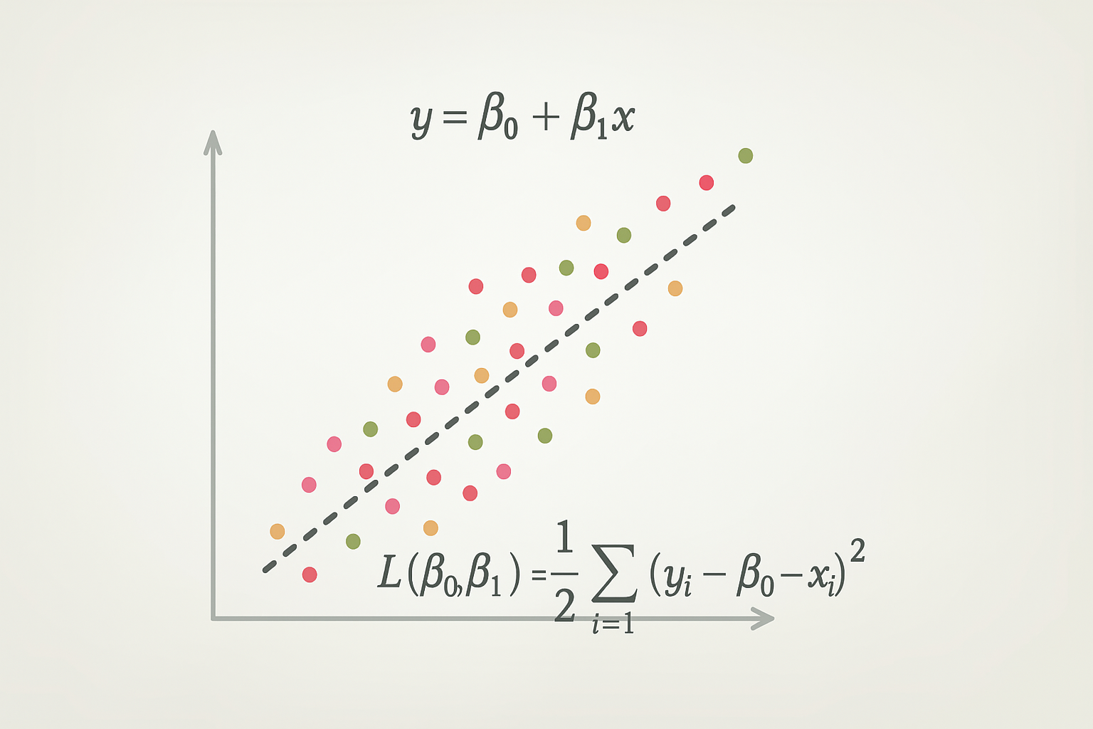
Intro to regression

Slide 2
Linear Regression

Slide 3
Linear Regression
Linear regression is a supervised learning approach for predicting a quantitative response
Linear regression has been around for a long time
Still very widely used
Best method for truly linear relationships
Many "fancier" methods are based on linear regression

Slide 4
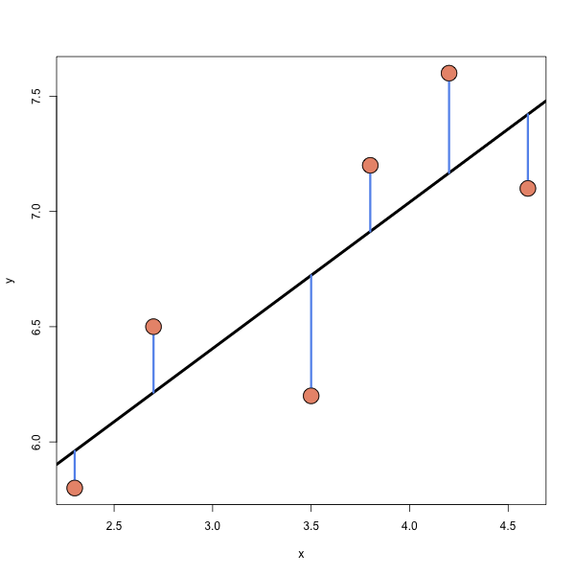
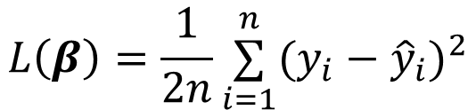
Least Squares
Least squares line is the line that minimizes
$$L\left(β\right)=\frac{1}{2n}\overset{n}{\underset{i=1}{∑}}(y_{i}−{\hat{y}}_{i})^{2}$$

Slide 5
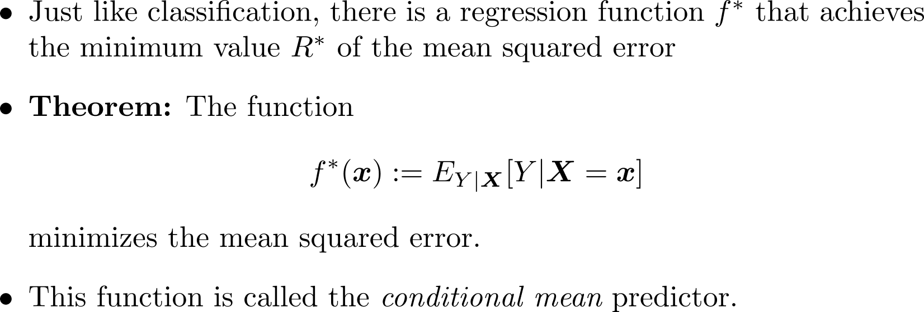
Conditional Mean

Slide 6
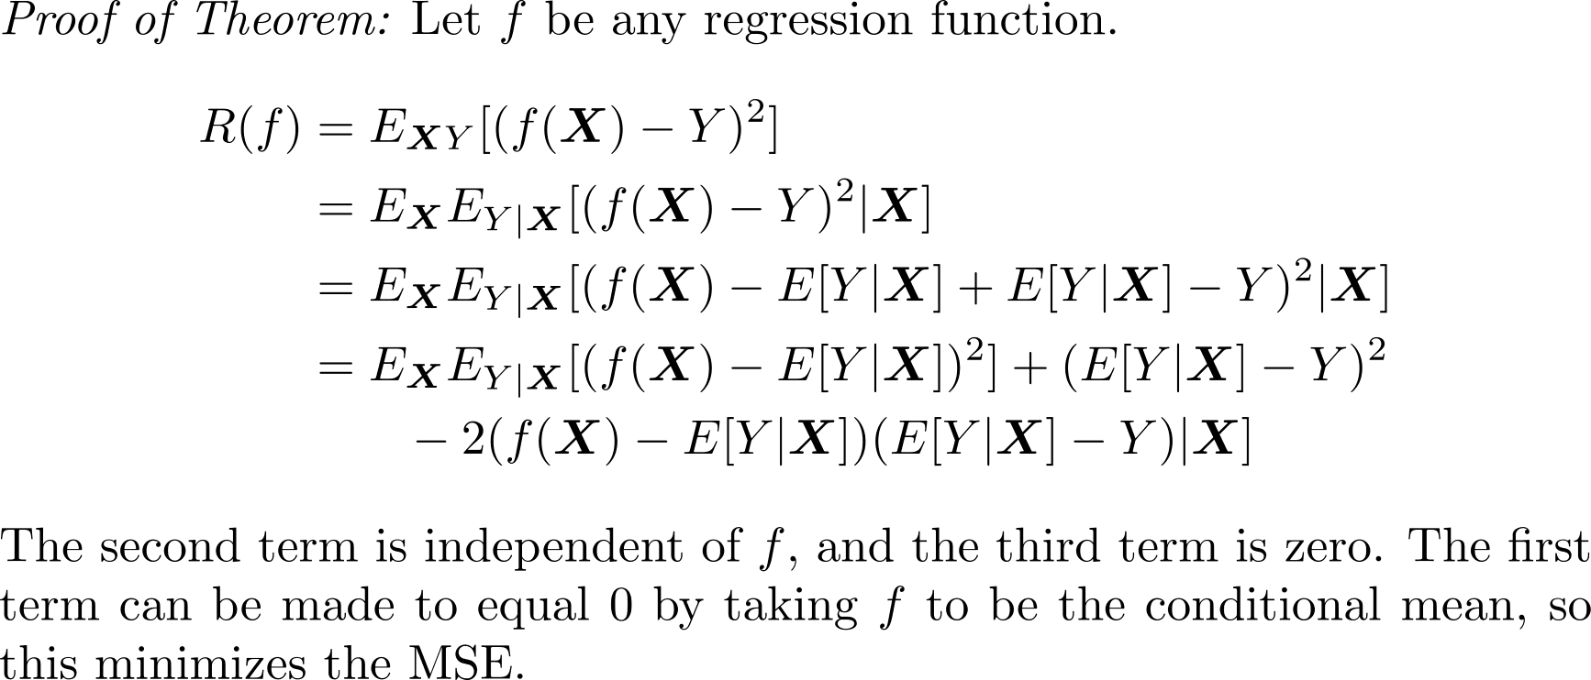
Conditional Mean

Slide 7
Training a Linear Regression Model

Slide 8
General model-based training
Define an appropriate objective function
Cost/Loss functions are minimized (machine learning)
Utility/Fitness functions are maximized (statistics)
For example, the likelihood in MLE is a utility function
“Train” the model by solving the optimization problem using an appropriate optimization method
a “closed-form” solution (rare)
a numerical method (usually)
Gradient descent or variants (Adam, Newton’s method)

Slide 9
Optimizing the objective function
Minimum vs. Minimizer
Given a function, f, how do we minimize the function?
What if there is no analytic solution? (I.e., no closed form?)
A minimizer is the value x that produces the smallest output f(x).
Differential calculus!
Numerical approaches.

Slide 10


Typical Forms of linear regression models
Scalar Form
$y_{i}=β_{0}+\sum_{j=1}^{p}{β_{j}}x_{ij}+ε_{i} \text{ for }i=1,2,…,n$
Matrix Notation
$y=Xβ+ε$
Assumptions
Linearity
Homoscedasticity
Independence of Errors
Normal Residuals
No Multicollinearity

Slide 11

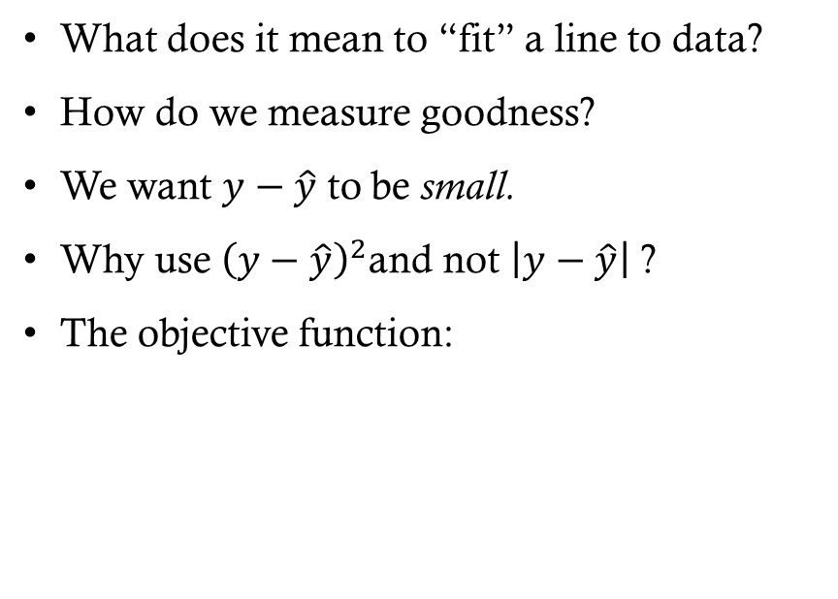
Ordinary least squares objective
What does it mean to “fit” a line to data?
How do we measure goodness?
We want $y−\hat{y}$ to be small.
Why use ${\left(y−\hat{y}\right)}^{2}$and not $\left|y−\hat{y}\right|$ ?
The objective function:
We want $\hat{y}=Xβ$ to be a good approximation.
Differentiability/punishing larger errors.
$$J\left(β\right)=\frac{1}{2n}​{\left(y−Xβ\right)}^{T}\left(y−Xβ\right)$$

Slide 12

Method 1: Normal Equations
Matrix notation cost function: $J(β)=\frac{1}{2n}(y−Xβ)^{T}(y−Xβ)$
Optimal $\hat{β}$: $\hat{β}=(X^{T}X)^{−1}X^{T}y$

Slide 13
Method 2: Gradient Descent
To be continued…!

Slide 14
“Nonlinear” linear regression

Slide 15
Polynomial Regression
Sometimes the relationship between X and y is non-linear
We can use linear regression to model non-linear relationships (between X and y)
Add quadratic, cubic, etc. terms to the model
This is sometimes called polynomial regression
(Now we are moving into the realm of multiple regression, where we have more than one predictor)
$$y_{i}=β_{0}+β_{1}x_{i}+β_{2}x_{i}^{2}+β_{3}x_{i}^{3}+ε_{i}$$

Slide 16
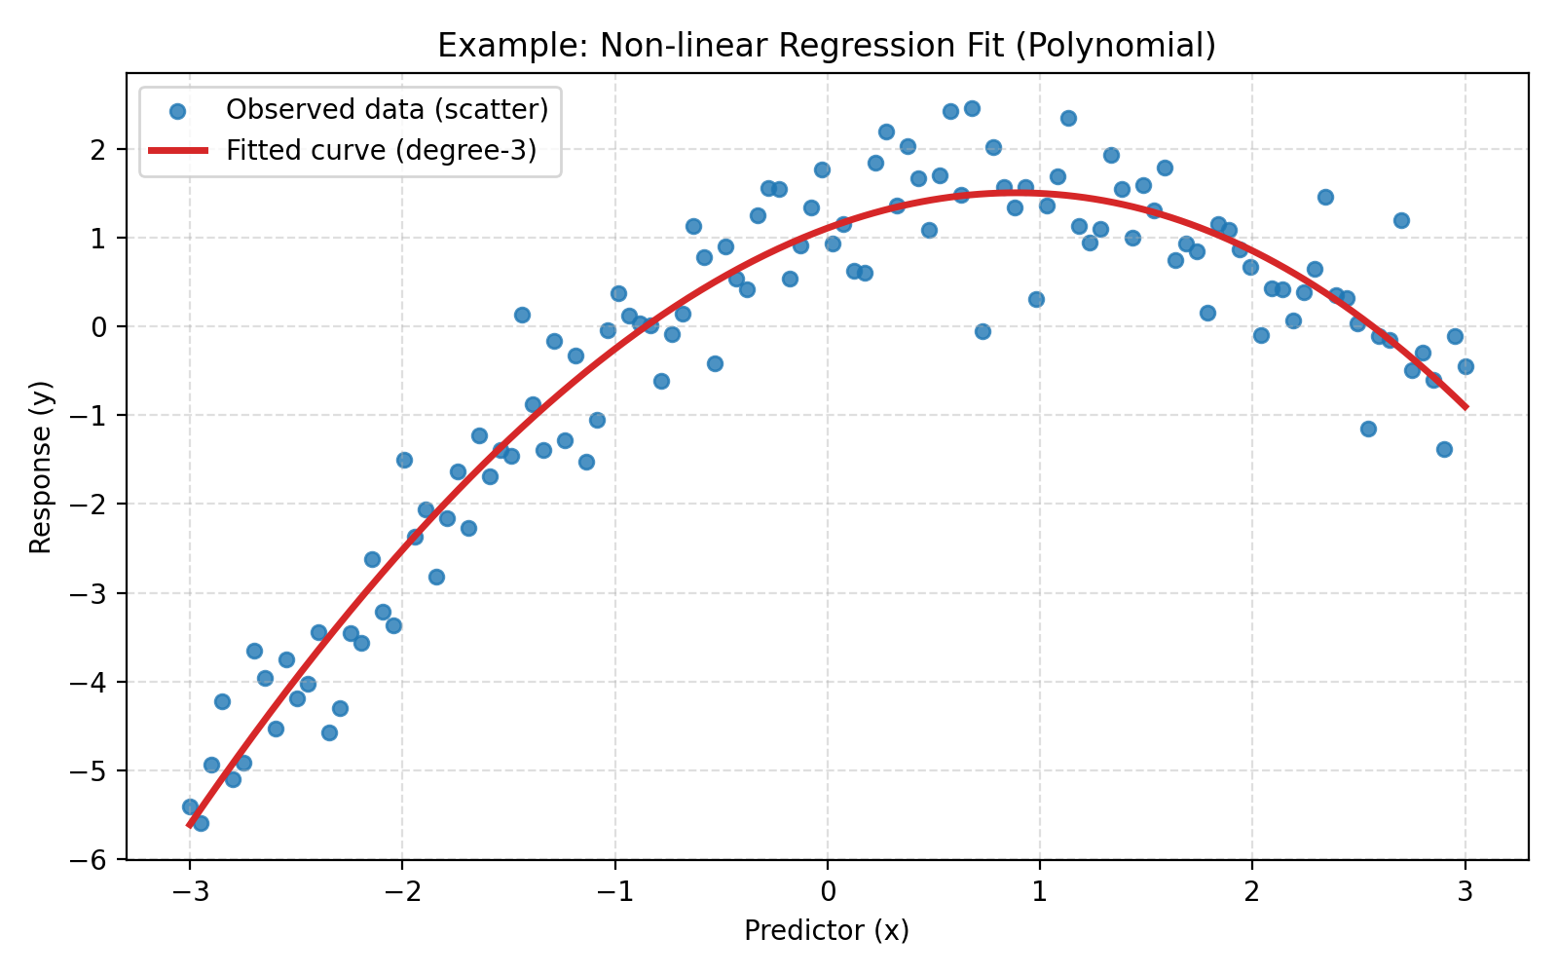
Polynomial Regression
$$y_{i}=β_{0}+β_{1}x_{i}+β_{2}x_{i}^{2}+ε_{i}$$

Slide 17
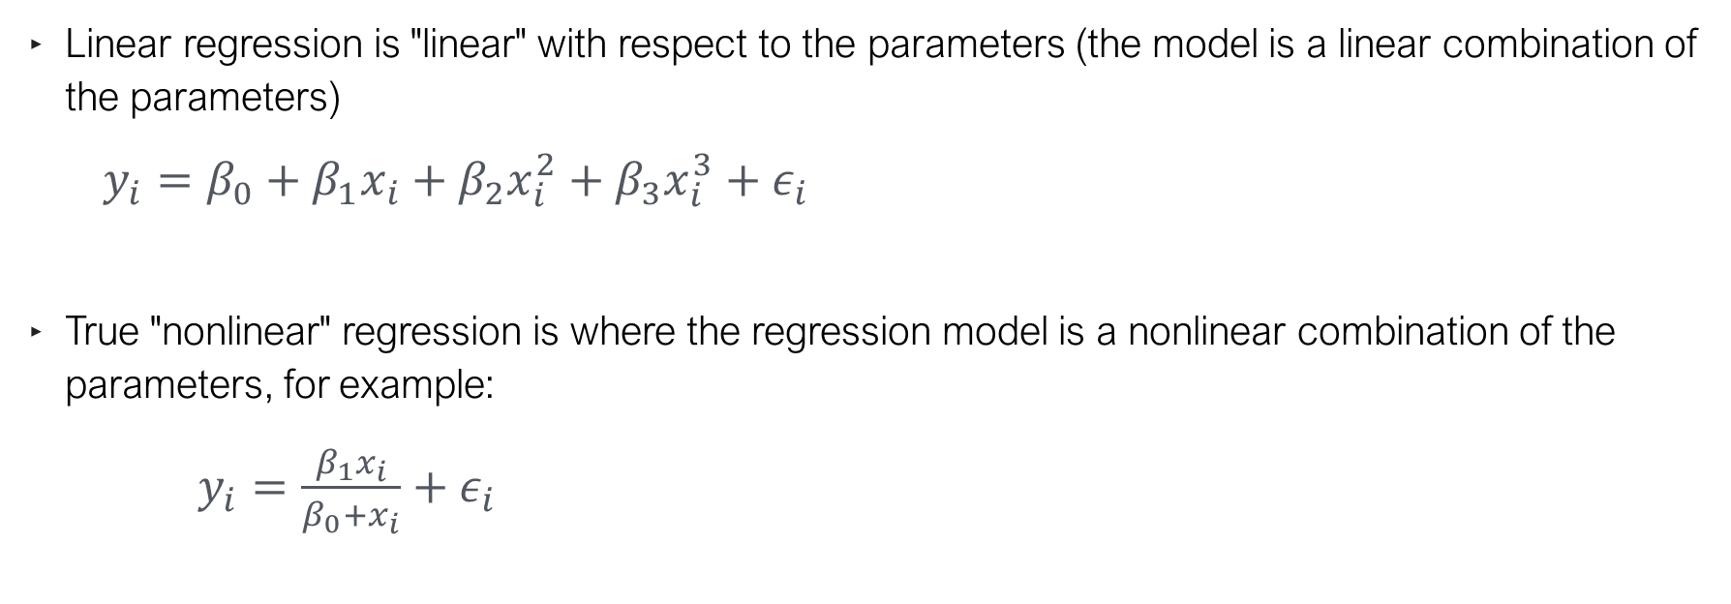
Terminology
Linear regression is "linear" with respect to the parameters (the model is a linear combination of the parameters)
$y_{i}=β_{0}+β_{1}x_{i}+β_{2}x_{i}^{2}+β_{3}x_{i}^{3}+ε_{i}$
True "nonlinear" regression is where the regression model is a nonlinear combination of the parameters, for example:
$y_{i}=\frac{β_{1}x_{i}}{β_{0}+x_{i}}+ε_{i}$

Slide 18
More Terminology
Just FYI:
Multiple regression is a regression model with more than one predictor (or feature)
Multivariate regression is a regression model with more than one response (or target)

Slide 19
Interaction & polynomial features
from sklearn.linear_model import LinearRegression
from sklearn.preprocessing import PolynomialFeatures
# Add squared and cubed features for every predictor plus interactions
poly = PolynomialFeatures(degree=3)
X = poly.fit_transform(X)
# Only include up to 3rd-order interactions
inter = PolynomialFeatures(degree=3, interaction_only=True)
X = inter.fit_transform(X)

Slide 20
Regression Metrics

Slide 21

Evaluating a regression model
In regression (we are predicting a numeric variable), what does a “good” prediction look like?
Ideally, $\hat{y}$, (the prediction) is close to $y$ (the observed value)

Slide 22
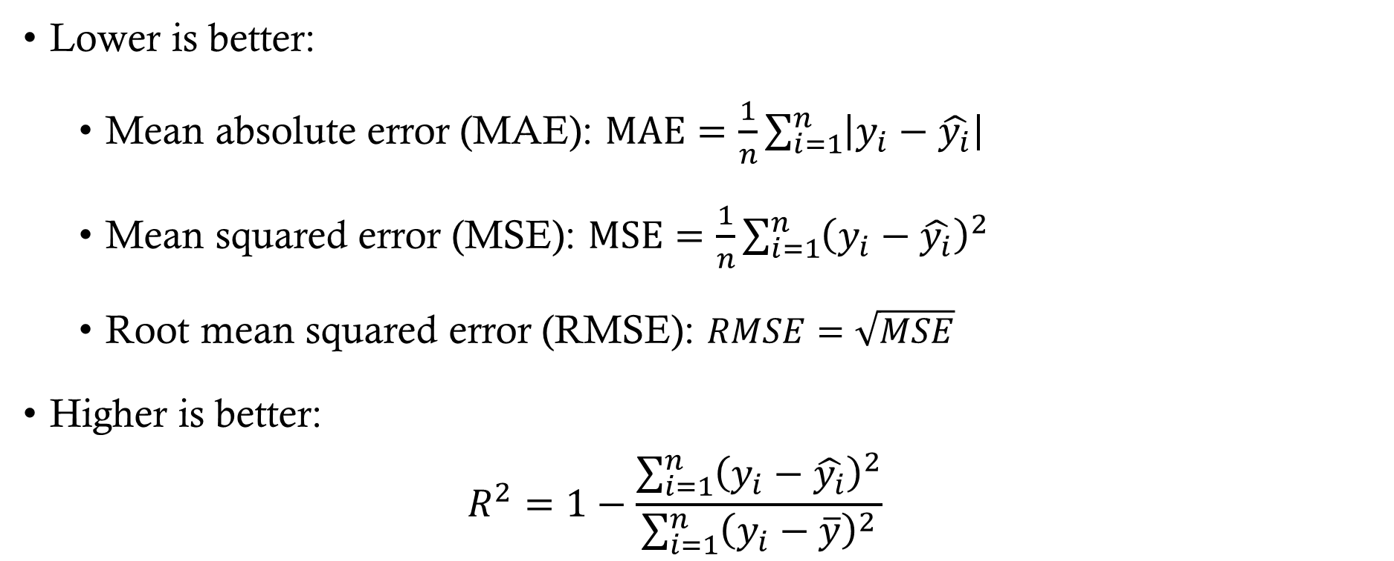
Common Regression Metrics
Lower is better:
Mean absolute error (MAE): $\text{MAE}=\frac{1}{n}\sum_{i=1}^{n}{\left|y_{i}−\hat{y_{i}}\right|}$
Mean squared error (MSE): $\text{MSE}=\frac{1}{n}\sum_{i=1}^{n}{{\left(y_{i}−\hat{y_{i}}\right)}^{2}}$
Root mean squared error (RMSE): $RMSE=\sqrt{MSE}$
Higher is better:
$$R^{2}=1−\frac{\sum_{i=1}^{n}{{\left(y_{i}−\hat{y_{i}}\right)}^{2}}}{\sum_{i=1}^{n}{{\left(y_{i}−\overline{y}\right)}^{2}}}$$

Slide 23
Regression Metric Comparisons
MAE Mean Absolute Error
+ Easy to interpret
+ Tolerant of outliers
− Underweights large errors
R² Coefficient of Determination
+ Variance explained
+ Comparable across models
− Misleading for non-linear
MSE Mean Squared Error
+ Penalizes large errors
+ Optimization-friendly
− Sensitive to outliers
RMSE Root Mean Squared Error
+ Same units as target
+ Highlights large errors
− Sensitive to outliers

Slide 24
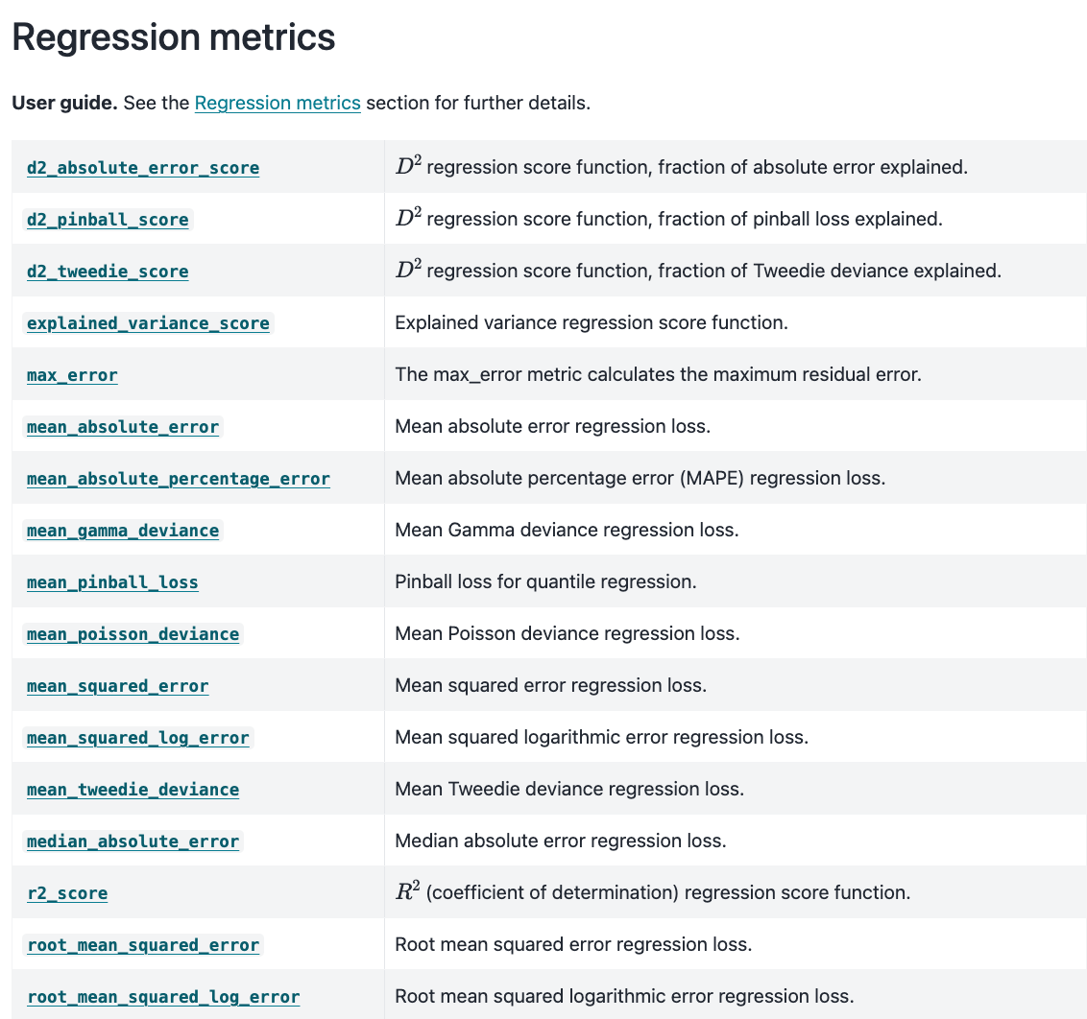
Regression Metrics in Scikit-Learn
In v1.4 or greater (previous versions have a “squared” argument in the MSE function)

Slide 25
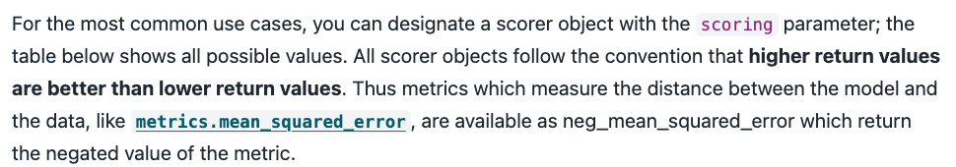
Model Selection Metrics
Models selection tools, such as “GridSearchCV” and “cross_val_score” use a scoring parameter
‘neg_root_mean_squared_error’ requires v1.4+; earlier versions use the “squared” argument

