Slide 1
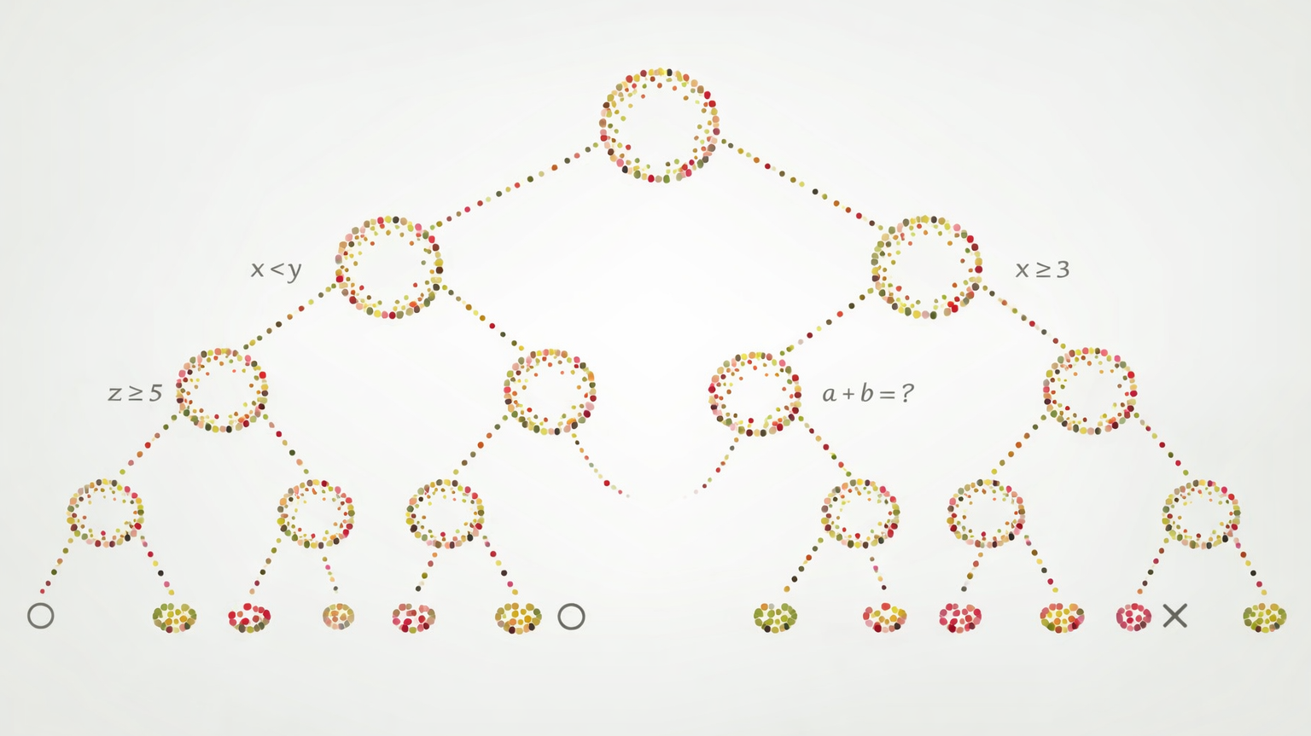
Decision Trees

Slide 2
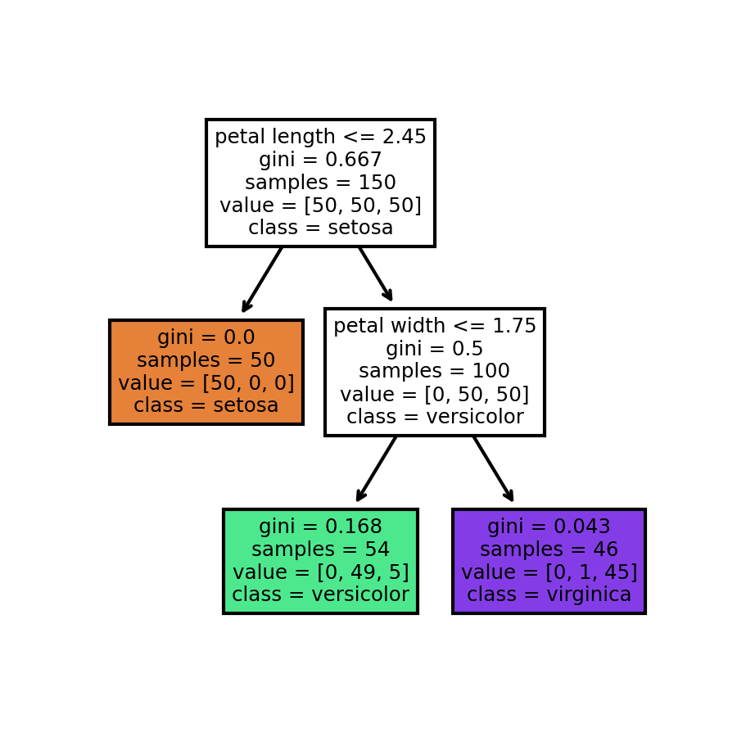
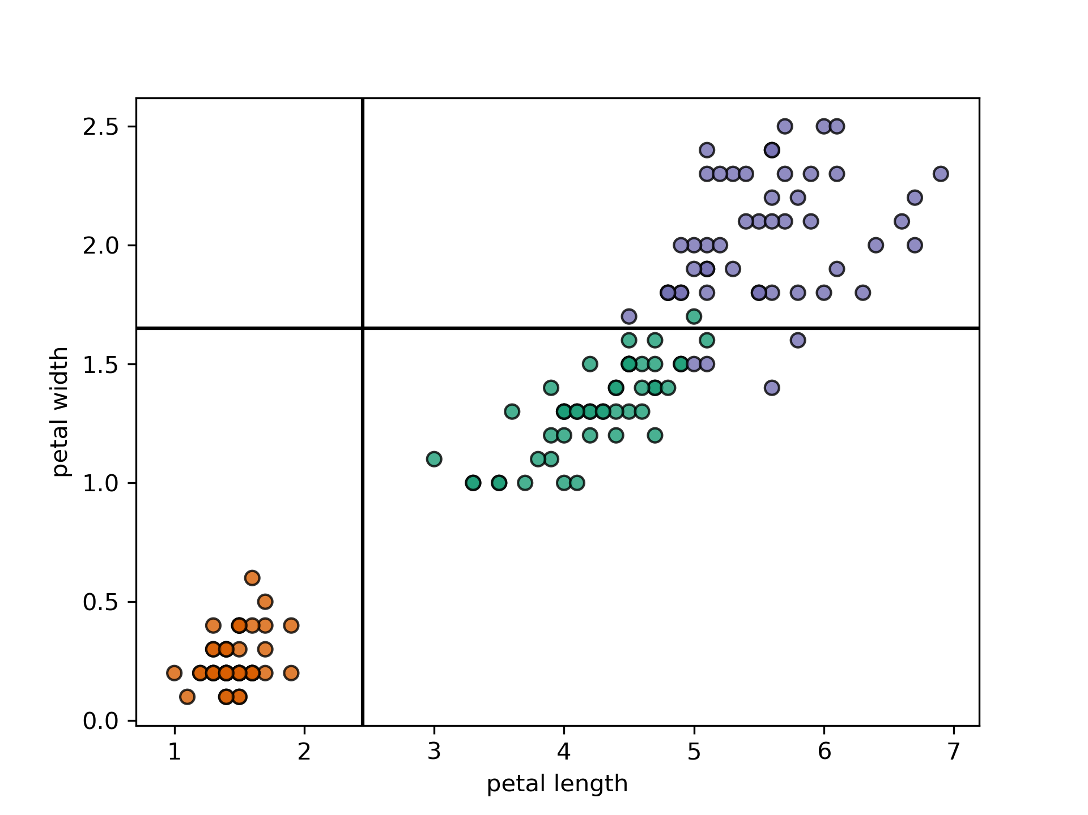
Example Decision Tree

Slide 3
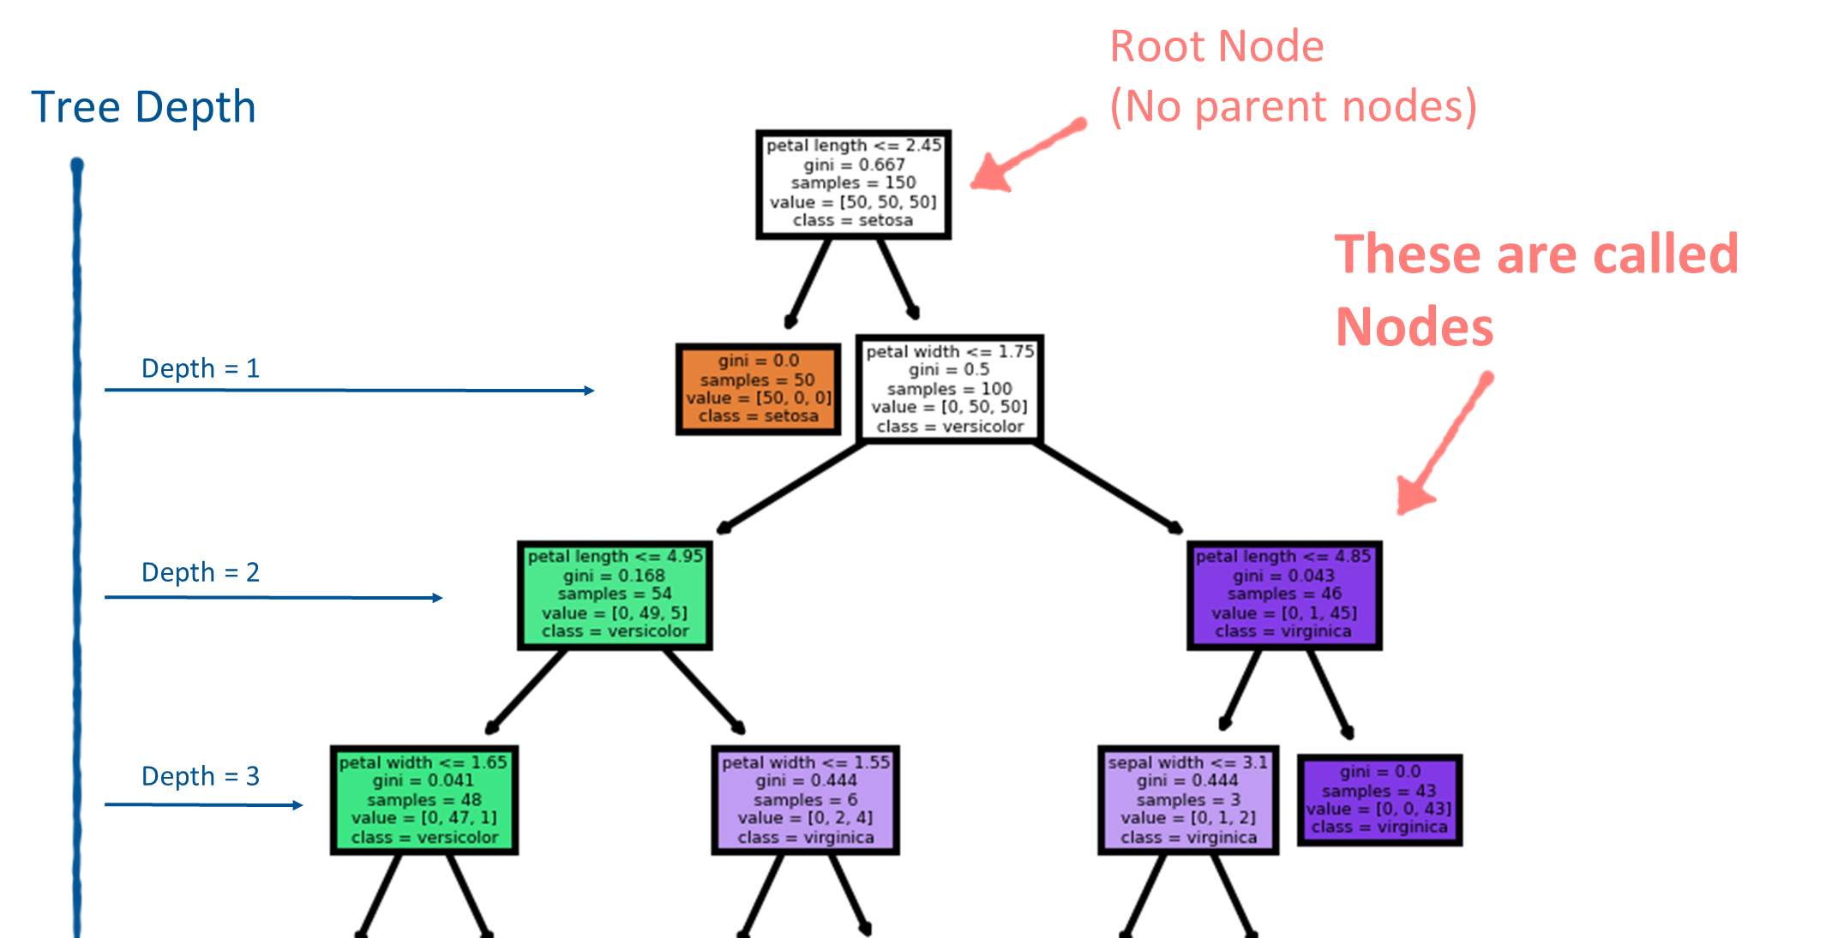

Slide 4
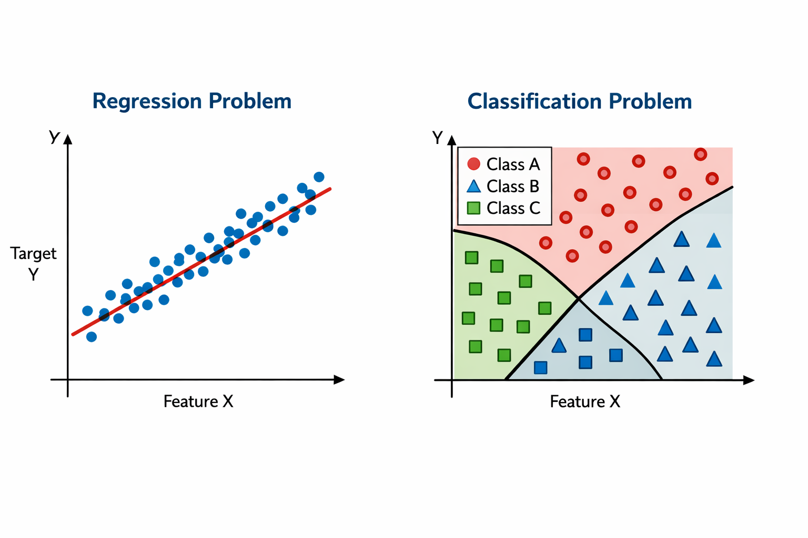
How To fit?
Binary decision search algorithm.
Partition (split) data to optimize some objective.
What might that objective be?

Slide 5

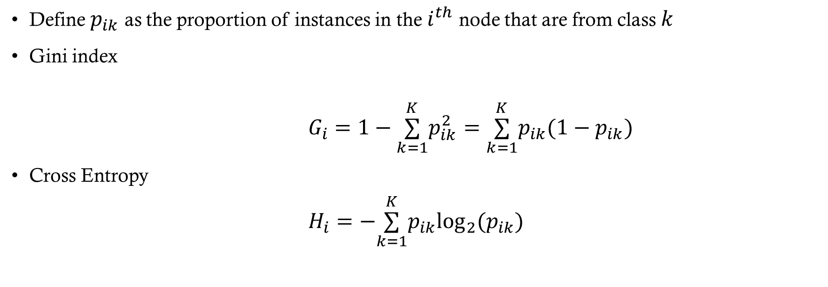
Node Impurity Measures (Classification)
Define $p_{ik}$ as the proportion of instances in the $i^{th}$ node that are from class $k$
Gini index
$G_{i}=1−\overset{K}{\underset{k=1}{∑}}p_{ik}^{2}=\overset{K}{\underset{k=1}{∑}}p_{ik}(1−p_{ik})$
Cross Entropy
$H_{i}=−\overset{K}{\underset{k=1}{∑}}p_{ik}\log_{2}(p_{ik})$
$$\text{if}p_{ik}≠0$$

Slide 6

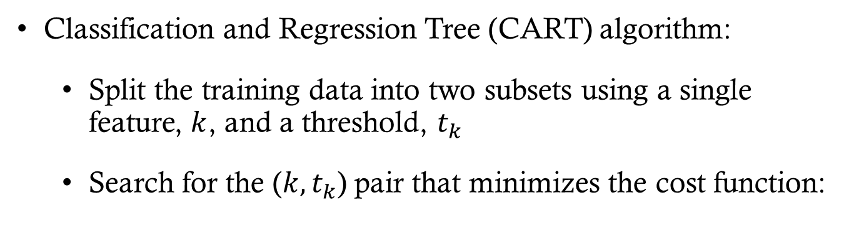


Growing the Tree (Fitting)
Classification and Regression Tree (CART) algorithm:
  Split the training data into two subsets using a single feature, $k$, and a threshold, $t_{k}$
  Search for the ($k,t_{k}$) pair that minimizes the cost function:
CLASSIFICATION
$$\frac{n_{left}}{n}G_{left}+\frac{n_{right}}{n}G_{right}$$
Where $G$ is a measure of node impurity
REGRESSION
$$\frac{n_{left}}{n}MSE_{left}+\frac{n_{right}}{n}MSE_{right}$$

Slide 7
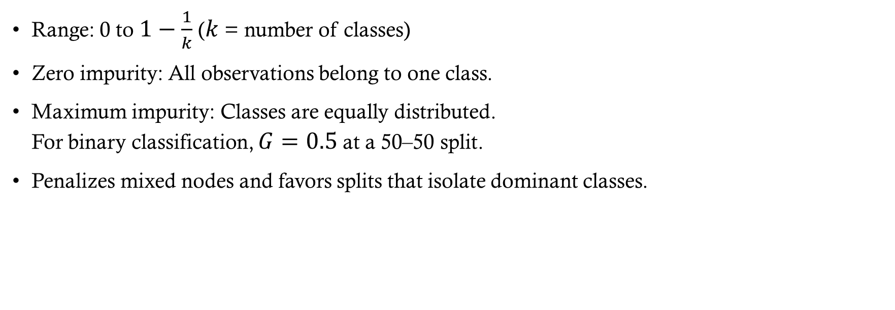
Gini Index
Range: 0 to $1−\frac{1}{k}$ ($k$ = number of classes)
Zero impurity: All observations belong to one class.
Maximum impurity: Classes are equally distributed.
For binary classification, $G=0.5$ at a 50–50 split.
Penalizes mixed nodes and favors splits that isolate dominant classes.

Slide 8

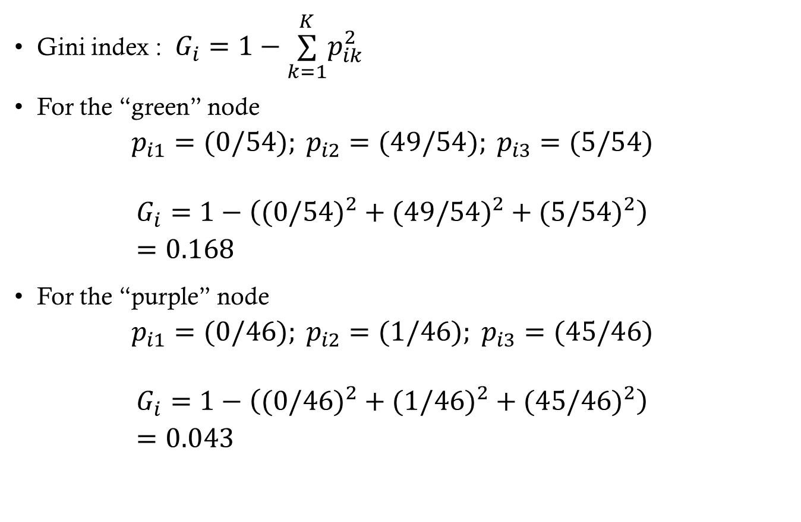
GINI Impurity CALCULATIONS
Gini index : $G_{i}=1−\overset{K}{\underset{k=1}{∑}}p_{ik}^{2}$
For the “green” node
$$p_{i1}=(0/54); p_{i2}=(49/54); p_{i3}=(5/54)$$
$$G_{i}=1−\left((0/54)^{2}+(49/54)^{2}+(5/54)^{2}\right) \\ =0.168$$
For the “purple” node
$$p_{i1}=(0/46); p_{i2}=(1/46); p_{i3}=(45/46)$$
$$G_{i}=1−\left((0/46)^{2}+(1/46)^{2}+(45/46)^{2}\right) \\ =0.043$$

Slide 9
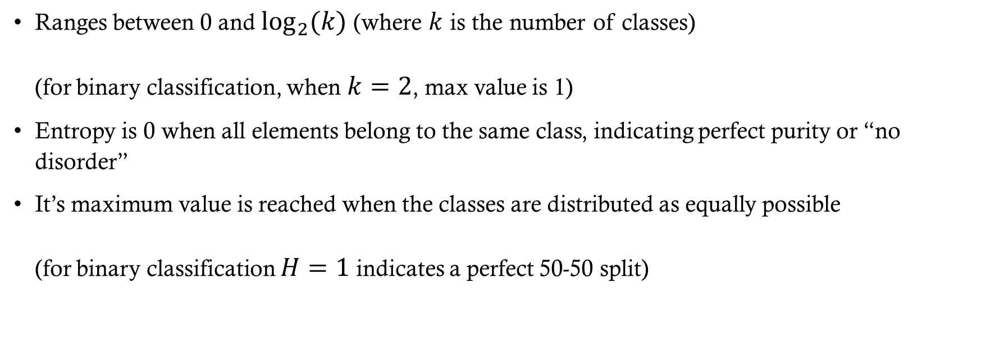
Entropy
Ranges between 0 and $\log_{2}(k)$ (where $k$ is the number of classes)
(for binary classification, when $k=2$, max value is 1)
Entropy is 0 when all elements belong to the same class, indicating perfect purity or “no disorder”
It’s maximum value is reached when the classes are distributed as equally possible
(for binary classification $H=1$ indicates a perfect 50-50 split)

Slide 10
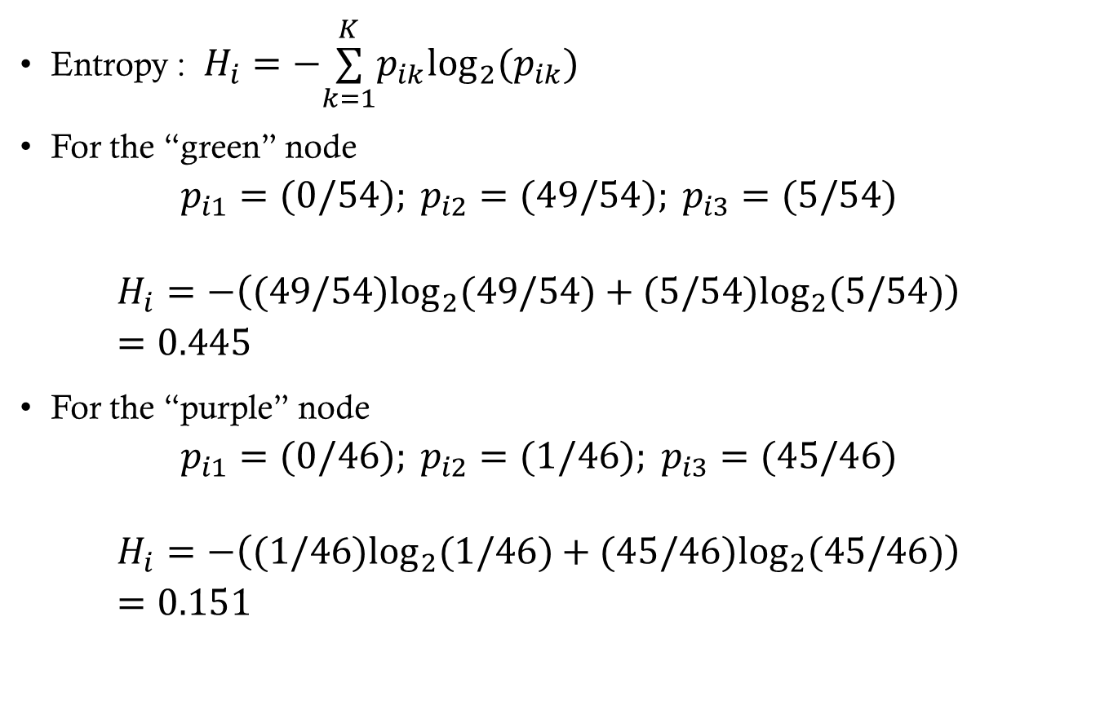
ENTROPY CALCULATIONS
Entropy : $H_{i}=−\overset{K}{\underset{k=1}{∑}}p_{ik}\log_{2}(p_{ik})$
For the “green” node
$$p_{i1}=(0/54); p_{i2}=(49/54); p_{i3}=(5/54)$$
$$H_{i}=−\left((49/54)\log_{2}(49/54)+(5/54)\log_{2}(5/54)\right) \\ =0.445$$
For the “purple” node
$$p_{i1}=(0/46); p_{i2}=(1/46); p_{i3}=(45/46)$$
$$H_{i}=−\left((1/46)\log_{2}(1/46)+(45/46)\log_{2}(45/46)\right) \\ =0.151$$

Slide 11
Gini vs. Entropy
Node | Class counts | Gini index | Entropy (bits)
Green | [0, 49, 5] | 0.168 | 0.445
Purple | [0, 1, 45] | 0.043 | 0.151
Both measures rank the purple node as purer. Their raw scores use different scales.
Gini is faster to compute and is the scikit-learn default. Both usually produce similar trees.
When they differ, entropy tends to produce more balanced trees, while Gini tends to isolate the most frequent class.
Notes:
Sources: slides 8 and 10 of this presentation. Table reproduces their displayed scores and class counts. Both measures give the purple node a lower impurity score. Gini uses squared class proportions, while entropy uses base-2 logarithms (bits), as defined in the source slides.
Merged discussion from original slide 12: Gini is the scikit-learn default and faster to compute. Most often the measures lead to similar trees. When they differ, entropy tends to yield more balanced trees and Gini tends to isolate the most frequent class. Further reading from original slide 12: https://homl.info/19
The purple node has 1 minority-class observation among 46, versus 5 among 54 in the green node.

Slide 12
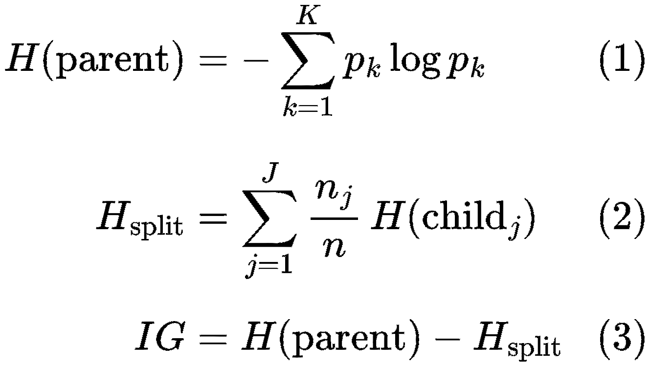
Information Gain
Entropy is used to calculate the information gained from the split
Information gain:
  Entropy(parent) – Entropy(split)

Slide 13
Making Predictions
We can predict the target of a new instance by following the tree from top to bottom
At the terminal (leaf) nodes predict using:
  Classification: The majority class in the node
  Regression: The mean target value of the training values in the node

Slide 14
Making Predictions (Classification)
We can predict the target of a new instance by following the tree from top to bottom
At the terminal (leaf) nodes predict using:
  Classification: The majority class in the node

Slide 15
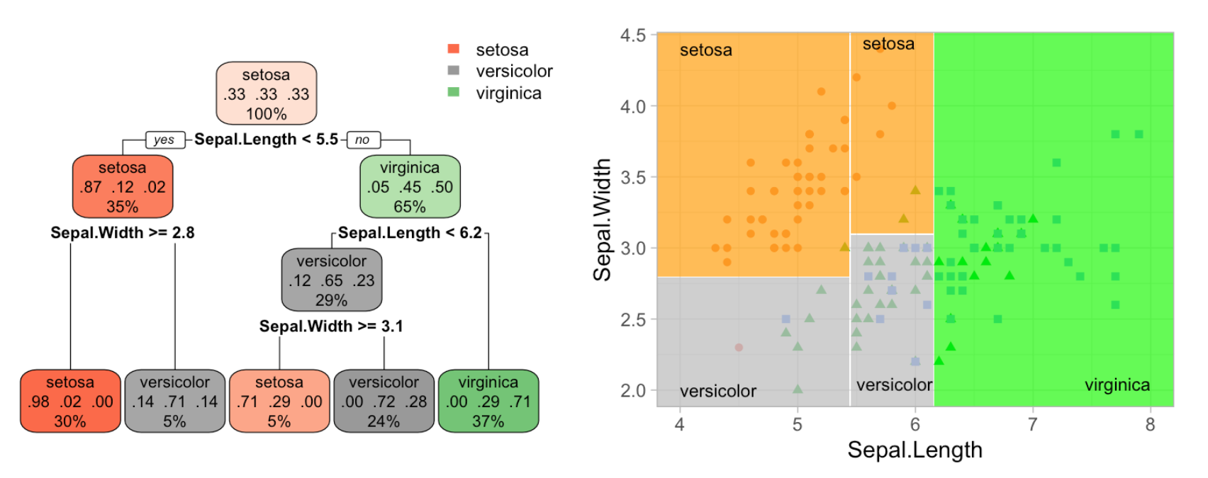
Classification Boundary Example
HOML R

Slide 16
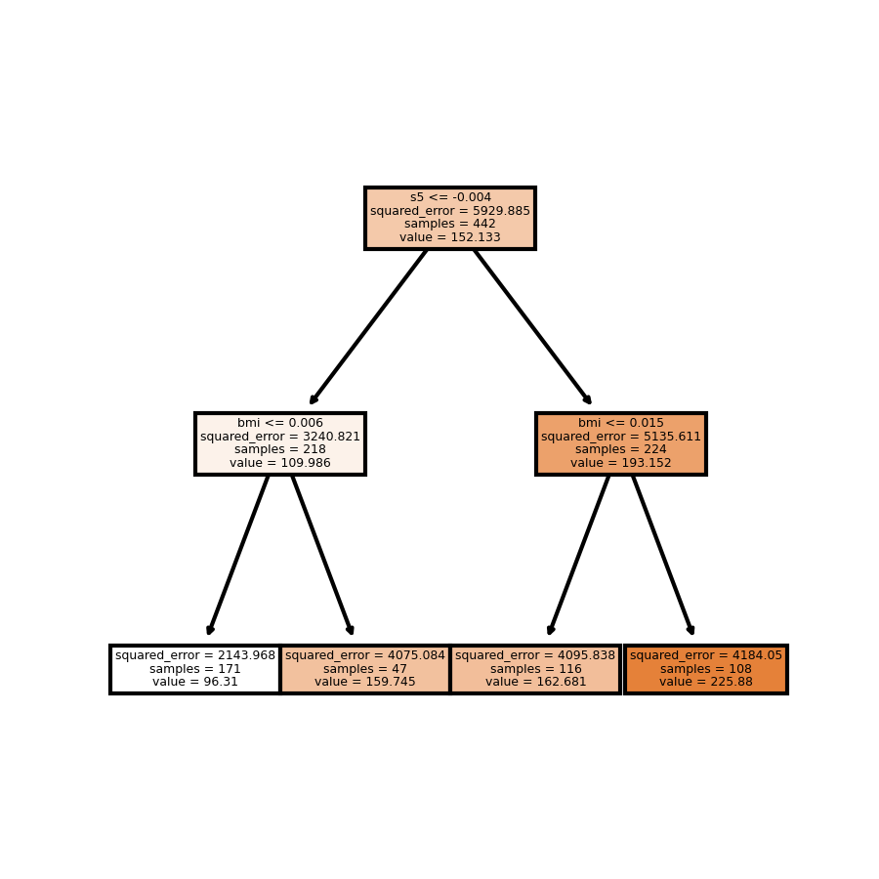
Making Predictions (Regression)

Slide 17
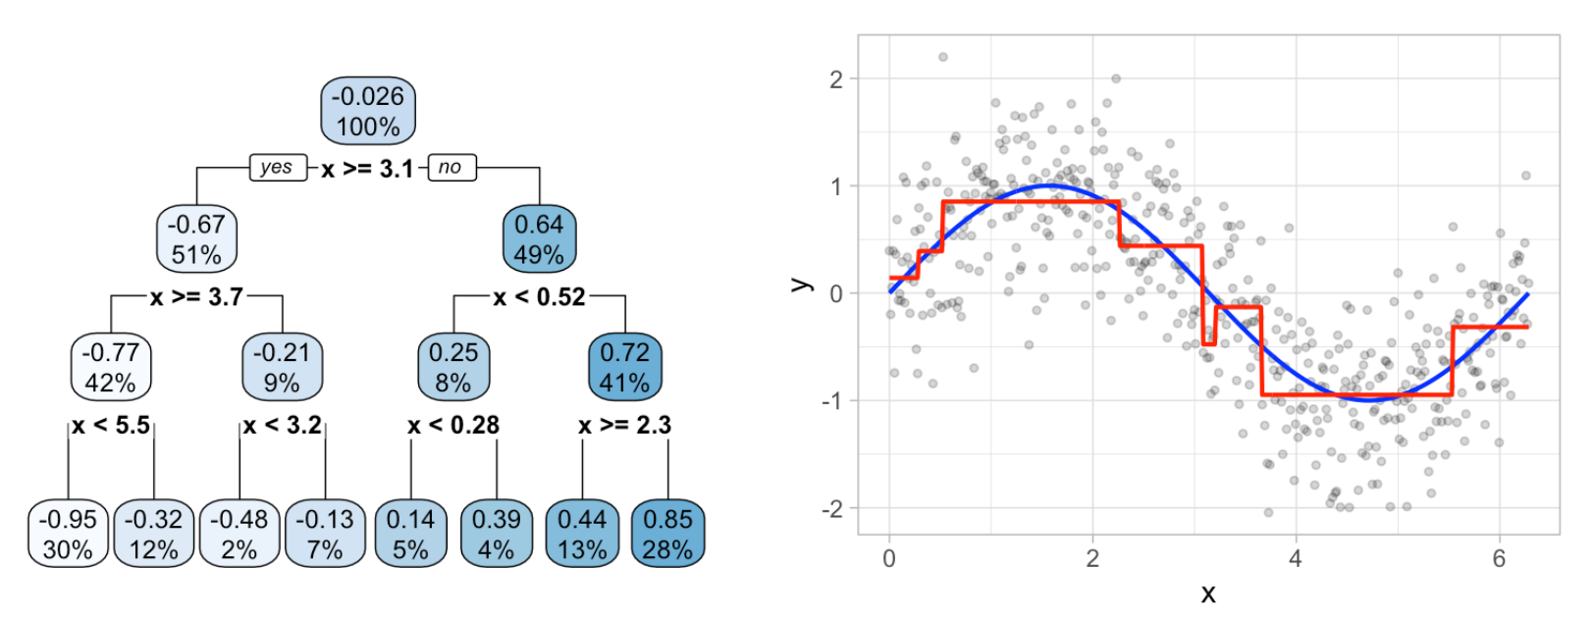
Example: Regression Decisions
HOML R

Slide 18
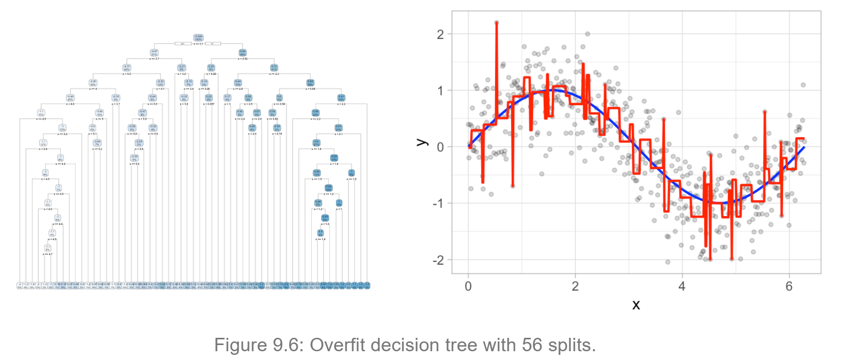
Example: Regression Decisions
HOML R

Slide 19
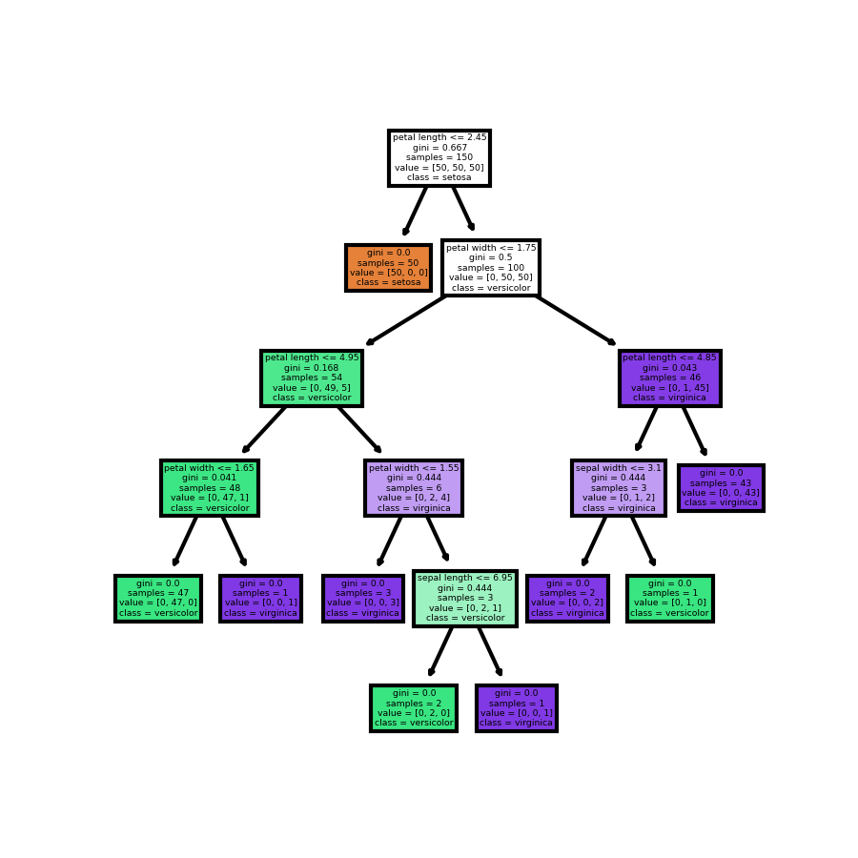
Trees can grow very large if left unconstrained

Slide 20
Regularization
Recall that regularization means constraining the model to prevent overfitting
Decision Trees can be regularized by
  Constraining growth (pre-pruning)
  Post-pruning the unconstrained tree (cost complexity pruning)

Slide 21
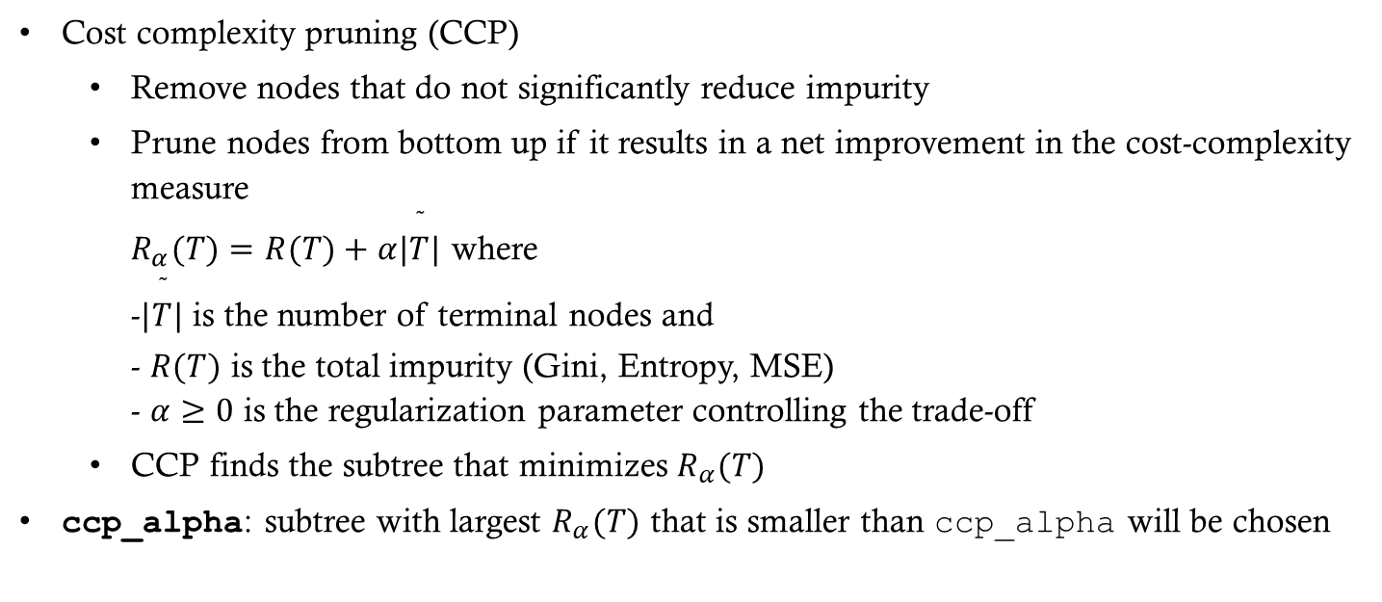
Post-pruning regularization
Cost complexity pruning (CCP)
  Remove nodes that do not significantly reduce impurity
  Prune nodes from bottom up if it results in a net improvement in the cost-complexity measure
  $R_{α}(T)=R(T)+α|\overset{˜}{T}|$ where
  -$|\overset{˜}{T}|$ is the number of terminal nodes and
  - $R(T)$ is the total impurity (Gini, Entropy, MSE)
  - $α≥0$ is the regularization parameter controlling the trade-off
  CCP finds the subtree that minimizes $R_{α}(T)$
ccp_alpha: subtree with largest $R_{α}(T)$ that is smaller than ccp_alpha will be chosen

Slide 22
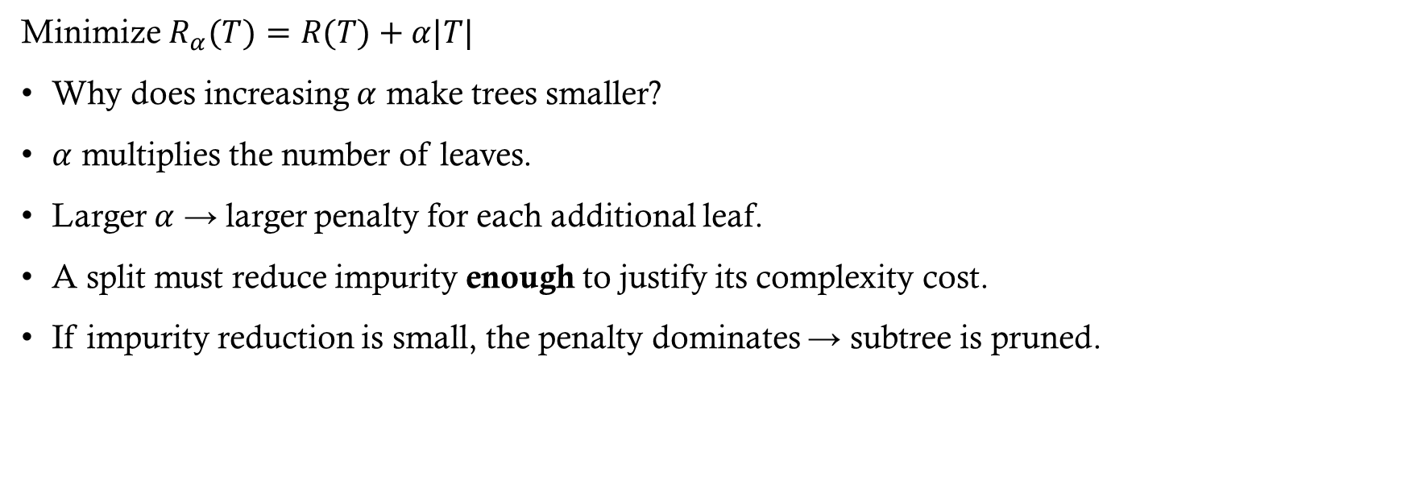
Cost-Complexity Pruning (CCP): Intuition
Minimize $R_{α}​(T)=R(T)+α|T|$
Why does increasing $α$ make trees smaller?
$α$ multiplies the number of leaves.
Larger $α$ → larger penalty for each additional leaf.
A split must reduce impurity enough to justify its complexity cost.
If impurity reduction is small, the penalty dominates → subtree is pruned.

Slide 23
Pre- versus Post-Pruning
Choice depends on:
  Specific dataset and overfitting behavior observed
  Domain knowledge
  Model performance on a validation set
  Personal preference

Slide 24
Pre-pruning regularization
Stop tree growth before it perfectly classifies the training data
  max_depth: maximum depth of tree
  min_samples_split: minimum number of samples required to split an internal node.
  min_samples_leaf: minimum number of sample required to be at a leaf node
  max_leaf_nodes: maximum number of leaf nodes
  min_impurity_decrease: a node will be split if the split induces a decrease of impurity greater than or equal to this value
reduce “max” parameters and/or increase “min” parameters if tree is overfitting

Slide 25
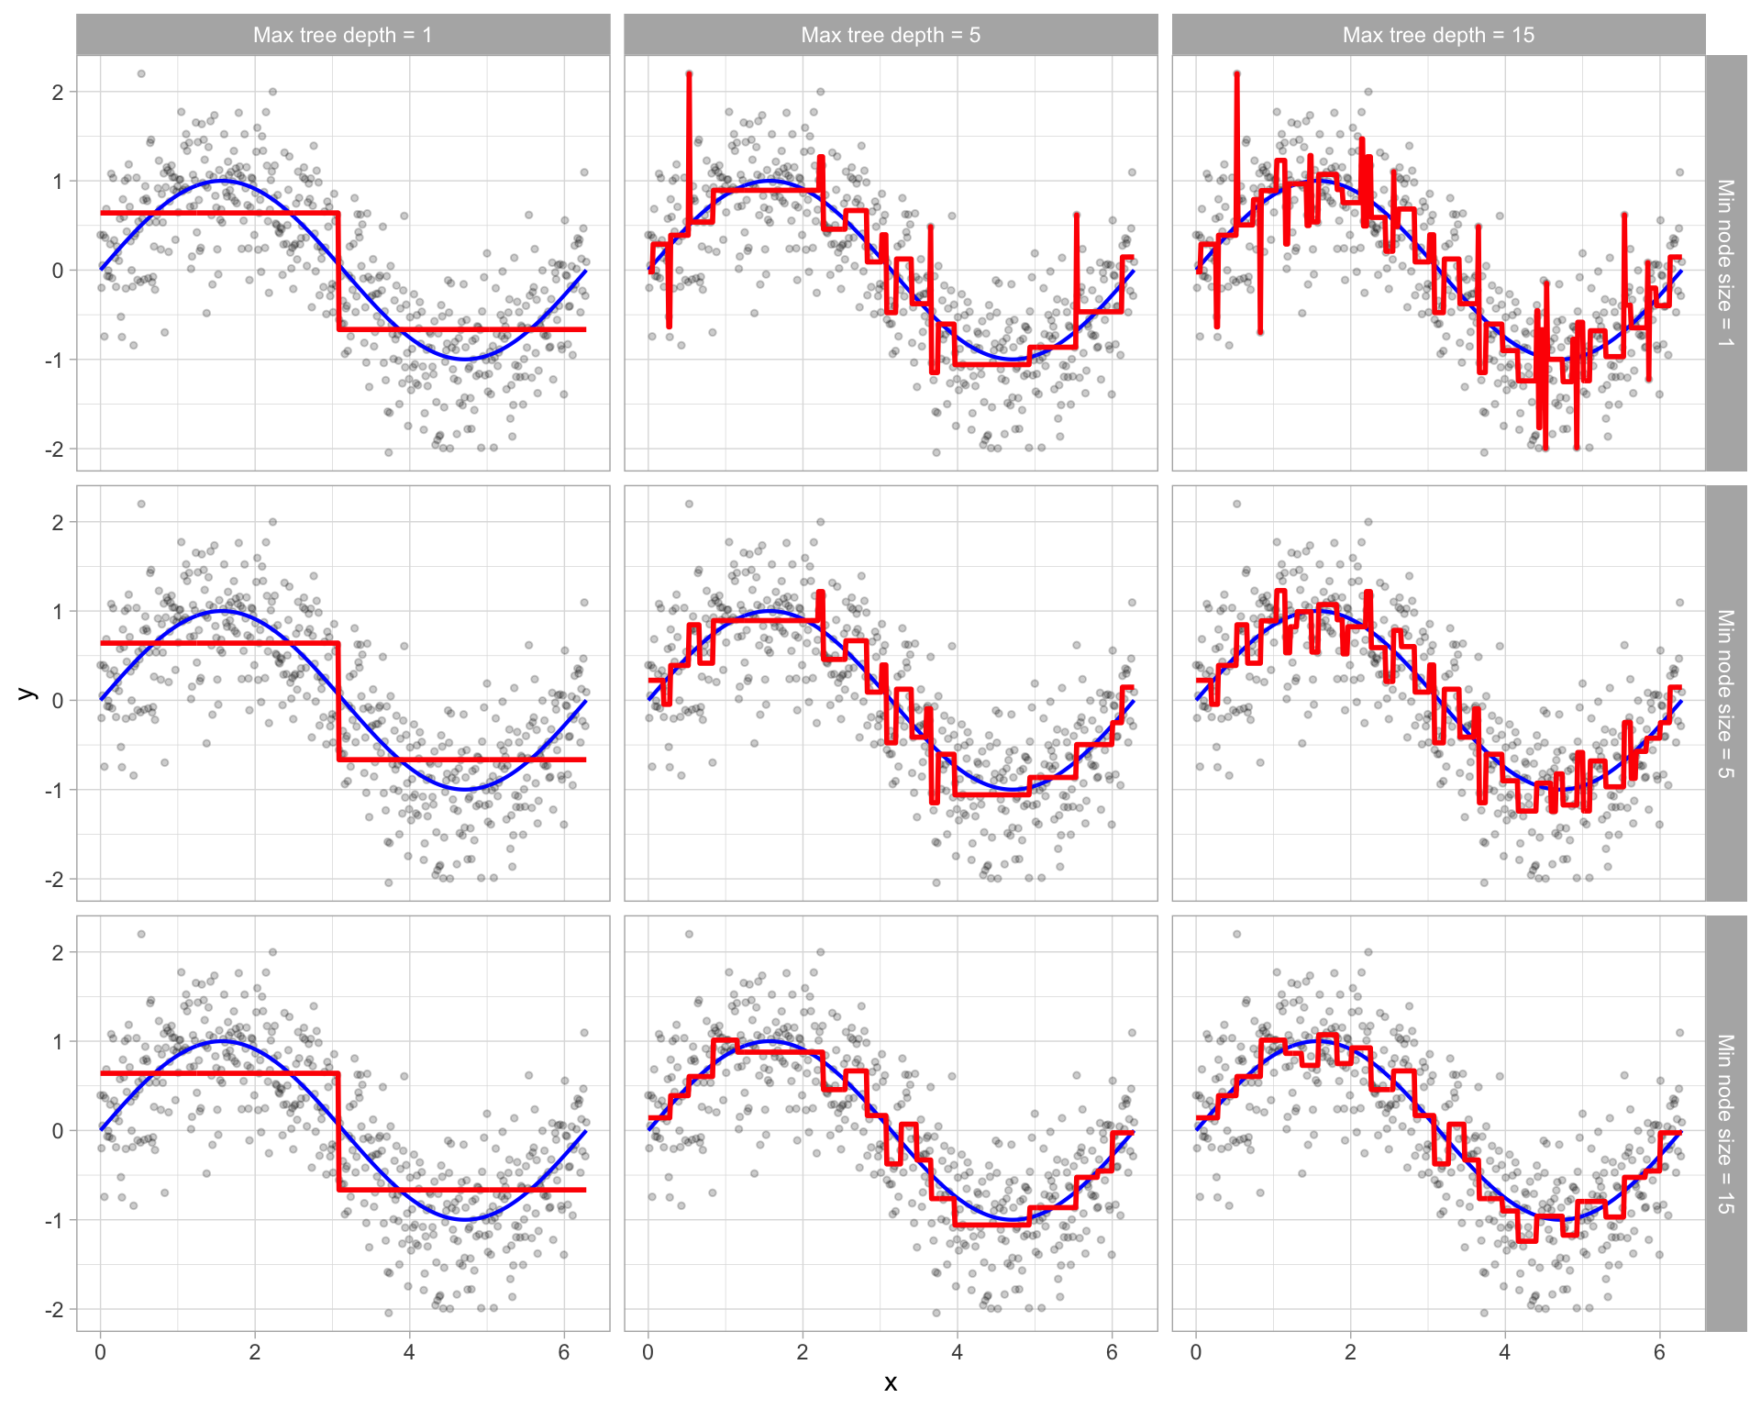

Slide 26
Other Decision Tree Algorithms
CART is a very popular tree algorithm but it isn’t the only one
(though it is the only one in scikit-learn)
Other algorithms:
  ID3 - designed for classification problems
  - Uses information gain to select the feature that best splits the set of items
  - Works only with categorical features
  - More than two branches can be created from a node
  C4.5 - extension of ID3 that handles both continuous and discrete features
  C5.0 - improved version of C4.5
  CHAID - uses chi-square tests to determine the best split

Slide 27
Pros and Cons of Trees
Pros
  Easy to build and explain
  Non-parametric and can easily capture non-linear relationships
  Very little data preprocessing is required
Cons
  Tendency to overfit
  Difficulty with linear relationships
  High variance models (training set selection has a huge impact on the resulting tree!)

