Slide 1
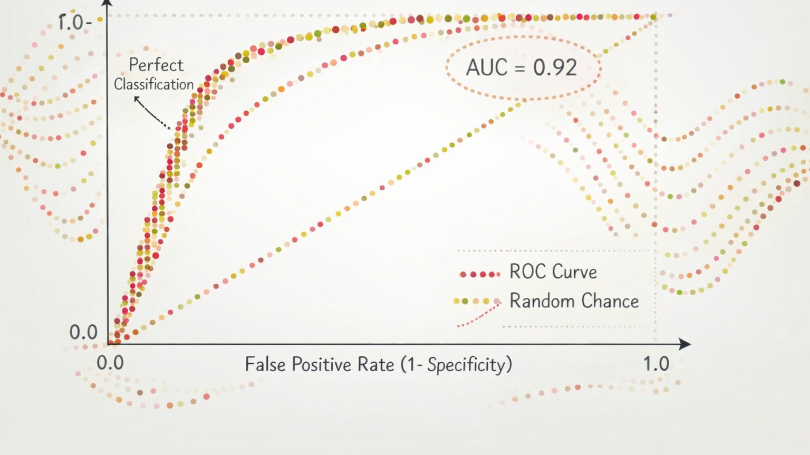
Classification Metrics

Slide 2
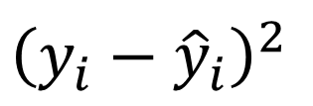

Regression vs Classification (Review)
Regression and Classification are both supervised learning methods
Regression
  The target or response variable (y) is numeric
  Model predicts the value of y
  Prediction accuracy is measured by how close the predicted value is to the truth, such as
              or
$${\left(y_{i}−{\hat{y}}_{i}\right)}^{2}$$
$${\left|y_{i}−{\hat{y}}_{i}\right|}^{}$$
Notes:
LaTeX: (y_i-\hat{y}_i)^2
LaTeX: \left|y_i-\hat{y}_i\right|^2

Slide 3

Accuracy and error rate
Classification predicts categorical outcomes or class probabilities.
$$ErrorRate=\frac{1}{n}\sum_{i=1}^{n}{1\left\{y_{i}≠{\hat{y}}_{i}\right\}}$$
$$\text{Accuracy}=\frac{\text{Correct predictions}}{\text{Total predictions}}\text{ = }\text{1 -} \text{Error rate}$$
Both metrics treat all errors equally, regardless of their cost.
With class imbalance, predicting only the majority class can yield high accuracy.
Notes:
Classification is a supervised learning method with a categorical response y. Models predict a class or class probabilities given features.
Accuracy counts correct predictions; error rate counts incorrect predictions on the same set of n cases. Their sum is 1. Both treat errors equally and can obscure poor minority-class performance when classes are imbalanced.
LaTeX: \mathrm{Accuracy}=\frac{\mathrm{Correct\ predictions}}{\mathrm{Total\ predictions}}=1-\mathrm{Error\ rate}
LaTeX: \mathrm{Error\ rate}=\frac{1}{n}\sum_{i=1}^{n}1\{y_i\ne\hat{y}_i\}

Slide 4
Confusion Matrix
Predicted Output
Positive (PP)
Negative (PN)
True Positives
TP
False Negatives
FN
Positive (P)
True Values
False Positives
FP
True Negatives
TN
Negative (N)

Slide 5
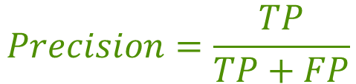
Precision
Predicted Output
Positive (PP)
Negative (PN)
True Positives
TP
False Negatives
FN
Positive (P)
Of those that are predicted to be positive, the percent that are actually positive
Describes how good the model is at predicting the positive class
Also call positive predictive value
True Values
False Positives
FP
True Negatives
TN
Negative (N)
$$Precision=\frac{TP}{TP+FP}$$
Under what conditions is high precision the most appropriate performance objective for a classification model?
Notes:
High precision is most important when false positives are costly, harmful, or difficult to reverse, even if some true cases are missed.

Slide 6
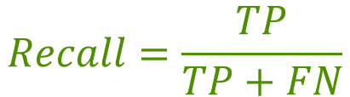
Recall
Predicted Output
Positive (PP)
Negative (PN)
True Positives
TP
False Negatives
FN
Positive (P)
Of those that are actually positive, the percent that are predicted to be positive
The proportion of positives that are correctly identified
Also called sensitivity or
true positive rate
True Values
False Positives
FP
True Negatives
TN
Negative (N)
$$Recall=\frac{TP}{TP+FN}$$
Under what conditions is high recall the most appropriate performance objective for a classification model?
Notes:
High recall is most important when missing true positives is costly or dangerous, and false positives can be tolerated or corrected later.

Slide 7
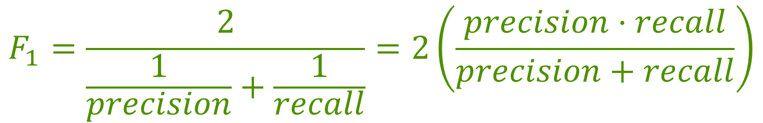
F1 Score
The precision & recall are often combined into one metric called F1
F1 is the harmonic mean of the precision and recall
$$F_{1}=\frac{2}{\frac{1}{precision}+\frac{1}{recall}}=2\left(\frac{precision⋅recall}{precision+recall}\right)$$
The F1 score favors classifiers with similar precision and recall scores

Slide 8
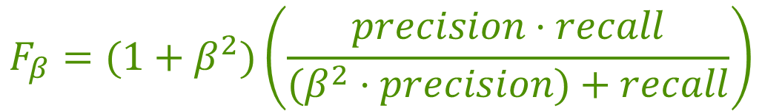
F𝛽 Score
The F1 score can be generalized to give more weight to either the precision or recall
$$F_{β}=(1+β^{2})\left(\frac{precision⋅recall}{(β^{2}⋅precision)+recall}\right)$$
0 < 𝛽 < 1 ⟹ More weight given to the precision
𝛽 > 1 ⟹ More weight given to the recall
𝛽 = 1 ⟹ Equal weight given to precision and recall (F1)

Slide 9





Other Measures
Recall / Sensitivity / True Positive Rate
Precision /
Positive Predictive Value
Predicted Output
Predicted Output
Positive (PP)
Negative (PN)
F1
Positive (PP)
Negative (PN)
TP
FN
TP
FN
$$\frac{TP}{TP+FP}$$
Positive (P)
$$\frac{TP}{TP+FN}$$
Positive (P)
True Values
True Values
FP
TN
FP
TN
Negative (N)
Negative (N)
ROC Curve &
AUC
Specificity /
True Negative Rate
Negative Predictive Value
Predicted Output
Predicted Output
Positive (PP)
Negative (PN)
Positive (PP)
Negative (PN)
TP
FN
$$\frac{TN}{TN+FN}$$
TP
FN
$$\frac{TN}{TN+FP}$$
Positive (P)
Positive (P)
True Values
True Values
FP
TN
FP
TN
Negative (N)
Negative (N)

Slide 10
Classification Thresholds
A threshold converts a predicted probability or score into a class label.
  Probability above the threshold: positive. At or below: negative.
Example: A spam filter assigns an email P(spam) = 0.65.
  Threshold 0.50: predict spam. Threshold 0.80: predict not spam.
Lower thresholds predict more positives, with fewer misses but more false alarms.
ROC curves compare true and false positive rates across thresholds.

Slide 11
ROC Curve and AUC
A threshold converts a predicted probability or score into a class label.
  Predict positive if P(yi = positive) > p (0 < p < 1)
ROC plots true positive rate vs. false positive rate as the threshold varies.
  True positive rate = sensitivity. False positive rate = 1 − specificity.
AUC (area under the ROC curve) summarizes performance.
  AUC = 1: perfect model. AUC = 0.5: random performance.

Slide 12
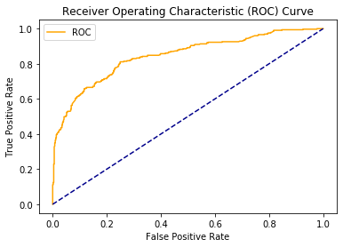
Example ROC Curve
Each point uses a threshold. Predict positive when the score exceeds it.
Lower threshold: More positives. TPR and FPR cannot decrease. Move up/right toward (1, 1).
Higher threshold: Fewer positives. TPR and FPR cannot increase. Move down/left toward (0, 0).
Tradeoff: Lower thresholds miss fewer positives but raise false alarms. Higher thresholds do the reverse.
TPR = sensitivity. FPR = 1 − specificity.
AUC (area under the ROC curve) summarizes performance. 1 = perfect, 0.5 = random.

Slide 13
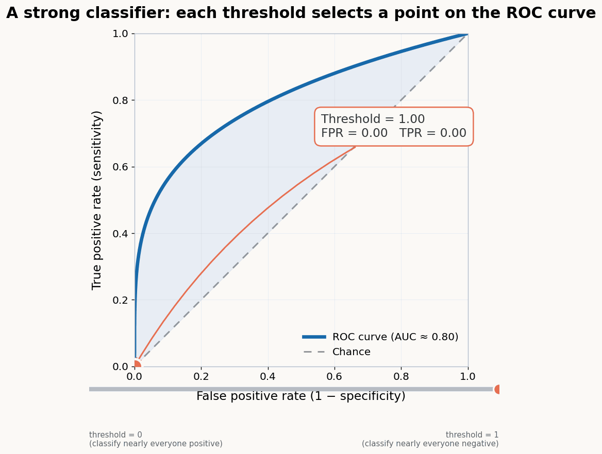
Example ROC Curve

Slide 14
Thresholds and ROC
Example: same ranking, different probabilities. Predict positive if P(+) > t.
Compare and contrast these models.
A. Scores near 0.5
B. Nearly binary
Case | True class | P(+)
1 | + | 0.52
2 | + | 0.51
3 | − | 0.49
4 | − | 0.48
Case | True class | P(+)
1 | + | 0.95
2 | + | 0.90
3 | − | 0.10
4 | − | 0.05

Slide 15
Metrics in Scikit-Learn

Slide 16
.predict() vs .predict_proba()
For classification estimators, there are two ways to product predictions
.predict() will produce an 1D array with n rows with the class prediction
      Class with the highest probability
.predict_proba() will produce a 2D array with n rows and n-class columns
      Each column is the probability of the row observation being in class 0 to n-class

Slide 17
Function names
https://scikit-learn.org/stable/api/sklearn.metrics.html#
accuracy_score(y_true, y_pred)
(default for many functions)
classification_report(y_true, y_pred)
confusion_matrix(y_true, y_pred)
f1_score(y_true, y_pred)
precision_score(y_true, y_pred)
recall_score(y_true, y_pred)
roc_auc_score(y_true, y_score)
  Note: The second argument must be a score (e.g. probability) and not a class prediction

Slide 18
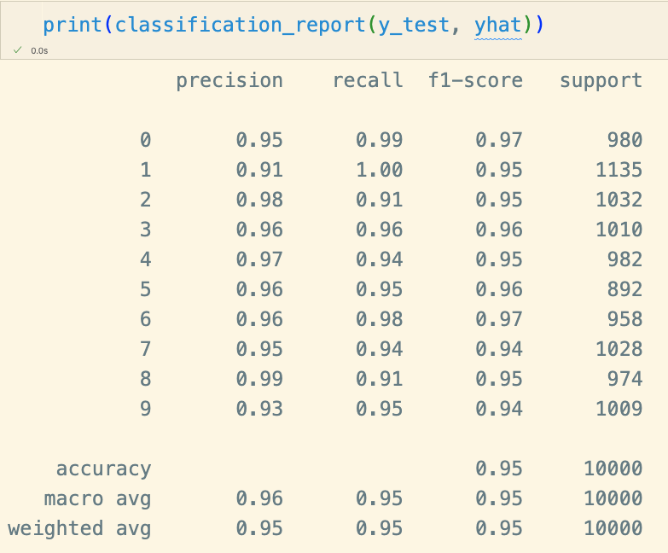
Classification Report
This special function will show precision, recall, f1, and accuracy for all class (treat each class as positive class)

Slide 19
Multi-class Classification

Slide 20
Multi-class Strategies
Some classifiers (e.g., Naive Bayes, KNN) are capable of handling multiple classes directly
Other classifiers (e.g., logistic regression) are binary classifiers
For binary classifiers, there are two strategies for extending to multiple classes:
    One-versus-all (OvA) (sometimes called One-versus-rest (OvR))
    One-versus-one (OvO)

Slide 21
One Versus All (OvA)
For each class, train a model that classify that class versus all the rest:
    Classify 1 versus not 1
    Classify 2 versus not 2
    etc.
Classify a value into the classier whose classifier outputs the highest score (e.g., predictive probabilities)

Slide 22
One Versus One (OvO)
Train a binary classifier for every pair of classes
    1 vs 2
    1 vs 3
    2 vs 3
    4 vs 5
    Etc.
Classify value into the class that wins the most duels

Slide 23
OvA Versus OvO
Suppose there are q classes
OvO requires training q(q-1)/2 classifiers
    For the MNIST example this means 10(10-1)/2 = 45 classifiers
    However, each classifier needs only use a small subset of the data
In general OvA is the preferred strategy (only trains q classifiers)
But for classifiers that scale poorly with the size of the training set (e.g., SVM) OvO is preferred

Slide 24

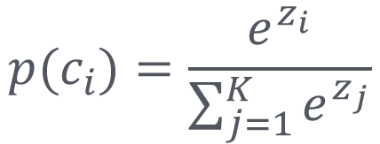
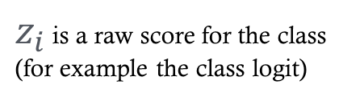
Softmax function
OvA and OvO combine binary classifiers to handle multiple classes.
Softmax supports another approach: extend logistic regression to predict all classes together.
It converts one real-valued score per class into a probability distribution.
Softmax also serves as the output function in multi-class neural networks.
$z_{i}$ is a raw score for the class (for example the class logit)
$$p(c_{i})=\frac{e^{z_{i}}}{\sum_{j=1}^{K}{e^{z_{j}}}}$$
Probability of class $c_{i}$
Sum over all classes

