Slide 1
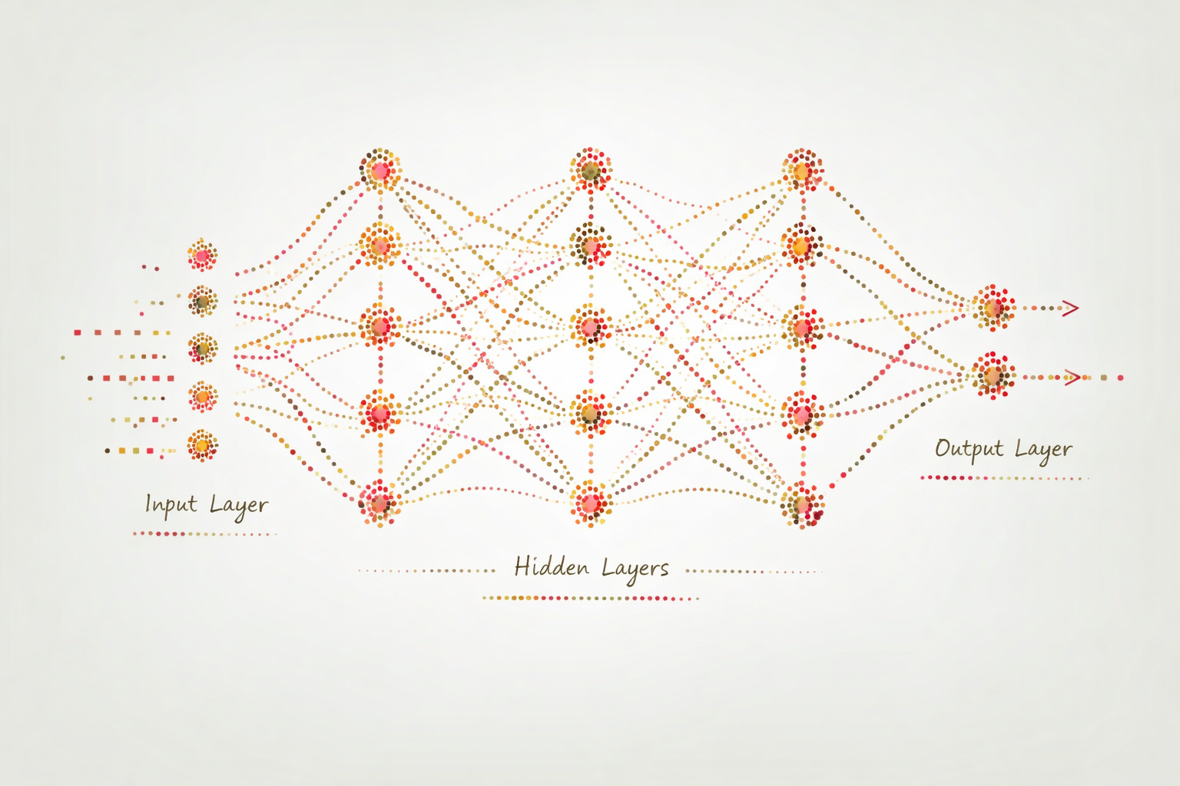
Artificial Neural Networks

Slide 2
Artificial Neural Networks
Artificial neural networks (ANNs) are a class of machine learning models inspired by the structure and function of the brain
The first ANN was introduced in 1943 by Warren McCulloch (a neurophysiologist) and Walter Pitts (a mathematician and logician)
In the 1940s it was known that the brain is built of neurons wired together
  Each neuron has inputs (dendrites)
  As well as outputs (axon)
  When impulses coming in exceed a threshold, the neuron emits a pulse, which is taken as input to the next neuron

Slide 3
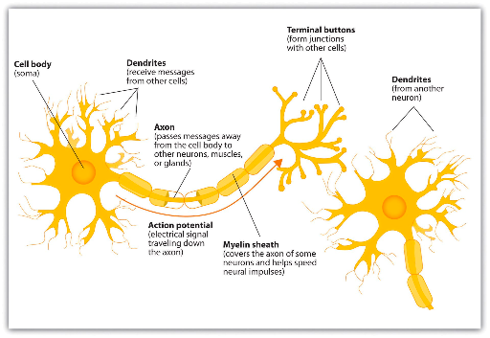
Biological Neuron

Slide 4
The first ANNs
The network proposed by McCulloch and Pitts was a binary threshold network
  Inputs can only be binary
  Used for simple logical operations
In 1958, Frank Rosenblatt proposed a more complex ANN called the Perceptron
  Inputs are weighted sums of inputs
  Binary output is based on an activation function
  Has the ability to learn by adjusting weights according to its mistakes

Slide 5
The Perceptron
The name “perceptron” is in reference to a device that “perceives” a pattern
Originally, it was intended to be a machine
A perceptron is basically a linear classifier or regression function
A multilayer perceptron (MLP) is a nonlinear model for a regression function

Slide 6
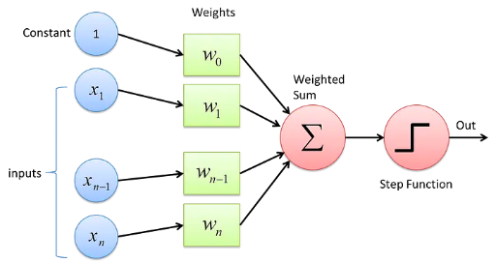
The Perceptron
(2) Assign weights to the inputs
(3) Compute the weighted sum
(4) Generate output according to the activation function
(1) Receive input

Slide 7
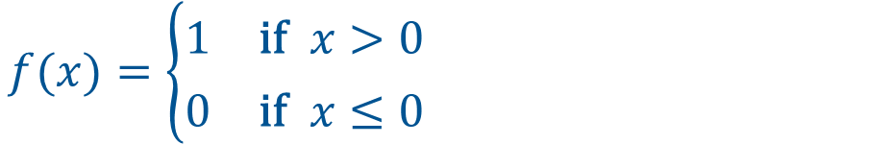
The Perceptron
(1)(0.9)+(5.1)(1.5)+
(3.5)(6.2)+
(1.4)(−8.7) = 18.1
0.9
5.1
1.5
1
3.5
6.2
$$f(x)=\left\{\begin{aligned}&1\text{ if }x>0 \\ &0\text{ if }x≤0\end{aligned}\right.$$
1.4
−8.7
(2) Assign weights to the inputs
(3) Compute the weighted sum
(4) Generate output according to the activation function
(1) Receive input

Slide 8
The Perceptron
(1)(0.9)+(6.3)(1.5)+
(3.3)(6.2)+
(6.0)(−8.7) = −21.4
0.9
6.3
1.5
0
3.3
6.2
$$f(x)=\left\{\begin{aligned}&1\text{ if }x>0 \\ &0\text{ if }x≤0\end{aligned}\right.$$
6.0
−8.7
(2) Assign weights to the inputs
(3) Compute the weighted sum
(4) Generate output according to the activation function
(1) Receive input

Slide 9
Training the Perceptron
Training is the process of find the weights of the Perceptron
Perceptron Algorithm:
  Assign weights randomly
  Compute the output
  Compare the output to the true values
  Adjust weights according to the error by:
    increasing weights that were too low and
    decreasing weights that were too high
  Repeat

Slide 10
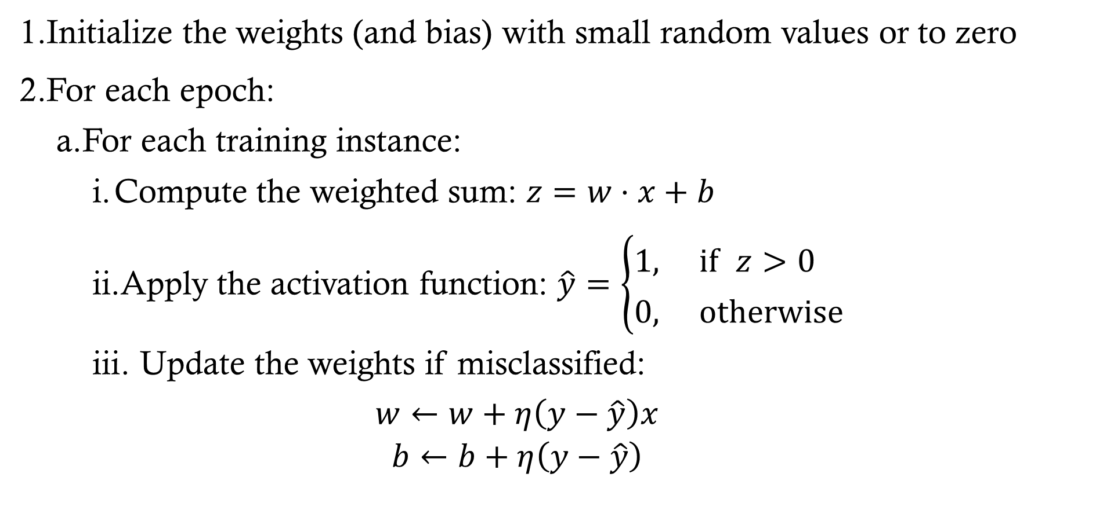
Perceptron Training Algorithm
Initialize the weights (and bias) with small random values or to zero
For each epoch:
  For each training instance:
    Compute the weighted sum: $z=w⋅x+b$
    Apply the activation function: $\hat{y}=\left\{\begin{aligned}&1,\text{ if }z>0 \\ &0,\text{ otherwise}\end{aligned}\right.$
    Update the weights if misclassified:
    $$\begin{aligned}w←w+η\left(y−\hat{y}\right)x \\ b←b+η\left(y−\hat{y}\right)\end{aligned}$$
Note: Updates only happen when misclassified.

Slide 11
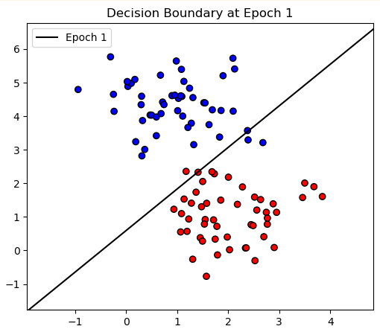
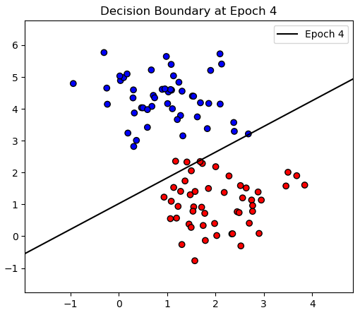
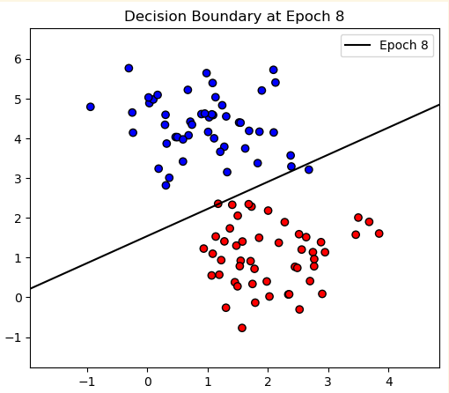
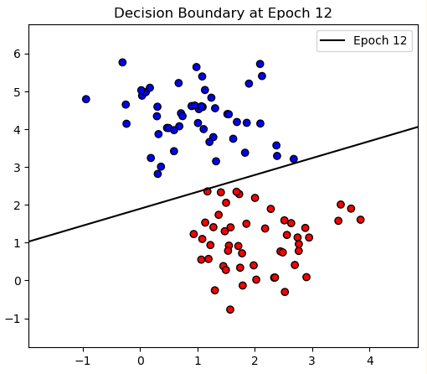
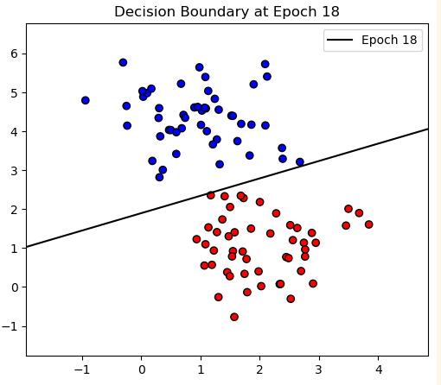
Perceptron Training Algorithm
If the classes are linearly separable, the perceptron algorithm will converge

Slide 12
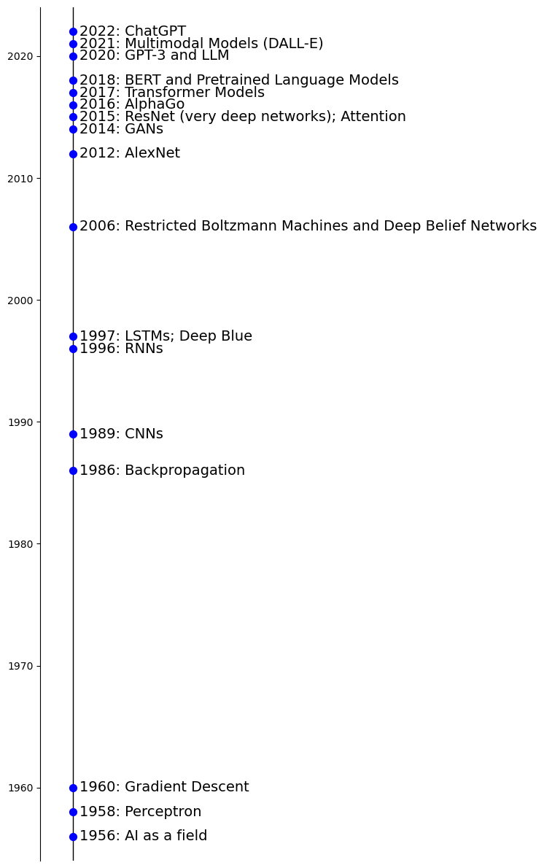
Timeline of Deep Learning Milestones

Slide 13


Timeline of Deep Learning Milestones
Second AI Winter
First AI Winter

Slide 14
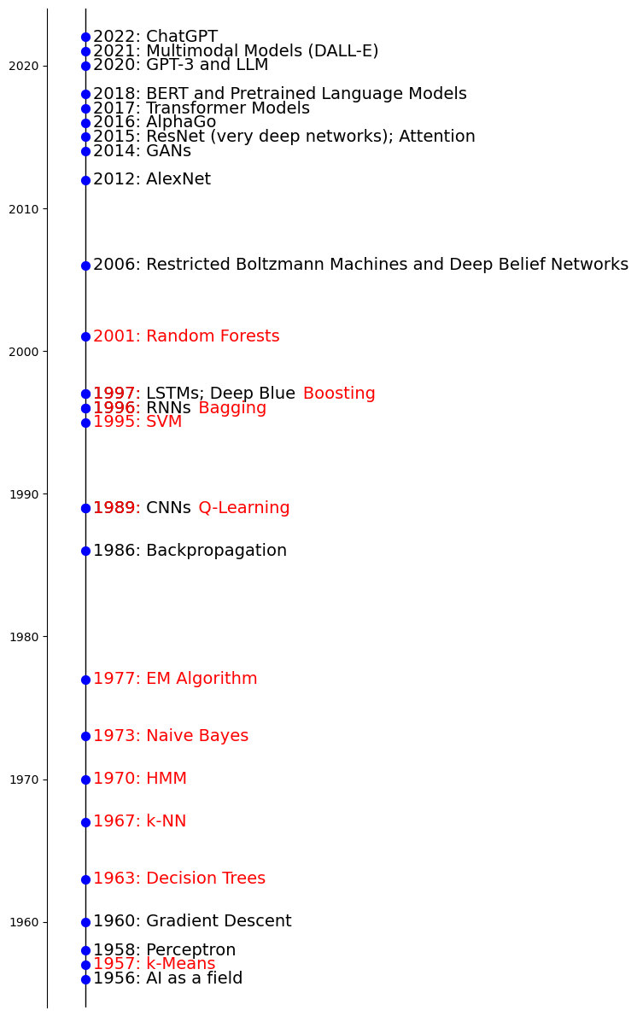
Timeline of Deep Learning Milestones
1950s: Bayesian Inference
1901: PCA
1805: Linear Regression
1763: Bayes Theorem

Slide 15
Improvements to the Perceptron
Nonlinear activation functions
  The original step function activation is not able to capture complex nonlinear relationships
  Nonlinear differentiable functions (such as the sigmoid or hyperbolic tangent were introduced
Multiple layers
  Hidden layers can capture complex, nonlinear relationships
  Each layer can transform the input in sophisticated ways

Slide 16
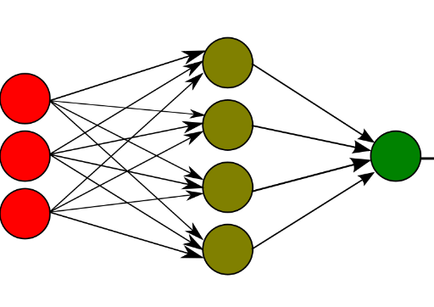
Multilayer Perceptron
Also called a fully connected feed-forward neural network
Input Layer
Hidden Layer
Output Layer

Slide 17
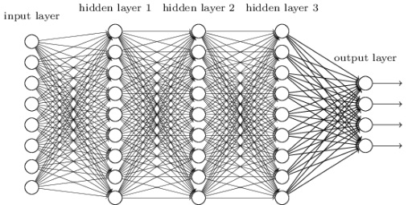
Multilayer Perceptron
Also called a fully connected feed-forward neural network

Slide 18
Problem
How can we efficiently train the multilayer perceptron?
  Adjust the weights at every level
  In a computationally feasible way

Slide 19
Multilayer Perceptron
Approximately, how many parameters are estimated?

Slide 20
New ANN excitement
In 1986, a paper showed how to train ANNs with “back-propagation”
  Discovered independently several times earlier, but not popular until 1986
Backpropagation efficiently computes the gradient of a loss function
  Gradient for each weight computed using the chain rule one layer at a time
  Iterates backward from the last layer to avoid redundant calculations of intermediate terms
Weights are then adjusted using gradient descent or similar

Slide 21
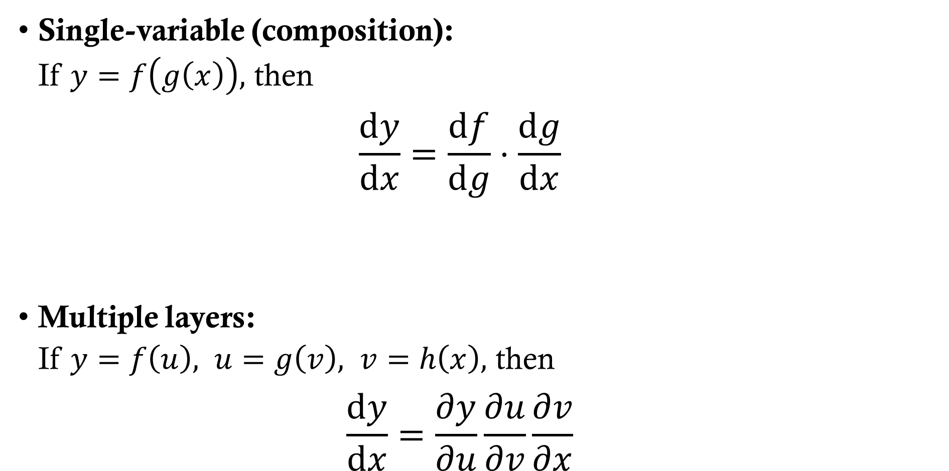
Chain Rule: Review
Single-variable (composition):
If $y=f\left(g\left(x\right)\right),$ then
  $$\frac{dy}{dx}=\frac{df}{dg}⋅\frac{dg}{dx}$$
Multiple layers:
If $y=f\left(u\right), u=g\left(v\right), v=h\left(x\right),$ then
  $$\frac{dy}{dx}=\frac{∂y}{∂u}\frac{∂u}{∂v}\frac{∂v}{∂x}$$

Slide 22
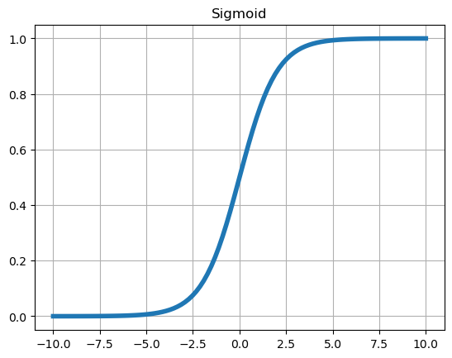
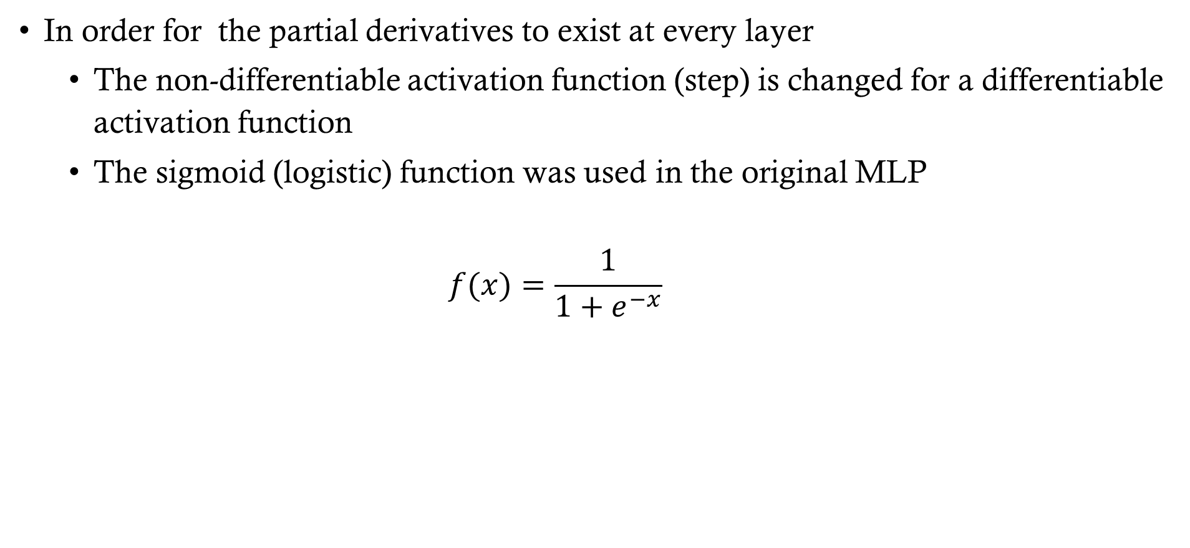
New Activation Function
In order for the partial derivatives to exist at every layer
  The non-differentiable activation function (step) is changed for a differentiable activation function
  The sigmoid (logistic) function was used in the original MLP
  $f(x)=\frac{1}{1+e^{−x}}$

Slide 23
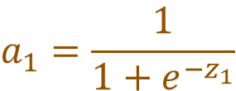

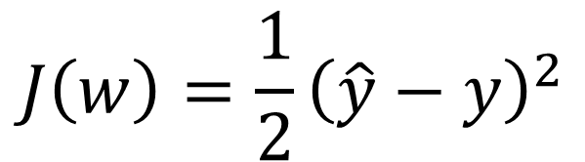
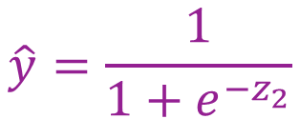

Understanding Backpropagation
In order to develop intuition about the back propagation algorithm, consider a very simple neural network:
Input Layer
Hidden Layer
Output Layer
x
w1
z1 a1
w2
z2 a2
$$a_{1}=\frac{1}{1+e^{−z_{1}}}$$
$$\hat{y}=\frac{1}{1+e^{−z_{2}}}$$
$$z_{1}=xw_{1}$$
$$z_{2}=a_{1}w_{2}$$
Linear combination
Activation
Linear combination
Activation
The goal is to compute the gradient of cost function J with respect to w1 and w2 in order find the direction of steepest descent
$$J\left(w\right)=\frac{1}{2}{\left(\hat{y}−y\right)}^{2}$$

Slide 24
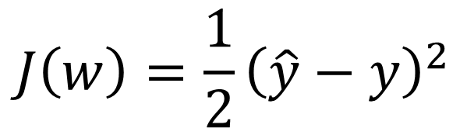
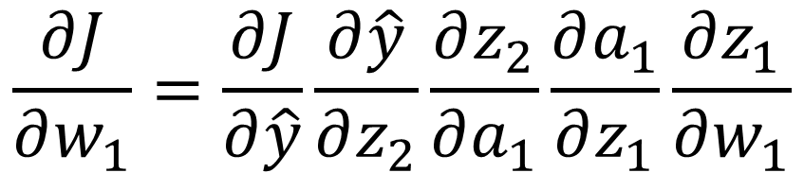
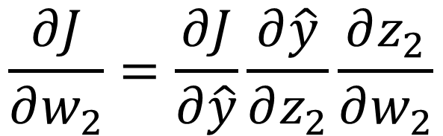
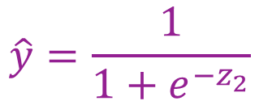
Understanding Backpropagation
In order to develop intuition about the back propagation algorithm, consider a very simple neural network:
Input Layer
Hidden Layer
Output Layer
x
w1
z1 a1
w2
z2 a2
$$a_{1}=\frac{1}{1+e^{−z_{1}}}$$
$$\hat{y}=\frac{1}{1+e^{−z_{2}}}$$
$$z_{1}=xw_{1}$$
$$z_{2}=a_{1}w_{2}$$
Linear combination
Activation
Linear combination
Activation
$$\frac{∂J}{∂w_{2}}=\frac{∂J}{∂\hat{y}}\frac{∂\hat{y}}{∂z_{2}}\frac{∂z_{2}}{∂w_{2}}$$
$$J\left(w\right)=\frac{1}{2}{\left(\hat{y}−y\right)}^{2}$$
$$\frac{∂J}{∂w_{1}}=\frac{∂J}{∂\hat{y}}\frac{∂\hat{y}}{∂z_{2}}\frac{∂z_{2}}{∂a_{1}}\frac{∂a_{1}}{∂z_{1}}\frac{∂z_{1}}{∂w_{1}}$$

Slide 25

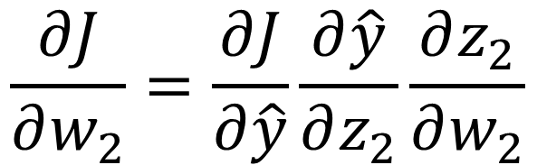
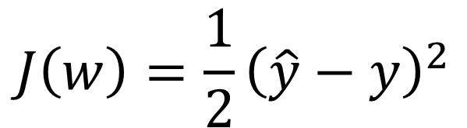
Understanding Backpropagation
In order to develop intuition about the back propagation algorithm, consider a very simple neural network:
Input Layer
Hidden Layer
Output Layer
x
w1
z1 a1
w2
z2 a2
$$a_{1}=\frac{1}{1+e^{−z_{1}}}$$
$$\hat{y}=\frac{1}{1+e^{−z_{2}}}$$
$$z_{1}=xw_{1}$$
$$z_{2}=a_{1}w_{2}$$
Linear combination
Activation
Linear combination
Activation
$$\frac{∂J}{∂w_{2}}=\frac{∂J}{∂\hat{y}}\frac{∂\hat{y}}{∂z_{2}}\frac{∂z_{2}}{∂w_{2}}$$
$$J\left(w\right)=\frac{1}{2}{\left(\hat{y}−y\right)}^{2}$$
$$\frac{∂J}{∂w_{1}}=\frac{∂J}{∂\hat{y}}\frac{∂\hat{y}}{∂z_{2}}\frac{∂z_{2}}{∂a_{1}}\frac{∂a_{1}}{∂z_{1}}\frac{∂z_{1}}{∂w_{1}}$$

Slide 26

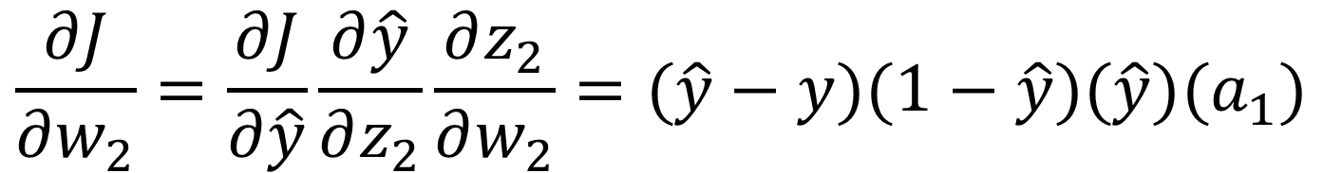

Understanding Backpropagation
In order to develop intuition about the back propagation algorithm, consider a very simple neural network:
Input Layer
Hidden Layer
Output Layer
x
w1
z1 a1
w2
z2 a2
$$a_{1}=\frac{1}{1+e^{−z_{1}}}$$
$$\hat{y}=\frac{1}{1+e^{−z_{2}}}$$
$$z_{1}=xw_{1}$$
$$z_{2}=a_{1}w_{2}$$
Linear combination
Activation
Linear combination
Activation
$$\frac{∂J}{∂w_{2}}=\frac{∂J}{∂\hat{y}}\frac{∂\hat{y}}{∂z_{2}}\frac{∂z_{2}}{∂w_{2}}=(\hat{y}−y)(1−\hat{y})(\hat{y})(a_{1})$$
$$\frac{∂J}{∂w_{1}}=\frac{∂J}{∂\hat{y}}\frac{∂\hat{y}}{∂z_{2}}\frac{∂z_{2}}{∂a_{1}}\frac{∂a_{1}}{∂z_{1}}\frac{∂z_{1}}{∂w_{1}}=(\hat{y}−y)(1−\hat{y})(\hat{y})w_{2}(1−a_{1})(a_{1})x$$

Slide 27

Understanding Backpropagation
Forward pass
Input Layer
Hidden Layer
Output Layer
2
z1 a1
z2 a2
$$y=5$$
0.3
1.4
$$a_{1}=\frac{1}{1+e^{−z_{1}}}$$
$$\hat{y}=\frac{1}{1+e^{−z_{2}}}$$
$$z_{1}=xw_{1}$$
$$z_{2}=a_{1}w_{2}$$
Linear combination
Activation
Linear combination
Activation

Slide 28

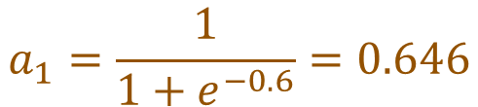

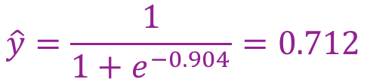
Understanding Backpropagation
Forward pass
Input Layer
Hidden Layer
Output Layer
2
z1 a1
z2 a2
$$y=5$$
0.3
1.4
$$a_{1}=\frac{1}{1+e^{−z_{1}}}$$
$$\hat{y}=\frac{1}{1+e^{−z_{2}}}$$
$$z_{1}=xw_{1}$$
$$z_{2}=a_{1}w_{2}$$
$$z_{1}=(0.3)(2)=0.6$$
$$z_{2}=(0.646)(1.4)=0.904$$
$$a_{1}=\frac{1}{1+e^{−0.6}}=0.646$$
$$\hat{y}=\frac{1}{1+e^{−0.904}}=0.712$$

Slide 29

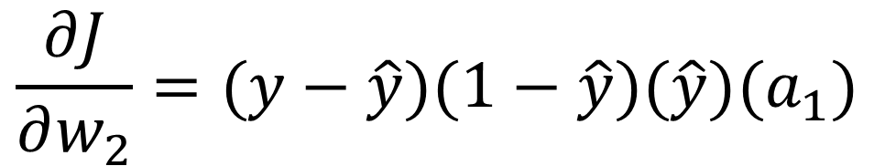
Understanding Backpropagation
Back propagation
Input Layer
Hidden Layer
Output Layer
2
z1 a1
z2 a2
$$y=5$$
0.3
1.4
$$a_{1}=\frac{1}{1+e^{−z_{1}}}$$
$$\hat{y}=\frac{1}{1+e^{−z_{2}}}$$
$$z_{1}=xw_{1}$$
$$z_{2}=a_{1}w_{2}$$
$$z_{1}=(0.3)(2)=0.6$$
$$z_{2}=(0.646)(1.4)=0.904$$
$$a_{1}=\frac{1}{1+e^{−0.6}}=0.646$$
$$\hat{y}=\frac{1}{1+e^{−0.904}}=0.712$$
$$\frac{∂J}{∂w_{2}}=(y−\hat{y})(1−\hat{y})(\hat{y})(a_{1})$$
$$=(5−0.712)(1−0.712)(0.712)(0.646)$$
$$=0.568$$

Slide 30

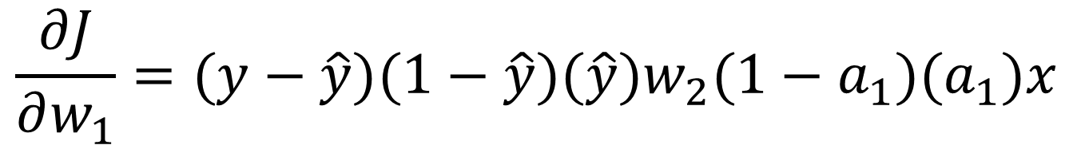
Understanding Backpropagation
Back propagation
Input Layer
Hidden Layer
Output Layer
2
z1 a1
z2 a2
$$y=5$$
0.3
1.4
$$a_{1}=\frac{1}{1+e^{−z_{1}}}$$
$$\hat{y}=\frac{1}{1+e^{−z_{2}}}$$
$$z_{1}=xw_{1}$$
$$z_{2}=a_{1}w_{2}$$
$$z_{1}=(0.3)(2)=0.6$$
$$z_{2}=(0.646)(1.4)=0.904$$
$$a_{1}=\frac{1}{1+e^{−0.6}}=0.646$$
$$\hat{y}=\frac{1}{1+e^{−0.904}}=0.712$$
$$\frac{∂J}{∂w_{1}}=(y−\hat{y})(1−\hat{y})(\hat{y})w_{2}(1−a_{1})(a_{1})x$$
$$=(5−0.712)(1−0.712)(0.712)(1.4)(1−0.646)(0.646)(2)$$
$$=0.563$$

Slide 31


Understanding Backpropagation
Update and repeat
Input Layer
Hidden Layer
Output Layer
2
z1 a1
z2 a2
$$y=5$$
$$0.3−η\left(0.563\right)$$
$$1.4−η\left(0.568\right)$$
$$a_{1}=\frac{1}{1+e^{−z_{1}}}$$
$$\hat{y}=\frac{1}{1+e^{−z_{2}}}$$
$$z_{1}=xw_{1}$$
$$z_{2}=a_{1}w_{2}$$

Slide 32
More places to understand
3Blue1Brown (YouTube Channel)
Deep Learning
  Chapter 1 (But what is a neural network? ~ 19min)
  Chapter 2 (Gradient descent, how neural networks learn ~20min)
  Chapter 3 (What is backpropagation really doing? ~ 13min)
  Chapter 4 (Backpropagation calculus ~ 10min)
Jeremy Jordan Blog
A thorough and easy-to-follow walkthrough of ANNs and backprop
https://www.jeremyjordan.me/neural-networks-training/

Slide 33
Output Layer
Backpropagation shows how to train a network, but first the network must produce the right kind of output: the number of output neurons AND their activation function depend on the task
    (what does the target look like?)
Regression
  Usually one output layer, several activations functions possible (often the “identity” activation function)
  For multivariate regression (multiple targets), one neuron is needed for each output dimension

Slide 34
Output Layer
The number of neurons in the output layer AND the activation function corresponds to the desired output
    (what does the target look like?)
Classification
  For binary classification, only one output neuron is needed using sigmoid activation function
  For multiclass classification, one output neuron per class using the softmax activation function
    Softmax is also possible for binary classification with two output neurons

Slide 35
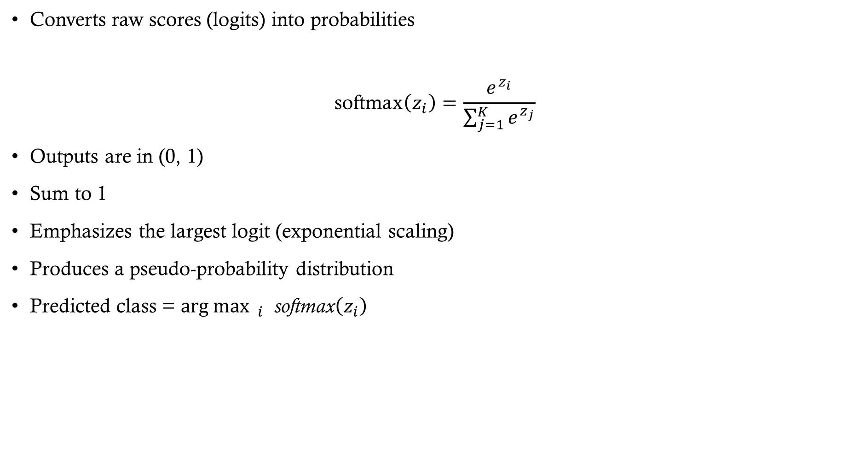
Softmax
Converts raw scores (logits) into probabilities
$$\text{softmax}\left(z_{i}\right)=\frac{e^{z_{i}}}{\sum_{j=1}^{K}{e^{z_{j}}}}$$
Outputs are in (0, 1)
Sum to 1
Emphasizes the largest logit (exponential scaling)
Produces a pseudo-probability distribution
Predicted class = $\arg{{\max{ }}_{i}} \text{softmax}\left(z_{i}\right)$

Slide 36
Another deep problem
Backpropagation with sigmoid units made training multilayer networks practical
But the chain rule multiplies one derivative per layer, so gradients for early layers are long products of terms
The sigmoid’s derivative is never larger than 0.25. What happens to these products as depth grows?

Slide 37
Vanishing Gradient Problem
When the derivative of the activation function is less than one, multiplying small numbers repeatedly causes the gradient to become very small
This leads to slow converges and poor performance
The opposite problem can also occur (exploding gradients)

Slide 38
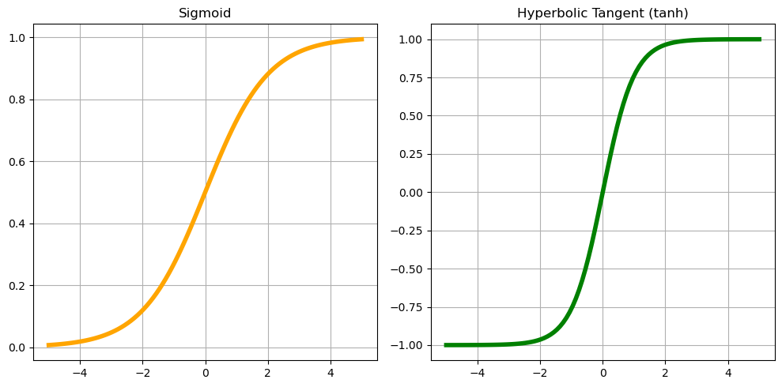
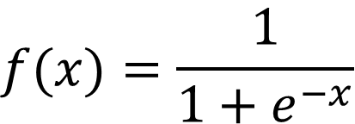
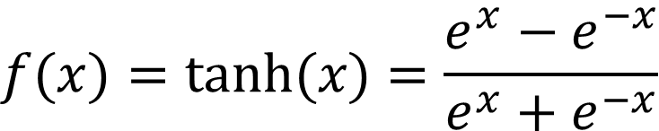
Saturating Activation Functions
$$f(x)=\frac{1}{1+e^{−x}}$$
$$f(x)=tanh(x)=\frac{e^{x}−e^{−x}}{e^{x}+e^{−x}}$$

Slide 39
Solutions for unstable gradients
Activation functions
  Designed to alleviate this problem
  ReLU and its variants (next two slides)
Weight initialization
  Sets weights to values that reduce the risk of unstable gradients at the start
Normalization
  Techniques such as batch normalization maintain stability by normalizing the inputs to each layer
Network architectures
  Some architectures are designed to help mitigate this issue

Slide 40
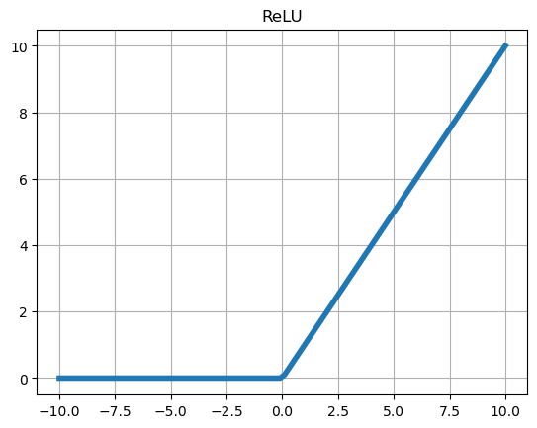
Rectified Linear Unit (ReLU)

Slide 41
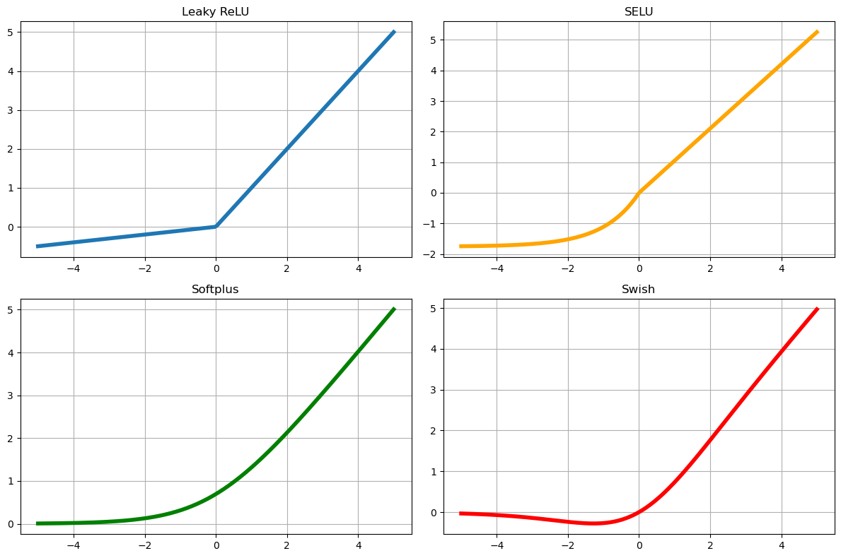
ReLU Variants (not an exhaustive list)

Slide 42
Weight Initialization
Why it matters
  Poor starting weights make signals and gradients shrink or explode layer by layer
Break symmetry
  Zero or identical weights make every neuron in a layer learn the same thing, so use small random values
Keep variance stable
  Scale initial weights by layer size so activation and gradient variance stay roughly constant
Common schemes
  Glorot (Xavier) for sigmoid/tanh: variance 1 / fan_avg
  He for ReLU: variance 2 / fan_in (ReLU zeroes half its inputs)
  See pages 359-360 HOML

Slide 43
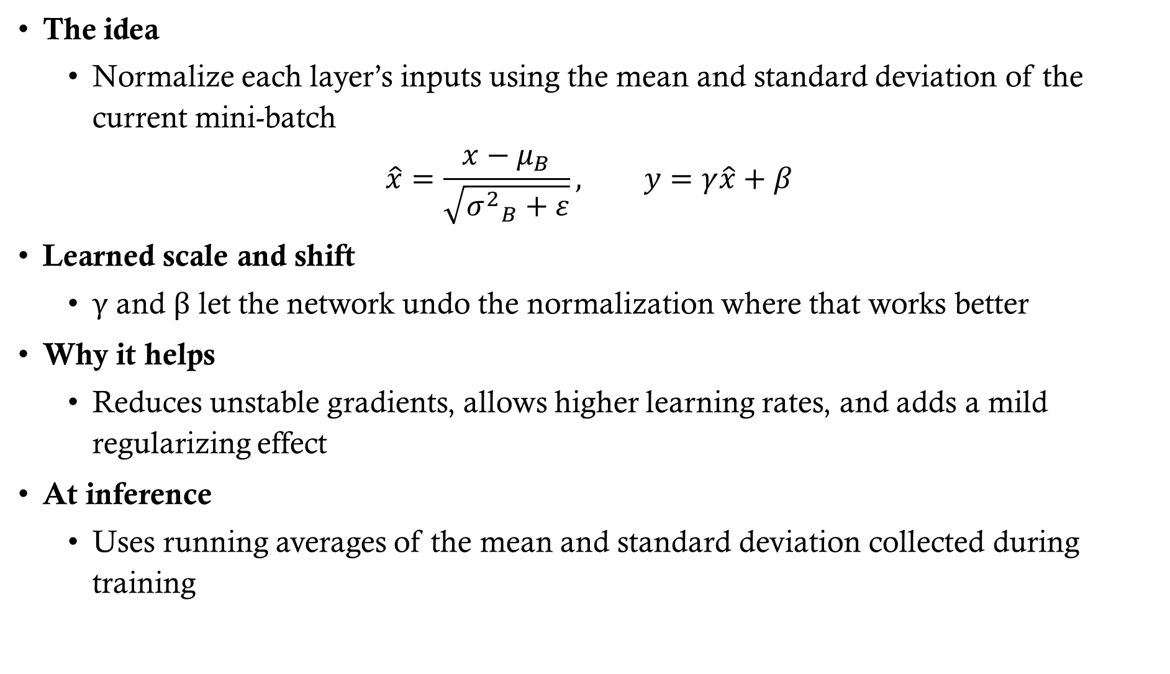
Batch Normalization
The idea
  Normalize each layer’s inputs using the mean and standard deviation of the current mini-batch
$$\hat{x}=\frac{x−μ_{B}}{\sqrt{{σ^{2}}_{B}+ε}}, y=γ\hat{x}+β$$
Learned scale and shift
  γ and β let the network undo the normalization where that works better
Why it helps
  Reduces unstable gradients, allows higher learning rates, and adds a mild regularizing effect
At inference
  Uses running averages of the mean and standard deviation collected during training

Slide 44
Tuning a DNN
Architecture
  Number of hidden layers
  Number of neurons per hidden layer
Optimization
  Learning rate
  Optimizer
  Batch size / epochs
Generalization
  Regularization
Stability (covered in the unstable-gradient fixes)
  Activation function / initialization / normalization

Slide 45
Learning Rate
Step size of each update
  Too high: may diverge; too low: slow or stuck
Rules of thumb
  Adam ≈ 1e-3; SGD ≈ 1e-2 to 1e-1; search on a log scale
Learning rate range test
  Grow rate exponentially; pick near steepest loss drop

Slide 46
Schedules & Adaptive Rates
Learning rate schedules
  Step, exponential, cosine decay, 1cycle, warmup
Reduce on plateau
  Cut rate by 2–10× when validation loss stalls
Adaptive optimizers
  AdaGrad, RMSProp, Adam scale rates per parameter
Still tune the base rate
  Adaptive methods reduce, not remove, the need

Slide 47
Optimizer
A single fixed learning rate is hard to get right, so variations of gradient descent were developed to be faster and more stable
  Adam: Adaptive Moment Estimation
    Requires minimal memory
    Computationally efficient
    Suited for large problem (large n and/or large p)
    Effective for noise or sparse gradients

Slide 48
Optimizer: Other Options
SGD with momentum
  Smooths updates; often generalizes well
RMSProp / AdaGrad
  Per-parameter rates; AdaGrad's rate decays too fast
AdamW / Nadam
  Adam with decoupled weight decay / Nesterov momentum
Rule of thumb
  Start with Adam; try tuned SGD+momentum if generalization lags

Slide 49
Batch Size & Number of Epochs
Batch Size: Number of training examples used in one iteration of model training
  Model weights are updated after computing the gradient over batches
  Large batch sizes are processed more efficiently but can lead to instabilities (see pg 352 HOML)
Epoch: One full passthrough of the entire training data
  Each epoch consists of the number of iterations needed to use all training examples once
  Too many epochs can lead to overfitting and too few can lead to underfitting

Slide 50
Regularization: Reducing Overfitting
L1 and L2 regularization
  Add a penalty to cost function and prevent weights from becoming too large
Dropout
  At every step, every neuron has probability p of being ignored
Early stopping
  Stop training if test error begins to go up
Data augmentation
  Artificially add more data (works especially well for CNNs)

Slide 51
Let’s take a look at the
TensorFlow playground
(https://playground.tensorflow.org)
Try varying depth, activation, learning rate, and regularization

