Slide 1
The Systems Aware Quality Attribute Workshop

Slide 2
Content
Introduction
Systems Thinking vs. Systems Engineering
Soft Systems Methodology
Quality Attributes and Scenarios
Overview of SAQAW
The steps
SAQAW vs. Other methods

Slide 3
What is the Systems Aware Quality Attribute Workshop (SAQAW)?
„Systems Aware“ – Relies on modeling of the context/organisational System for requirements elicitation
Uses Systems Thinking (based on SSM) combined with established Software Architecture techniques
Developed as part of Masters thesis

Slide 4
Software Architecture
Underlying structure of a system
Driven by Non-functional requirements expressed as quality attributes
Most established techniques are scenario-based

Slide 5
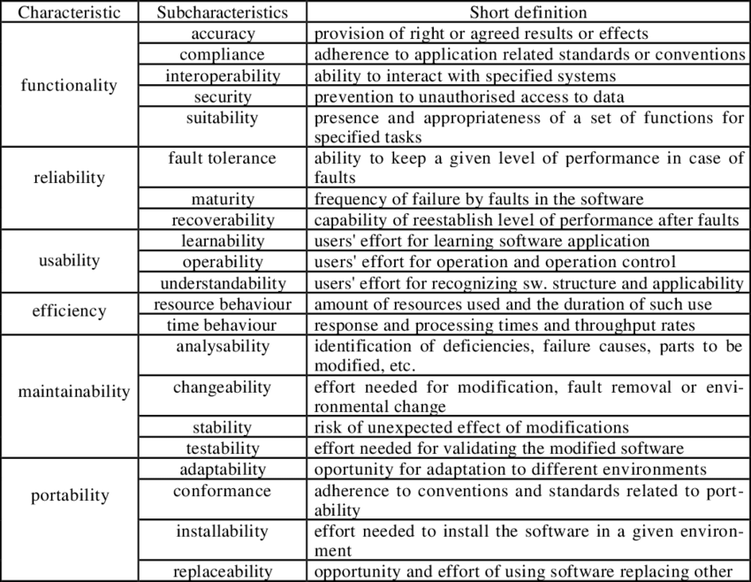
Quality Attributes
Performance
Modfiablity
Extensibility
Reliability
Deployability
Testability
…..
Refinement of Quality attributes as shown in
“Modeling Non-Functional Requirements” Botella et al. (2001)

Slide 6
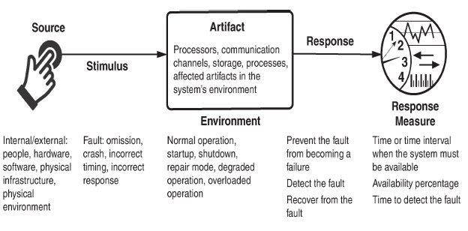
Quality Attribute Scenarios
Structure of Quality Attribute Scenarios taken from Bass et al. (2021)

Slide 7
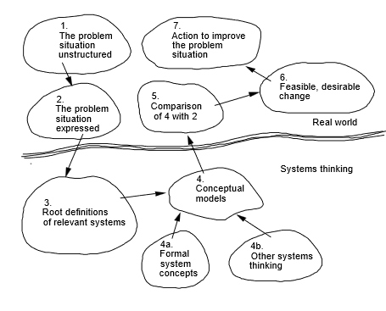
Soft Systems Methodology (SSM)
Developed by Peter Checkland in 1981
Operationalizes Systems Thinking for „ill-defined“ problematic situation
Rationale: Analysing the real-world as is to inspire purposeful action
7-steps of SSM as defined by Peter Checkland (1981)

Slide 8
Systems Thinking vs. Systems Engineering
ST: A System is a complex situation with socio-technical factors that have certain relations and complexities that need to be analysed as they are to inspire learning and create purposeful solutions
SE: A System needs to be abstracted so a solution can be egineered based on the abstractions, certain aspects of the real-world cannot and should not be expressed

Slide 9
The SAQAW Structure
8 steps in 2 phases:
First phase: Soft Systems Phase
Second phase : Scenario Generation Phase

Slide 10
Soft Systems Phase
Step 1: Introductory Presentation
Step 2: Mission and plan presentation
Step 3: Rich picture creation
Step 4: Root Definition

Slide 11
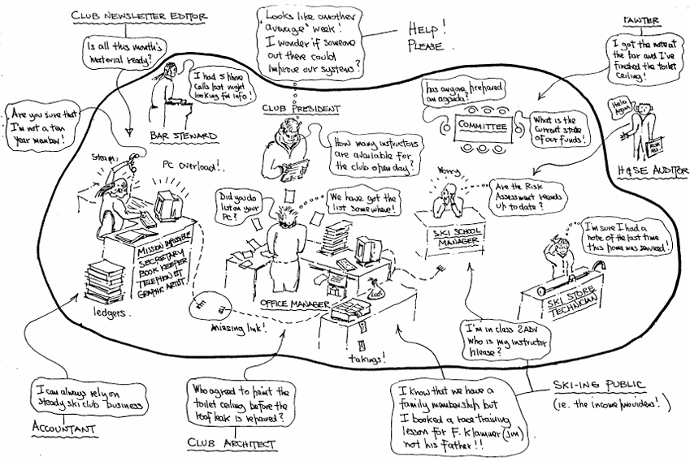
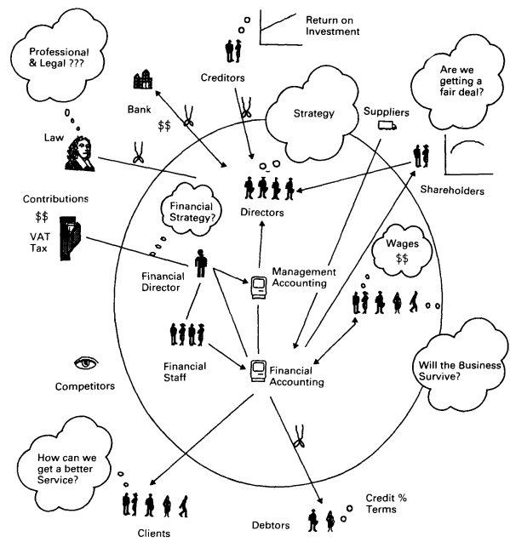
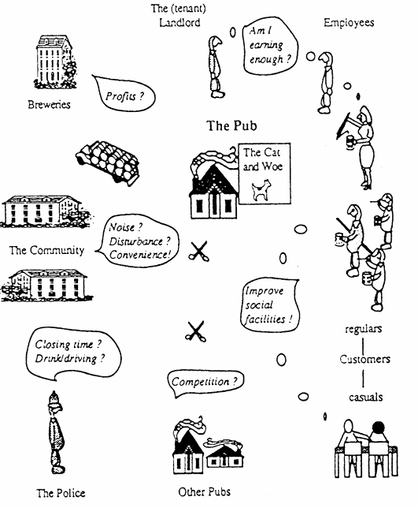
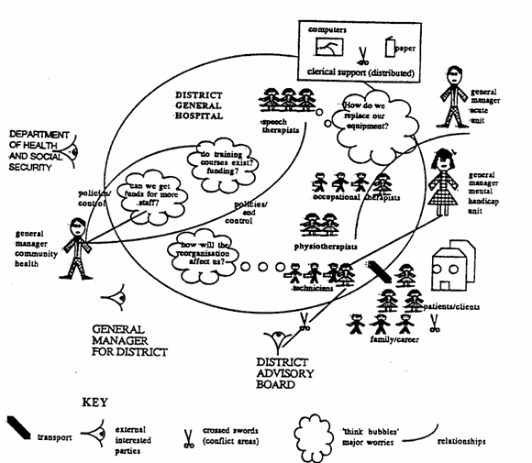
1
2
4
3

Slide 12
Scneario Generation Phase
Step 5: Scenario Brainstorming (based on rich picture)
Step 6: Scenario Consolidation
Step 7: Scenario Prioritization
Step 8: Scenario Refinement

Slide 13
References
Bass, L., Clements, P., & Kazman, R. (2021). Practice, Software Architecture in Practice, Fourth Edition. Boston: Addison-Wesley Professional
Checkland, P. (1981). Systems Thinking, Systems Practice. John Wiley & Sons Ltd .
Botella, P., Burgués, X., Franch, X. & Huerta, M. (2001). Modeling Non-Functional Requirements
Rich Pictures:
1: Bronte-Stewart, M. (1999). Regarding Rich Pictures as Tools for Communication in Information Systems Development. Computing and Information Systems, 83 - 102.
2: Avison, D. E., G. P., & Shah, H. U. (1992). Towards an SSM toolkit: rich picture diagramming. European Journal of Information Systems, 397 - 408.
3: Avison, D., & Fitzgerald, G. (2002). Information Systems Development: Methodologies, Techniques and Tools. McGraw Hill Higher Education.
4: Patching, D. (1990). Practical Soft Systems Analysis. Financial Times.

