Slide 1
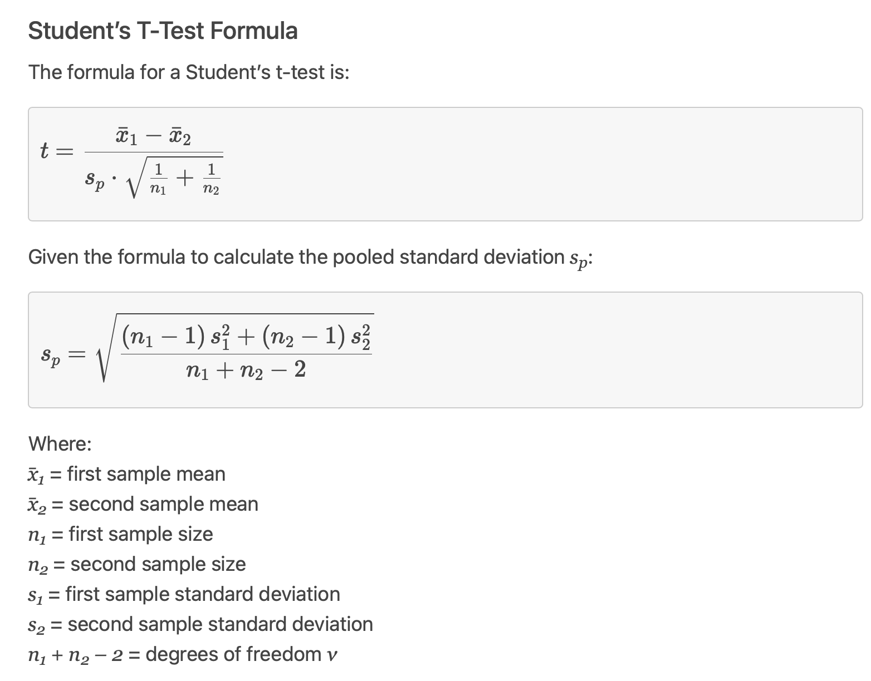

Slide 2
The t-test uses an approximation to the sampling distribution of the difference in sample means based on the Central Limit Theorem, which ensures that for sufficiently large samples, the sampling distribution will be very close to Normal. The mean of the sampling distribution will be the difference in population means, and the variance of the sampling distribution will be the standard error of the difference in sample means. This approximation works quite well even for small samples (say sample sizes of 10 for both conditions) unless the data are highly skewed.
If the null hypothesis was true we expect that group mean difference would be close to zero. "close" is relative to the sampling distribution. And we have an estimate of the SD of the sampling distribution. Statistical theory then tells us that if the underlying populations are close to Normal, are independent and there is no difference in population means, then

Slide 3
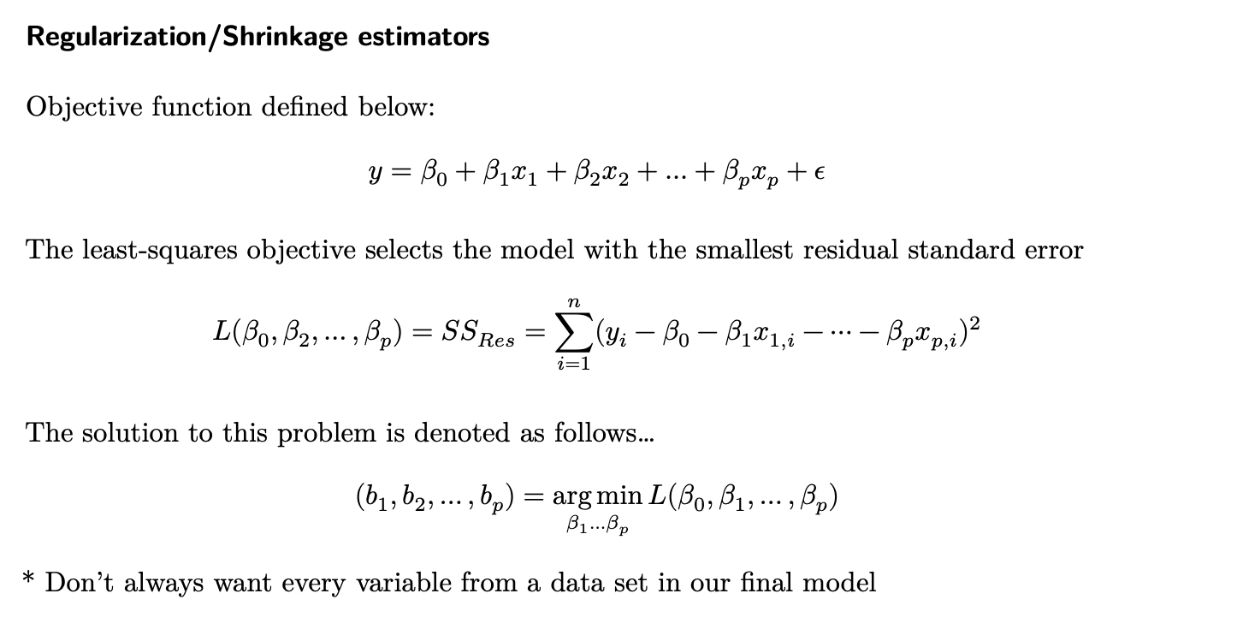

Slide 4
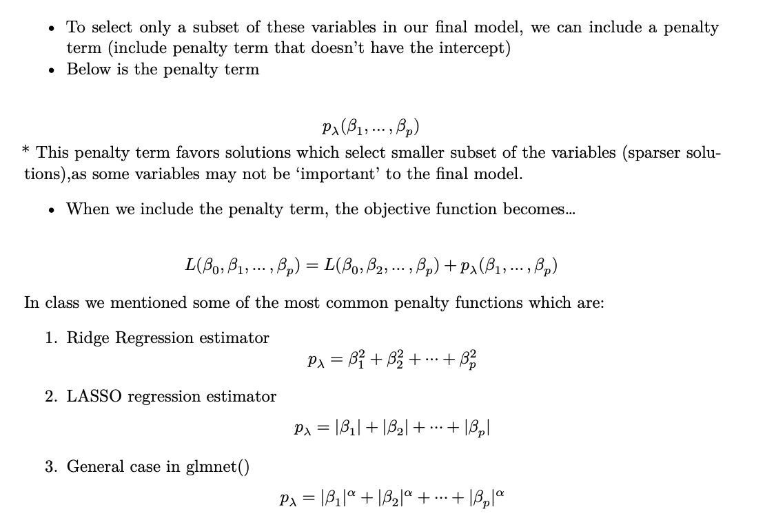

Slide 5
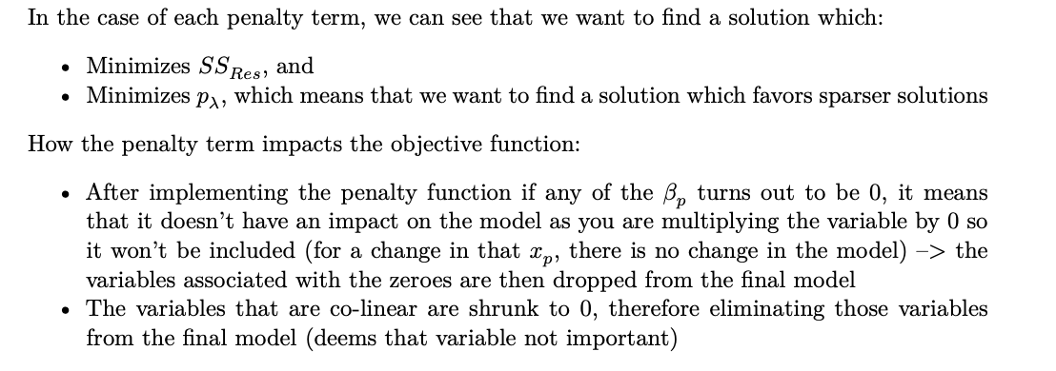

Slide 6
