Slide 1

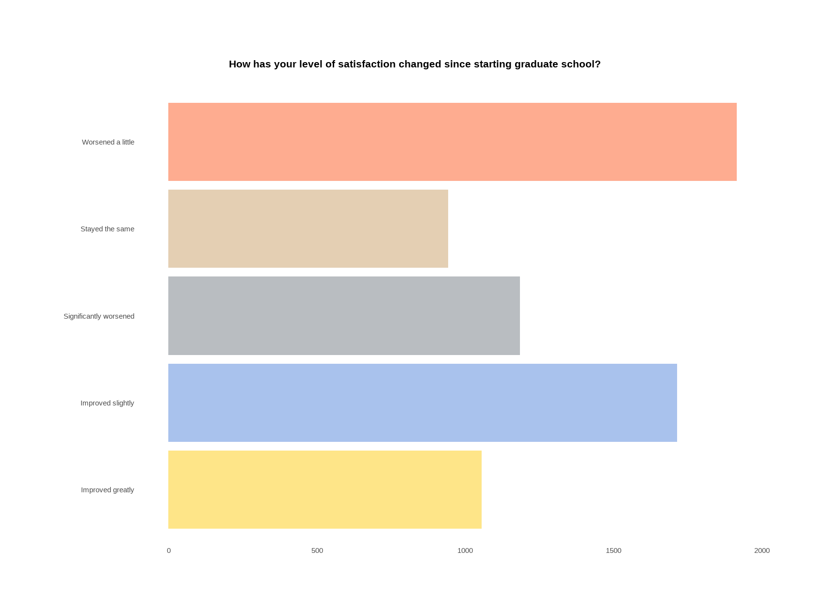


















search
FINDING SATISFACTION IN YOUR PhD
a data-based approach of the sources of happiness in graduate school
home
about
contact

Slide 2
search
FINDING SATISFACTION IN YOUR PhD
a data-based approach of the sources of happiness in graduate school
home
about
contact

