Slide 1

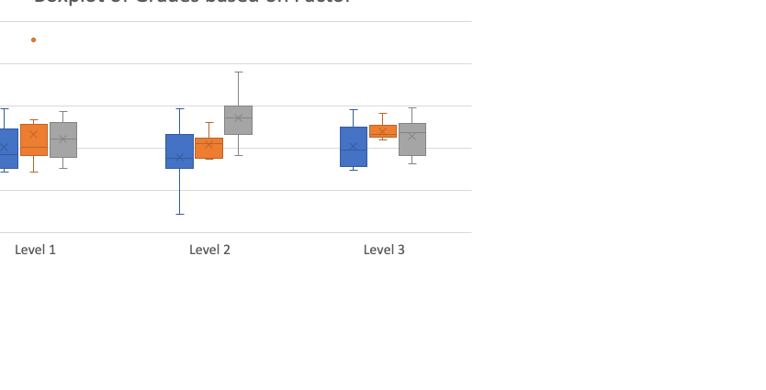
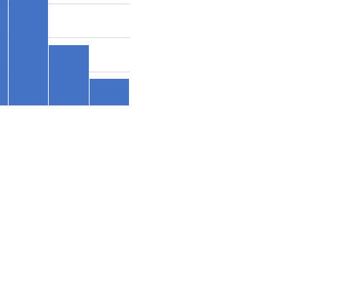
Dropdown:
Includes:Sex, mom_edu, dad_edu, weekend_alc, weekday_alc, health,fam_support, other variables etc.
These are different tabs (panels)
OVERVIEW MODE
Analysis Mode
Select a factor
Final Grades
Term 2 Grades
Term 1 Grades
Select Plot
X
Boxplot
X
Histogram
X
Demographic Bar Chart

Slide 2
These are different tabs (panels)
OVERVIEW MODE
Analysis Mode
Only includes certain variable like weekend_alc,weekday_alc, maternal education, mainly numerically coded variables
Select Variable to plot by (x)
Weekend_alc
Which Grade?(y)
Final Grades
Term 2 Grades
Term 1 Grades
X
Colour by a Variable?
Sex
Only includes certain variables such as
Sex, family support (mainly yes/no-->
binary to improve ease of reading)
A scatterplot of the variables selected with a linear model fitted line of the selected variable

