Slide 1
Types of Sums of Squares
Testing different hypotheses

Slide 2
Types of Sums of Squares
There are four different types of sums of squares
The two most important (that is, most common) are Type I and Type III
In many cases, the types will be equivalent and hence the distinction isn’t important
Goal: Explore when the types are the same, when they are different, and which one to use if they are different

Slide 3
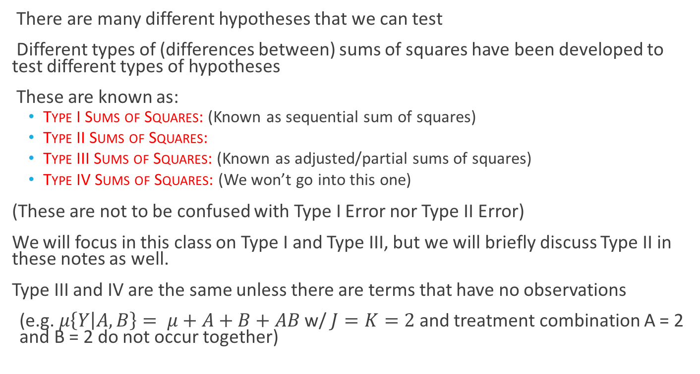
Extra Sums of Squares Tests
There are many different hypotheses that we can test
Different types of (differences between) sums of squares have been developed to test different types of hypotheses
These are known as:
Type I Sums of Squares: (Known as sequential sum of squares)
Type II Sums of Squares:
Type III Sums of Squares: (Known as adjusted/partial sums of squares)
Type IV Sums of Squares: (We won’t go into this one)
(These are not to be confused with Type I Error nor Type II Error)
We will focus in this class on Type I and Type III, but we will briefly discuss Type II in these notes as well.
Type III and IV are the same unless there are terms that have no observations
(e.g. $μ\left\{Y | A,B\right\}= μ+A+B+AB$ w/ $J=K=2$ and treatment combination A = 2 and B = 2 do not occur together)

Slide 4
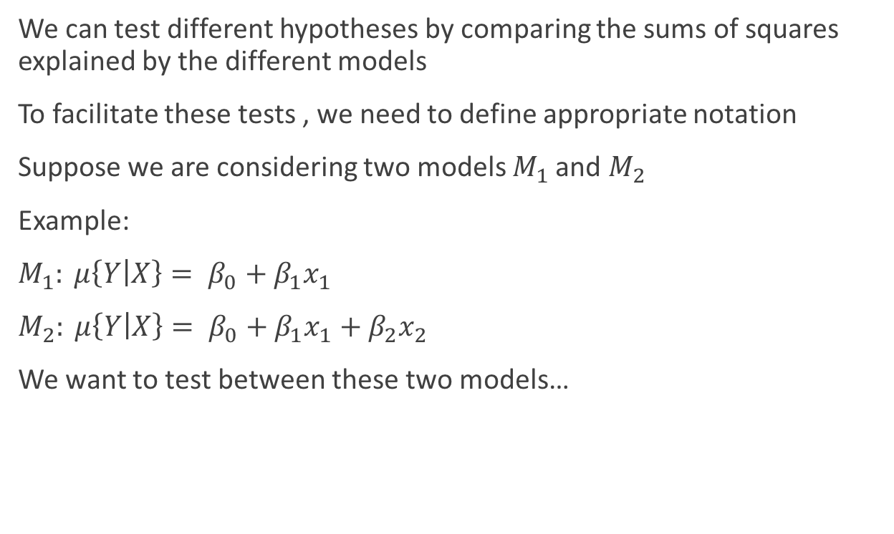
General Notation
We can test different hypotheses by comparing the sums of squares explained by the different models
To facilitate these tests , we need to define appropriate notation
Suppose we are considering two models $M_{1}$ and $M_{2}$
Example:
$M_{1}: μ\left\{Y | X\right\}= β_{0}+β_{1}x_{1}$
$M_{2}: μ\left\{Y | X\right\}= β_{0}+β_{1}x_{1}+β_{2}x_{2}$
We want to test between these two models…

Slide 5
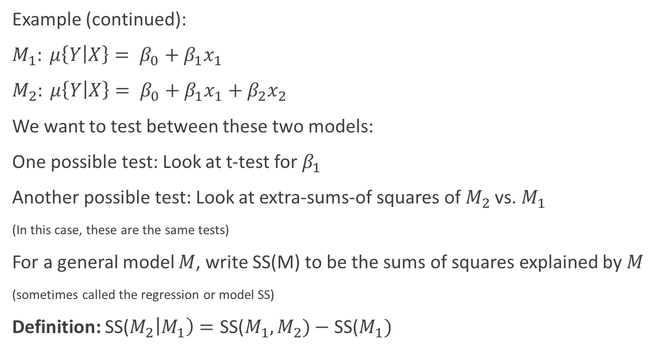
General Notation
Example (continued):
$M_{1}: μ\left\{Y | X\right\}= β_{0}+β_{1}x_{1}$
$M_{2}: μ\left\{Y | X\right\}= β_{0}+β_{1}x_{1}+β_{2}x_{2}$
We want to test between these two models:
One possible test: Look at t-test for $β_{1}$
Another possible test: Look at extra-sums-of squares of $M_{2}$ vs. $M_{1}$
(In this case, these are the same tests)
For a general model $M$, write SS(M) to be the sums of squares explained by $M$
(sometimes called the regression or model SS)
Definition: SS($M_{2}\left|M_{1}\right)=\text{SS}\text{(}M_{1},M_{2})−\text{SS}\text{(}M_{1})$

Slide 6
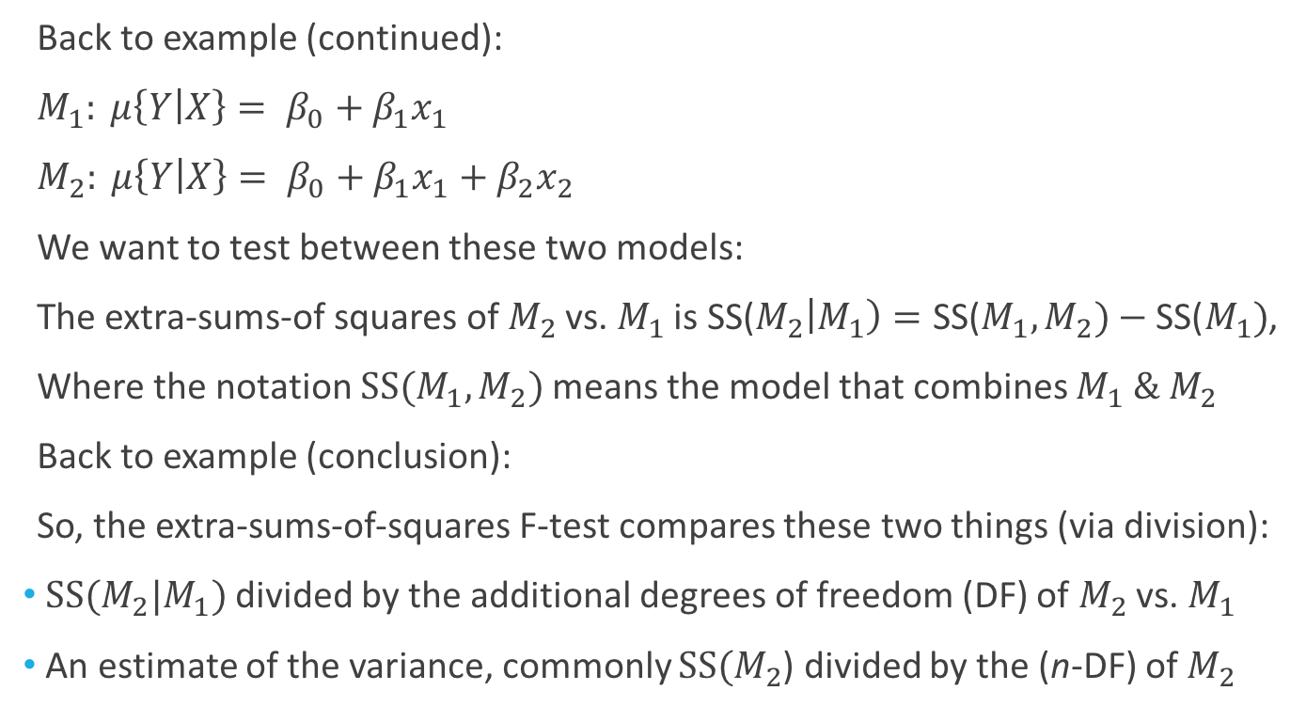
Using this Notation
Back to example (continued):
$M_{1}: μ\left\{Y | X\right\}= β_{0}+β_{1}x_{1}$
$M_{2}: μ\left\{Y | X\right\}= β_{0}+β_{1}x_{1}+β_{2}x_{2}$
We want to test between these two models:
The extra-sums-of squares of $M_{2}$ vs. $M_{1}$ is SS($M_{2}\left|M_{1}\right)=\text{SS}\text{(}M_{1},M_{2})−\text{SS}\text{(}M_{1})$,
Where the notation $SS(M_{1},M_{2})$ means the model that combines $M_{1} \& M_{2}$
Back to example (conclusion):
So, the extra-sums-of-squares F-test compares these two things (via division):
$SS(M_{2}|M_{1})$ divided by the additional degrees of freedom (DF) of $M_{2}$ vs. $M_{1}$
An estimate of the variance, commonly $SS(M_{2}$) divided by the (n-DF) of $M_{2}$

Slide 7
Type I Sums of Squares

Slide 8
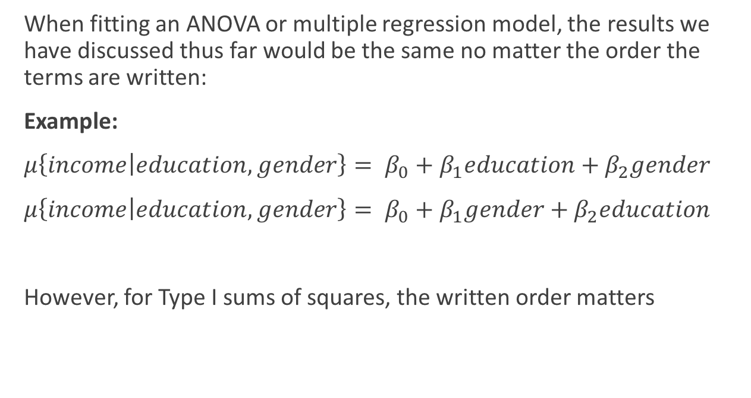
Type I Sums of Squares
When fitting an ANOVA or multiple regression model, the results we have discussed thus far would be the same no matter the order the terms are written:
Example:
$μ\left\{income | education,gender\right\}= β_{0}+β_{1}education+β_{2}gender$
$μ\left\{income | education,gender\right\}= β_{0}+β_{1}gender+β_{2}education$
However, for Type I sums of squares, the written order matters

Slide 9
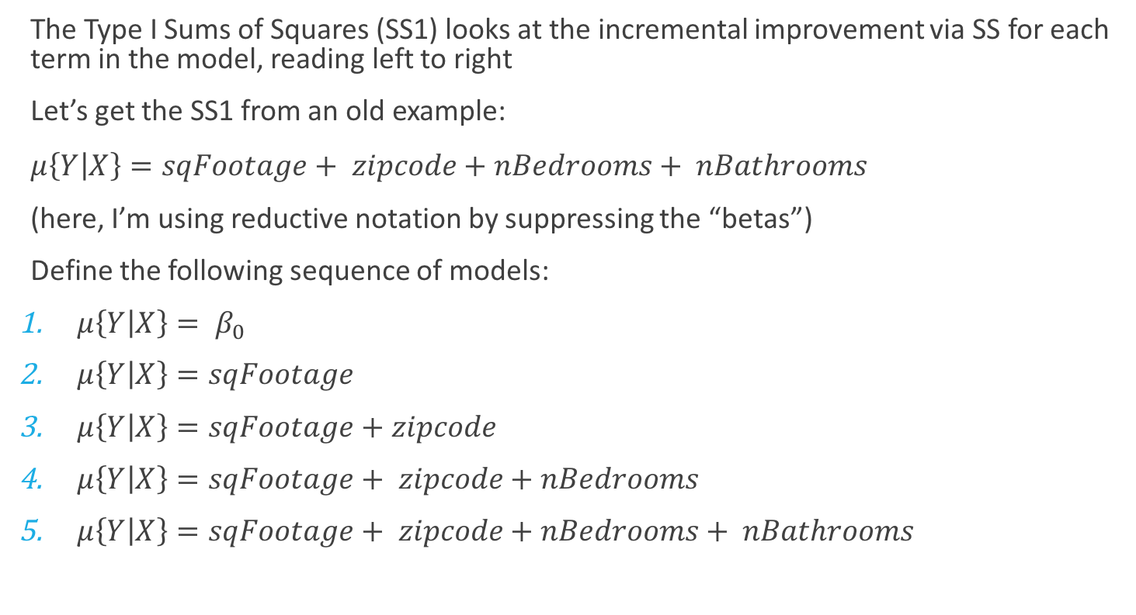
Type I Sums of Squares (SS1)
The Type I Sums of Squares (SS1) looks at the incremental improvement via SS for each term in the model, reading left to right
Let’s get the SS1 from an old example:
$μ\left\{Y | X\right\}=sqFootage+ zipcode+nBedrooms+ nBathrooms$
(here, I’m using reductive notation by suppressing the “betas”)
Define the following sequence of models:
$μ\left\{Y | X\right\}= β_{0}$
$μ\left\{Y | X\right\}=sqFootage$
$μ\left\{Y | X\right\}=sqFootage+zipcode$
$μ\left\{Y | X\right\}=sqFootage+ zipcode+nBedrooms$
$μ\left\{Y | X\right\}=sqFootage+ zipcode+nBedrooms+ nBathrooms$

Slide 10
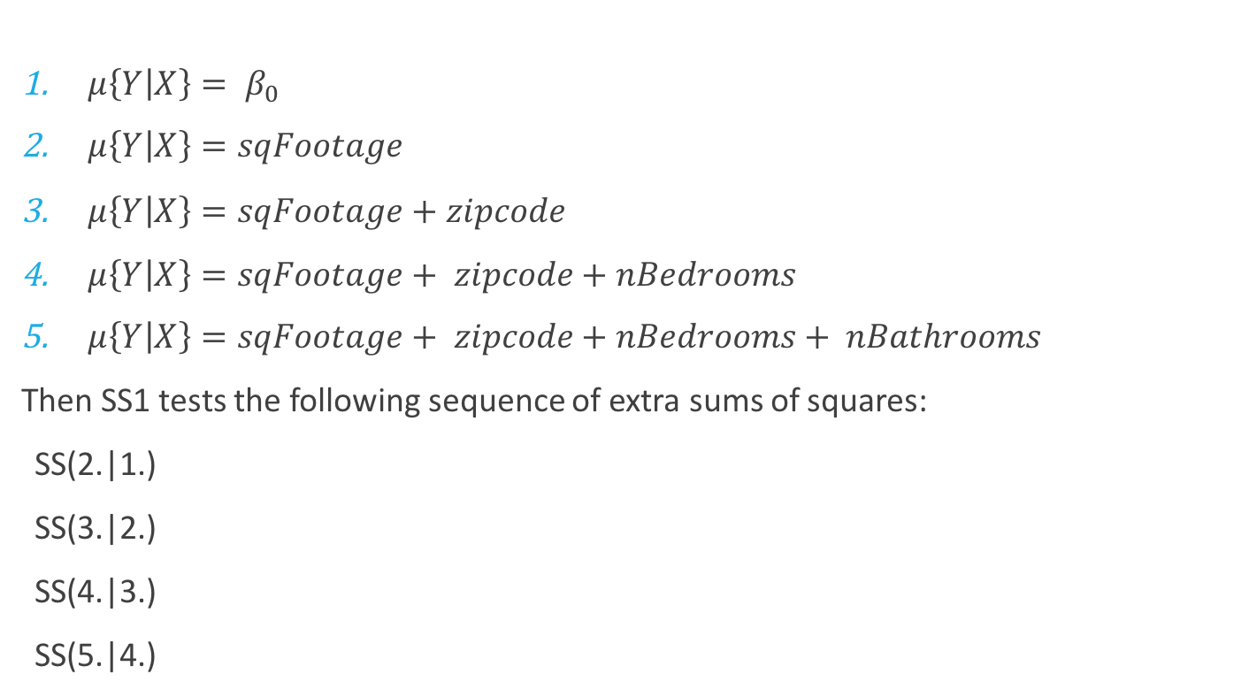
Type I Sums of Squares (SS1): Sequential
$μ\left\{Y | X\right\}= β_{0}$
$μ\left\{Y | X\right\}=sqFootage$
$μ\left\{Y | X\right\}=sqFootage+zipcode$
$μ\left\{Y | X\right\}=sqFootage+ zipcode+nBedrooms$
$μ\left\{Y | X\right\}=sqFootage+ zipcode+nBedrooms+ nBathrooms$
Then SS1 tests the following sequence of extra sums of squares:
SS(2.|1.)
SS(3.|2.)
SS(4.|3.)
SS(5.|4.)

Slide 11
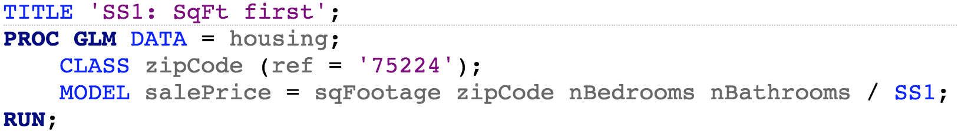
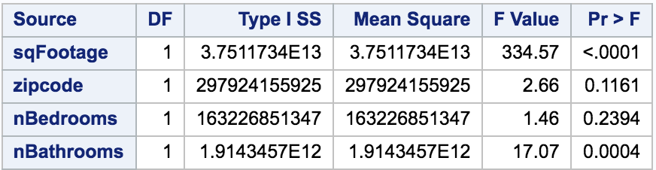
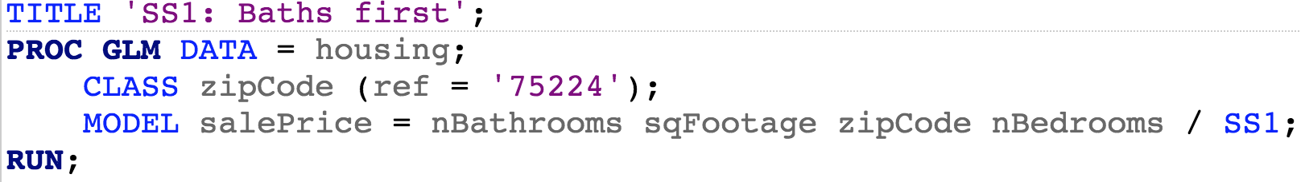
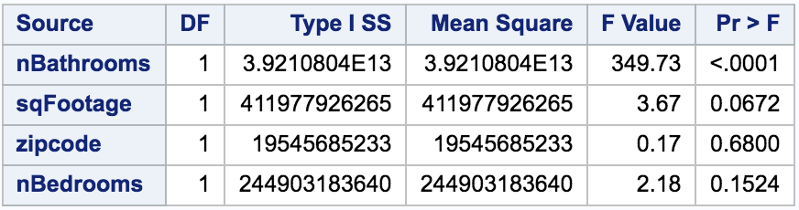
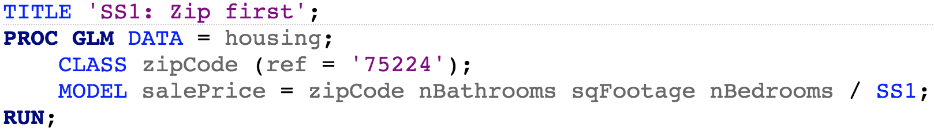
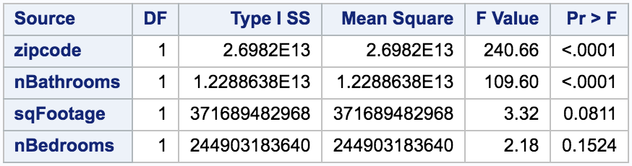
Type I Sums of Squares (SS1): Sequential
(these are with respect to the order in each MODEL statement)
SS(2.|1.)
SS(3.|2.)
SS(4.|3.)
SS(5.|4.)
SS(2.|1.)
SS(3.|2.)
SS(4.|3.)
SS(5.|4.)
SS(2.|1.)
SS(3.|2.)
SS(4.|3.)
SS(5.|4.)

Slide 12
Type I Sums of Squares: Sequential
Reasons for using SS1:
Primarily, if we have an interest in a specific nesting of explanatory variables
Example: Suppose we are looking at the Zillow data and we want to make sure all comparisons control for location via including zipcode
Also, we have the following research questions:
Is there an estimated effect of square footage given zipcode is fixed?
Is there an estimated effect of bedrooms given zipcode and square footage are fixed?
Is there an estimated effect of bathrooms given zipcode, square footage, and bedrooms are fixed?
Then SS1, alternatively known as sequential sums of squares, is the appropriate analysis

Slide 13
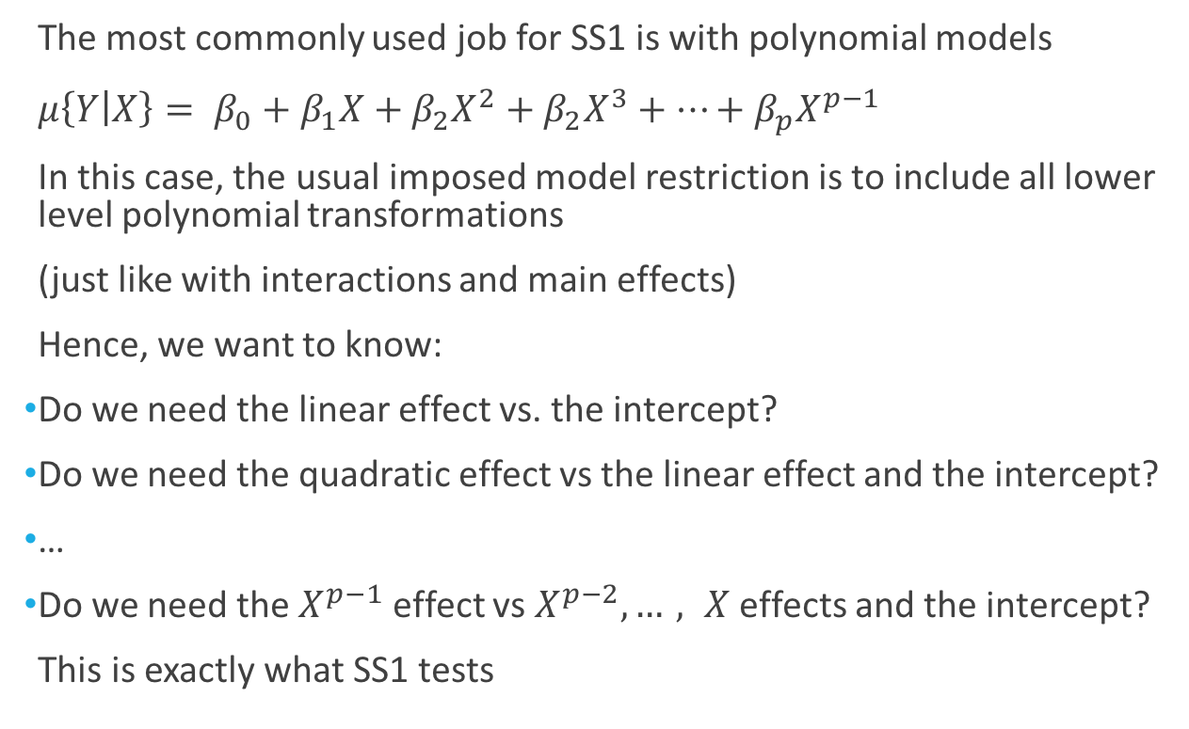
Type I Sums of Squares: Sequential
The most commonly used job for SS1 is with polynomial models
$μ\left\{Y | X\right\}= β_{0}+β_{1}X+β_{2}X^{2}+β_{2}X^{3}+…+β_{p}X^{p−1}$
In this case, the usual imposed model restriction is to include all lower level polynomial transformations
(just like with interactions and main effects)
Hence, we want to know:
Do we need the linear effect vs. the intercept?
Do we need the quadratic effect vs the linear effect and the intercept?
…
Do we need the $X^{p−1}$ effect vs $X^{p−2},…, X$ effects and the intercept?
This is exactly what SS1 tests

Slide 14
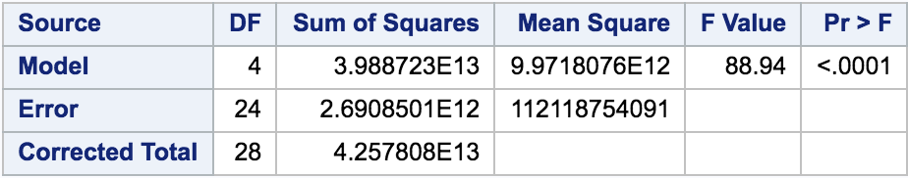
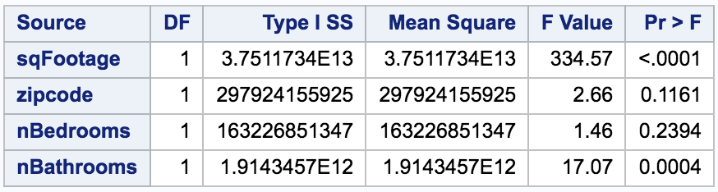
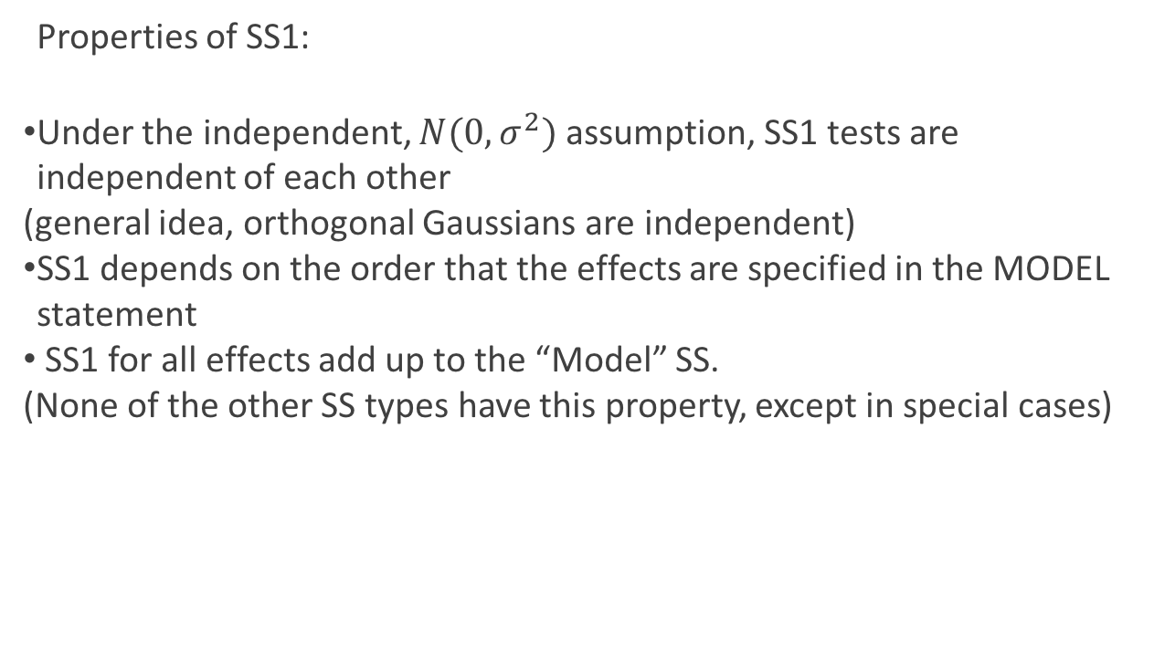
Type I Sums of Squares: Sequential
Properties of SS1:
Under the independent, $N(0,σ^{2})$ assumption, SS1 tests are independent of each other
(general idea, orthogonal Gaussians are independent)
SS1 depends on the order that the effects are specified in the MODEL statement
SS1 for all effects add up to the “Model” SS.
(None of the other SS types have this property, except in special cases)
(These are very related concepts)

Slide 15
Type II Sums of Squares

Slide 16
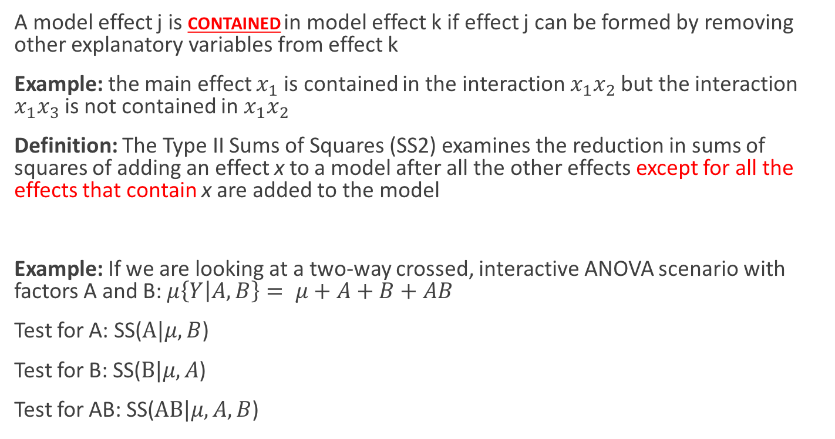
Type II Sums of Squares (SS2)
A model effect j is contained in model effect k if effect j can be formed by removing other explanatory variables from effect k
Example: the main effect $x_{1}$ is contained in the interaction $x_{1}x_{2}$ but the interaction $x_{1}x_{3}$ is not contained in $x_{1}x_{2}$
Definition: The Type II Sums of Squares (SS2) examines the reduction in sums of squares of adding an effect x to a model after all the other effects except for all the effects that contain x are added to the model
Example: If we are looking at a two-way crossed, interactive ANOVA scenario with factors A and B: $μ\left\{Y | A,B\right\}= μ+A+B+AB$
Test for A: SS($A|μ,B$)
Test for B: SS($B|μ,A$)
Test for AB: SS($AB|μ,A,B$)

Slide 17
Type III Sums of Squares

Slide 18
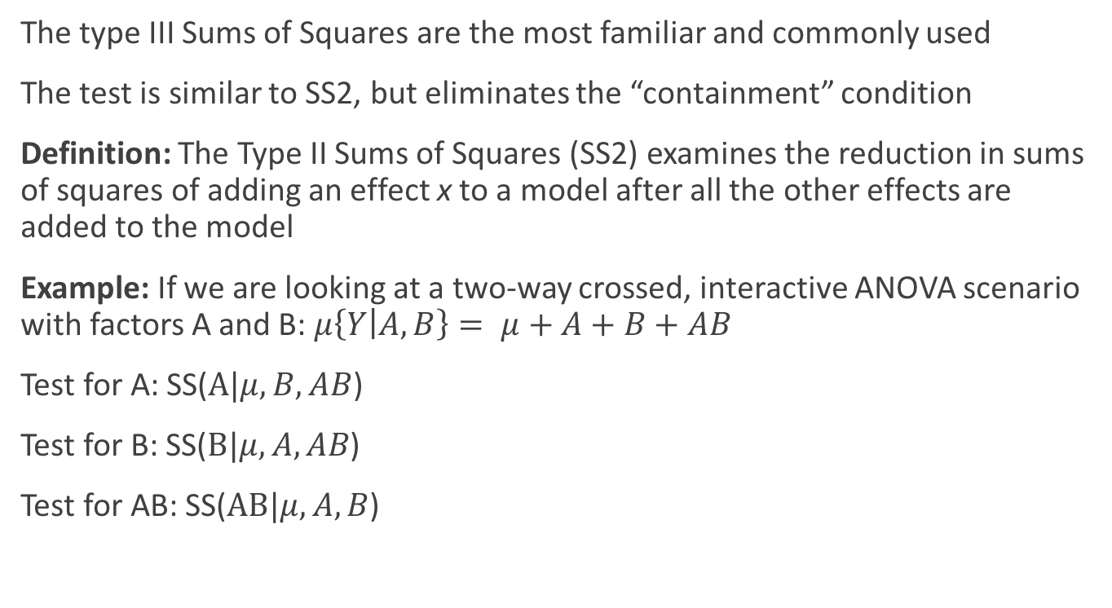
Type III Sums of Squares (SS3)
The type III Sums of Squares are the most familiar and commonly used
The test is similar to SS2, but eliminates the “containment” condition
Definition: The Type II Sums of Squares (SS2) examines the reduction in sums of squares of adding an effect x to a model after all the other effects are added to the model
Example: If we are looking at a two-way crossed, interactive ANOVA scenario with factors A and B: $μ\left\{Y | A,B\right\}= μ+A+B+AB$
Test for A: SS($A|μ,B, AB$)
Test for B: SS($B|μ,A, AB$)
Test for AB: SS($AB|μ,A,B$)

Slide 19
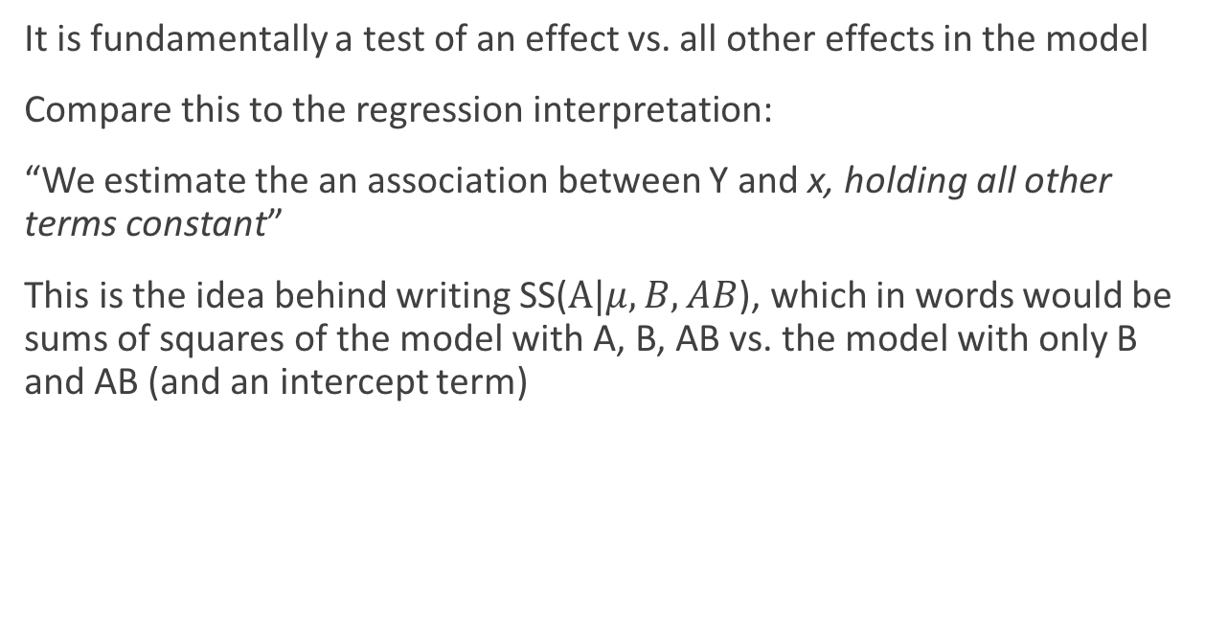
Type III Sums of Squares (SS3)
It is fundamentally a test of an effect vs. all other effects in the model
Compare this to the regression interpretation:
“We estimate the an association between Y and x, holding all other terms constant”
This is the idea behind writing SS($A|μ,B, AB$), which in words would be sums of squares of the model with A, B, AB vs. the model with only B and AB (and an intercept term)

Slide 20
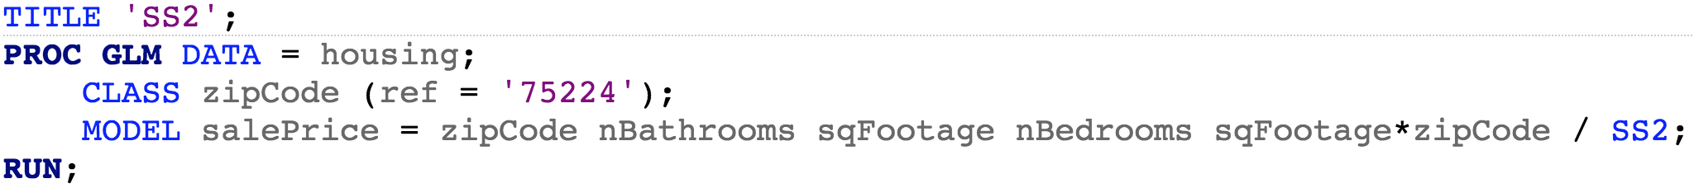
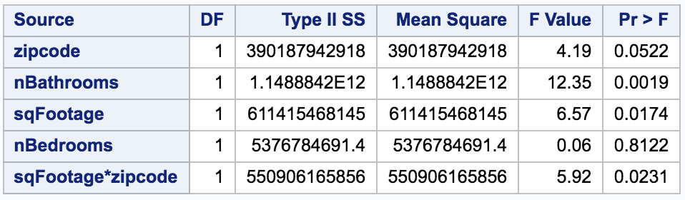
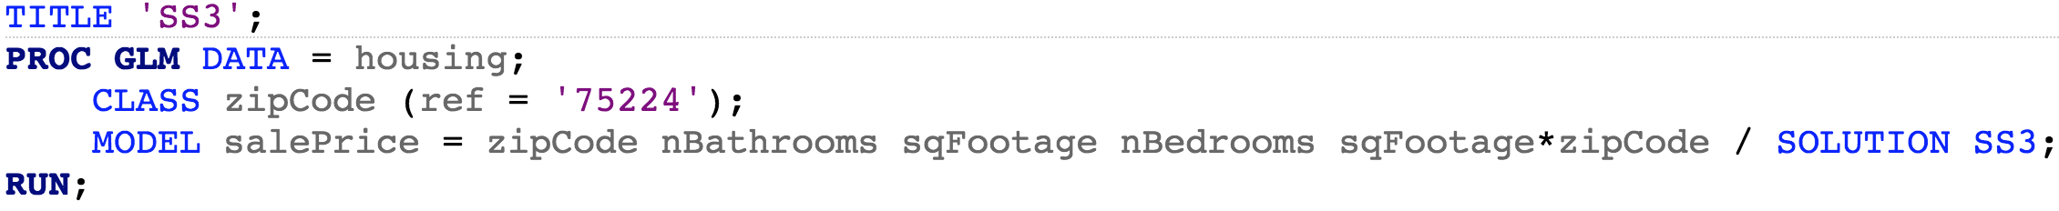
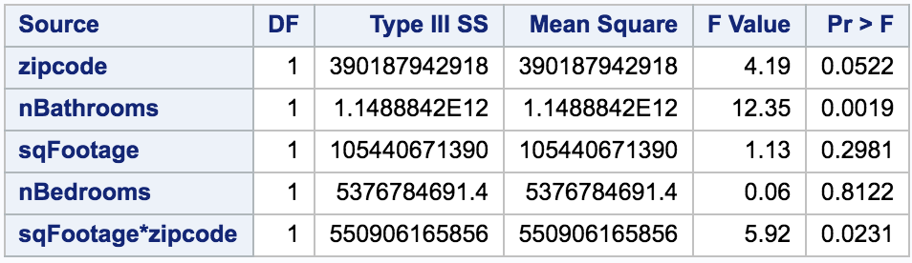
Type III Sums of Squares (SS3)
This tests the ESS for model
zipcode, nBaths, nBeds, sqFt
vs.
nBaths, nBeds, sqFt
This tests the ESS for model
zipcode, nBaths, nBeds, sqFt, zipcode*sqFt
vs.
nBaths, nBeds, sqFt, zipcode*sqFt

Slide 21
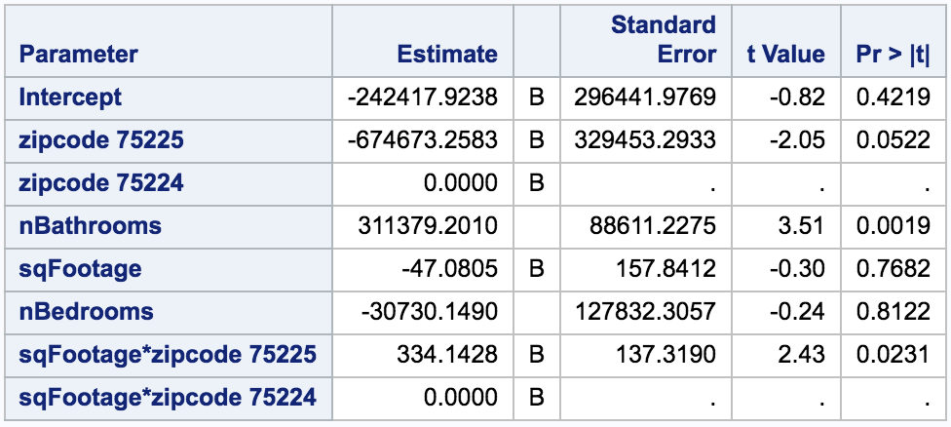
Type III Sums of Squares (SS3)
When the factor explanatory variables have two levels, SS3 will exactly mimic the regression table
However, when the factors have more than 2 levels, the SS3 will test all of the level combinations at the same time, while the regression table will test them all individually
Let’s look at an example..
(Note: We will just look at SS3 but all 4 SS types test factor levels as a group)

Slide 22
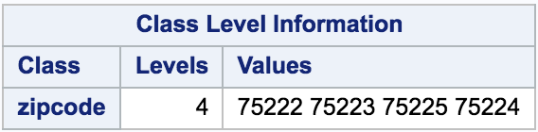
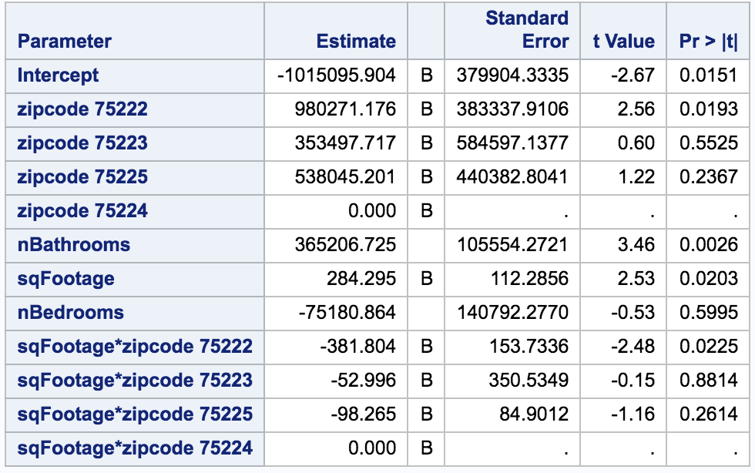
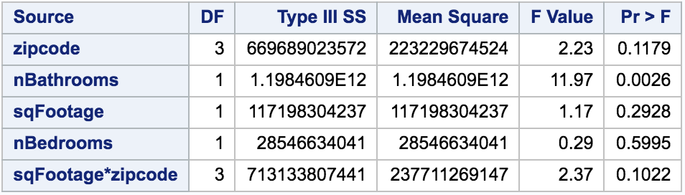
Type III Sums of Squares (SS3): More than 2 Factor Levels
ANOVA Table: Testing levels as group
Regression Table: Testing levels individually

Slide 23
Comparing SS2 to SS3

Slide 24
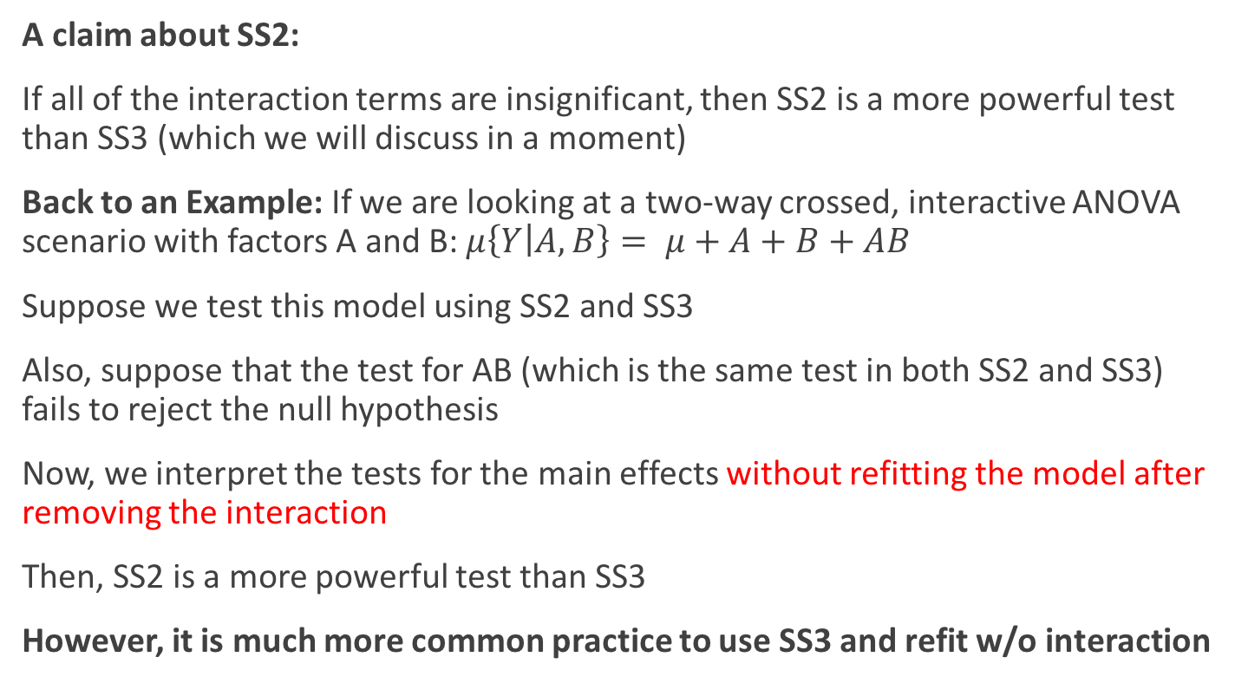
Type II Sums of Squares (SS2)
A claim about SS2:
If all of the interaction terms are insignificant, then SS2 is a more powerful test than SS3 (which we will discuss in a moment)
Back to an Example: If we are looking at a two-way crossed, interactive ANOVA scenario with factors A and B: $μ\left\{Y | A,B\right\}= μ+A+B+AB$
Suppose we test this model using SS2 and SS3
Also, suppose that the test for AB (which is the same test in both SS2 and SS3) fails to reject the null hypothesis
Now, we interpret the tests for the main effects without refitting the model after removing the interaction
Then, SS2 is a more powerful test than SS3
However, it is much more common practice to use SS3 and refit w/o interaction

