Slide 1
Multiple Regression: A Model for the Mean
Extra Sums of squares tests
Testing different hypotheses
A Preliminary look at Prediction

Slide 2
Testing For Groups of Explanatory Variables

Slide 3
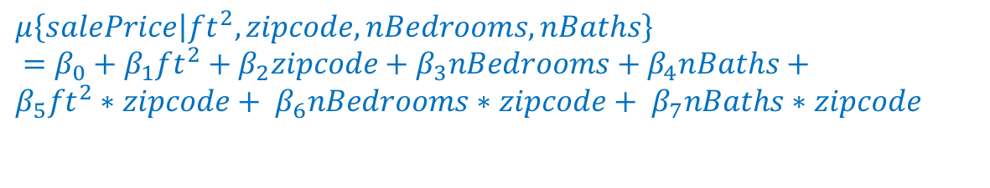
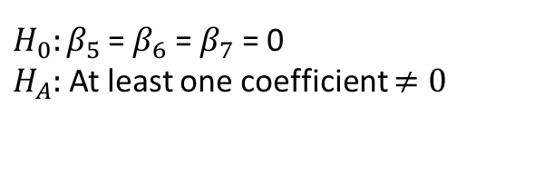
Extra Sums of Squares F-Test
Consider comparing the “reduced” model:
with a “full” model that interacts each of the main effects with zipcode:
If we want to test for the suitability of the more complex model, we need to test the hypothesis:
The default t-tests do not address this hypothesis
$$μ\left\{salePrice | {ft}^{2}, zipcode, nBedrooms, nBaths\right\}=β_{0}+{β_{1}ft}^{2}+β_{2}zipcode+β_{3}nBedrooms+β_{4}nBaths$$
$$μ\left\{salePrice | {ft}^{2}, zipcode, nBedrooms, nBaths\right\}$$
$=β_{0}+{β_{1}ft}^{2}+β_{2}zipcode+β_{3}nBedrooms+β_{4}nBaths+$
$${β_{5}ft}^{2}∗zipcode+{ β}_{6}nBedrooms∗zipcode+{ β}_{7}nBaths∗zipcode$$
$H_{0}:β_{5}$ = $β_{6}$ = $β_{7}$ = 0
$H_{A}:$At least one coefficient $≠0$

Slide 4
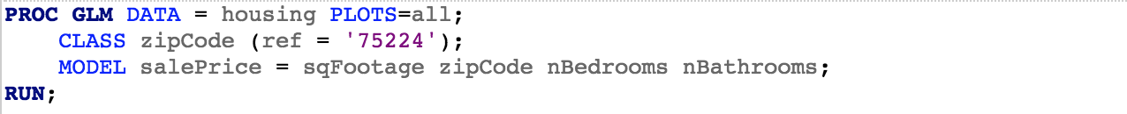
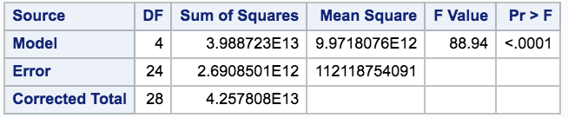
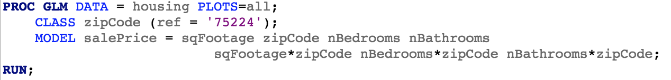
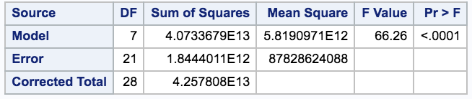
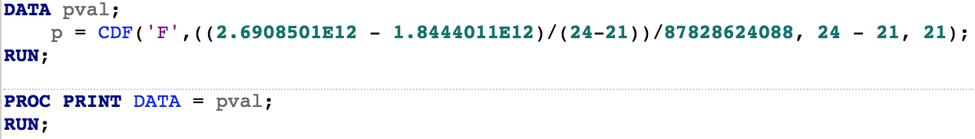

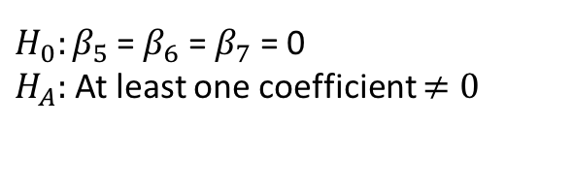
Extra Sums of Squares F-Test: General Case
(see lecture notes: 5c_ESSforSpock for a discussion of extra sums of squares tests for ANOVA and Chapter 10.3 in the book)
$H_{0}:β_{5}$ = $β_{6}$ = $β_{7}$ = 0
$H_{A}:$At least one coefficient $≠0$
P-value = 0.0437
What does this mean?

Slide 5
Extra Sums of Squares F-Test: Special Cases
There are two special cases of note:
Testing a single coefficient
Testing the fit of a model to the intercept-only model
We will cover each of these in the next slides..

Slide 6
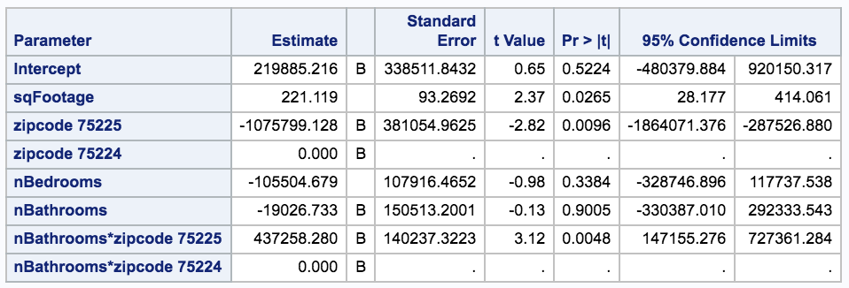
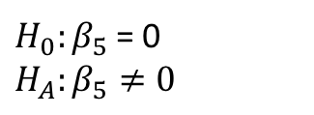
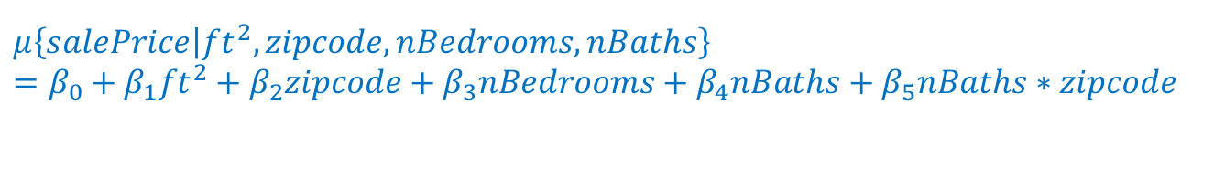
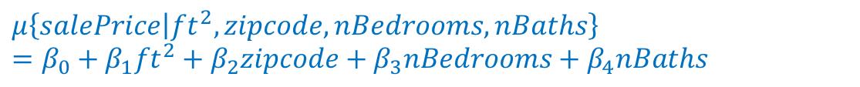
Testing a Single Coefficient
Compare the “reduced” model:
to the “full” model that adds an interaction of nBaths and zipcode:
This reduces to testing
$$μ\left\{salePrice | {ft}^{2}, zipcode, nBedrooms, nBaths\right\}=β_{0}+{β_{1}ft}^{2}+β_{2}zipcode+β_{3}nBedrooms+β_{4}nBaths$$
$$μ\left\{salePrice | {ft}^{2}, zipcode, nBedrooms, nBaths\right\}$$
$=β_{0}+{β_{1}ft}^{2}+β_{2}zipcode+β_{3}nBedrooms+β_{4}nBaths$ $+{ β}_{5}nBaths∗zipcode$
$H_{0}:β_{5}$ = 0
$H_{A}:β_{5}≠0$
(Exercise: Convince yourself you get the same answer as an extra sums of squares F-test)

Slide 7
Testing the Fit of a Model to the Intercept-only Model
The default PROC GLM output provides this test:
Exercise: Convince yourself that this output corresponds to an extra sums of squares test for the considered model vs. the “reduced” model
$$μ\left\{salePrice | {ft}^{2}, zipcode, nBedrooms, nBaths\right\}=β_{0}$$

Slide 8
Making Predictions

Slide 9
Returning to Some Scientific Questions
It is very important to do statistics from the perspective of a scientist
This means always keeping in mind the scientific question(s) of interest
What are some scientific questions of interest for the housing data?
Suppose instead of trying to infer the relationship between aspects of a house and its sales price, we want to get a prediction of the sales price.
A survey of housing data + multiple regression could be used

Slide 10
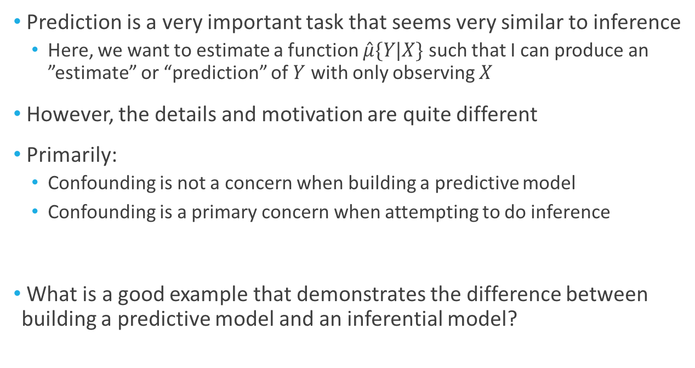
Prediction
Prediction is a very important task that seems very similar to inference
Here, we want to estimate a function $\hat{μ}\{Y|X\text{\}}$ such that I can produce an ”estimate” or “prediction” of $Y$ with only observing $X$
However, the details and motivation are quite different
Primarily:
Confounding is not a concern when building a predictive model
Confounding is a primary concern when attempting to do inference
What is a good example that demonstrates the difference between building a predictive model and an inferential model?

Slide 11
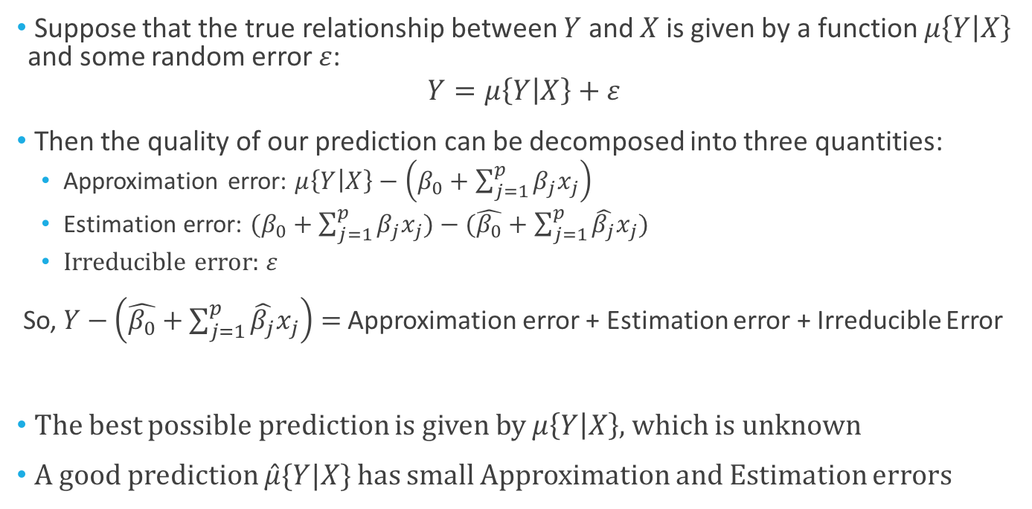
Prediction
Suppose that the true relationship between $Y$ and $X$ is given by a function $μ\left\{Y | X\right\}$ and some random error $ε$:
$$Y=μ\left\{Y | X\right\}+ε$$
Then the quality of our prediction can be decomposed into three quantities:
Approximation error: $μ\left\{Y | X\right\}−\left(β_{0}+\sum_{j=1}^{p}{β_{j}x_{j}}\right)$
Estimation error: $(β_{0}+\sum_{j=1}^{p}{β_{j}x_{j}})−(\hat{β_{0}}+\sum_{j=1}^{p}{\hat{β_{j}}x_{j}})$
Irreducible error: $ε$
So, $Y−\left(\hat{β_{0}}+\sum_{j=1}^{p}{\hat{β_{j}}x_{j}}\right)=$ Approximation error + Estimation error + Irreducible Error
The best possible prediction is given by $μ\left\{Y | X\right\}$, which is unknown
A good prediction $\hat{μ}\{Y|X\text{\}}$ has small Approximation and Estimation errors

Slide 12
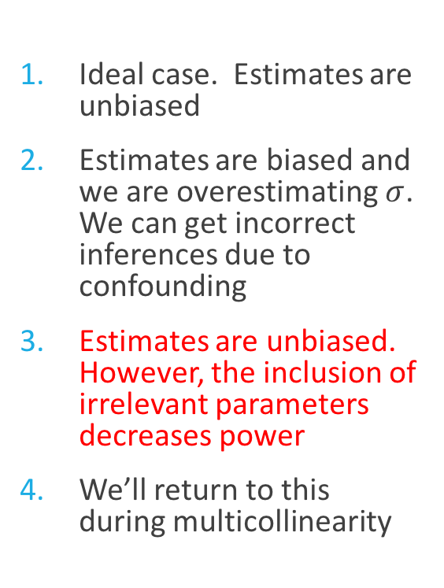
Returning to: Including “Wrong” Explanatory Variables
There are roughly four possible (unknown) outcomes:
Model is correctly specified. All relevant explanatory variables are included
Model is under specified. Some important explanatory variables are omitted
Model includes unimportant explanatory variables
Model is over specified. Some redundant (or nearly redundant) explanatory variables are included
Ideal case. Estimates are unbiased
Estimates are biased and we are overestimating $σ$. We can get incorrect inferences due to confounding
Estimates are unbiased. However, the inclusion of irrelevant parameters decreases power
We’ll return to this during multicollinearity

Slide 13
Making Predictions
When the scientific question of interest is primarily about making predictions, the decrease in power from too large a model is important
If we want to build a predictive model for housing prices, confounding isn’t a concern
Let’s return to the ”main effects” fitted model

Slide 14
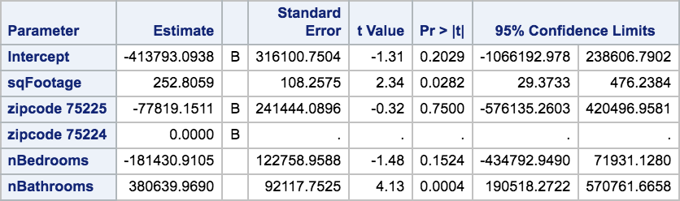
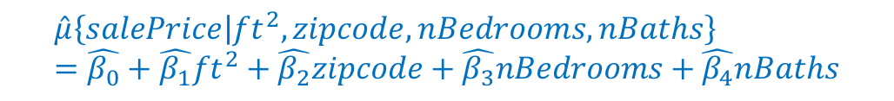
Making Predictions
Previously, we left the zipcode and nBedroom terms in the model, due to being more concerned about confounding
When considering building a predictive model, it makes sense to make sure that each of the terms in the model are important
In this case, we can try and jointly test for inclusion of zipcode and nBedroom
$$\hat{μ}\left\{salePrice | {ft}^{2}, zipcode, nBedrooms, nBaths\right\}=\hat{β_{0}}+{\hat{β_{1}}ft}^{2}+\hat{β_{2}}zipcode+\hat{β_{3}}nBedrooms+\hat{β_{4}}nBaths$$

Slide 15
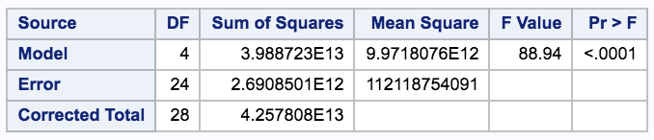
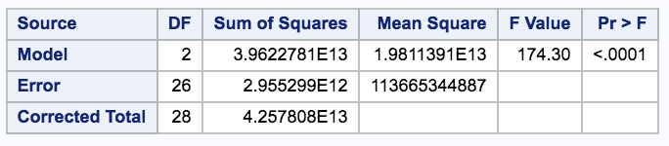
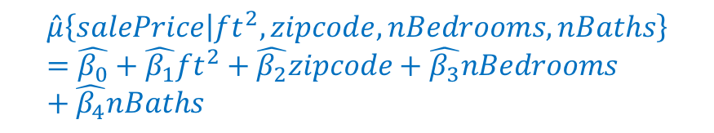
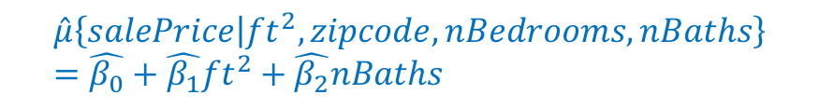
Making Predictions
$$\hat{μ}\left\{salePrice | {ft}^{2}, zipcode, nBedrooms, nBaths\right\}=\hat{β_{0}}+{\hat{β_{1}}ft}^{2}+\hat{β_{2}}zipcode+\hat{β_{3}}nBedrooms+\hat{β_{4}}nBaths$$
Source | DF | SS | MS | F | Pr > F
Model | 2 | 2.7E11 | 1.08E11 | 0.97 | 0.394
Error | 24 | 2.69E12 | 1.12E11
Corrected Total | 26 | 2.96E12
Fail to reject… What does that mean?
$$\hat{μ}\left\{salePrice | {ft}^{2}, zipcode, nBedrooms, nBaths\right\}=\hat{β_{0}}+{\hat{β_{1}}ft}^{2}+\hat{β_{2}}nBaths$$

Slide 16
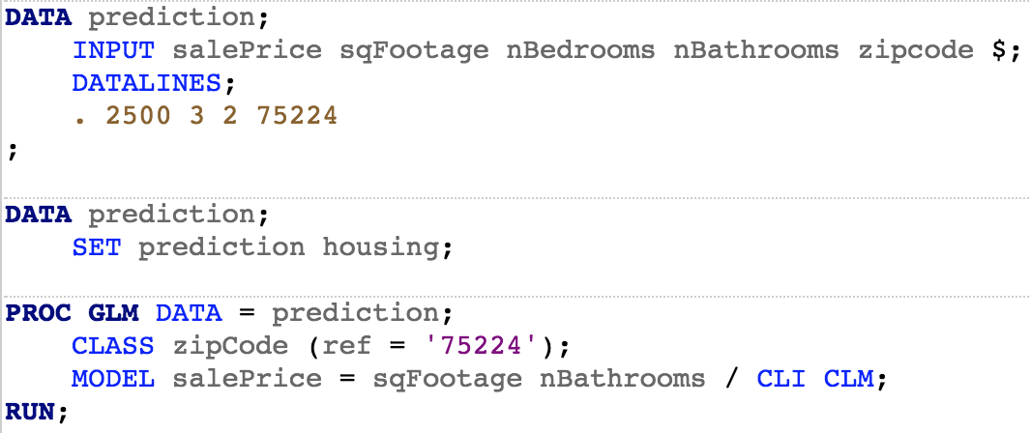
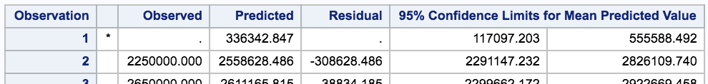
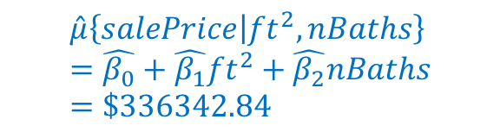
Making Predictions
(This discussion is from Chapter 10.2.4. We will return to this again in Chapter 12 when we discuss model selection)
$$\hat{μ}\left\{salePrice | {ft}^{2}, nBaths\right\}=\hat{β_{0}}+{\hat{β_{1}}ft}^{2}+\hat{β_{2}}nBaths=\$336342.84$$
The confidence limits we choose again depends on the scientific question..
(details in 7b_linearRegressionDarren)

