Slide 1
Drawing Statistical Conclusions
Randomized Experiments V. Observational Studies
Random Samples v. self-selection

Slide 2
Two motivating examples

Slide 3
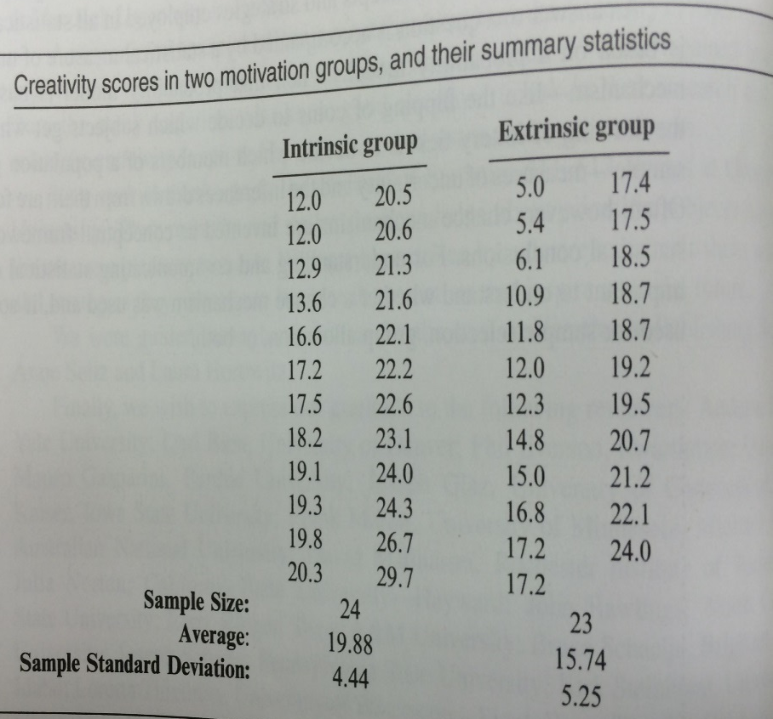
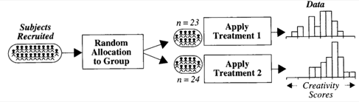
Creativity Scores: Intrinsic vs. Extrinsic Motivation
A 95% confidence interval for a difference in score due to having extrinsic motivation rather than intrinsic motivation is between 1.3 and 7.0 points.
Subjects Volunteered for the Study.
Notes:
This is an example of what the book calls “Statistical Conclusion”.

Slide 4
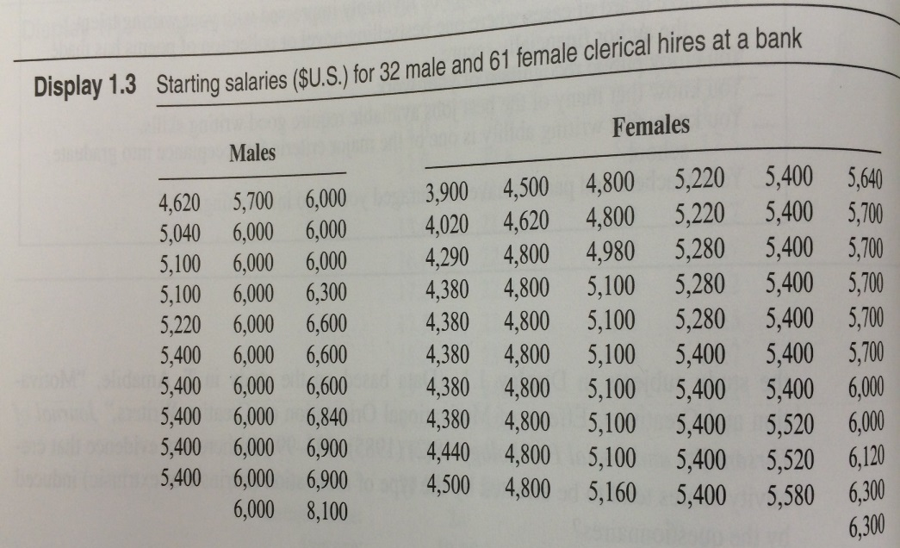
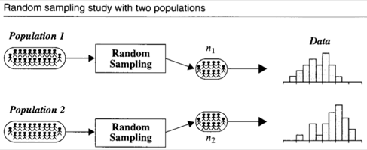
Starting Salaries: Female vs. Male
The mean starting salary for males is estimated to be $560 to $1080 larger than the mean starting salary for females (95% confidence). Such a large difference is unlikely to occur by chance (p-value < .00001 from a two sample t-test of means).
n = 32 males
n = 61 females
Notes:
Point out that this slide follows the book’s policy of using materials before they are introduced (e.g. p-value for t-test)

Slide 5
Cause, Effect, and Inference to Populations

Slide 6
Types of Studies
Creativity Study
Salary Study
Randomized Experiment
Observational Study

Slide 7
Causal Inference: Randomized vs. Observational Study
Causal inferences can be drawn from randomized experiments
Causal inferences cannot be drawn from observational studies due to Confounding
Confounding Variable: Related to both group membership and to the outcome
Example: Since 2000 the U.S. median wage…
has overall increased about 1%
Has decreased for high school (or below) dropouts and high school graduates
Is this a paradox?
(Technical point: there are causal inference techniques for observational studies)
No, more people are graduating high school

Slide 8

Causal Inference: Randomized vs. Observational Study
Causal inferences can be drawn from randomized experiments
Causal inferences cannot be drawn from observational studies due to Confounding
Maybe males have
more education
more seniority
more age (older)
Younger
oyyoyyyoyoo
oooyyyoyoyy
oyyoyyyoyooy
oooyyyoyoyy
Older

Slide 9
Why do an observational study?
Establishing causation not always the goal
Randomization may not be ethical
May be arguable scientifically that a confounder is “unlikely”
Might have an incidentally observed dataset
Predict whether or not an email is spam
Assign clinical trial subjects to treatment or placebo
6 month smoking ban in Helena, MT coinciding with 40% reduction in heart attacks
Walmart collects petabytes of data/day. Should this data be discarded because it is observational?
Notes:
From June 2002 to December 2002 a smoking ban in Helena was enacted. During this time heart attacks dropped by 40%, but returned to previous levels afterwards. Helena has 1 hospital, so no hospital effect. Vietnam war draft is another example of Natural experiment.

Slide 10
Inference to Populations: Random Sample vs. Self-Selection
Inference to populations can be drawn from a Random sample
Inference to populations cannot be drawn if units are self-selected
Random sample: Experimental units selected via a “chance mechanism” from a well defined population
Simple random sample: Every subset of size n is equally likely
Example: call randomly selected phone numbers for a survey
Example: I’ll assign everyone in this class a random integer 17, 200, -3, 472, … and survey the n people (units) with smallest numbers
Notes:
Ask: To what population is the SRS referencing?
Ask: After talking about simple random sample, talk about why the phone number example isn’t a simple random sample for the population of all people in a city.

Slide 11
Inference to Populations: Random Sample vs. Self-Selection
Inference to populations can be drawn from a Random sample
Inference to populations cannot be drawn if units are self-selected
Neither study uses random sampling
Creativity study: units are volunteers
Bank study: units are the entire staff
No inference about a larger population is possible
Does not mean the results are not interesting or compelling!
Notes:
Ask: To what population is the SRS referencing?
Ask: After talking about simple random sample, talk about why the phone number example isn’t a simple random sample for the population of all people in a city.

Slide 12
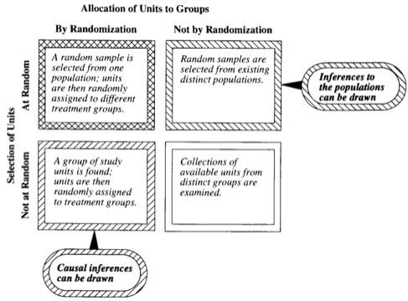
Statistical Inferences Permitted by Study Design
Notes:
Display 1.5

Slide 13
Digitus Tertius

