Slide 1
Drawing Statistical Conclusions
Measuring uncertainty in randomized and observational studies

Slide 2
Quantifying Uncertainty

Slide 3
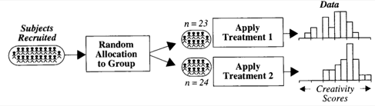


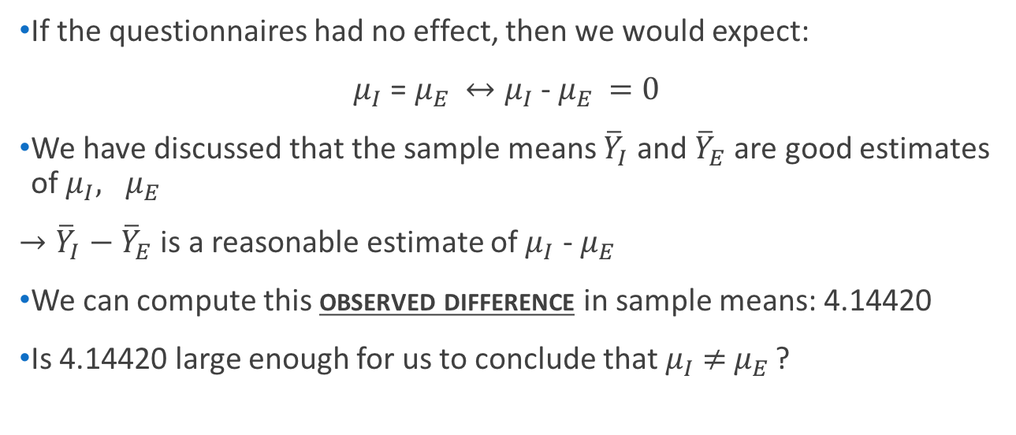
Creativity Study
$→$ Population mean: $μ_{I}$
I
I
$→$ Population mean: $μ_{E}$
E
If the questionnaires had no effect, then we would expect:
$μ_{I}$ = $μ_{E }↔μ_{I}$ - $μ_{E }=0$
We have discussed that the sample means ${\overline{Y}}_{I}$ and ${\overline{Y}}_{E}$ are good estimates of $μ_{I}, μ_{E }$
$→{\overline{Y}}_{I}−{\overline{Y}}_{E}$ is a reasonable estimate of $μ_{I}$ - $μ_{E }$
We can compute this observed difference in sample means: 4.14420
Is 4.14420 large enough for us to conclude that $μ_{I}$ $≠$ $μ_{E }$?
(null hypothesis)
(test statistic)
(alternate hypothesis)

Slide 4
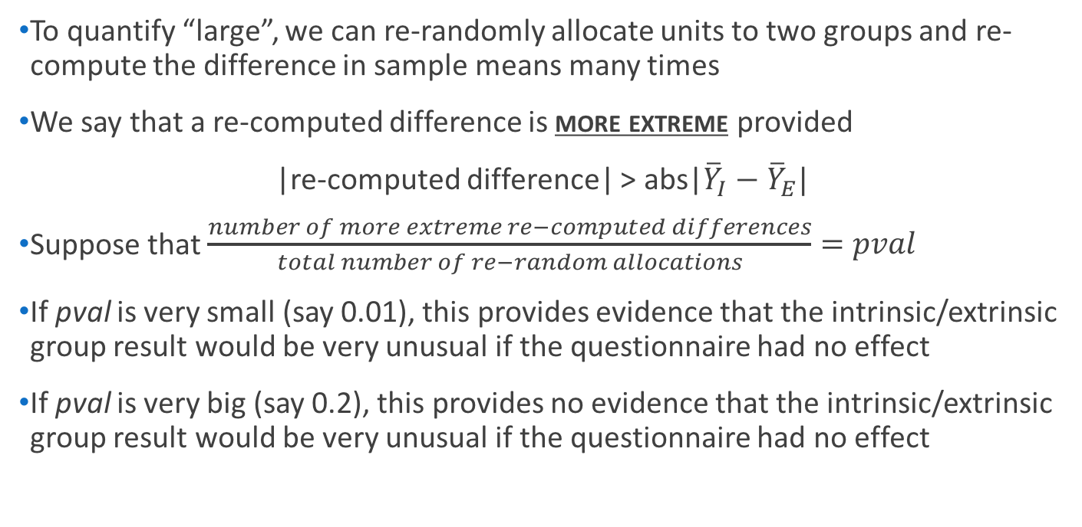
Creativity Study
To quantify “large”, we can re-randomly allocate units to two groups and re-compute the difference in sample means many times
We say that a re-computed difference is more extreme provided
|re-computed difference| > abs|${\overline{Y}}_{I}−{\overline{Y}}_{E}|$
Suppose that $\frac{number of more extreme re−computed differences}{total number of re−random allocations}=pval$
If pval is very small (say 0.01), this provides evidence that the intrinsic/extrinsic group result would be very unusual if the questionnaire had no effect
If pval is very big (say 0.2), this provides no evidence that the intrinsic/extrinsic group result would be very unusual if the questionnaire had no effect
(p-value)
Notes:
Mention that the book does a “one-tailed test” and this is a two tailed test. We will get to one-tailed tests soon.

Slide 5
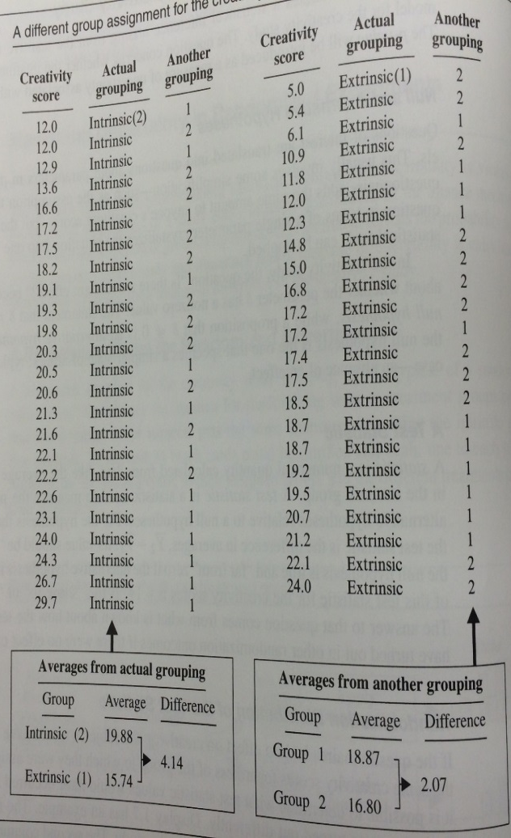
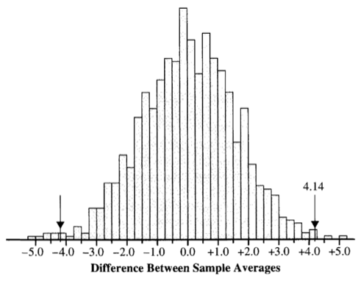

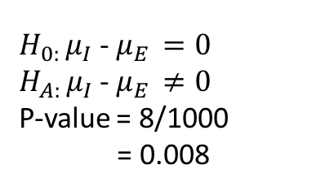
Creativity Study: Testing the Hypothesis
Number of random regroupings:1.6 x 10¹³
1000 different groupings
$H_{0: }μ_{I}$ - $μ_{E }=0$
$H_{A: }μ_{I}$ - $μ_{E }≠0$
P-value = 8/1000
= 0.008
Half a year with a computer that can perform a million calculations per second!
-4.14
(Still only 84% of the U.S. Federal Government debt in dollars, though)

Slide 6
From Randomized to Observational Studies
In the Creativity study, the Intrinsic/Extrinsic groups were randomly assigned to subjects
This motivated comparing the observed difference to re-randomized difference to test a hypothesis about the questionnaire having no effect.
This is known as a randomization test
In observational studies, the groups are not randomly assigned
Though not technically the same test, we can still apply exactly the same re-randomization idea to observational data
However, now it is called a permutation test

Slide 7
Age Discrimination
In the United States, it is illegal to discriminate against people based on various attributes. One example is age. An active lawsuit, filed August 30, 2011, in the Las Angeles District Office is a case against the American Somoa Government for systematic age discrimination by preferentially firing older workers.
Is there evidence for age discrimination in this study?

