Slide 1
Inference Using t-Distributions
Distribution of the sample average
Using the t-distribution for one sample inference
Starting to explore t-distribution for two sample inference

Slide 2
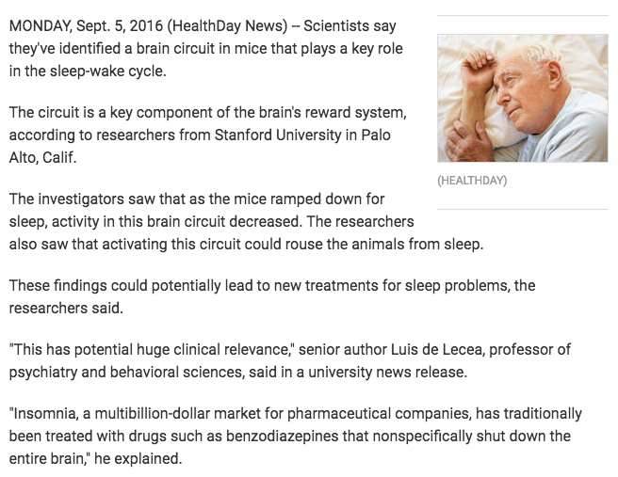
Study Analysis

Slide 3
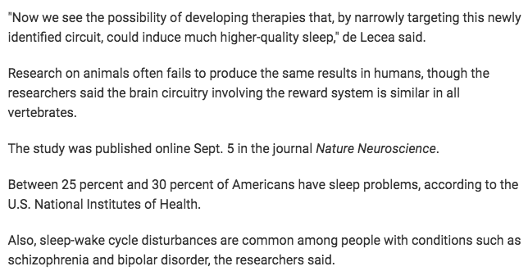
Study Analysis

Slide 4
One Sample Inference With the t-Distribution

Slide 5
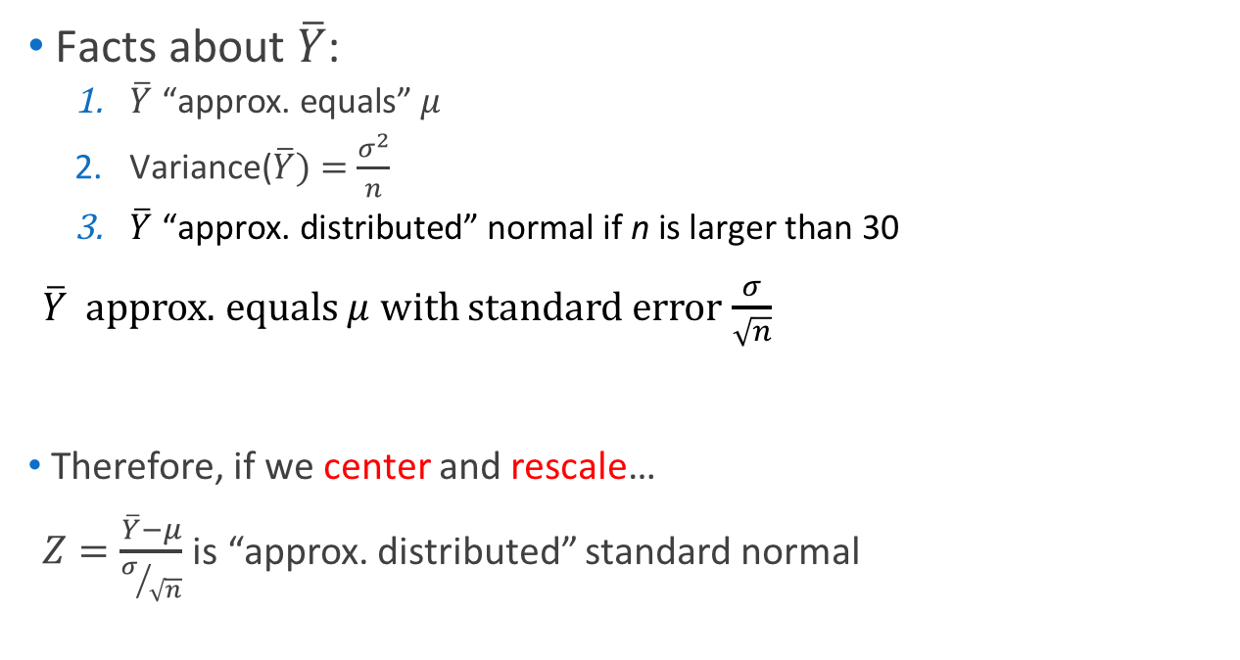
Z-ratio
$\text{Facts} \text{about} \overline{Y}$:
$\overline{Y}\text{ “}\text{approx}\text{. }\text{equals}\text{” }μ$
$\text{Variance}\text{(}\overline{Y})=\frac{σ^{2}}{n}$
$\overline{Y}\text{ “}\text{approx}\text{. }\text{distributed}\text{” }\text{normal} \text{if} \text{n} \text{is} \text{larger} \text{than}\text{ 30}$
$\overline{Y}$ approx. equals $μ$ with standard error $\frac{σ}{\sqrt{n}}$
Therefore, if we center and rescale…
$Z=\frac{\overline{Y}−μ}{σ/{\sqrt{n}}}$ is “approx. distributed” standard normal

Slide 6
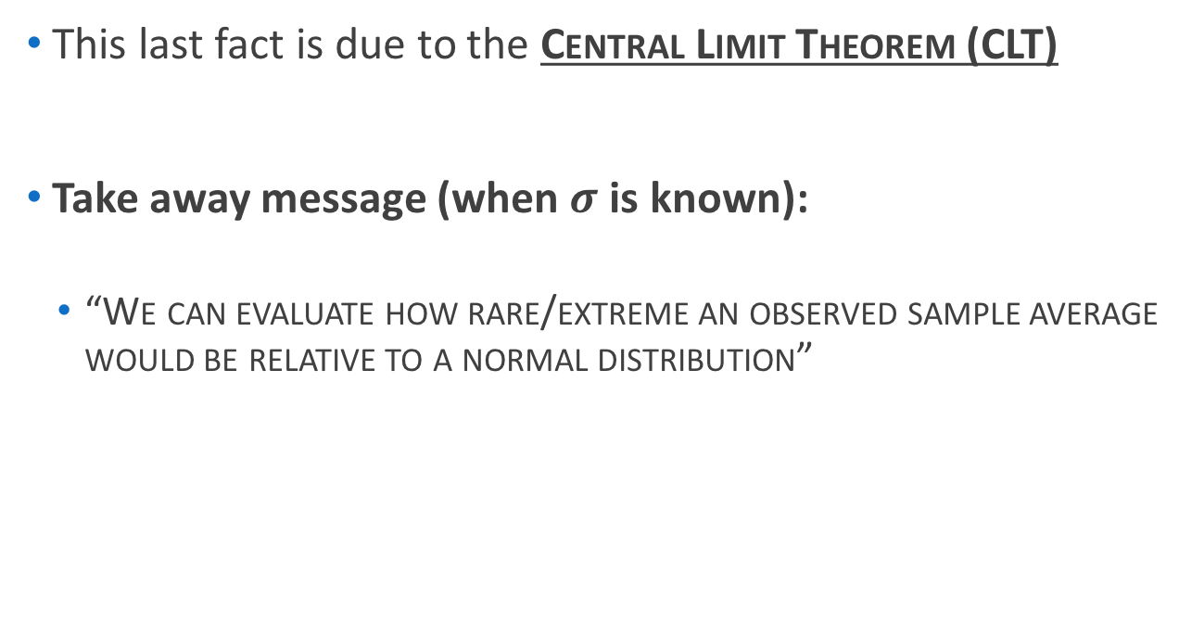
Distribution of Sample Average
This last fact is due to the Central Limit Theorem (CLT)
Take away message (when $σ$ is known):
“We can evaluate how rare/extreme an observed sample average would be relative to a normal distribution”

Slide 7

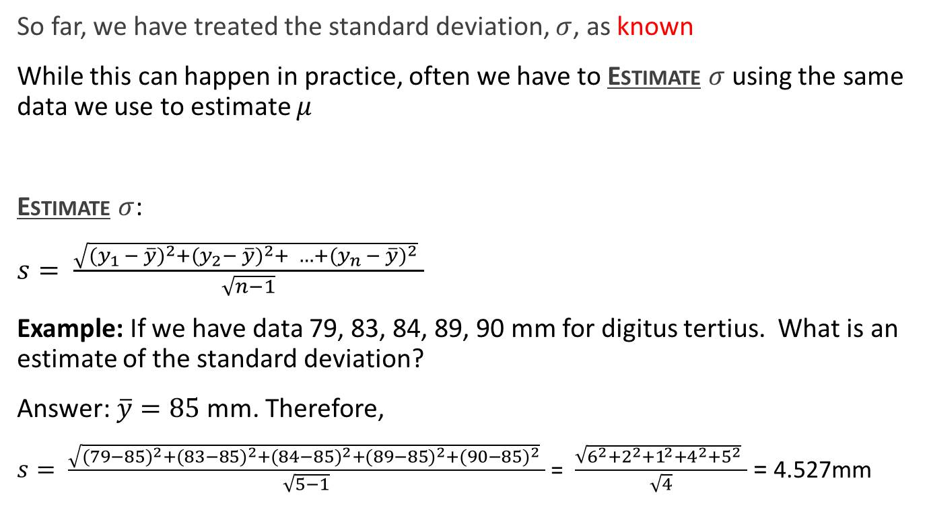
About that known $σ…$
So far, we have treated the standard deviation, $σ$, as known
While this can happen in practice, often we have to Estimate $σ$using the same data we use to estimate $μ$
Estimate $σ$:
$s= \frac{\sqrt{{(y_{1 }− \overline{y})}^{2}+{(y_{2}− \overline{y})}^{2}+ …+{(y_{n }− \overline{y})}^{2}} }{\sqrt{n−1}}$
Example: If we have data 79, 83, 84, 89, 90 mm for digitus tertius. What is an estimate of the standard deviation?
Answer: $\overline{y}=85$ mm. Therefore,
$s= \frac{\sqrt{{(79−85)}^{2}+{(83−85)}^{2}+{(84−85)}^{2}+{(89−85)}^{2}+{(90−85)}^{2}} }{\sqrt{5−1}}$= $\frac{\sqrt{6^{2}+2^{2}+1^{2}+4^{2}+5^{2}} }{\sqrt{4}}$ = 4.527mm

Slide 8
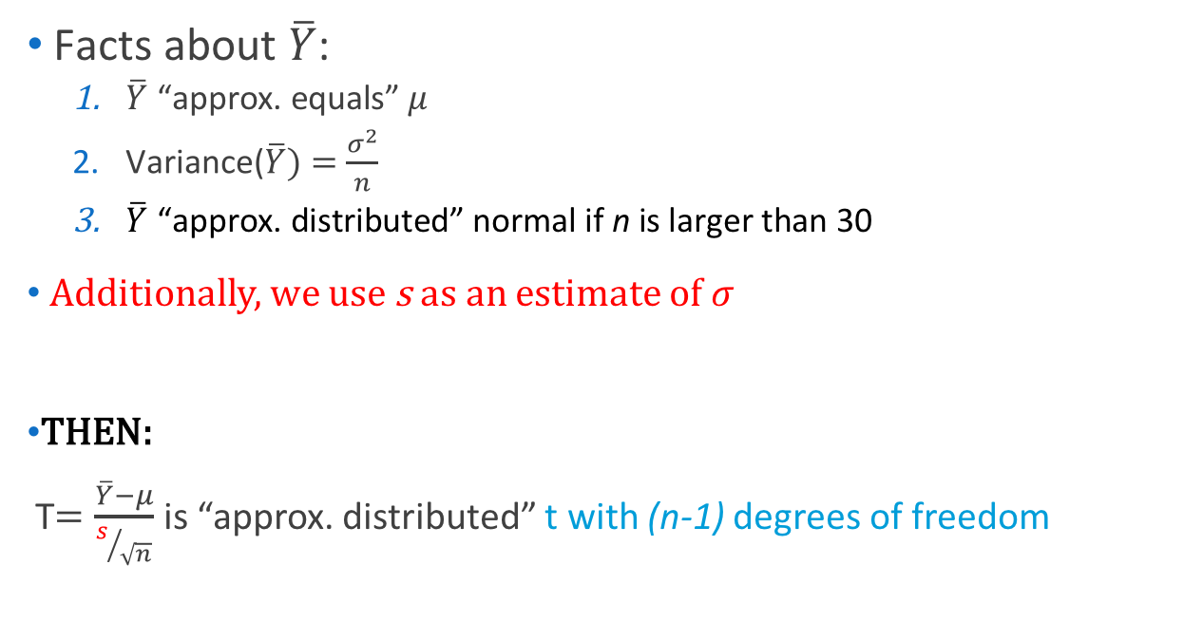
t-Ratio
$\text{Facts} \text{about} \overline{Y}$:
$\overline{Y}\text{ “}\text{approx}\text{. }\text{equals}\text{” }μ$
$\text{Variance}\text{(}\overline{Y})=\frac{σ^{2}}{n}$
$\overline{Y}\text{ “}\text{approx}\text{. }\text{distributed}\text{” }\text{normal} \text{if} \text{n} \text{is} \text{larger} \text{than}\text{ 30}$
Additionally, we use s as an estimate of $σ$
THEN:
T$=\frac{\overline{Y}−μ}{s/{\sqrt{n}}}$ is “approx. distributed” t with (n-1) degrees of freedom

Slide 9

Note the Difference…
$s= \frac{\sqrt{{(y_{1 }− \overline{y})}^{2}+{(y_{2}− \overline{y})}^{2}+ …+{(y_{n }− \overline{y})}^{2}} }{\sqrt{n−1}}$
Versus
T$=\frac{\overline{Y}−μ}{s/{\sqrt{n}}}$
This is an easy spot for confusion!

Slide 10

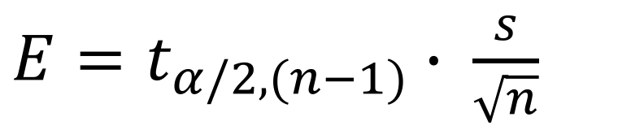
t-Confidence Interval
$$\overline{Y} −E< μ< \overline{Y}+E$$
$E=t_{α/2,(n−1)}$ $∙$ $\frac{s}{\sqrt{n}}$
How does $z_{α/2}$ compare with $t_{α/2,(n−1)}$?

Slide 11
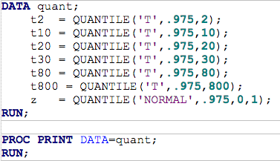

t-Confidence Interval
How does $z_{α/2}$ compare with $t_{α/2,(n−1)}$?

Slide 12

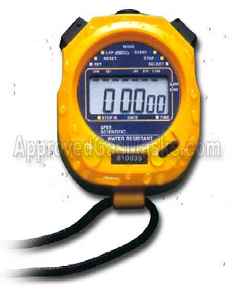
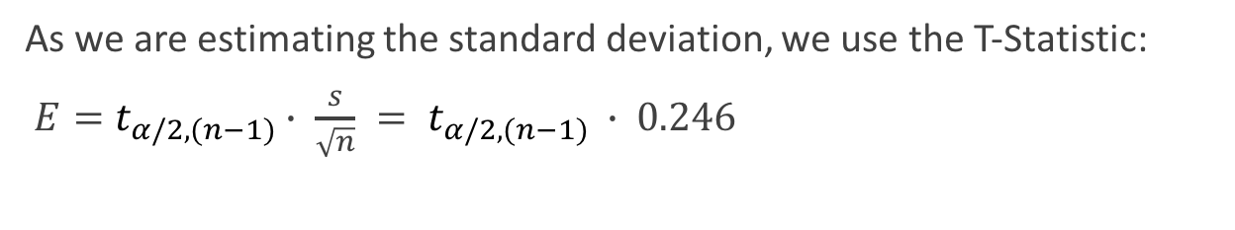
Revisiting…
Length of Time to Earn a Bachelor’s Degree: In a study of the length of time that students require to earn bachelors degrees, 80 students are randomly selected and found to have a sample mean of 4.8 years (National Center for Education Statistics). We compute the sample standard deviation, s = 2.2 years. Let’s construct a 98.2% confidence interval.
As we are estimating the standard deviation, we use the T-Statistic:
$E=t_{α/2,(n−1)}$ $∙$ $\frac{s}{\sqrt{n}} = t_{α/2,(n−1)}$ $∙$0.246

Slide 13
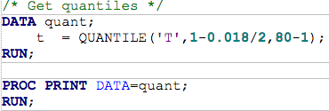

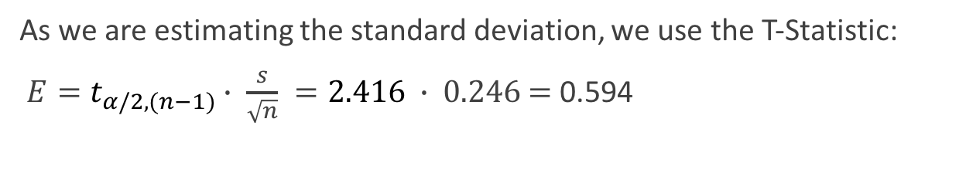
Revisiting…
As we are estimating the standard deviation, we use the T-Statistic:
$E=t_{α/2,(n−1)}$ $∙$ $\frac{s}{\sqrt{n}} =2.416$ $∙$0.246 = 0.594

Slide 14
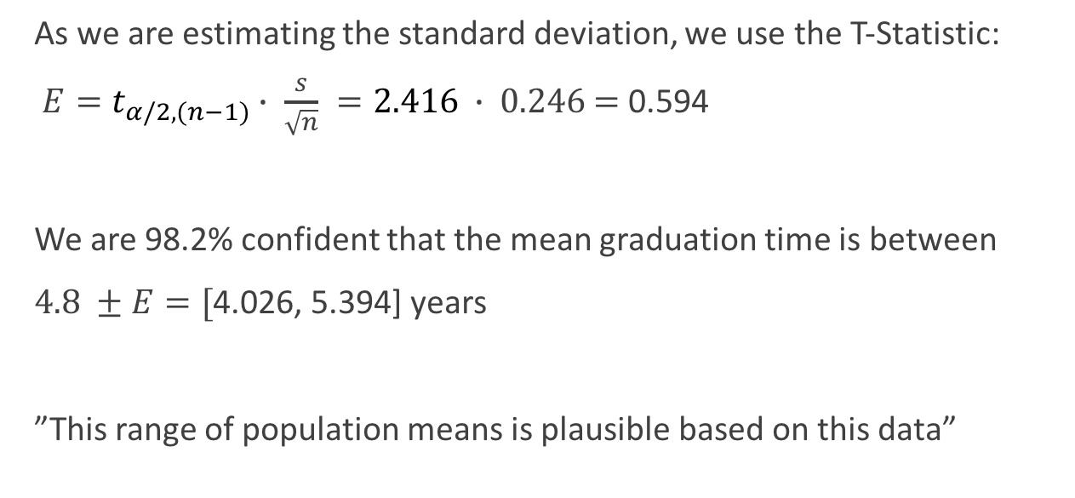
Revisiting…
As we are estimating the standard deviation, we use the T-Statistic:
$E=t_{α/2,(n−1)}$ $∙$ $\frac{s}{\sqrt{n}} =2.416$ $∙$0.246 = 0.594
We are 98.2% confident that the mean graduation time is between
$4.8 ±E=[$4.026, 5.394] years
”This range of population means is plausible based on this data”

Slide 15
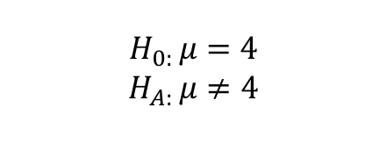
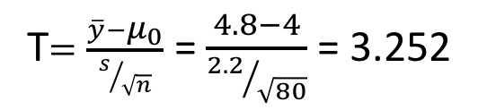

Revisiting…
(confidence interval)
Let’s suppose instead of asking for a range of plausible values, we want to know if $μ_{0}=4$ years is a plausible value
(null hypothesis)
$$H_{0: }μ=4$$
$$H_{A: }μ≠4$$
How much evidence does this provide that 4 years isn’t plausible?
(test statistic)
T$=\frac{\overline{y}−μ_{0}}{s/{\sqrt{n}}}$ = $\frac{4.8−4}{{2.2}/{\sqrt{80}}}$ = 3.252

Slide 16
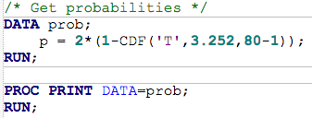

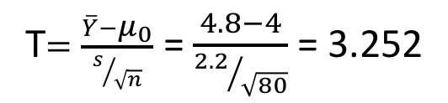
Revisiting…
Let’s suppose instead of asking for a range of plausible values, we want to know if $μ_{0}=4$ years is a plausible value
$$H_{0: }μ=4$$
$$H_{A: }μ≠4$$
T$=\frac{\overline{Y}−μ_{0}}{s/{\sqrt{n}}}$ = $\frac{4.8−4}{{2.2}/{\sqrt{80}}}$ = 3.252
(p-value)

Slide 17
Revisiting…
(p-value)

Slide 18
Revisiting…
(Zoomed in)
(p-value)

Slide 19
Revisiting…
Let’s suppose instead of asking for a range of plausible values, we want to know if $μ_{0}=4$ years is a plausible value
(statistical conclusion)
We have strong evidence that 4 years is an implausible value for mean graduation time (p-value of approx. 0.0017 from a one-sample t-test).
$$H_{0: }μ=4$$
$$H_{A: }μ≠4$$
(scope of inference)
These graduates were randomly sampled from the National Center for Education Statistics (NCES) and hence we can extend our inference to the population that the NCES draws from.
T$=\frac{\overline{Y}−μ_{0}}{s/{\sqrt{n}}}$ = $\frac{4.8−4}{{2.2}/{\sqrt{80}}}$ = 3.252

Slide 20
Two Sample Inference With the t-Distribution

Slide 21
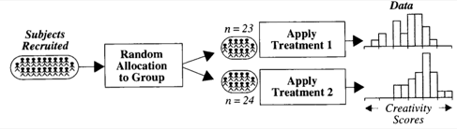


Creativity Study
$→$ Population mean: $μ_{I}$
I
$→$ Population mean: $μ_{E}$
E
If the questionnaires had no effect, then we would expect:
$μ_{I}$ = $μ_{E }↔μ_{I}$ - $μ_{E }=0$
We have discussed that the sample means ${\overline{Y}}_{I}$ and ${\overline{Y}}_{E}$ are good estimates of $μ_{I}, μ_{E }$
$→{\overline{Y}}_{I}−{\overline{Y}}_{E}$ is a reasonable estimate of $μ_{I}$ - $μ_{E }$
We can compute this observed difference in sample means: 4.14420
Is 4.14420 large enough for us to conclude that $μ_{I}$ $≠$ $μ_{E }$?
(null hypothesis)
(test statistic)
(alternative hypothesis)

Slide 22


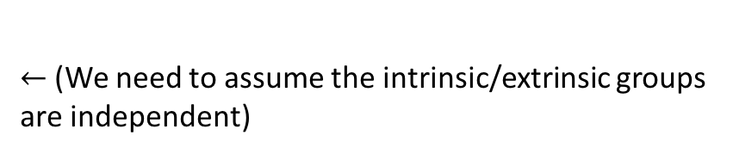
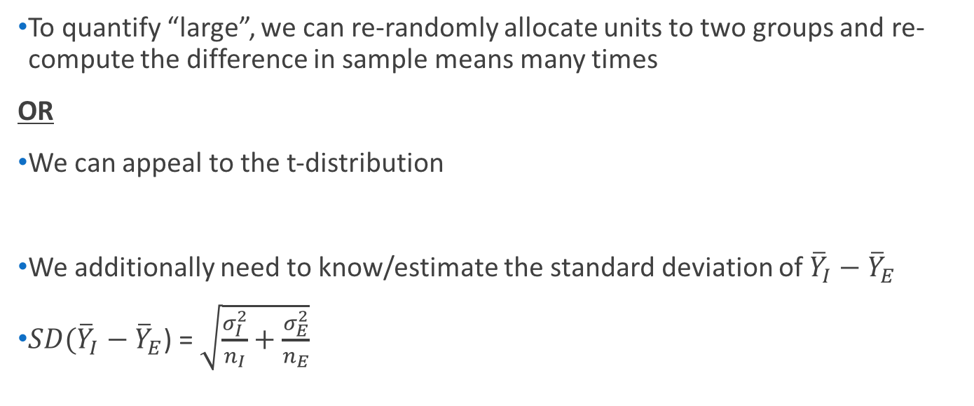
Creativity Study
$→$ Population mean: $μ_{I}$
I
$→$ Population sd: $σ_{I}$
$→$ Population mean: $μ_{E}$
E
$→$ Population sd: $σ_{E}$
To quantify “large”, we can re-randomly allocate units to two groups and re-compute the difference in sample means many times
OR
We can appeal to the t-distribution
We additionally need to know/estimate the standard deviation of ${\overline{Y}}_{I}−{\overline{Y}}_{E}$
$SD({\overline{Y}}_{I}−{\overline{Y}}_{E}$) = $\sqrt{\frac{σ_{I}^{2}}{n_{I}}+\frac{σ_{E}^{2}}{n_{E}}}$
(randomization test)
(two sample t test)
$←$(We need to assume the intrinsic/extrinsic groups are independent)

Slide 23
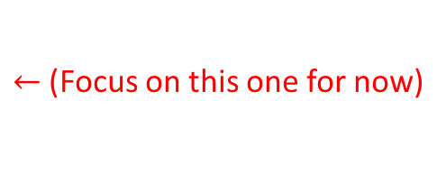
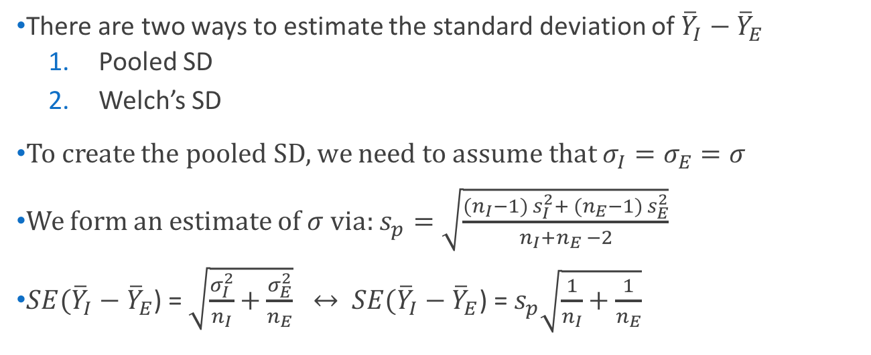
Creativity Study
$→$ Population mean: $μ_{I}$
I
$→$ Population sd: $σ_{I}$
$→$ Population mean: $μ_{E}$
E
$→$ Population sd: $σ_{E}$
There are two ways to estimate the standard deviation of ${\overline{Y}}_{I}−{\overline{Y}}_{E}$
Pooled SD
Welch’s SD
To create the pooled SD, we need to assume that $σ_{I}=σ_{E}=σ$
We form an estimate of $σ$ via: $s_{p}=\sqrt{\frac{({n_{I}−1) s}_{I}^{2}+ ({n_{E}−1) s}_{E}^{2}}{n_{I}+n_{E} −2}}$
$SE({\overline{Y}}_{I}−{\overline{Y}}_{E}$) = $\sqrt{\frac{σ_{I}^{2}}{n_{I}}+\frac{σ_{E}^{2}}{n_{E}}} ↔$ $SE({\overline{Y}}_{I}−{\overline{Y}}_{E}$) = $s_{p}\sqrt{\frac{1}{n_{I}}+\frac{1}{n_{E}}}$
$←$(Focus on this one for now)

Slide 24
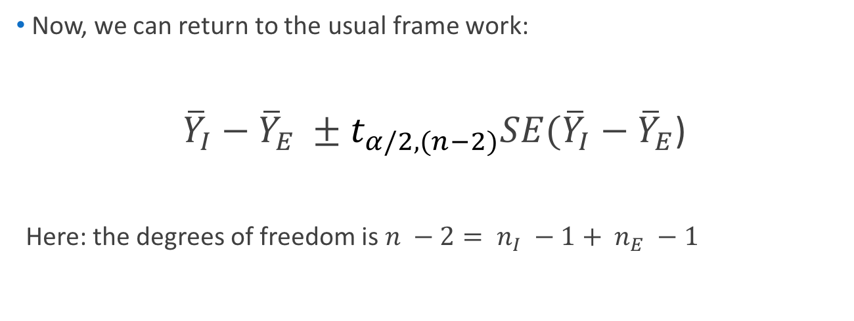
Creativity Study: Next time
$→$ Population mean: $μ_{I}$
I
$→$ Population sd: $σ_{I}$
$→$ Population mean: $μ_{E}$
E
$→$ Population sd: $σ_{E}$
Now, we can return to the usual frame work:
${\overline{Y}}_{I}−{\overline{Y}}_{E} ±t_{α/2,(n−2)}SE({\overline{Y}}_{I}−{\overline{Y}}_{E}$)
Here: the degrees of freedom is $n −2= n_{I} −1+ n_{E} −1$

