Slide 1
Inference Using t-Distributions
t-distribution for two sample inference

Slide 2
Two Sample Inference With the t-Distribution

Slide 3
Confidence Intervals

Slide 4
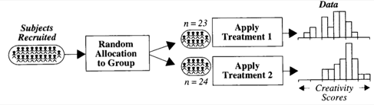

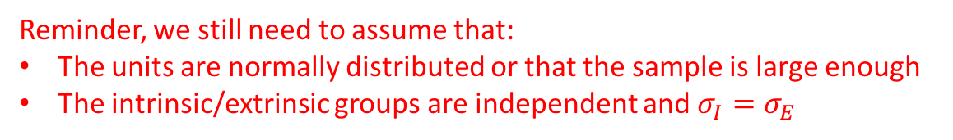



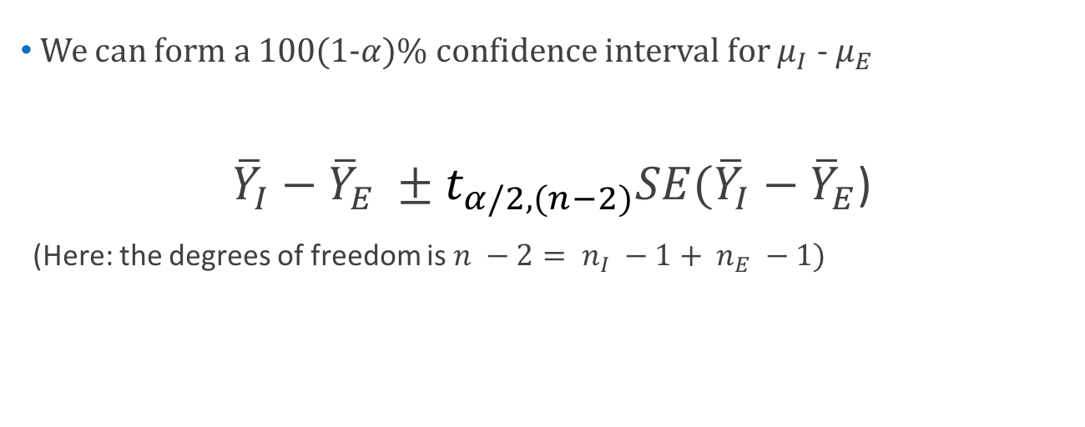
Creativity Study: Confidence Interval
$→$ Population mean: $μ_{I}$
I
$→$ Population sd: $σ_{I}$
$→$ Population mean: $μ_{E}$
E
$→$ Population sd: $σ_{E}$
We can form a 100(1-$α)\%$ confidence interval for $μ_{I}$ - $μ_{E }$
${\overline{Y}}_{I}−{\overline{Y}}_{E} ±t_{α/2,(n−2)}SE({\overline{Y}}_{I}−{\overline{Y}}_{E}$)
(Here: the degrees of freedom is $n −2= n_{I} −1+ n_{E} −1)$
Reminder, we still need to assume that:
The units are normally distributed or that the sample is large enough
The intrinsic/extrinsic groups are independent and $σ_{I}=σ_{E}$

Slide 5


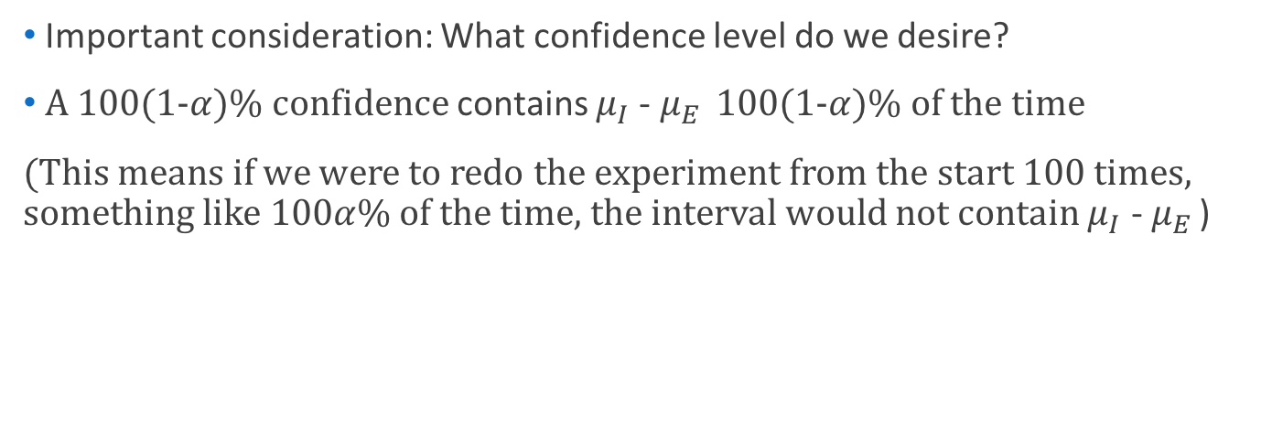
Creativity Study: Confidence Interval
$→$ Population mean: $μ_{I}$
I
$→$ Population sd: $σ_{I}$
$→$ Population mean: $μ_{E}$
E
$→$ Population sd: $σ_{E}$
Important consideration: What confidence level do we desire?
A 100(1-$α)\%$ confidence contains $μ_{I}$ - $μ_{E }$ 100(1-$α)\%$ of the time
(This means if we were to redo the experiment from the start 100 times, something like 100$α$% of the time, the interval would not contain $μ_{I}$ - $μ_{E }$)

Slide 6
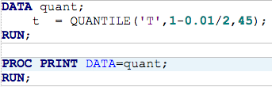



Creativity Study: Confidence Interval
Let’s demand a 99% confidence interval $→α=0.01$
For this study, $n=23+24=47→$ the degrees of freedom$=47 −2=45$
$→t_{α/2,(n−2)}$ = 2.68959

Slide 7
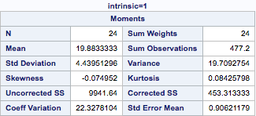
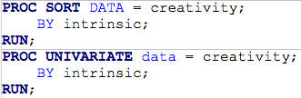
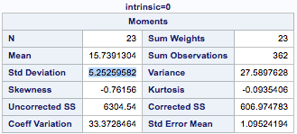

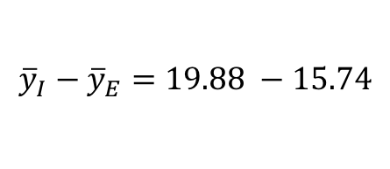

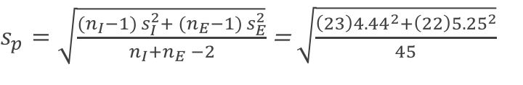
Creativity Study: Confidence Interval
$$→{\overline{y}}_{I}−{\overline{y}}_{E}=4.14$$
$${\overline{y}}_{I}−{\overline{y}}_{E}=19.88 −15.74$$
$s_{p}=\sqrt{\frac{({n_{I}−1) s}_{I}^{2}+ ({n_{E}−1) s}_{E}^{2}}{n_{I}+n_{E} −2}}$ = $\sqrt{\frac{\left(23\right){4.44}^{2}+\left(22\right){5.25}^{2}}{45}}$
$→s_{p}$ = 4.85

Slide 8
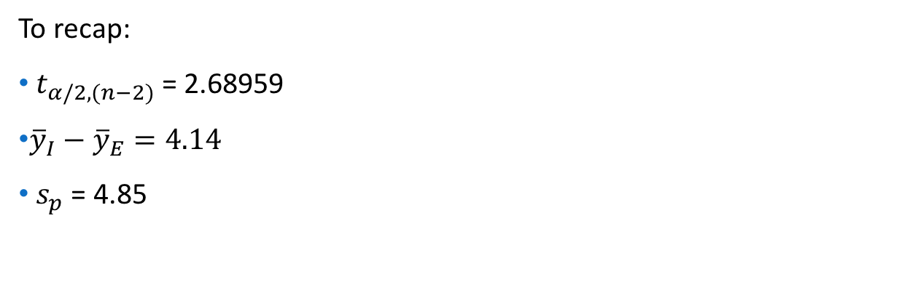
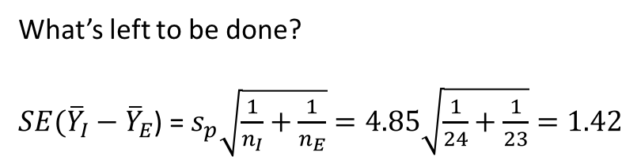
Creativity Study: Confidence Interval
To recap:
$t_{α/2,(n−2)}$ = 2.68959
${\overline{y}}_{I}−{\overline{y}}_{E}=4.14$
$s_{p}$ = 4.85
What’s left to be done?
$SE({\overline{Y}}_{I}−{\overline{Y}}_{E}$) = $s_{p}\sqrt{\frac{1}{n_{I}}+\frac{1}{n_{E}}}=4.85\sqrt{\frac{1}{24}+\frac{1}{23}}=1.42$

Slide 9
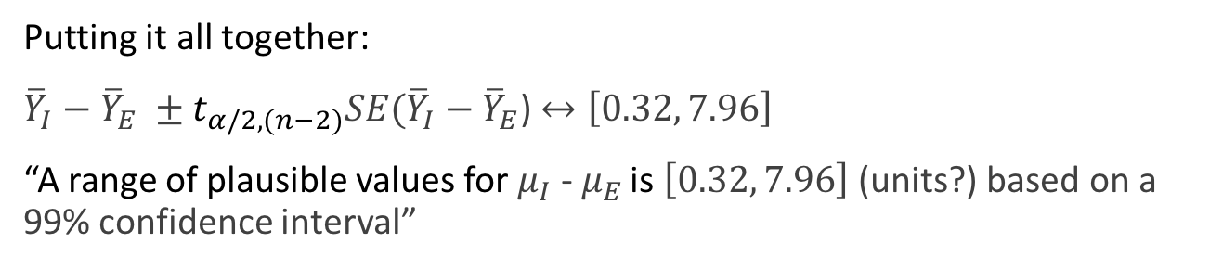

Creativity Study: Confidence Interval
To recap:
$t_{α/2,(n−2)}$ = 2.68959
${\overline{Y}}_{I}−{\overline{Y}}_{E}=4.14$
$s_{p}$ = 4.85
$SE({\overline{Y}}_{I}−{\overline{Y}}_{E}$) = $s_{p}\sqrt{\frac{1}{n_{I}}+\frac{1}{n_{E}}}=4.85\sqrt{\frac{1}{24}+\frac{1}{23}}=1.42$
Putting it all together:
${\overline{Y}}_{I}−{\overline{Y}}_{E} ±t_{α/2,(n−2)}SE({\overline{Y}}_{I}−{\overline{Y}}_{E}$) $↔\left[0.32, 7.96\right]$
“A range of plausible values for $μ_{I}$ - $μ_{E }$is $\left[0.32, 7.96\right]$ (units?) based on a 99% confidence interval”

Slide 10

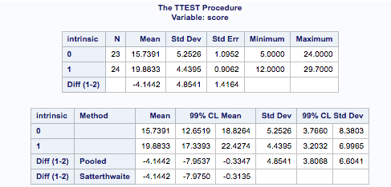
Creativity Study: Confidence Interval with SAS

Slide 11

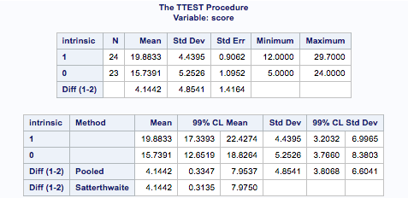
Creativity Study: Confidence Interval with SAS

Slide 12
Hypothesis Test

Slide 13
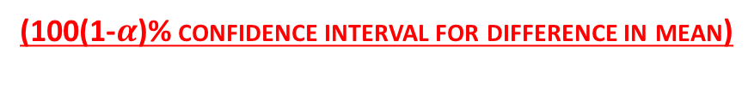

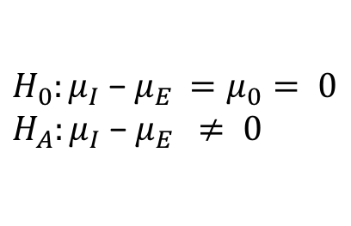

Testing Hypothesis: Difference in Means
Suppose that the observations are independent and normal (or n > 30)
Then:
T$=\frac{\overline{Y}−μ}{s/{\sqrt{n}}}$ is “approx. distributed” t with (n-1) degrees of freedom
If additionally the groups are independent, then
${\overline{Y}}_{I}−{\overline{Y}}_{E} ±t_{α/2,(n−2)}SE({\overline{Y}}_{I}−{\overline{Y}}_{E}$)
(one sample t-test statistic)
(100(1-$α$)% confidence interval for difference in mean)
$$H_{0}:μ_{I}\text{ − }μ_{E }=μ_{0}= 0$$
$$H_{A}:μ_{I}\text{ − }μ_{E } ≠ 0$$
t-statistic = $\frac{({\overline{Y}}_{I}−{\overline{Y}}_{E}) −μ_{0}}{SE({\overline{Y}}_{I}−{\overline{Y}}_{E}\text{)}}$
“The p-value is the probability of getting a draw from a t-distribution (w/ n-2 degrees of freedom) that is at least extreme as the t-statistic”
14

Slide 14
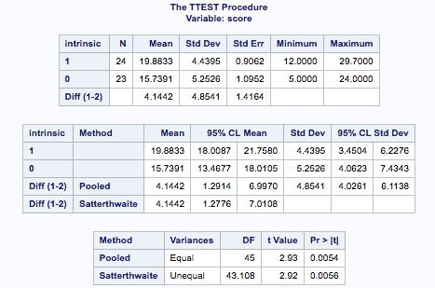

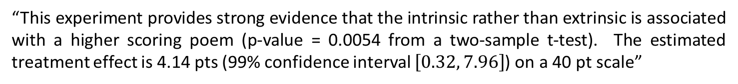
Testing Hypothesis: Difference in Means
(statistical conclusion)
“This experiment provides strong evidence that the intrinsic rather than extrinsic is associated with a higher scoring poem (p-value = 0.0054 from a two-sample t-test). The estimated treatment effect is 4.14 pts (99% confidence interval $\left[0.32, 7.96\right]$) on a 40 pt scale”

Slide 15
Testing Hypothesis: Difference in Means
(Randomization versus T-test in SAS)

