Slide 1
Inference Using t-Distributions
t-distribution for two sample inference
One-sided hypothesis testing and confidence intervals

Slide 2
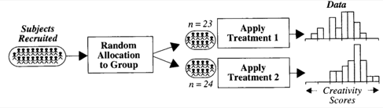
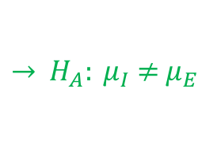
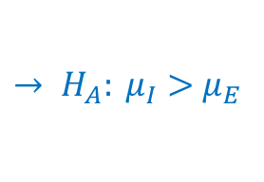
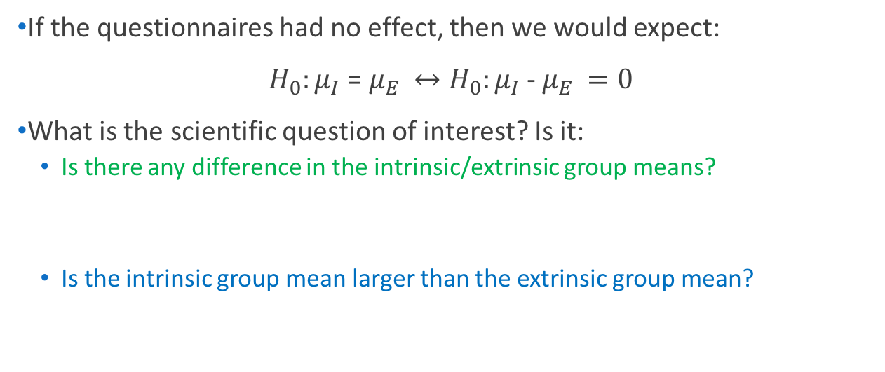
Creativity Study
$→$ Population mean: $μ_{I}$
I
$→$ Population mean: $μ_{E}$
E
If the questionnaires had no effect, then we would expect:
$H_{0}:μ_{I}$ = $μ_{E }↔H_{0}:μ_{I}$ - $μ_{E }=0$
What is the scientific question of interest? Is it:
Is there any difference in the intrinsic/extrinsic group means?
Is the intrinsic group mean larger than the extrinsic group mean?
(null hypothesis)
$→{ H}_{A}: μ_{I}$ $≠$ $μ_{E }$
(alternative hypotheses)
$→ H_{A}: μ_{I}>$ $μ_{E }$

Slide 3
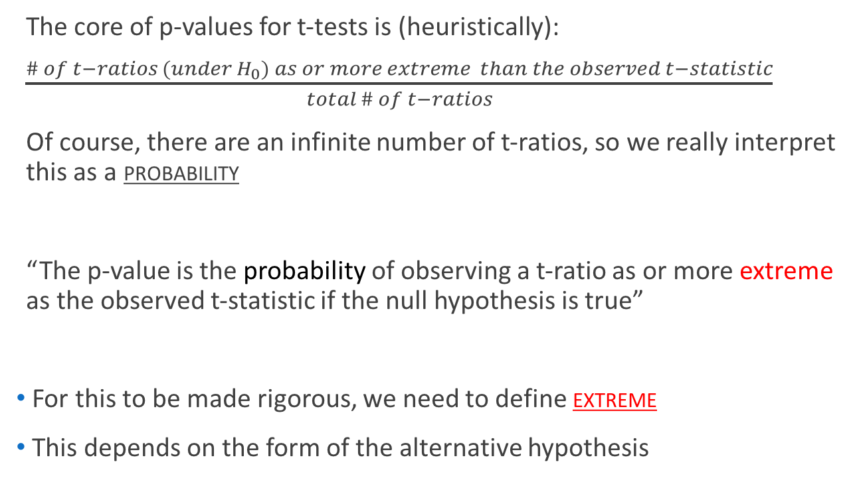
One-Sided vs. Two-Sided
The core of p-values for t-tests is (heuristically):
$\frac{\# of t−ratios (under H_{0}) as or more extreme than the observed t−statistic}{total \# of t−ratios}$
Of course, there are an infinite number of t-ratios, so we really interpret this as a probability
“The p-value is the probability of observing a t-ratio as or more extreme as the observed t-statistic if the null hypothesis is true”
For this to be made rigorous, we need to define extreme
This depends on the form of the alternative hypothesis
Notes:
Display 1.5

Slide 4
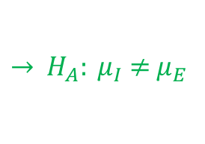

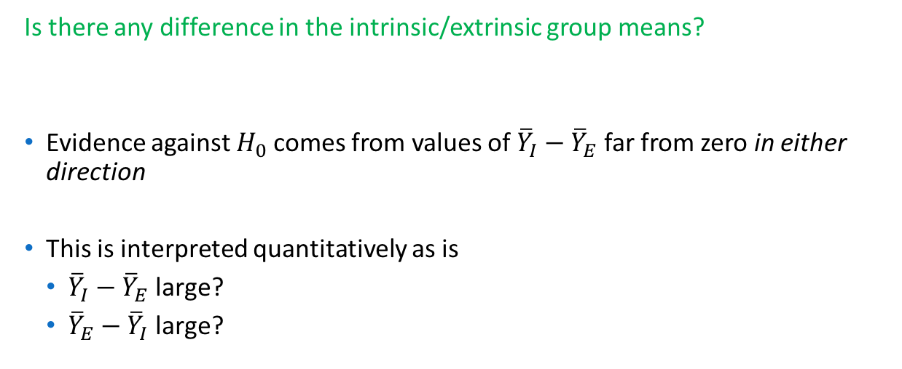
Two-Sided P-values
Is there any difference in the intrinsic/extrinsic group means?
Evidence against $H_{0}$comes from values of ${\overline{Y}}_{I}−{\overline{Y}}_{E}$ far from zero in either direction
This is interpreted quantitatively as is
${\overline{Y}}_{I}−{\overline{Y}}_{E}$ large?
${\overline{Y}}_{E}−{\overline{Y}}_{I}$ large?
$→{ H}_{A}: μ_{I}$ $≠$ $μ_{E }$
This can be summarized as:
Is $|{\overline{Y}}_{I}−{\overline{Y}}_{E}$| large?

Slide 5
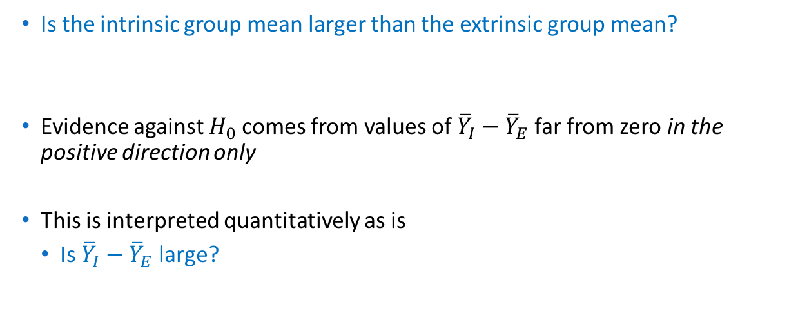
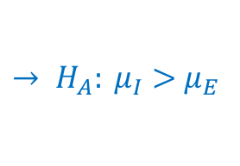
One-Sided P-values
Is the intrinsic group mean larger than the extrinsic group mean?
Evidence against $H_{0}$comes from values of ${\overline{Y}}_{I}−{\overline{Y}}_{E}$ far from zero in the positive direction only
This is interpreted quantitatively as is
Is ${\overline{Y}}_{I}−{\overline{Y}}_{E}$ large?
$→ H_{A}: μ_{I}>$ $μ_{E }$

Slide 6
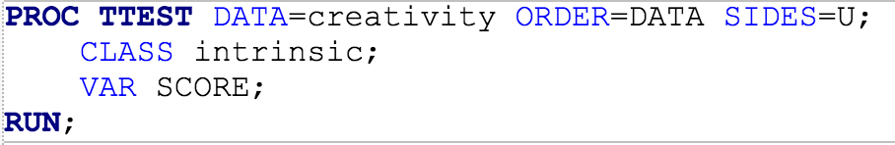
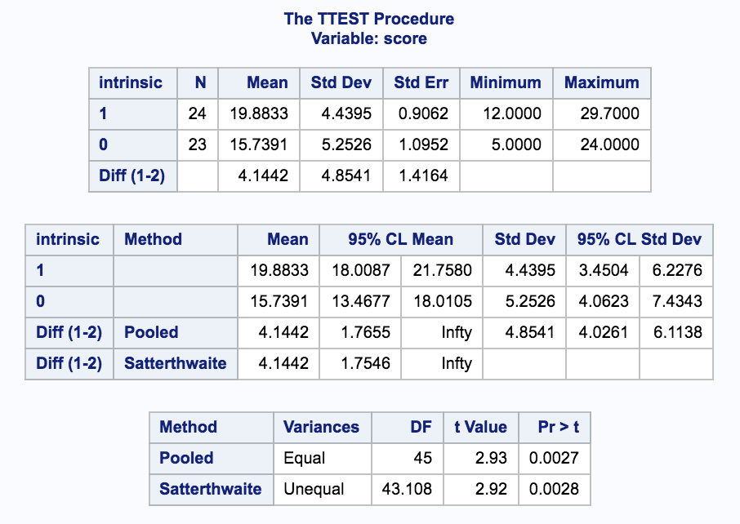
One-Sided P-values in SAS
One-sided CI

Slide 7
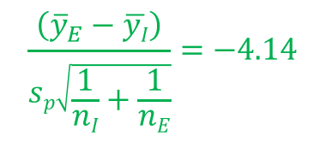
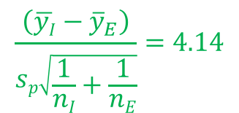
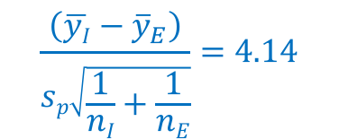
Comparing the Distributions
Two-sided
One-sided
$$\frac{\left({\overline{y}}_{E}−\overline{yI}\right)}{sp\sqrt{\frac{1}{nI}+\frac{1}{nE}}}=−4.14$$
$$\frac{\left(\overline{yI}−{\overline{y}}_{E}\right)}{sp\sqrt{\frac{1}{nI}+\frac{1}{nE}}}=4.14$$
$$\frac{\left(\overline{yI}−{\overline{y}}_{E}\right)}{sp\sqrt{\frac{1}{nI}+\frac{1}{nE}}}=4.14$$

Slide 8
One and Two Tailed Confidence Intervals

Slide 9
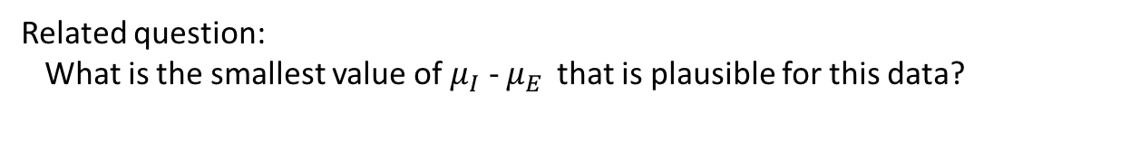
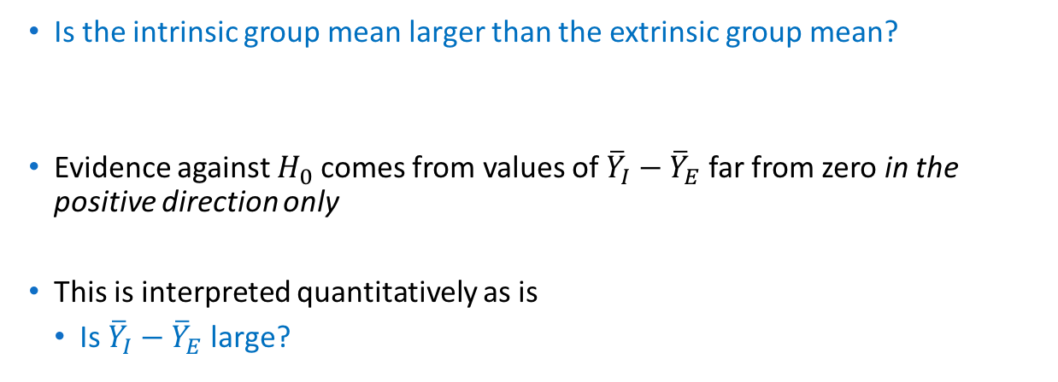
One-Sided P-values
Is the intrinsic group mean larger than the extrinsic group mean?
Evidence against $H_{0}$comes from values of ${\overline{Y}}_{I}−{\overline{Y}}_{E}$ far from zero in the positive direction only
This is interpreted quantitatively as is
Is ${\overline{Y}}_{I}−{\overline{Y}}_{E}$ large?
$→ H_{A}: μ_{I}>$ $μ_{E }$
Related question:
What is the smallest value of $μ_{I}$ - $μ_{E }$ that is plausible for this data?

Slide 10
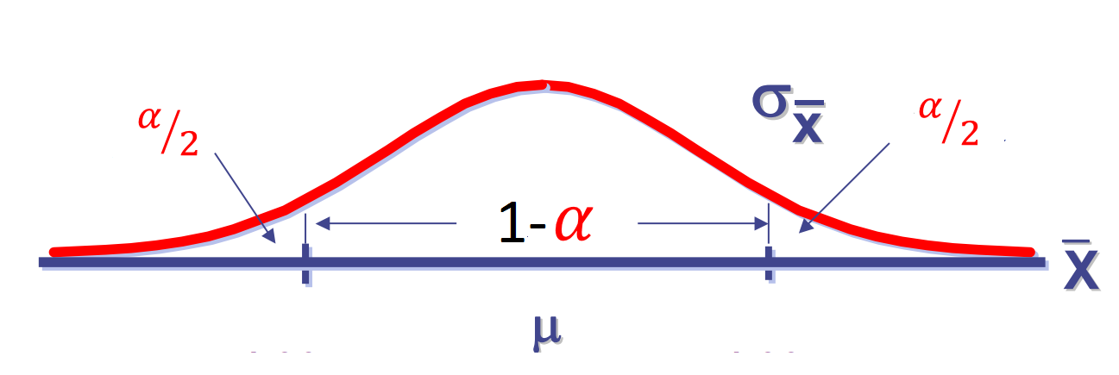

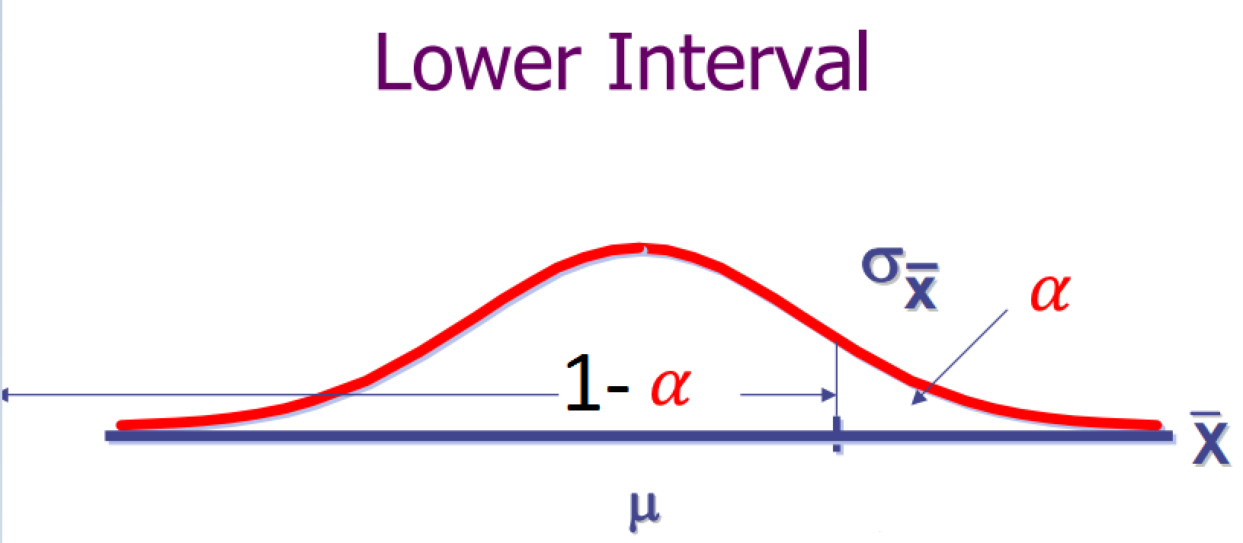
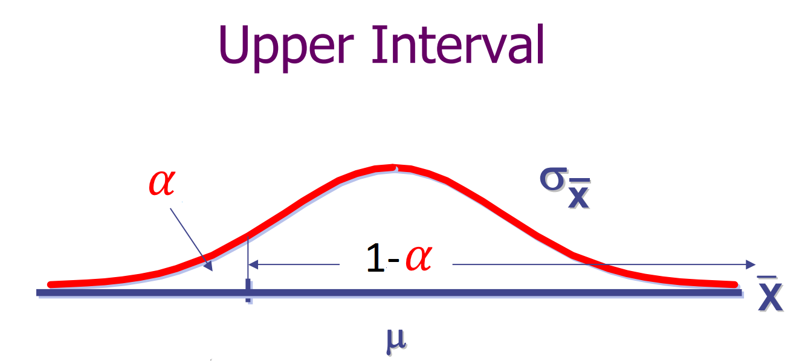
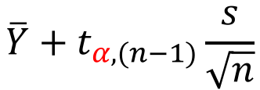
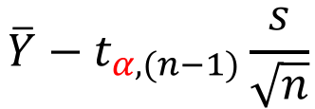
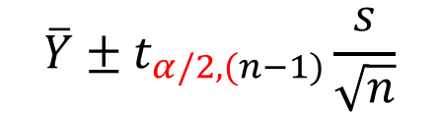
One Sample Confidence Interval
Two Tailed
$$\overline{Y}±t_{α/2,(n−1)}\frac{s}{\sqrt{n}}$$
Lower One Tailed
$$\overline{Y}+t_{α,(n−1)}\frac{s}{\sqrt{n}}$$
Upper One Tailed
$$\overline{Y}−t_{α,(n−1)}\frac{s}{\sqrt{n}}$$

Slide 11
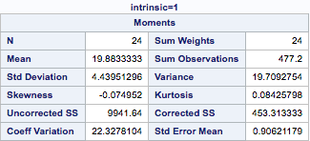
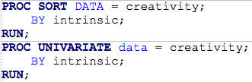
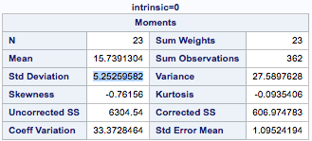
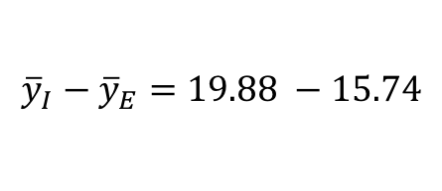

Creativity Study: Confidence Interval
$$→{\overline{y}}_{I}−{\overline{y}}_{E}=4.14$$
$${\overline{y}}_{I}−{\overline{y}}_{E}=19.88 −15.74$$
$s_{p}=\sqrt{\frac{({n_{I}−1) s}_{I}^{2}+ ({n_{E}−1) s}_{E}^{2}}{n_{I}+n_{E} −2}}$ = $\sqrt{\frac{\left(23\right){4.44}^{2}+\left(22\right){5.25}^{2}}{45}}$
$→s_{p}$ = 4.85

Slide 12
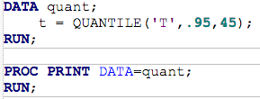

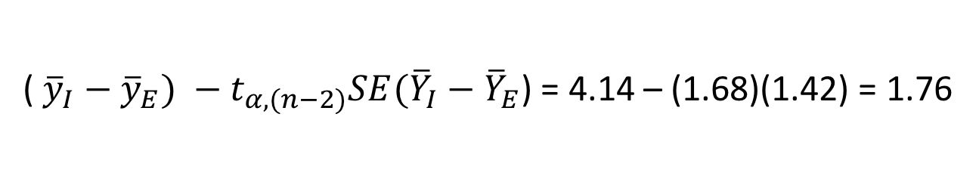
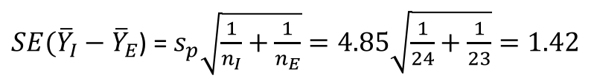

Constructing an Upper One-Tailed Confidence Interval
$$µI−µE$$
$SE({\overline{Y}}_{I}−{\overline{Y}}_{E}$) = $s_{p}\sqrt{\frac{1}{n_{I}}+\frac{1}{n_{E}}}=4.85\sqrt{\frac{1}{24}+\frac{1}{23}}=1.42$
(${\overline{y}}_{I}−{\overline{y}}_{E}) −t_{α,(n−2)}SE({\overline{Y}}_{I}−{\overline{Y}}_{E}$) = 4.14 – (1.68)(1.42) = 1.76

Slide 13
One-Sided P-values in SAS
One-sided CI
“We are 95% confident that the difference in the mean creativity score for the intrinsic group vs. the extrinsic group is at least 1.7655 [units?]”

Slide 14
Five Steps to Hypothesis Testing

Slide 15
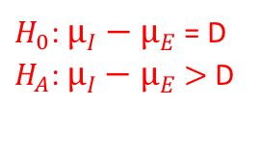
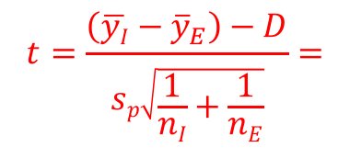
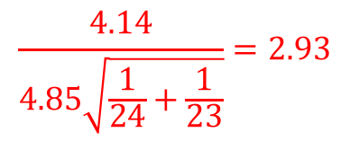
Five steps
(D = 0)
$H_{0}$: $µI−µE$ = D
$H_{A}$: $µI−µE$ $>$D
Step 1: Identify the null and alternative hypothesis.
Step 2: Find the test statistic.
$$t=\frac{\left(\overline{yI}−{\overline{y}}_{E}\right)−D}{sp\sqrt{\frac{1}{nI}+\frac{1}{nE}}}=$$
$$\frac{4.14}{4.85\sqrt{\frac{1}{24}+\frac{1}{23}}}=2.93$$
Step 3: Draw and shade the correct density according to $H_{A}$
t w/ df = 24 +23 – 2 = 45

Slide 16
Five steps
Step 4: Find the size of the shaded region
t w/ df = 24 +23 – 2 = 45
(p-value)
Step 5: Include the results in a statistical conclusion (hypothesis, p-value, and whether it is one-sided or two sided)
“There is convincing evidence that the intrinsic questionnaire mean is larger than the extrinsic (one-sided p-value =0.0027 from a pooled two-sample t-test for equal means)…”

