Slide 1
A Closer Look at Assumptions
One last time: Confidence interval/hypothesis test duality
Robustness of T-tools

Slide 2
Examining Confidence Intervals

Slide 3
To the “Rossman/Chance” applet:
http://www.rossmanchance.com/applets/ConfSim.html

Slide 4

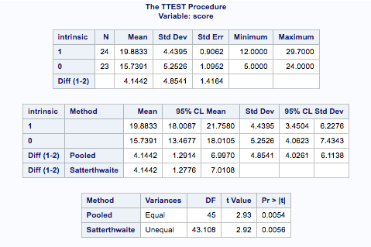
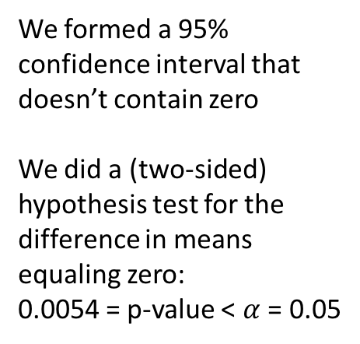
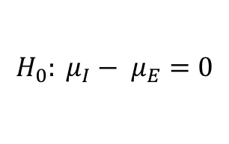
Confidence Intervals & Hypothesis Tests
$$H_{0}: μ_{I}− μ_{E}=0$$
We formed a 95% confidence interval that doesn’t contain zero
We did a (two-sided) hypothesis test for the difference in means equaling zero:
0.0054 = p-value < $α$ = 0.05
Question:
Is this a coincidence?

Slide 5


Answer: Not At All!
Using these ingredients…
Let’s get a more precise p-value

Slide 6

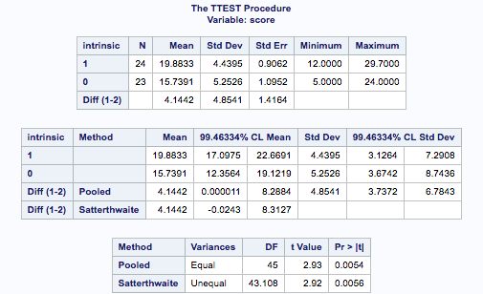
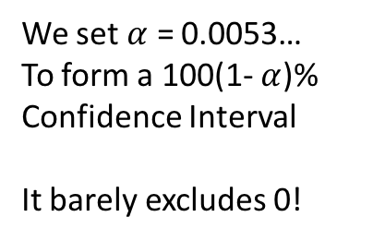
Confidence Intervals & Hypothesis Tests
$$H_{0}: μ_{I}− μ_{E}=0$$
We set $α$ = 0.0053…
To form a 100(1- $α$)% Confidence Interval
It barely excludes 0!

Slide 7
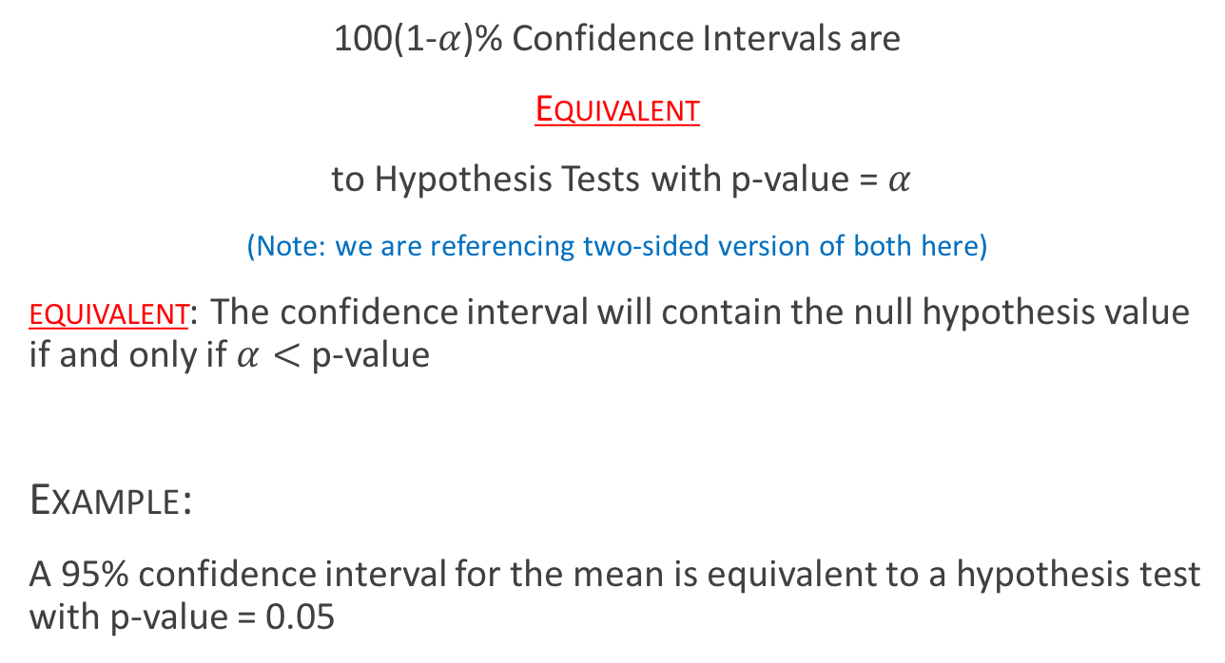
The Take Away
100(1-$α$)% Confidence Intervals are
Equivalent
to Hypothesis Tests with p-value = $α$
(Note: we are referencing two-sided version of both here)
equivalent: The confidence interval will contain the null hypothesis value if and only if $α<$ p-value
Example:
A 95% confidence interval for the mean is equivalent to a hypothesis test with p-value = 0.05

Slide 8
Assumptions for T-Tools: Normality

Slide 9
Assumptions of the One Sample T-Tools
Samples are drawn from a Normally distributed population.
The observations in the sample are independent of one another.
When the original (population) distribution is not normal, the one sample t-test is still valid with a large enough sample size.
That is, the one sample t-test is robust to the normality assumption when the sample size is large enough.
Robust means that even though the assumption isn’t necessarily met, the procedure can (but not always) work fine
(central limit theorem)

Slide 10
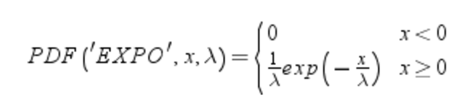
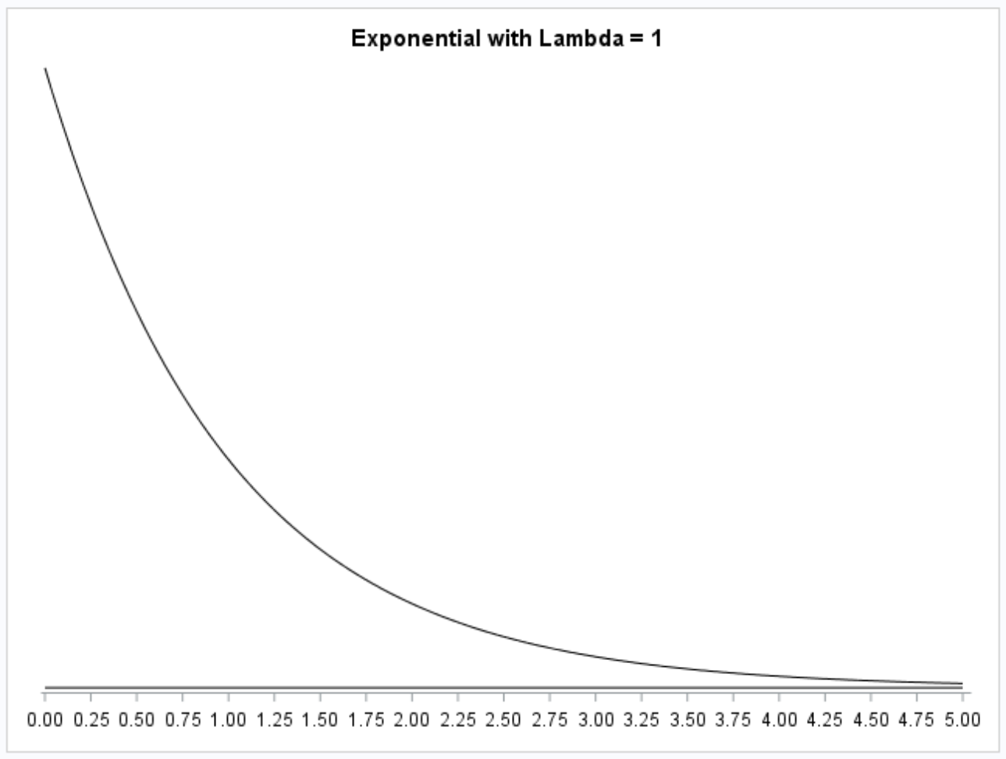
Robustness of T-tools

Slide 11
Back To the “Rossman/Chance” applet:
http://www.rossmanchance.com/applets/ConfSim.html

Slide 12
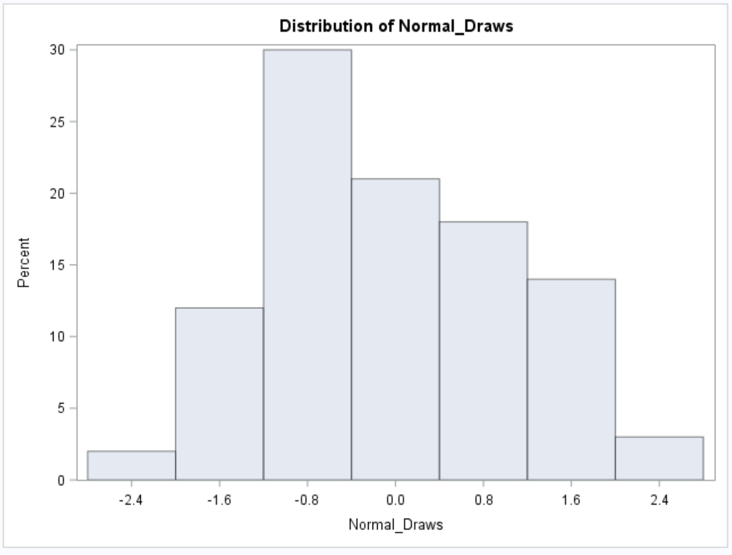
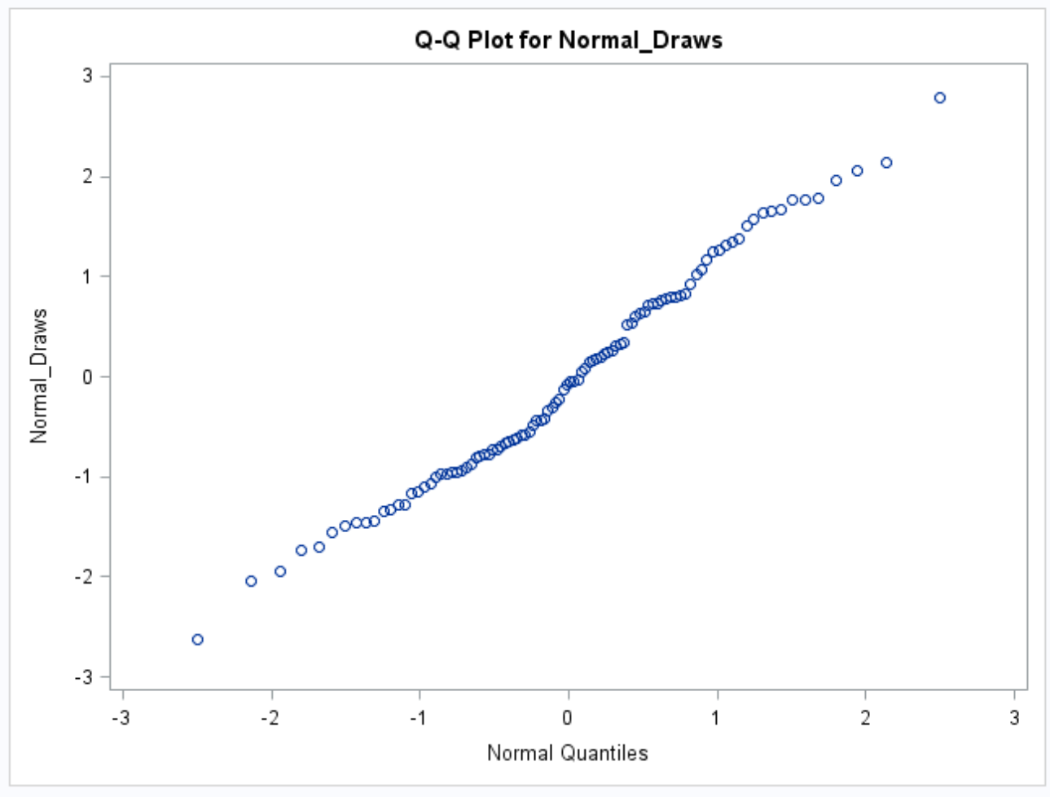
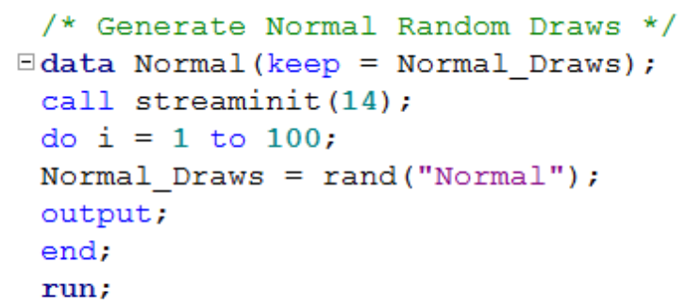
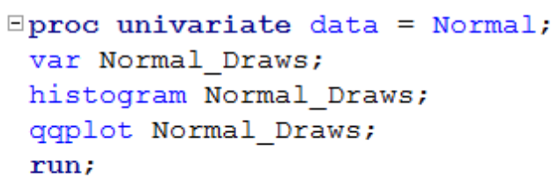
Given Data, How Do We Check the Normality Assumption?
n = 100
n = 100
Histogram
QQ Plot

Slide 13
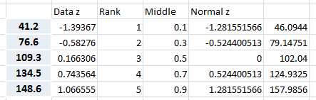
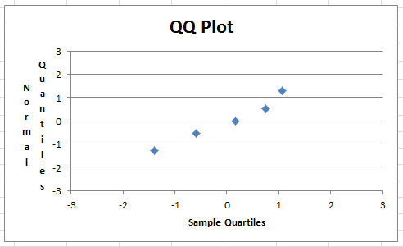
Creating QQ plots
DATA
41.2
76.6
109.3
134.5
148.6

Slide 14
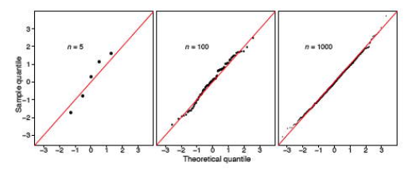
Normal QQ Plot
If the sample comes from a normal distribution, it will have similar quantiles as the normal

Slide 15
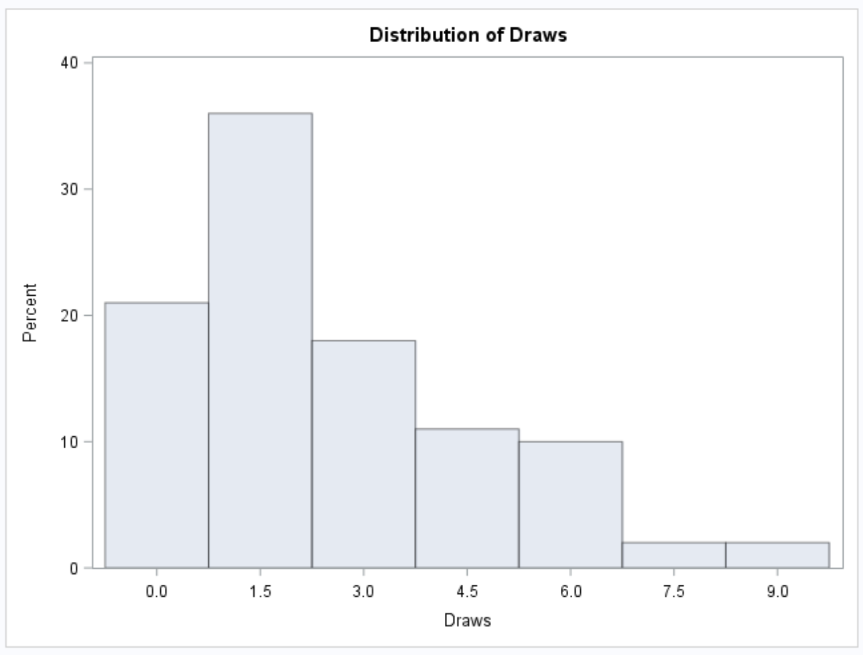
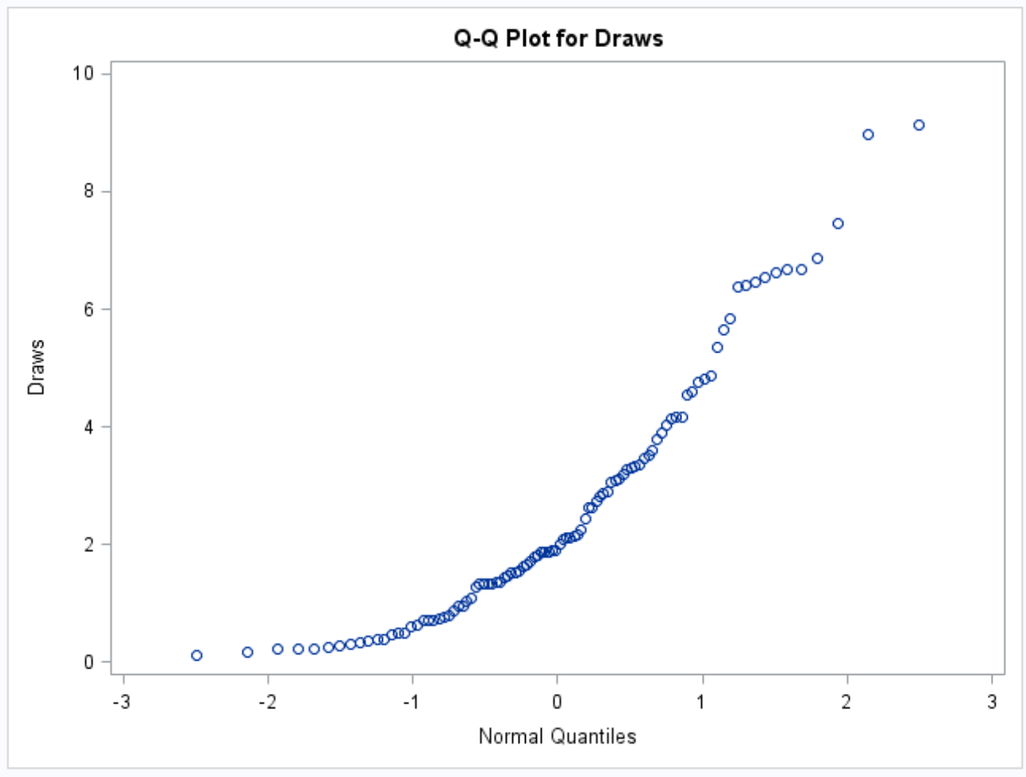
Given Data, How Do We Check the Normality Assumption?
n = 100
n = 100
Histogram
QQ Plot
What about in this case?
Exponential distribution

Slide 16
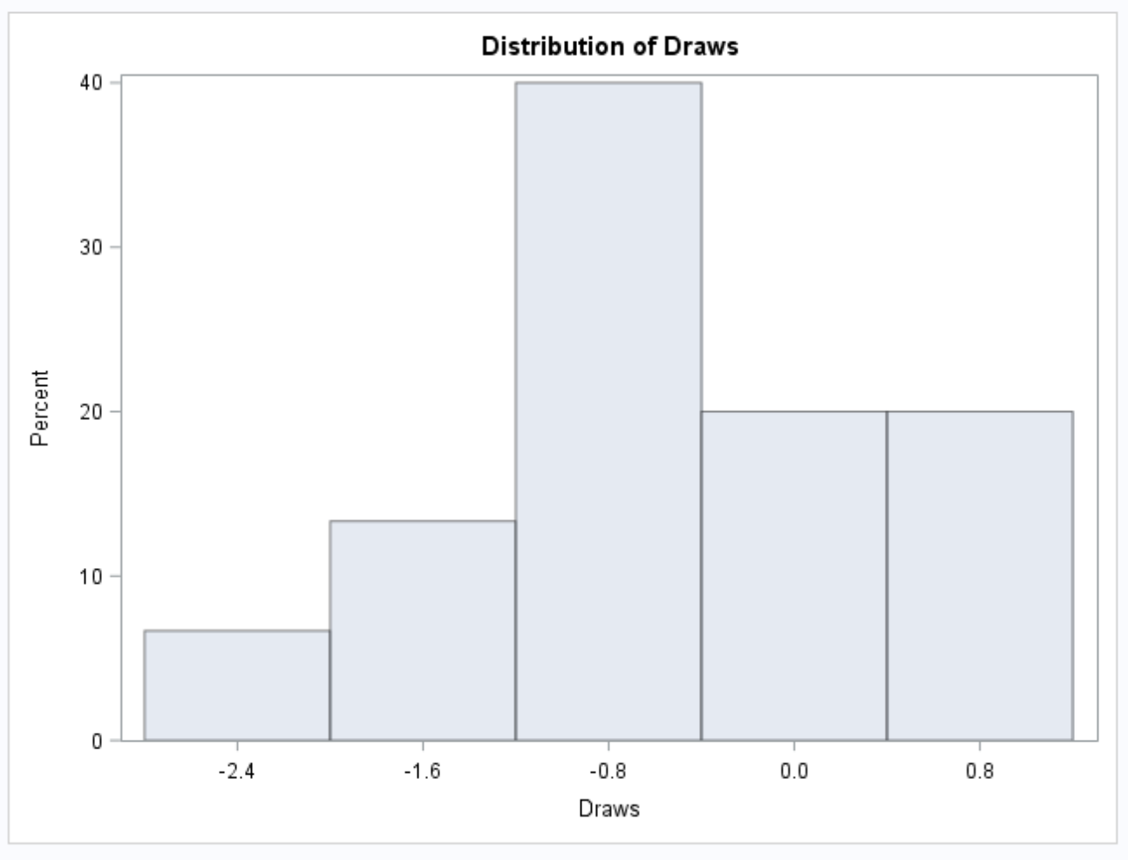
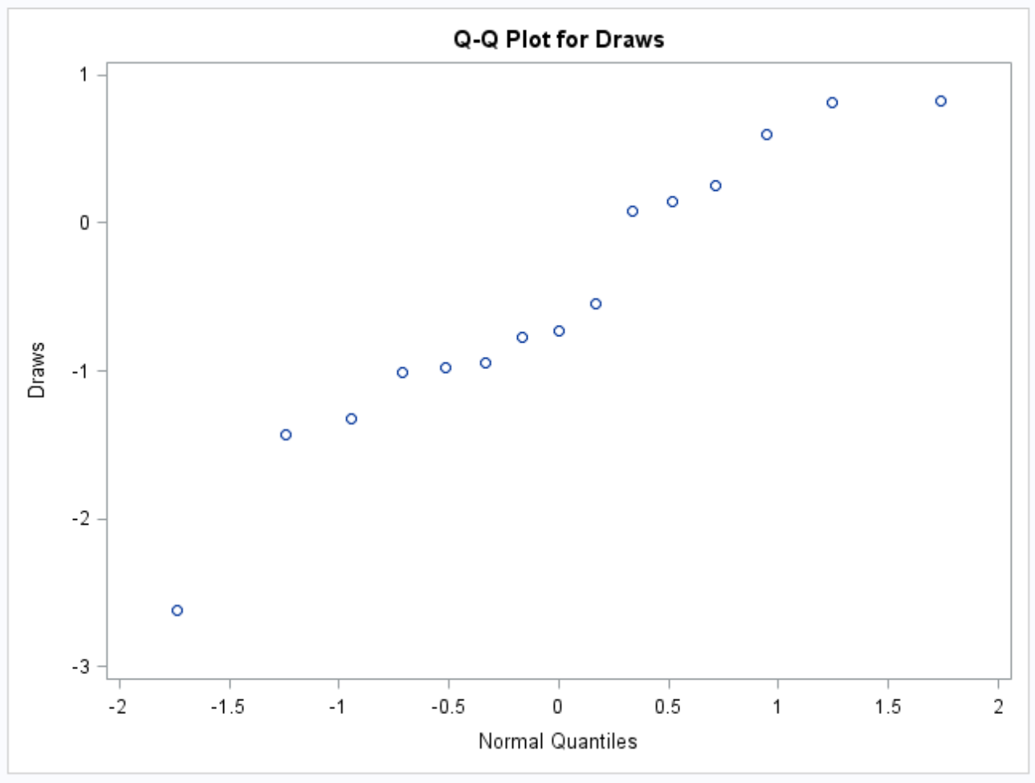
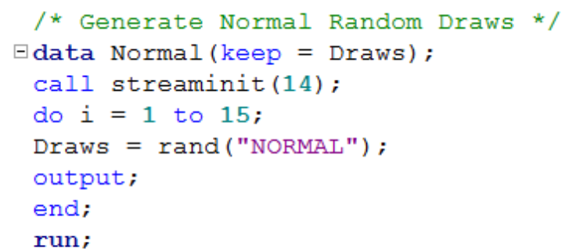
Given Data, How Do We Check the Normality Assumption?
n = 15
n = 15
Histogram
QQ Plot
What about in this case?

Slide 17
A Way to Decide:
 | Small Sample Size | Large Sample Size
Little to no Evidence Against Normality | No Problem if you feel Normality is a safe assumption … run the T-Test. (You may want to be “conservative” here and run a test with less assumptions. | No Problem! Run the T-Test
Significant Evidence Against Normality | Assumptions are not met and test is not robust here … Do not run the T-Test and proceed to a test with less / different assumptions. | No Problem .. You have the CLT. Run the T-Test.

Slide 18
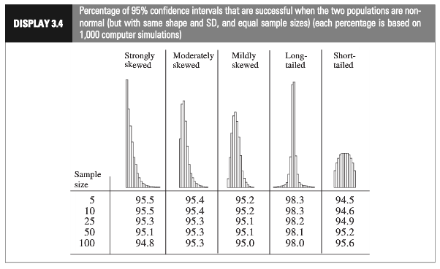

Slide 19
Assumptions for T-Tools: Equal Variances

Slide 20
Assumptions of two sample T-Tools
Samples are drawn from a normally distributed population
The observations in the sample are independent of one another
If it is a two sample test, both populations are assumed to have the same standard deviation
There are two standard diagnoses:
Look at histograms of the groups
Do a hypothesis test for equal variances

Slide 21
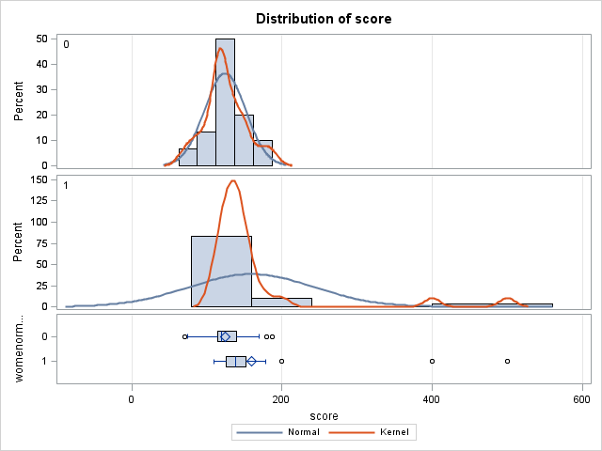
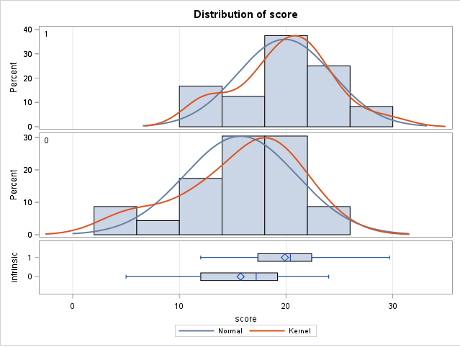
Looking at Histograms

Slide 22
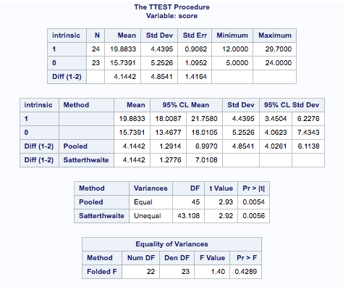

Test for Equal Variances
$H_{0}$: population variances are equal
$H_{A}$: population variances are not equal

Slide 23


Looking at Histograms & Test for Equal Variances

Slide 24
What happens if we detect unequal variances?
It no longer makes sense to “pool” the sample standard deviation estimators together
We need to make some sort of change
This could mean a transformation or a different method

