Slide 1
A Closer Look at Assumptions
Robustness of T-tools

Slide 2
Assumptions for T-Tools: Equal Variances

Slide 3
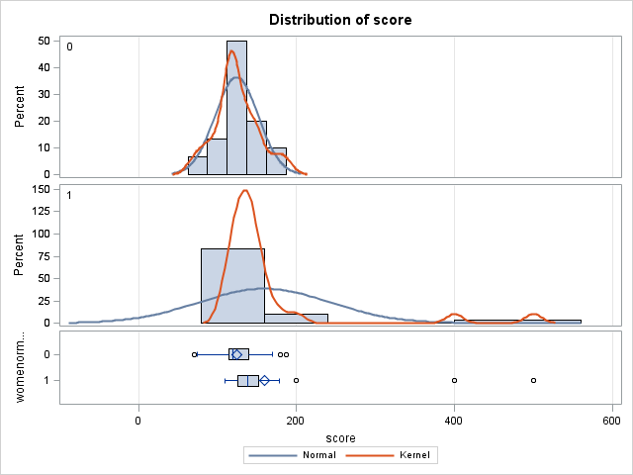
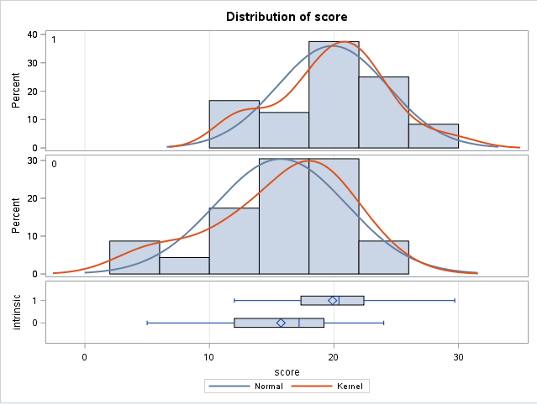


Looking at Histograms & Test for Equal Variances

Slide 4
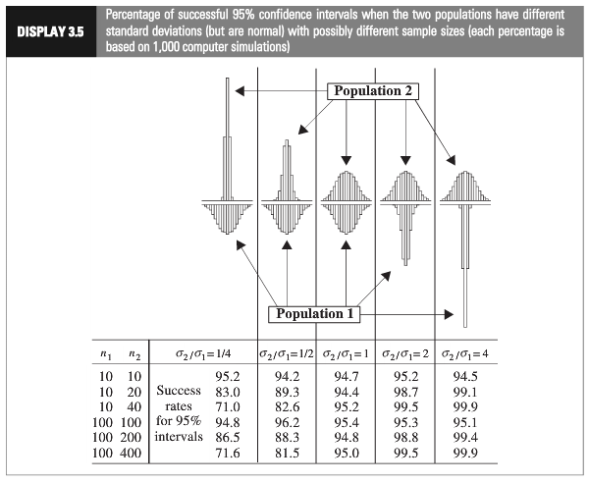
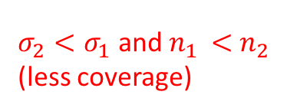

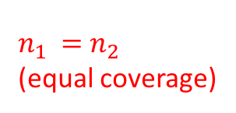
$n_{1 }=$ $n_{2 }$
(equal coverage)
$σ_{2}<σ_{1}$ and $n_{1 }<$ $n_{2 }$
(less coverage)
$σ_{2}>σ_{1}$ and $n_{1 }<$ $n_{2 }$
(more coverage)
Notes:
Worst case: the variance from the larger group is smaller than the variance from smaller group:

Slide 5
Assumptions of Two sample T-Tools
Samples are drawn from a Normally distributed population.
If it is a two sample test, both populations are assumed to have the same standard deviation (same shape).
The observations in the sample are independent of one another.

Slide 6
Assumptions for T-Tools: Independence

Slide 7
Independence
A major assumption underlying the Central Limit Theorem and/or the T-tools is independence
Independence: “Whenever knowledge about one observation gives information about another observation”
Example: If I measure your parents’ height, that would give me information about your height without even measuring you.
Two common types of independence
Cluster Effects: Observations are naturally in subgroups
Serial Effects: Observations are collected over time/space.
Notes:
Question: Suppose you really don’t like me and find out I’m attending a party. So, you don’t attend that party. Are we independent?

Slide 8
Independence: Cluster Effects
Two common types of independence
Cluster Effects: Observations are naturally in subgroups
Serial Effects: Observations are collected over time/space.
Examples:
Genetic Similarity: If we sample from all cattle at a ranch, some of the cattle could be dependent due to genetics
Sociodemographic: People tend to spend their days with people of the same race/income/…
Notes:
Question: Suppose you really don’t like me and find out I’m attending a party. So, you don’t attend that party. Are we independent?

Slide 9
Independence: Serial Effects
Two common types of independence
Cluster Effects: Observations are naturally in subgroups
Serial Effects: Observations are collected over time/space.
Examples:
Suppose we are testing the effect of new software on productivity. For all the subjects, we have them perform a task using old software and then the same task with new software
We grow 10 different bacterial colonies on a single culture medium. The size of bacterial colonies near each other with be negatively associated due to resource competition

Slide 10
Independence: Serial Effects
Two common types of independence
Cluster Effects: Observations are naturally in subgroups
Serial Effects: Observations are collected over time/space.
How to diagnose?
There are statistical techniques for estimating/testing/accounting for these effects.
Some of these methods will be discussed later in the class/the next class.
For now, just be aware of these types of assumption violations

Slide 11
Outliers and Resistance

Slide 12
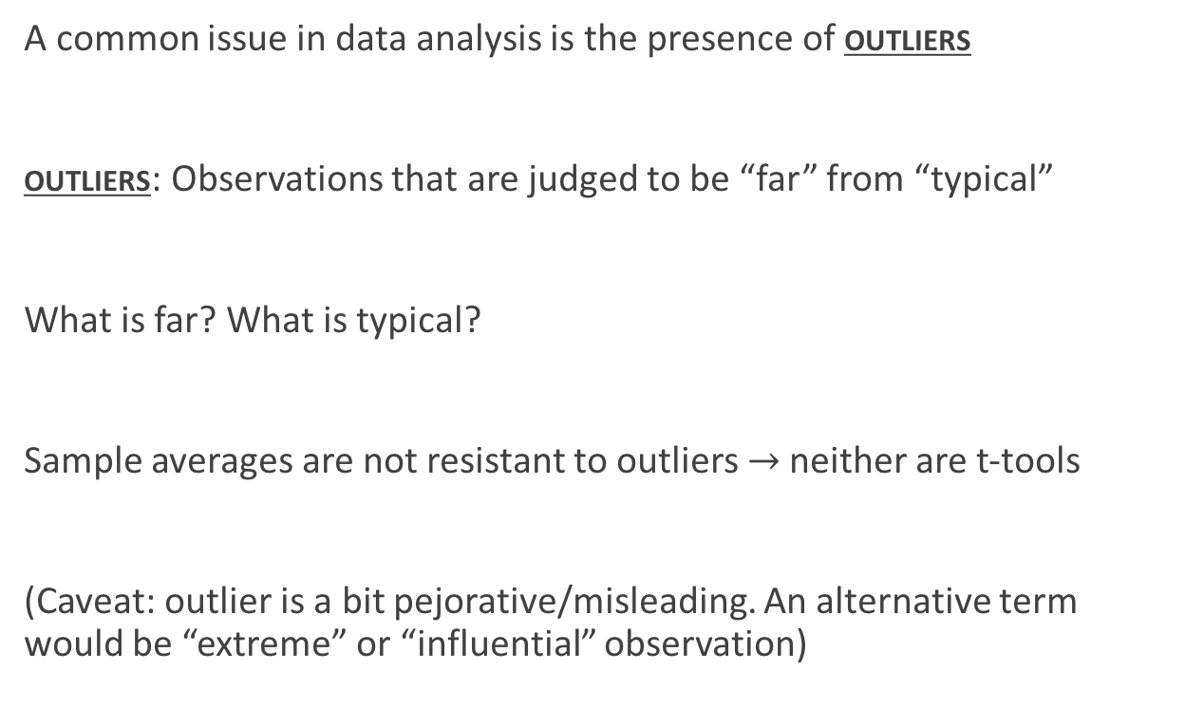
Outliers
A common issue in data analysis is the presence of outliers
outliers: Observations that are judged to be “far” from “typical”
What is far? What is typical?
Sample averages are not resistant to outliers $→$neither are t-tools
(Caveat: outlier is a bit pejorative/misleading. An alternative term would be “extreme” or “influential” observation)

Slide 13
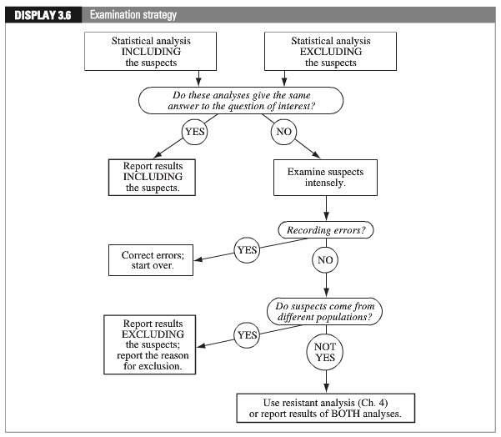
Strategy For Data Sets with Outliers

Slide 14

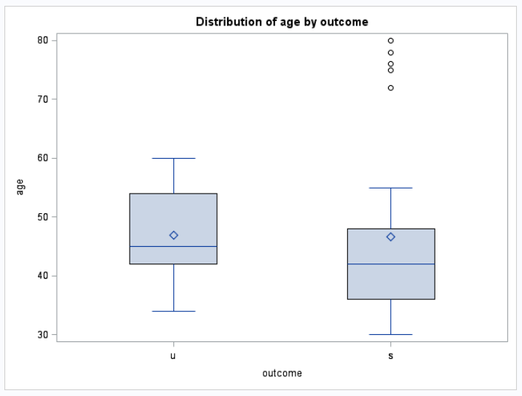
Example: Age by Promotion Status
Errors?

Slide 15
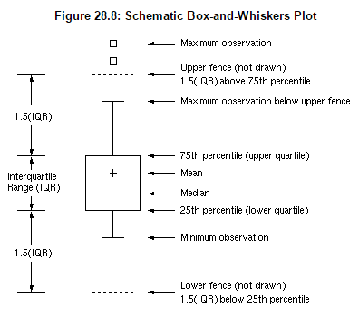
SAS procedure: The “schematic” option

Slide 16
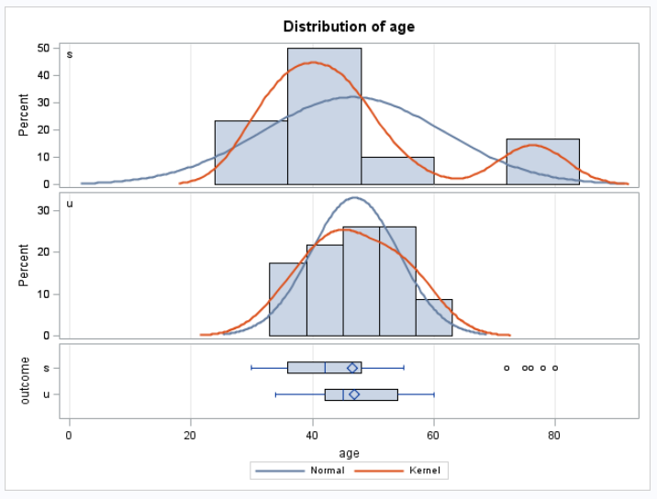
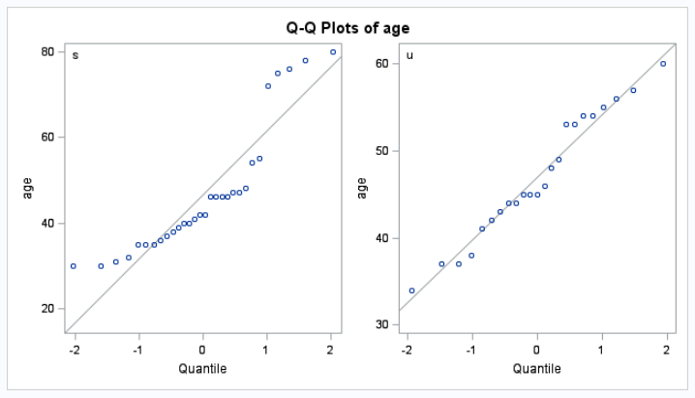
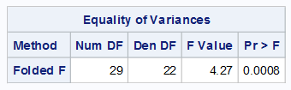
Re-check Assumptions

Slide 17

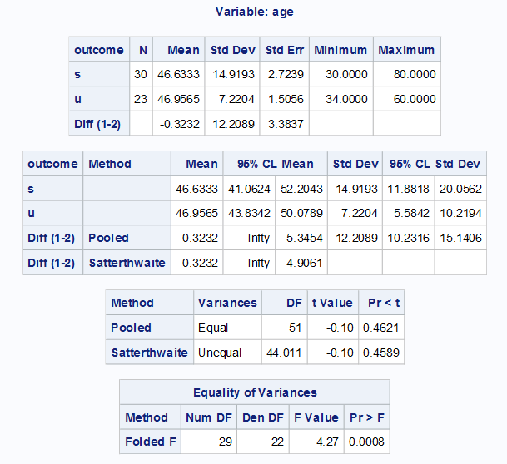
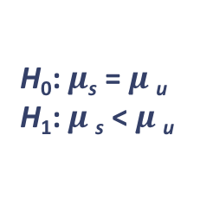
Results with Outliers
H₀: $μ$_{s} = $μ$_{u}
H₁: $μ$_{s} < $μ$_{u}
Statistical Conclusion:
The data provide no evidence against the null hypothesis that the mean age of the “successful” group is lower than the mean age of the “unsuccessful” group (one sided, two sample pooled t-test p-value = 0.4621). The assumptions about normality and equal variances seem suspect, however.

Slide 18
Strategy For Data Sets with Outliers

Slide 19


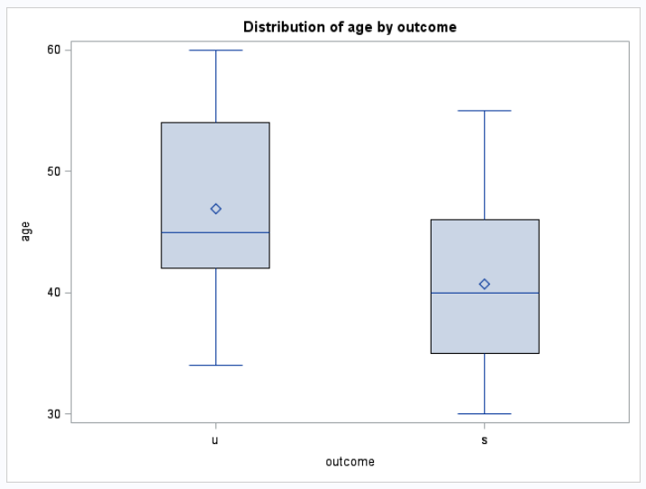
New Box Plot Without Outliers

Slide 20
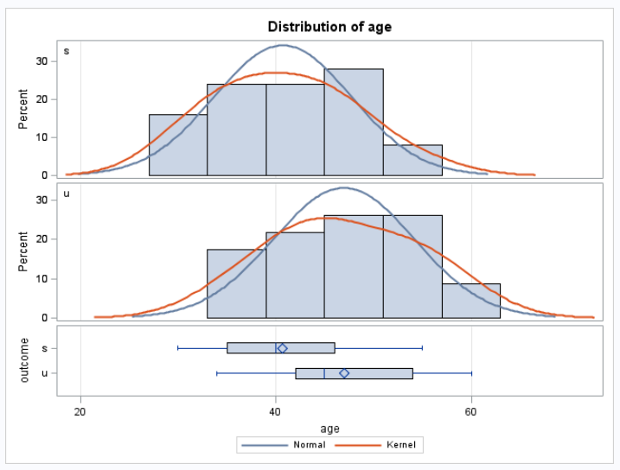
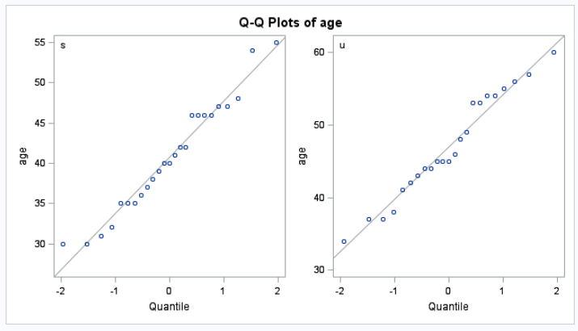
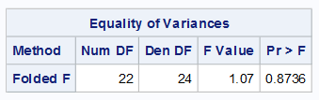
Re-check Assumptions

Slide 21

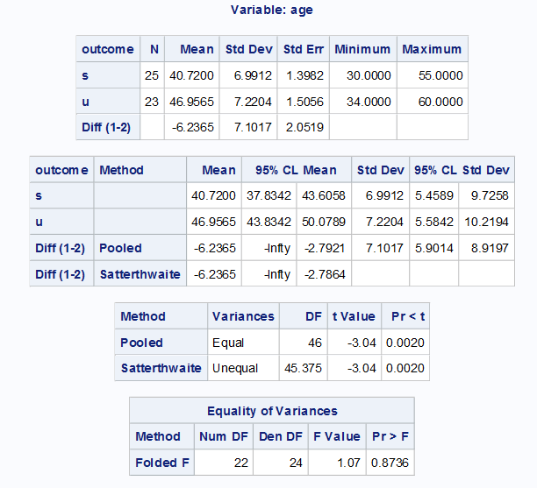
Results Excluding the Suspects
H₀: $μ$_{s} = $μ$_{u}
H₁: $μ$_{s} < $μ$_{u}
Statistical Conclusion:
There is strong evidence against the null hypothesis that the mean age of the “successful” group is lower than the mean age of the “unsuccessful” group (one sided, two sample pooled t-test
p-value =0.002). We estimate that the mean difference is -6.2365 years, with up to -2.7921 years a plausible value (95% one-tailed pooled t-dist. confidence interval).

Slide 22
Included v. Excluded
Included
Excluded

Slide 23
Strategy For Data Sets with Outliers

Slide 24

Examination of Outliers
Careful review of the outlying observations was conducted and it was found that the data point that was recorded as “80 years” was actually supposed to be recorded as a “30 years”!
The other outliers were found to be recorded correctly.

Slide 25
Strategy For Data Sets with Outliers

Slide 26
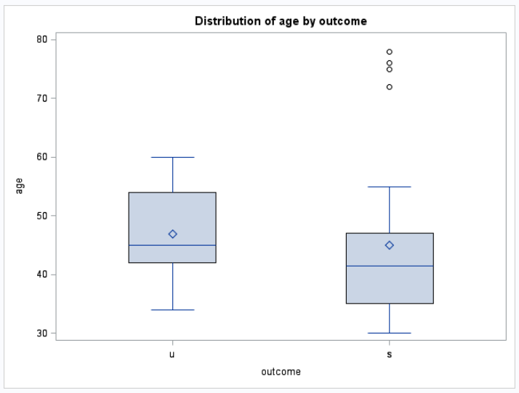
New Box Plot After Correction
Original
After Correction

Slide 27
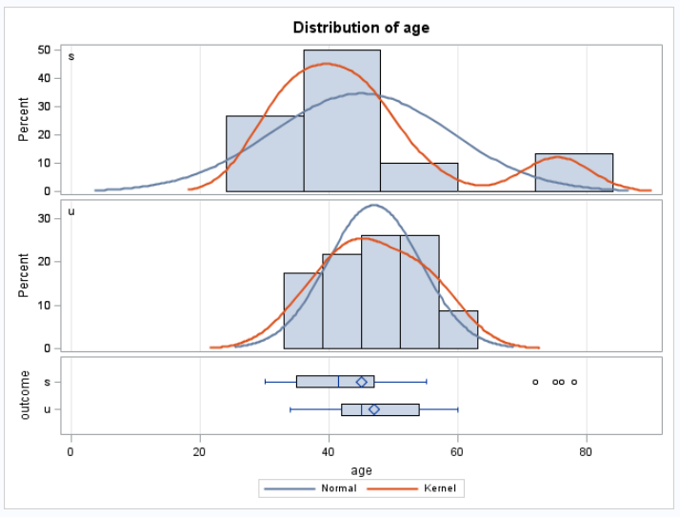
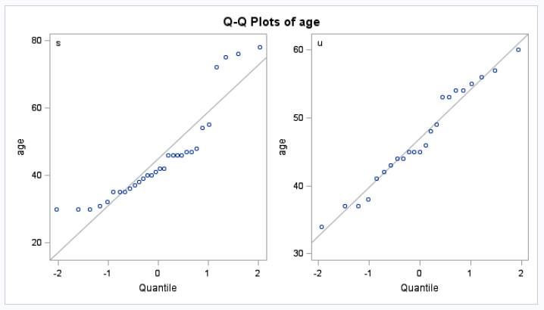
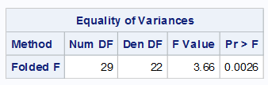
Another Look at Assumptions

Slide 28
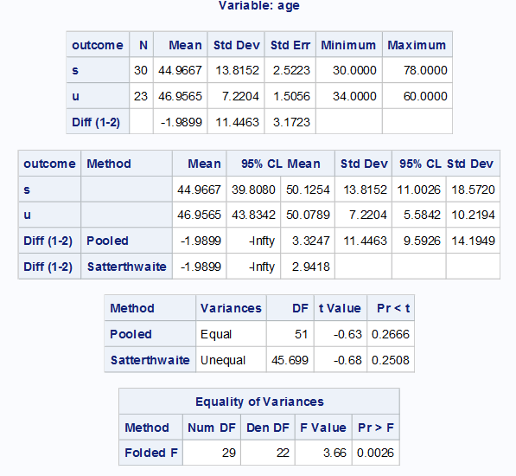
Another Look At the Promotion Data
After Correction
Excluding all Outliers (Suspects)

Slide 29
Strategy For Data Sets with Outliers

Slide 30

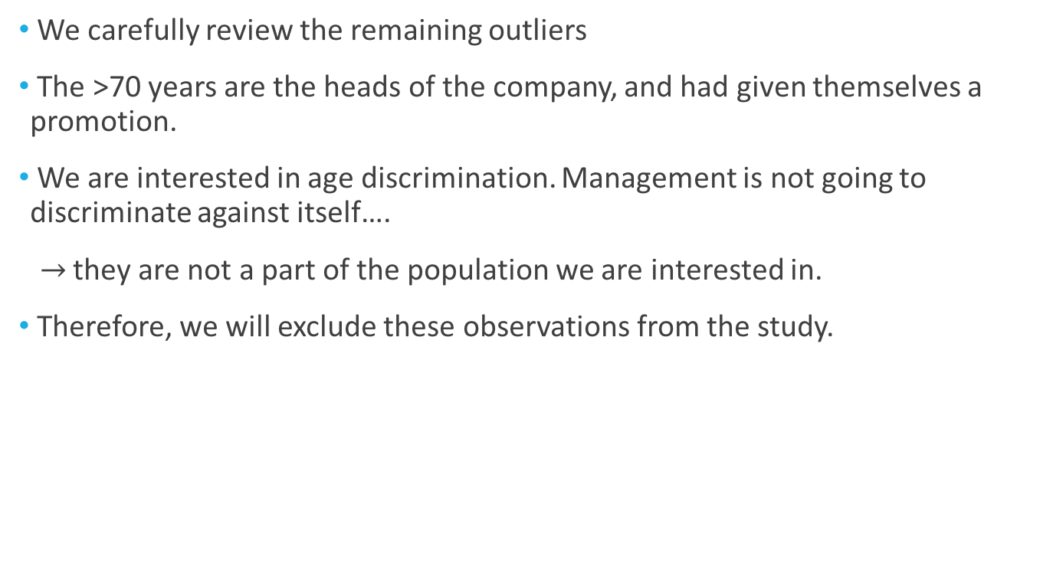
Examination of Outliers
We carefully review the remaining outliers
The >70 years are the heads of the company, and had given themselves a promotion.
We are interested in age discrimination. Management is not going to discriminate against itself….
$→$they are not a part of the population we are interested in.
Therefore, we will exclude these observations from the study.

Slide 31
Strategy For Data Sets with Outliers

Slide 32
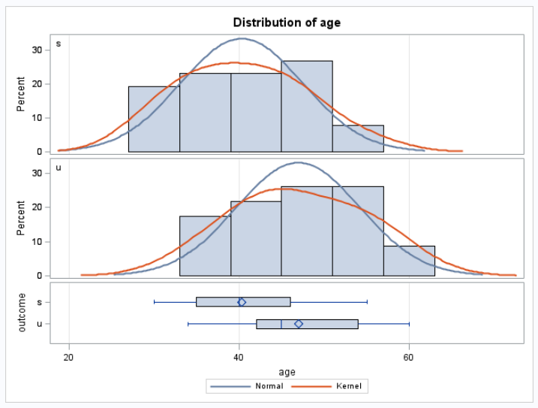
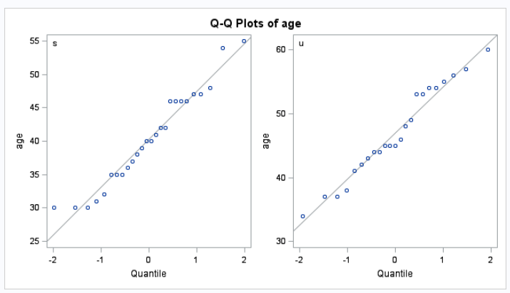
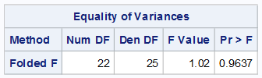
With Correction with no outliers

Slide 33
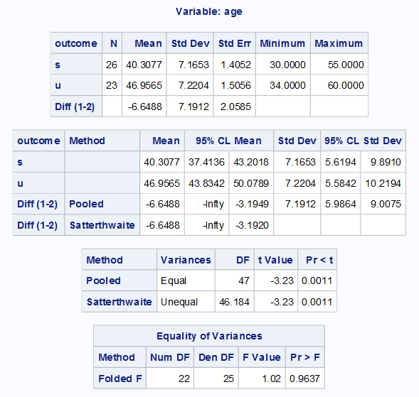
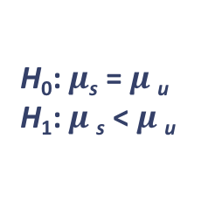
Report Results Excluding the Suspects
H₀: $μ$_{s} = $μ$_{u}
H₁: $μ$_{s} < $μ$_{u}
Statistical Conclusion:
There is strong evidence against the null hypothesis that the mean age of the “successful” group is lower than the mean age of the “unsuccessful” group (one sided, two sample pooled t-test p-value = 0.0011). We estimate that the mean difference is -6.6488 years, with up to -3.1949 years a plausible value (95% one-tailed pooled t-dist. confidence interval).
We excluded workers with age > 66 years due to being management.

Slide 34
Transformations

Slide 35
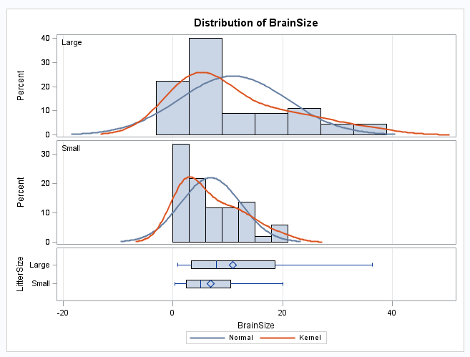
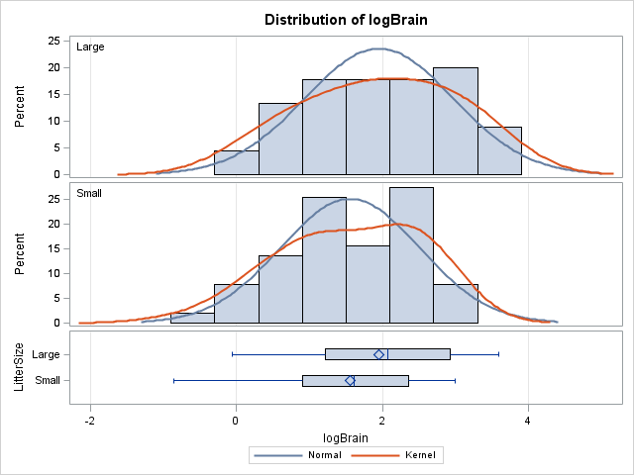
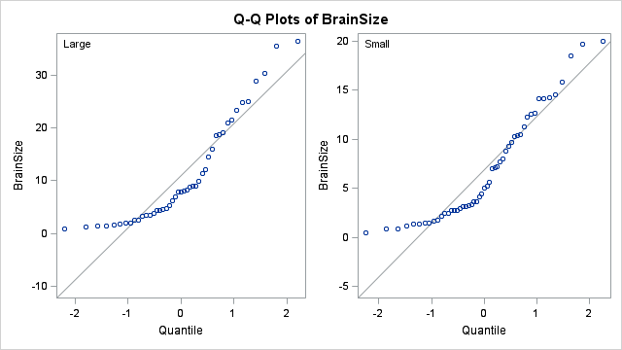
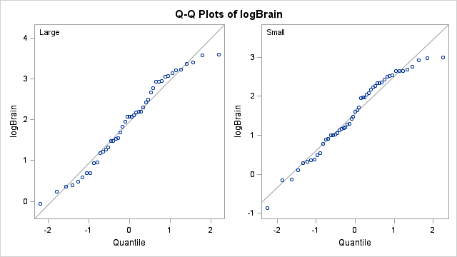
Checking Assumptions…

Slide 36
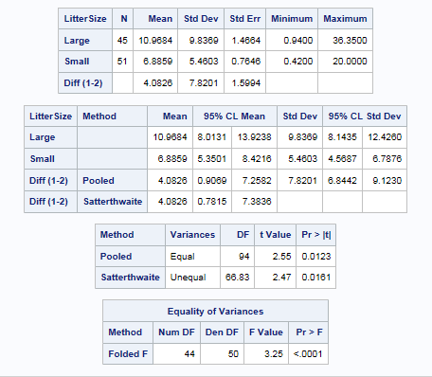
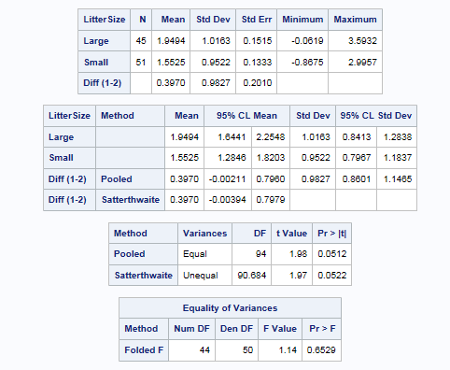
Checking Assumptions…
Original Data
Log Transformed Data

Slide 37
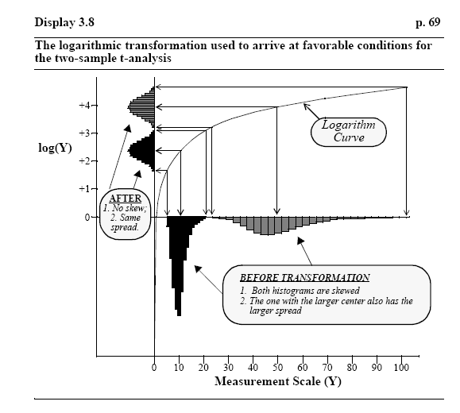
Log Transformation

Slide 38
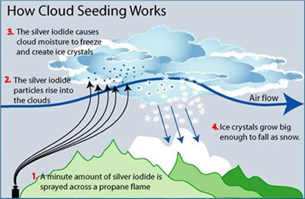
Example: Cloud Seeding

Slide 39
Does Cloud Seeding Work?
On days that were deemed suitable for cloud seeding, a random mechanism was used to decide whether to seed the target cloud on that day or to leave it unseeded as a control
Precipitation was measured as the total rain volume falling from the cloud base following the seeding run (as measured by radar)
We would like to test whether cloud seeding is effective in increasing precipitation.

Slide 40
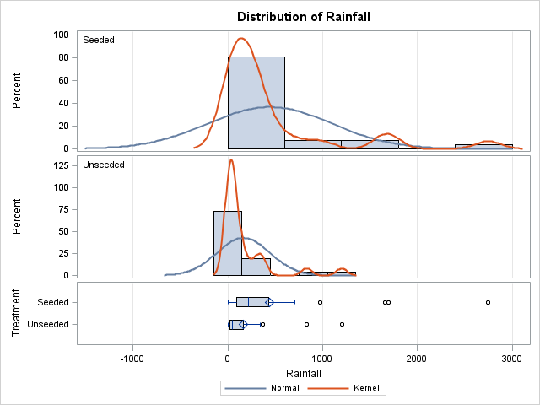
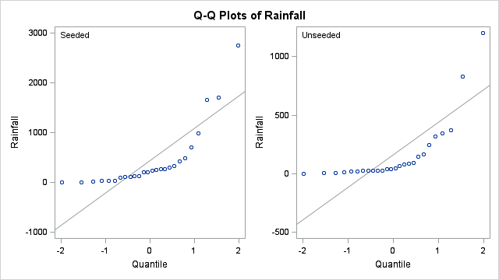

Cloud Seeding: Original Data

Slide 41
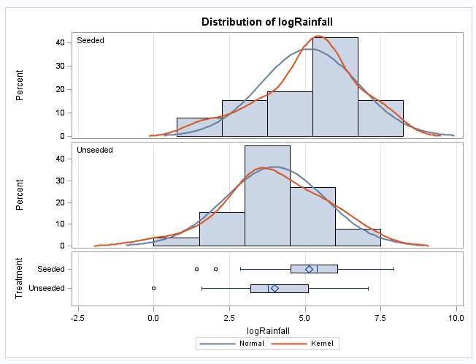
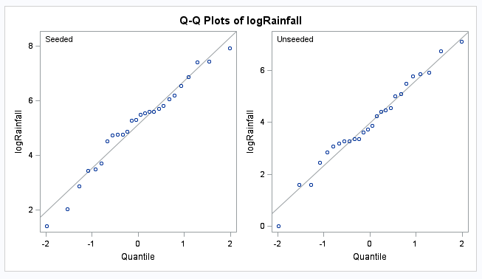
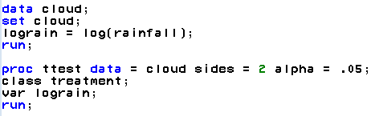
After Log Transformation
Create lograin
Analyze lograin

Slide 42
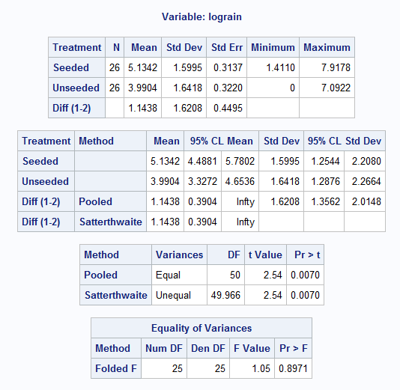


Hypothesis Test
H₀: Cloud Seeding does not work.
H₁: Cloud Seeding does work.
H₀: $μ$_{seeded} = $μ$_{unseeded}
H₁: $μ$_{seeded} > $μ$_{unseeded}
H₀: $μ$_{log(seeded)} = $μ$_{log(unseeded)}
H₁: $μ$_{log(seeded)} > $μ$_{log(unseeded)}
Statistical Conclusion:
There is strong evidence against the null hypothesis that the mean log(precip.) of the “seeded” group is greater than the mean log(precip.) of the “unseeded” group (one sided, two sample pooled t-test p-value = 0.007)…

Slide 43

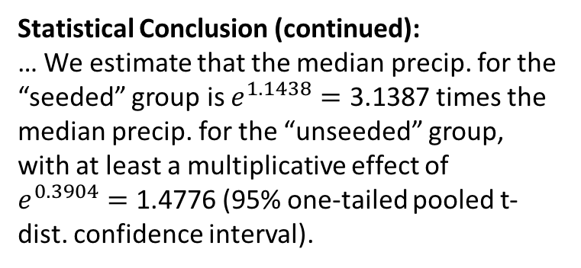

Hypothesis Test
H₀: Cloud Seeding does not work.
H₁: Cloud Seeding does work.
H₀: $μ$_{seeded} = $μ$_{unseeded}
H₁: $μ$_{seeded} > $μ$_{unseeded}
H₀: $μ$_{log(seeded)} = $μ$_{log(unseeded)}
H₁: $μ$_{log(seeded)} > $μ$_{log(unseeded)}
Statistical Conclusion (continued):
… We estimate that the median precip. for the “seeded” group is $e^{1.1438}=\text{3.138}\text{7}$ times the median precip. for the “unseeded” group, with at least a multiplicative effect of $e^{0.3904}=\text{1.477}\text{6 }$(95% one-tailed pooled t-dist. confidence interval).
Scope of Inference:
As this is a randomized study, we can infer that seeding mechanism caused this difference. We can only extend these results to this location and to ”suitable” days.

