Slide 1
Power and Size
Quantifying the errors of a Hypothesis Test

Slide 2
Two Experiments
Suppose we are running two chemistry experiments.
We run two-sample, two-sided, pooled t-tests for differences in the mean
Experiment 1:
We calculate a very low p-value (say 0.0001) and choose to reject the null hypothesis
Experiment 2:
We calculate a large p-value (say 0.2) and choose to fail to reject the null hypothesis
Of course, we don’t know the truth. But, is there anything that can be said further about the types of errors we might be making?

Slide 3
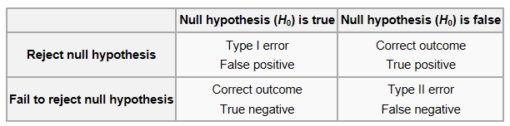





Types of Errors

Slide 4
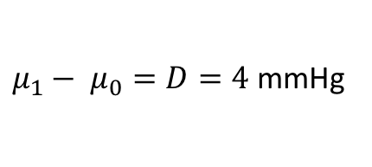
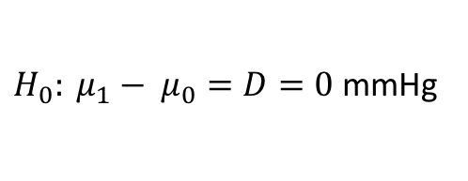
A Thought Experiment
$H_{0}: μ_{1}− μ_{0}=D=0$ mmHg
Suppose we specify a null hypothesis of:
A clinically meaningful difference is:
(This is the smallest difference we want to be able to detect)
Can we say how likely our test is to detect this difference?
$μ_{1}− μ_{0}=D=4$ mmHg

Slide 5
Power
The power of a hypothesis test is the probability of rejecting the null hypothesis when the null hypothesis is false (1 – Probability(Type II error))
Power generally increases with sample size
The test need be sufficiently powered to detect a meaningful difference (e.g. 4 mmHg in the example)
An increase in power means an increase in the cost of conducting the experiment (e.g. measuring more people’s middle finger)
Not having enough observations may lead an “under-powered” test

Slide 6
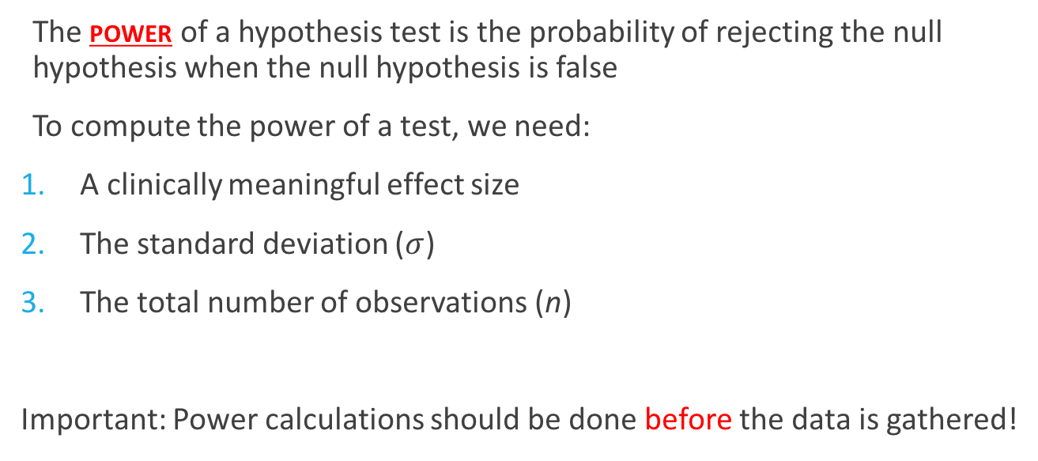
Power
The power of a hypothesis test is the probability of rejecting the null hypothesis when the null hypothesis is false
To compute the power of a test, we need:
A clinically meaningful effect size
The standard deviation ($σ$)
The total number of observations (n)
Important: Power calculations should be done before the data is gathered!

Slide 7
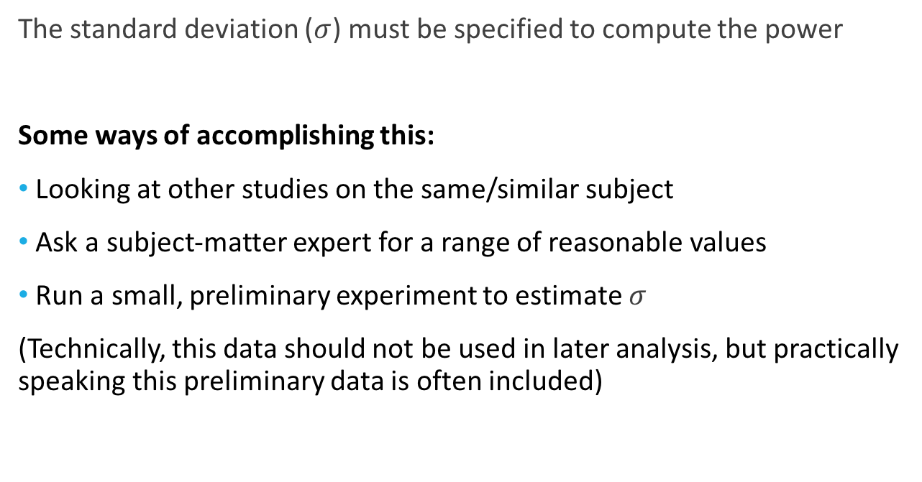
The Standard Deviation
The standard deviation ($σ$) must be specified to compute the power
Some ways of accomplishing this:
Looking at other studies on the same/similar subject
Ask a subject-matter expert for a range of reasonable values
Run a small, preliminary experiment to estimate $σ$
(Technically, this data should not be used in later analysis, but practically speaking this preliminary data is often included)

Slide 8
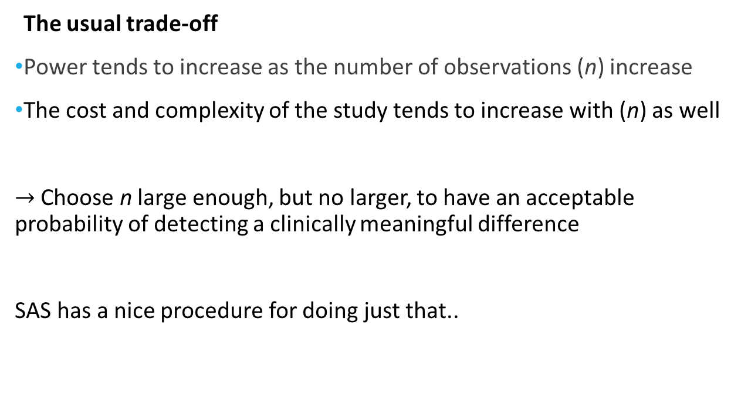
Total # of Observations
The usual trade-off
Power tends to increase as the number of observations (n) increase
The cost and complexity of the study tends to increase with (n) as well
$→$ Choose n large enough, but no larger, to have an acceptable probability of detecting a clinically meaningful difference
SAS has a nice procedure for doing just that..

Slide 9
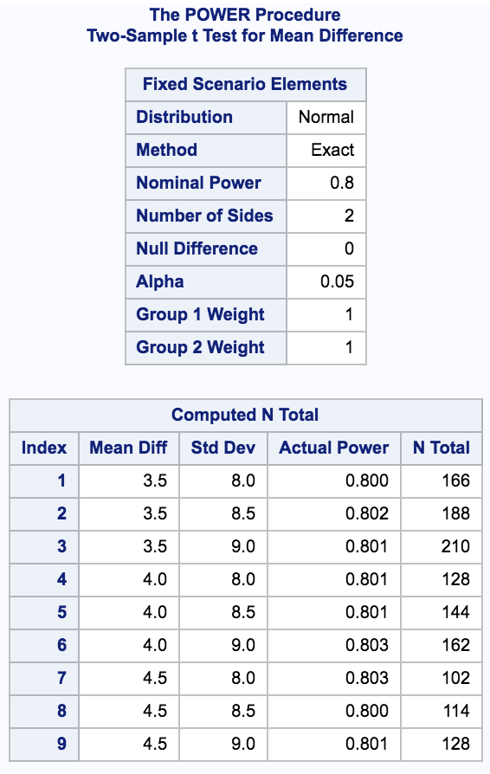
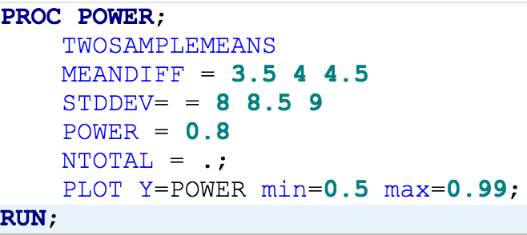
PROC POWER
Important: There is no data here!
Look at a range of n
Plot power from .5 to .99 over a range of n (next slide)

Slide 10
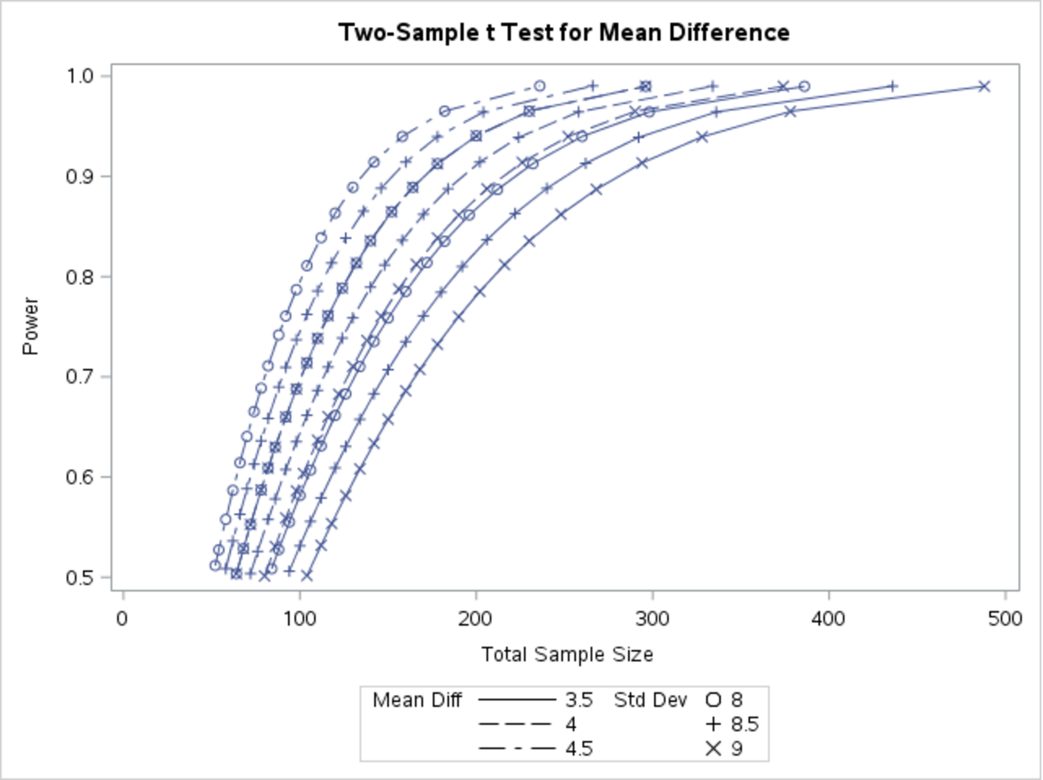
Power Plot

Slide 11
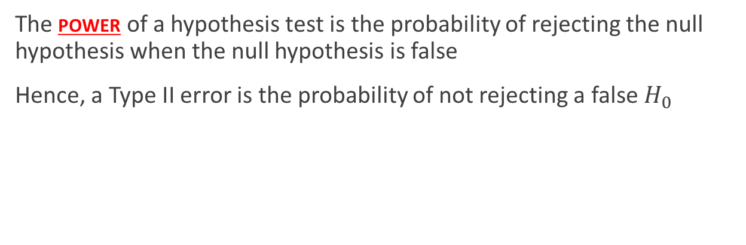
Complement of Power
The power of a hypothesis test is the probability of rejecting the null hypothesis when the null hypothesis is false
Hence, a Type II error is the probability of not rejecting a false $H_{0}$

Slide 12
PROC POWER
Important: There is no data here!
For these possible experiments, the
Prob(Type II error) = 0.2

Slide 13
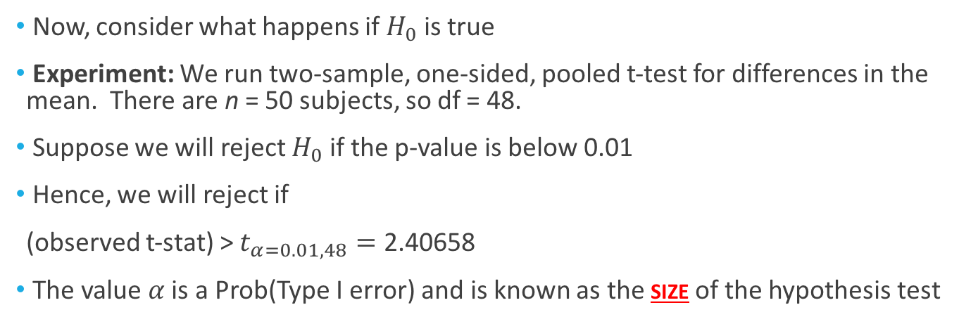
Type I Error
Now, consider what happens if $H_{0}$ is true
Experiment: We run two-sample, one-sided, pooled t-test for differences in the mean. There are n = 50 subjects, so df = 48.
Suppose we will reject $H_{0}$ if the p-value is below 0.01
Hence, we will reject if
(observed t-stat) > $t_{α=0.01, 48}=\text{2.40658}$
The value $α$ is a Prob(Type I error) and is known as the size of the hypothesis test
(critical value)

Slide 14

Putting it All Together
Fail to Reject Ho
Reject Ho

