Slide 1
Alternatives to t-Tools
Rank Sum Test
Welch’s Test

Slide 2

Epigenetics & Smoking

Slide 3
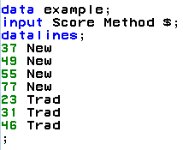
Let’s Start With an Example
IBM gives each employee in the marketing department technical training
Based on further testing, it appears the traditional training method isn’t effective
Hence, a new training method is developed
Below are the test scores of 4 individuals that just finished the “New Method” and the last 3 test scores from employees trained via the “Traditional Method” course
Is there evidence to suggest that the “New Method” increases test scores?
New Method | Traditional Method
37 | 23
49 | 31
55 | 46
77

Slide 4
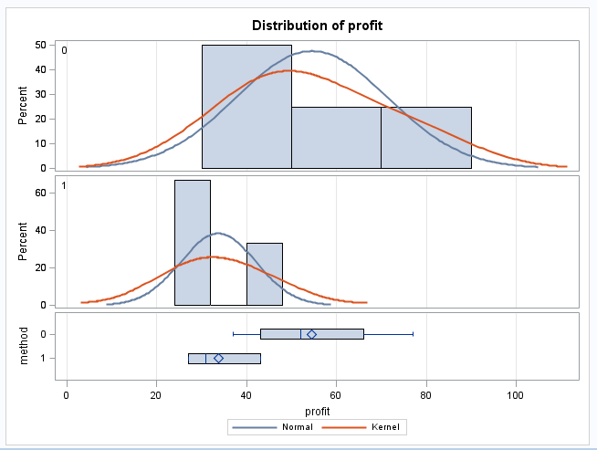
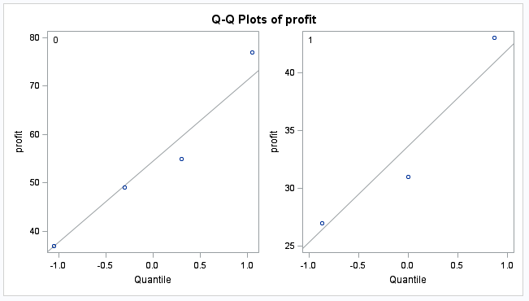
Examining the t-Tools Assumptions
Since the standard deviation appear to be different and the sample sizes are both different and exceptionally small, the pooled t-test was not deemed appropriate and the non parametric rank sum test was performed.

Slide 5
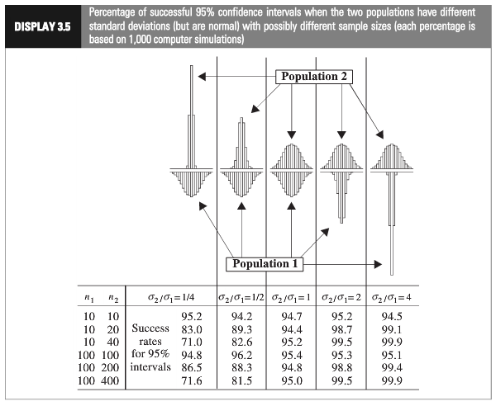
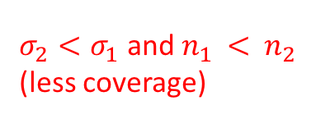
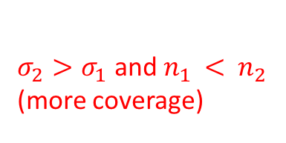
Which situation does it appear we are in?
$σ_{2}<σ_{1}$ and $n_{1 }<$ $n_{2 }$
(less coverage)
$σ_{2}>σ_{1}$ and $n_{1 }<$ ${ n}_{2 }$
(more coverage)
Using a t-test could have low power
Notes:
Worst case: the variance from the larger group is smaller than the variance from smaller group:

Slide 6
Rank-Sum Tests

Slide 7
Nonparametric Methods
A nonparametric or distribution-free test doesn’t depend on (as many) underlying assumptions
This makes them ideal for use when the assumptions of non-nonparametric (that is, parametric) tests aren’t met
The trade-off is that nonparametric methods perform somewhat worse than parametric methods if the assumptions are approximately correct
We already explored a nonparametric test: the randomization/permutation test from Chapter 1
Now we will consider the “rank-sum test”

Slide 8
Rank-Sum Test: Discussion and Assumptions
No distributional assumptions and resistant to outliers
When t-test assumptions are met, the rank-sum test performs about 95.49% as well
Performs arbitrarily better if the t-test assumptions are not (approximately) met
Works well with ordinal data
(Nominal: order is arbitrary. ordinal: order matters. Interval: subtraction is meaningful. Ratio: multiplication is meaningful)
Works with censored values
(Censored means that the actual value was too large/small to
be accurately recorded)
It still requires some assumptions:
All observations are independent
The Y values are ordinal
(Realistically required for t-tools)
59 patients with arthritis who participated in a clinical trial were assigned to two groups, active and placebo. The response status:
(excellent=5, good=4, moderate=3, fair=2, poor=1)
of each patient was recorded.

Slide 9
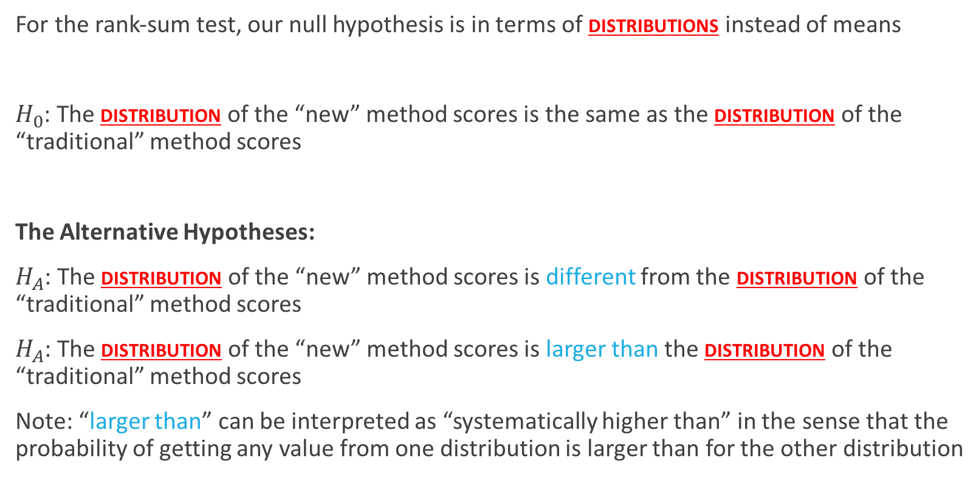
Rank-Sum Test: Hypotheses
For the rank-sum test, our null hypothesis is in terms of distributions instead of means
$H_{0}$: The distribution of the “new” method scores is the same as the distribution of the “traditional” method scores
The Alternative Hypotheses:
$H_{A}$: The distribution of the “new” method scores is different from the distribution of the “traditional” method scores
$H_{A}$: The distribution of the “new” method scores is larger than the distribution of the “traditional” method scores
Note: “larger than” can be interpreted as “systematically higher than” in the sense that the probability of getting any value from one distribution is larger than for the other distribution
(Two sided)
(one sided)

Slide 10
The Rank-Sum test
We can compute the rank-sum test using the following steps:
List all observations from both groups in increasing order
Assign each observation a rank, from 1 to n
If there are any ties, assign each such observation’s rank to be the average of their ranks.
Identify each observation with its group
The test statistic, T, is the sum of the ranks in one of the groups.
We can find a p-value in two ways:
Normal approximation (use this if the sample size is very large)
Exact
Note: n is the total # of observations

Slide 11
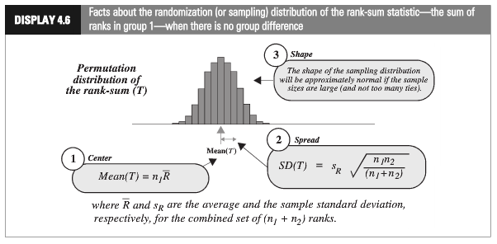
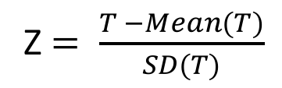
Rank-Sum Test: Normal Approximation
Z $= \frac{T −Mean(T)}{SD(T)}$

Slide 12
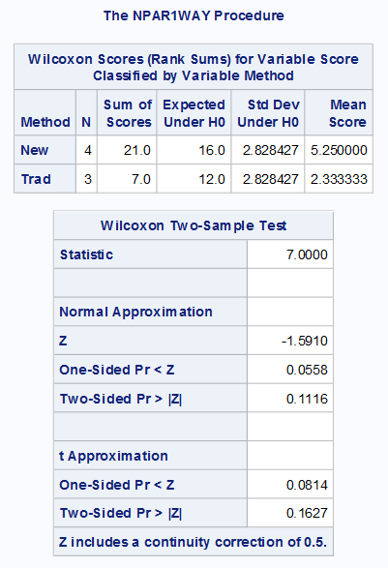

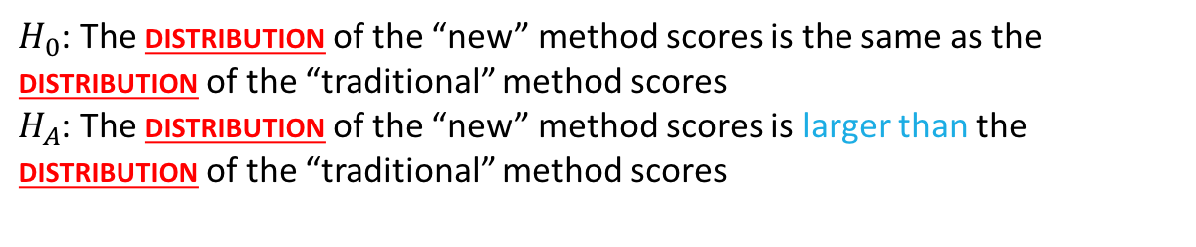
Rank-Sum Test: Normal Approximation
$H_{0}$: The distribution of the “new” method scores is the same as the distribution of the “traditional” method scores
$H_{A}$: The distribution of the “new” method scores is larger than the distribution of the “traditional” method scores
There is mild evidence to suggest that the distribution of scores from the “New” method is greater than the distribution of the “Traditional” method (normal approximation to rank-sum test with continuity correction p-value = 0.0558).

Slide 13
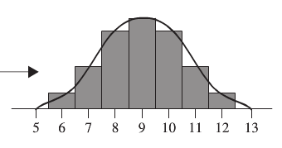
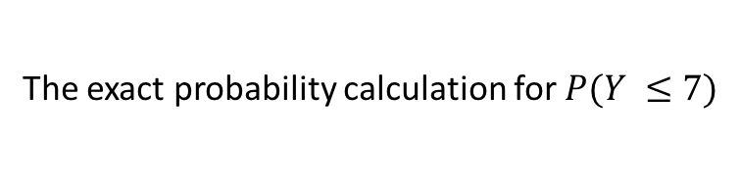
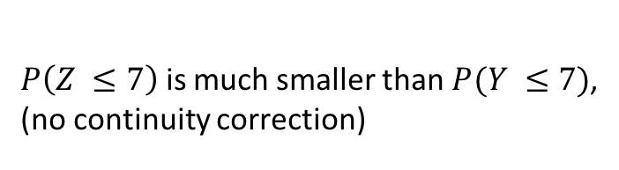
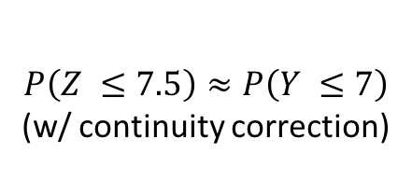
Continuity Correction: Main Idea
$P\left(Z ≤7\right)$ is much smaller than $P(Y ≤7)$,
(no continuity correction)
$$P\left(Z ≤7.5\right)≈P\left(Y ≤7\right)$$
(w/ continuity correction)
The exact probability calculation for $P(Y ≤7)$

Slide 14
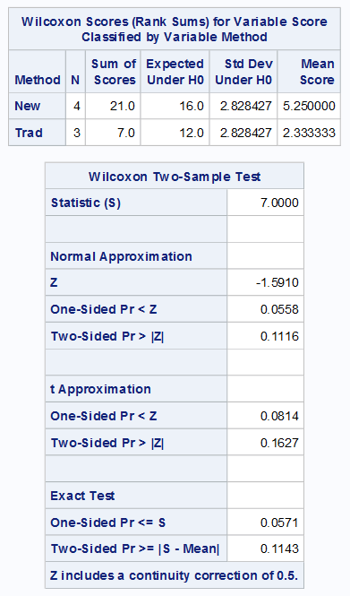

Rank-Sum Test: Exact
Normal approximation p-values
Exact p-values
Which p-value should we use in problem?

Slide 15
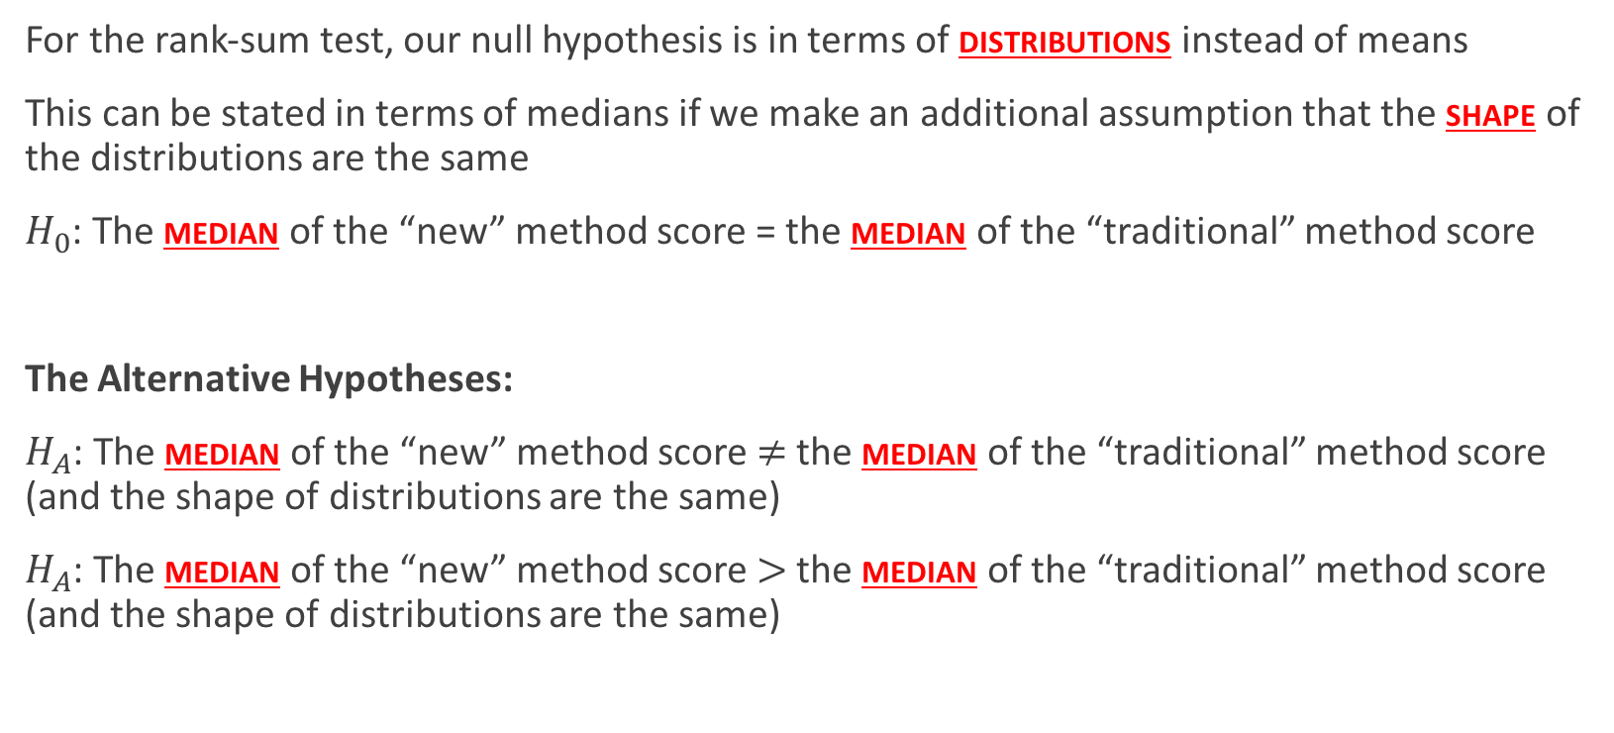
Rank-Sum Test: Hypotheses about medians
For the rank-sum test, our null hypothesis is in terms of distributions instead of means
This can be stated in terms of medians if we make an additional assumption that the shape of the distributions are the same
$H_{0}$: The median of the “new” method score = the median of the “traditional” method score
The Alternative Hypotheses:
$H_{A}$: The median of the “new” method score $≠$ the median of the “traditional” method score (and the shape of distributions are the same)
$H_{A}$: The median of the “new” method score $>$ the median of the “traditional” method score (and the shape of distributions are the same)
(Two sided)
(one sided)

Slide 16
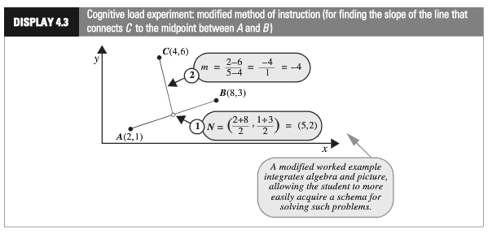
Cognitive Load Experiment
Researchers compared the effectiveness of conventional textbook examples to modified ones
They selected 28 ninth-year students, who had no previous exposure to coordinate geometry
The students were randomly assigned to one of two self study instructional groups, using conventional and modified instructional materials.
After instruction they were given a test and the time to complete one of the problems was recorded.
Is there sufficient evidence to suggest that the cognitive load theory (modified instruction) shortened response times?

Slide 17
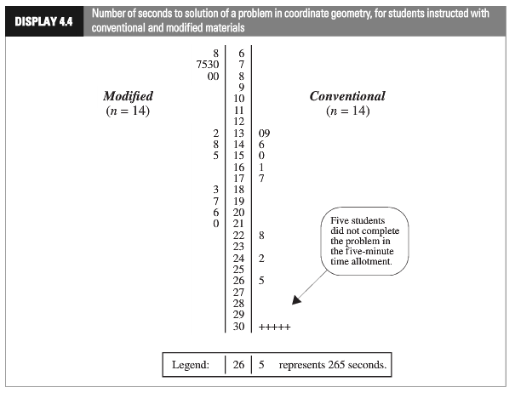
Cognitive Load Experiment
(censored data)

Slide 18
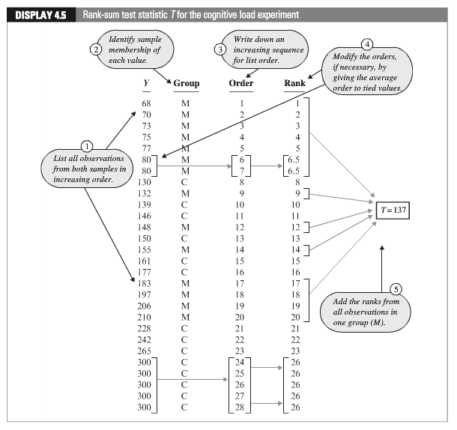
Cognitive Load Experiment

Slide 19
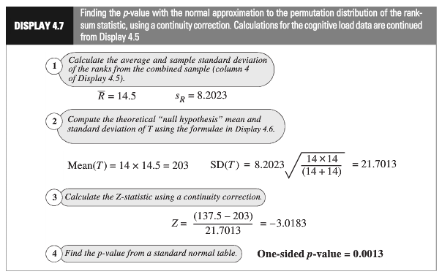
Cognitive Load Experiment: Normal Approximation
(continuity correction)
Statistical Conclusion: The data provide convincing evidence that the distribution of times to solve the problem for students in “modiﬁed” group is larger for the “conventional” group (one-sided rank-sum test, normal approximation w/ C.C. p-value = 0.0013).

Slide 20
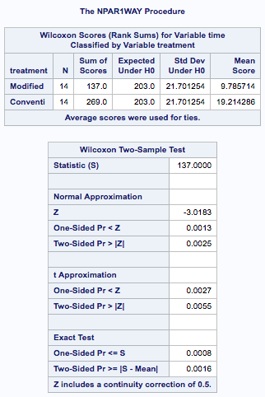
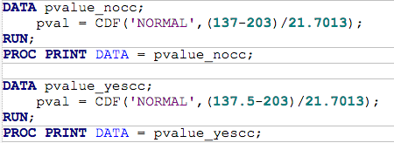



Cognitive Load Experiment: Using SAS

Slide 21


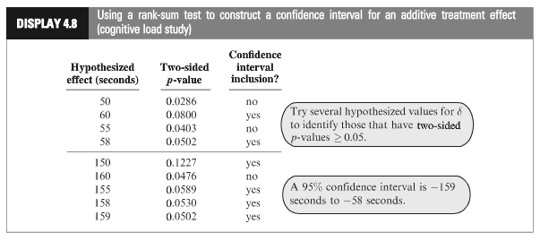
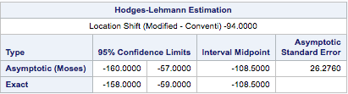
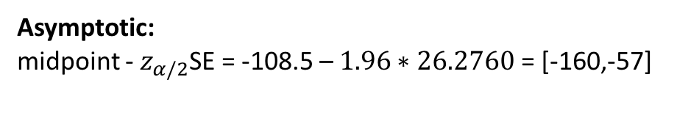
Cognitive Load Experiment: Confidence Interval (Chap. 4.2.4)
(Adding here produces the exact statistics and confidence intervals)
Looks at the median value of all pairwise differences between the two groups in the data
Asymptotic:
midpoint - $z_{α/2}$SE = -108.5 – $1.96∗26.2760$ = [-160,-57]
Statistical Conclusion (continued): A range of plausible values the difference in median for the “modified” distribution vs. the “traditional” is [-158, -59] s. (95% conﬁdence interval based on a rank-sum test) with a point-estimate of 108.5 s.
Notes:
Interesting Quiz: how do I make a one-sided confidence interval out of this output?

Slide 22
Welch’s T-Tools

Slide 23
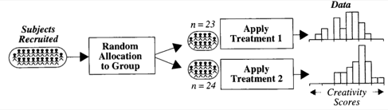


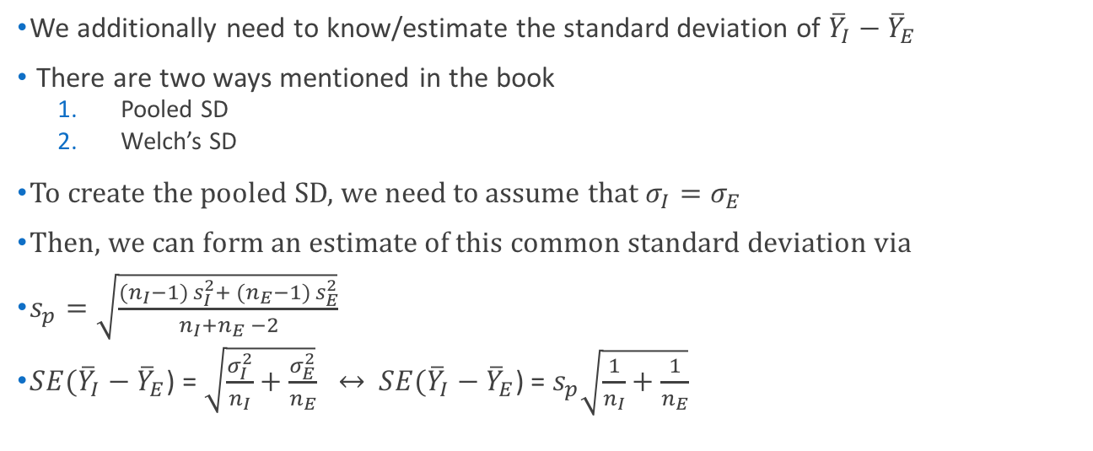
Creativity Study: Reminder
$→$ Population mean: $μ_{I}$
I
$→$ Population sd: $σ_{I}$
$→$ Population mean: $μ_{E}$
E
$→$ Population sd: $σ_{E}$
We additionally need to know/estimate the standard deviation of ${\overline{Y}}_{I}−{\overline{Y}}_{E}$
There are two ways mentioned in the book
Pooled SD
Welch’s SD
To create the pooled SD, we need to assume that $σ_{I}=σ_{E}$
Then, we can form an estimate of this common standard deviation via
$s_{p}=\sqrt{\frac{({n_{I}−1) s}_{I}^{2}+ ({n_{E}−1) s}_{E}^{2}}{n_{I}+n_{E} −2}}$
$SE({\overline{Y}}_{I}−{\overline{Y}}_{E}$) = $\sqrt{\frac{σ_{I}^{2}}{n_{I}}+\frac{σ_{E}^{2}}{n_{E}}} ↔$ $SE({\overline{Y}}_{I}−{\overline{Y}}_{E}$) = $s_{p}\sqrt{\frac{1}{n_{I}}+\frac{1}{n_{E}}}$
What if this assumption isn’t true?

Slide 24
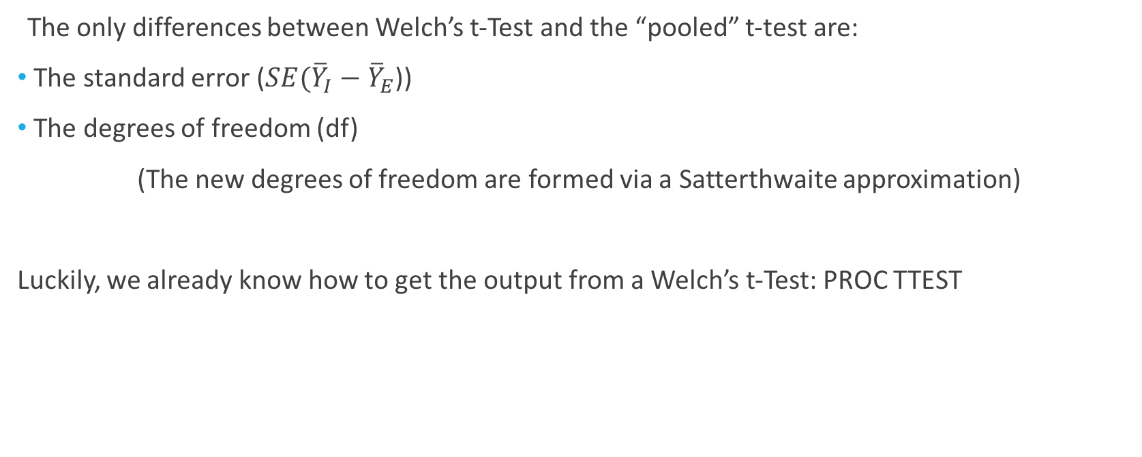
Welch’s t-Test
The only differences between Welch’s t-Test and the “pooled” t-test are:
The standard error ($SE({\overline{Y}}_{I}−{\overline{Y}}_{E}$))
The degrees of freedom (df)
(The new degrees of freedom are formed via a Satterthwaite approximation)
Luckily, we already know how to get the output from a Welch’s t-Test: PROC TTEST

Slide 25
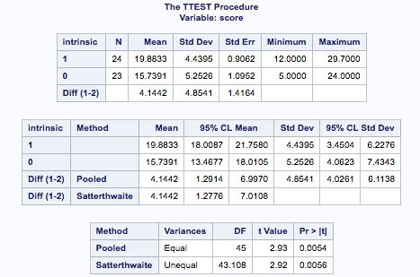

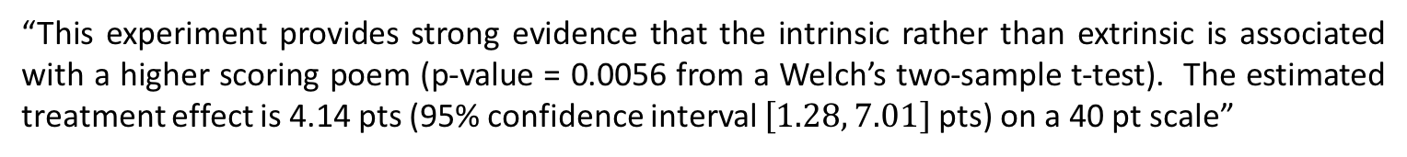
Testing Hypothesis: Welch’s t-Tools
“This experiment provides strong evidence that the intrinsic rather than extrinsic is associated with a higher scoring poem (p-value = 0.0056 from a Welch’s two-sample t-test). The estimated treatment effect is 4.14 pts (95% confidence interval $\left[1.28, 7.01\right]$ pts) on a 40 pt scale”

Slide 26
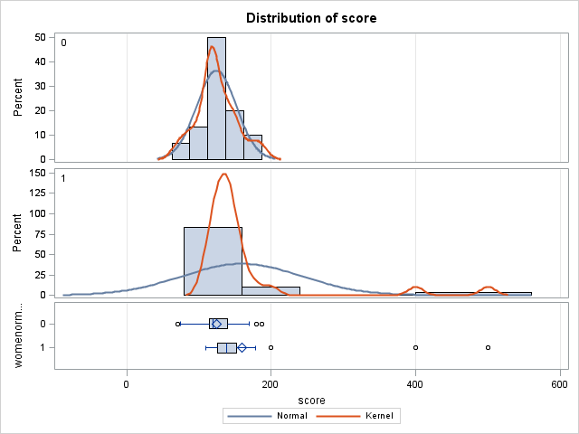
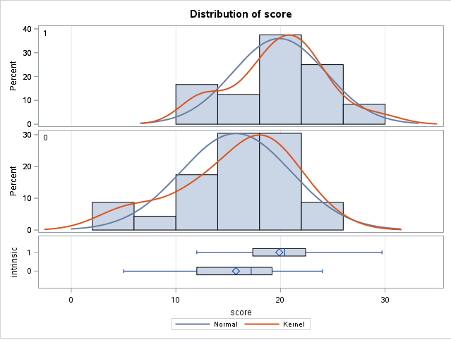
How to Decide?
Use Welch’s if the standard deviations are different but all other assumptions of t-Tools are met
If the t-Tool assumptions are at all questionable, use a nonparametric test

Slide 27
Example: Forest Fires
When wildfires ravage forests, the timber industry argues that logging the burned trees enhances forest recovery; the EPA argues the opposite. The 2002 Biscuit Fire in southwest Oregon provided a test case. Researchers selected 16 fire-affected plots in 2004-before any logging was done-and counted tree seedlings along a randomly located transect pattern in each plot. They returned in 2005, after nine of the plots had been logged, and counted the tree seedlings along the same transects. The percent of seedlings lost from 2004 to 2005 is recorded in the table below for logged (L) and unlogged (U) plots:
Test the EPA’s assertion that logging decreased the percentage of seedlings from 2004 to 2005.

