Slide 1
Alternatives to t-Tools
Paired t-test
Nonparametric paired tests

Slide 2
Paired or Matched t-Tools

Slide 3
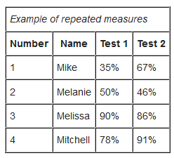
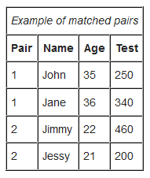
Paired t-Test
Known alternatively as Matched Pairs or Dependent t-Test
Assumptions
Data are either:
From one sample that has been test twice (example pre and post test / repeated measures)
Or from a group of subjects that are thought to be similar and can thus be matched or paired (example from same family, or twins)
Data are Normally distributed, independent between observations, and have identical variances.

Slide 4
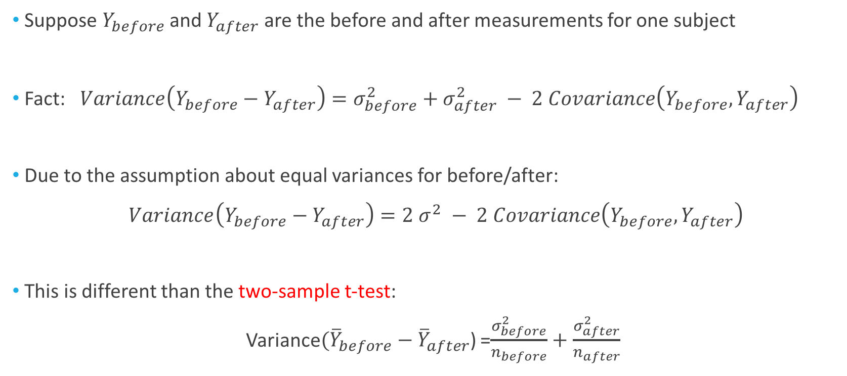
A Look at the Variance
Suppose $Y_{before}$ and $Y_{after}$ are the before and after measurements for one subject
Fact: $Variance\left(Y_{before}−Y_{after}\right)=σ_{before}^{2}+σ_{after}^{2} − 2 Covariance\left(Y_{before},Y_{after}\right)$
Due to the assumption about equal variances for before/after:
$Variance\left(Y_{before}−Y_{after}\right)=2$ $σ^{2} −$ $2 Covariance\left(Y_{before},Y_{after}\right)$
This is different than the two-sample t-test:
Variance$({\overline{Y}}_{before}−{\overline{Y}}_{after}$) =$\frac{σ_{before}^{2}}{n_{before}}+\frac{σ_{after}^{2}}{n_{after}}$

Slide 5
Example: Medical Reasoning Test
The AMA has a diagnostic test for medical reasoning
On average, people score about 500 points on this test
We have data from 10 subjects who took the medical reasoning test. These subjects were randomly selected from St. Paul Hospital in Dallas
Not fatigued: is the baseline, taking the test before a shift
Fatigued: is after the treatment; working for 12 operational hours prior to re-taking the test
Subject # | Not Fatigued | Fatigued
1 | 567 | 530
2 | 512 | 492
3 | 509 | 510
4 | 593 | 580
5 | 588 | 600
6 | 491 | 483
7 | 520 | 512
8 | 588 | 575
9 | 529 | 530
10 | 508 | 490
(Lower numbers = worse score)

Slide 6

Example: Medical Reasoning Test
A scientific question would be if there is a decrease in medical reasoning after a long shift
To convert this to a statistical question, we can try to test whether the difference of the means between the fatigued scores and the non fatigued scores is less than zero
Since this is a medical application, let’s use a 0.01 decision rule for the p-value
$$H_{0}:μ_{fatigued}{−μ}_{not fatigued}=0$$
$$H_{A}:μ_{fatigued}{−μ}_{not fatigued} <0$$

Slide 7

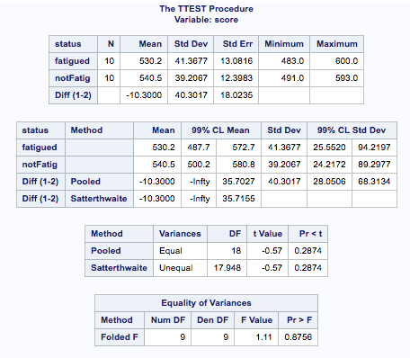
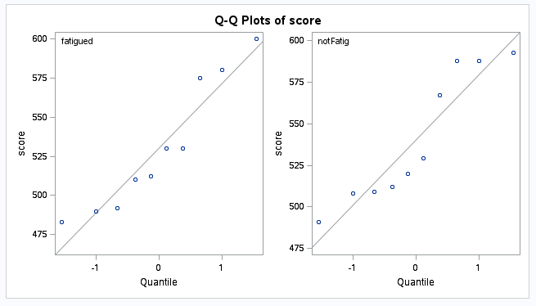
Example: Medical Reasoning Test
If we did this, we would be wrong! Why?
A fundamental assumption is violated: independence

Slide 8


Assumption Check Failure
We need to account for the dependence between the two groups

Slide 9
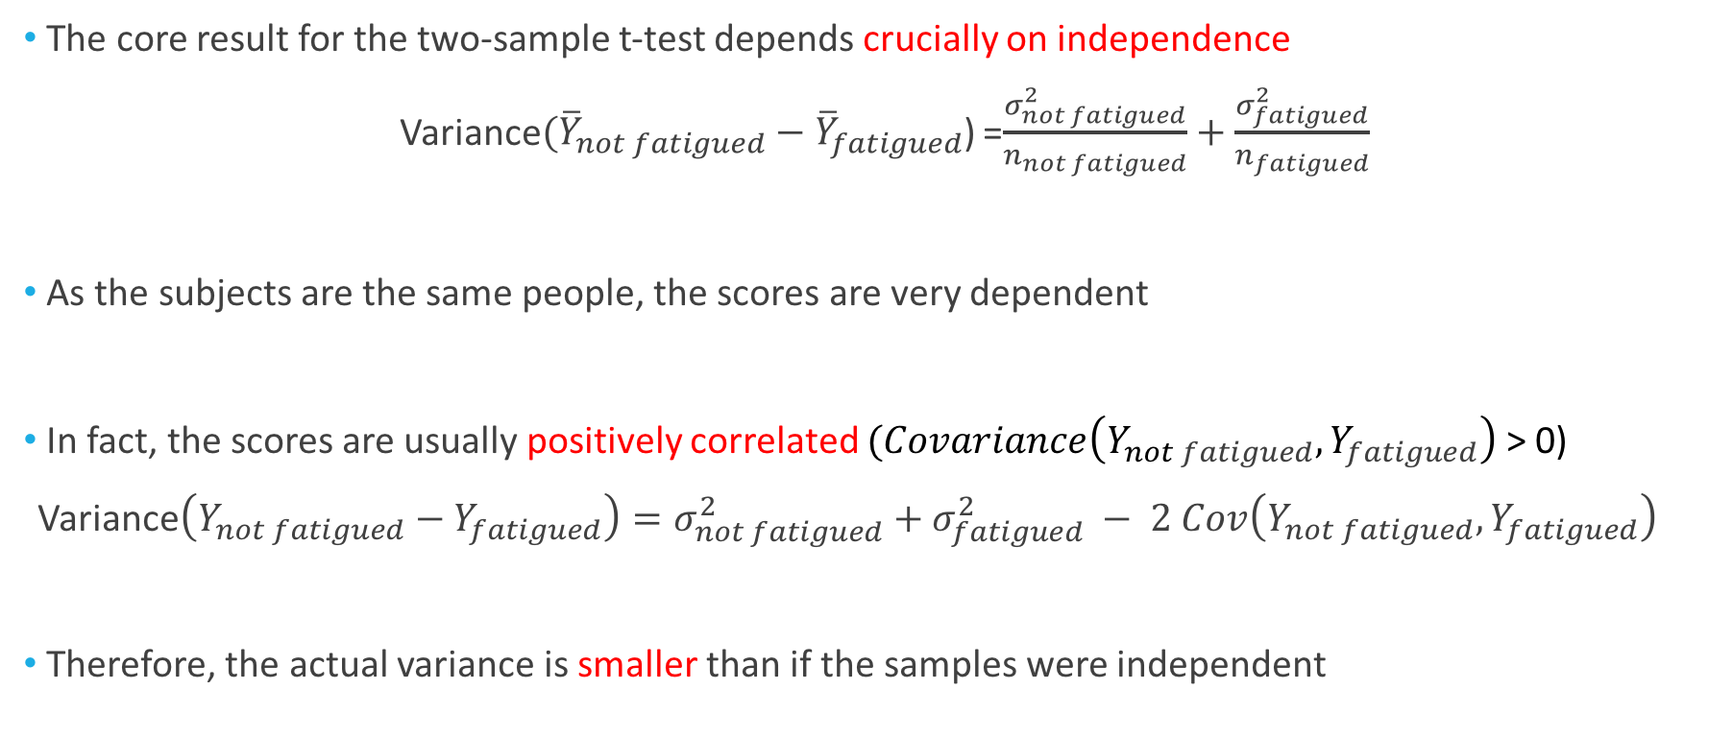
A Look (back) at the Variance
The core result for the two-sample t-test depends crucially on independence
Variance$({\overline{Y}}_{not fatigued}−{\overline{Y}}_{fatigued}$) =$\frac{σ_{not fatigued}^{2}}{n_{not fatigued}}+\frac{σ_{fatigued}^{2}}{n_{fatigued}}$
As the subjects are the same people, the scores are very dependent
In fact, the scores are usually positively correlated $(Covariance\left(Y_{not fatigued},Y_{fatigued}\right)$ > 0)
Variance$\left(Y_{not fatigued}−Y_{fatigued}\right)=σ_{not fatigued}^{2}+σ_{fatigued}^{2} − 2 Cov\left(Y_{not fatigued},Y_{fatigued}\right)$
Therefore, the actual variance is smaller than if the samples were independent

Slide 10
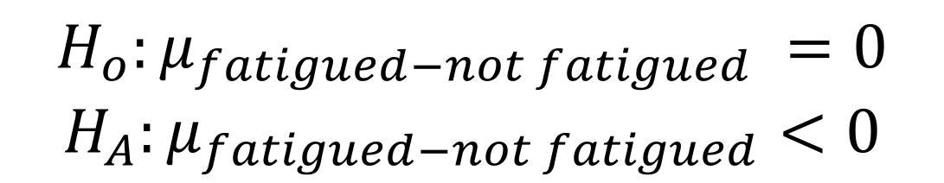

Example: Medical Reasoning Test
Instead of testing the difference of the means:
$$H_{A}:μ_{fatigued}{−μ}_{not fatigued} <0$$
Subject | Not Fatigued | Fatigued | Difference
1 | 567 | 530 | -37
2 | 512 | 492 | -20
3 | 509 | 510 | 1
4 | 593 | 580 | -13
5 | 588 | 600 | 12
6 | 491 | 483 | -8
7 | 520 | 512 | -8
8 | 588 | 575 | -13
9 | 529 | 530 | 1
10 | 508 | 490 | -18
We should test the mean of the differences:
$$H_{o}:μ_{fatigued−not fatigued} =0$$
$$H_{A}:μ_{fatigued−not fatigued}<0$$

Slide 11

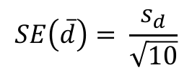
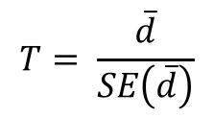
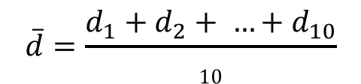
Paired T-test
(d_{i})
Subject | Not Fatigued | Fatigued | Difference
1 | 567 | 530 | -37
2 | 512 | 492 | -20
3 | 509 | 510 | 1
4 | 593 | 580 | -13
5 | 588 | 600 | 12
6 | 491 | 483 | -8
7 | 520 | 512 | -8
8 | 588 | 575 | -13
9 | 529 | 530 | 1
10 | 508 | 490 | -18
$$\overline{d}=\frac{d_{1}+d_{2}+ …+d_{10}}{10}$$
$sd$ is the sample std. dev.
$$SE\left(\overline{d}\right)= \frac{s_{d}}{\sqrt{10}}$$
$$T= \frac{\overline{d}}{SE\left(\overline{d}\right)}$$

Slide 12
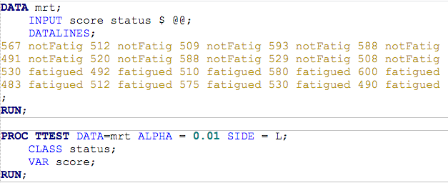
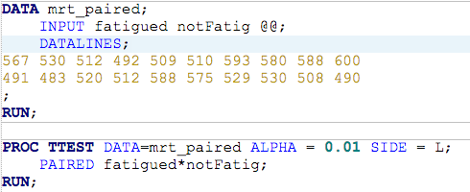
A SAS Code Comparison
(Two sample T-Test)
(Paired T-test)

Slide 13
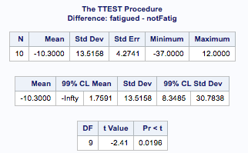
A SAS Code Comparison
(Paired T-test)
(Two sample T-Test)

Slide 14
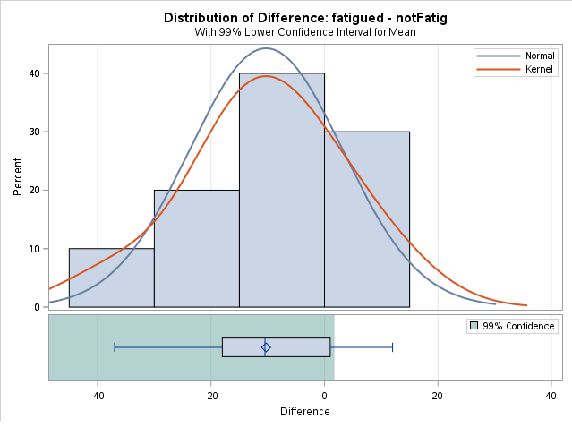
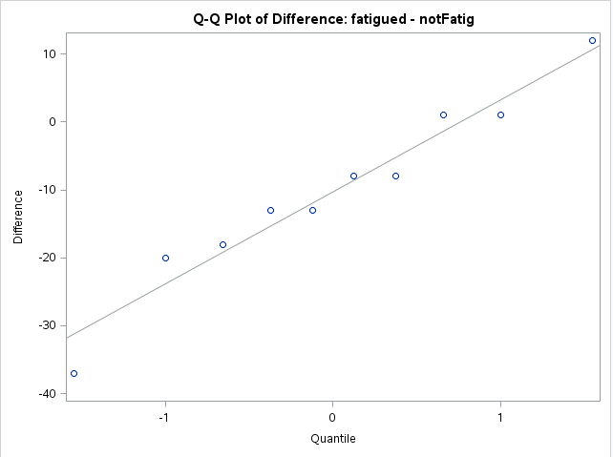
Checking the Assumptions
Also: is it reasonable for all the differences to be independent with the same variance?

Slide 15
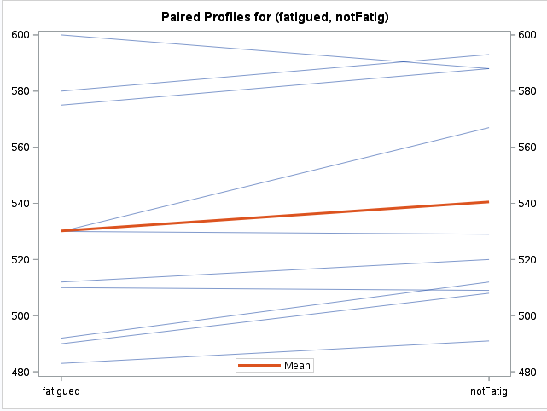
Additional Information
We can look at a profile plot
The lines connect the scores on the MRT in the “fatigued” versus “not fatigued” states for each subject

Slide 16
Conclusion
Statistical Conclusion: While there is some evidence that, on average, the fatigued subjects score lower than the non-fatigued subjects, we find the evidence not compelling enough for this application (paired one-sided t-test p-value = .0196) and hence conclude that there is no mean difference in MRT results. A 99% one tailed confidence interval for the mean difference in scores finds that a maximum plausible value for the mean difference is 1.76 points.
Scope of Inference: Since this was a random sample from St. Paul Hospital in Dallas, we can extend this result to the entire hospital.
Question: Would this maximum plausible value be positive or negative for a 95% one-tailed confidence interval?
Answer: Negative

Slide 17
Alternatives to the t-Test for Paired Data

Slide 18
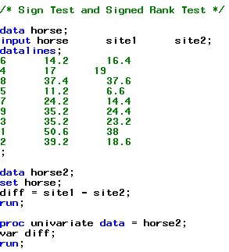
For each of the 9 horses, a veterinary anatomist measured the density of nerve cells at specified sites in the intestine.
Example: Nerve Site Data
horse | site1 | site2
6 | 14.2 | 16.4
4 | 17 | 19
8 | 37.4 | 37.6
5 | 11.2 | 6.6
7 | 24.2 | 14.4
9 | 35.2 | 24.4
3 | 35.2 | 23.2
1 | 50.6 | 38
2 | 39.2 | 18.6

Slide 19
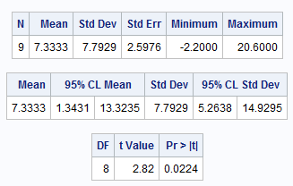
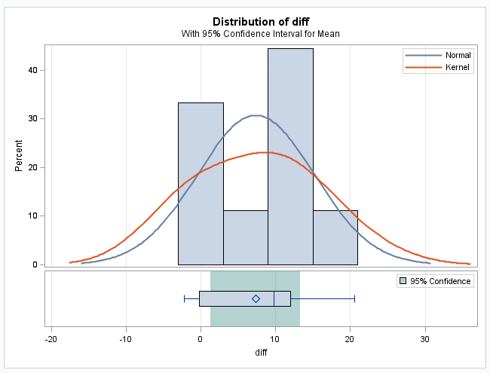
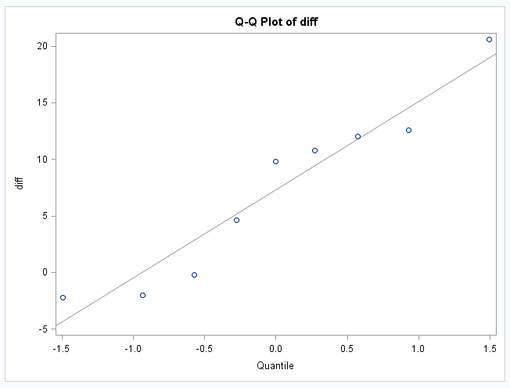
Using the paired t-Test
The sample size is rather small, hence the normality assumption is suspect

Slide 20
The Sign Test: Discussion and Assumptions
No distributional assumptions and resistant to outliers
It still requires some assumptions:
Differences between paired observations are independent of other differences and come from the same distribution
The Y values should be interval (though sometimes it is used with ordinal data as well)
Can also be used as a 1-sample test for medians (instead of means)

Slide 21
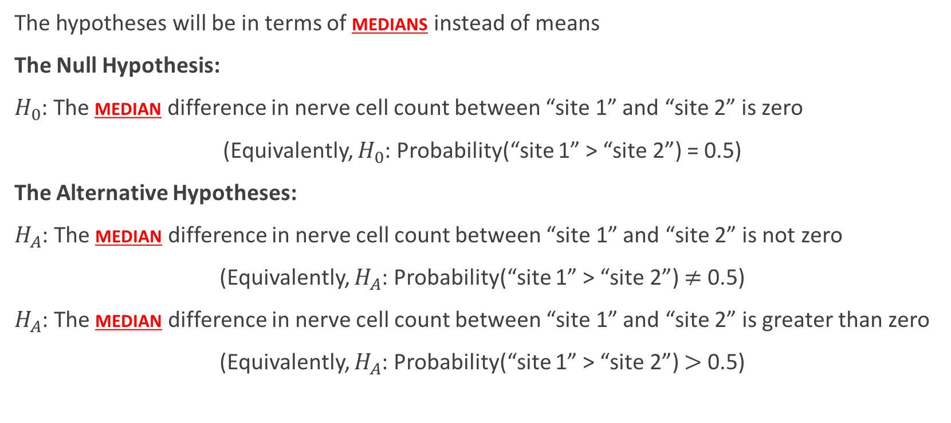
The Sign Test: Hypotheses
The hypotheses will be in terms of medians instead of means
The Null Hypothesis:
$H_{0}$: The median difference in nerve cell count between “site 1” and “site 2” is zero
(Equivalently, $H_{0}$: Probability(“site 1” > “site 2”) = 0.5)
The Alternative Hypotheses:
$H_{A}$: The median difference in nerve cell count between “site 1” and “site 2” is not zero
(Equivalently, $H_{A}$: Probability(“site 1” > “site 2”) $≠$ 0.5)
$H_{A}$: The median difference in nerve cell count between “site 1” and “site 2” is greater than zero
(Equivalently, $H_{A}$: Probability(“site 1” > “site 2”) $>$ 0.5)
(Two sided)
(one sided)

Slide 22

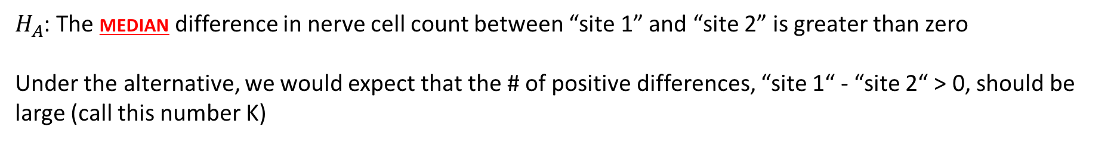
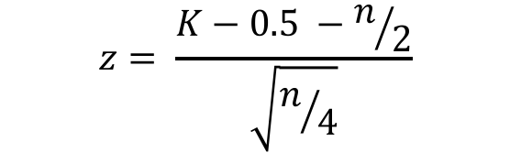
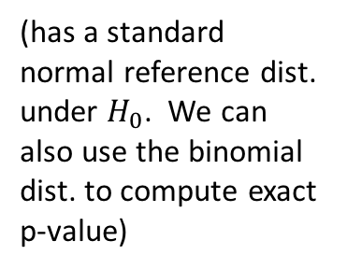
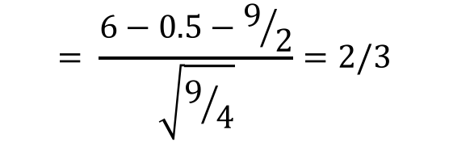
The Sign Test: Nerve Site Data
$H_{A}$: The median difference in nerve cell count between “site 1” and “site 2” is greater than zero
Under the alternative, we would expect that the # of positive differences, “site 1“ - “site 2“ > 0, should be large (call this number K)
horse | site1 | site2 | diff | Sign
8 | 37.4 | 37.6 | -0.2 | -
4 | 17 | 19 | -2 | -
6 | 14.2 | 16.4 | -2.2 | -
5 | 11.2 | 6.6 | 4.6 | +
7 | 24.2 | 14.4 | 9.8 | +
9 | 35.2 | 24.4 | 10.8 | +
3 | 35.2 | 23.2 | 12 | +
1 | 50.6 | 38 | 12.6 | +
2 | 39.2 | 18.6 | 20.6 | +
$$z= \frac{K−0.5 −n/2}{\sqrt{n/4}}$$
(has a standard normal reference dist. under $H_{0}$. We can also use the binomial dist. to compute exact p-value)
$$= \frac{6−0.5−9/2}{\sqrt{9/4}}=2/3$$
K = 6
$$P\left(Z>2/3\right)=0.2527$$
(one sided, CC p-value)

Slide 23
The Signed-Rank Test: Discussion and Assumptions
Nearly the same as for the sign test, save for the bolded comments below:
Almost no distributional assumptions and resistant to outliers
It still requires some assumptions:
Differences between paired observations are independent of other differences and come from the same distribution
The Y values should be interval (though sometimes it is used with ordinal data as well)
The distribution of the differences is symmetric (see next slide for details)
Can also be used as a 1-sample test for medians (instead of means)

Slide 24
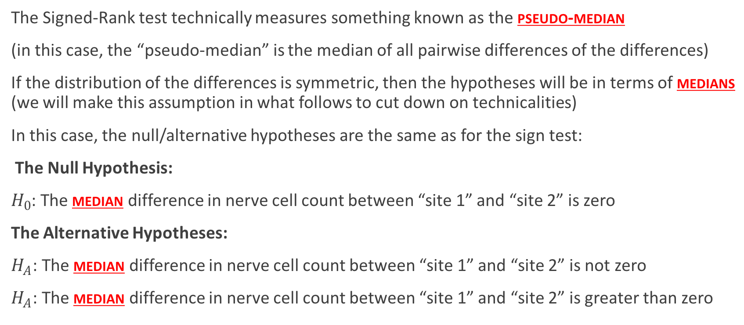
The Signed-Rank Test: Hypotheses
The Signed-Rank test technically measures something known as the pseudo-median
(in this case, the “pseudo-median” is the median of all pairwise differences of the differences)
If the distribution of the differences is symmetric, then the hypotheses will be in terms of medians (we will make this assumption in what follows to cut down on technicalities)
In this case, the null/alternative hypotheses are the same as for the sign test:
The Null Hypothesis:
$H_{0}$: The median difference in nerve cell count between “site 1” and “site 2” is zero
The Alternative Hypotheses:
$H_{A}$: The median difference in nerve cell count between “site 1” and “site 2” is not zero
$H_{A}$: The median difference in nerve cell count between “site 1” and “site 2” is greater than zero
(Two sided)
(one sided)

Slide 25
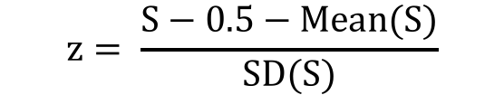
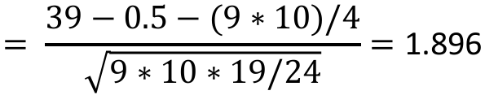
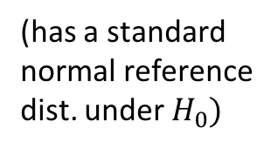
The Signed-Rank Test
Under the alternative, we would expect that the # of positive differences, K, should be large AND the sum of the ranks of the magnitudes for those K differences, |“site 1“ - “site 2“|, should large as well (call this number S)
$$z= \frac{S−0.5−Mean(S)}{SD(S)}$$
horse | site1 | site2 | abs(diff) | Sign | rank
8 | 37.4 | 37.6 | 0.2 | - | 1
4 | 17 | 19 | 2 | - | 2
6 | 14.2 | 16.4 | 2.2 | - | 3
5 | 11.2 | 6.6 | 4.6 | + | 4
7 | 24.2 | 14.4 | 9.8 | + | 5
9 | 35.2 | 24.4 | 10.8 | + | 6
3 | 35.2 | 23.2 | 12 | + | 7
1 | 50.6 | 38 | 12.6 | + | 8
2 | 39.2 | 18.6 | 20.6 | + | 9
$$= \frac{39−0.5−(9∗10)/4}{\sqrt{9∗10∗19/24}}=\text{1.8}\text{96}$$
(has a standard normal reference dist. under $H_{0})$
S = 39
$$P\left(Z>1.896\right)=\text{0.029}$$
(one sided, CC p-value)

Slide 26
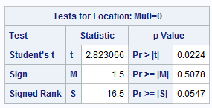
Signed and Signed-Rank tests: Horse Data
These are two sided p-values, so the one-sided p-values are half as large

Slide 27
Conclusion and Some Notes
Statistical Conclusion: There is strong evidence that the distribution of nerve density at site 1 is larger than the distribution of nerve density at site 2 (Wilcoxon signed-rank test one-sided p-value of 0.0274). This means that for any value for nerve density, the probability of getting that value at site 1 is larger than the probability of getting that value at site 2.
Note:
The signed-rank test has more power than the sign test
(Compare the p-values 0.254 vs. 0.0274)
Both tests make very few assumptions about the distributions

