Slide 1
Comparisons Among Several Samples
Several-groups problem
ANOVA

Slide 2
From Two-Groups to Many-Groups
Subjects in a study can be in many different groups. This is known by two, equivalent terms:
several-group problem (the two-sample tools from Chapters 2-4 are examples where there are two groups)
one-way classification problem (This naming convention extends to two-way classification, where there are two different grouping variables)
When there are many different groups, there are many possible comparisons that can be made

Slide 3
Assumptions for the Several-Groups Problem
Normality: Each group are drawn from a normal distribution
Equal population variances: All the groups have the same standard deviation
Independence: The observations within and between each group are independent

Slide 4
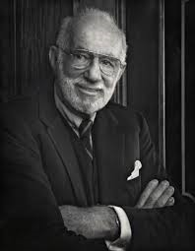
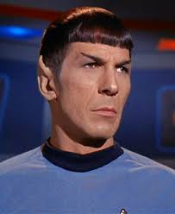
Spock Trial
1968: Dr. Ben Spock was accused of conspiracy to violate the Selective Service Act by encouraging young men to resist being drafted into military service
Jury Selection: A “venire” of 30 potential jurors are selected at random from a list of 300 names that were previously selected at random
A jury is then selected not at random by the attorneys trying the case
For this case, the venire consisted of only one woman, who was let go by the prosecution thus resulting in an all male jury.
There was reason to believe that women were more sympathetic to Dr. Spock
The defense argued that the judge in this case had a history of venires that underrepresented women, which is contrary to the law
Let’s see if there is any evidence for this claim

Slide 5
Spock Trial
To test the claim, the Spock Judge’s (which we will call S) recent venires are compared with 6 other Judge’s recent venires (which we notate A to F)
There are two key questions
Is there evidence that women are unrepresented on S’s venire relative to A through F’s?
Is there evidence of a difference in women’s representation on A to F’s venires?
(Worth considering: How were these judges chosen?)
The question of interest is addressed by 1
The strength of the result in 1. would be diminished if 2 is true

Slide 6
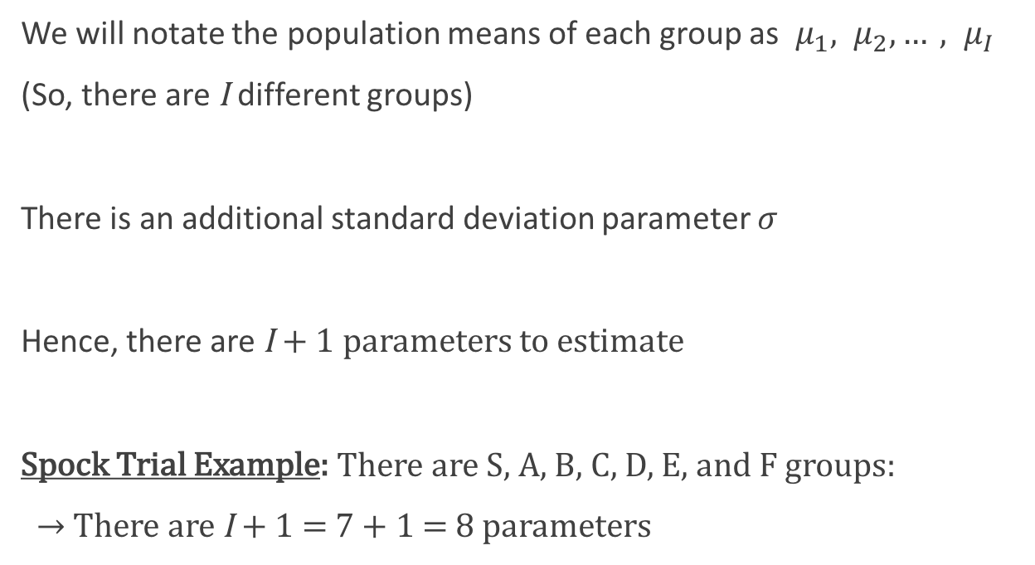
Several-Groups Parameters
We will notate the population means of each group as $μ_{1}, μ_{2}, …, μ_{I}$
(So, there are I different groups)
There is an additional standard deviation parameter $σ$
Hence, there are I + 1 parameters to estimate
Spock Trial Example: There are S, A, B, C, D, E, and F groups:
$→$ There are I + 1 = 7 + 1 = 8 parameters
(7-Groups)

Slide 7

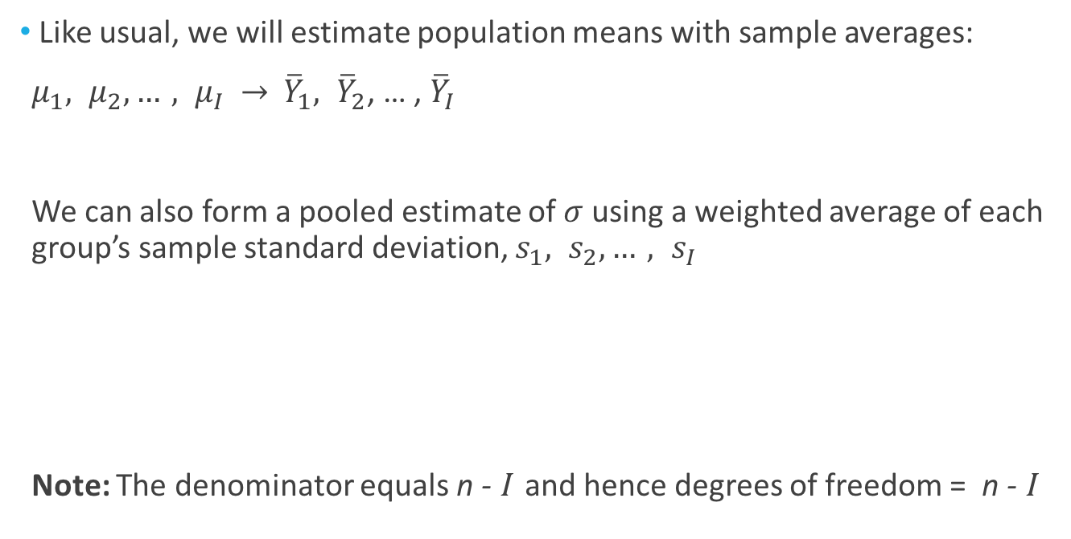
Estimation in Several-Groups Model
Like usual, we will estimate population means with sample averages:
$μ_{1}, μ_{2}, …, μ_{I}$ $→$ ${\overline{Y}}_{1}, {\overline{Y}}_{2}$, … , ${\overline{Y}}_{I}$
We can also form a pooled estimate of $σ$ using a weighted average of each group’s sample standard deviation, $s_{1}, s_{2}, …, s_{I}$
Note: The denominator equals n - I and hence degrees of freedom = n - I

Slide 8
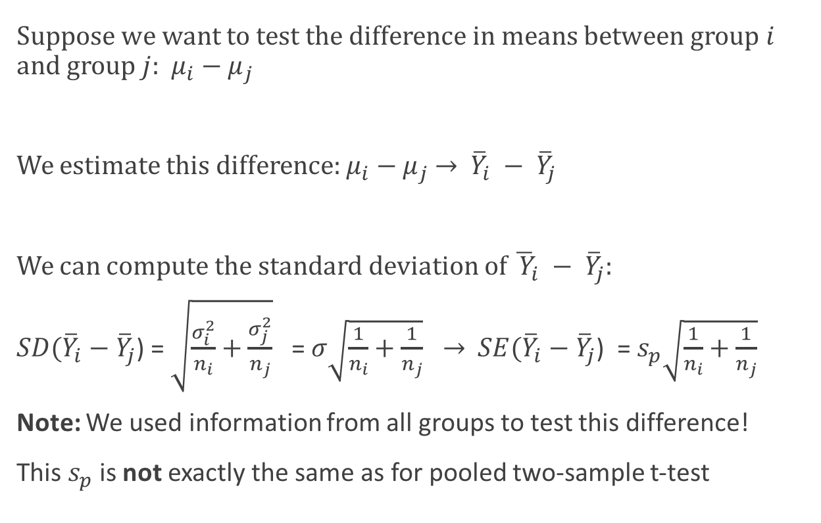
Reminder: Std. Dev. of the Difference
Suppose we want to test the difference in means between group $i$ and group $j$: $μ_{i}−μ_{j}$
We estimate this difference: $μ_{i}−μ_{j}$ $→$ ${\overline{Y}}_{i} − {\overline{Y}}_{j}$
We can compute the standard deviation of ${\overline{ Y}}_{i} − {\overline{Y}}_{j}$:
$SD({\overline{Y}}_{i}−{\overline{Y}}_{j}$) = $\sqrt{\frac{σ_{i}^{2}}{n_{i}}+\frac{σ_{j}^{2}}{n_{j}}}$ =$σ\sqrt{\frac{1}{n_{i}}+\frac{1}{n_{j}}} →$ $SE({\overline{Y}}_{i}−{\overline{Y}}_{j}$) = $s_{p}\sqrt{\frac{1}{n_{i}}+\frac{1}{n_{j}}}$
Note: We used information from all groups to test this difference!
This $s_{p}$ is not exactly the same as for pooled two-sample t-test
(equal variances)

Slide 9
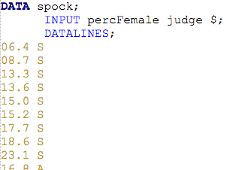

Spock Data Steps
Question: Suppose we wish to test if the “S” judge’s venires are different from the “F” judge’s.

Slide 10

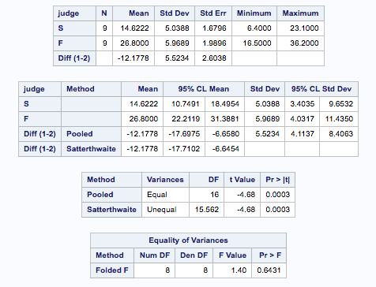
Two Judge Analysis w/ t-Tools
Statistical Conclusion: We find that there is substantial evidence that the difference in the mean percentage of females on judge S and judge F venires is not equal to zero.
Estimated Diff = -12.1778
Pooled Std. Error = 2.6038
t-Statistic = -4.68
Deg. of freedom = 16

Slide 11
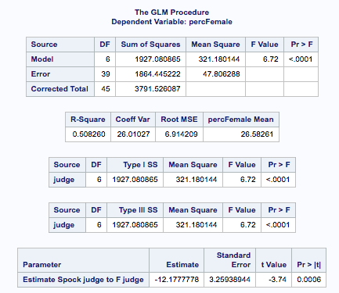

Two Judge Analysis w/ Several-Groups
From PROC TTEST:
Estimated Diff = -12.1778
Pooled Std. Error = 2.6038
t-Statistic = -4.68
Deg. of freedom = 16
Deg. of freedom = 46 – 7 = 39

Slide 12
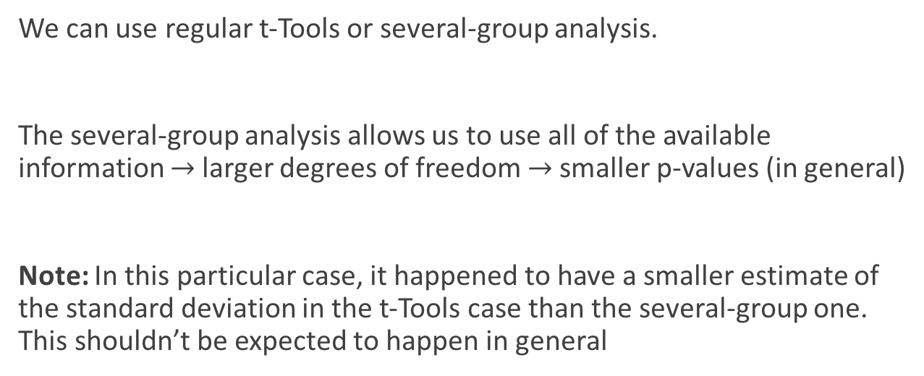
Two Judge Analysis: Conclusion
Question: Suppose we wish to test if the “S” judge’s venires are different from the “F” judge’s.
Answer: There is evidence that the means of the two groups are different
We can use regular t-Tools or several-group analysis.
The several-group analysis allows us to use all of the available information $→$larger degrees of freedom $→$ smaller p-values (in general)
Note: In this particular case, it happened to have a smaller estimate of the standard deviation in the t-Tools case than the several-group one. This shouldn’t be expected to happen in general

Slide 13
Several-Groups Analysis: Analysis of Variance (ANOVA)
We can do a lot more than reduce the degrees of freedom in a two-sample comparison
A core stage in the analysis of several-group data is answering the question “is there evidence that any of the groups are different?”
This question is answered by conducting an analysis of variance (ANOVA)
(Warning: Though the word “variance” appears in the name, it is very much a test of means, not variances)

Slide 14
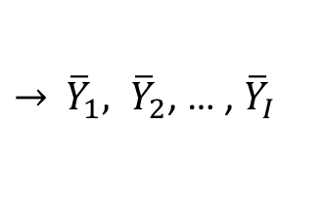
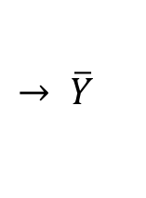
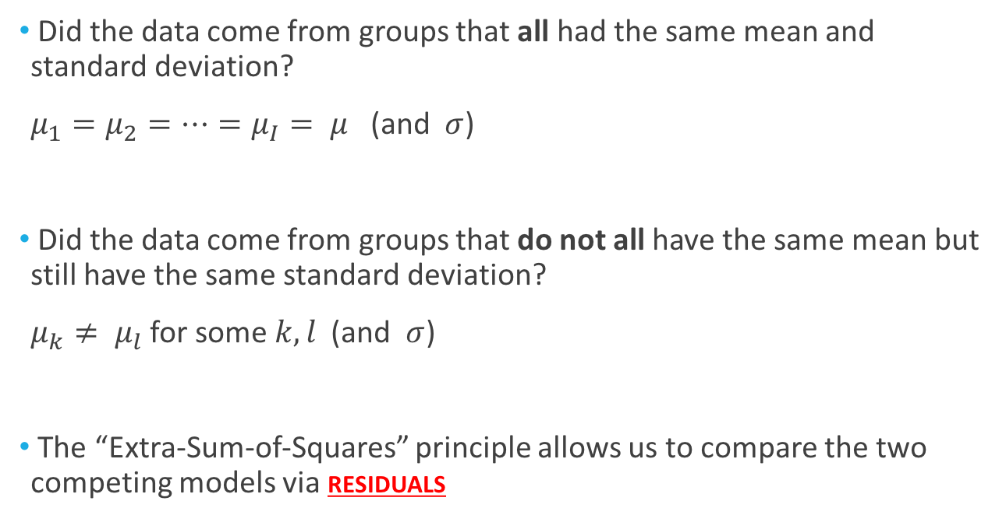
Analysis of Variance (ANOVA)
Did the data come from groups that all had the same mean and standard deviation?
$μ_{1}=μ_{2}=…=μ_{I}= μ$ (and $σ$)
Did the data come from groups that do not all have the same mean but still have the same standard deviation?
$μ_{k}≠ μ_{l}$ for some $k,l$ (and $σ$)
The “Extra-Sum-of-Squares” principle allows us to compare the two competing models via residuals
(The reduced or equal means model)
$$→ \overline{Y}$$
(The grand mean)
(The full or separate means model)
$→$ ${\overline{Y}}_{1}, {\overline{Y}}_{2}$, … , ${\overline{Y}}_{I}$

Slide 15
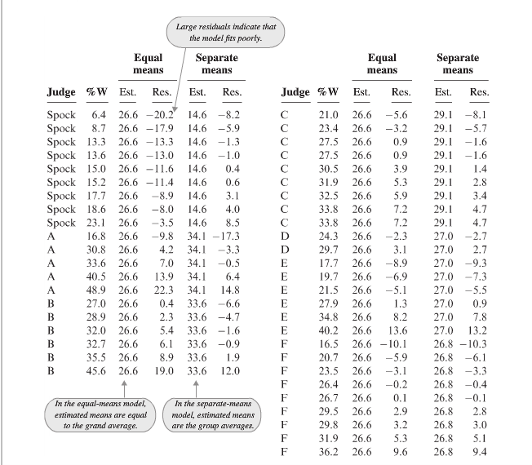
If the equal means model is correct, then the magnitude of the residuals should be about the same as the separate mean model
Important: as the residuals of the equal means model will always be larger in magnitude than separate means

Slide 16
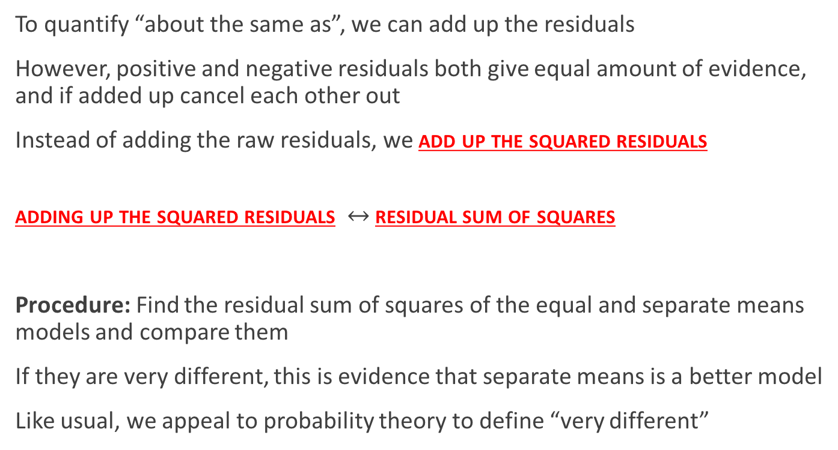
Extra-Sum-of-Squares
To quantify “about the same as”, we can add up the residuals
However, positive and negative residuals both give equal amount of evidence, and if added up cancel each other out
Instead of adding the raw residuals, we add up the squared residuals
adding up the squared residuals $↔$residual sum of squares
Procedure: Find the residual sum of squares of the equal and separate means models and compare them
If they are very different, this is evidence that separate means is a better model
Like usual, we appeal to probability theory to define “very different”

Slide 17


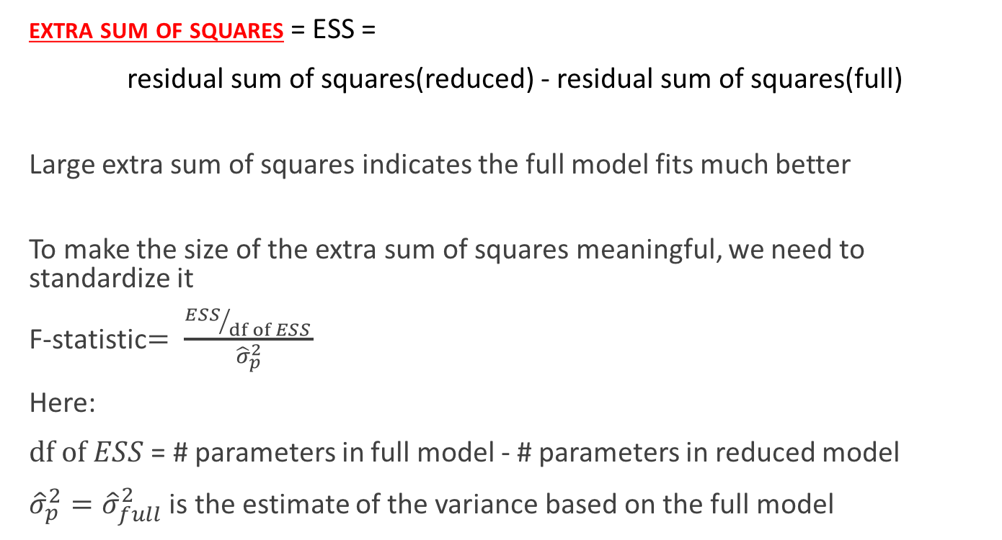
Extra-Sum-of-Squares
extra sum of squares = ESS =
residual sum of squares(reduced) - residual sum of squares(full)
Large extra sum of squares indicates the full model fits much better
To make the size of the extra sum of squares meaningful, we need to standardize it
F-statistic$= \frac{{ESS}/{df of ESS }}{{\hat{σ}}_{p}^{2}}$
Here:
$df of ESS$ = # parameters in full model - # parameters in reduced model
${{\hat{σ}}_{p}^{2}=\hat{σ}}_{full}^{2}$ is the estimate of the variance based on the full model
$$(I+1)$$
$$(2)$$

Slide 18
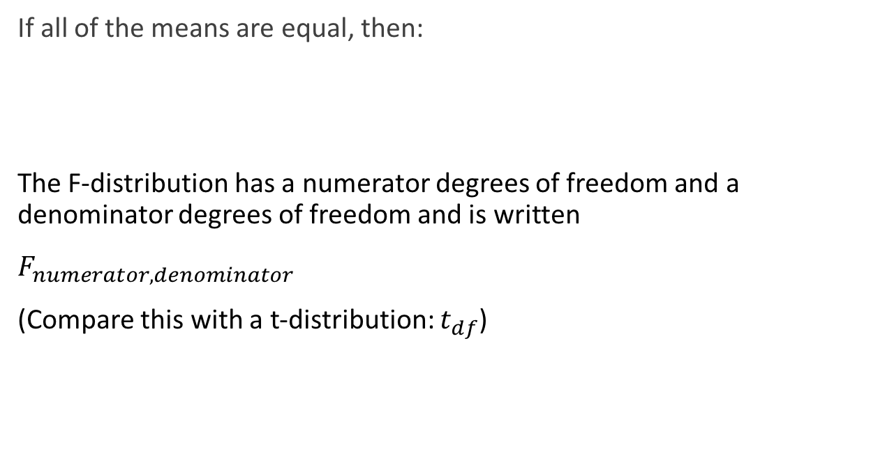
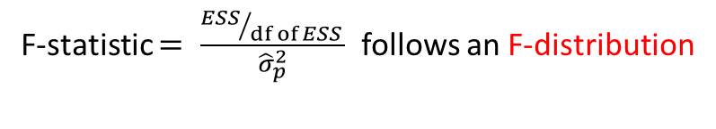
F-statistic
If all of the means are equal, then:
The F-distribution has a numerator degrees of freedom and a denominator degrees of freedom and is written
$F_{numerator, denominator}$
(Compare this with a t-distribution: $t_{df}$)
F-statistic $= \frac{{ESS}/{df of ESS }}{{\hat{σ}}_{p}^{2}}$ follows an F-distribution

Slide 19
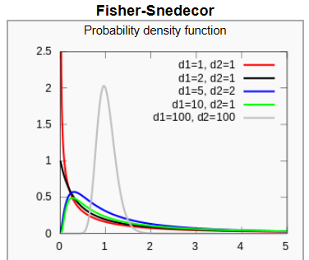

F-Distributions
$$F_{d1,d2}$$

Slide 20
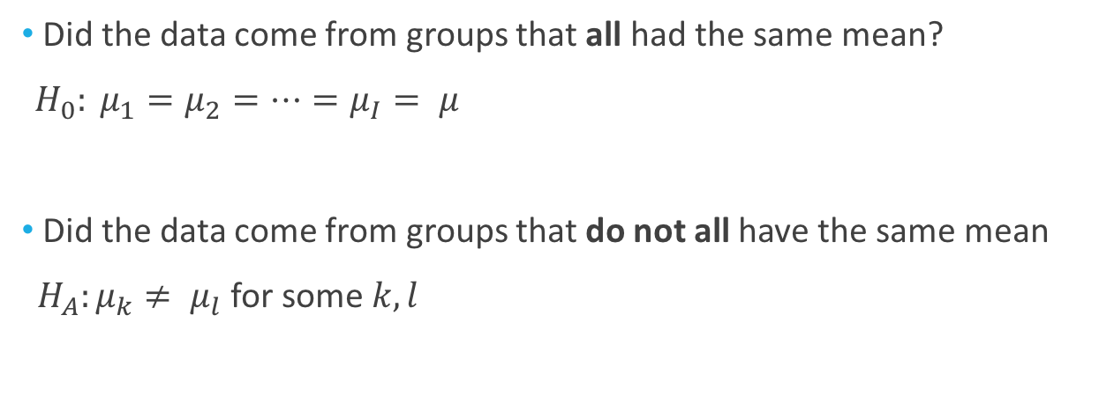
From Extra Sums of Squares to the ANOVA Table
(ESS)
extra sum of squares = ESS =
residual sum of squares(reduced) - residual sum of squares(full)
Large extra sum of squares indicates the full model fits much better
Reminder
RSS(reduced)
RSS(full)
Did the data come from groups that all had the same mean?
${H_{0}: μ}_{1}=μ_{2}=…=μ_{I}= μ$
Did the data come from groups that do not all have the same mean
${H_{A}:μ}_{k}≠ μ_{l}$ for some $k,l$
(The reduced or equal means model)
(The full or separate means model)

Slide 21
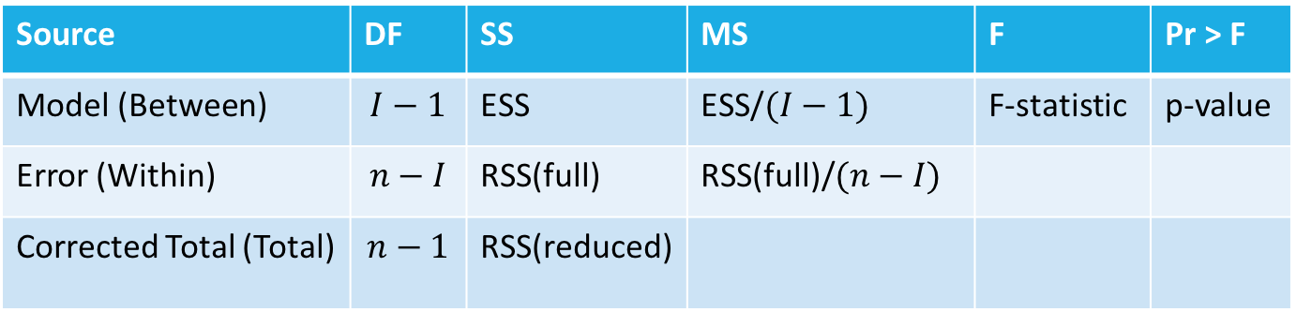

From Extra Sums of Squares to the ANOVA Table
(ESS)
extra sum of squares =
residual sum of squares(reduced) - residual sum of squares(full)
Large extra sum of squares indicates the full model fits much better
ANOVA table:
Reminder
RSS(reduced)
RSS(full)
$$F_{I−1,n−I }$$
Source | DF | SS | MS | F | Pr > F
Model (Between) | $$I−1$$ | ESS | ESS/$(I−1)$ | F-statistic | p-value
Error (Within) | $$n−I$$ | RSS(full) | RSS(full)/$(n−I)$
Corrected Total (Total) | $$n−1$$ | RSS(reduced)
Notes:
The Source terminology is SAS (Model, Error, Corrected Total) and the book (Between, Within, Total)

Slide 22
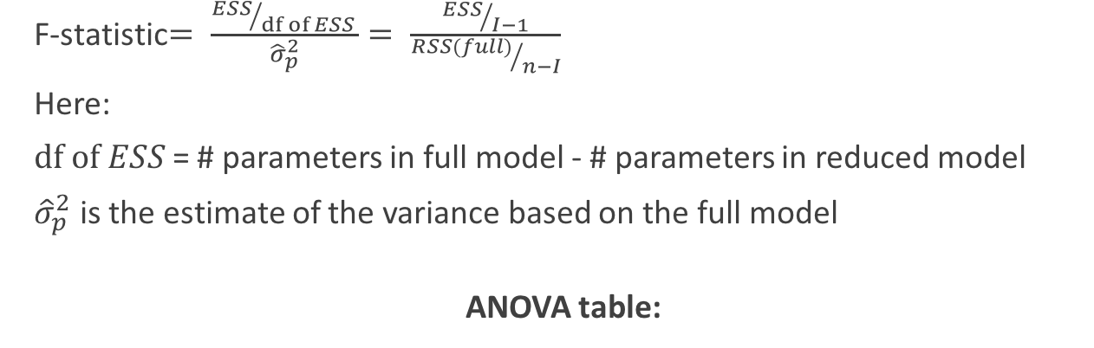

From Extra Sums of Squares to the ANOVA Table
F-statistic$= \frac{{ESS}/{df of ESS }}{{\hat{σ}}_{p}^{2}}= \frac{{ESS}/{I−1}}{{RSS(full)}/{n−I}}$
Here:
$df of ESS$ = # parameters in full model - # parameters in reduced model
${\hat{σ}}_{p}^{2}$ is the estimate of the variance based on the full model
ANOVA table:
Reminder
$$F_{I−1,n−I }$$
Source | DF | SS | MS | F | Pr > F
Model (Between) | $$I−1$$ | ESS | ESS/$(I−1)$ | F-statistic | p-value
Error (Within) | $$n−I$$ | RSS(full) | RSS(full)/$(n−I)$
Corrected Total (Total) | $$n−1$$ | RSS(reduced)
Notes:
The Source terminology is SAS (Model, Error, Corrected Total) and the book (Between, Within, Total)

Slide 23
Class Example
Treatment 1 | Treatment 2 | Placebo
3 | 10 | 20
5 | 12 | 22
7 | 14 | 24

Slide 24
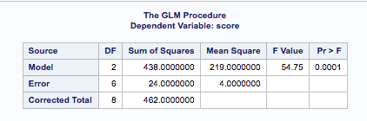
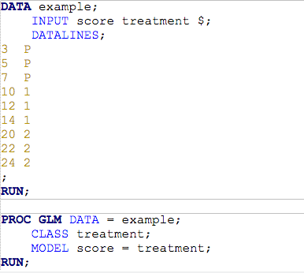
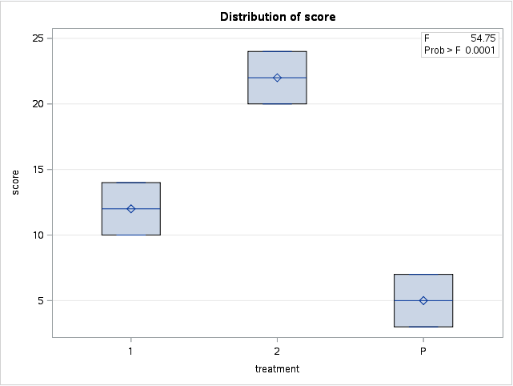
Class Example: SAS
Ho: µ₁= µ₂ = µ₃ (Equal Means Model)
Ha: At least 1 pair are different (Separate Means Model)

Slide 25

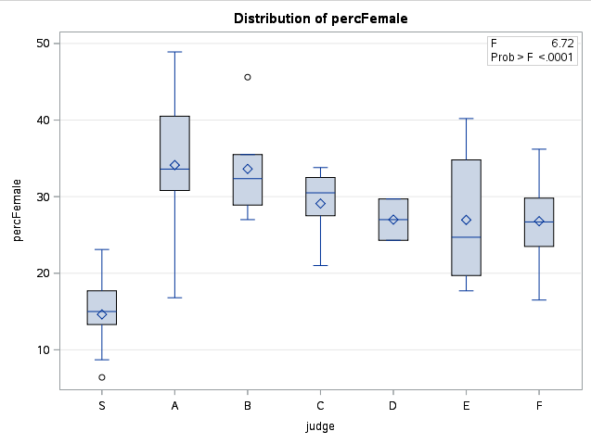
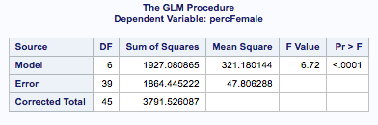
ANOVA in the Spock Example
Ho: All means are equal (Spock and Others)
Ha: At least 2 are different (Spock and Others)
ESS
RSS(full)
RSS(reduced)
Statistical Conclusion: There is substantial evidence that the mean percent of females on venires is not the same for all seven judges (ANOVA p-value less than 0.0001).

Slide 26
Assumptions for ANOVA
Normality: Each group are drawn from a normal distribution
(Look at QQ plot or check sample sizes)
Equal Standard Deviations: All the groups have the same standard deviation
(Look at the residuals)
Independence: The observations within and between each group are independent
(Examine the study to see if independence is reasonable)

Slide 27
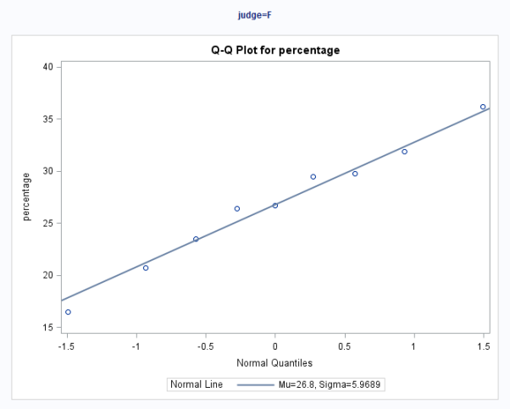
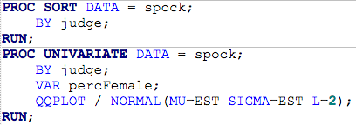
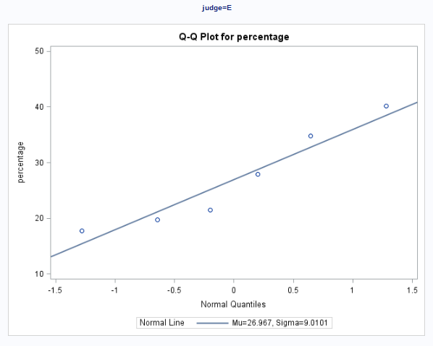
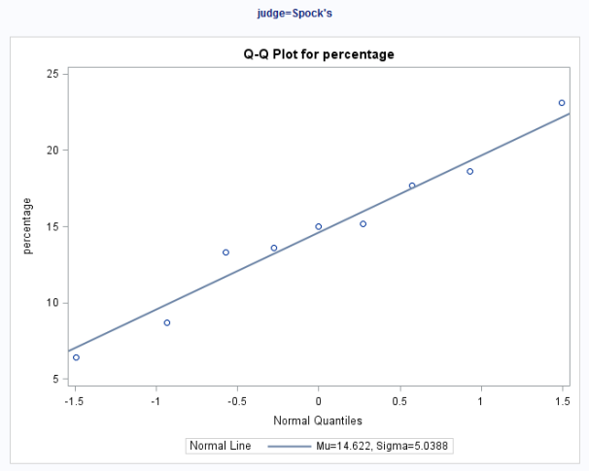
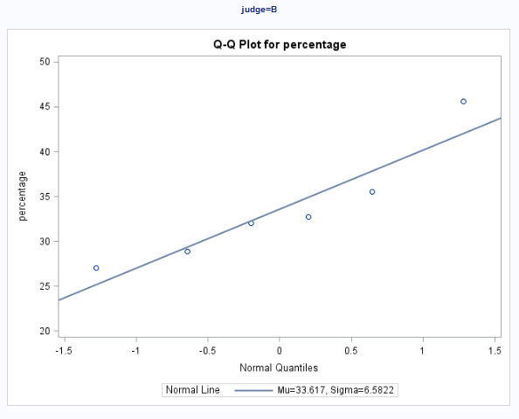
Normality
(This is only 4 out of 7 plots for brevity’s sake)

Slide 28

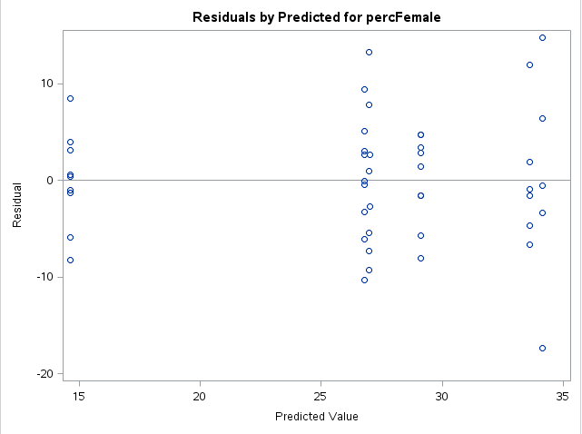
Residuals
We are looking for:
Funnel Shapes
Non-constant Variance
(no problems in this case)
Notes:
Only look at the first reported plot with this code.
“Predicted Value” is the same as “Estimated Means” in Display 5.15

