Slide 1
Comparisons Among Several Samples
More applications of extra-sum-of-squares test

Slide 2
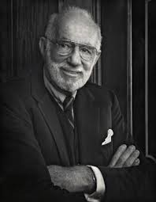
Spock Trial (Reminder)
To test the claim, the Spock Judge’s (which we will call S) recent venires are compared with 6 other Judge’s recent venires (which we notate A to F)
There are two key questions
Is there evidence that women are unrepresented on S’s venire relative to A to F’s?
Is there evidence in a difference in women’s representation on A to F’s venires?
The question of interest is addressed by 1
The strength of the result in 1. would be substantially diminished if 2 is true

Slide 3
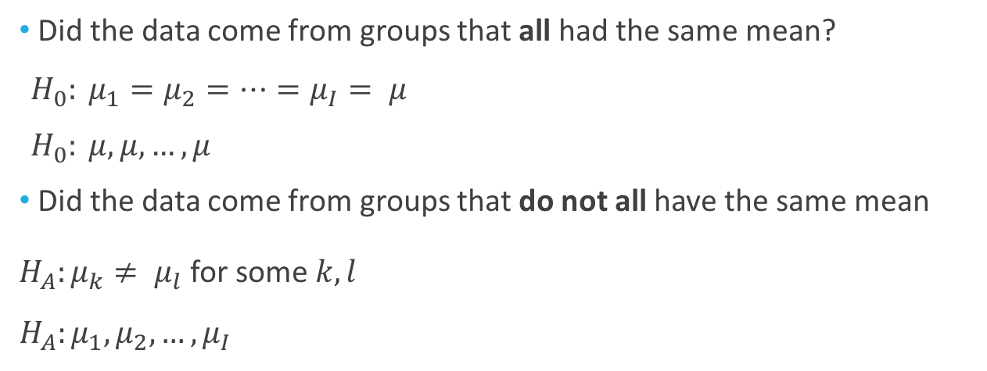

New Notation for Hypothesis Tests
(ESS)
extra sum of squares =
residual sum of squares(reduced) - residual sum of squares(full)
Large extra sum of squares indicates the full model fits much better
Reminder
RSS(reduced)
RSS(full)
Did the data come from groups that all had the same mean?
${H_{0}: μ}_{1}=μ_{2}=…=μ_{I}= μ$
$H_{0}: μ,μ,…,μ$
Did the data come from groups that do not all have the same mean
${H_{A}:μ}_{k}≠ μ_{l}$ for some $k,l$
$$H_{A}:μ_{1},μ_{2},…,μ_{I}$$
(equivalent)
(The reduced or equal means model)
$(I$ times)
(The full or separate means model)
(equivalent)

Slide 4
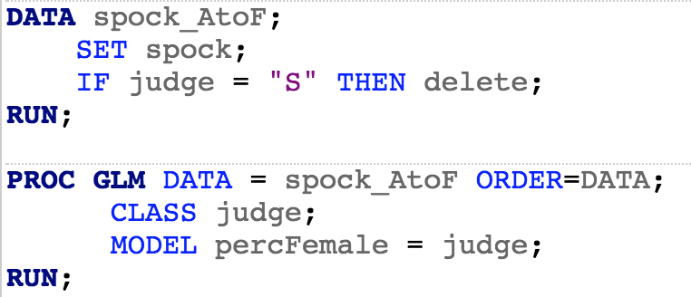
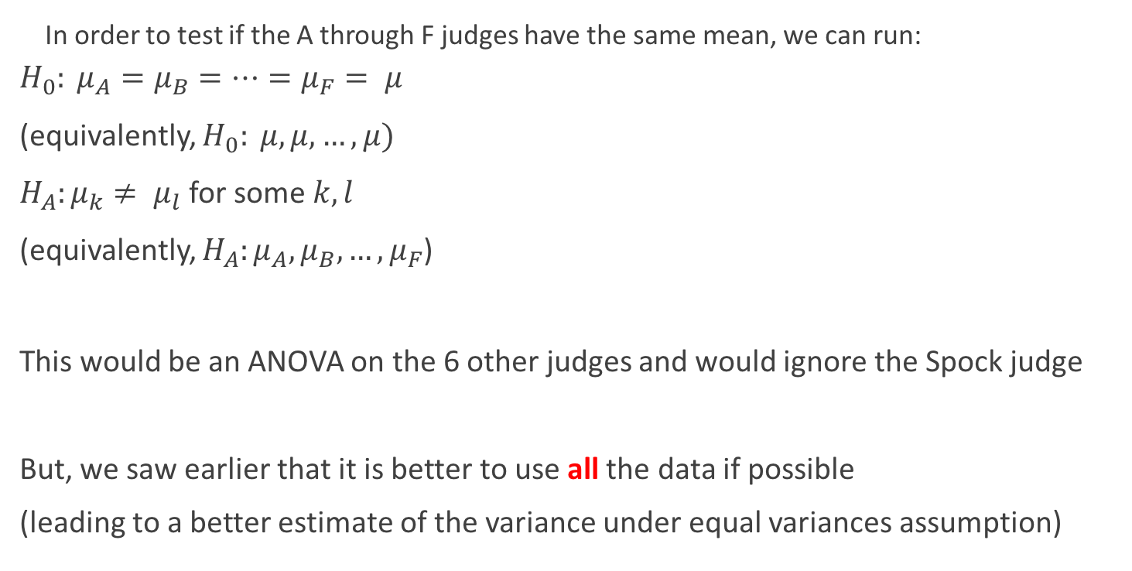
Comparing Judges A-F: A First Take
In order to test if the A through F judges have the same mean, we can run:
$${H_{0}: μ}_{A}=μ_{B}=…=μ_{F}= μ$$
(equivalently, $H_{0}: μ,μ,…,μ)$
${H_{A}:μ}_{k}≠ μ_{l}$ for some $k,l$
(equivalently, $H_{A}:μ_{A},μ_{B},…,μ_{F}$)
This would be an ANOVA on the 6 other judges and would ignore the Spock judge
But, we saw earlier that it is better to use all the data if possible
(leading to a better estimate of the variance under equal variances assumption)

Slide 5
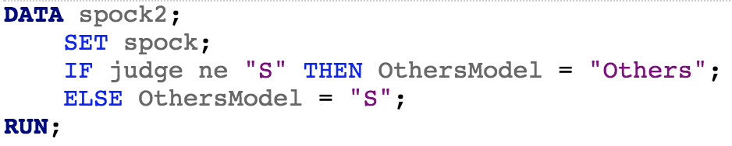

Comparing Judges A-F: A Better Approach
Let’s add the Spock judge’s data by including another parameter
${H_{0}: μ}_{S},μ,μ,…,μ$
$${H_{A}: μ}_{S},μ_{A},μ_{B},…,μ_{F}$$
(The reduced model)
(The full model)

Slide 6
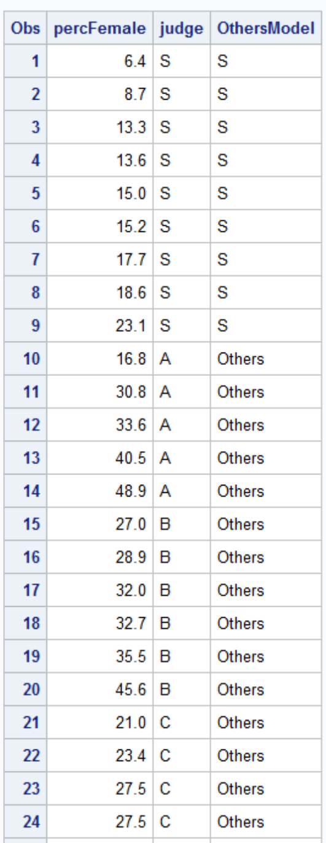

Comparing Judges A-F: A Better Approach
Let’s add the Spock judge’s data by including another parameter
${H_{0}: μ}_{S},μ,μ,…,μ$
$${H_{A}: μ}_{S},μ_{A},μ_{B},…,μ_{F}$$
Now, we need to test this hypothesis
$→$ Extra sum of squares test!
(The reduced model)
(The full model)

Slide 7

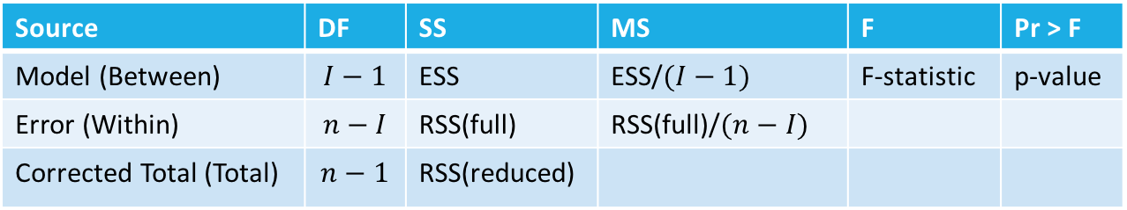
Comparing Judges A-F: A Better Approach
Let’s add the Spock judge’s data by including another parameter
${H_{0}: μ}_{S},μ,μ,…,μ$
$${H_{A}: μ}_{S},μ_{A},μ_{B},…,μ_{F}$$
We need to compute:
RSS(reduced)
RSS(full)
the degrees of freedom
(The reduced model)
(The full model)
Source | DF | SS | MS | F | Pr > F
Model (Between) | $$I−1$$ | ESS | ESS/$(I−1)$ | F-statistic | p-value
Error (Within) | $$n−I$$ | RSS(full) | RSS(full)/$(n−I)$
Corrected Total (Total) | $$n−1$$ | RSS(reduced)

Slide 8
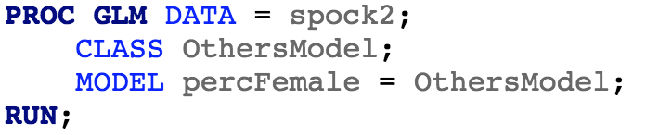
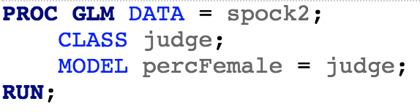
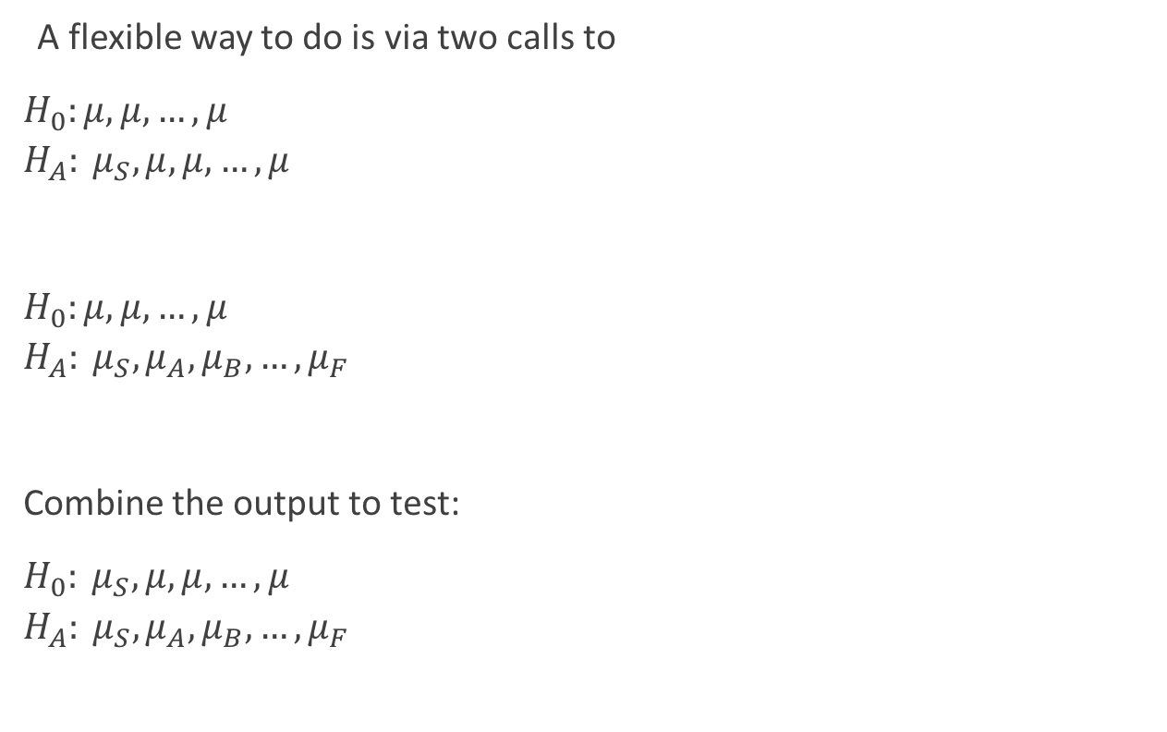
Comparing Judges A-F: A Better Approach
A flexible way to do is via two calls to
$H_{0}:μ,μ,…,μ$
$${H_{A}: μ}_{S},μ,μ,…,μ$$
$H_{0}:μ,μ,…,μ$
$${H_{A}: μ}_{S},μ_{A},μ_{B},…,μ_{F}$$
Combine the output to test:
${H_{0}: μ}_{S},μ,μ,…,μ$
$${H_{A}: μ}_{S},μ_{A},μ_{B},…,μ_{F}$$
(The reduced model)
(The full model)

Slide 9
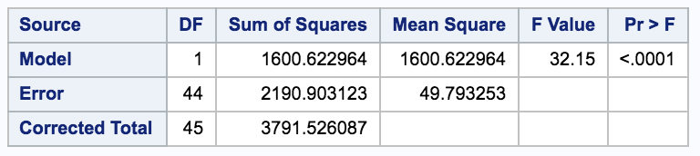
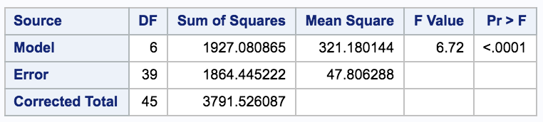
Comparing Judges A-F: Extra Sums of Squares
A flexible way to do is via two calls to
$H_{0}:μ,μ,…,μ$
$${H_{A}: μ}_{S},μ,μ,…,μ$$
$H_{0}:μ,μ,…,μ$
$${H_{A}: μ}_{S},μ_{A},μ_{B},…,μ_{F}$$
Combine the output to test:
${H_{0}: μ}_{S},μ,μ,…,μ$
$${H_{A}: μ}_{S},μ_{A},μ_{B},…,μ_{F}$$
(This “full” model is the new “reduced” model)
Source | DF | SS | MS | F | Pr > F
Model (ESS) | 5 | 326.5 | 65.29 | 1.37 | 0.26
Error (Full) | 39 | 1864.4 | 47.81
Total (Reduced) | 44 | 2190.9

Slide 10
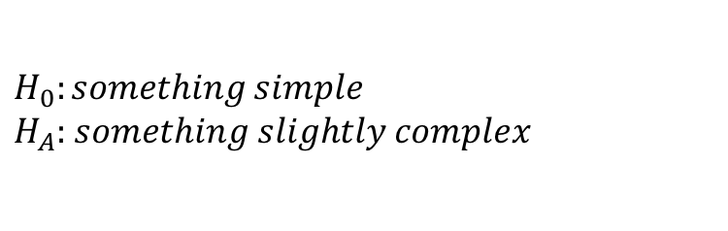
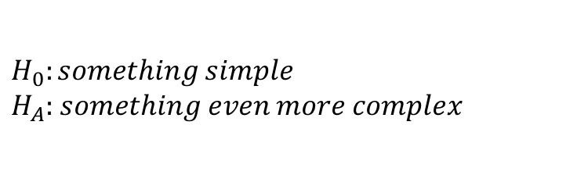
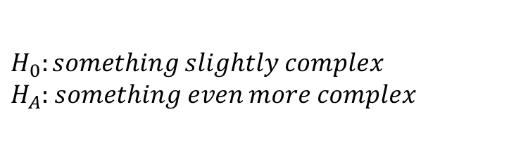
Summarizing
(ESS)
extra sum of squares =
residual sum of squares(reduced) - residual sum of squares(full)
Large extra sum of squares indicates the full model fits much better
Reminder
RSS(reduced)
RSS(full)
We can test “nested” hypothesis; that is, where one is a special case of the other
Run two tests: the alternatives are the new null and alternative hypotheses
$$H_{0}:something simple$$
$H_{A}:$ $something slightly complex$
$$H_{0}:something slightly complex$$
$H_{A}:$ $something even more complex$
$$H_{0}:something simple$$
$H_{A}:$ $something even more complex$

