Slide 1
Return to Spock Example

Slide 2
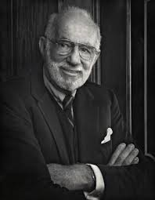
Spock Trial (Reminder)
To test the claim that the Spock Judge’s (which we call S) recent venires are compared with 6 other Judge’s recent venires (which we notate A to F)
There are two key questions
Is there evidence that women are unrepresented on S’s venire relative to A to F’s?
Is there evidence of a difference in women’s representation on A to F’s venire
To answer this question, we need to generalize our understanding of ANOVA

Slide 3
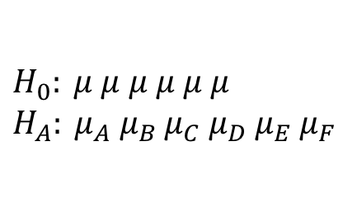

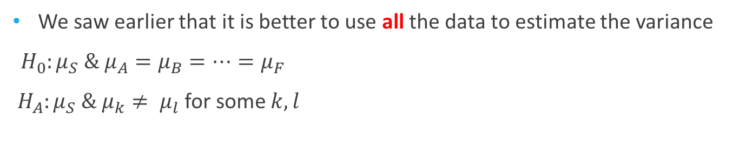

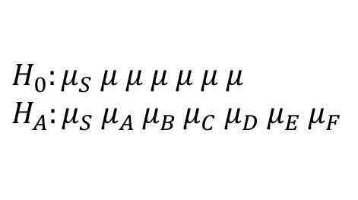
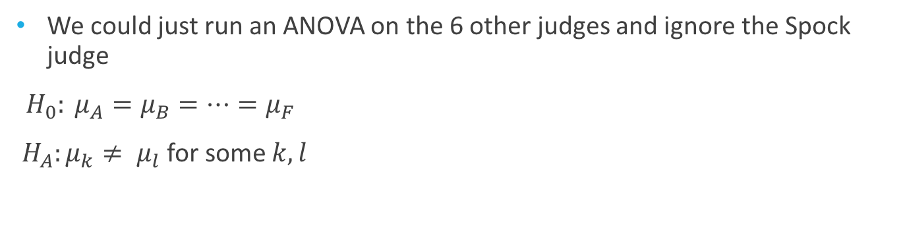
Comparing Judges A - F
We could just run an ANOVA on the 6 other judges and ignore the Spock judge
${H_{0}: μ}_{A}=μ_{B}=…=μ_{F}$
${H_{A}:μ}_{k}≠ μ_{l}$ for some $k,l$
$$H_{0}: μ μ μ μ μ μ$$
$H_{A}: μ_{A}{ μ}_{B}$ $μ_{C}$ $μ_{D}$ $μ_{E}$ $μ_{F}$
$$↔$$
We saw earlier that it is better to use all the data to estimate the variance
${H_{0}:μ_{S} \& μ}_{A}=μ_{B}=…=μ_{F}$
${H_{A}:μ_{S} \& μ}_{k}≠ μ_{l}$ for some $k,l$
(The reduced model)
$$↔$$
$$H_{0}:μ_{S} μ μ μ μ μ μ$$
$H_{A}:μ_{S} μ_{A}{ μ}_{B}$ $μ_{C}$ $μ_{D}$ $μ_{E}$ $μ_{F}$
(The full model)

Slide 4
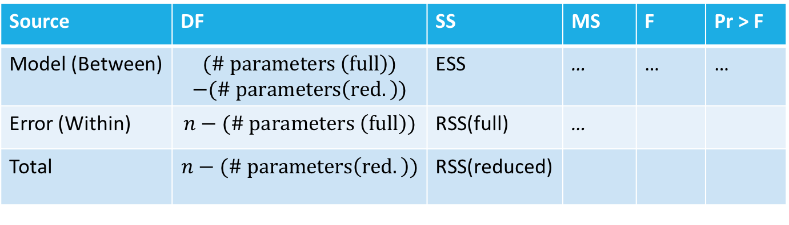
The (General) ANOVA table
(ESS)
extra sum of squares =
residual sum of squares(reduced) - residual sum of squares(full)
Large extra sum of squares indicates the full model fits much better
Reminder
RSS(reduced)
RSS(full)
Source | DF | SS | MS | F | Pr > F
Model (Between) | $$(\# parameters \left(full\right))$$ $$−(\# parameters\left(red.\right))$$ | ESS | … | … | …
Error (Within) | $$n−(\# parameters \left(full\right))$$ | RSS(full) | …
Total | $$n−(\# parameters\left(red.\right))$$ | RSS(reduced)
Notes:
The Source terminology is SAS (Model, Error, Corrected Total) and the book (Between, Within, Total)

Slide 5
Back to Comparing Judges A - F
We could just run an ANOVA on the 6 other judges and ignore the Spock judge
${H_{0}: μ}_{A}=μ_{B}=…=μ_{F}$
${H_{A}:μ}_{k}≠ μ_{l}$ for some $k,l$
$$H_{0}: μ μ μ μ μ μ$$
$H_{A}: μ_{A}{ μ}_{B}$ $μ_{C}$ $μ_{D}$ $μ_{E}$ $μ_{F}$
$$↔$$
We saw earlier that it is better to use all the data to estimate the variance
${H_{0}:μ_{S} \& μ}_{A}=μ_{B}=…=μ_{F}$
${H_{A}:μ_{S} \& μ}_{k}≠ μ_{l}$ for some $k,l$
(The reduced model)
$$↔$$
$$H_{0}:μ_{S} μ μ μ μ μ μ$$
$H_{A}:μ_{S} μ_{A}{ μ}_{B}$ $μ_{C}$ $μ_{D}$ $μ_{E}$ $μ_{F}$
(The full model)
So, we need to find the RSS(reduced), RSS(full), and the degrees of freedom for each
We can make SAS do some of the computations

Slide 6
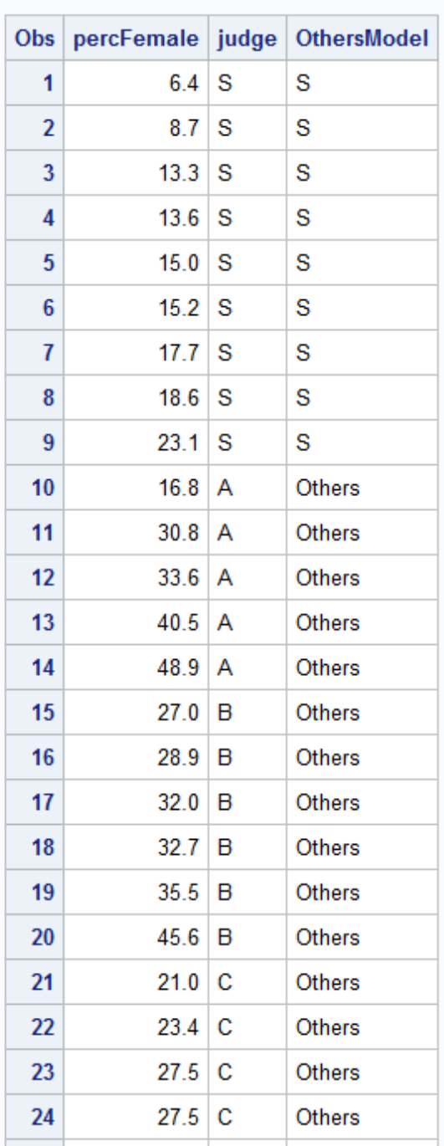
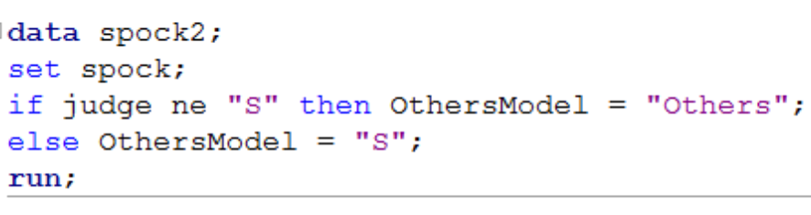
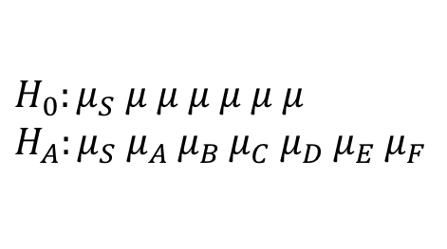
Comparing Judges A - F
(The reduced model)
$$H_{0}:μ_{S} μ μ μ μ μ μ$$
$H_{A}:μ_{S} μ_{A}{ μ}_{B}$ $μ_{C}$ $μ_{D}$ $μ_{E}$ $μ_{F}$
(The full model)

Slide 7
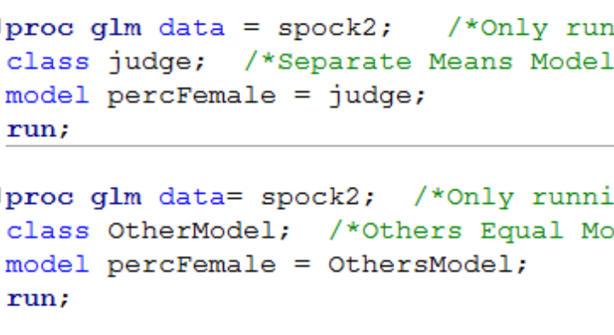
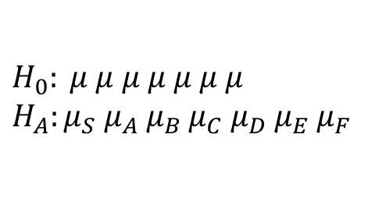
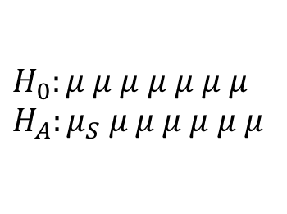
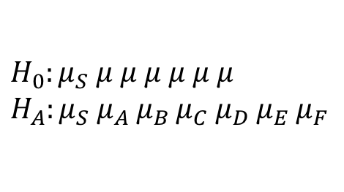
Comparing Judges A - F
(A reduced model)
$$H_{0}: μ μ μ μ μ μ μ$$
$H_{A}:μ_{S} μ_{A}{ μ}_{B}$ $μ_{C}$ $μ_{D}$ $μ_{E}$ $μ_{F}$
(A full model)
$$H_{0}:μ_{S} μ μ μ μ μ μ$$
$H_{A}:μ_{S} μ_{A}{ μ}_{B}$ $μ_{C}$ $μ_{D}$ $μ_{E}$ $μ_{F}$
(A reduced model)
$$H_{0}:μ μ μ μ μ μ μ$$
$$H_{A}:μ_{S} μ μ μ μ μ μ$$
So, to answer the question of interest, we need to compare the full model from the two other ANOVAs
(A full model)

Slide 8
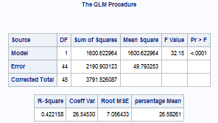
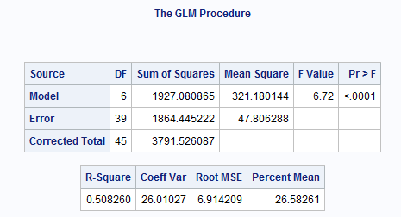
Comparing Judges A - F
(A reduced model)
$$H_{0}: μ μ μ μ μ μ μ$$
$H_{A}:μ_{S} μ_{A}{ μ}_{B}$ $μ_{C}$ $μ_{D}$ $μ_{E}$ $μ_{F}$
(A full model)
(A reduced model)
$$H_{0}:μ μ μ μ μ μ μ$$
$$H_{A}:μ_{S} μ μ μ μ μ μ$$
(A full model)

Slide 9
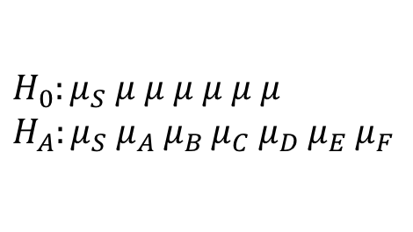
$$H_{0}: μ μ μ μ μ μ μ$$
$H_{A}:μ_{S} μ_{A}{ μ}_{B}$ $μ_{C}$ $μ_{D}$ $μ_{E}$ $μ_{F}$
$$H_{0}:μ μ μ μ μ μ μ$$
$$H_{A}:μ_{S} μ μ μ μ μ μ$$
The “old” full model is still the more complex model, hence it is the “new” full model
The “old” full model is now the less complex model, hence it is the “new” reduced model
$$H_{0}:μ_{S} μ μ μ μ μ μ$$
$H_{A}:μ_{S} μ_{A}{ μ}_{B}$ $μ_{C}$ $μ_{D}$ $μ_{E}$ $μ_{F}$
(Extra sums of squares test)
Source | DF | SS | MS | F | Pr > F
Model | 5 | 326.5 | 65.29 | 1.37 | 0.26
Error | 39 | 1864.4 | 47.81
Corrected Total | 44 | 2190.9

