Slide 1
Comparisons Among Several Samples
Kruskal-wallis “nonparametric anova”
Welch’s anova

Slide 2
Rank-Sum Test: Review

Slide 3
Rank-Sum Test: Discussion and Assumptions
No distributional assumptions and resistant to outliers
When t-test assumptions are met, the rank-sum test performs about 95.49% as well
Performs arbitrarily better if the t-test assumptions are not (approximately) met
Works well with ordinal data
(Nominal: order is arbitrary. ordinal: order matters. Interval: subtraction is meaningful. Ratio: multiplication is meaningful)
Works with censored values
(Censored means that the actual value was too large/small to
be accurately recorded)
It still requires some assumptions:
All observations are independent
The Y values are at least ordinal
(Realistically required for t-tools)
59 patients with arthritis who participated in a clinical trial were assigned to two groups, active and placebo. The response status:
(excellent=5, good=4, moderate=3, fair=2, poor=1)
of each patient was recorded.

Slide 4
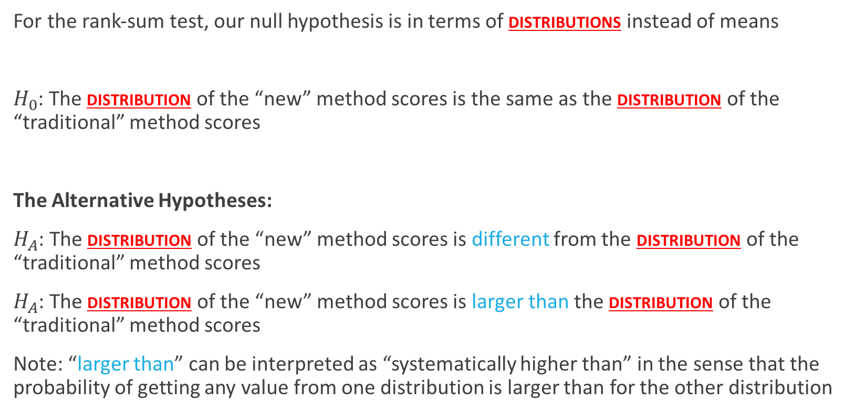
Rank-Sum Test: Hypotheses
For the rank-sum test, our null hypothesis is in terms of distributions instead of means
$H_{0}$: The distribution of the “new” method scores is the same as the distribution of the “traditional” method scores
The Alternative Hypotheses:
$H_{A}$: The distribution of the “new” method scores is different from the distribution of the “traditional” method scores
$H_{A}$: The distribution of the “new” method scores is larger than the distribution of the “traditional” method scores
Note: “larger than” can be interpreted as “systematically higher than” in the sense that the probability of getting any value from one distribution is larger than for the other distribution
(Two sided)
(one sided)

Slide 5
Kruskal-Wallis Test

Slide 6
Kruskal-Wallis test
When there are/is…
extreme values/outliers
Small or very unequal sample sizes + lack of normality
strong evidence of unequal variances between groups
… a nonparametric version of ANOVA is preferable
Though there are various tests for detecting unequal variances, it is best practice to evaluate this assumption visually

Slide 7
Kruskal-Wallis test: Assumptions
Resistant to outliers
Works well with ordinal data (this is the main application in practice)
(Nominal: order is arbitrary. ordinal: order matters. Interval: subtraction is meaningful. Ratio: multiplication is meaningful)
Can work with censored values
(Censored means that the actual value was too large/small to be accurately recorded)
It still requires some assumptions:
All observations are independent
The groups are independent
The Y values are at least ordinal
Under these assumptions, we can perform the following hypothesis tests

Slide 8
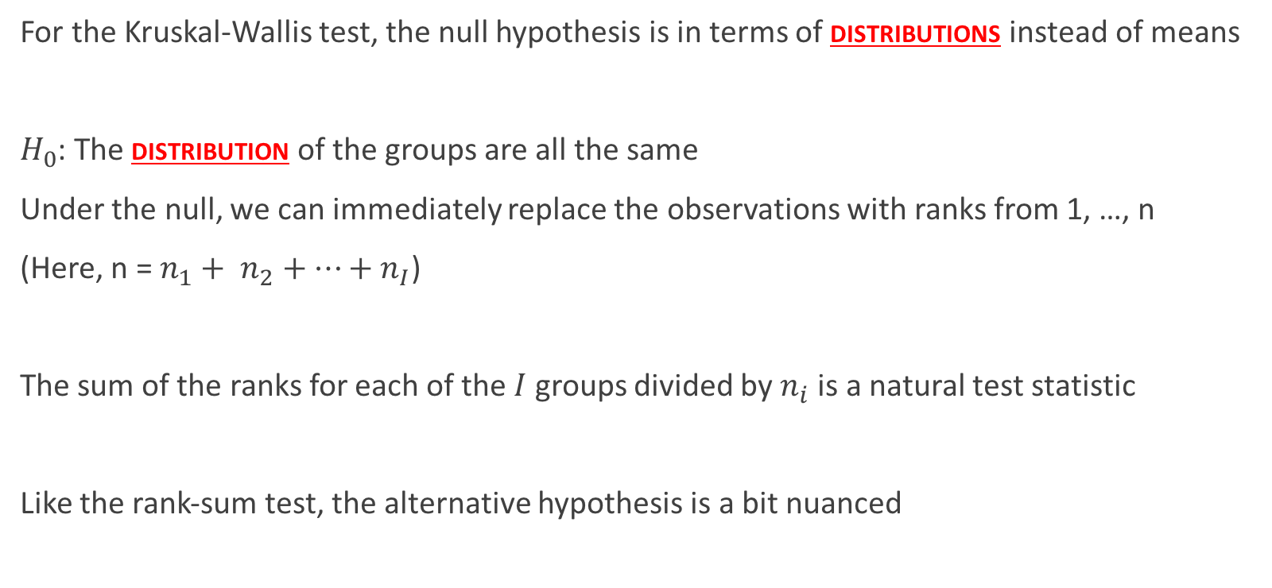
Kruskal-Wallis test: Hypotheses
For the Kruskal-Wallis test, the null hypothesis is in terms of distributions instead of means
$H_{0}$: The distribution of the groups are all the same
Under the null, we can immediately replace the observations with ranks from 1, …, n
(Here, n = $n_{1}+ n_{2}+…+n_{I}$)
The sum of the ranks for each of the $I$ groups divided by $n_{i}$is a natural test statistic
Like the rank-sum test, the alternative hypothesis is a bit nuanced

Slide 9
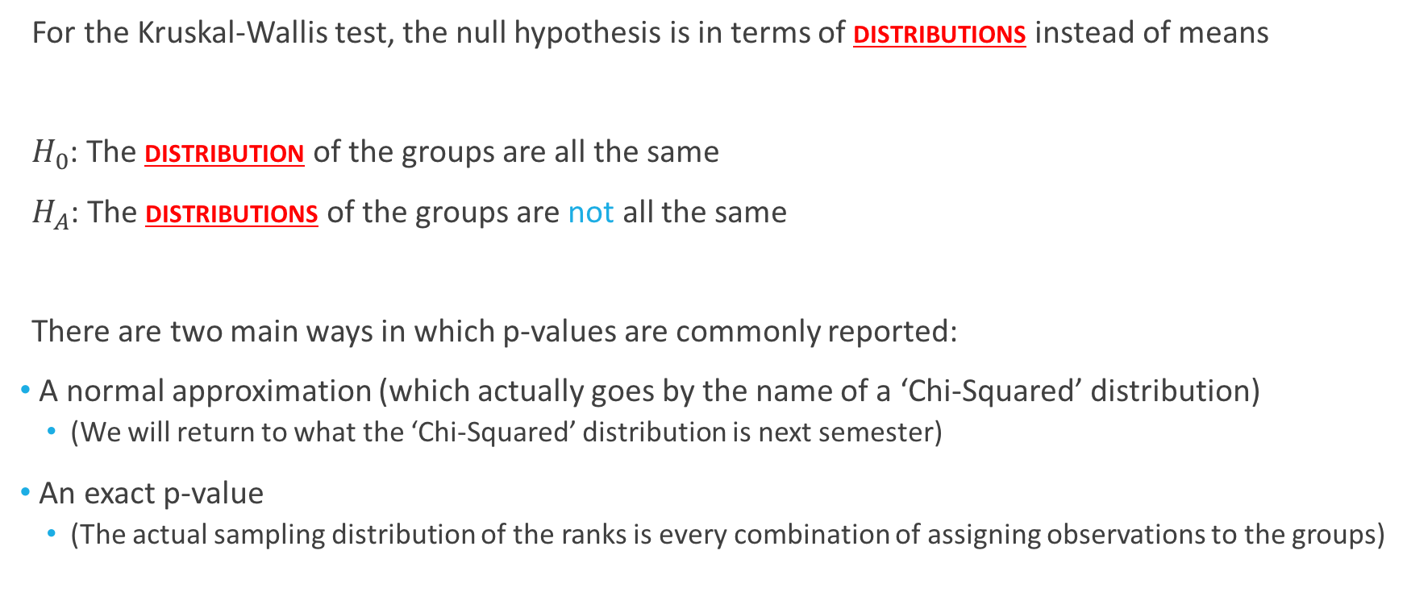
Kruskal-Wallis test: P-values
For the Kruskal-Wallis test, the null hypothesis is in terms of distributions instead of means
$H_{0}$: The distribution of the groups are all the same
$H_{A}$: The distributions of the groups are not all the same
There are two main ways in which p-values are commonly reported:
A normal approximation (which actually goes by the name of a ‘Chi-Squared’ distribution)
(We will return to what the ‘Chi-Squared’ distribution is next semester)
An exact p-value
(The actual sampling distribution of the ranks is every combination of assigning observations to the groups)

Slide 10
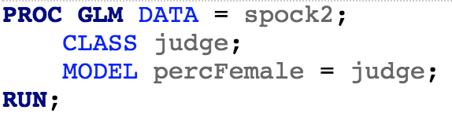
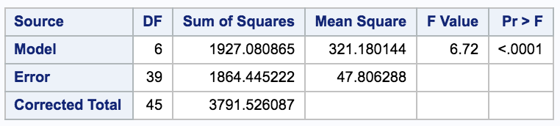
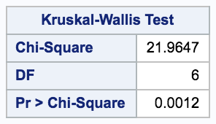
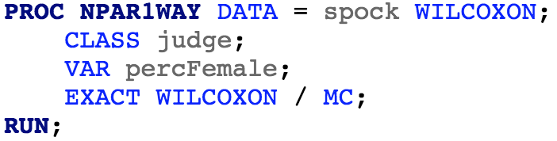
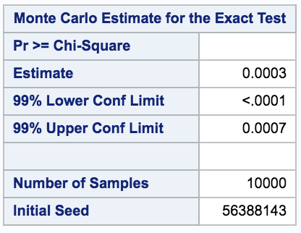
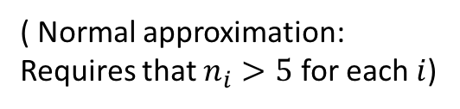
Kruskal-Wallis test: Spock data
( Normal approximation: Requires that $n_{i}>5$ for each $i$)
(Approximates the exact distribution with 10000 re-randomizations)

Slide 11
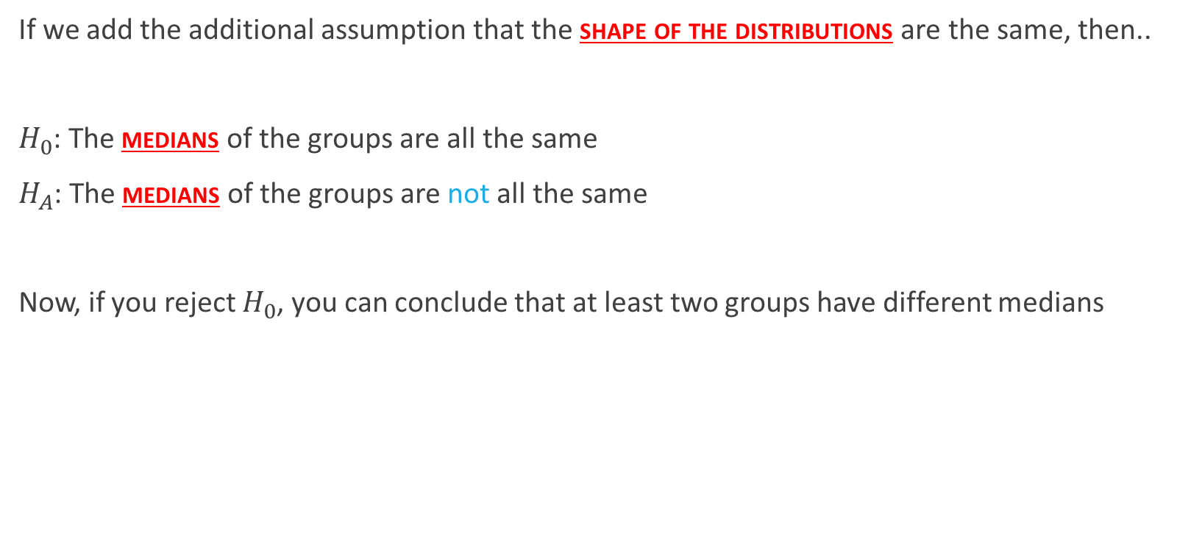
Kruskal-Wallis test: P-values
If we add the additional assumption that the shape of the distributions are the same, then..
$H_{0}$: The medians of the groups are all the same
$H_{A}$: The medians of the groups are not all the same
Now, if you reject $H_{0}$, you can conclude that at least two groups have different medians

Slide 12
Welch’s T-Tools

Slide 13
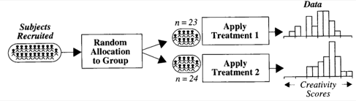


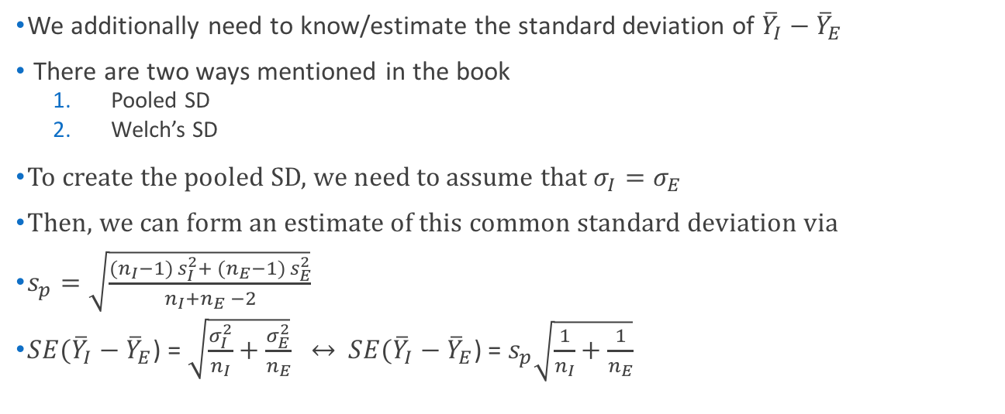
Creativity Study: Reminder
$→$ Population mean: $μ_{I}$
I
$→$ Population sd: $σ_{I}$
$→$ Population mean: $μ_{E}$
E
$→$ Population sd: $σ_{E}$
We additionally need to know/estimate the standard deviation of ${\overline{Y}}_{I}−{\overline{Y}}_{E}$
There are two ways mentioned in the book
Pooled SD
Welch’s SD
To create the pooled SD, we need to assume that $σ_{I}=σ_{E}$
Then, we can form an estimate of this common standard deviation via
$s_{p}=\sqrt{\frac{({n_{I}−1) s}_{I}^{2}+ ({n_{E}−1) s}_{E}^{2}}{n_{I}+n_{E} −2}}$
$SE({\overline{Y}}_{I}−{\overline{Y}}_{E}$) = $\sqrt{\frac{σ_{I}^{2}}{n_{I}}+\frac{σ_{E}^{2}}{n_{E}}} ↔$ $SE({\overline{Y}}_{I}−{\overline{Y}}_{E}$) = $s_{p}\sqrt{\frac{1}{n_{I}}+\frac{1}{n_{E}}}$
What if this assumption isn’t true?

Slide 14
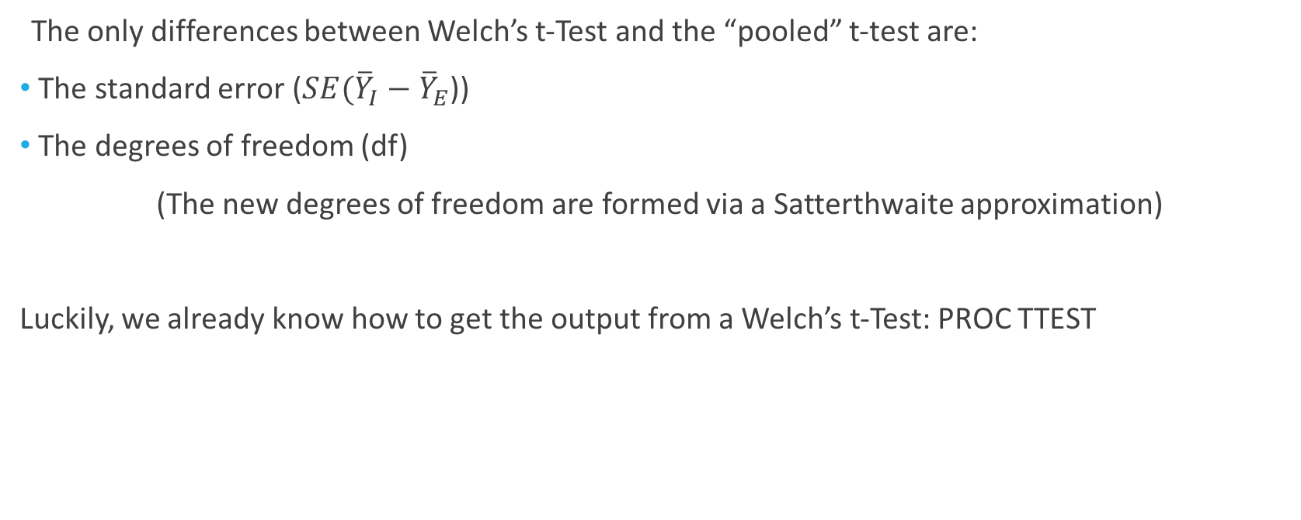
Welch’s t-Test
The only differences between Welch’s t-Test and the “pooled” t-test are:
The standard error ($SE({\overline{Y}}_{I}−{\overline{Y}}_{E}$))
The degrees of freedom (df)
(The new degrees of freedom are formed via a Satterthwaite approximation)
Luckily, we already know how to get the output from a Welch’s t-Test: PROC TTEST

Slide 15
Welch’s ANOVA

Slide 16
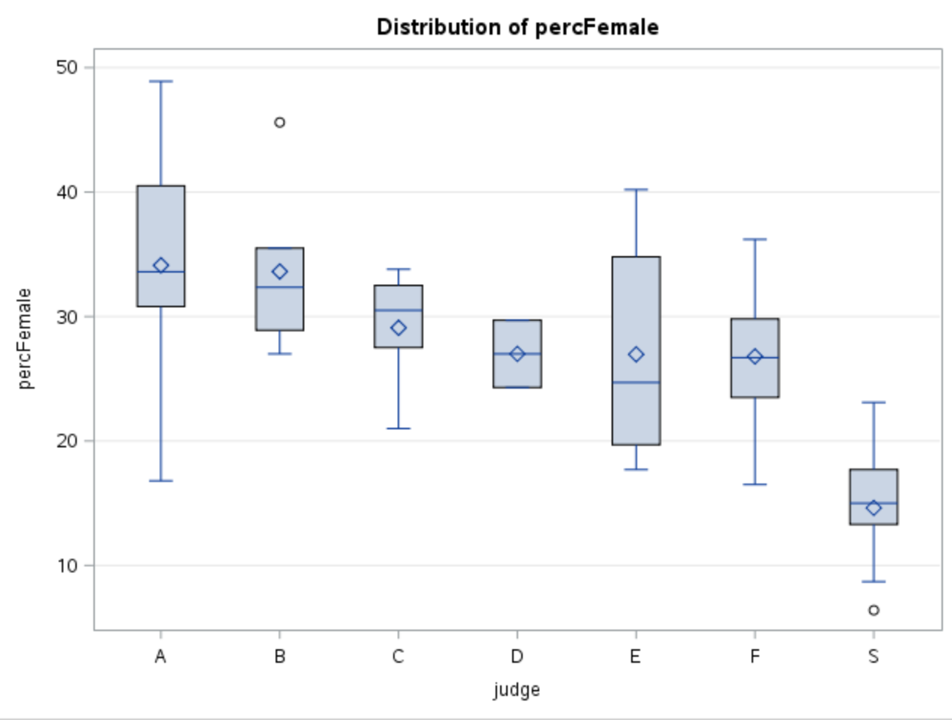
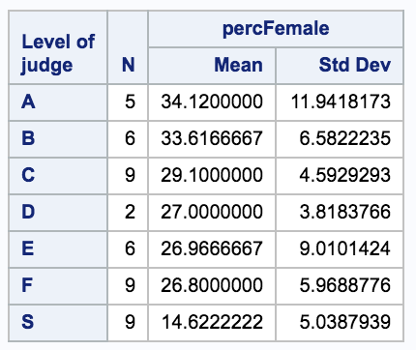
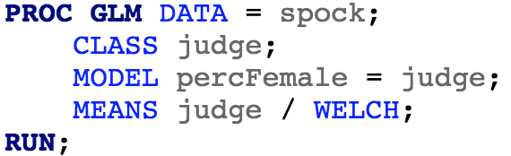
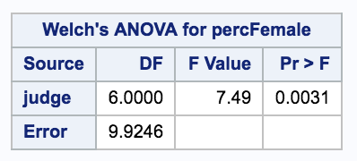

Welch’s ANOVA
Just like with Welch’s t-test, we can test the hypothesis
$H_{0}:μ,μ,…,μ$
$${H_{A}: μ}_{S},μ_{A},μ_{B},…,μ_{F}$$
without the assumption of equal variances:

Slide 17
Additional ANOVA assumption checks

Slide 18
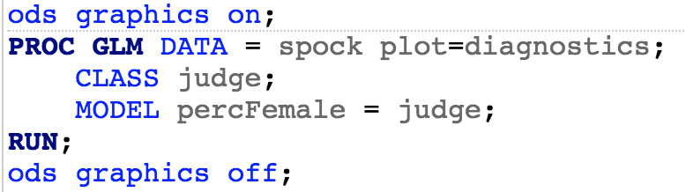
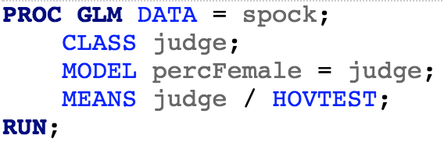
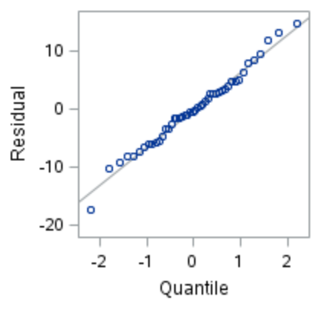
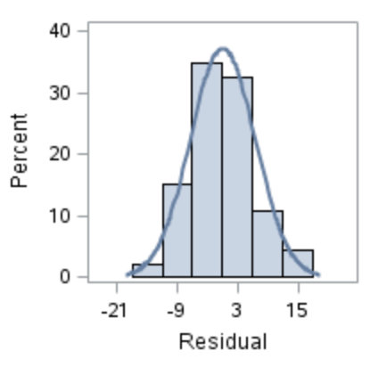
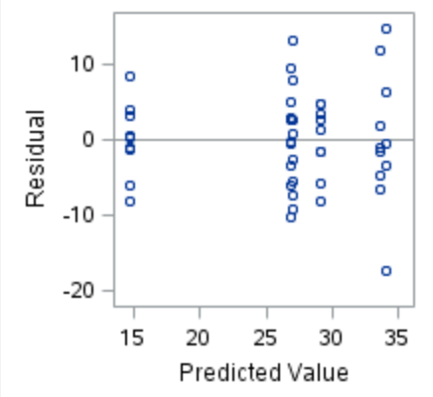
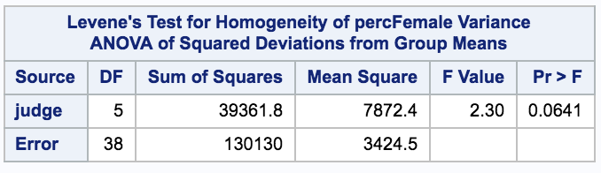


Additional ANOVA assumption checks
$H_{0}$: Equal variances
$H_{A}$: At least two variances unequal
(Note: it is considered best practice to use visual checks for the variance assumption instead of hypothesis tests)
(This is only some of the output)

