Slide 1
Linear Combinations and Multiple Comparisons
Multiple Hypothesis Tests
Tukey-kramer, Dunnett, Scheffé, LSD, Bonferroni, ….
(Note: Skip Planned vs. Unplanned Multiple Comparisons)

Slide 2
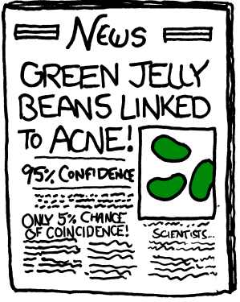
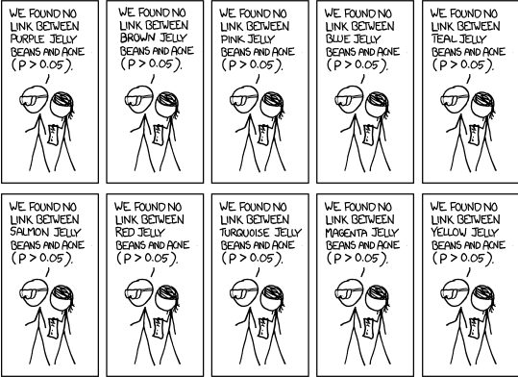
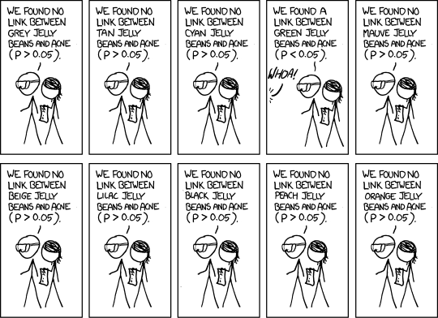
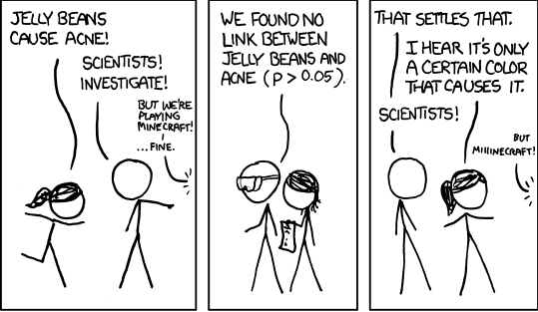
The Green Jelly Bean Problem
https://xkcd.com/882/

Slide 3
The Green Jelly Bean Problem & Study Designs
Suppose we are really interested in investigating whether jelly beans cause acne
We “find” a group of people, randomly split them into two groups
One group (treatment) who are instructed to eat lots of jelly beans
Other group (control) who are banned from eating jelly beans
After some time you measure/compare the acne in the two groups
If more people in the group that eat jelly beans have acne then you might think that jelly beans cause acne.
(Ideally: neither the researchers nor subjects should know who is in which group)

Slide 4
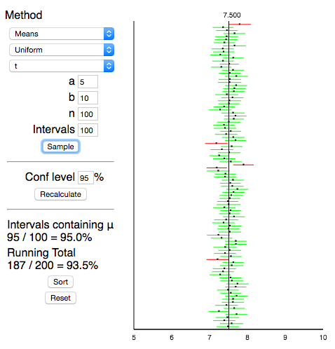

Confidence Intervals
The confidence level is the fraction of times that the true parameter is in the interval (if the assumptions are met) if we were to repeat the same experiment a large number of times

Slide 5
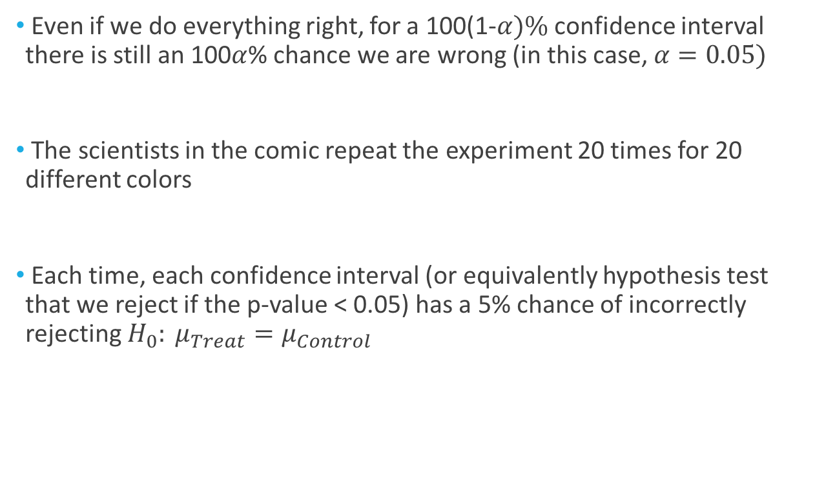
The Green Jelly Bean Problem & Multiple Comparisons
Even if we do everything right, for a 100(1-$α)\%$ confidence interval there is still an 100$α$% chance we are wrong (in this case, $α=0.05)$
The scientists in the comic repeat the experiment 20 times for 20 different colors
Each time, each confidence interval (or equivalently hypothesis test that we reject if the p-value < 0.05) has a 5% chance of incorrectly rejecting $H_{0}: μ_{Treat}=μ_{Control}$
(I’m ignoring the initial test for plain jelly beans)
(This is a “false positive” or “Type I error”)

Slide 6
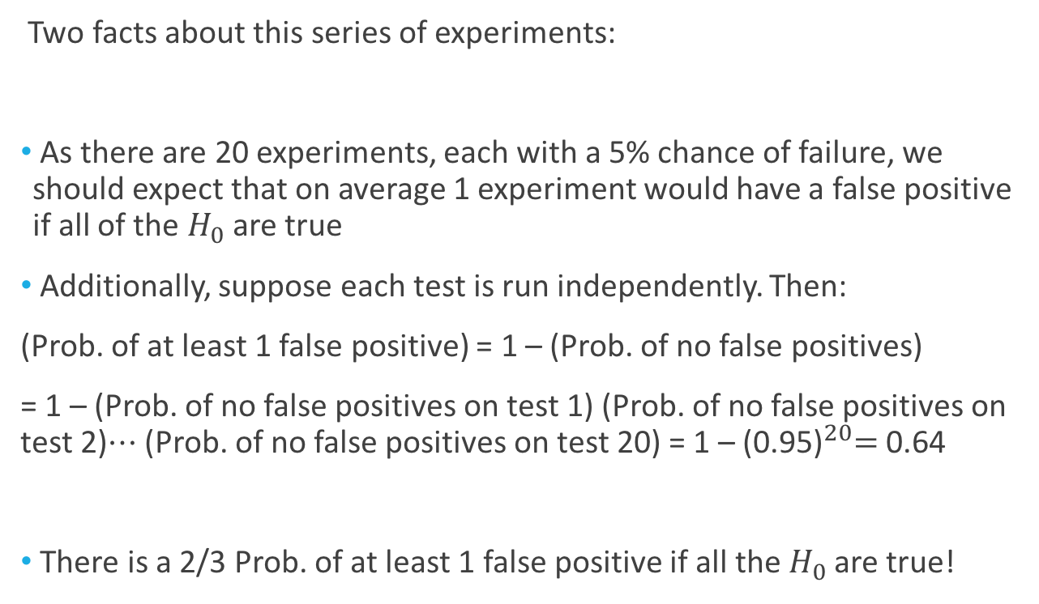
The Green Jelly Bean Problem & Multiple Comparisons
Two facts about this series of experiments:
As there are 20 experiments, each with a 5% chance of failure, we should expect that on average 1 experiment would have a false positive if all of the $H_{0}$ are true
Additionally, suppose each test is run independently. Then:
(Prob. of at least 1 false positive) = 1 – (Prob. of no false positives)
= 1 – (Prob. of no false positives on test 1) (Prob. of no false positives on test 2)$⋯$ (Prob. of no false positives on test 20) = 1 – ${\text{(0.95)}}^{20}=$0.64
There is a 2/3 Prob. of at least 1 false positive if all the $H_{0}$ are true!

Slide 7
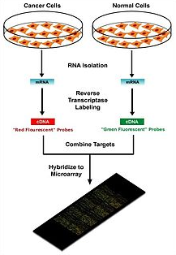
Another Example: Genetic Testing
A common task in modern medicine is to:
Find a group of people with some condition
(e.g. Pancreatic Cancer)
Find another group of people without that condition
Collect RNA samples from each subject and measure
how much specific genes of interest are expressed
We can now run (a possibly large number) of t-tests for the mean difference in gene expression in the two groups
The inference is that these genes are associated with the condition
(causality is very tough: can’t assign humans to cancer status..)
Notes:
This is a gene microarray experiment

Slide 8
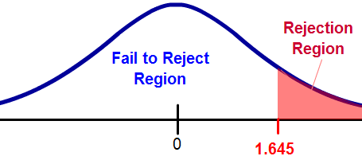
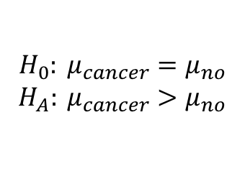

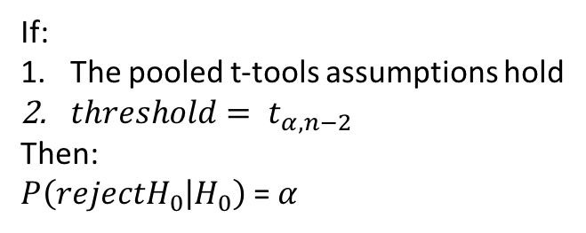
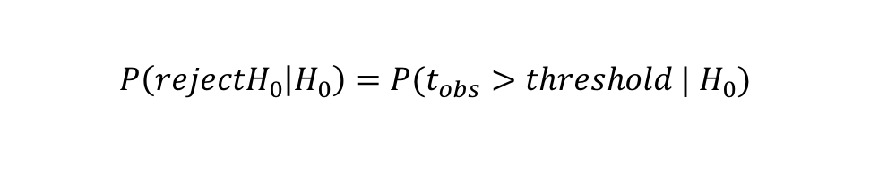
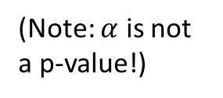
Genetic Testing: Single Gene
Gene 1
Is there evidence that the expression of “Gene 1” is larger for the cancer group than the not cancer group?
$$H_{0}: μ_{cancer}=μ_{no}$$
$$H_{A}: μ_{cancer}>μ_{no}$$
(Interpretation: the number of false positives if we were able to run a large number of identical experiments/trials)
Specify an $α$ such that $P\left(rejectH_{0} | H_{0}\right)=α$
$$P\left(rejectH_{0} | H_{0}\right)=P(t_{obs}>threshold |{ H}_{0})$$
If:
The pooled t-tools assumptions hold
${threshold= t}_{α,n−2}$
Then:
$P\left(rejectH_{0} | H_{0}\right)$ = $α$
(Note: $α$ is not a p-value!)

Slide 9

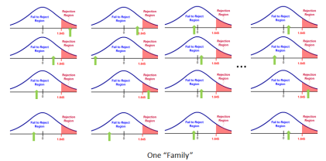
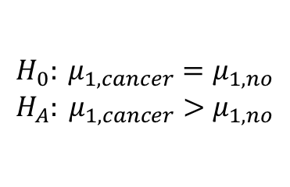
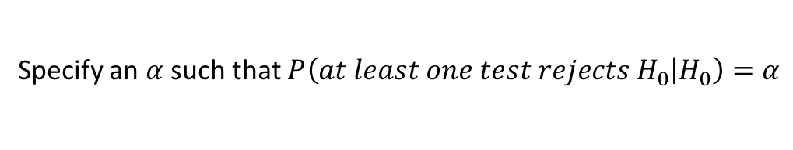
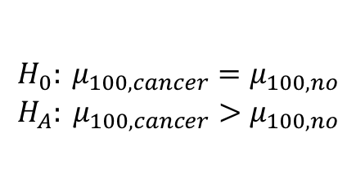
Genetic Testing: Multiple Genes
For each gene, is there evidence that the expression is larger for the cancer group than the not cancer group?
$$H_{0}: μ_{1,cancer}=μ_{1,no}$$
$$H_{A}: μ_{1,cancer}>μ_{1,no}$$
…
$$H_{0}: μ_{100,cancer}=μ_{100,no}$$
$$H_{A}: μ_{100,cancer}>μ_{100,no}$$
(Interpretation: the number of families of tests that have at least one false positive if we were able to run a large number of identical experiments/trials)
Specify an $α$ such that $P\left(at least one test rejects H_{0} | H_{0}\right)=α$

Slide 10
Genetic Testing: Multiple Genes
Gene 1
Gene 5
Gene 9
Gene 97
Gene 2
Gene 6
Gene 10
Gene 98
…
Gene 3
Gene 7
Gene 11
Gene 99
Gene 4
Gene 8
Gene 12
Gene 100

Slide 11
Genetic Testing: A Large # of Trials
…
Goal: control the number of false positives for a family of tests for a large # of trials)

Slide 12
Genetic Testing: A Large # of Trials
Each “YES” is a family of 100 individual tests all failing to reject Ho Correctly. Each “No” is a family of 100 individual tests that rejected at least once Incorrectly.
YES
YES
YES
YES
YES
YES
YES
YES
YES
NO
YES
YES
YES
YES
YES
YES
YES
YES
YES
YES
YES
YES
YES
YES
YES
YES
YES
…
YES
YES
YES
YES
YES
YES
YES
YES
YES
YES
YES
YES
YES
NO
YES
YES
NO
YES
YES
YES
YES
YES
YES
YES
YES
YES
YES
YES
YES
YES
YES
YES
YES
YES
YES
YES

Slide 13
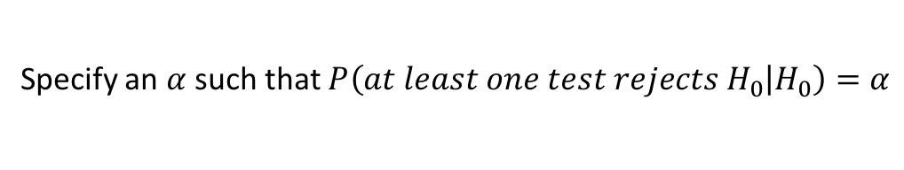
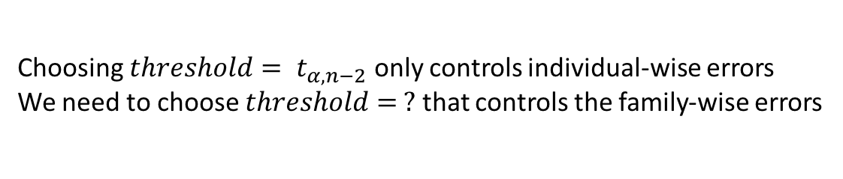
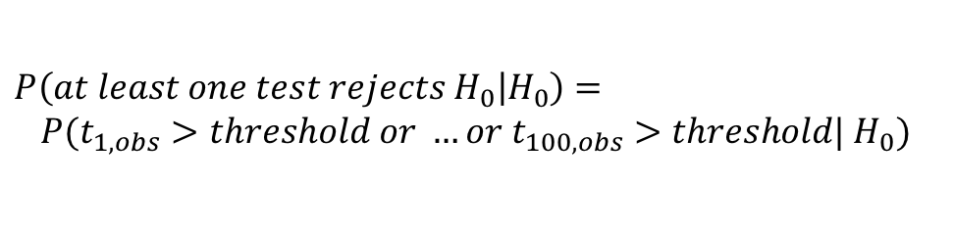
Genetic Testing: Multiple Genes
For each gene, is there evidence that the expression is larger for the cancer group than the not cancer group?
$$H_{0}: μ_{1,cancer}=μ_{1,no}$$
$$H_{A}: μ_{1,cancer}>μ_{1,no}$$
…
$$H_{0}: μ_{100,cancer}=μ_{100,no}$$
$$H_{A}: μ_{100,cancer}>μ_{100,no}$$
(Interpretation: the number of families of tests that have at least one false positive if we were able to run a large number of identical experiments/trials)
Specify an $α$ such that $P\left(at least one test rejects H_{0} | H_{0}\right)=α$
$$P\left(at least one test rejects H_{0} | H_{0}\right)=$$
$$P(t_{1,obs}>threshold or …or t_{100,obs}>threshold|{ H}_{0})$$
Choosing ${threshold= t}_{α,n−2}$ only controls individual-wise errors
We need to choose $threshold= ?$ that controls the family-wise errors

Slide 14
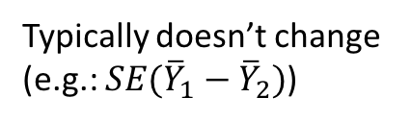
Multiple Hypothesis Tests: Procedures for Family-wise Errors
For ease of exposition, we will detail these procedures in terms of confidence intervals. The same procedures apply to hypothesis tests via adjusting the critical values
Typically doesn’t change (e.g.: $SE({\overline{Y}}_{1}−{\overline{Y}}_{2})$)
Typically gets adjusted to larger values to control for family-wise errors

Slide 15
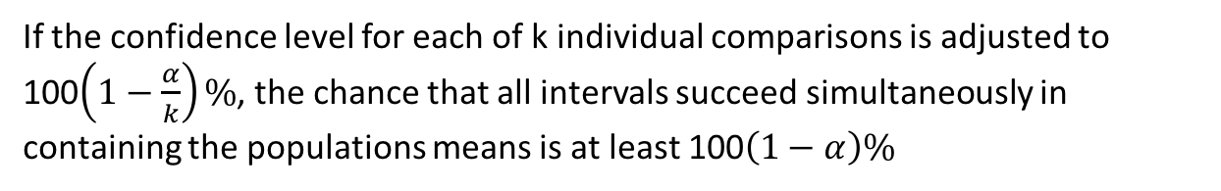
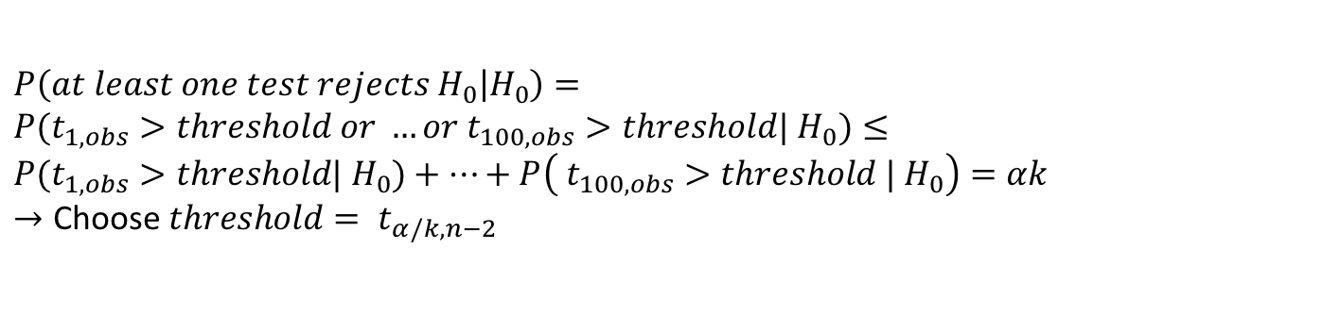

Multiple Hypothesis Tests : Bonferroni
If the confidence level for each of k individual comparisons is adjusted to 100$\left(1−\frac{α}{k}\right)\%$, the chance that all intervals succeed simultaneously in containing the populations means is at least 100$\left(1−α\right)\%$
(Multiplier) $=t_{\frac{α}{2k},df}$
This is a very conservative adjustment, which will lead to wide confidence intervals
$$P\left(at least one test rejects H_{0} | H_{0}\right)=$$
$$P(t_{1,obs}>threshold or …or t_{100,obs}>threshold|{ H}_{0})≤$$
$$P(t_{1,obs}>threshold|{ H}_{0})+…+P\left( t_{100,obs}>threshold |{ H}_{0}\right)=αk$$
$$→\text{Choos}\text{e} {threshold= t}_{α/k,n−2}$$

Slide 16
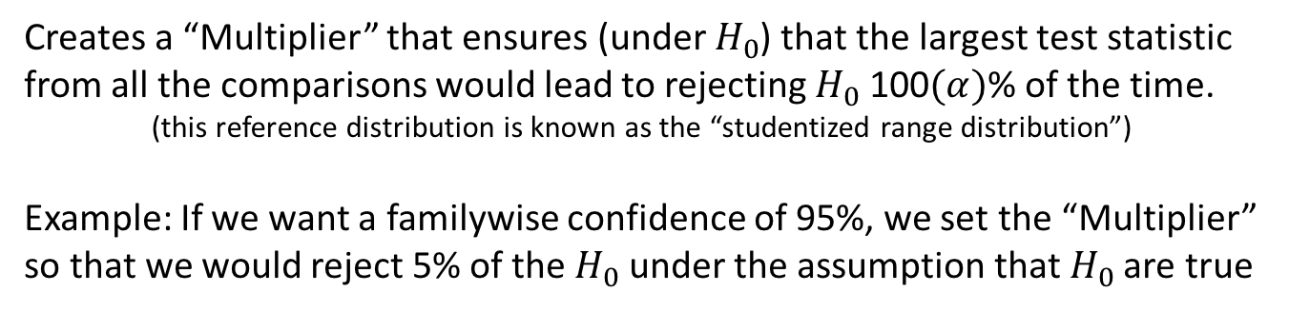
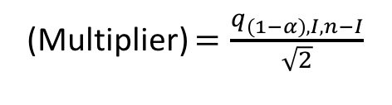
Multiple Hypothesis Tests : Tukey-Kramer
Creates a “Multiplier” that ensures (under $H_{0}$) that the largest test statistic from all the comparisons would lead to rejecting $H_{0}$ 100$(α)$% of the time.
(this reference distribution is known as the “studentized range distribution”)
Example: If we want a familywise confidence of 95%, we set the “Multiplier” so that we would reject 5% of the $H_{0}$ under the assumption that $H_{0}$ are true
(Multiplier) $=\frac{q_{\left(1−α\right),I,n−I}}{\sqrt{2}}$
This correction has a complicated reference distribution
It should only be used when making pairwise comparisons
(It is a very commonly used correction for this purpose)
This procedure requires a lot of assumptions (such as normality.

Slide 17
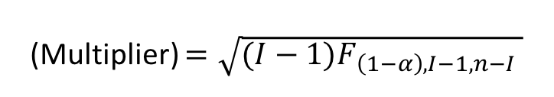
Multiple Hypothesis Tests : Scheffé
Creates a “Multiplier” that gives familywise control over all possible contrasts (of which, differences in means are a special case).
(Multiplier) $=\sqrt{(I−1)F_{\left(1−α\right),I−1,n−I} }$
As this procedure works for all contrasts, it is the most conservative approach and hence will have the widest confidence intervals
(generally to be used for confidence bands in multiple regression, not multiple groups)

Slide 18



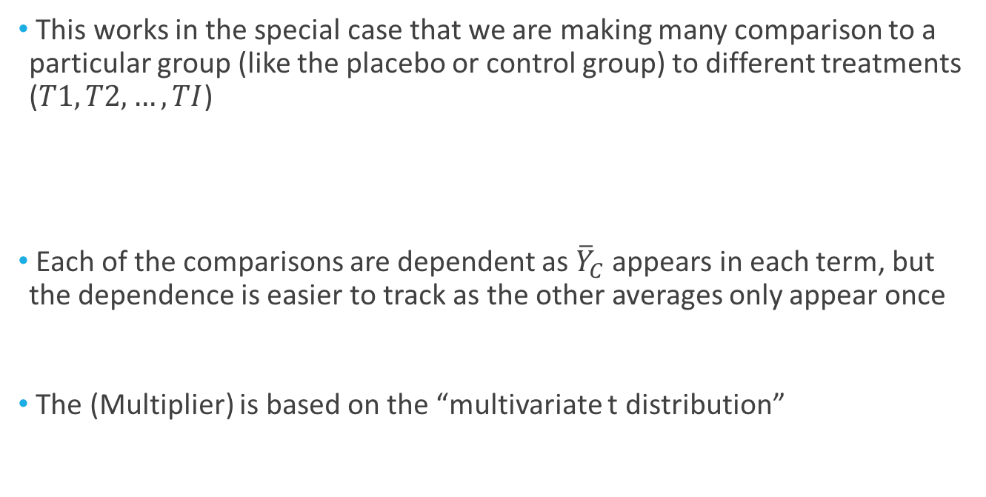
Multiple Hypothesis Tests : Dunnett’s Procedure
This works in the special case that we are making many comparison to a particular group (like the placebo or control group) to different treatments ($T1, T2, …, TI$)
Each of the comparisons are dependent as ${\overline{Y}}_{C}$ appears in each term, but the dependence is easier to track as the other averages only appear once
The (Multiplier) is based on the “multivariate t distribution”
$$t_{1}=\frac{{\overline{Y}}_{C}−{\overline{Y}}_{T1}}{SE({\overline{Y}}_{C}−{\overline{Y}}_{T1})}$$
$$t_{2}=\frac{{\overline{Y}}_{C}−{\overline{Y}}_{T2}}{SE({\overline{Y}}_{C}−{\overline{Y}}_{T2})}$$
$$t_{I}=\frac{{\overline{Y}}_{C}−{\overline{Y}}_{TI}}{SE({\overline{Y}}_{C}−{\overline{Y}}_{TI})}$$
…

Slide 19

Multiple Hypothesis Tests : Least Significant Difference (LSD)
Creates a “Multiplier” that gives individual control over false positive rate
(Multiplier) $=t_{\left(1−α/2\right), df}$
This is the procedure we have been using all along. It is the most liberal approach and hence will have the narrowest confidence intervals

Slide 20
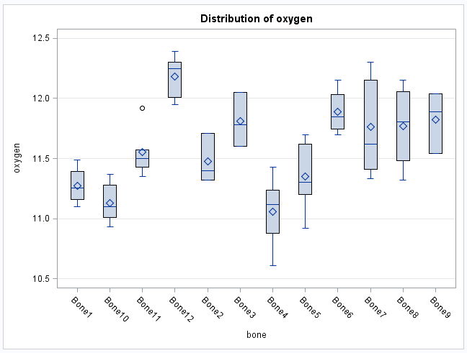
Example: Oxygen Levels in T-rex Bone Samples

Slide 21

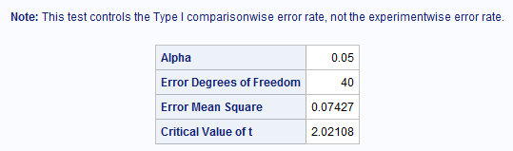
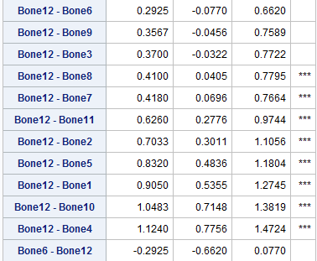

Least Significant Difference (LSD)
cldiff;
$→$ 62 significant differences

Slide 22

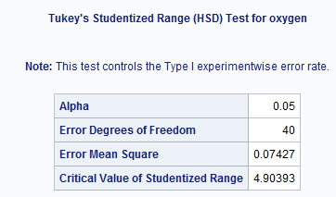
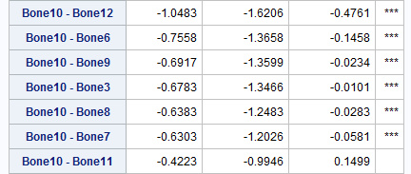

Tukey-Kramer
cldiff
$→$ 32 significant differences

Slide 23

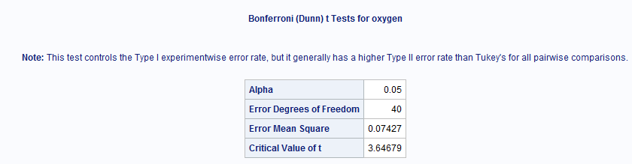
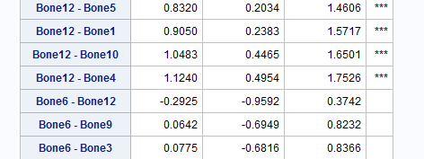

Bonferroni
cldiff
$→$ 22 significant differences

Slide 24
Example: Handicap & Capability Study
Goal: How do physical handicaps affect perception of employment qualification?
The researchers prepared 5 recorded job interviews with same actors
The tapes differed only in the handicap of the applicant:
No handicap
One leg amputated
Crutches
Hearing Impaired
Wheelchair
14 people were randomly assigned to each tape to rate applicants: 0-10 pts

Slide 25
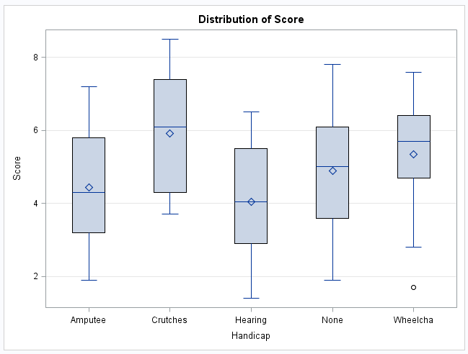
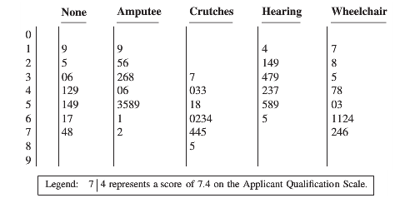
Example: Handicap & Capability Study
Do subjects systematically evaluate qualifications differently according to handicap?
If so, which handicaps are evaluated differently?

Slide 26
Example: Handicap & Capability Study
Questions of interest:
1. Is there any evidence that at least one pair of mean qualification scores are different?
2. Let’s say we are only interested in Amputee versus None. Test the claim the Amputee has a different mean score than the None group.
3. Now let’s assume that we are interested in “any” differences. Find evidence of any differences in the means between the groups.
4. Next assume that we were interested in testing the means of the handicapped groups to the non-handicap group. Test this claim and identify any significant differences.

Slide 27
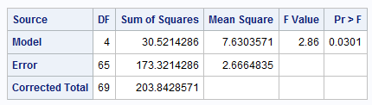


Handicap & Capability Study: First Question
$H_{0}:μ_{None}$=$μ_{Amp}$=$μ_{Crutch}$=$μ_{Hear}$=$μ_{Wheel}$= $μ$
$H_{A}:μ_{j}≠μ_{k}$ for some $j,k$
There is evidence to that there are at least two population means different (p-value of 0.0301 from a 1-way ANOVA).

Slide 28
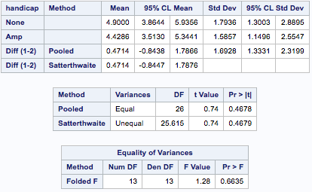

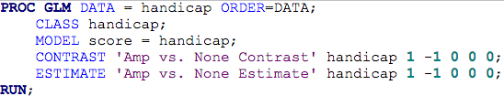


Handicap & Capability Study: Second Question
Amputee versus None:
$$H_{0}:μAmputee=μNone$$
$$H_{A}:μAmputee≠μNone$$
There is not sufficient evidence to suggest that the mean points for the amputee group is different than mean points for control group (p-value = 0.4477 from t-test contrast)

Slide 29
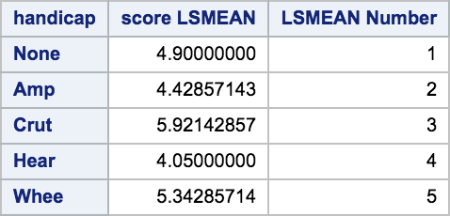

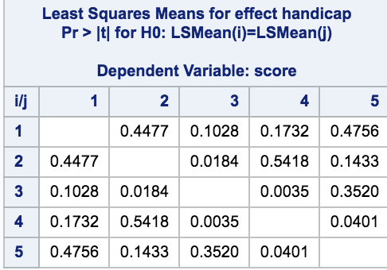
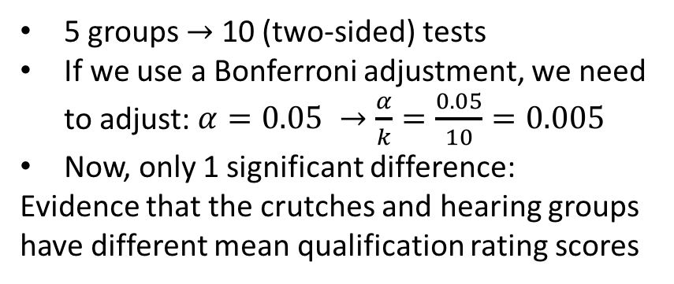
Handicap & Capability Study: Third Question
Find evidence of any differences in the means of the groups
(I used pdiff here as there are only 5 groups)
5 groups $→$ 10 (two-sided) tests
If we use a Bonferroni adjustment, we need to adjust: $α=0.05 →\frac{α}{k}=\frac{0.05}{10}=0.005$
Now, only 1 significant difference:
Evidence that the crutches and hearing groups have different mean qualification rating scores

Slide 30
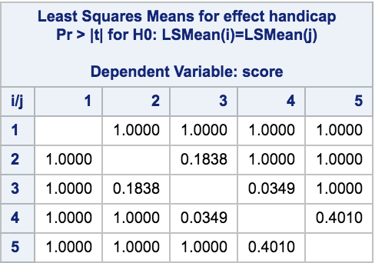

Handicap & Capability Study: Third Question

Slide 31
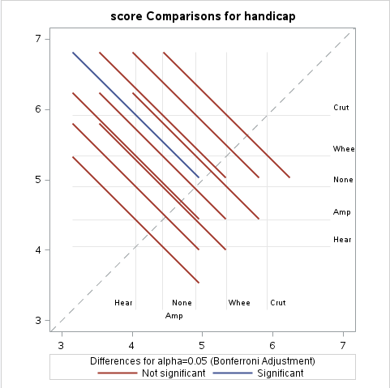
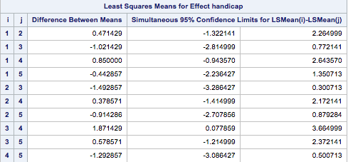
Handicap & Capability Study: Third Question

Slide 32
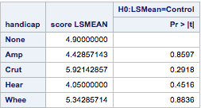

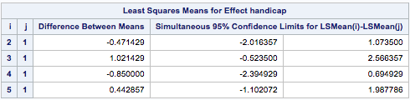
Handicap & Capability Study: Fourth Question
Is there a difference between any handicap and the control group (‘None’)?
There is insufficient evidence that there is a difference between any of the handicap groups and the mean of ’None’ group. The 95% Dunnett’s procedure-corrected confidence intervals all contain zero.

Slide 33


Multiple Comparisons in SAS
You can either use the “means” or “lsmeans” statements. I prefer to use ”lsmeans”.

